Slide 1
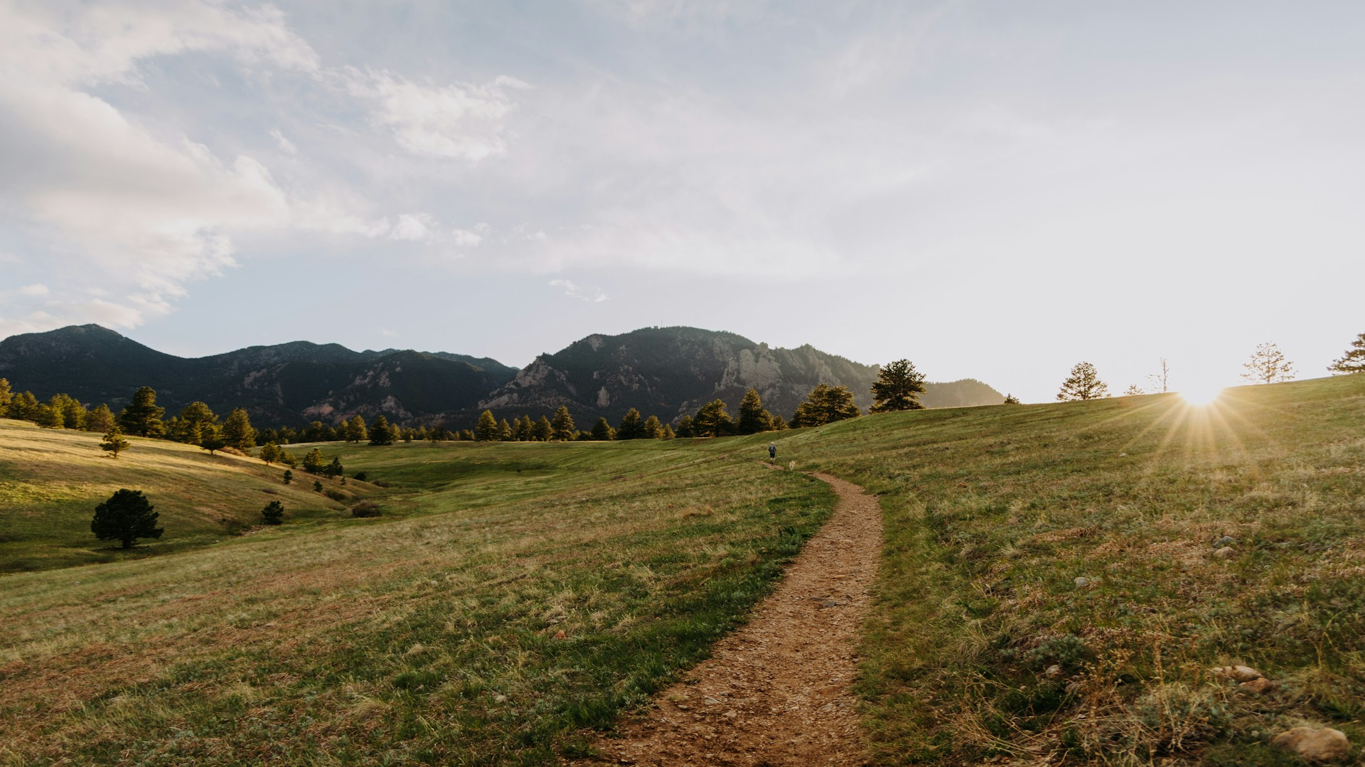
HEAVEN BIBLE STUDY • WEEK TWO
The Way Home
Christ, Assurance, and Eternity
First Friends & Temple Congregational
August 26, 2026
HEAVEN BIBLE STUDY • WEEK TWO
01
Notes:
[Sources]
- Heaven_Week_02_The_Way_Home_Working_Guide.docx.
- Image: Elijah Pilchard, Unsplash, https://unsplash.com/photos/a-scenic-trail-leads-toward-mountains-and-the-sun-1w4QHQrcxUE.
[/Sources]

Slide 2

THE QUESTION BENEATH THE EVENING
What gives a person genuine assurance when facing death?
HEAVEN BIBLE STUDY • WEEK TWO
02
Notes:
[Sources]
- Heaven_Week_02_The_Way_Home_Working_Guide.docx.
- Image: Greg Rosenke, Unsplash, https://unsplash.com/photos/an-open-door-in-a-dark-room-with-light-coming-in-1dnMXxhJT_g.
[/Sources]

Slide 3

TWO FALSE ASSURANCES
PRESUMPTION
PERFORMANCE
“I do not need rescue.”
“I must rescue myself.”
Both make the self the foundation.
HEAVEN BIBLE STUDY • WEEK TWO
03
Notes:
[Sources]
- Heaven_Week_02_The_Way_Home_Working_Guide.docx.
- Image: Katie Burkhart, Unsplash, https://unsplash.com/photos/selective-focus-photo-of-balance-stones-ks_e5Rf-Cn0.
[/Sources]

Slide 4
THE GOSPEL TURNS THE WEIGHT TOWARD CHRIST
Assurance is not confidence that we have done enough;
it is trust that Christ has done what we could never do—
and will hold those who belong to him.
HEAVEN BIBLE STUDY • WEEK TWO
04
Notes:
[Sources]
- Heaven_Week_02_The_Way_Home_Working_Guide.docx.
[/Sources]

Slide 5
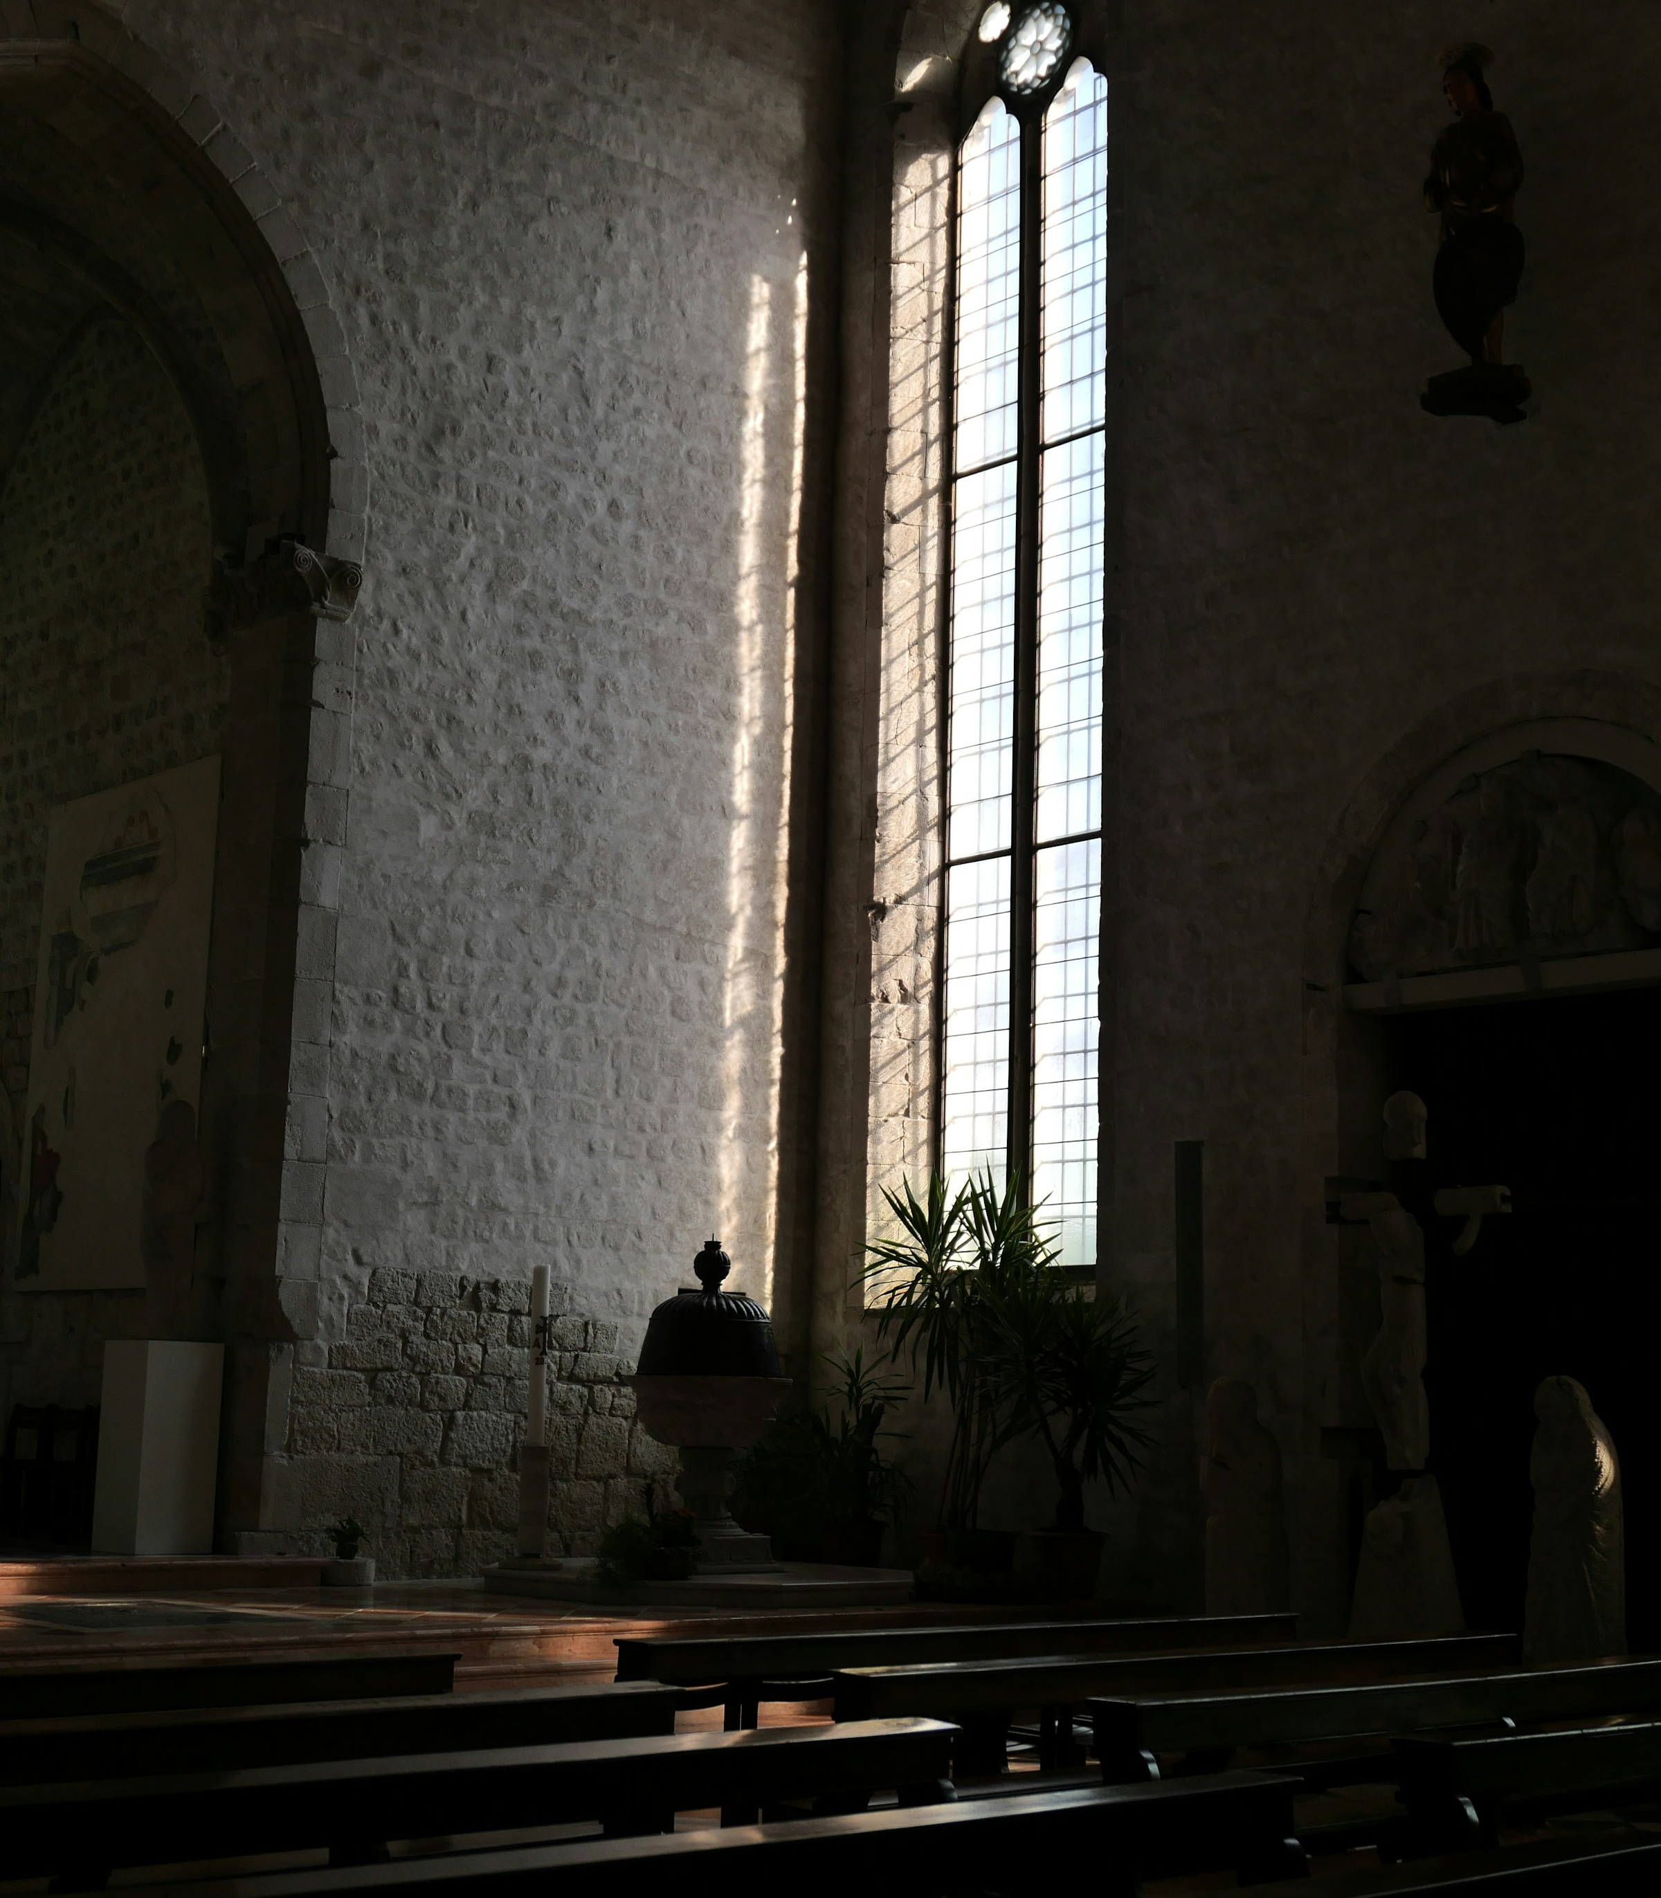
WAITING WORSHIP
“Do not let your hearts be troubled”
(John 14:1, NIV).
Bring Christ your fear, your confidence, your questions, and the names of those you love.
HEAVEN BIBLE STUDY • WEEK TWO
05
Notes:
[Sources]
- Heaven_Week_02_The_Way_Home_Working_Guide.docx.
- Scripture quotation: John 14:1, NIV.
- Image: Daniele Simon, Unsplash, https://unsplash.com/photos/sunlight-streams-through-a-tall-church-window-va5mWyA5EQ0.
[/Sources]

Slide 6
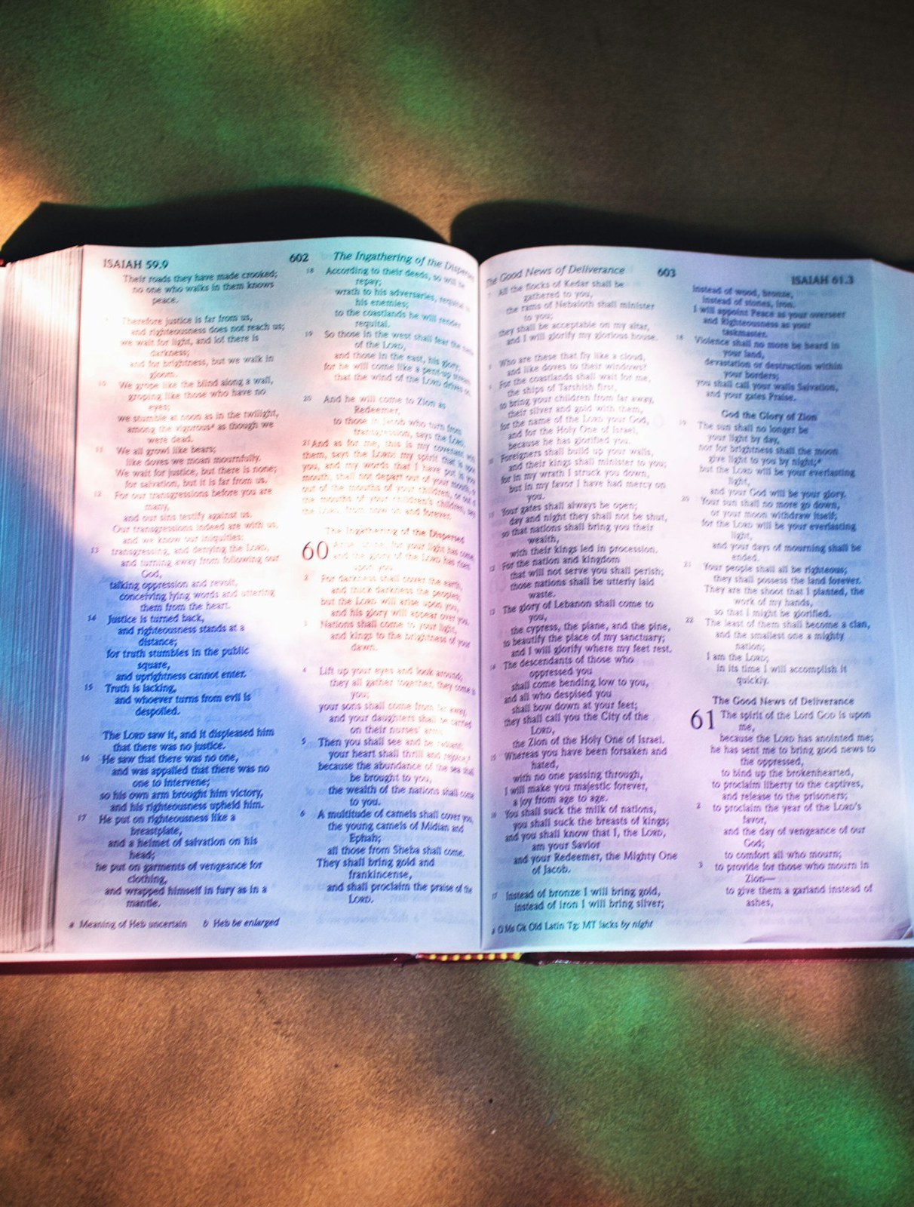
SCRIPTURE ENCOUNTER
Listen for what God does.
John 14:1–6
Romans 3:21–26
Romans 8:31–39
Promise • action • gift • response • security
HEAVEN BIBLE STUDY • WEEK TWO
06
Notes:
[Sources]
- Heaven_Week_02_The_Way_Home_Working_Guide.docx.
- Primary texts: John 14:1–6; Romans 3:21–26; Romans 8:31–39, NIV.
- Image: Shane Hoving, Unsplash, https://unsplash.com/photos/an-open-bible-on-a-table-in-the-sunlight-SZaxKdLwz6o.
[/Sources]

Slide 7
JOHN 14 • THE WAY
“I am the way and the truth and the life”
(John 14:6, NIV).
Jesus does not merely point toward the Father; he brings us to the Father.
HEAVEN BIBLE STUDY • WEEK TWO
07
Notes:
[Sources]
- Heaven_Week_02_The_Way_Home_Working_Guide.docx.
- Scripture quotation: John 14:6, NIV.
[/Sources]

Slide 8
CONVICTION WITHOUT ARROGANCE
The Way has
nail-scarred hands.
The Son of God came looking for us and opened the way we could not open.
HEAVEN BIBLE STUDY • WEEK TWO
08
Notes:
[Sources]
- Heaven_Week_02_The_Way_Home_Working_Guide.docx.
[/Sources]

Slide 9

ROMANS 3 • THE GROUND
“And all are justified freely by his grace through the redemption that came by Christ Jesus”
(Romans 3:24, NIV).
Grace does not pretend sin is harmless. At the cross, God judges sin and reconciles sinners.
HEAVEN BIBLE STUDY • WEEK TWO
09
Notes:
[Sources]
- Heaven_Week_02_The_Way_Home_Working_Guide.docx.
- Scripture quotation: Romans 3:24, NIV.
- Image: Arie van Vugt, Unsplash, https://unsplash.com/photos/golden-sunrise-over-a-wide-river-and-distant-hills-LCW_sqckoTU.
[/Sources]

Slide 10
ROMANS 8 • THE GRIP
“Neither height nor depth, nor anything else in all creation, will be able to separate us from the love of God that is in Christ Jesus our Lord” (Romans 8:39, NIV).
HEAVEN BIBLE STUDY • WEEK TWO
10
Notes:
[Sources]
- Heaven_Week_02_The_Way_Home_Working_Guide.docx.
- Scripture quotation excerpt: Romans 8:39, NIV.
- Image: Rod Long, Unsplash, https://unsplash.com/photos/sunlight-glints-on-a-breaking-ocean-wave-xtL60zAyU-I.
[/Sources]

Slide 11
ALCORN SYNTHESIS
Heaven is God’s gift in Christ.
Not an automatic entitlement.
Not a reward for moral achievement.
We proclaim the Savior and entrust final judgment to the Judge who knows every heart.
HEAVEN BIBLE STUDY • WEEK TWO
11
Notes:
[Sources]
- Heaven_Week_02_The_Way_Home_Working_Guide.docx.
- Randy Alcorn, Heaven (Tyndale House, 2004), ch. 3.
[/Sources]

Slide 12
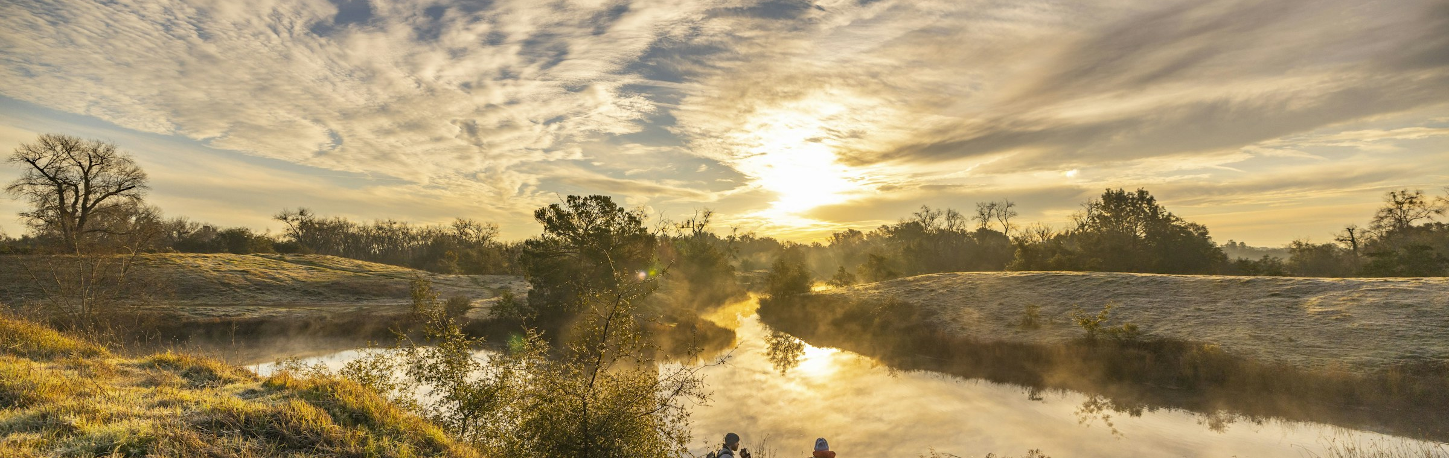
CHRIST IS THE WAY HOME
Jesus does not hand Thomas a ladder of achievement.
He gives Thomas himself.
HEAVEN BIBLE STUDY • WEEK TWO
12
Notes:
[Sources]
- Heaven_Week_02_The_Way_Home_Working_Guide.docx.
- Image: Leo_Visions, Unsplash, https://unsplash.com/photos/a-group-of-people-walking-on-a-trail-by-a-river-HdpzWHS8aSU.
[/Sources]

Slide 13
THE TRUTH IS NOT A POSSESSION WE WIELD
The truth is the reality of Christ
who possesses, corrects, forms, and sends us.
HEAVEN BIBLE STUDY • WEEK TWO
13
Notes:
[Sources]
- Heaven_Week_02_The_Way_Home_Working_Guide.docx.
[/Sources]

Slide 14
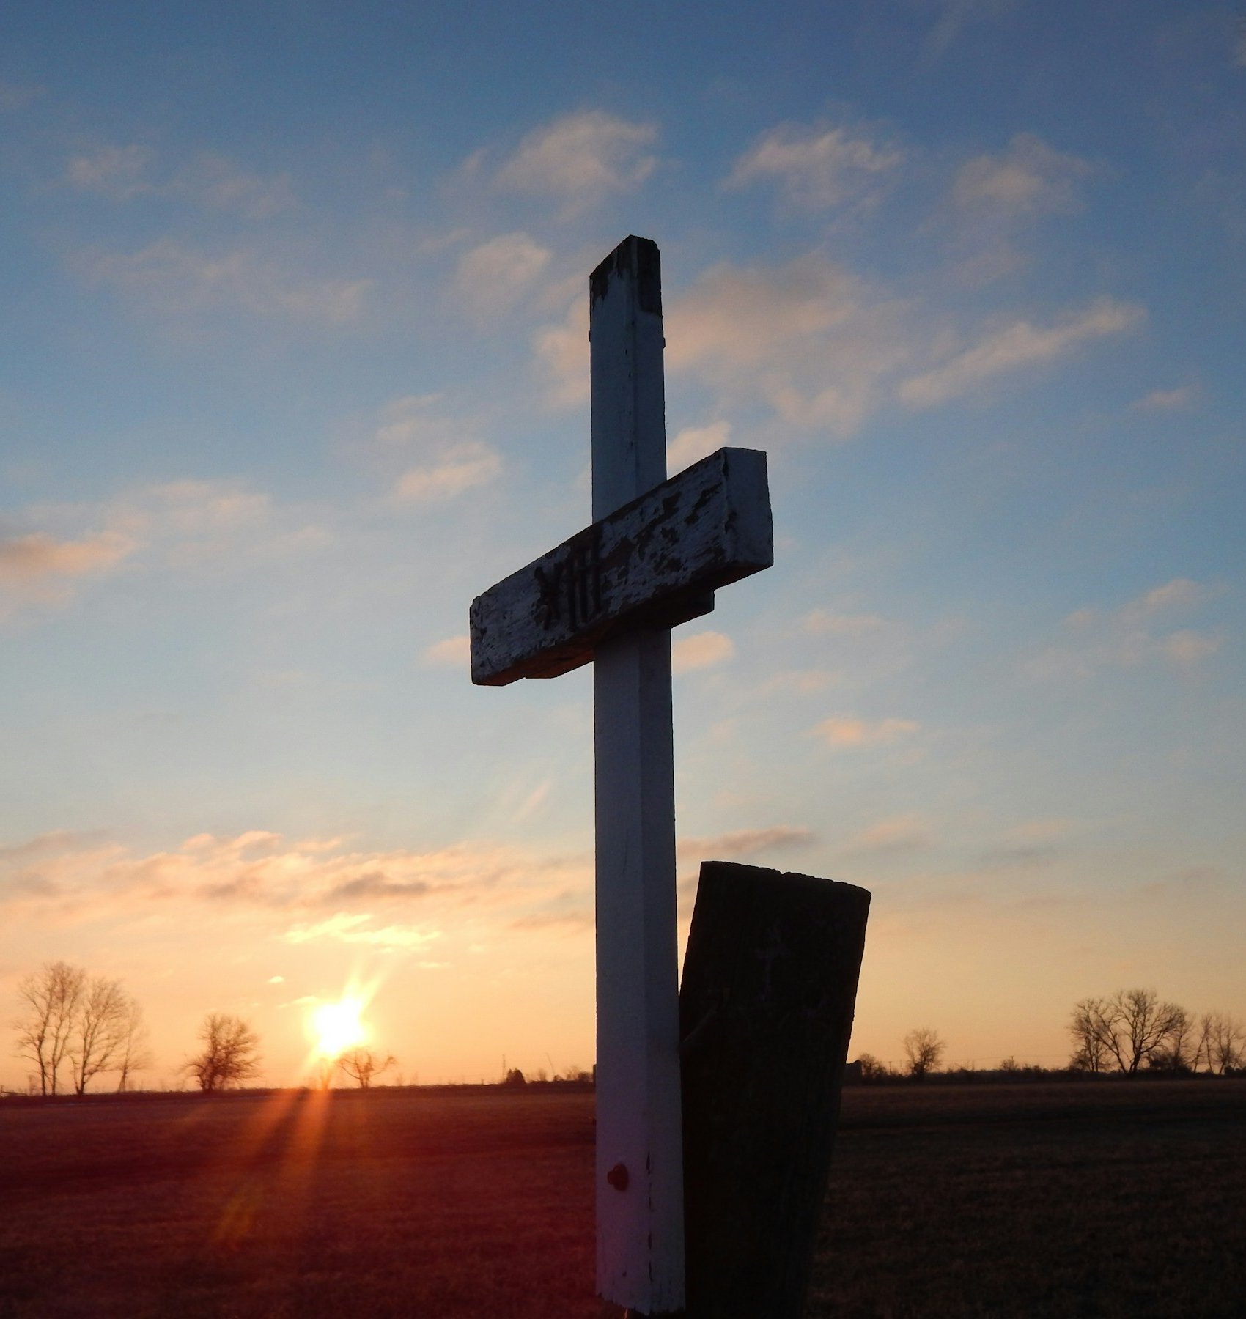
THE CROSS IS THE GROUND
At the cross,
holy judgment
and holy mercy meet.
Christ’s reconciling work addresses what sentiment cannot erase and achievement cannot repair.
HEAVEN BIBLE STUDY • WEEK TWO
14
Notes:
[Sources]
- Heaven_Week_02_The_Way_Home_Working_Guide.docx.
- Image: Josie Weiss, Unsplash, https://unsplash.com/photos/a-cross-in-a-field-with-the-sun-setting-in-the-background-vQlLGQRiqGQ.
[/Sources]

Slide 15
THE FLOW OF GRACE
One movement of God’s faithful love
GRACE AWAKENS
GRACE RECONCILES
GRACE FORMS
GRACE SENDS
Prevenient • Justifying • Sanctifying • Missional
HEAVEN BIBLE STUDY • WEEK TWO
15
Notes:
[Sources]
- Heaven_Week_02_The_Way_Home_Working_Guide.docx.
[/Sources]

Slide 16
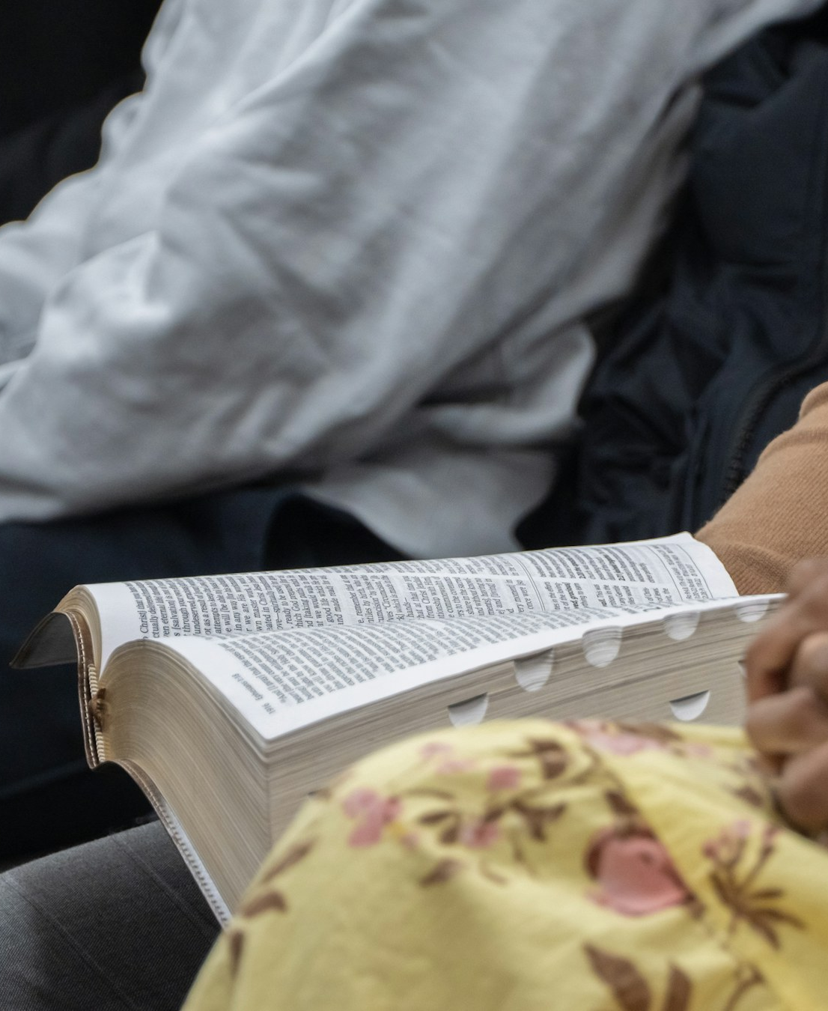
GRACE BEGINS A LIFE
Holiness is not the admission price for Heaven.
Holiness is the life of Heaven beginning to take shape in people received by mercy.
We follow because Christ’s love is reclaiming the whole life.
HEAVEN BIBLE STUDY • WEEK TWO
16
Notes:
[Sources]
- Heaven_Week_02_The_Way_Home_Working_Guide.docx.
- Image: Jor Eg, Unsplash, https://unsplash.com/photos/people-sitting-with-open-bible-and-clasped-hands-5AoQbO_-TYo.
[/Sources]

Slide 17
CHRIST’S LOVE IS THE GRIP
Assurance grows as we look away from the strength of our grip and toward the faithfulness of the One who holds us.
Feelings rise and fall. Christ died, was raised, intercedes, and holds.
HEAVEN BIBLE STUDY • WEEK TWO
17
Notes:
[Sources]
- Heaven_Week_02_The_Way_Home_Working_Guide.docx.
- Randy Alcorn, Heaven (Tyndale House, 2004), ch. 4.
[/Sources]

Slide 18
A FRIENDS’ WITNESS
Walking in the Light
The Light is the living Christ who exposes what is false, draws us toward mercy, teaches obedience, and forms a truthful people.
Assurance is relational rather than mechanical.
HEAVEN BIBLE STUDY • WEEK TWO
18
Notes:
[Sources]
- Heaven_Week_02_The_Way_Home_Working_Guide.docx.
[/Sources]

Slide 19
JUDGMENT MUST BE SPOKEN FROM BENEATH THE CROSS
Every warning must serve an invitation.
TRUTH
HUMILITY
COMPASSION
Do not edit away the words of Christ.
Do not claim knowledge God has not given.
Refuse manipulation and stay connected.
Speak as people who could not save themselves and have received undeserved mercy.
HEAVEN BIBLE STUDY • WEEK TWO
19
Notes:
[Sources]
- Heaven_Week_02_The_Way_Home_Working_Guide.docx.
[/Sources]

Slide 20
THREE GOSPEL ANCHORS
Where assurance rests
THE WAY
Christ brings us to the Father.
THE GROUND
The cross—not achievement.
God’s love is stronger than accusation, suffering, death, or any created power.
THE GRIP
HEAVEN BIBLE STUDY • WEEK TWO
20
Notes:
[Sources]
- Heaven_Week_02_The_Way_Home_Working_Guide.docx.
[/Sources]

Slide 21
CONGREGATIONAL CONVERSATION
Hold two quiet minutes before anyone explains or advises.
What does Jesus mean when he calls himself the way, the truth, and the life?
How do grace, repentance, trust, and following Christ belong together?
How can the church speak about judgment without manipulation or careless presumption?
You may answer one query, remain silent, or request a private conversation.
HEAVEN BIBLE STUDY • WEEK TWO
21
Notes:
[Sources]
- Heaven_Week_02_The_Way_Home_Working_Guide.docx.
[/Sources]

Slide 22

PRIVATE SELF-EXAMINATION
The ground I have been tempted to trust is ...
Christ is inviting me to turn from ...
The promise I want to receive is ...
The next faithful step of
following is ...
This is private—not a test and not a public invitation.
HEAVEN BIBLE STUDY • WEEK TWO
22
Notes:
[Sources]
- Heaven_Week_02_The_Way_Home_Working_Guide.docx.
- Image: Andrew Neel, Unsplash, https://unsplash.com/photos/a-notepad-sitting-on-top-of-a-wooden-table-next-to-a-pair-of-scissors-JWz11Q8Xof4.
[/Sources]

Slide 23

PRAYER AND SENDING
Go without boasting
and without fear.
Our hope does not rest in what we have achieved, but in Jesus Christ, who died, was raised, intercedes, and leads his people home.
Teach us to repent without despair, trust without presumption, follow without bargaining, and speak without manipulation.
HEAVEN BIBLE STUDY • WEEK TWO
23
Notes:
[Sources]
- Heaven_Week_02_The_Way_Home_Working_Guide.docx.
- Image: James Coleman, Unsplash, https://unsplash.com/photos/house-with-illuminated-windows-at-dusk-xoNUuUdWGF4.
[/Sources]

