Slide 1
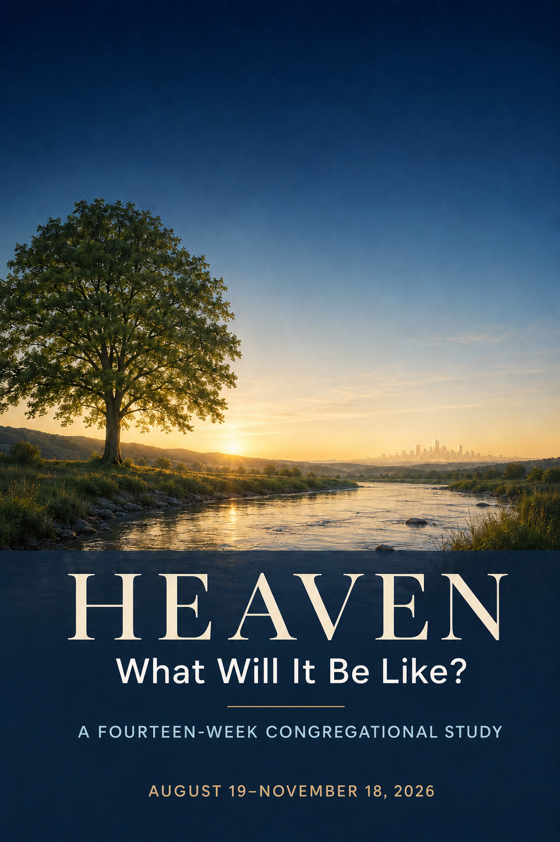
Welcome!
WEEK ONE
Wednesday, August 19, 2026
Notes:
Welcome everyone to the first gathering. Name that this is a Bible study shaped by Judy’s honest pastoral question, with Randy Alcorn as a conversation partner and Scripture as our authority.
[Sources]
- Paul David Bravard, Heaven Week One Working Leader Guide, 2026.

Slide 2
I Serve A Risen Savior
Alfred Henry Ackley (1887-1960)
Notes:
Welcome everyone to the first gathering. Name that this is a Bible study shaped by Judy’s honest pastoral question, with Randy Alcorn as a conversation partner and Scripture as our authority.
[Sources]
- Paul David Bravard, Heaven Week One Working Leader Guide, 2026.

Slide 3
I serve a risen Savior
He’s in the world today.
I know that He is living,
Whatever men may say.
I see His hand of mercy;
I hear His voice of cheer;
And just the time I need Him
He’s always near.
Notes:
Welcome everyone to the first gathering. Name that this is a Bible study shaped by Judy’s honest pastoral question, with Randy Alcorn as a conversation partner and Scripture as our authority.
[Sources]
- Paul David Bravard, Heaven Week One Working Leader Guide, 2026.

Slide 4
He lives, He lives, Christ Jesus lives today!
He walks with me and talks with me along life’s narrow way.
He lives, He lives, salvation to impart!
You ask me how I know He lives?
He lives within my heart.
Notes:
Welcome everyone to the first gathering. Name that this is a Bible study shaped by Judy’s honest pastoral question, with Randy Alcorn as a conversation partner and Scripture as our authority.
[Sources]
- Paul David Bravard, Heaven Week One Working Leader Guide, 2026.

Slide 5
In all the world around me
I see His loving care,
And though my heart grows weary,
I never will despair;
I know that He is leading,
Through all the stormy blast;
The day of His appearing
Will come at last.
Notes:
Welcome everyone to the first gathering. Name that this is a Bible study shaped by Judy’s honest pastoral question, with Randy Alcorn as a conversation partner and Scripture as our authority.
[Sources]
- Paul David Bravard, Heaven Week One Working Leader Guide, 2026.

Slide 6
He lives, He lives, Christ Jesus lives today!
He walks with me and talks with me along life’s narrow way.
He lives, He lives, salvation to impart!
You ask me how I know He lives?
He lives within my heart.
Notes:
Welcome everyone to the first gathering. Name that this is a Bible study shaped by Judy’s honest pastoral question, with Randy Alcorn as a conversation partner and Scripture as our authority.
[Sources]
- Paul David Bravard, Heaven Week One Working Leader Guide, 2026.

Slide 8
HEAVEN • WEEK ONE
Judy’s Question
What Will Heaven Be Like?
Christ has not left us with a blank sky;
he has given us enough light to long for home.
Wednesday, August 19, 2026
Notes:
Welcome everyone to the first gathering. Name that this is a Bible study shaped by Judy’s honest pastoral question, with Randy Alcorn as a conversation partner and Scripture as our authority.
[Sources]
- Paul David Bravard, Heaven Week One Working Leader Guide, 2026.

Slide 9

“I know that, Pastor …
but what will it be like?”
JUDY’S QUESTION
HEAVEN • WEEK ONE
2
Notes:
0–10 minutes. Tell Judy’s story in your own voice. Emphasize that she was not questioning whether Jesus would be enough; she was asking what Jesus had actually promised. Let the question remain in the room for a moment.
[Sources]
- Paul David Bravard, Heaven Week One Working Leader Guide, 2026.

Slide 10
WHY STUDY HEAVEN?
We are here because hope needs substance
Not idle curiosity
Death makes the question personal.
Not escape
Christian hope forms faithfulness now.
Not a blank sky
God has revealed enough to anchor hope.
HEAVEN • WEEK ONE
3
Notes:
Frame the evening pastorally rather than academically. People may be carrying grief, fear, illness, or unanswered prayer. Tell them they may pass on any question or speak privately afterward.
[Sources]
- Paul David Bravard, Heaven Week One Working Leader Guide, 2026.

Slide 11
WELCOME & CONNECTION
When you hear the word
Heaven …
What image, feeling, or question comes first?
Write quietly • Share with a neighbor • You may pass
HEAVEN • WEEK ONE
4
Notes:
Give each person an index card. Allow one quiet minute to write, then two minutes per partner. Receive three or four responses without correcting them. Say: These are the pictures we have inherited; tonight we begin testing them against Scripture.
[Sources]
- Paul David Bravard, Heaven Week One Working Leader Guide, 2026.

Slide 12

WAITING WORSHIP
“Open my eyes that I may see
wonderful things in your law”
(Psalm 119:18, NIV).
Bring your hope, fear, grief, and questions
into the presence of the living Christ.
HEAVEN • WEEK ONE
5
Notes:
10–15 minutes. Read Psalm 119:18 slowly, hold two minutes of silence, then pray: Living Christ, teach us through the Scriptures. Correct what is false, steady what is fearful, and awaken what has grown dull. Amen.
[Sources]
- The Holy Bible, New International Version (2011), Psalm 119:18.
- open-Bible visual, 2026.

Slide 13
CENTRAL TRUTH
God has not told us everything about Heaven,
but God has revealed enough to …
anchor our hope
awaken our longing
form our lives around Christ
HEAVEN • WEEK ONE
6
Notes:
State the central truth slowly. This is the interpretive center of the evening: humility about what is unrevealed, confidence about what God has made known, and Christ at the center.
[Sources]
- Paul David Bravard, Heaven Week One Working Leader Guide, 2026.

Slide 14

JOHN 14:1–6
“Do not let your hearts be troubled.
You believe in God; believe also in me”
(John 14:1, NIV).
Jesus offers himself, a prepared place,
and the promise of reunion.
HEAVEN • WEEK ONE
7
Notes:
15–23 minutes. Read John 14:1–6 twice. Ask: What does Jesus command? What does he promise? What makes the promised place comforting? Avoid building elaborate architecture from the word rooms or mansions.
[Sources]
- The Holy Bible, New International Version (2011), John 14:1–6.
- path-to-home visual, 2026.

Slide 15
JOHN 14:1–6
The comfort is personal before it is architectural
prepares
returns
receives
brings
What makes this promise comforting
to a troubled heart?
HEAVEN • WEEK ONE
8
Notes:
Invite observations before interpretation. Synthesize: Christ prepares, returns, receives, and brings his people to be with him. The center of Christian hope is communion with Christ.
[Sources]
- Paul David Bravard, Heaven Week One Working Leader Guide, 2026.

Slide 16
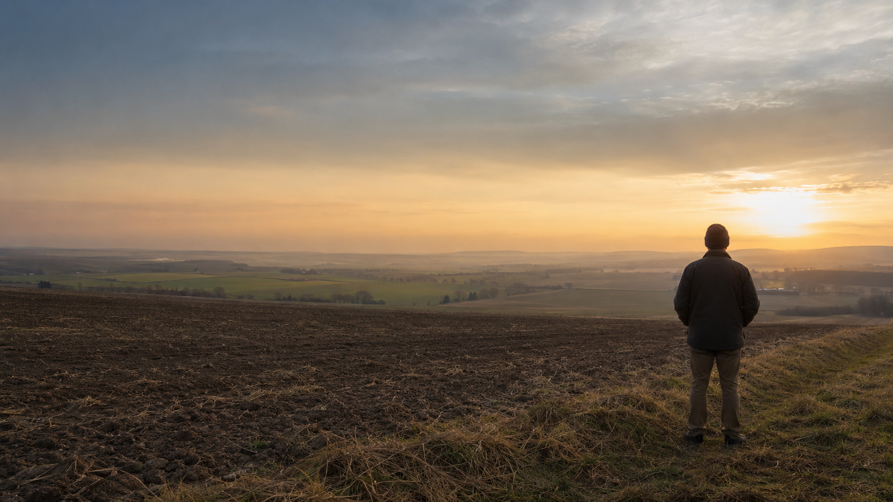
COLOSSIANS 3:1–4
“Set your hearts on things above, where Christ is”
(Colossians 3:1, NIV).
Heavenly attention is active,
Christ-centered, and present-forming.
HEAVEN • WEEK ONE
9
Notes:
23–31 minutes. Read Colossians 3:1–4 twice. Ask: Which verbs describe our response? Where is Christ? What future appearing is promised? Then connect verses 5–17: setting our minds on Christ does not produce contempt for Earth.
[Sources]
- The Holy Bible, New International Version (2011), Colossians 3:1–17.
- field-and-horizon visual, 2026.

Slide 17
SETTING OUR MINDS WHERE CHRIST IS
makes us more faithful here
compassion
forgiveness
peace
gratitude
love
HEAVEN • WEEK ONE
10
Notes:
Emphasize the Friends connection: the living Christ teaches, exposes, heals, guides, and sends. Waiting upon Christ is not withdrawal from the world.
[Sources]
- Paul David Bravard, Heaven Week One Working Leader Guide, 2026.

Slide 18
1 CORINTHIANS 2:6–13
“These are the things God has revealed to us by his Spirit”
(1 Corinthians 2:10, NIV).
Mystery is not the same as
permanent ignorance.
HEAVEN • WEEK ONE
11
Notes:
31–38 minutes. Read 1 Corinthians 2:6–13 twice. Clarify that Paul’s immediate subject is God’s saving wisdom in the crucified Christ, not a detailed description of Heaven. Still, verse 9 should not be used to silence study because the sentence continues with the Spirit’s revelation.
[Sources]
- The Holy Bible, New International Version (2011), 1 Corinthians 2:6–13.
- open-Bible visual, 2026.

Slide 19
1 CORINTHIANS 2
Humility is not the same as agnosticism
We cannot know everything
We must receive what is given
God remains greater than every picture.
The promised reality will exceed our present experience.
God’s words are meant to communicate.
We are responsible for what God has made known.
HEAVEN • WEEK ONE
12
Notes:
38–40 minutes. Place observations into the study’s three categories. Summarize: Christ promises; we seek; the Spirit reveals through Scripture.
[Sources]
- Paul David Bravard, Heaven Week One Working Leader Guide, 2026.

Slide 20
THREE WAYS WE WILL SPEAK
Clear biblical
teaching
Reasonable
inference
Faithful
imagination
What a passage directly affirms in context.
A conclusion that fits several biblical truths.
A possible picture held humbly and open to correction.
Scripture first • Christ at the center • Disciplined humility
HEAVEN • WEEK ONE
13
Notes:
Introduce these categories as the method for all fourteen weeks. The conscience is bound by Scripture, not by every conclusion in Alcorn’s book.
[Sources]
- Paul David Bravard, Heaven Week One Working Leader Guide, 2026.
- Randy Alcorn, Heaven (Tyndale House, 2004), chapters 1–2.

Slide 21
ALCORN’S DIAGNOSIS
Thin pictures cannot carry
the weight of grief.
inhuman
lonely
boring
The problem is not that Scripture has given us nothing.
Other pictures have sometimes become more vivid than Scripture.
HEAVEN • WEEK ONE
14
Notes:
40–44 minutes. Summarize Alcorn chapter 1: many Christians believe in Heaven but do not actually look forward to it because inherited images feel inhuman, lonely, or boring.
[Sources]
- Randy Alcorn, Heaven (Tyndale House, 2004), chapter 1.
- Paul David Bravard, Heaven Week One Working Leader Guide, 2026.

Slide 22
God has revealed enough
to awaken longing.
garden • city • kingdom • banquet
resurrection • worship • service • home
Enough light to long for home.
HEAVEN • WEEK ONE
15
Notes:
44–48 minutes. Summarize Alcorn chapter 2. We will not claim exhaustive knowledge; neither will we claim that God has revealed nothing. Biblical images give bridges into the world to come.
[Sources]
- Randy Alcorn, Heaven (Tyndale House, 2004), chapter 2.
- open-Bible visual, 2026.

Slide 23
CHRISTIAN IMAGINATION
alive—and disciplined
beneath Scripture
not a substitute for it
open to correction
not announced as doctrine
centered in Christ
not driven by curiosity alone
HEAVEN • WEEK ONE
16
Notes:
48–52 minutes. Alcorn gives Christians permission to imagine again. Explain that faithful imagination may help us hope, but it cannot bind another person’s conscience.
[Sources]
- Paul David Bravard, Heaven Week One Working Leader Guide, 2026.

Slide 24
Looking toward Heaven
should make us more faithful here.
more present • more courageous • more generous
more faithful in the work entrusted to us
HEAVEN • WEEK ONE
17
Notes:
52–55 minutes. Friends believe the living Christ still teaches his people. The Light exposes, heals, guides, and sends. A heavenward hope should make us more present to the person before us and more faithful in the work entrusted to us.
[Sources]
- Paul David Bravard, Heaven Week One Working Leader Guide, 2026.
- field-and-horizon visual, 2026.

Slide 25
TEACHING CONVERGENCE
A clearer hope of Heaven
steadies troubled hearts
and makes us more faithful on Earth.
HEAVEN • WEEK ONE
18
Notes:
Pause here before conversation. Repeat the convergence sentence once, slowly. Invite two minutes of silence before forming groups of three.
[Sources]
- Paul David Bravard, Heaven Week One Working Leader Guide, 2026.

Slide 26
CONGREGATIONAL CONVERSATION
Listen for the story beneath the answer
1. What picture of Heaven did you inherit—and what effect has it had on your faith or emotions?
2. What is the difference between admitting we cannot know everything and assuming we can know nothing?
HEAVEN • WEEK ONE
19
Notes:
55–65 minutes. Hold two minutes of silence, then nine minutes in groups of three. Participants may answer one query, remain silent, or speak privately afterward.
[Sources]
- Paul David Bravard, Heaven Week One Working Leader Guide, 2026.

Slide 27
CONGREGATIONAL CONVERSATION
Keep hope alive—and accountable
3 — How can Christian imagination remain both alive and accountable to Scripture?
4 — What might it mean to set our minds where Christ is without neglecting the people before us?
HEAVEN • WEEK ONE
20
Notes:
65–75 minutes. Invite whole-group sharing. Park later questions visibly rather than rushing them: the present Heaven, resurrection bodies, recognition, animals, work, culture, and boredom will receive their own weeks.
[Sources]
- Paul David Bravard, Heaven Week One Working Leader Guide, 2026.

Slide 28
PERSONAL RESPONSE
Release
One picture I am ready to release is …
Receive
One promise I want to receive is …
Carry
One question I want to carry is …
HEAVEN • WEEK ONE
21
Notes:
75–83 minutes. Return the index cards or distribute new ones. Do not collect the first two responses. Participants may submit the third response for the series question list.
[Sources]
- Paul David Bravard, Heaven Week One Working Leader Guide, 2026.

Slide 29
PRAYER & SENDING
Bring the whole evening back to Christ
Rejoice
Lord Jesus, we thank you that …
Repent
Forgive our false, fearful, or careless pictures.
Request
Open our eyes. Steady the grieving. Teach us to hope.
HEAVEN • WEEK ONE
22
Notes:
83–90 minutes. Settle into waiting worship. Allow brief spoken prayers or silence through Rejoice, Repent, and Request. Close: Jesus, when our hearts are troubled, teach us to trust you. Set our minds where you are. Guard our imagination with Scripture, and let your promised future make us faithful in the present. Amen.
[Sources]
- Paul David Bravard, Heaven Week One Working Leader Guide, 2026.

Slide 30
SENDING WORD
Go in hope.
Christ has not abandoned us to vague darkness.
He has spoken, and he will bring his people home.
NEXT WEEK • THE WAY HOME: CHRIST, ASSURANCE, AND ETERNITY
HEAVEN • WEEK ONE
23
Notes:
Send participants with hope. After the gathering, review submitted questions, contact anyone who expressed significant fear or fresh grief, and prepare for Week Two: our hope has a shape, but what makes that hope ours is Jesus Christ.
[Sources]
- Paul David Bravard, Heaven Week One Working Leader Guide, 2026.
- path-to-home visual, 2026.

