Slide 1
Why the 'Silence' Wasn’t Empty
Malachi 4 • Luke 1 • Amos 8:11–12
400 Years of Silence
9.7.2025

Slide 2

“Behold, I am going to send you Elijah the prophet before the coming of the great and terrible day of the Lord...” Malachi 4:5

Slide 3
The Last Words (Malachi 4:5–6)
Elijah promised before the day of the Lord
Signals hope, not abandonment
God sets expectations in silence

Slide 4


Slide 5
Silence Foretold (Amos 8:11–12)
Famine of hearing the Word
People stagger from sea to sea
Silence reveals the value of God’s voice

Slide 6
The First Sound (Luke 1:5–20)
Angel speaks to Zechariah
Fulfillment of Malachi’s prophecy
The Word returns through John

Slide 7
Place Shapes People (Geography)
Israel as the 'Land Between'
Influence, not dominance
Trade routes shape culture and mission

Slide 8
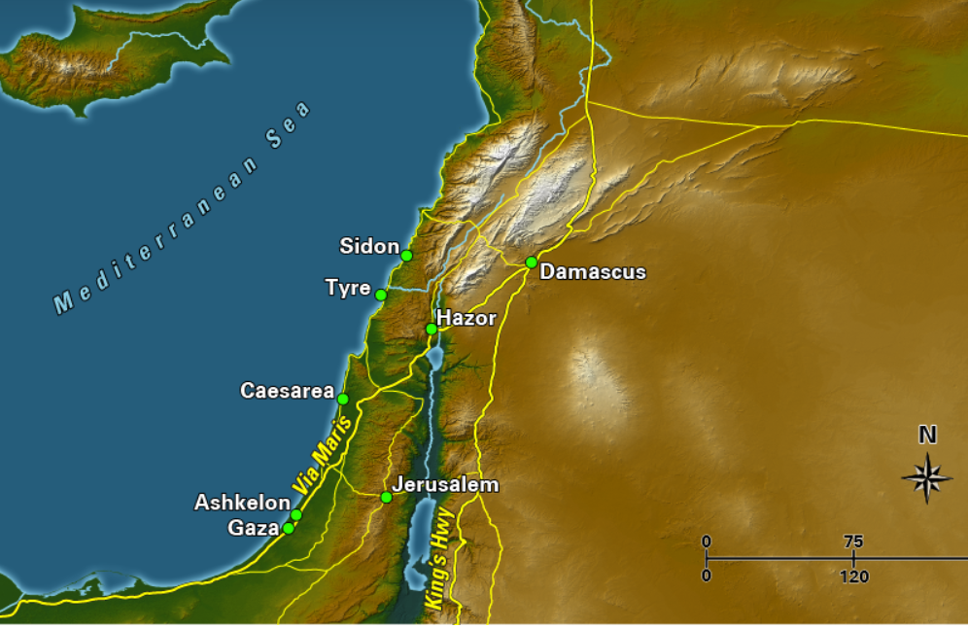
1st Century Trades Routes
Capernaum, on the shore of the Sea of Galilee, served as the primary base for Jesus' ministry, and the hometown of apostles Peter, Andrew, James, and Matthew
Nazareth

Slide 9
The People in the New Testament
Interactions that show Israel as a crossroads of cultures

Slide 10
Romans
Centurion of Capernaum (Matt 8)
Pilate & Roman trial of Jesus (John 18–19)
Cornelius’ conversion (Acts 10)
Roman garrison by the Temple (Acts 21)

Slide 11
Greeks
Greeks seek Jesus (John 12)
Paul at Athens (Acts 17)
Churches in Corinth, Philippi, Thessalonica
Greek language of NT & culture

Slide 12
Egyptians & Africans
Jesus’ flight to Egypt (Matt 2)
Apollos from Alexandria (Acts 18)
Ethiopian Eunuch baptized (Acts 8)
Simon of Cyrene (Mark 15)

Slide 13
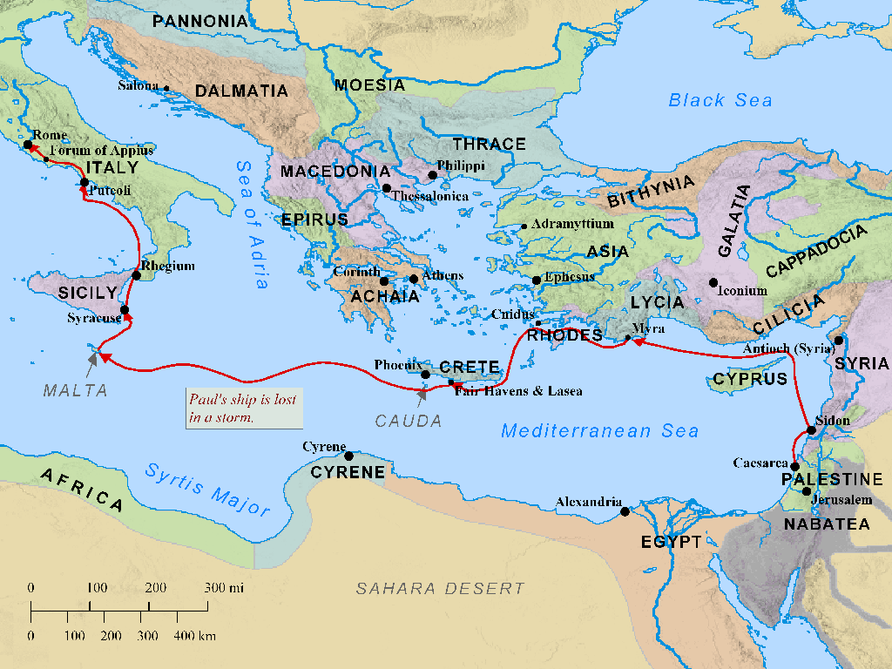

Slide 14
Others
Samaritan woman (John 4)
Syrophoenician woman (Mark 7)
Decapolis ministry (Mark 5, 7)
Temple Court of the Gentiles (Mark 11:17)

Slide 15
Summary
Israel was at the crossroads of empires, trade, and cultures.\nThe gospel arose in an international setting.\nGod’s plan was always for ALL nations (Matt 28:19).

Slide 16
The Silence Was Preparation
God was never absent
Silence cultivated hunger
The Word became flesh in the fullness of time

Slide 17
"Jesus is the light that dispels the darkness" is a powerful metaphor and reality…
This statement creates a clear analogy. It uses a concrete, easily understood image (light defeating darkness) to explain a spiritual concept
(the power of Jesus to conquer evil).

