Slide 1

RECONCILIATION
Mercy Tells
the Truth
9.6.2026
Matthew 18:15–20, Ezekiel 33:7–11, Romans 13:8–14

Slide 2
QUESTION
What does the mercy we receive from God form in a faithful follower of Jesus?
Mercy forms a person who can tell the truth for the sake of restoration.

Slide 3

We Are Very Good at Talking Around One Another
“The story I’m telling myself…”
Sometimes the wound grows before the conversation begins.
Brené Brown, Rising Strong (New York: Spiegel & Grau, 2015).

Slide 4

Scripture Reading — Matthew 18:15–20
“If your brother or sister sins, go and point out their fault, just between the two of you…”
GO TO THEM
WIN THEM OVER
“…you have won them over” (Matthew 18:15 NIV).

Slide 5
When Pain Forms a Triangle
A
hurt
B
C
D
“Everybody knows what A did… except A.”
Jesus: Go to the person.

Slide 6

BIG IDEA
Mercy tells the truth,
not to win against another person,
but to win the relationship back.

Slide 7
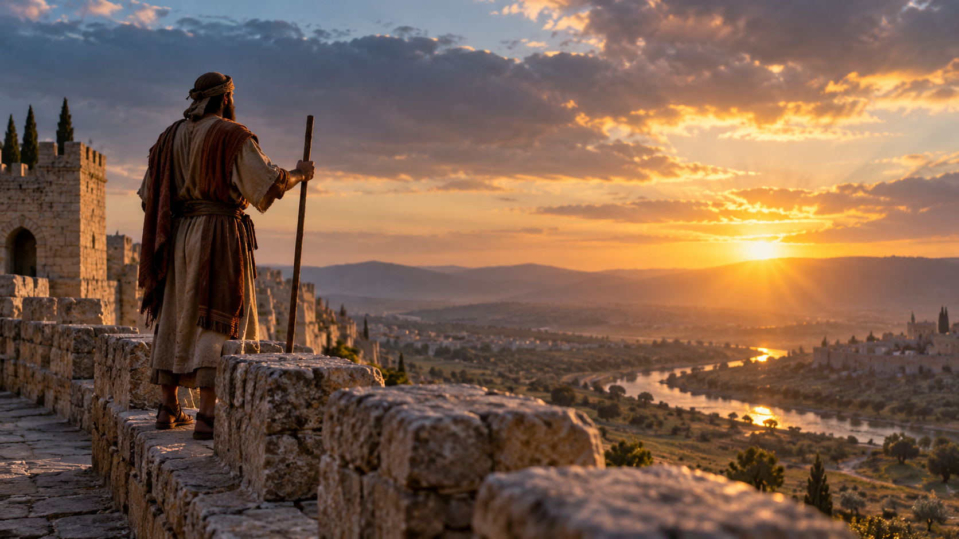
Mercy Tells the Truth Because Love Wants Life
“I take no pleasure in the death of the wicked, but rather that they turn from their ways and live” (Ezekiel 33:11 NIV).
TURN AROUND.
COME BACK.
LIVE.

Slide 8

Truthful Love Seeking Restoration
Mercy will not
weaponize the truth.
Mercy will not
hide from the truth.
“Love does no harm to a neighbor. Therefore love is the fulfillment of the law” (Romans 13:10).

Slide 9
The Goal Is Not Being Right — It Is About Relationship
PUNISHMENT
RESTORATION
VINDICATION
“You have won them over” (Matthew 18:15 NIV).
EMBARRASSMENT
The problem isn’t merely whether what I am saying is true.
The question is what I want the truth to accomplish.

Slide 10
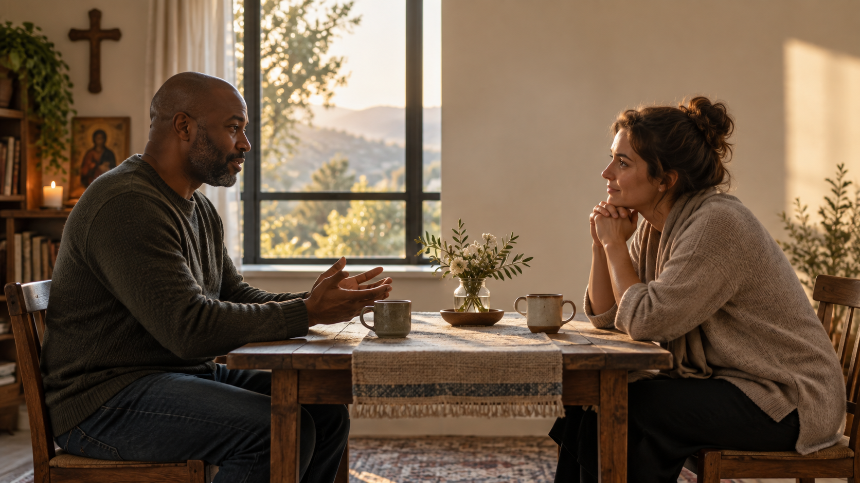
Mercy Listens
Here is what happened
from where I stood.
Help me understand what happened
from where you stood.

Slide 11
And Where Is Jesus While We Do This?
“For where two or three gather in my name, there am I with them” (Matthew 18:20 NIV).
I AM THERE.
God came toward us in Jesus Christ — to reconcile us.

Slide 12
What Does Mercy Form?
REMAIN
SPEAK
LISTEN
SEEK
present
truthfully
humbly
restoration
Mercy forms a person who can tell the truth for the sake of restoration.

Slide 13
HOLY RESPONSE
Is there someone I am talking about
whom Christ is asking me to talk with?
GO TOWARD ONE ANOTHER.
Mercy tells the truth — not because the relationship does not matter,
but because it matters too much to abandon without trying.

