Slide 1

Mercy Takes the Shape
of the Cross
What kind of person does God’s mercy form?
A person increasingly shaped like Jesus.
9.27.2026 · Marion First Friends Church

Slide 2

Scripture Reading
Philippians 2:5–11
“In your relationships with one another,
have the same mindset as Christ Jesus.”
Philippians 2:5 NIV

Slide 3

“Tom, disarm them.”
Thomas was ready to answer force with force.

Slide 4
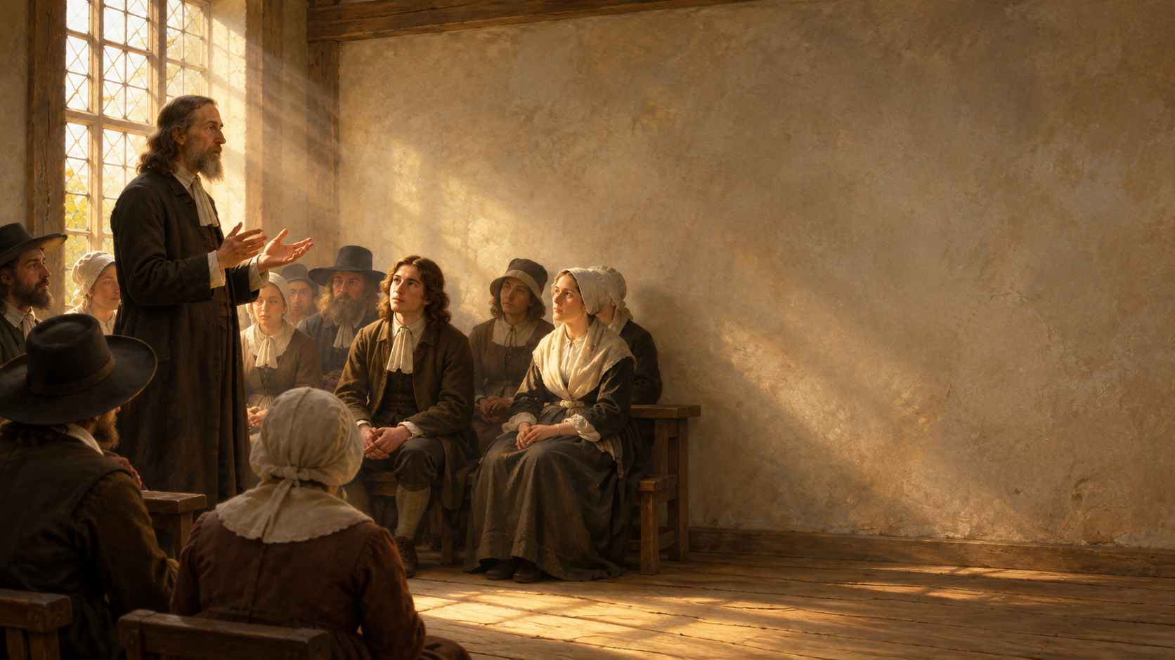
Then, in 1659,
something began to change.
“Something warmed his heart
in a way preaching had never done before.”
Christ was getting hold of him.

Slide 5

The person who hurts me
does not have to determine
the person I become.
Jesus had changed what his courage was for.

Slide 6
When I feel threatened, slighted, ignored,
disappointed, or entitled—
do I protect myself first,
or do I let Jesus teach me how to love?

Slide 7
Mercy takes the shape
of the cross.
What kind of person does God’s mercy form?
A person increasingly shaped like Jesus.

Slide 8

“Show me your ways, LORD,
teach me your paths.”
Psalm 25:4 NIV
Mercy makes humility possible.

Slide 9

“Which of the two did
what his father wanted?”
Matthew 21:31 NIV
Eventually holy words have to become a holy life.

Slide 10
“Have the same mindset
as Christ Jesus.”
Philippians 2:5 NIV
He takes the form of a servant.
He humbles himself.
He obeys—all the way to the cross.

Slide 11
Holiness is Christ becoming
increasingly visible
in the life of a person.
The risen Christ forms a people whose lives bear witness to Jesus.

Slide 12
Jesus shapes us most clearly
where we would rather
protect ourselves than love.

Slide 13
What am I trying to protect right now?
What would love require of me here?

Slide 14
Will the wound decide
what comes out of me next—
or will Jesus?
Jesus shapes us most clearly where we would rather protect ourselves than love.
Mercy takes the shape of the cross.

