Slide 1
Announcements

Slide 2
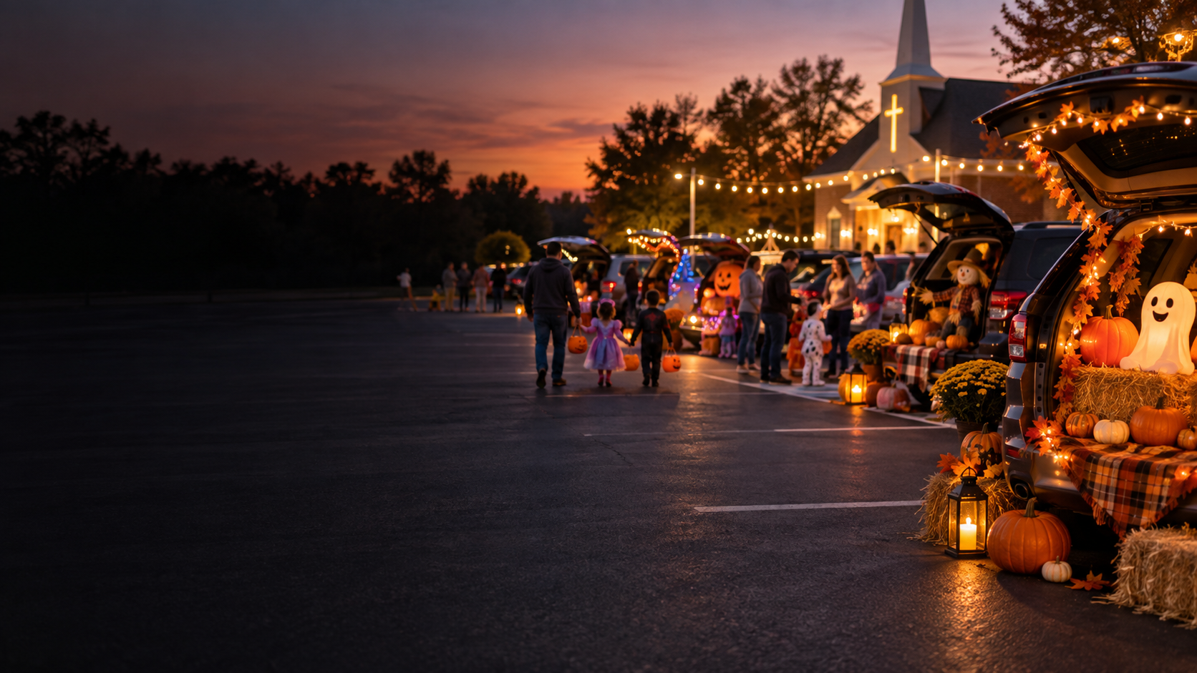
MARION FIRST FRIENDS
Trunk or Treat
Tuesday, October 27
Setup at 5:30 PM
Event from 6:00–7:00 PM
First Friends west parking lot

Slide 3
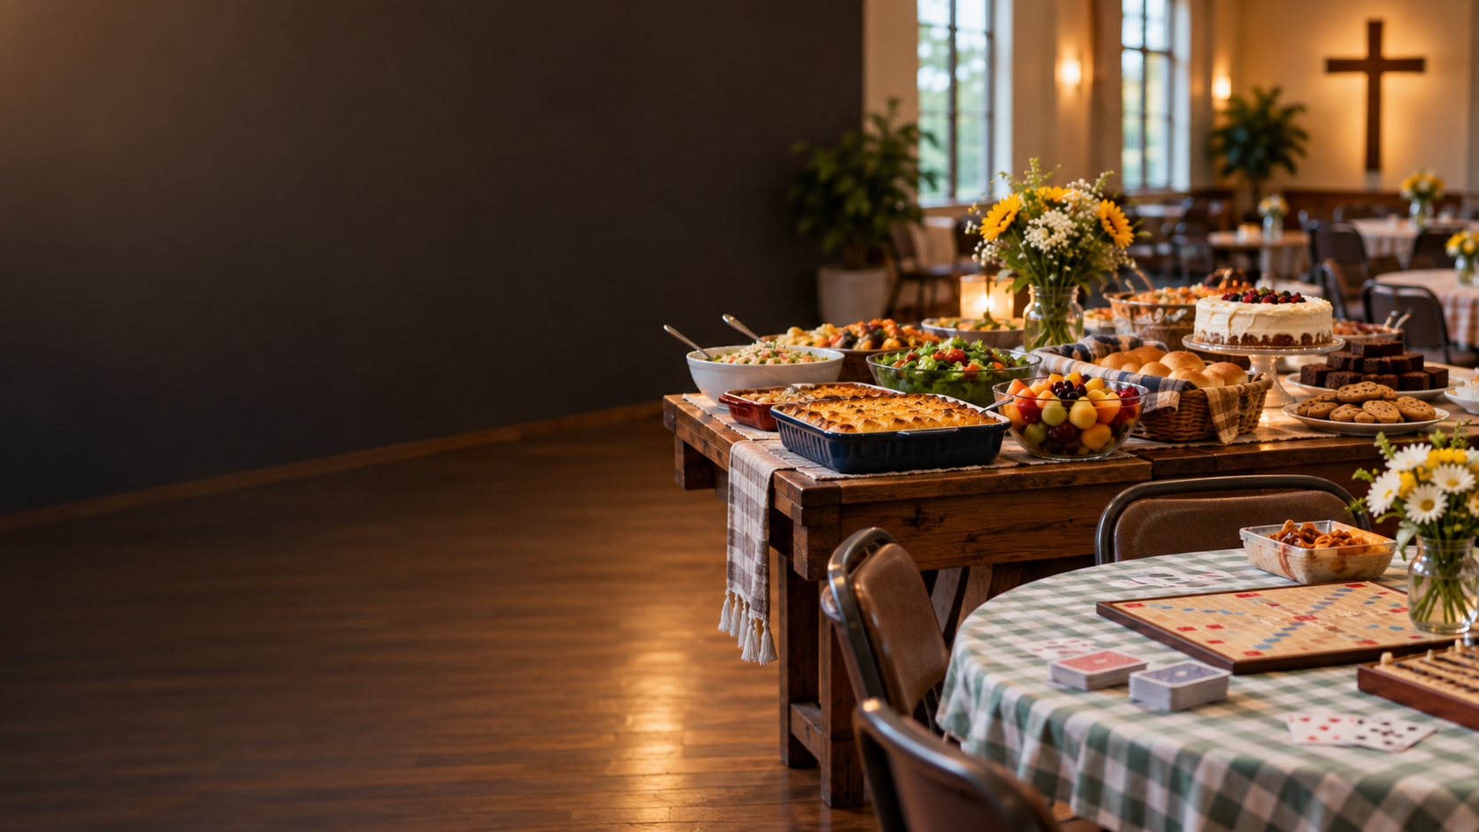
MARION FIRST FRIENDS
Carry-In & Game Day
Sunday, October 18
After worship
Bring a dish to share and stay for fellowship.

Slide 4

MARION FIRST FRIENDS
Wednesday Morning
Bible Study
Wednesdays
10:30 AM–12:30 PM
Bring your Bible and join the conversation.

Slide 5

MARION FIRST FRIENDS
Monthly Meeting
Sunday, October 25
After worship
Members and attenders are encouraged to stay.

Slide 6
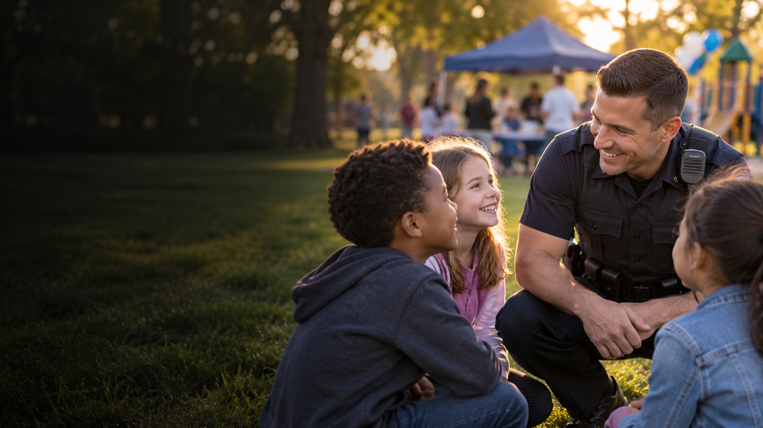
MARION FIRST FRIENDS
Local Mission Spotlight
Brian Sharp
Cops & Kids
Local mission recipient from July through September

Slide 7

MARION FIRST FRIENDS
Heaven Study
Wednesdays
Soup at 5:15 PM
Study at 5:30 PM
Through November 18

Slide 8
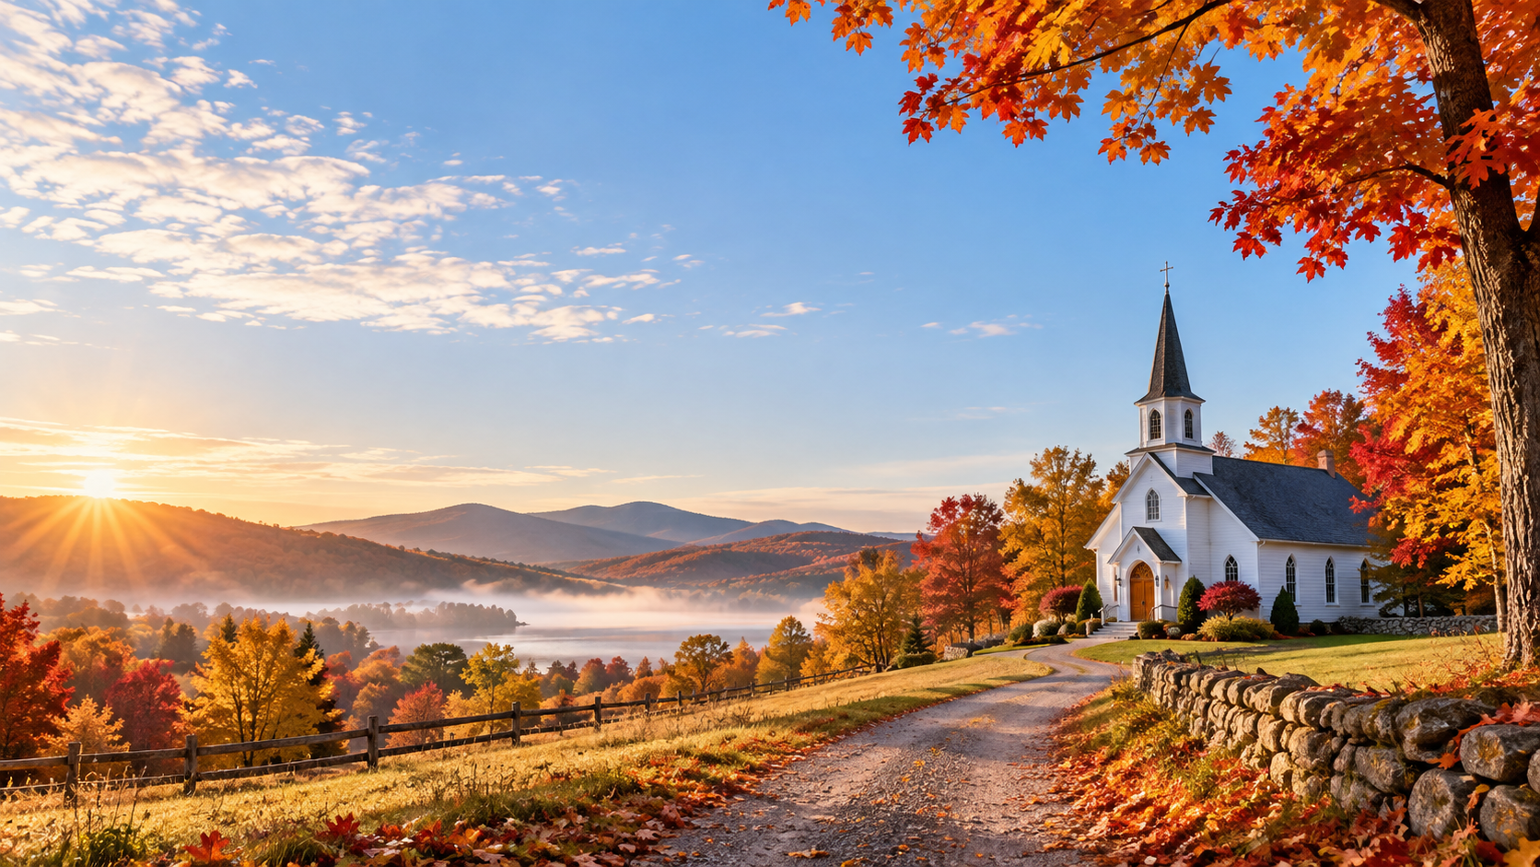
MARION FIRST FRIENDS
MARION FIRST FRIENDS
Thursday Worship Group
Thursday Worship Group
Thursdays at 5:30 PM
Thursdays at 5:30 PM
A quiet place for prayer, song, and shared worship. Join us!
And no, we won’t expect you to sing upfront that Sunday…
A quiet place for prayer, song, and shared worship. Join us!
And no, we won’t expect you to sing upfront that Sunday…

Slide 9


Slide 10
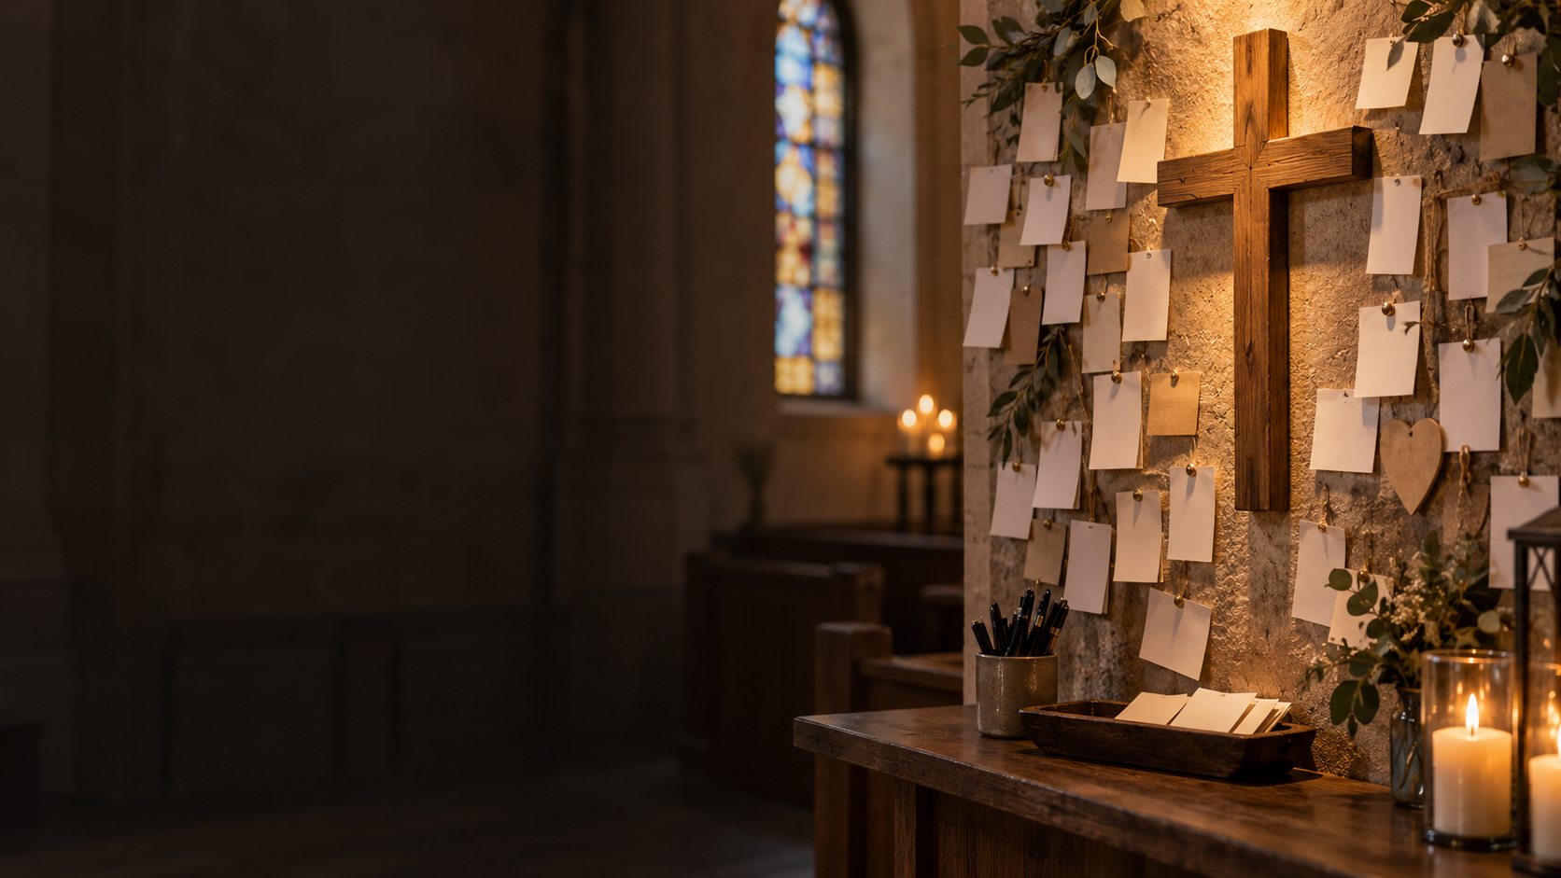
MARION FIRST FRIENDS
Prayer Requests
How may we pray with you today?
Share a request, a burden, or a name.

Slide 11

MARION FIRST FRIENDS
Praises & Holy Nudges
Where have you seen God at work?
Share a moment the Holy Spirit nudges you, “Check this out!”

Slide 12
Sermon Manuscript

Slide 13

Mercy Gives More
Than We Think Is Fair
Matthew 20:1–16 • Jonah 3:10–4:11
Psalm 145:1–8 • Philippians 1:21–30
Marion First Friends Church • 9.20.2026

Slide 14
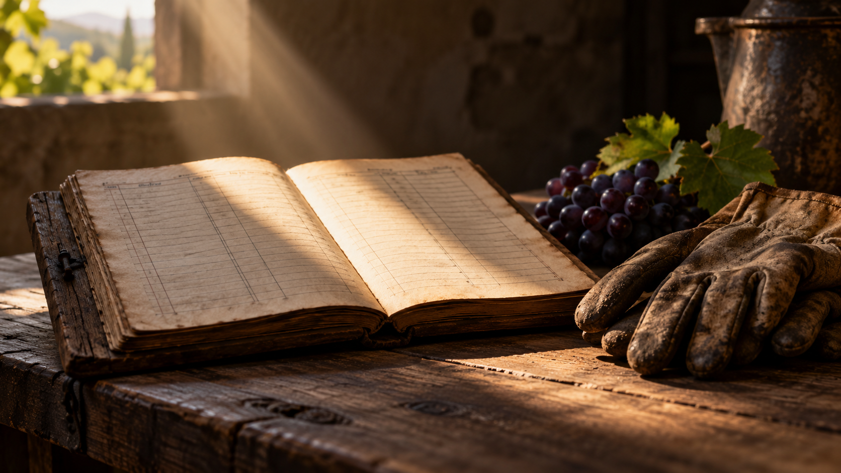
God’s goodness is not a limited resource.
Grace is not wages.
Marion First Friends Church • 9.20.2026

Slide 15
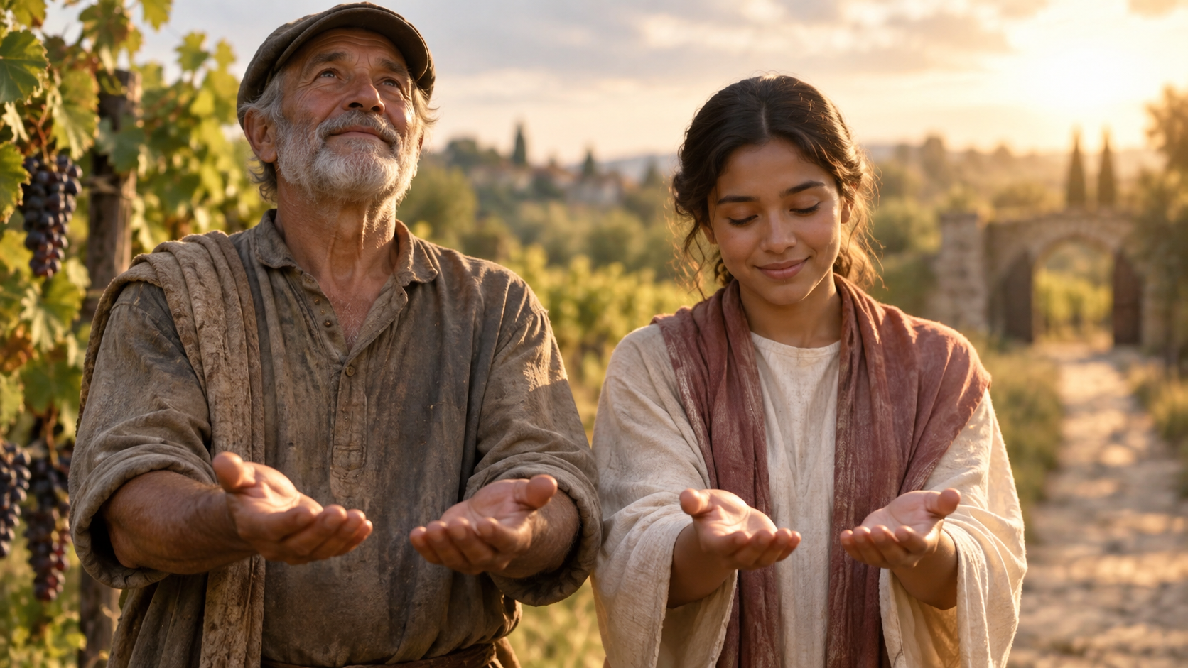
Sunday Query
Can I receive God’s grace deeply enough
that I can rejoice when God gives it to
someone I would have made wait?
Who am I still hoping God will give less to?
Marion First Friends Church • 9.20.2026

Slide 16
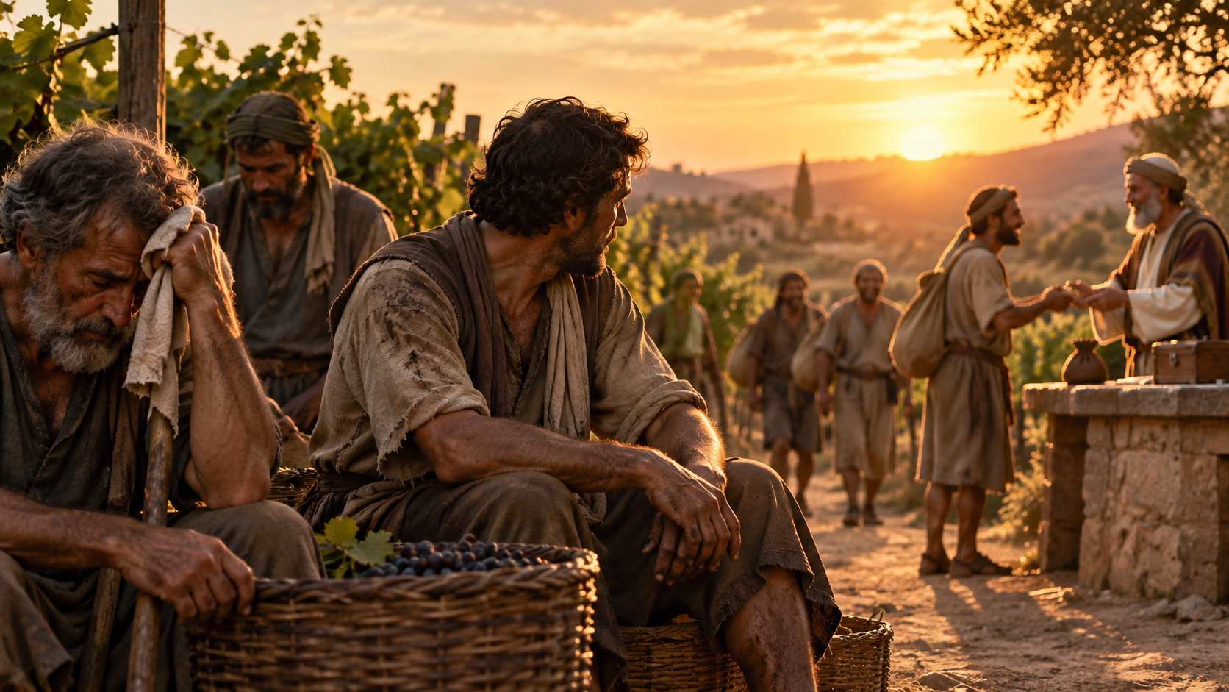
The Parable of the Vineyard… And the Ledger
“Friend, I am not being unfair to you…”
Matthew 20:13, 15 NIV
“Are you envious because I am generous?”
Marion First Friends Church • 9.20.2026

Slide 17
What Comparison Does…
Their blessing did not become smaller.
“You have made them
equal to us.”
Comparison made it feel smaller.
Matthew 20:12 NIV
They needed the late workers to receive less,
so their own work would feel more valuable.
Marion First Friends Church • 9.20.2026

Slide 18
When Another Person’s Mercy Feels Unfair:
I served while they stayed away.
I remained faithful while they wandered.
I carried the responsibility.
I forgave, waited, prayed, and showed up.
When does their mercy begin to feel like my injury?
Marion First Friends Church • 9.20.2026

Slide 19
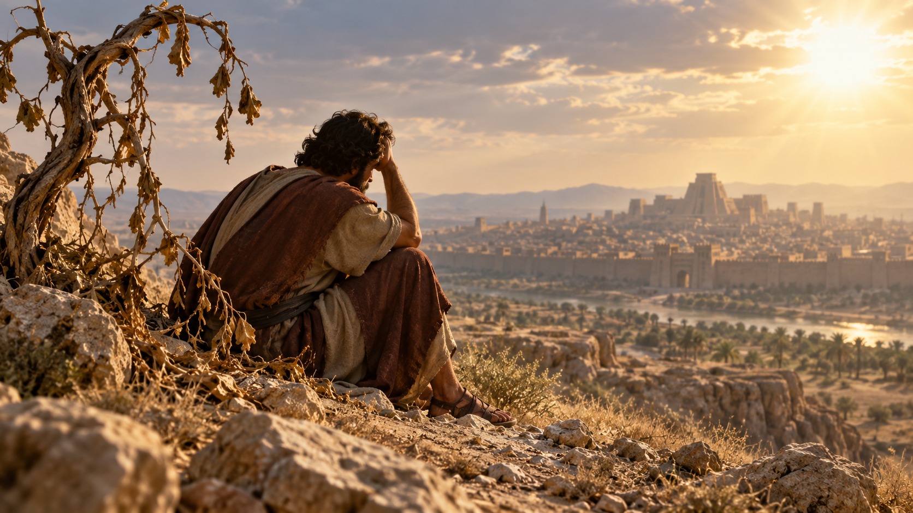
Jonah 3:10-4:11, Jonah knew God was gracious.
“I knew that you are a gracious and compassionate God, slow to anger and abounding in love…”
Jonah 4:2 NIV
He just did not like where grace landed.
Marion First Friends Church • 9.20.2026

Slide 20
Grace Reveals Where We Seek Our Worth
“I learned it the hard way.”
can quietly become
“So should you.”
If God can spare them some of that pain—praise God.
Marion First Friends Church • 9.20.2026

Slide 21
Psalm 145
Grace is not a small supply
to be divided among
the deserving.
“The LORD is gracious and compassionate,
slow to anger and rich in love.”
Psalm 145:8 NIV
Marion First Friends Church • 9.20.2026

Slide 22
The Sanctifying Work of Grace
Sanctifying grace teaches me to stop needing
someone else to receive less
in order for me to know that I am loved.
Their blessing
does not reduce mine.
Their forgiveness
does not threaten my place.
Their welcome
does not mean I am forgotten.
Marion First Friends Church • 9.20.2026

Slide 23
Philippians 1
“Whatever happens,
conduct yourselves in a manner
worthy of the gospel of Christ.”
Philippians 1:27 NIV
Grace changes why we are faithful.
We labor because he called our name.
Marion First Friends Church • 9.20.2026

Slide 24
The Gospel Gives Us Empty Hands
The same mercy that welcomes
the late worker
is the mercy that welcomes us.
When I remember whose I am,
I no longer need someone else
to receive less.
Marion First Friends Church • 9.20.2026

Slide 25
Invitation to Reflection
Whose experience of God’s goodness
is hardest for me to celebrate?
Is there hurt that needs truth?
Is there a boundary that needs wisdom?
Is there a ledger grace is asking me to release?
Marion First Friends Church • 9.20.2026

Slide 26
Open Worship Query
Who am I still hoping God will give less to?
What is it in me that needs them to receive less?
Can I receive God’s grace deeply enough that I can rejoice
when God gives it to someone I would have made wait?
Marion First Friends Church • 9.20.2026

