Slide 1


Slide 2
God’s lordship steers empires to prepare the world for Jesus.

Slide 3
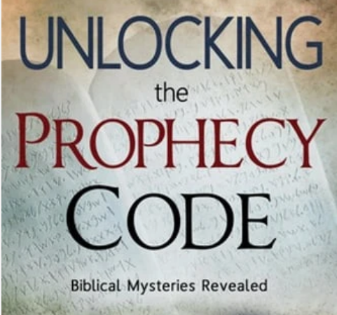

Slide 4
Daniel: Courage and Trust
maintaining faith and obedience in exile.
refused to compromise his beliefs for political gain.
prayed for deliverance even when faced with death.
forced into a lion's den for his devotion.

Slide 5
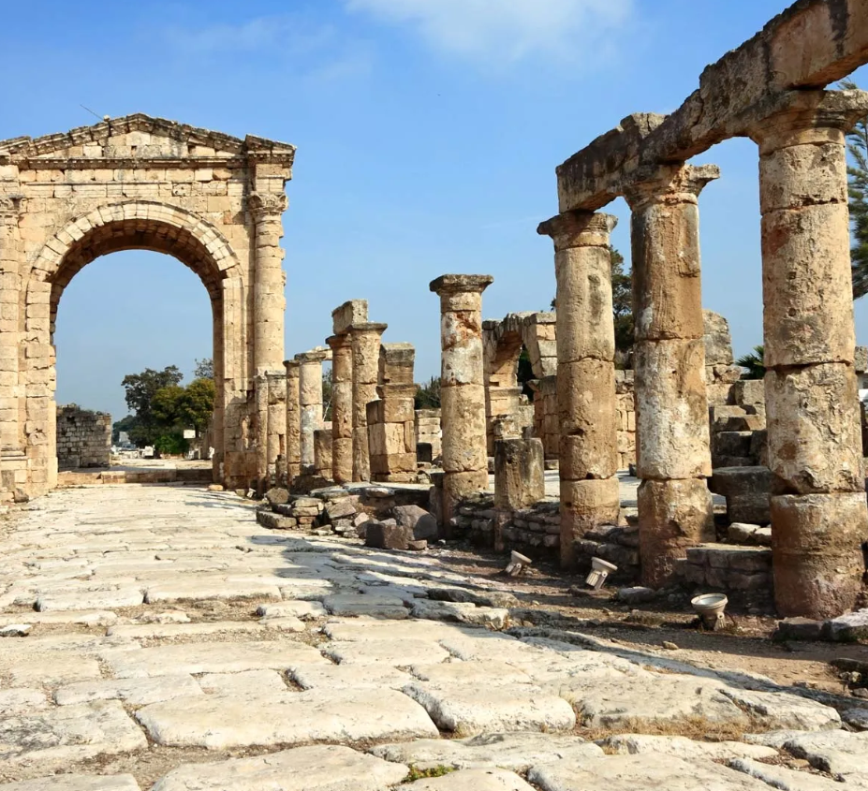
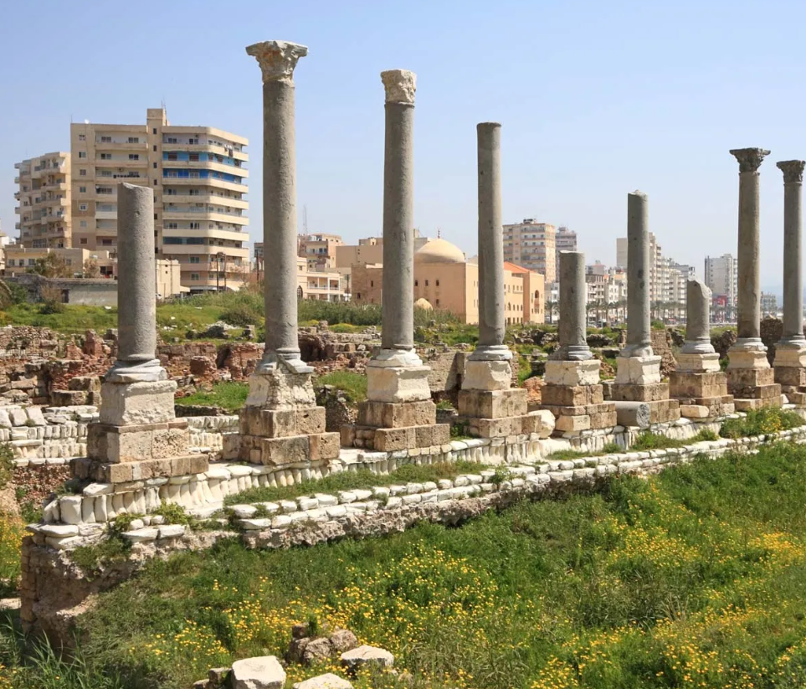
Tyre, Lebanon

Slide 6
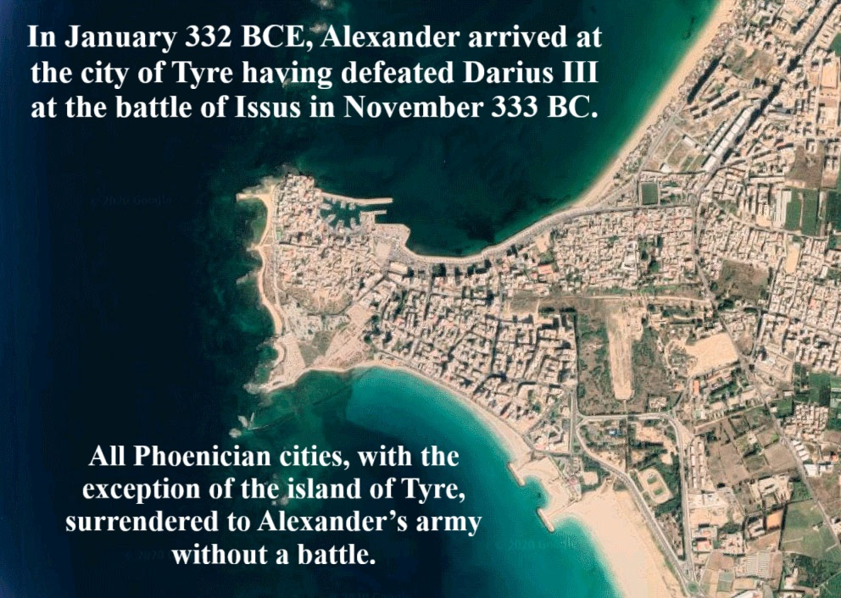

Slide 7
Book of Ezekiel, chapter 28, verse 3
“The word of the Lord came to me:
“Son of man, say to the ruler of Tyre…
Pew Bible, page 847.

Slide 9
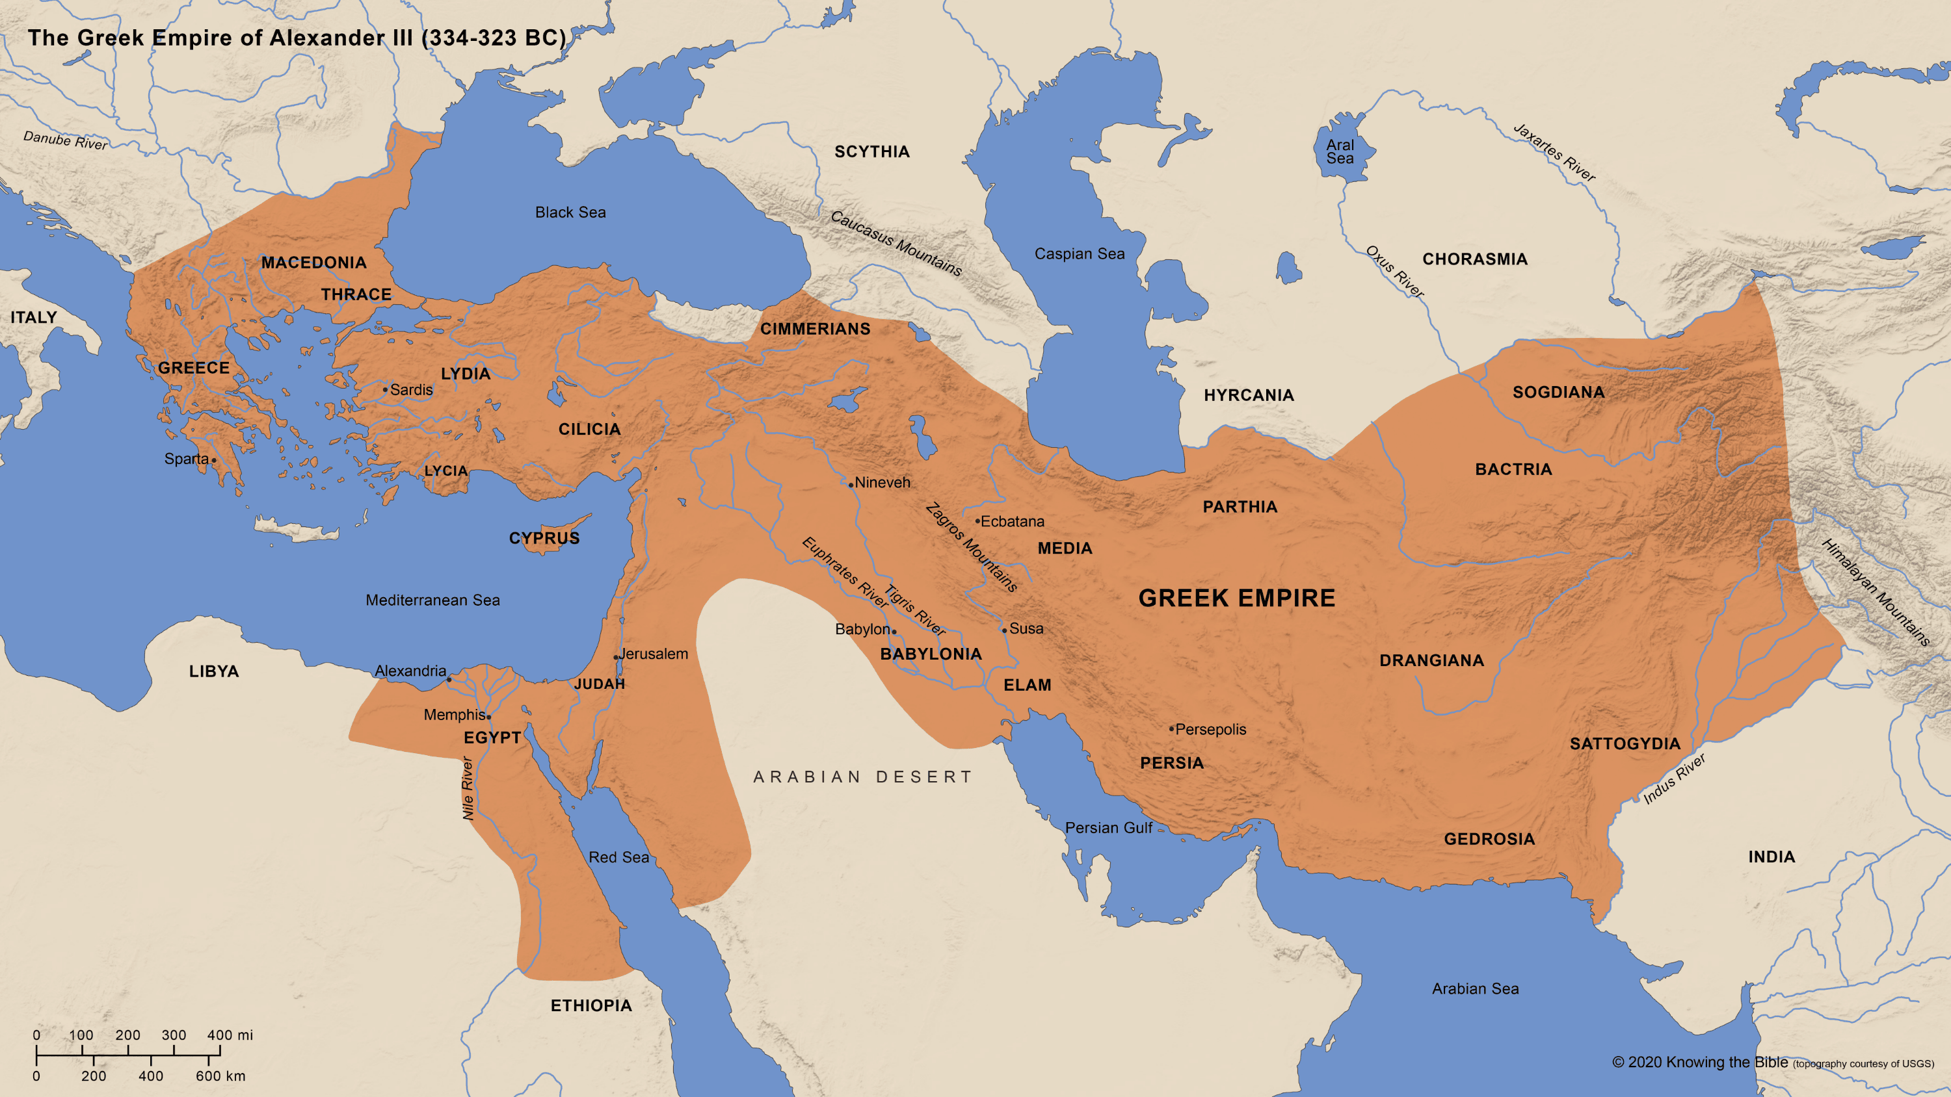
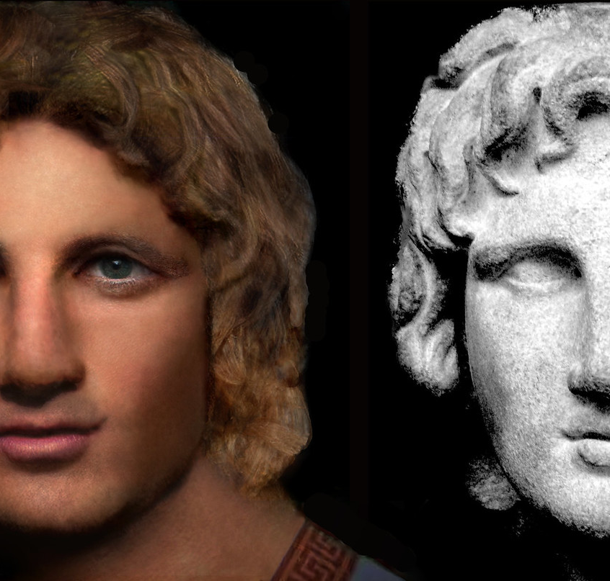
Alexander wept...

Slide 10
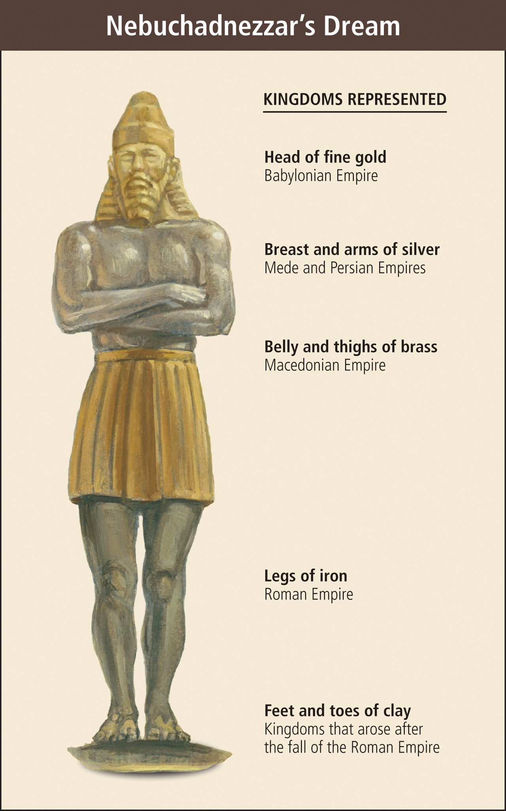
Daniel Chapter 2, he interprets Nebuchadnezzar's dream, describing the giant statue composed of different metals—gold, silver, bronze, and iron mixed with clay, which represents successive kingdoms.

Slide 11
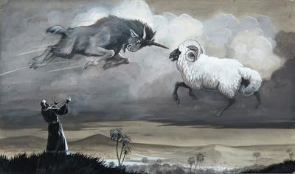
The ram = Medo-Persia. The goat = Greece.
The “horn” (first king) rises swiftly, then breaks, and the kingdom divides

Slide 12
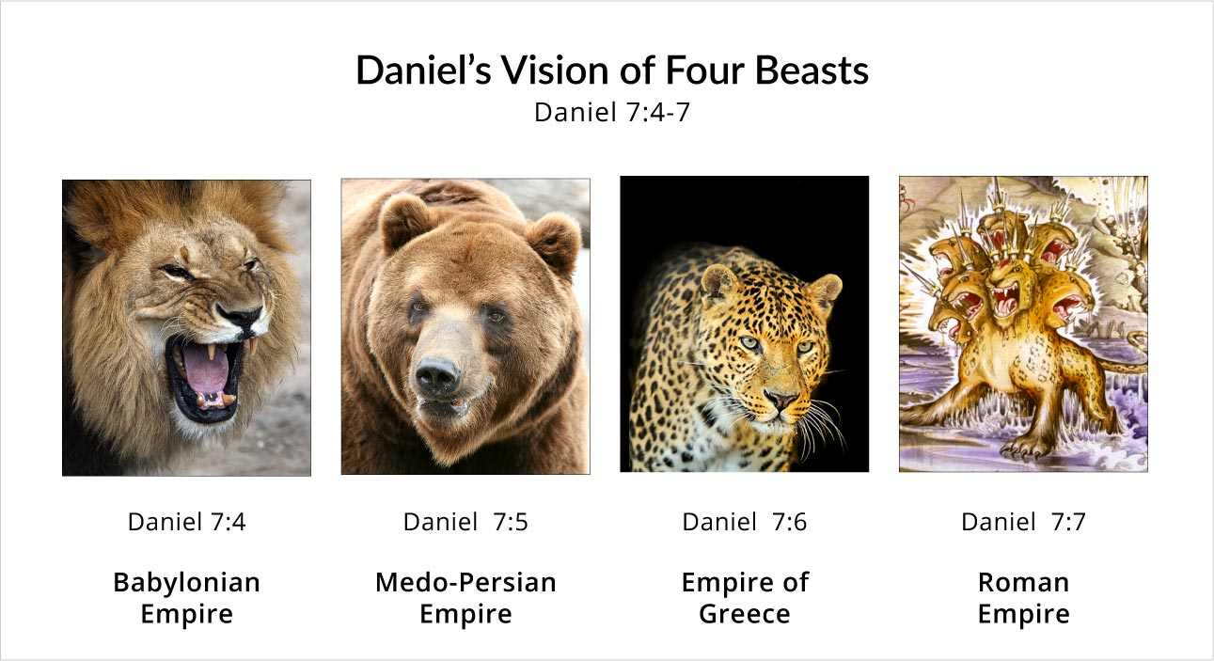
Daniel 7 (the beasts) he has visions that trace the sequence of the successive kingdoms: Babylon → Medo-Persia → Greece → Rome → the kingdom of God.

Slide 13
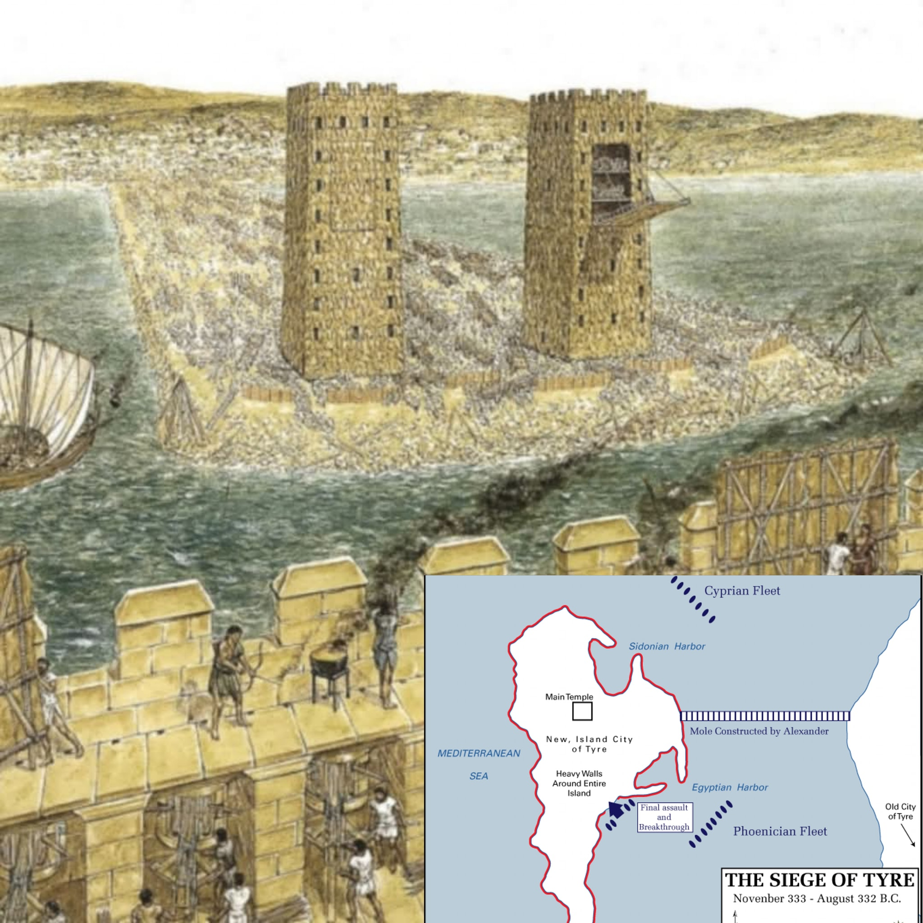

Slide 14
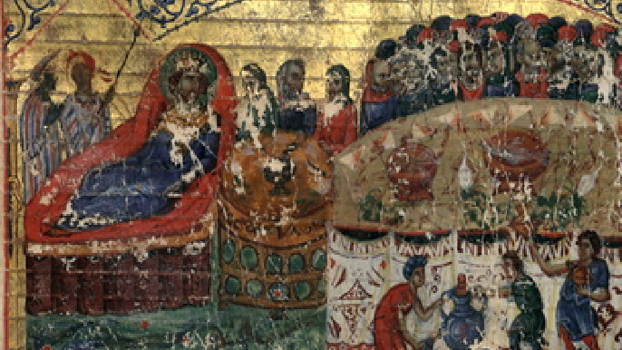
THE FIRST TRANSLATION OF THE OLD TESTAMENT
Ptolemy giving a banquet for the translators of the Septuagint (280 BC).

Slide 15
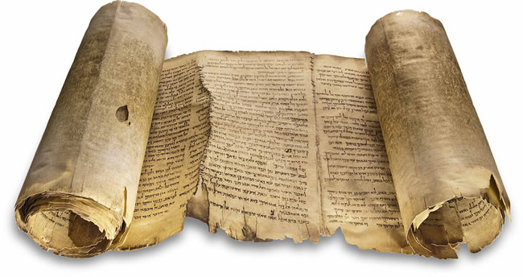
Septuagint (LXX)

Slide 16
Where has God placed you between worlds (work/home, generations, church/community)?
Which “valley/road” (relationship, team, classroom, neighborhood) do you quietly stabilize?
This week’s non-dominating influence: one conversation, one act of service, one healthy boundary.

