Slide 1

FORGIVENESS
Mercy Stops
Keeping Score
9.13.2026
Mercy Series
1

Slide 2
SCRIPTURE READINGS
Genesis 50:15–21
Psalm 103:8–13
Romans 14:1–12
Matthew 18:21–35
Mercy tells the truth.
Mercy also learns what to do with the debt.
2

Slide 3
MATTHEW 18:21
“Lord, how many times
shall I forgive?”
Up to seven times?
Peter wants a number.
3

Slide 4
Jesus is not giving Peter
a larger number for the spreadsheet.
Jesus is destroying
the spreadsheet.
STOP COUNTING.
4

Slide 5
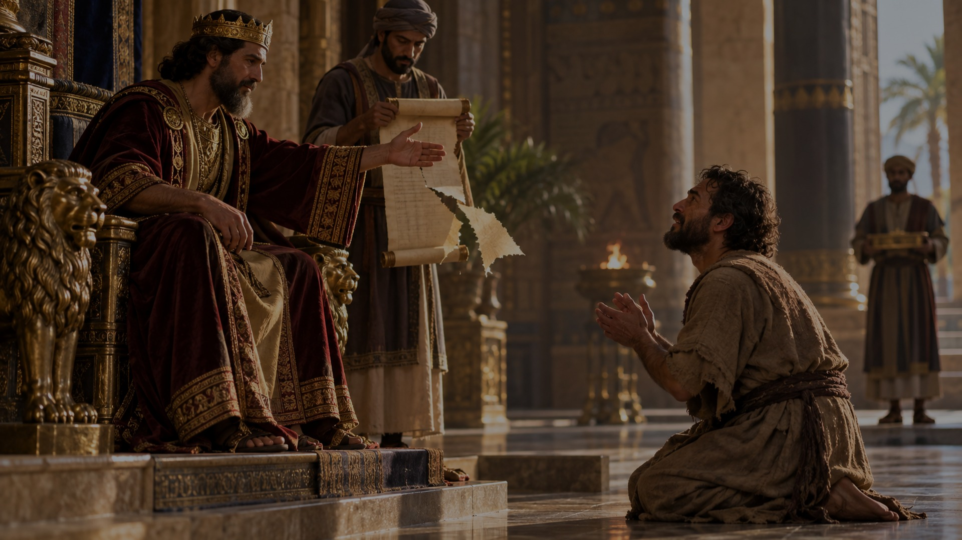
THE SERVANT WHO KEPT COLLECTING
“The servant’s master took pity on him,
canceled the debt and let him go.”
Matthew 18:27 NIV
The man whose impossible debt was canceled
is still living like a collector.
5

Slide 6
HOLINESS
Holiness is not simply
being forgiven.
Holiness is what the mercy of Christ begins forming
in the forgiven person.
6

Slide 7
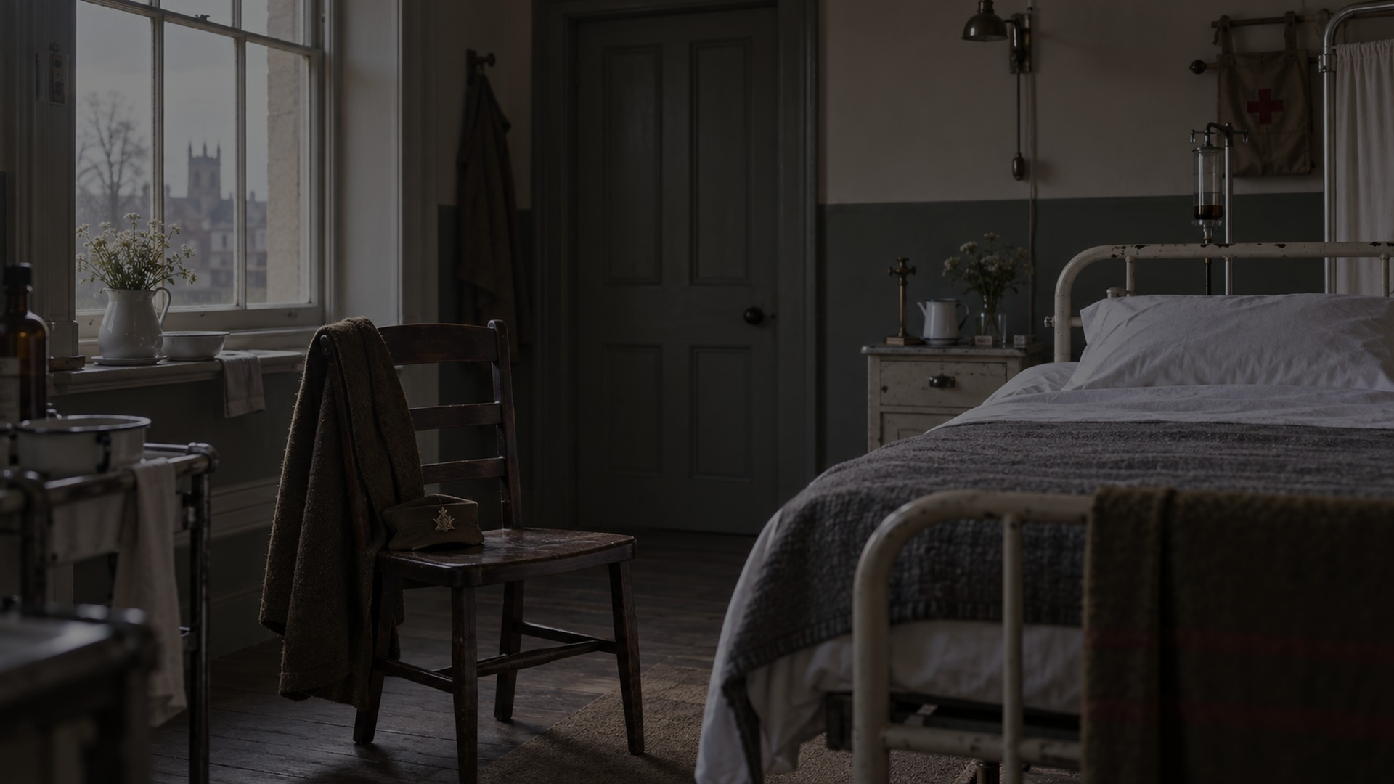
C. S. LEWIS
When the Wound
Has a Face
• Mother died when he was nine
• Sent away to boarding school
• Wounded by artillery in 1918
• Asked his father to visit. He did not come.
7

Slide 8
“His theology was written from inside
a wounded human life, not from outside one.”
The wound was real.
It did not have to become the whole truth.
8

Slide 9
FORGIVENESS
Forgiveness is not saying:
“You did not hurt me.”
Forgiveness is saying:
“What you did will no longer
determine what I become.”
9

Slide 10
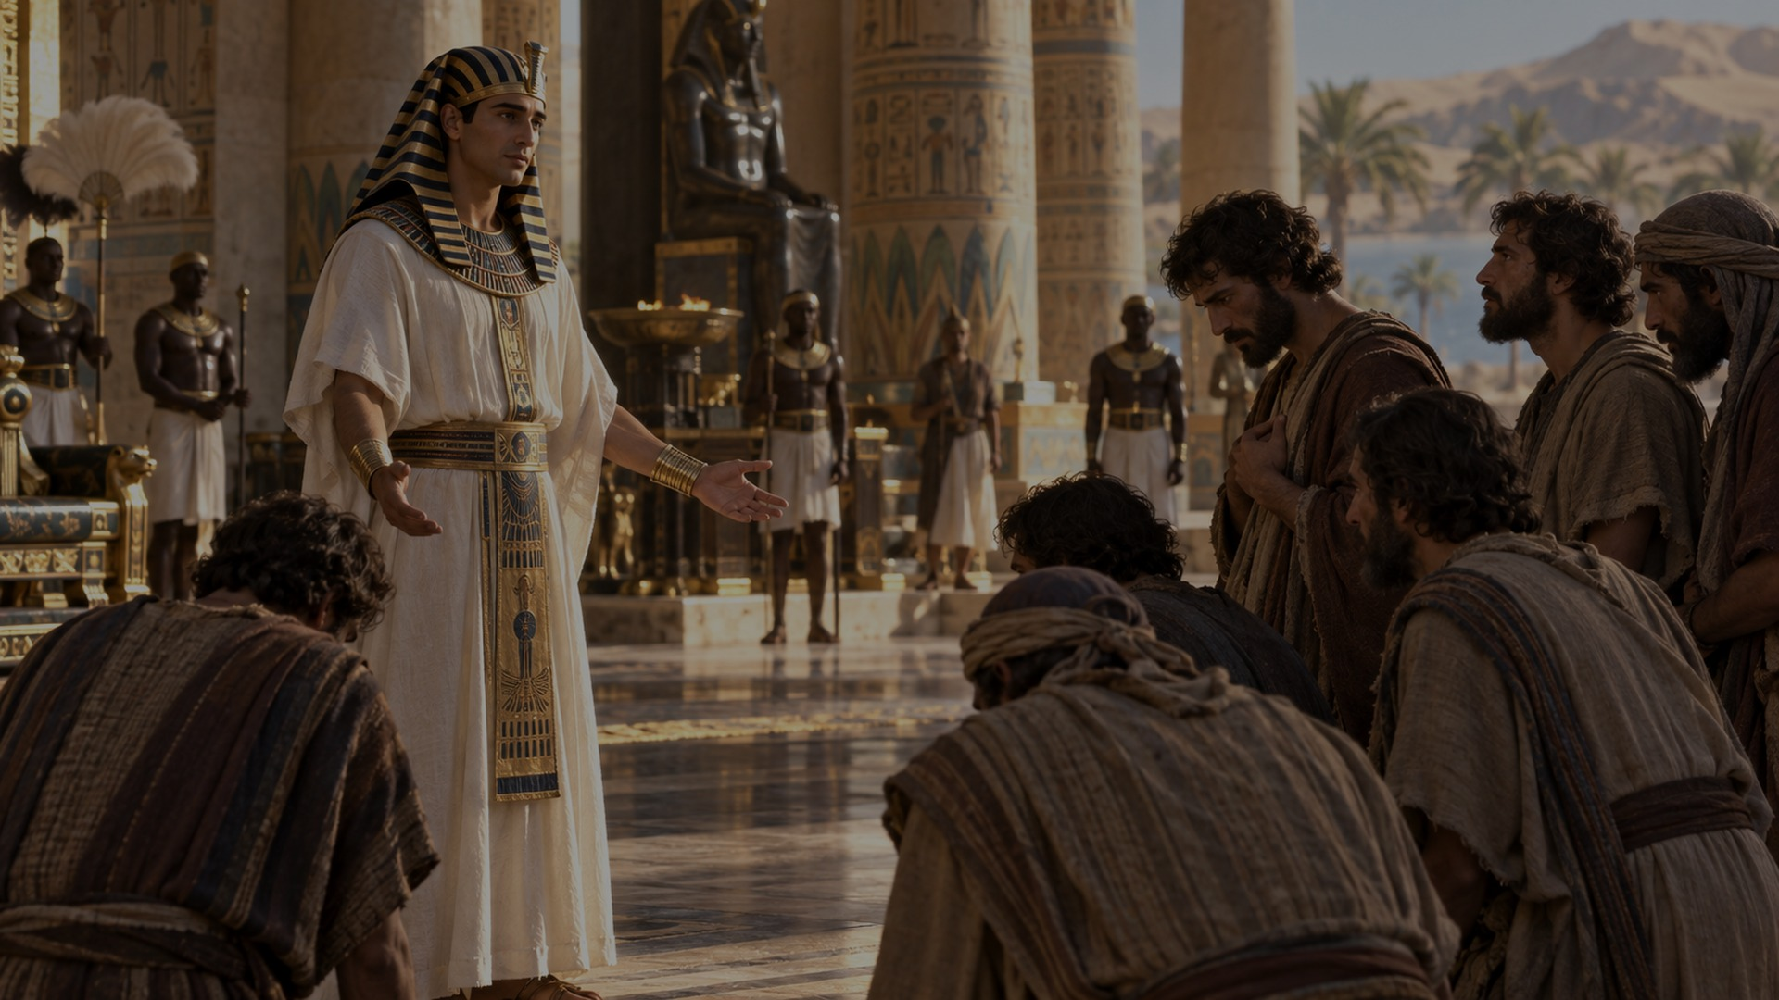
JOSEPH REFUSES TO COLLECT
“You intended to harm me,
but God intended it for good…”
Genesis 50:20 NIV
You intended harm. That is truth.
God intended good. That is redemption.
10

Slide 11
FORGIVENESS ≠ TRUST
Forgiveness releases the debt.
Trust determines whether I hand you
my wallet again.
Those are not the same thing.
Boundaries • Accountability • Wisdom • Time
11

Slide 12
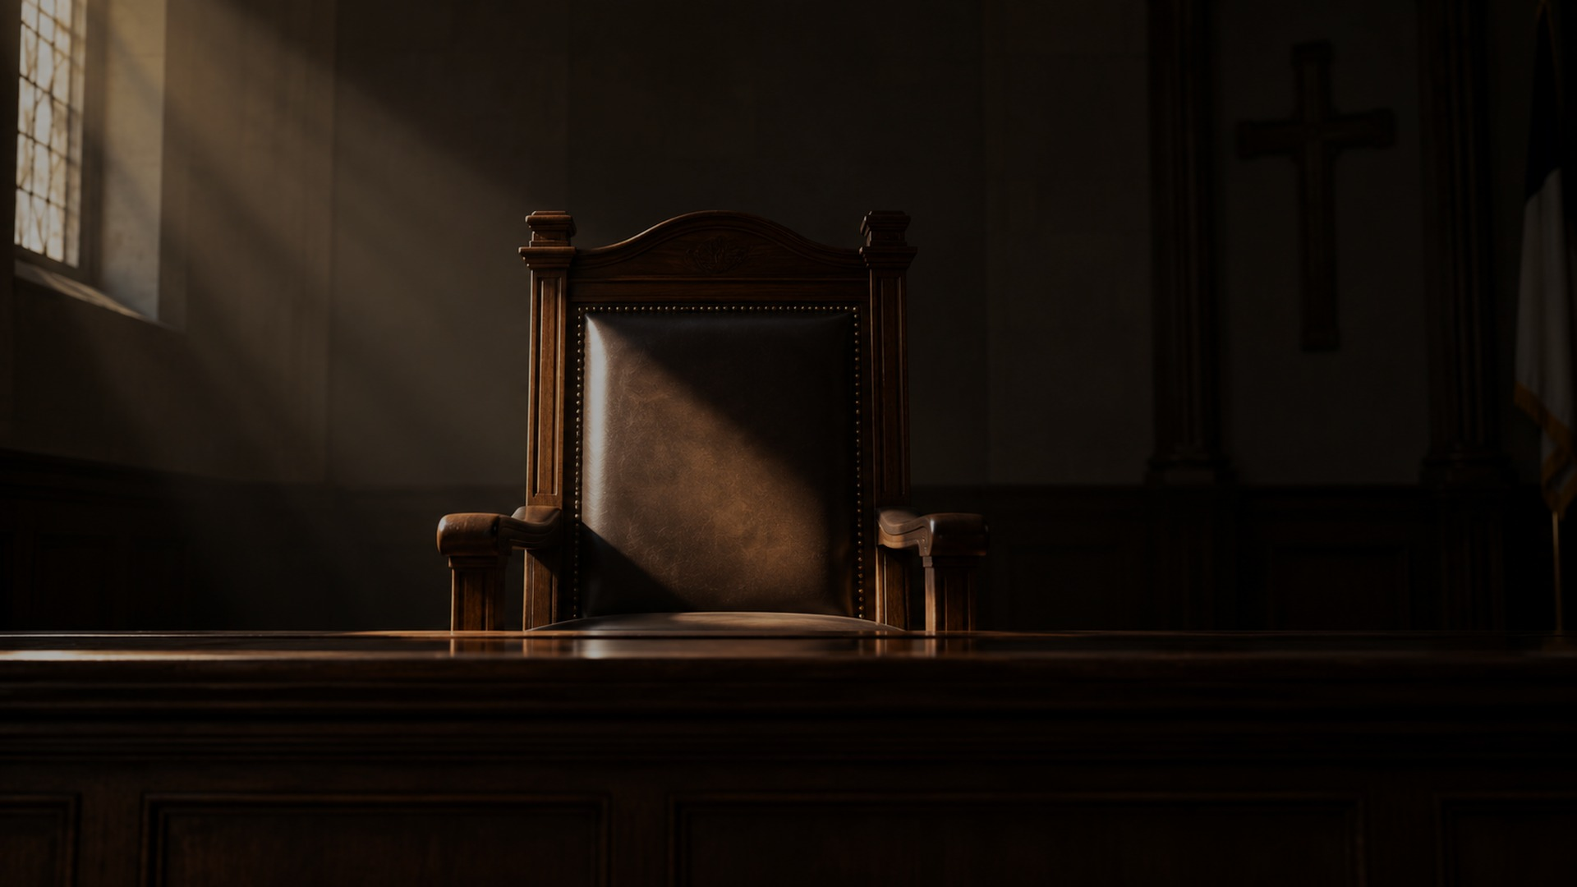
ROMANS 14
Forgiveness means
giving God his chair back.
“For we will all stand before
God’s judgment seat.”
Romans 14:10 NIV
There is a Judge.
But I am not him.
12

Slide 13
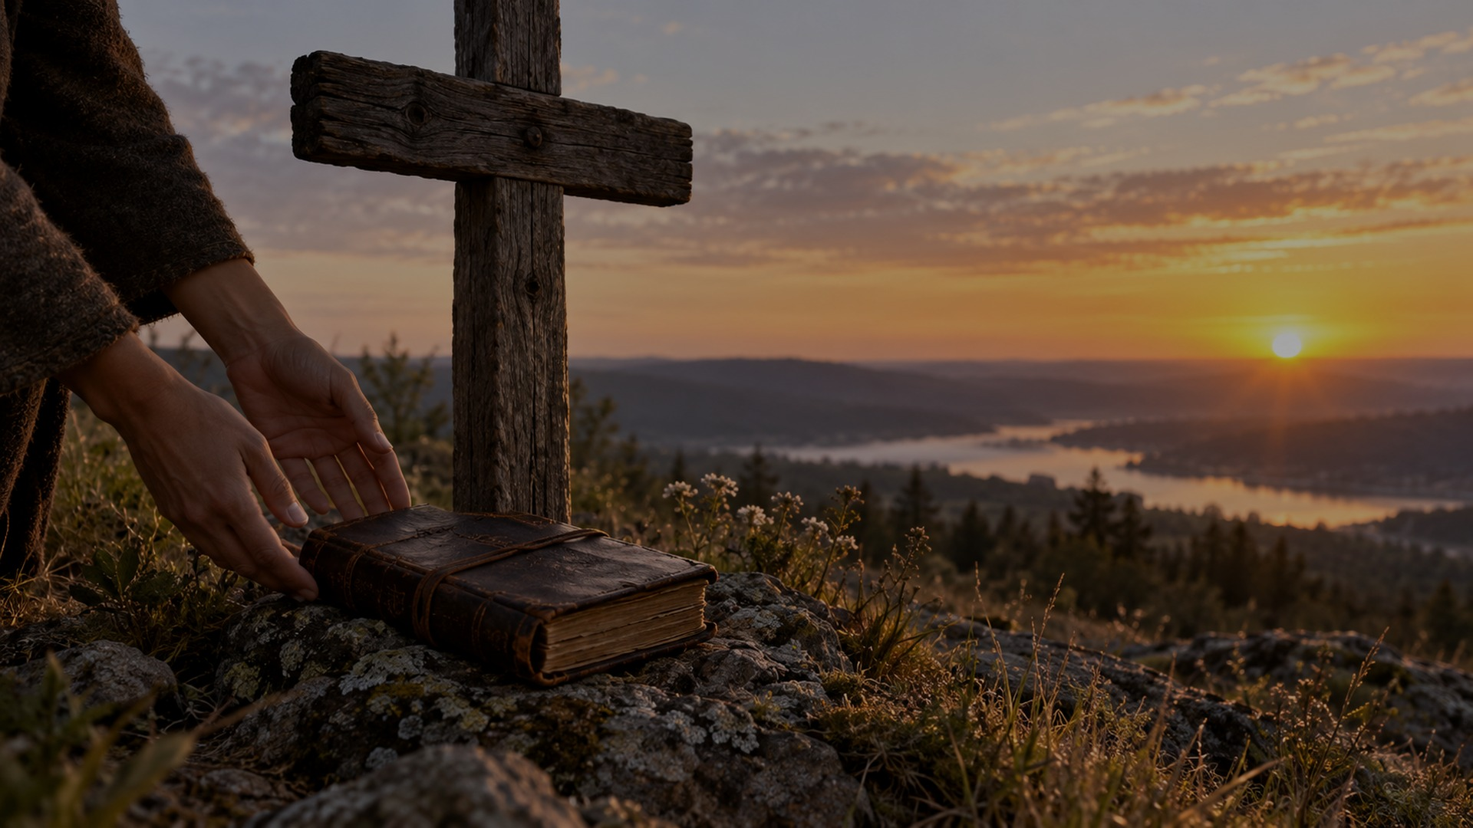
PSALM 103
“He does not treat us as our sins deserve
or repay us according to our iniquities.”
Psalm 103:10 NIV
“As far as the east is from the west,
so far has he removed our transgressions from us.”
Psalm 103:12 NIV
We are people living by canceled debt.
13

Slide 14
QUERY
Whose account
are you still carrying?
Jesus does not ask you to pretend
the debt was unreal.
He asks you to give him the ledger.
14

Slide 15
CONCLUSION
I give you the ledger.
Mercy tells the truth.
Mercy remembers what happened.
Mercy stops collecting the debt.
The wound may remain part of the story —
but through Christ, it does not have to keep writing the story.
15

Slide 16
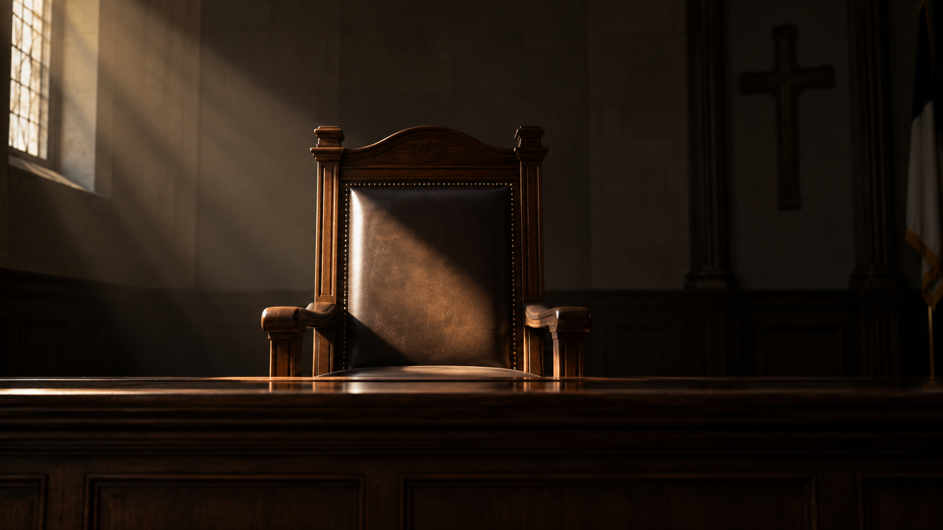

Slide 17


Slide 18
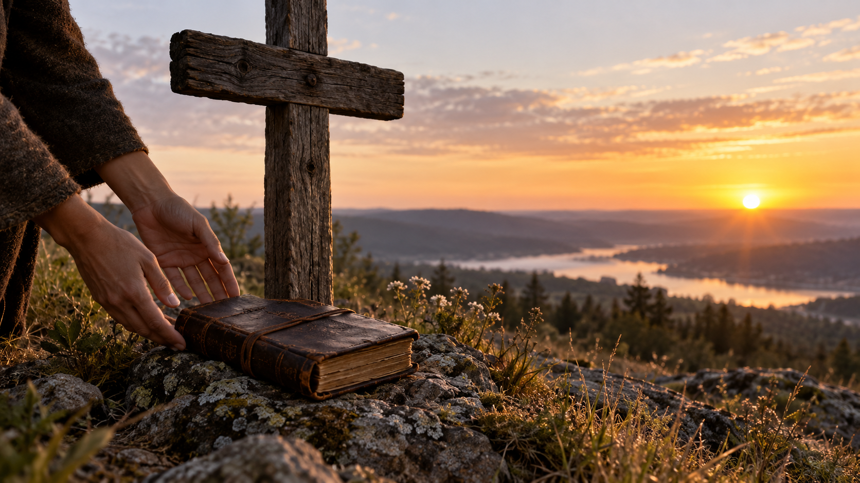

Slide 19


Slide 20
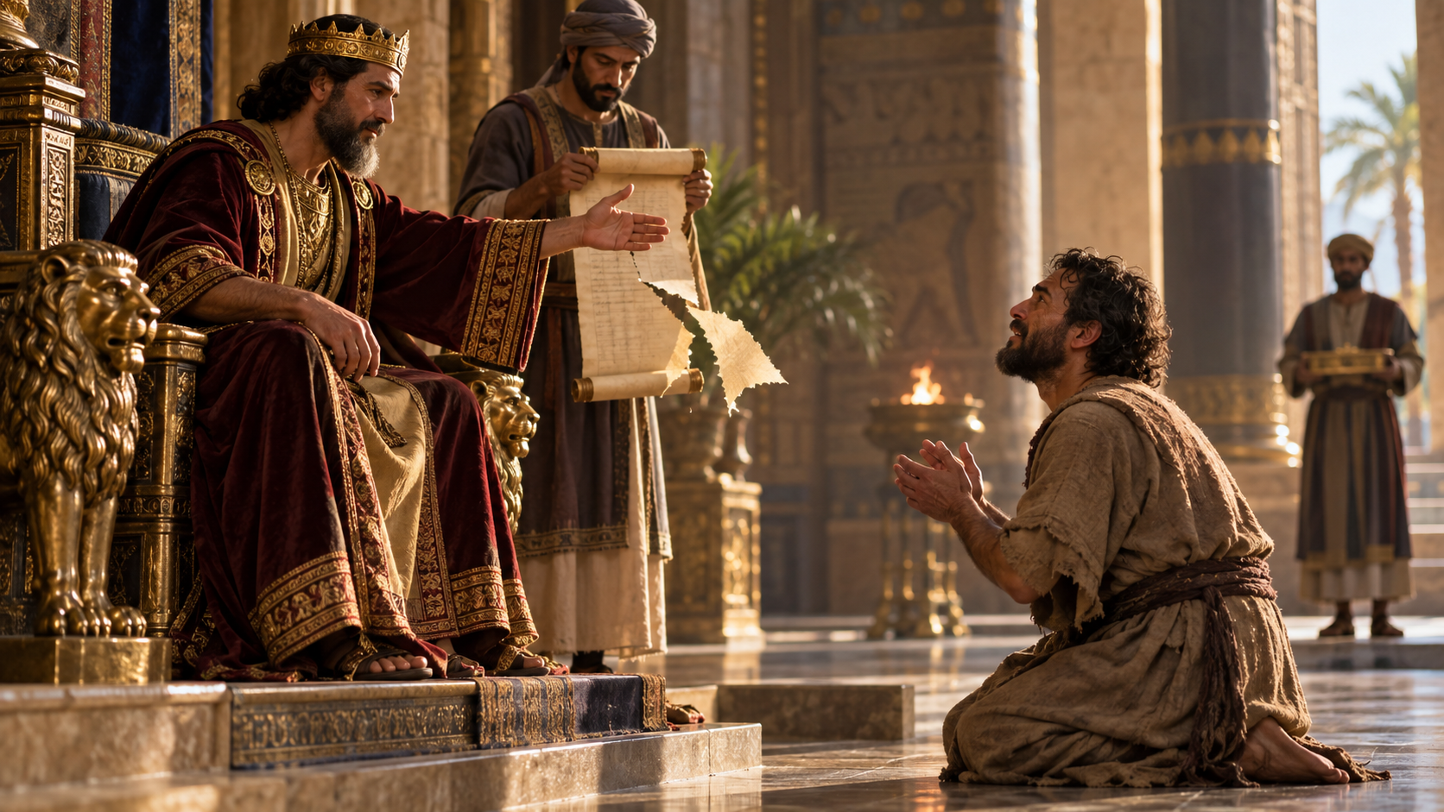

Slide 21
