Slide 1
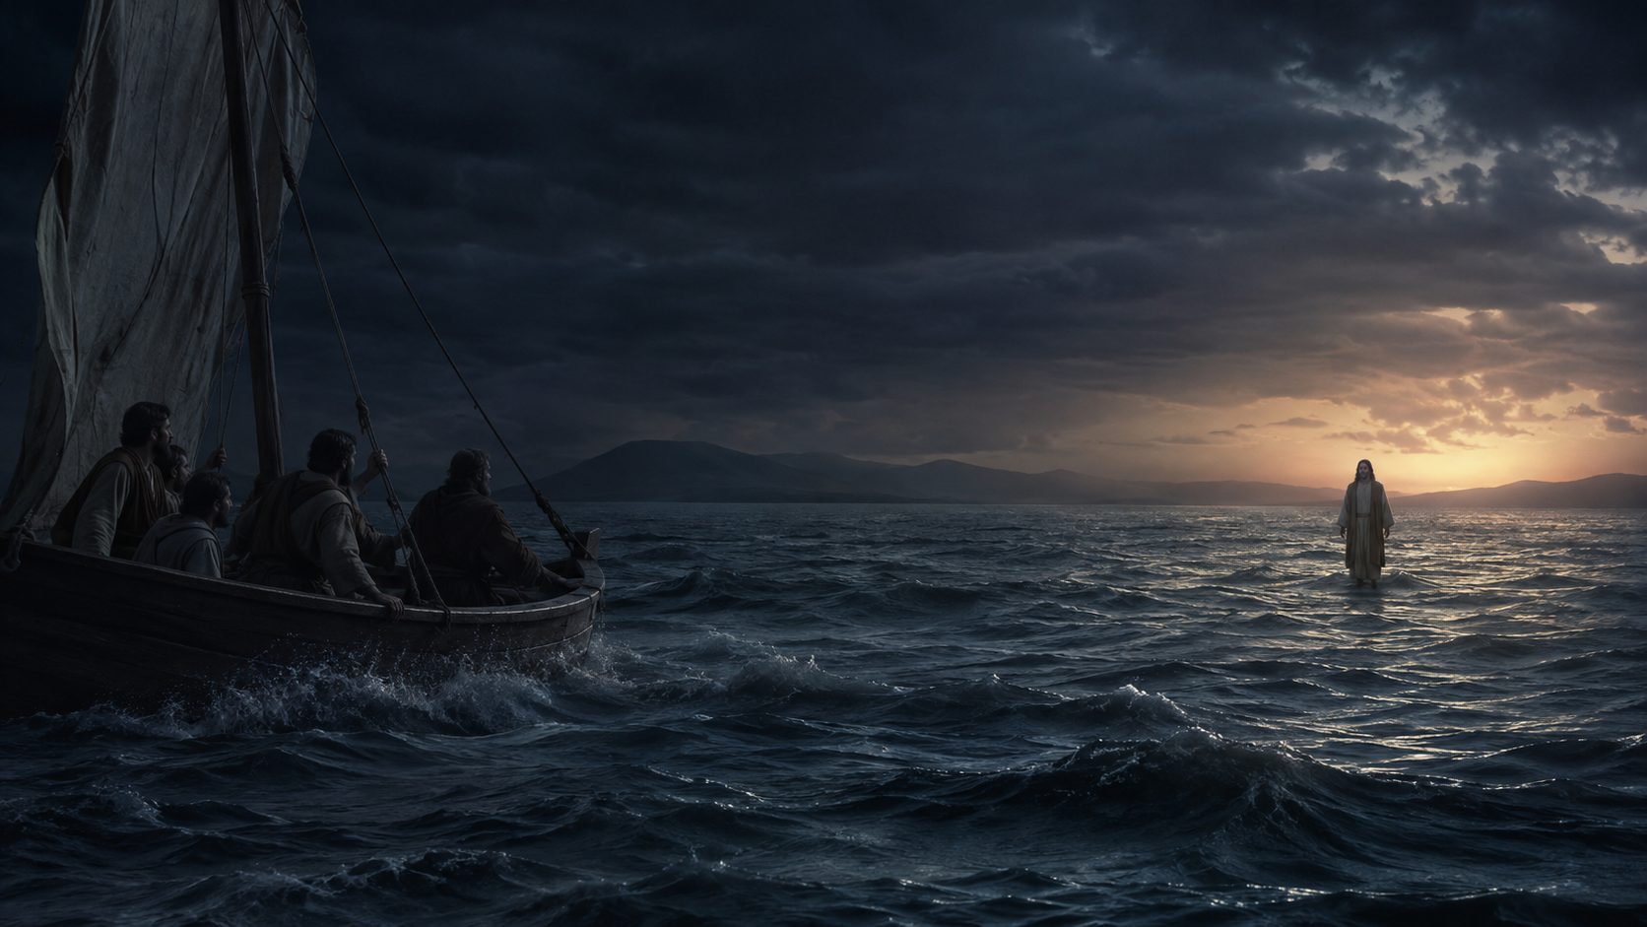
Call on the Name
of the Lord
He Who Saves, Steadies, and Sends
Romans 10:5–15 • Matthew 14:22–33
Notes:
[Sources]
- Paul Bravard, ‘Call on the Name of the Lord,’ sermon manuscript, August 9, 2026.
- Visual: Original AI-generated image created for this deck with OpenAI image generation, August 9, 2026 (Jesus approaching the storm-tossed boat).
[/Sources]

Slide 2

BIG IDEA
The name of Jesus is not a religious formula.
It is the presence of the risen Lord—near enough to hear our cry, reorder ordinary life, and send us with good news.
Notes:
[Sources]
- Paul Bravard, ‘Call on the Name of the Lord,’ sermon manuscript, August 9, 2026.
- Visual: Original AI-generated image created for this deck with OpenAI image generation, August 9, 2026 (flowered baptismal font).
[/Sources]

Slide 3

THE WORD IS NEAR
“The word is near you; it is in your mouth and in your heart” (Romans 10:8 NIV).
Notes:
[Sources]
- Paul Bravard, ‘Call on the Name of the Lord,’ sermon manuscript, August 9, 2026.
- Scripture quotation: The Holy Bible, New International Version, Romans 10:8.
- Visual: Original AI-generated image created for this deck with OpenAI image generation, August 9, 2026 (ordinary-life prayer at a kitchen table).
[/Sources]

Slide 4
The risen Lord comes near.
Near enough to be trusted.
Near enough to be named.
Near enough to be called upon.
Notes:
[Sources]
- Paul Bravard, ‘Call on the Name of the Lord,’ sermon manuscript, August 9, 2026.
- Visual: Original AI-generated image created for this deck with OpenAI image generation, August 9, 2026 (ordinary-life prayer at a kitchen table).
[/Sources]

Slide 5
Matthew puts the promise on dark water in a hard wind.
Notes:
[Sources]
- Paul Bravard, ‘Call on the Name of the Lord,’ sermon manuscript, August 9, 2026.
- Visual: Original AI-generated image created for this deck with OpenAI image generation, August 9, 2026 (Jesus approaching the storm-tossed boat).
[/Sources]

Slide 6
THE STORM REVEALS OUR ATTENTION
The disciples are in the boat because Jesus sent them there.
Obedience can carry us into a night we cannot manage.
Notes:
[Sources]
- Paul Bravard, ‘Call on the Name of the Lord,’ sermon manuscript, August 9, 2026.
- Visual: Original AI-generated image created for this deck with OpenAI image generation, August 9, 2026 (Jesus approaching the storm-tossed boat).
[/Sources]

Slide 7
HIS FIRST GIFT IS HIMSELF
“Take courage! It is I. Don’t be afraid” (Matthew 14:27 NIV).
Notes:
[Sources]
- Paul Bravard, ‘Call on the Name of the Lord,’ sermon manuscript, August 9, 2026.
- Scripture quotation: The Holy Bible, New International Version, Matthew 14:27.
- Visual: Original AI-generated image created for this deck with OpenAI image generation, August 9, 2026 (Jesus approaching the storm-tossed boat).
[/Sources]

Slide 8
The storm had been there all along.
What changed was where Peter’s attention settled.
Notes:
[Sources]
- Paul Bravard, ‘Call on the Name of the Lord,’ sermon manuscript, August 9, 2026.
- Visual: Original AI-generated image created for this deck with OpenAI image generation, August 9, 2026 (Jesus approaching the storm-tossed boat).
[/Sources]

Slide 9
The wind became more defining than the One standing before him.
Notes:
[Sources]
- Paul Bravard, ‘Call on the Name of the Lord,’ sermon manuscript, August 9, 2026.
- Visual: Original AI-generated image created for this deck with OpenAI image generation, August 9, 2026 (Jesus approaching the storm-tossed boat).
[/Sources]

Slide 10
HOLINESS BECOMES PERSONAL
Holiness is what Christ forms in me when pressure rises.
Grace returns my attention to Jesus before anxiety decides who I will become.
Notes:
[Sources]
- Paul Bravard, ‘Call on the Name of the Lord,’ sermon manuscript, August 9, 2026.
- Visual: Original AI-generated image created for this deck with OpenAI image generation, August 9, 2026 (ordinary-life prayer at a kitchen table).
[/Sources]

Slide 11
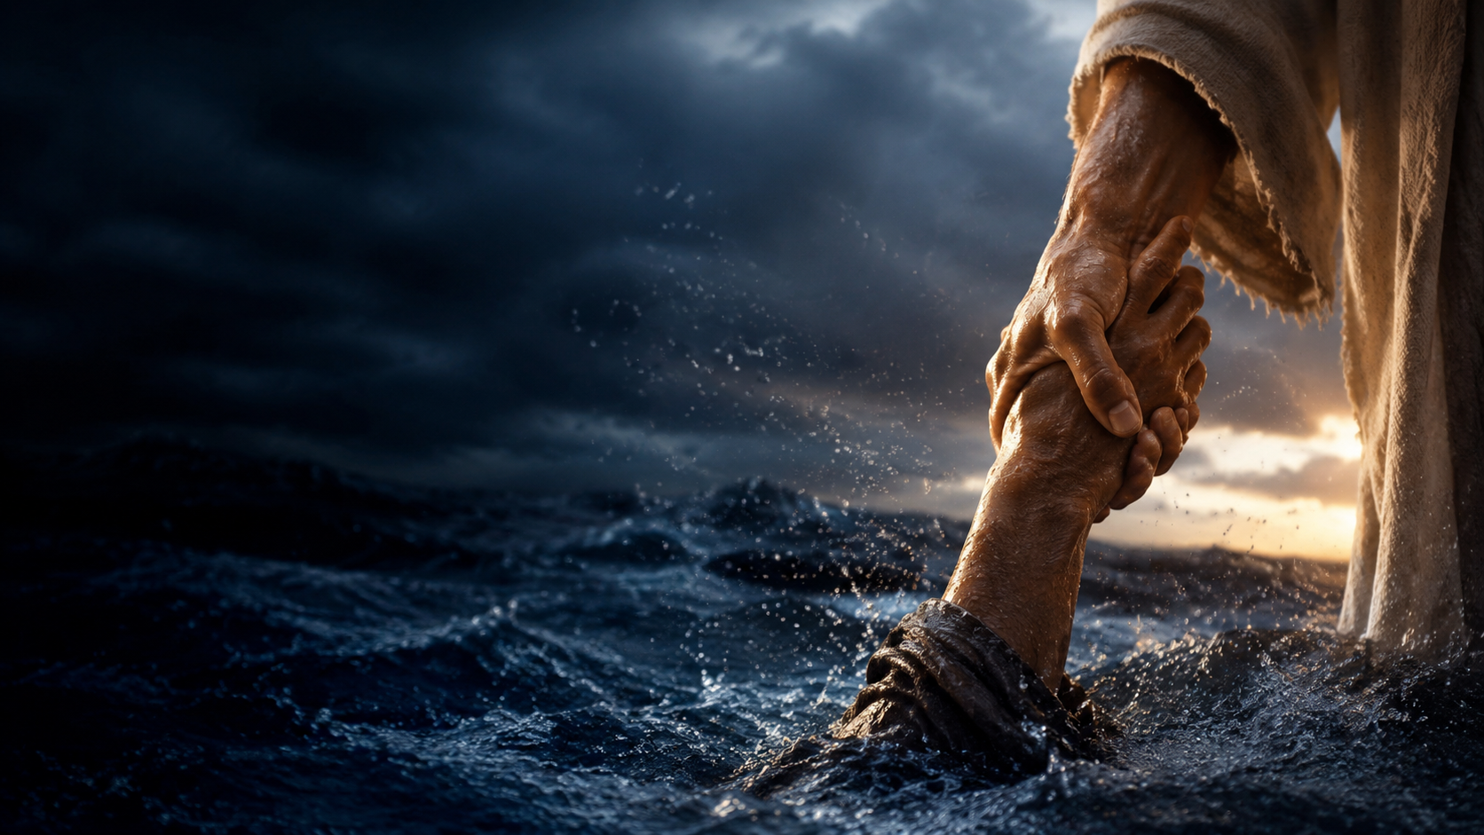
PETER’S PRAYER
“Lord, save me!”
(Matthew 14:30 NIV).
Notes:
[Sources]
- Paul Bravard, ‘Call on the Name of the Lord,’ sermon manuscript, August 9, 2026.
- Scripture quotation: The Holy Bible, New International Version, Matthew 14:30.
- Visual: Original AI-generated image created for this deck with OpenAI image generation, August 9, 2026 (the saving hand catching Peter).
[/Sources]

Slide 12
THE SAVING HAND
“Immediately Jesus reached out his hand and caught him” (Matthew 14:31 NIV).
Notes:
[Sources]
- Paul Bravard, ‘Call on the Name of the Lord,’ sermon manuscript, August 9, 2026.
- Scripture quotation: The Holy Bible, New International Version, Matthew 14:31.
- Visual: Original AI-generated image created for this deck with OpenAI image generation, August 9, 2026 (the saving hand catching Peter).
[/Sources]

Slide 13
The correction comes after the saving hand.
Mercy arrives first.
Notes:
[Sources]
- Paul Bravard, ‘Call on the Name of the Lord,’ sermon manuscript, August 9, 2026.
- Visual: Original AI-generated image created for this deck with OpenAI image generation, August 9, 2026 (the saving hand catching Peter).
[/Sources]

Slide 14
THE PROMISE BECOMES PERSONAL
“Everyone who calls on the name of the Lord will be saved” (Romans 10:13 NIV).
Notes:
[Sources]
- Paul Bravard, ‘Call on the Name of the Lord,’ sermon manuscript, August 9, 2026.
- Scripture quotation: The Holy Bible, New International Version, Romans 10:13.
- Visual: Original AI-generated image created for this deck with OpenAI image generation, August 9, 2026 (the saving hand catching Peter).
[/Sources]

Slide 15
The saving word is near because the Savior is near.
Notes:
[Sources]
- Paul Bravard, ‘Call on the Name of the Lord,’ sermon manuscript, August 9, 2026.
- Visual: Original AI-generated image created for this deck with OpenAI image generation, August 9, 2026 (the saving hand catching Peter).
[/Sources]

Slide 16
A PRACTICED RETURN
Lord Jesus Christ,
Son of God,
have mercy on me, a sinner.
It does not end every storm. It returns me to the living Center.
Notes:
[Sources]
- Paul Bravard, ‘Call on the Name of the Lord,’ sermon manuscript, August 9, 2026.
- Visual: Original AI-generated image created for this deck with OpenAI image generation, August 9, 2026 (ordinary-life prayer at a kitchen table).
[/Sources]

Slide 17

THOSE WHO CALL BECOME
THOSE WHO CARRY
We do not become the answer.
We carry the name of the One who reached for us.
Notes:
[Sources]
- Paul Bravard, ‘Call on the Name of the Lord,’ sermon manuscript, August 9, 2026.
- Visual: Original AI-generated image created for this deck with OpenAI image generation, August 9, 2026 (walking into an ordinary neighborhood at sunrise).
[/Sources]

Slide 18
“How beautiful are the feet of those who bring good news!” (Romans 10:15 NIV).
Mercy received becomes mercy made visible.
Notes:
[Sources]
- Paul Bravard, ‘Call on the Name of the Lord,’ sermon manuscript, August 9, 2026.
- Scripture quotation: The Holy Bible, New International Version, Romans 10:15.
- Visual: Original AI-generated image created for this deck with OpenAI image generation, August 9, 2026 (walking into an ordinary neighborhood at sunrise).
[/Sources]

Slide 19
OPEN WORSHIP
Where has the wind become larger than Christ in my attention?
If the water is rising: “Lord, save me.”
If Christ has steadied you: Whom is he sending you toward?
Notes:
[Sources]
- Paul Bravard, ‘Call on the Name of the Lord,’ sermon manuscript, August 9, 2026.
- Scripture quotation: The Holy Bible, New International Version, Matthew 14:30.
- Visual: Original AI-generated image created for this deck with OpenAI image generation, August 9, 2026 (Jesus approaching the storm-tossed boat).
[/Sources]

Slide 20
Jesus is near enough
to save us,
steady us,
and send us.
Call on the name of the Lord.
Notes:
[Sources]
- Paul Bravard, ‘Call on the Name of the Lord,’ sermon manuscript, August 9, 2026.
- Visual: Original AI-generated image created for this deck with OpenAI image generation, August 9, 2026 (flowered baptismal font).
[/Sources]

