Slide 1
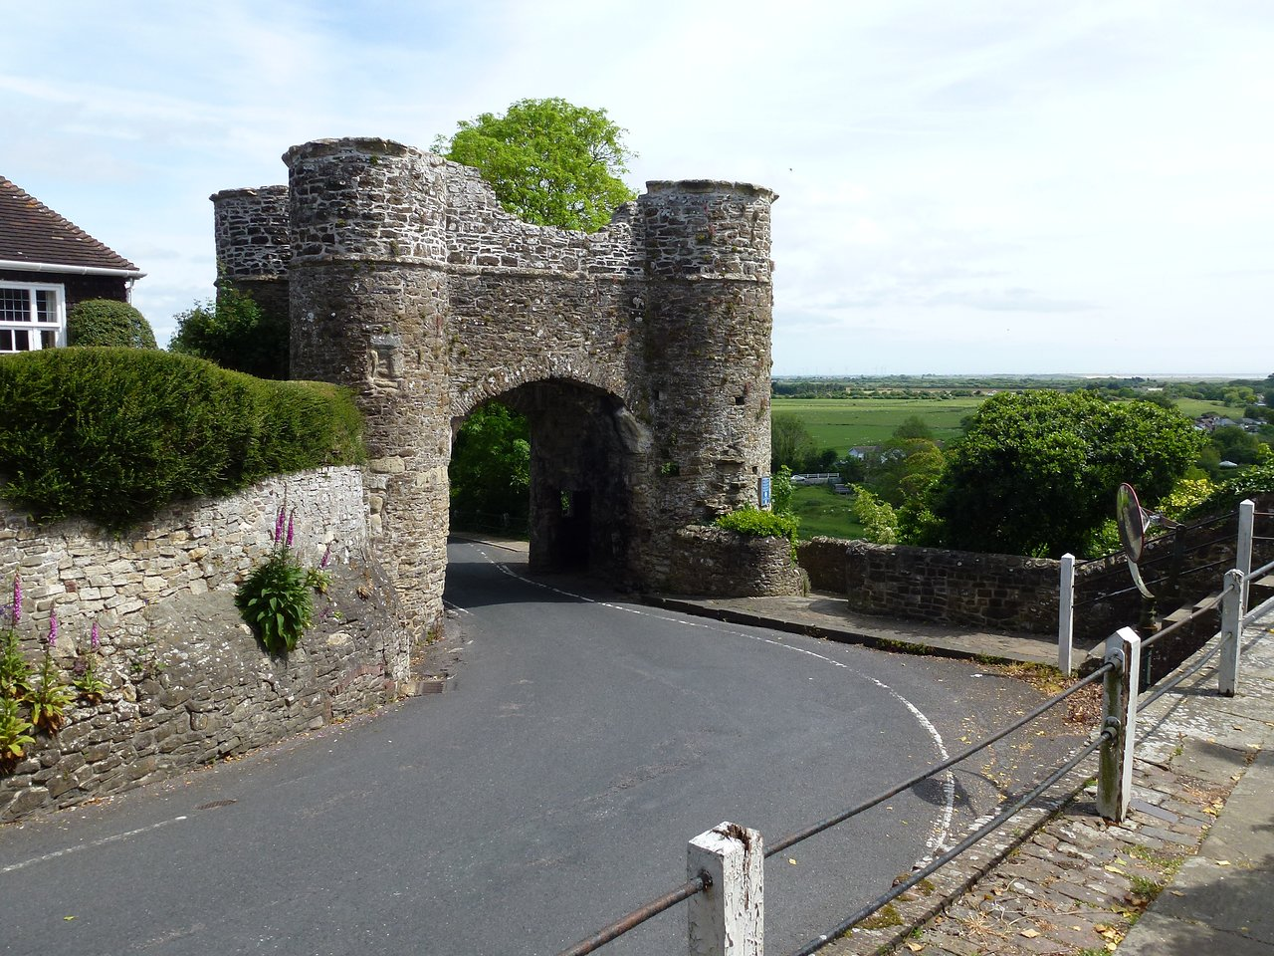
Faith That Walks → 400 Years of Silence
“God’s silence is not God’s absence.”

Slide 2
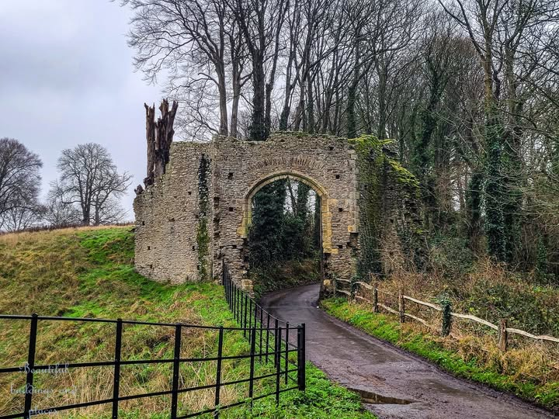
Faith That Walks → 400 Years of Silence
“God’s silence is not God’s absence.”

Slide 3
Faith That Walks → 400 Years of Silence
“God’s silence is not God’s absence.”

Slide 4
Faith That Walks → 400 Years of Silence
From Walking in God’s Promises to Waiting in God’s Silence
Matthew
Malachi

Slide 5
Four Texts Overview:
Psalm 103 – Who God is
Isaiah 58 – What love does
Luke 13 – How Jesus embodies it
Hebrews 12 – How we worship in it
“God’s silence is not God’s absence.”

Slide 6
Logic of the Passage (Heb 12:18–29)
Gift → Gratitude → Service → Awe
Gift: An unshakable kingdom
Gratitude: “Let us be thankful / let us have grace”
Service: Latreuō = priestly service, worship beyond songs
Awe: Holy love as consuming fire

Slide 7
Gratitude Check Questions
Gratitude: Is my week fueled by thanks or by ought-to?
Service: Where will my worship be visible to a neighbor?
Awe: What anxious pattern will I release to God’s refining fire?

Slide 8
Concluding Response: Release & Delight
Delight: Celebrate with food bags and visits
Release: One possession, expense, or block of time redirected to mercy
Sabbath of Mercy: One rest practice + one neighbor-care act
Prayer: “Restore us, O God; let your face shine.” (Ps 80:3)

Slide 9
Monthly Practices (4 Weeks)
Week 1 – Promise Journal (write & share)
Week 2 – Justice Action (sign-up, grocery bag)
Week 3 – Readiness & Delight (give away possession)

Slide 10

“God’s silence is not God’s absence.”

Slide 11
400 Years of Silence:
Preparing the Way of the Lord
No prophet’s voice… but not empty silence
Empires rise and fall
Languages spread
The land itself shaken (roads, rivers, armies)
God preparing for Christ

Slide 12
Takeaway:
The God who gave Israel hope in silence is the same God who gives us an unshakable kingdom in Christ.
Visual: A cornerstone being laid on a stone foundation.

