Slide 1
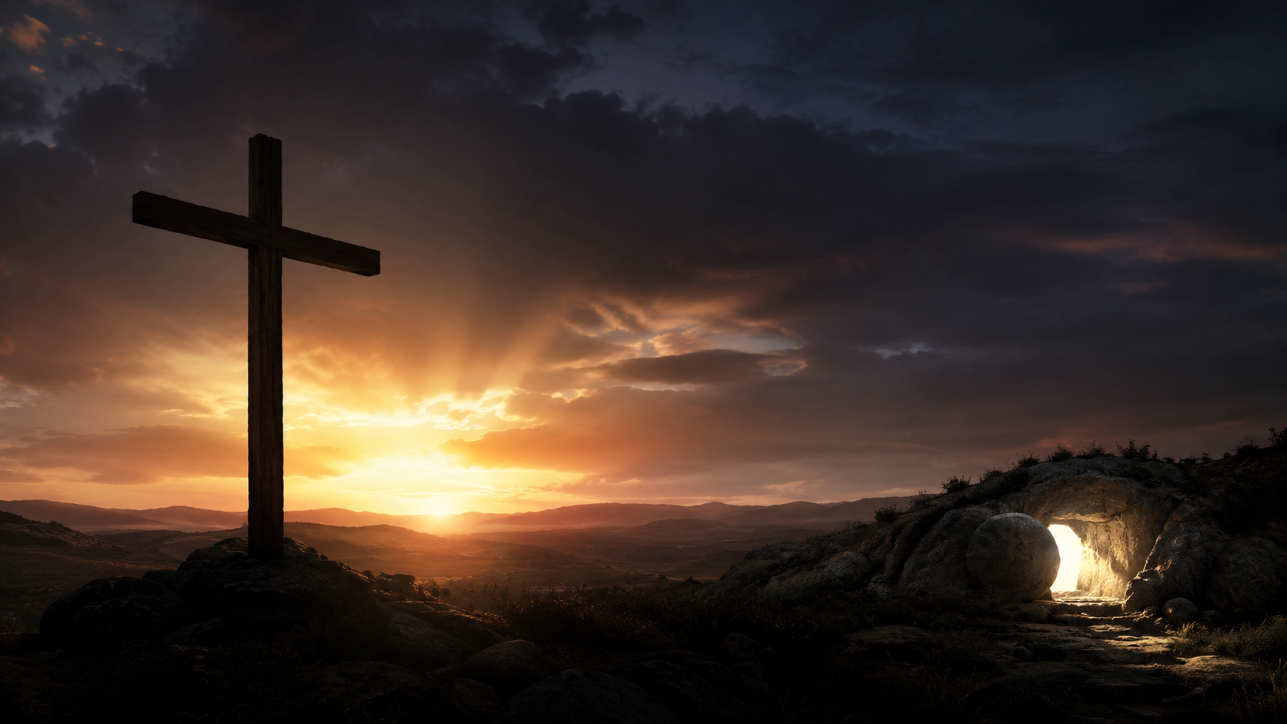
Lord’s Day • 8.30.2026
Mercy Will Not
Be Overcome
“Mercy does not become what wounded it.”
First Friends Church • Marion, Indiana

Slide 2
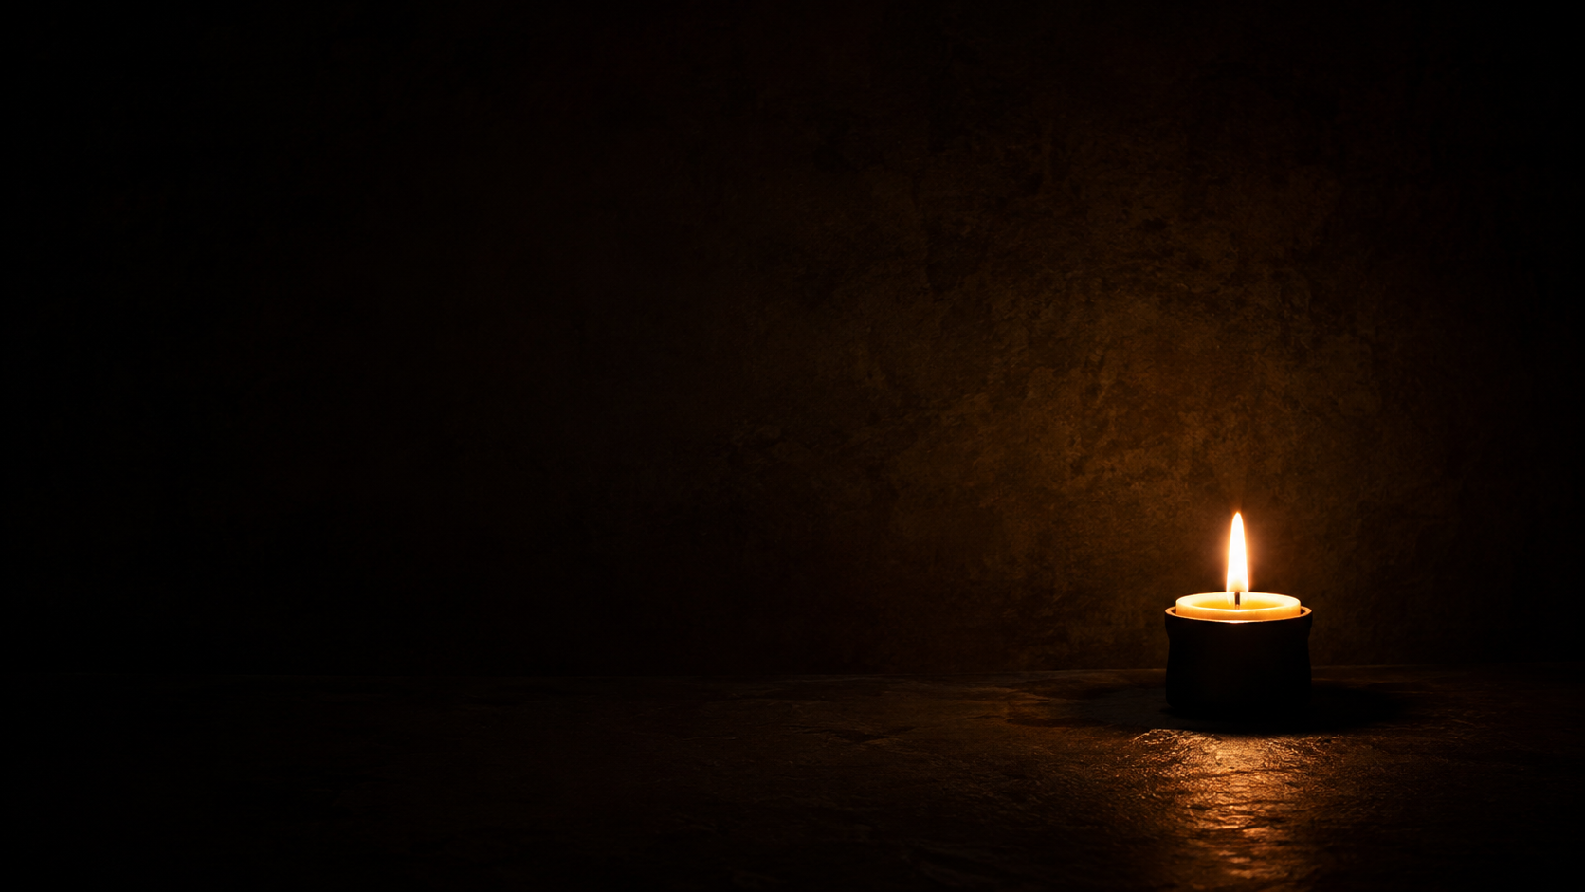
THREE WITNESSES
Today’s Scriptures
Matthew 16:21–28
Romans 12:9–21
Exodus 3:7–12
Because the crucified and risen Christ has shown us God’s mercy, he forms us into a holy people who refuse to mirror the evil around us and overcome evil with good.

Slide 3
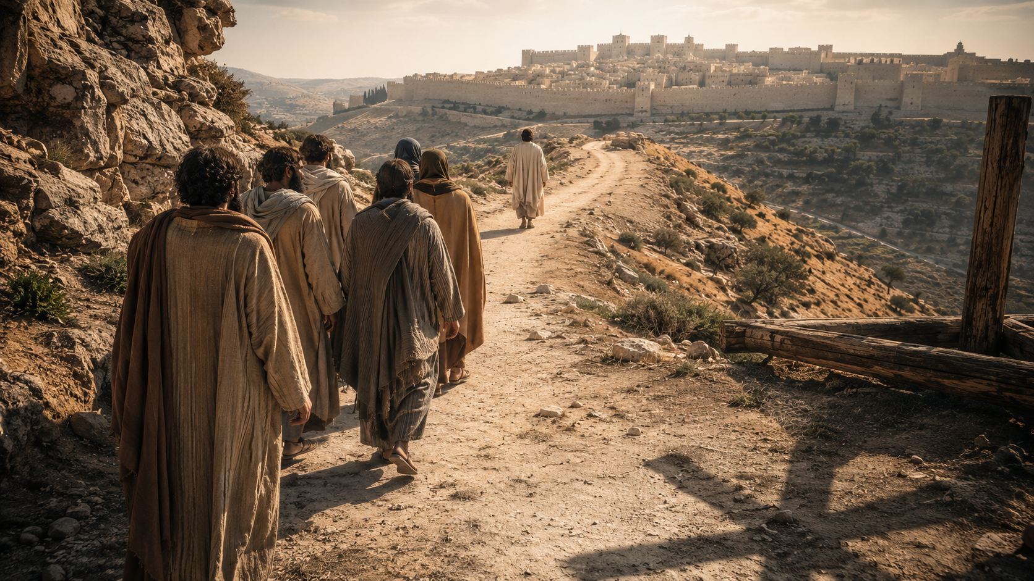
THE RIGHT CHRIST, THE WRONG WAY
“You are the Messiah, the Son of the living God.”
The truth Peter spoke with his mouth now had to govern his feet.
Matthew 16:16

Slide 4
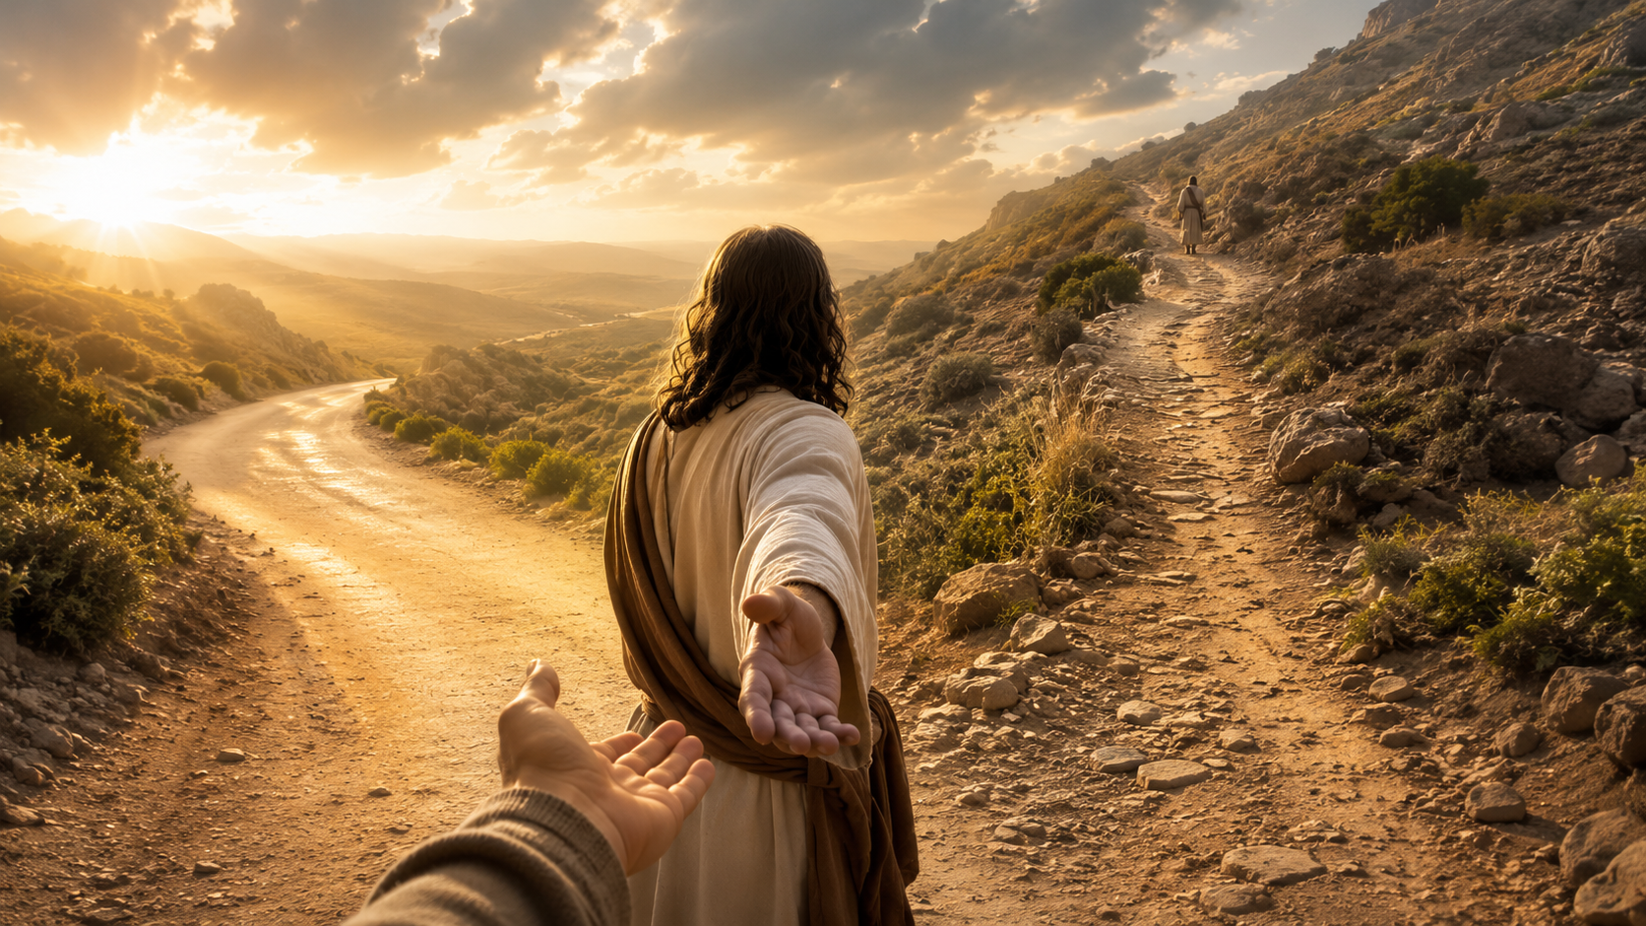
GET BEHIND ME
“Whoever wants to be my disciple must deny themselves and take up their cross and follow me.”
Peter confessed the right Christ—
but resisted the way of Christ.
Matthew 16:24

Slide 5
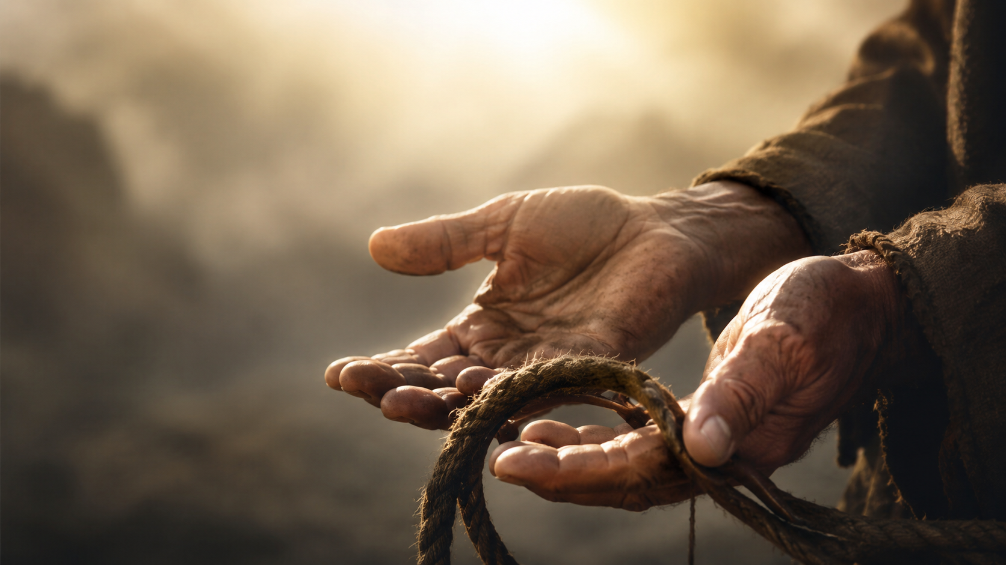
SELF-DENIAL IS NOT SELF-HATRED
Take our hands off the life we have been trying to control…
…and place it in the hands of Christ.
Stop asking Jesus to follow our preferred road. Return to our place behind him.

Slide 6
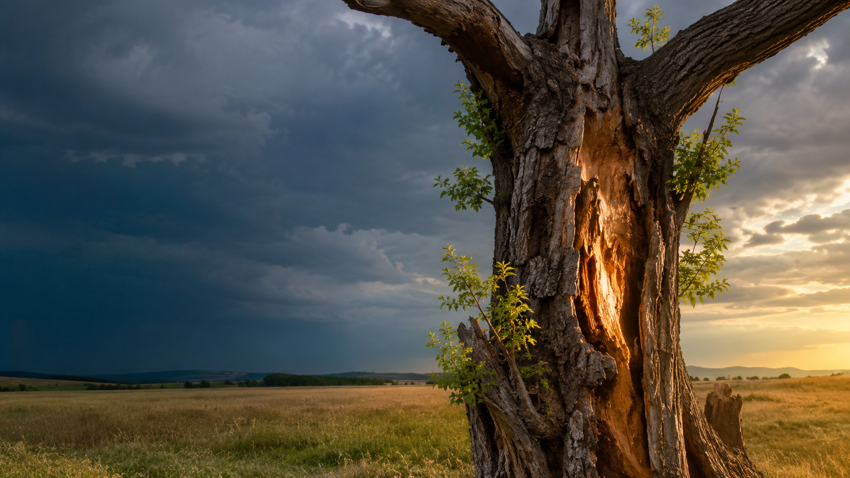
MAIN POINT
Mercy does not
become what
wounded it.
Holiness is Christ’s mercy so deeply formed in us that evil does not determine what flows from us.

Slide 7
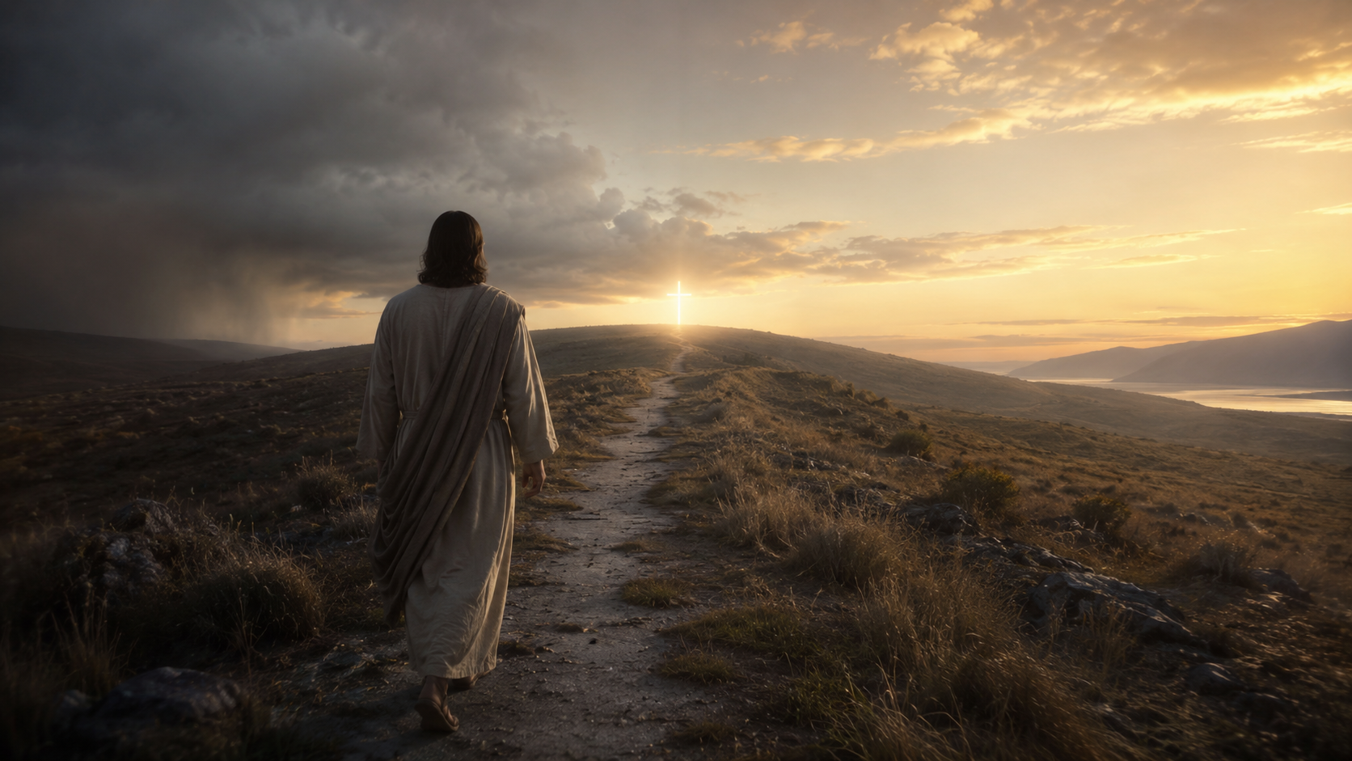
THE SHAPE OF GOD’S MERCY
Evil wounds him,
but evil does not remake him in its image.
In Jesus Christ, mercy confronts evil without becoming evil.

Slide 8
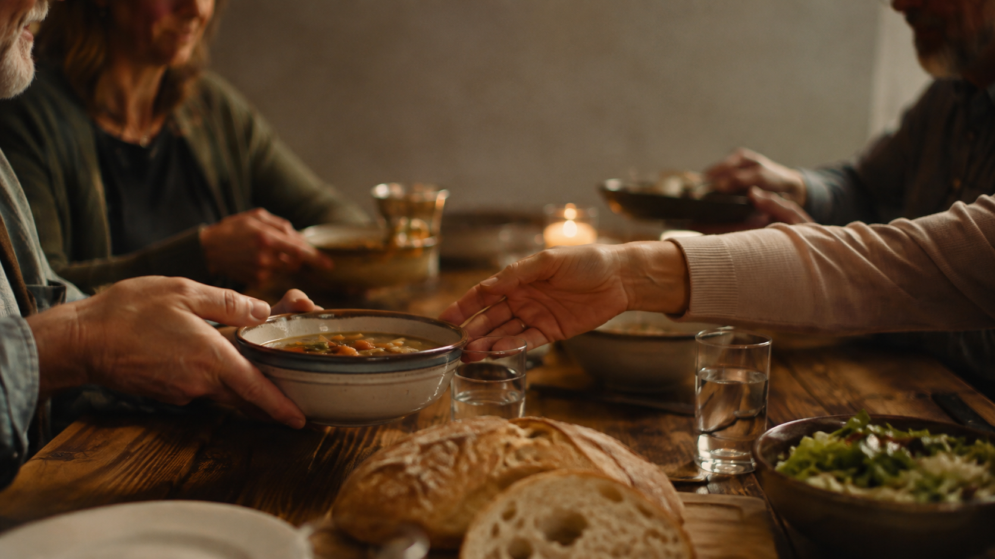
ROMANS 12 • LOVE IN ACTION
What does cross-shaped mercy look like?
Bless those who persecute you.
Do not repay evil for evil.
Feed the enemy.
Romans 12:9–21

Slide 9
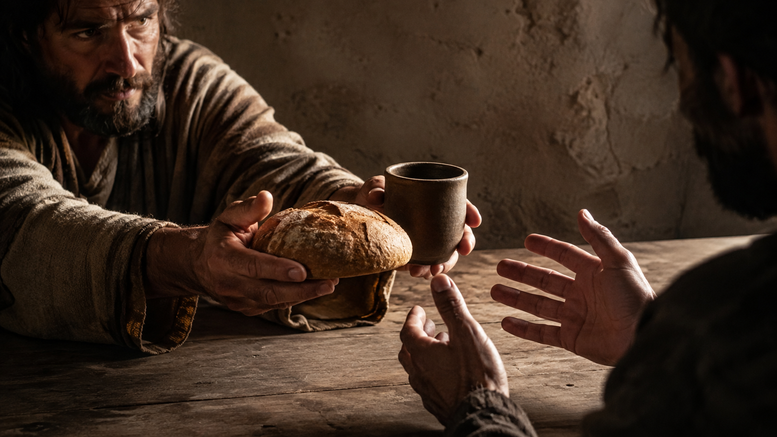
WHAT CROSS-SHAPED MERCY LOOKS LIKE
Feed the enemy
rather than
become the enemy.
Mercy may tell the truth, set a boundary, or protect the vulnerable—without letting another person’s sin dictate our character.

Slide 10
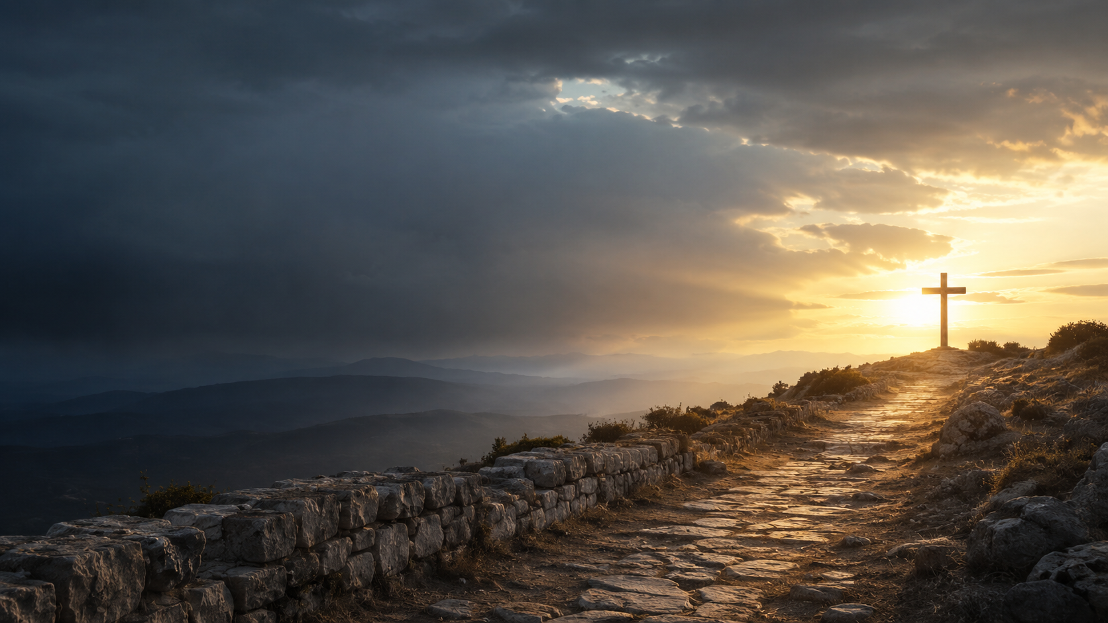
THE SENTENCE THAT GATHERS IT ALL
“Do not be overcome by evil, but overcome evil with good.”
Romans 12:21

Slide 11
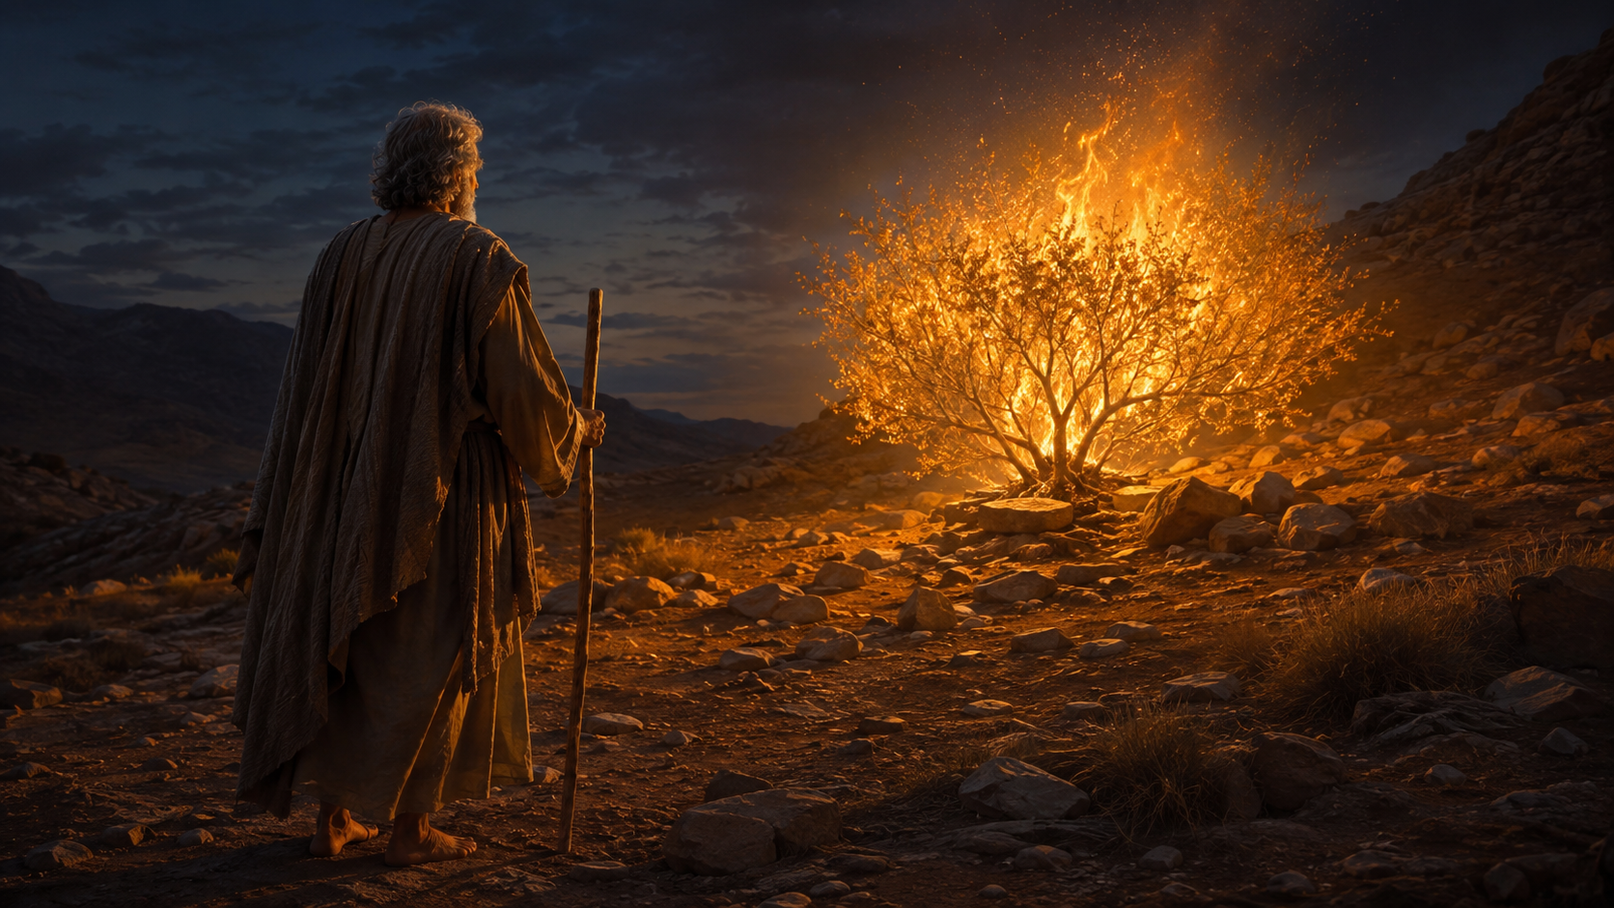
I WILL BE WITH YOU
“Who am I?”
“I will be with you.”
Before God calls us to do something, God calls us to Someone.
Exodus 3:11–12

Slide 12

SANCTIFYING GRACE
Christ does not merely restrain our retaliation.
He changes what flows from the heart.
Holiness • meekness • patience • love

Slide 13
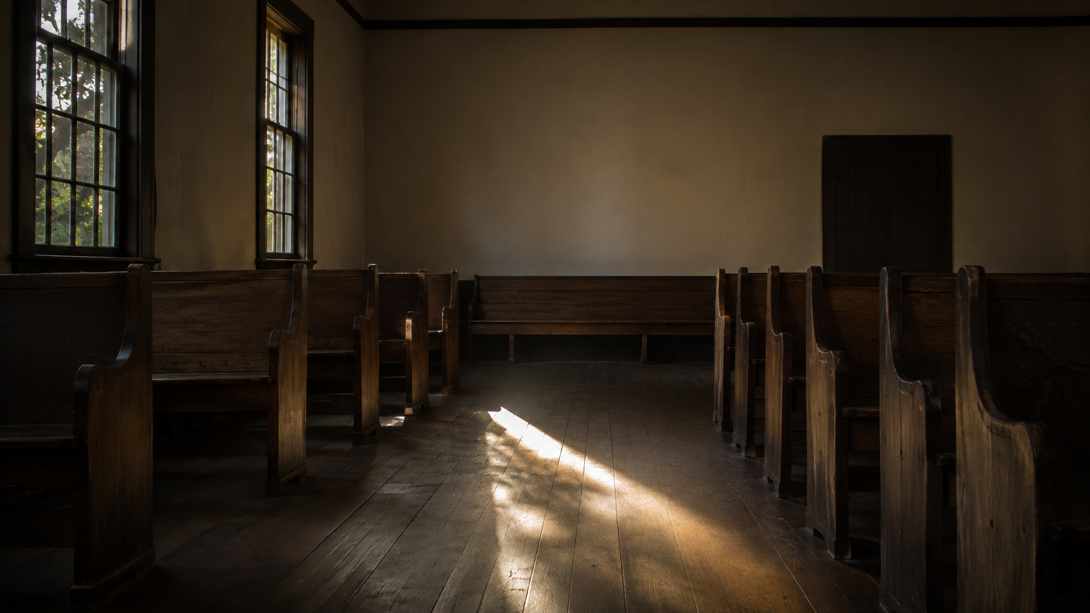
HOLY RESPONSE • OPEN WORSHIP
What wound is in danger of determining what flows from me?
Lord Jesus, bring us behind you again.

Slide 14
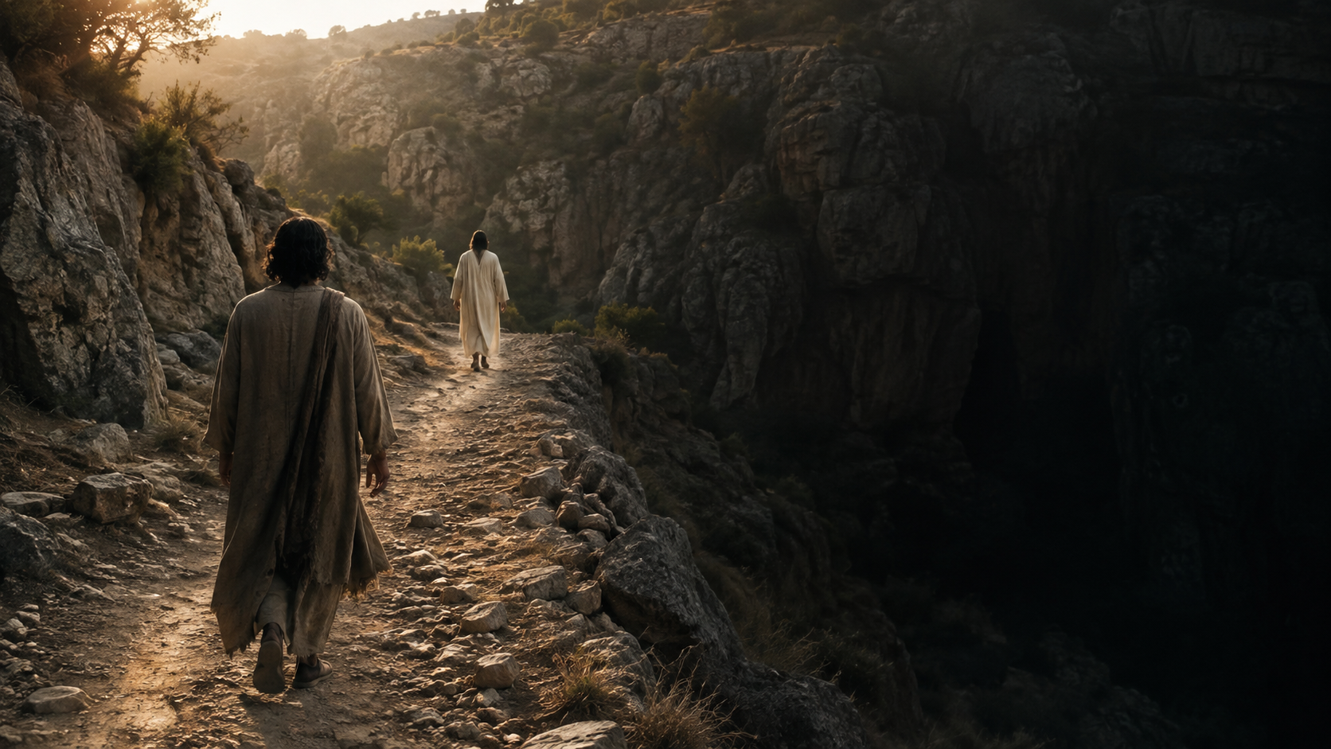
BEHIND JESUS
Mercy arrived first.
Mercy became visible.
Mercy formed us into a people.
And now, behind Jesus, mercy becomes cross-shaped.
Mercy does not become what wounded it.
Mercy overcomes evil with good.

