Slide 1


Slide 2
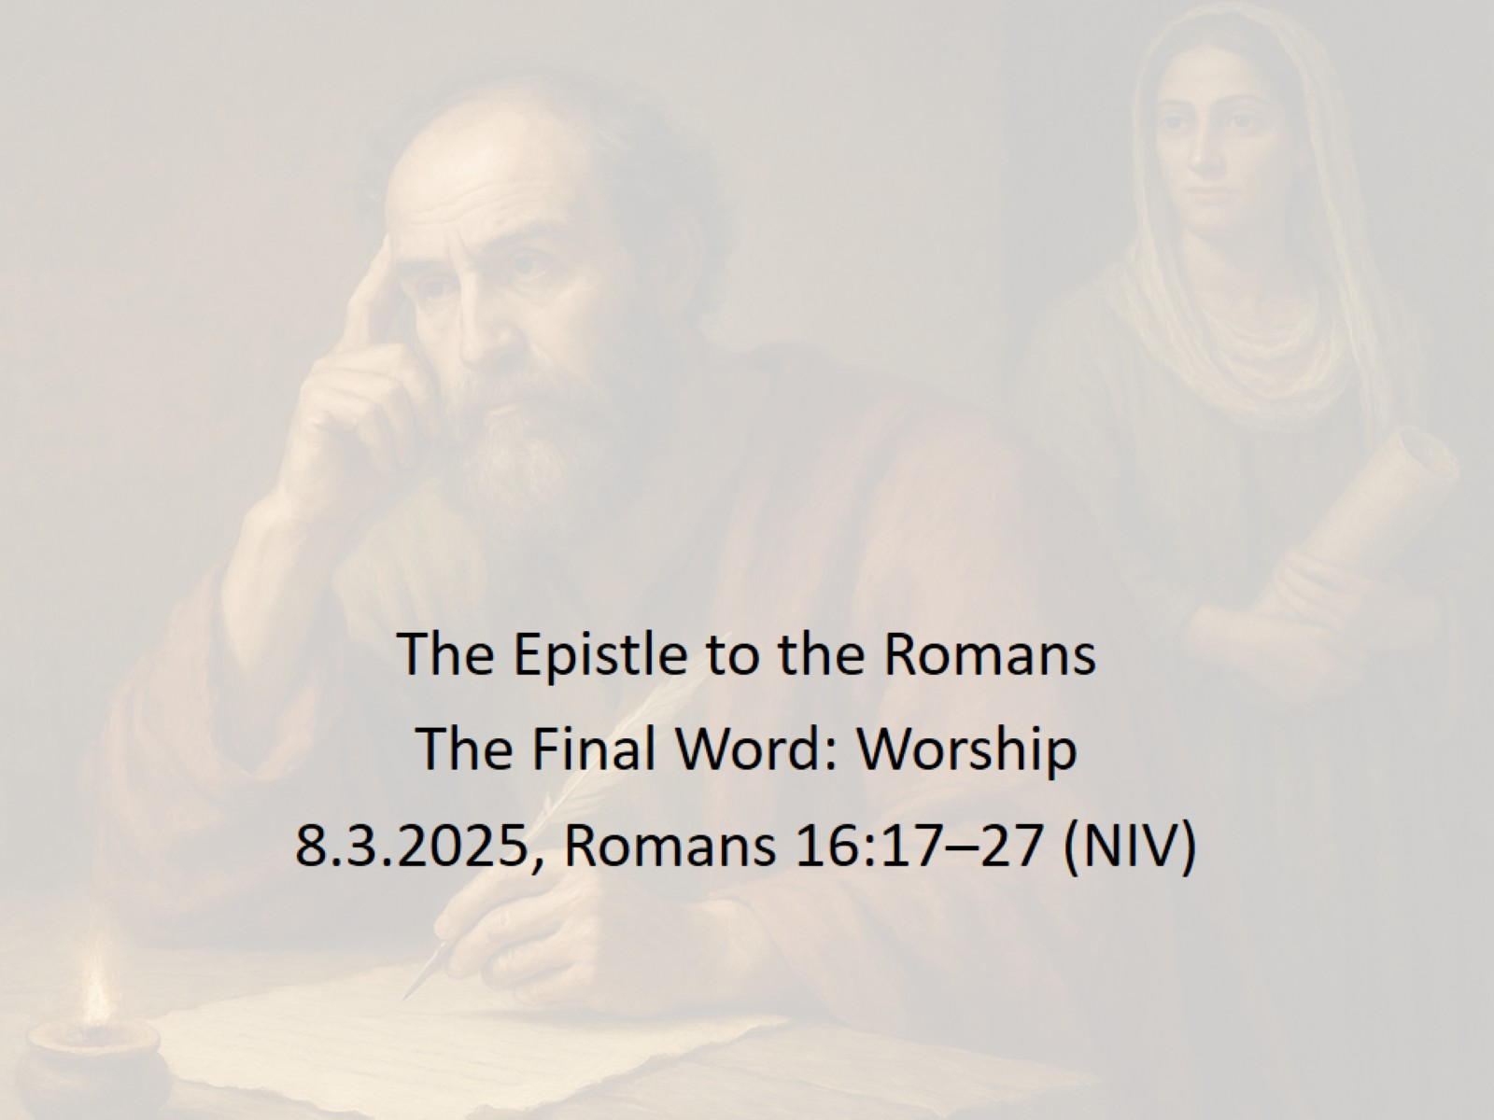

Slide 3
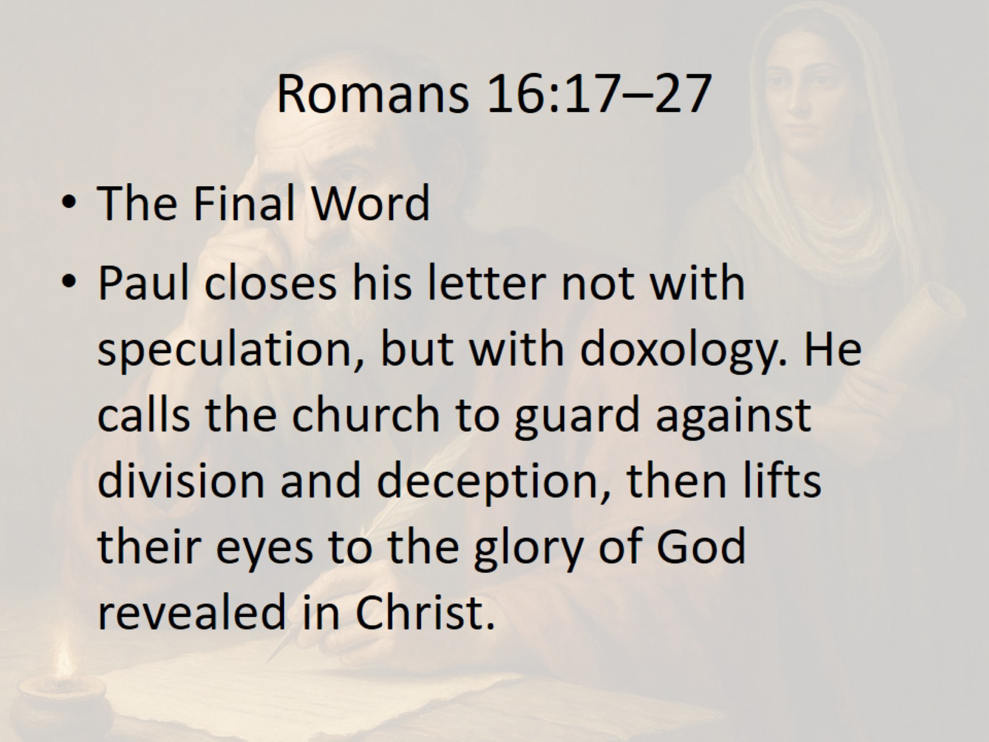
Romans 16:17–27

Slide 4
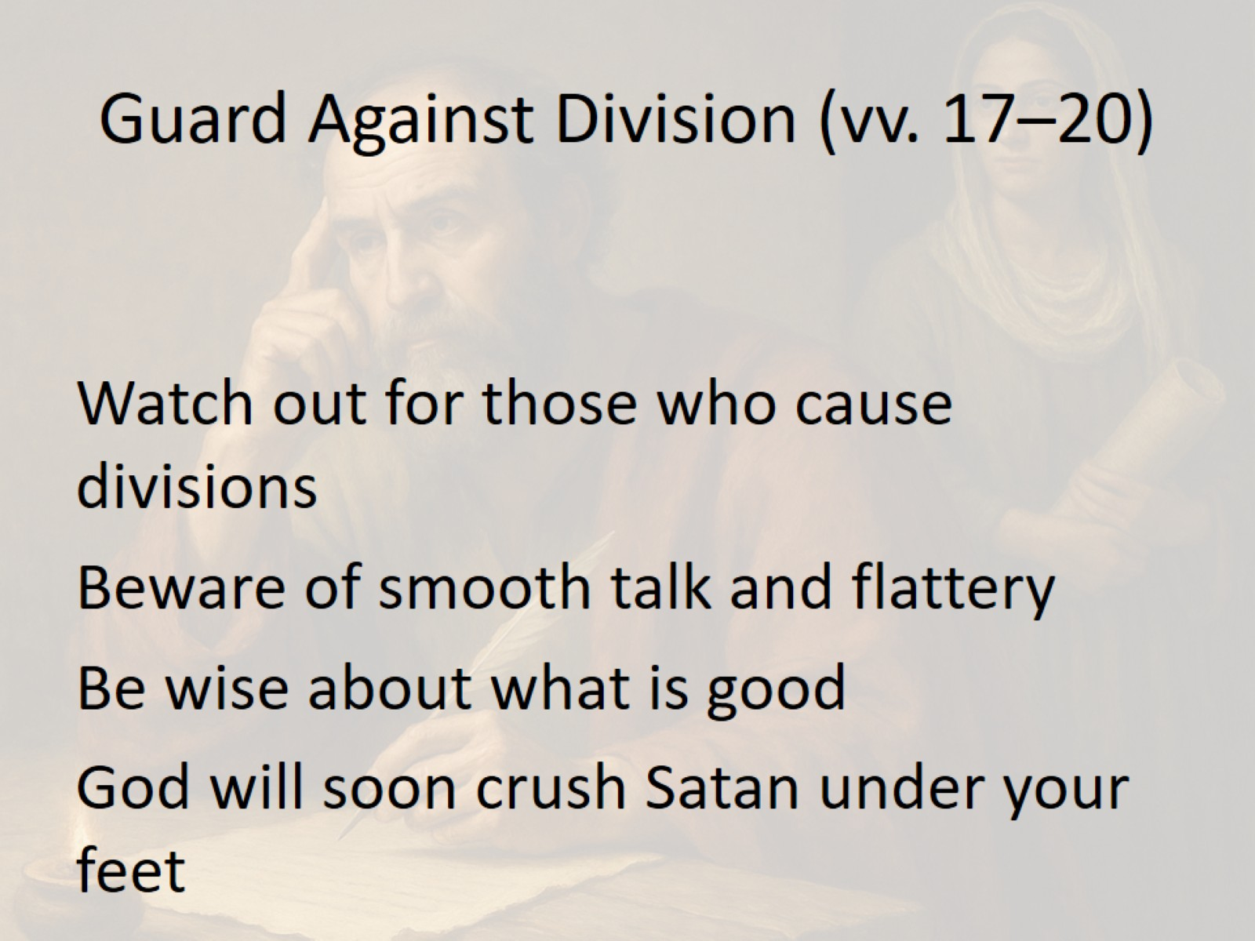
Guard Against Division (vv. 17–20)

Slide 5
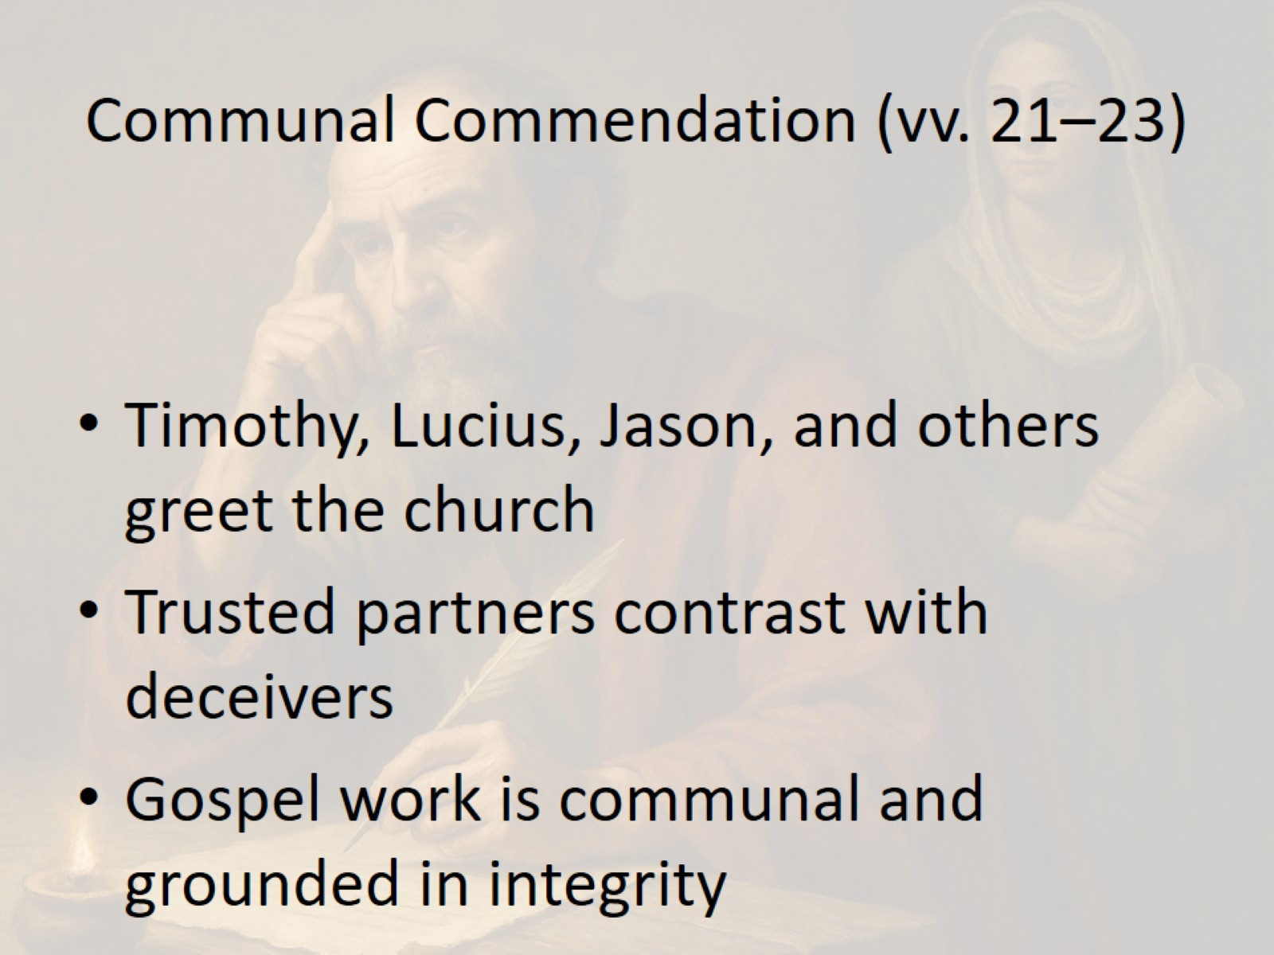
Communal Commendation (vv. 21–23)

Slide 6
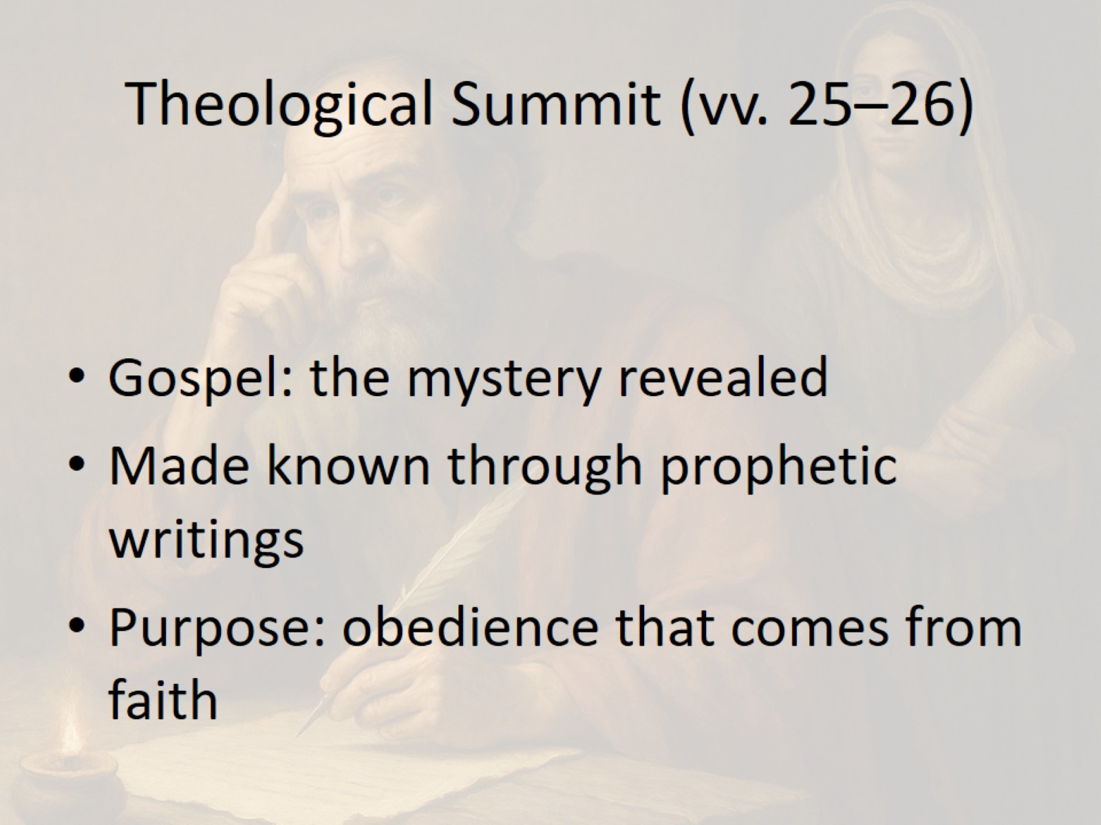
Theological Summit (vv. 25–26)

Slide 7
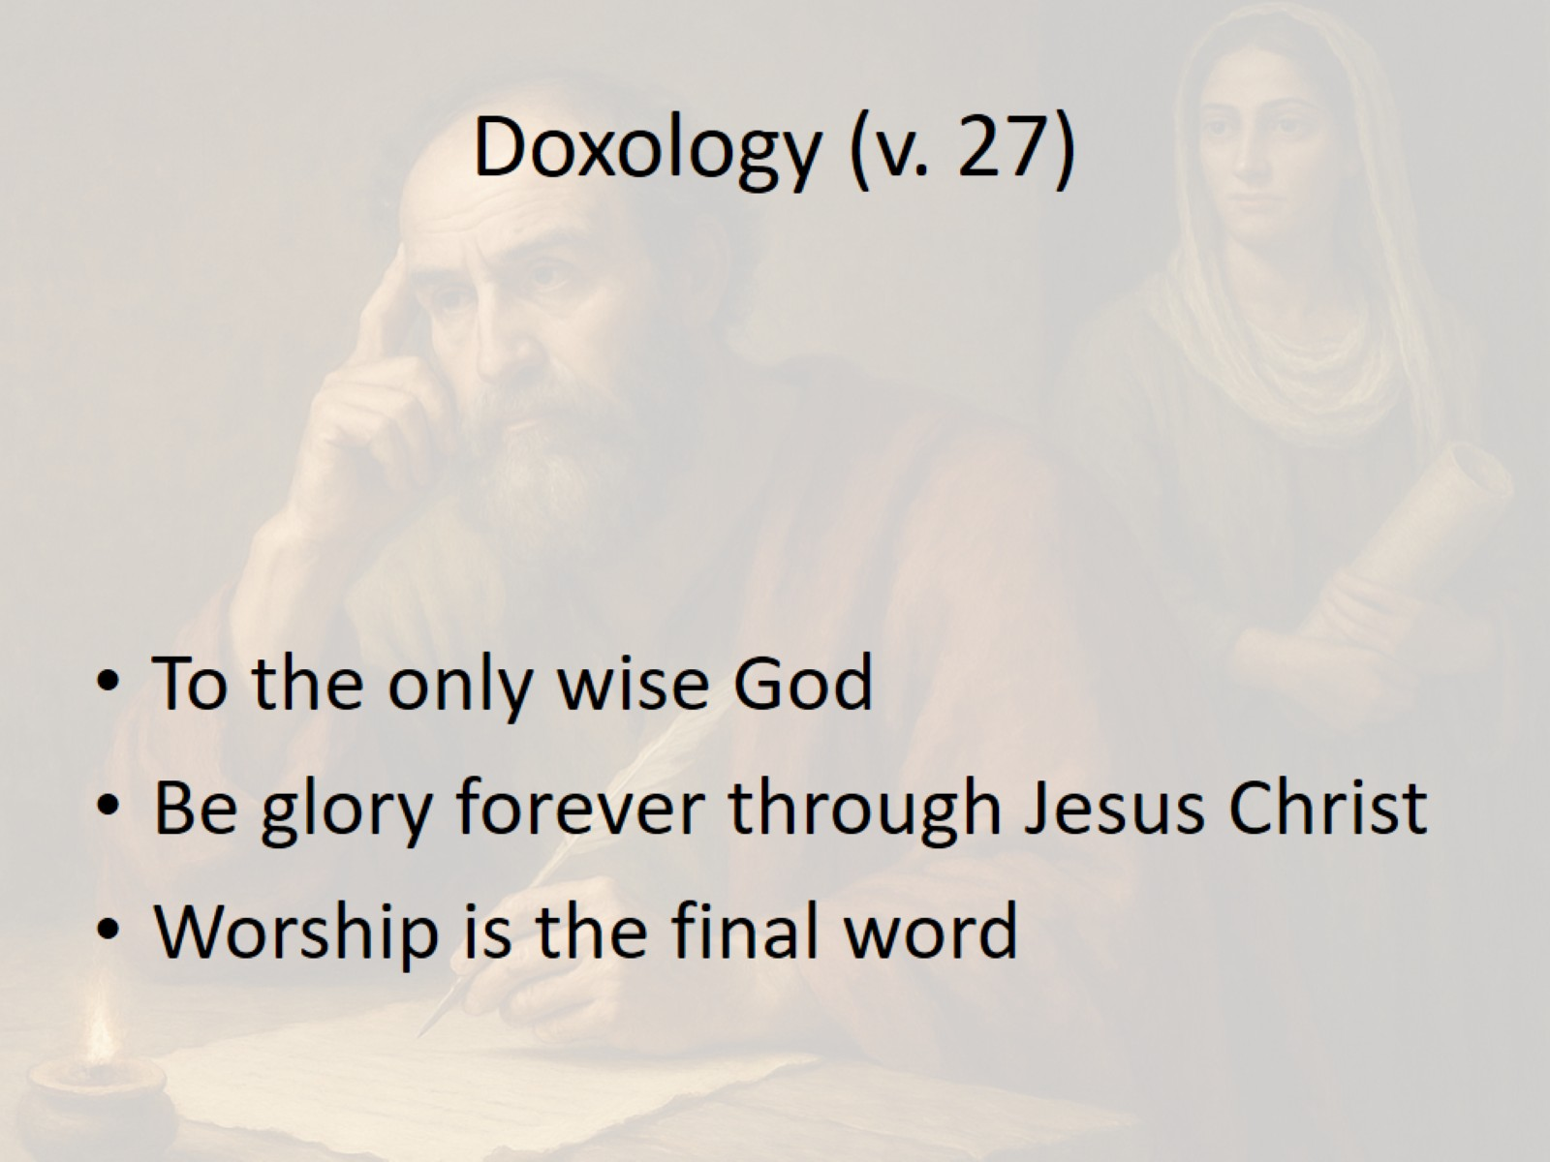
Doxology (v. 27)

Slide 8
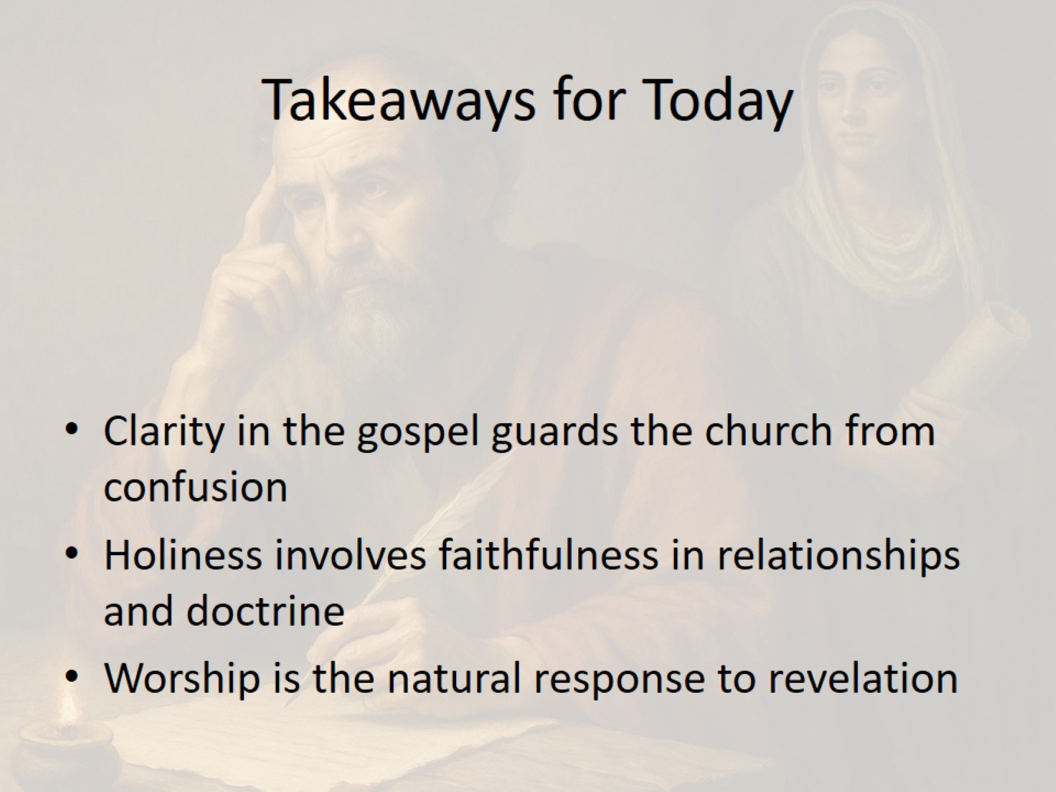
Takeaways for Today

Slide 9
