Slide 1

Mercy Takes
a Body
The Christ Who Forms a People
8.23.2026
01

Slide 2
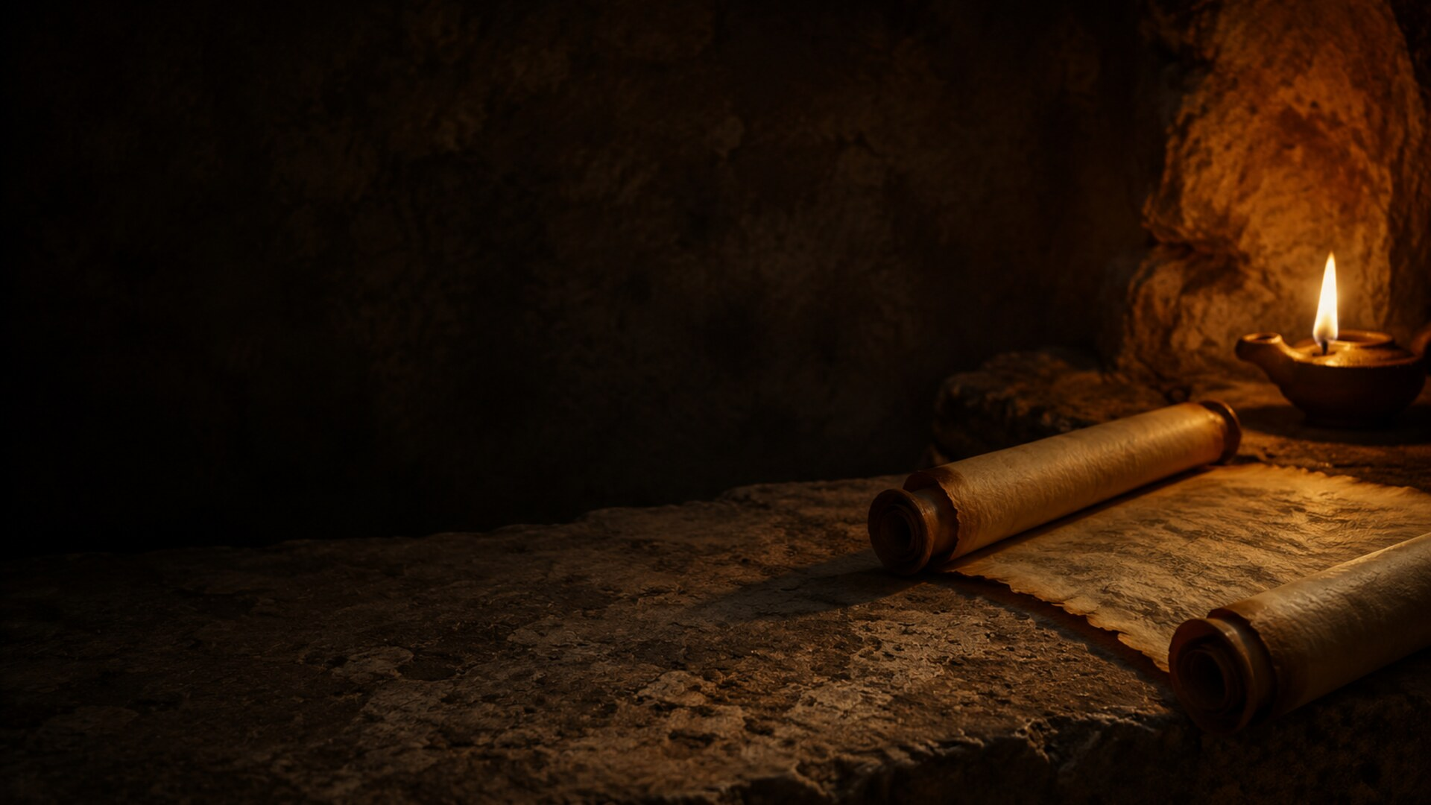
TODAY’S READINGS
Exodus 1:8–2:10
Psalm 124
Romans 12:1–8
Matthew 16:13–20
02

Slide 3
Our Centering Idea
God’s mercy does not stop
with rescuing individuals.
In Christ, mercy forms a holy people who resist fear, renew their minds, preserve life, and offer their gifts together.
03

Slide 4
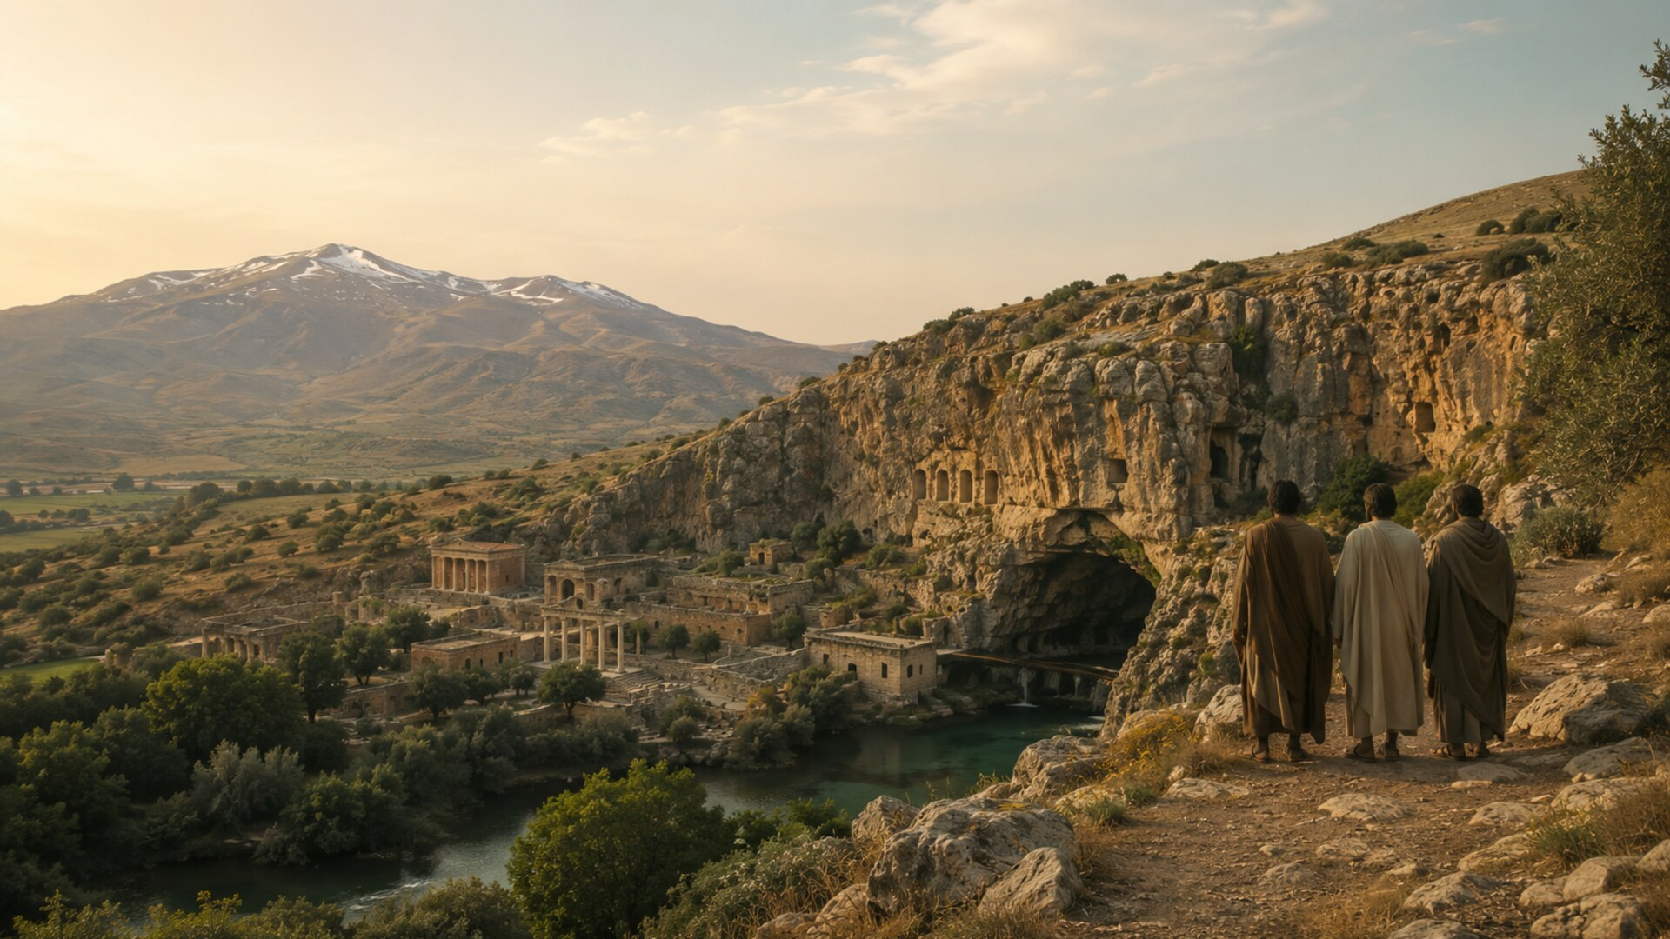
HISTORICAL GEOGRAPHY
Caesarea
Philippi
Caesar rules.
The old gods remain.
Power belongs to the strong.
04

Slide 5
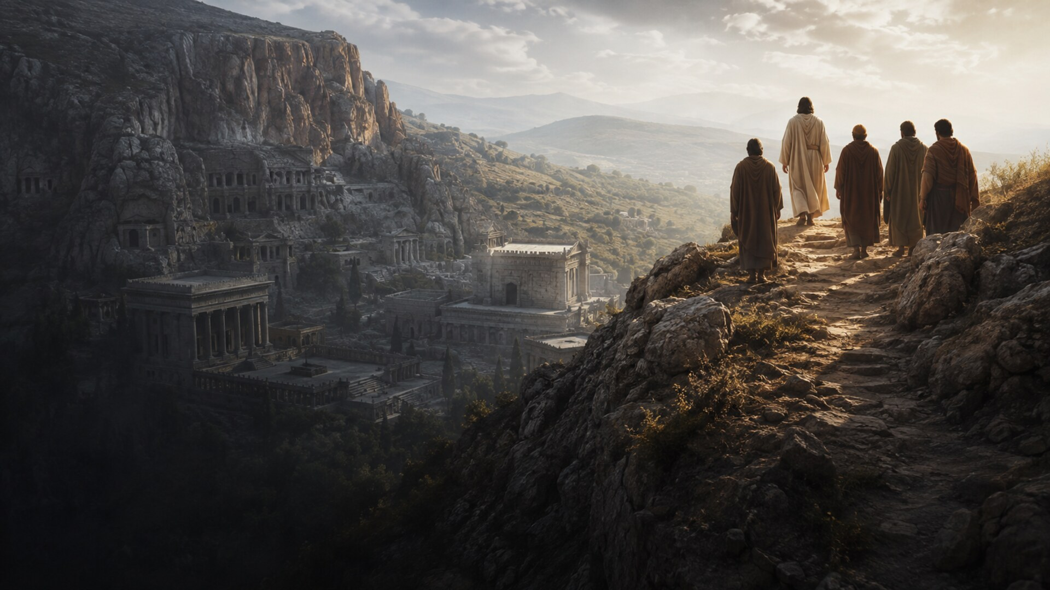
But who was really
standing above whom?
05

Slide 6
The first question is not,
“Who am I?”
Who is Jesus?
Only when Jesus is rightly confessed
can the church understand who it is.
06

Slide 7
SCRIPTURE READING
Matthew 16:13–20
Caesarea Philippi • Confession • Church
07

Slide 8
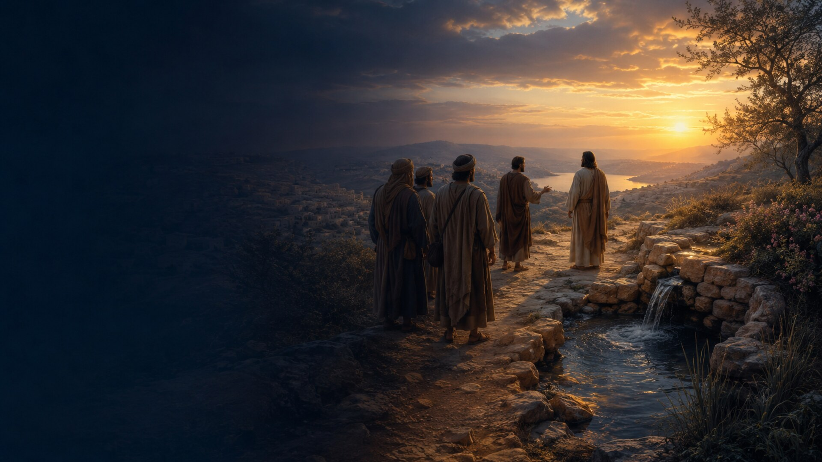
PETER’S CONFESSION
“You are the Messiah,
the Son of the living God.”
Matthew 16:16
08

Slide 9
THE GREAT CONFESSION
“I will build
my church.”
The church belongs to Christ.
Matthew 16:18
09

Slide 10
SCRIPTURE READING
Exodus 1:8–22; 2:1–10
Fear • Courage • Life preserved
10

Slide 11
TAKEAWAY
When fear becomes a system
fear
forced labor
violence
death
Pharaoh uses power to preserve himself.
11

Slide 12
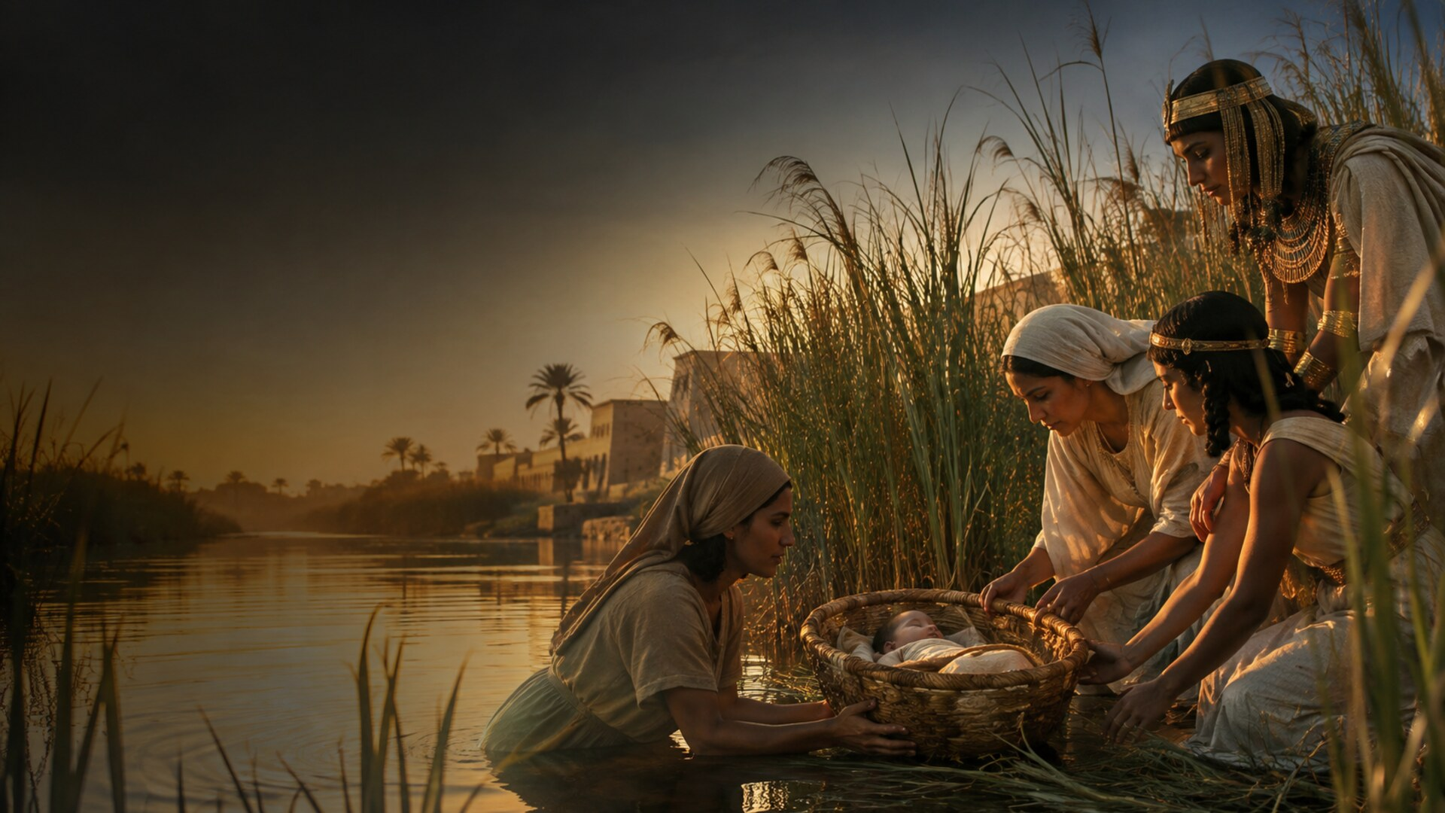
WOMEN PRESERVE LIFE
Mercy becomes
hands,
arms,
eyes,
courage.
12

Slide 13

PSALM 124
“Our help is in
the name of the Lord.”
Psalm 124:8
13

Slide 14
SCRIPTURE READING
Romans 12:1–8
Mercy received • A life offered
“In view of God’s mercy … offer your bodies as a living sacrifice.”
14

Slide 15
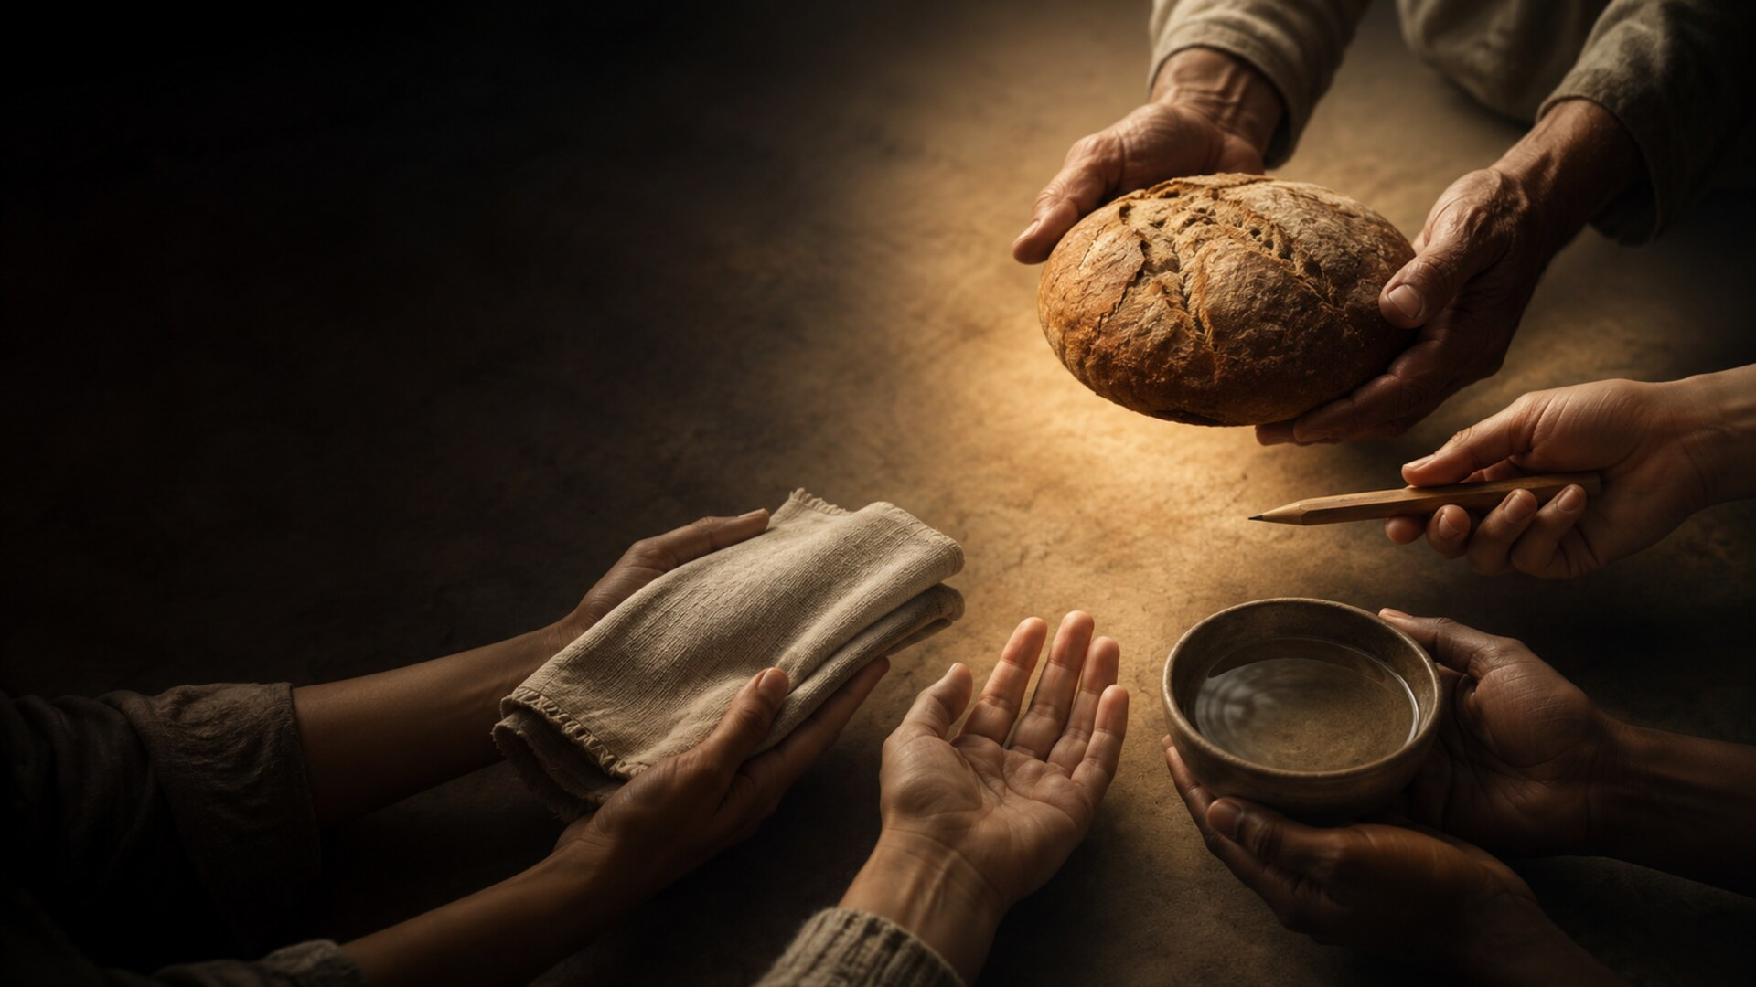
TAKEAWAY
Mercy takes
a body.
Offered bodies.
Renewed minds.
Shared gifts.
15

Slide 16
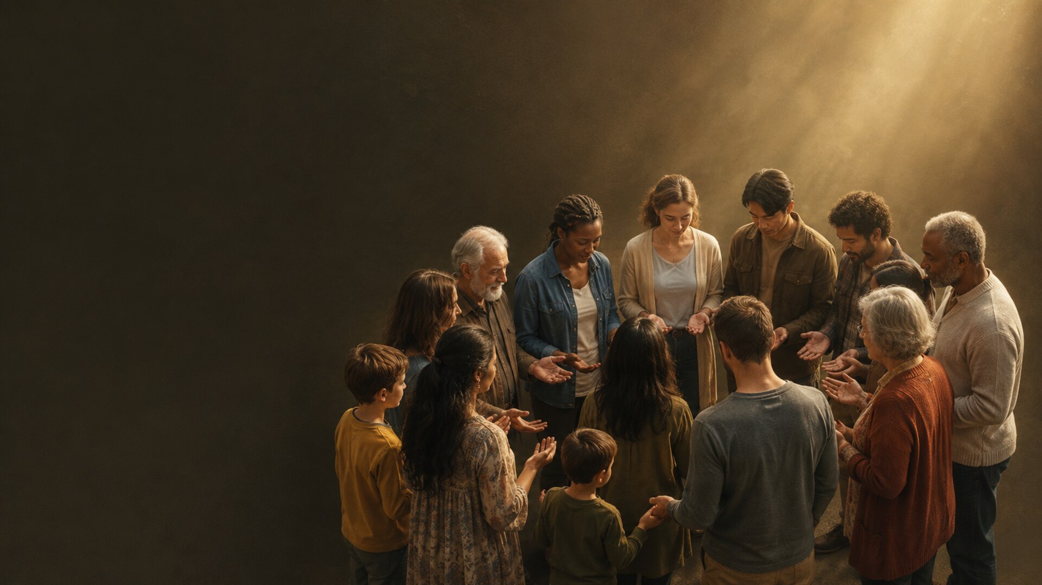
A HOLY PEOPLE IN CHRIST
Resist fear.
Renew your mind.
Preserve life.
Offer your gift.
16

Slide 17

OPEN WORSHIP
Jesus is the Messiah,
the Son of the living God.
Mercy received
becomes a life offered.
17

Slide 18


Slide 19
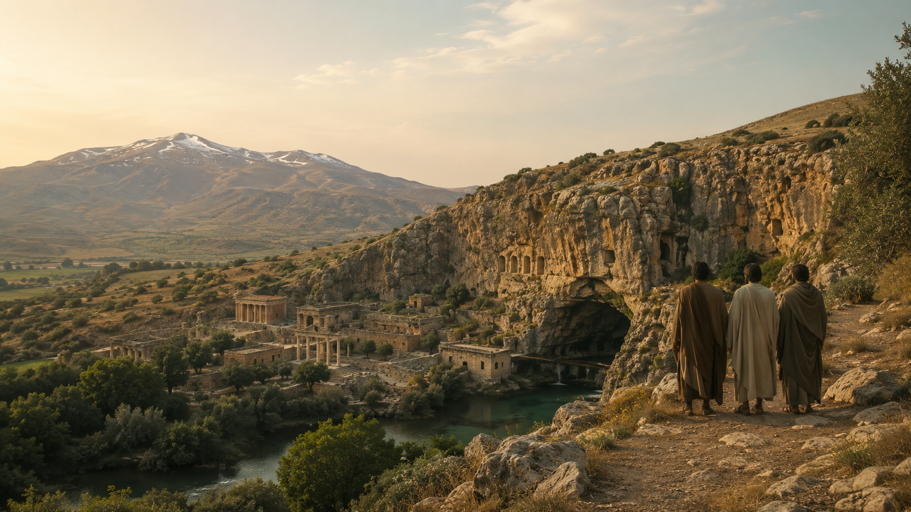

Slide 20
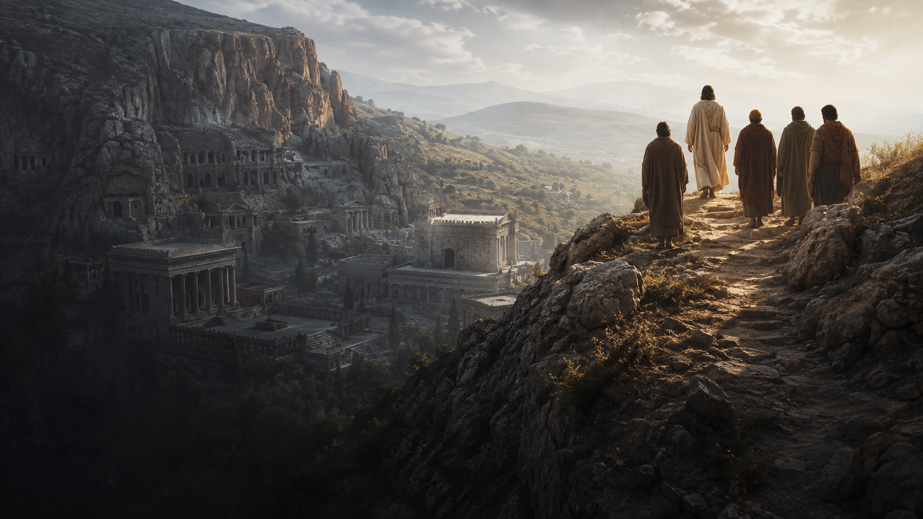

Slide 21


Slide 22


Slide 23


Slide 24


Slide 25


Slide 26
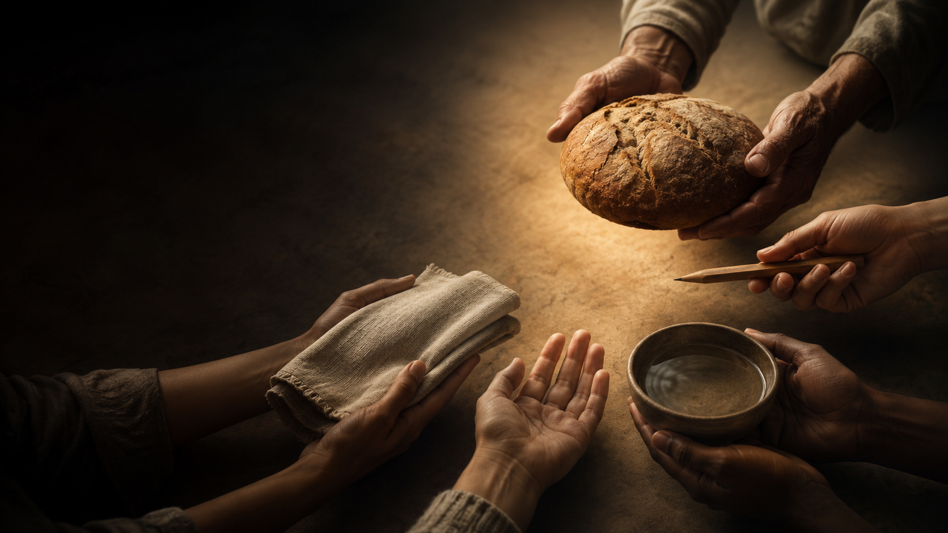

Slide 27


