Slide 1
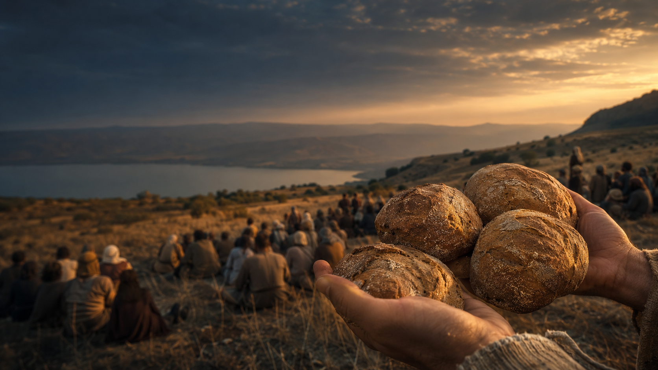
SUNDAY WORSHIP • 8.2.2026
You Give Them
Something to Eat
Compassion • Sufficiency • Holy Participation
Matthew 14:13–21
Notes:
[Sources]
- Sermon content: user-provided manuscript.
- Visual: original OpenAI-generated image for this deck.

Slide 2
THE BIBLICAL WITNESS
One Gospel movement, many witnesses
Matthew 14:13–21
Romans 9:1–5
Psalm 17:1–7, 15
Isaiah 55:1–5
Psalm 145:8–9, 14–21
Notes:
[Sources]
- New International Version passages listed in the user-provided manuscript.

Slide 3
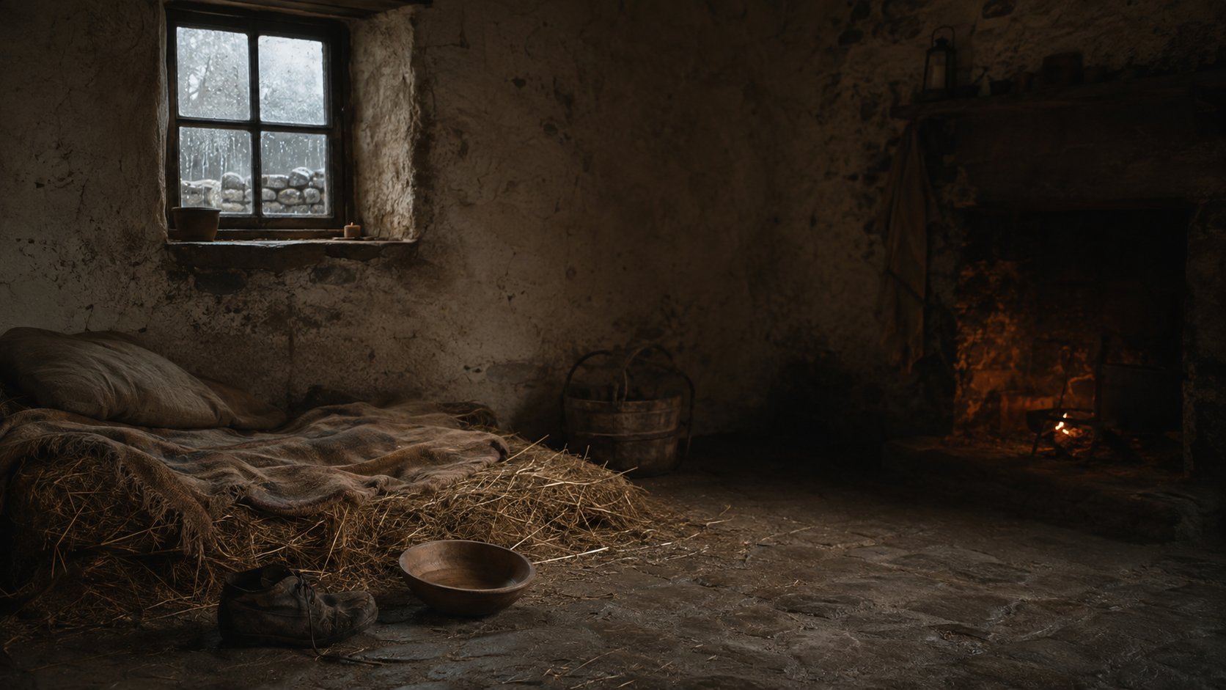
TRALEE, COUNTY KERRY • CHRISTMAS DAY, 1846
When Hunger
Has a Name
The Great Famine entered one small room.
Notes:
[Sources]
- Irish Newspaper Archives, “Tralee & the Great Famine,” https://irishnewsarchive.com/wp/tralee-and-the-great-famine/
- Visual: original OpenAI-generated historical scene for this deck.

Slide 4
MICHAEL CONNELL AND HIS CHILDREN
• A widower, about 45–50
• Three children, ages 5–12
• Weeks weakened by hunger
• Two lay beside his body on straw
• The third had gone to beg for food
Notes:
[Sources]
- Irish Newspaper Archives, “Tralee & the Great Famine,” quoting the Kerry Examiner, December 25, 1846, https://irishnewsarchive.com/wp/tralee-and-the-great-famine/
- Visual: original OpenAI-generated historical scene for this deck.

Slide 5
“Once suffering has a face, it becomes much harder to send it away.”
Hunger is no longer an idea.
Notes:
[Sources]
- Sermon reflection: user-provided manuscript.
- Visual: original OpenAI-generated historical scene for this deck.

Slide 6
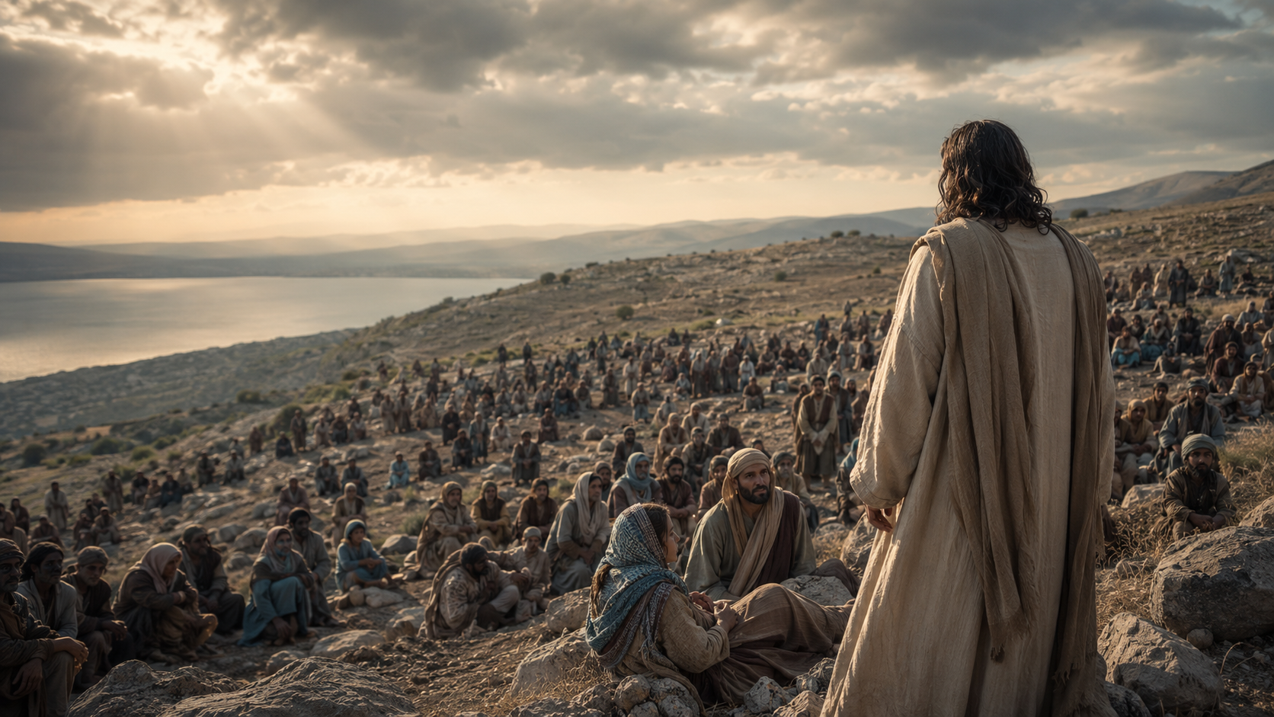
MATTHEW 14
Jesus Sees
What Others
Would Send Away
Before bread is multiplied, compassion refuses to send the hungry away.
Notes:
[Sources]
- Matthew 14:13–21 NIV; sermon content from the user-provided manuscript.
- Visual: original OpenAI-generated historical scene for this deck.

Slide 7
“When Jesus landed and saw a large crowd, he had compassion on them and healed their sick”
(Matthew 14:14 NIV).
Notes:
[Sources]
- Matthew 14:14 NIV.
- Visual: original OpenAI-generated historical scene for this deck.

Slide 8
THE HEART OF GOD
“The Lord is gracious and compassionate, slow to anger and rich in love”
(Psalm 145:8 NIV).
Notes:
[Sources]
- Psalm 145:8 NIV.

Slide 9
THE ARITHMETIC OF SCARCITY
Remote place. Late hour. Large crowd.
5 loaves
5,000 people
The disciples count what they lack.
Notes:
[Sources]
- Matthew 14:15–17 NIV; sermon content from the user-provided manuscript.

Slide 10
THE FEAR BENEATH WITHDRAWAL
“If this need becomes ours, it will consume us.”
Scarcity may tell the truth about our resources. But it becomes a hiding place when we assume our only choices are to fix everything or walk away.
Notes:
[Sources]
- Sermon reflection: user-provided manuscript.

Slide 11
“You give them something to eat”
(Matthew 14:16 NIV).
Notes:
[Sources]
- Matthew 14:16 NIV.
- Visual: original OpenAI-generated image for this deck.

Slide 12
THE TURNING POINT
“Bring them here to me”
(Matthew 14:18 NIV).
Apart from Jesus, duty becomes burden. In His hands, participation becomes grace.
Notes:
[Sources]
- Matthew 14:18 NIV; sermon content from the user-provided manuscript.
- Visual: original OpenAI-generated image for this deck.

Slide 13
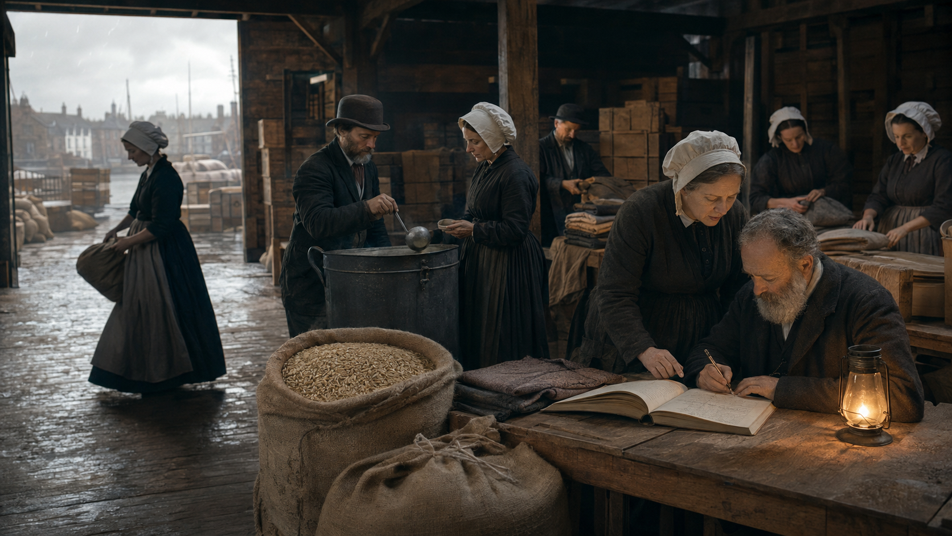
IRISH FRIENDS • NOVEMBER 1846
A Suitable
Channel
They could not match the need.
They placed what they possessed within reach of compassion.
Notes:
[Sources]
- Rob Goodbody, A Suitable Channel: Quaker Relief in the Great Famine (1995).
- Rob Goodbody, “Quakers & the Famine,” https://historyireland.com/quakers-the-famine/
- Visual: original OpenAI-generated historical scene for this deck.

Slide 14
THE NEED WAS OVERWHELMING
21 Friends gathered
within an Irish Society of Friends of about 3,000
amid a nation of more than 8,000,000
Notes:
[Sources]
- Rob Goodbody, “Quakers & the Famine,” https://historyireland.com/quakers-the-famine/
- Visual: original OpenAI-generated historical scene for this deck.

Slide 15
WHAT THEY HAD
Business. Shipping. Purchasing. Storage.
Meetinghouses. Kitchens. Ledgers. Willing hands.
They worked across religious lines. No one had to become a Quaker to receive food.
Notes:
[Sources]
- Rob Goodbody, A Suitable Channel (1995); “Quakers & the Famine,” https://historyireland.com/quakers-the-famine/
- Visual: original OpenAI-generated historical scene for this deck.

Slide 16
MERCY MOVED THROUGH ORDINARY HANDS
Nearly 8,000 tons of food
Almost 300 soup boilers
Seed for thousands of small farmers
Notes:
[Sources]
- Rob Goodbody, “Quakers & the Famine,” https://historyireland.com/quakers-the-famine/

Slide 17
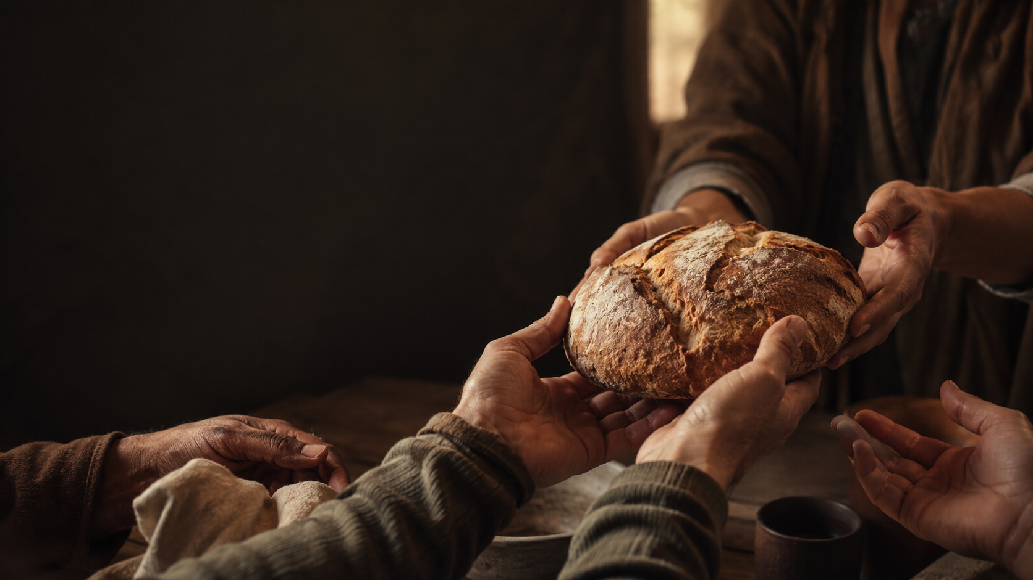
HOLY PARTICIPATION
They did not become
the Breadgiver.
They became a channel—willing hands through which mercy could move.
Notes:
[Sources]
- Sermon synthesis based on Goodbody’s description of Friends relief as “a suitable channel.”
- Visual: original OpenAI-generated image for this deck.

Slide 18
THE SUFFICIENCY BELONGS TO CHRIST
Their hands
into Jesus’ hands
back through their hands
to the hunger before them
Notes:
[Sources]
- Matthew 14:19–20 NIV; sermon content from the user-provided manuscript.
- Visual: original OpenAI-generated image for this deck.

Slide 19
“They all ate and were satisfied”
(Matthew 14:20 NIV).
Notes:
[Sources]
- Matthew 14:20 NIV.
- Visual: original OpenAI-generated image for this deck.

Slide 20
THE GOSPEL PATTERN
Grace comes before response.
Christ gives before He commands.
Holiness is Christ’s compassion becoming visible through surrendered lives.
Notes:
[Sources]
- Sermon gospel pattern and pulse sentence: user-provided manuscript.

Slide 21
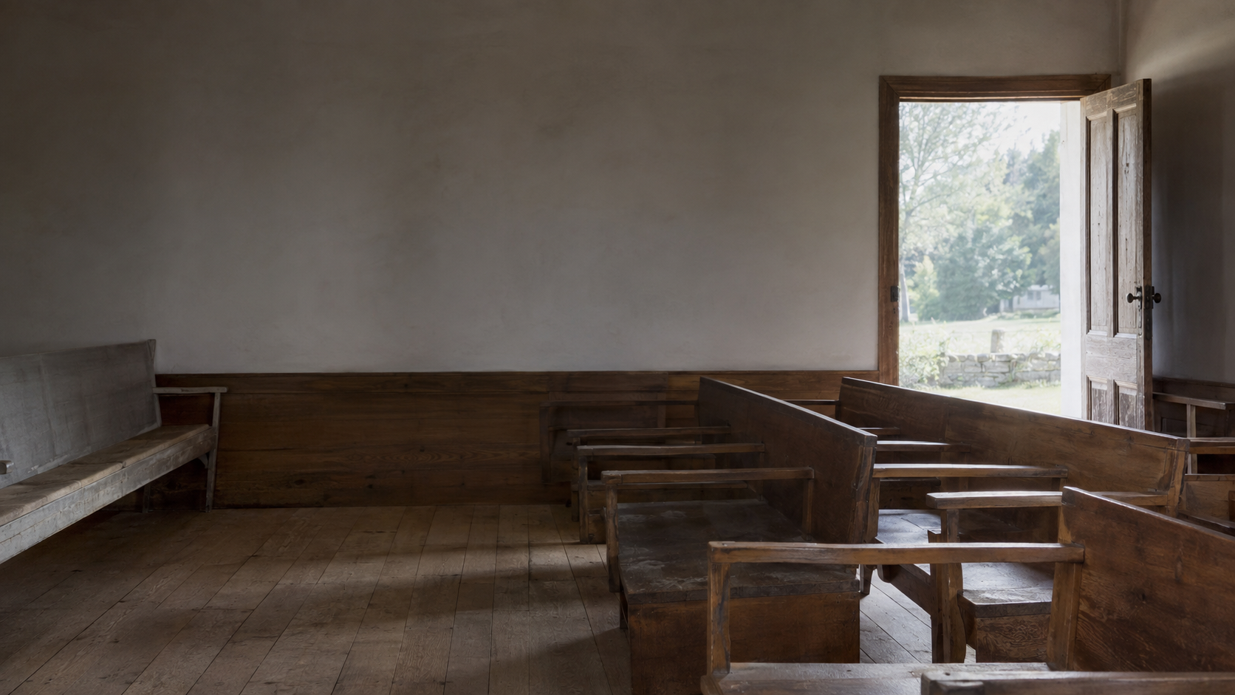
A QUESTION FROM INDIANA YEARLY MEETING
Why can’t we get
more people
to become involved?
Apathy? Complacency? Or something else?
Notes:
[Sources]
- Pastoral reflection from Indiana Yearly Meeting in the user-provided manuscript.
- Visual: original OpenAI-generated Friends meetinghouse image for this deck.

Slide 22
WHAT IF SOME PEOPLE CARE—BUT FEAR WHAT CARING WILL COST?
“One yes” becomes “five more requests.”
If showing up feels like a blank check, the safest boundary may seem to be never entering at all.
Notes:
[Sources]
- Pastoral reflection developed in the user-provided manuscript.
- Visual: original OpenAI-generated Friends meetinghouse image for this deck.

Slide 23
JESUS REFUSES BOTH DISTORTIONS
“Someone else should care.”
“Everything depends on me.”
Holy participation says: “I will place my part in Christ’s hands.”
Notes:
[Sources]
- Sermon reflection: user-provided manuscript.

Slide 24
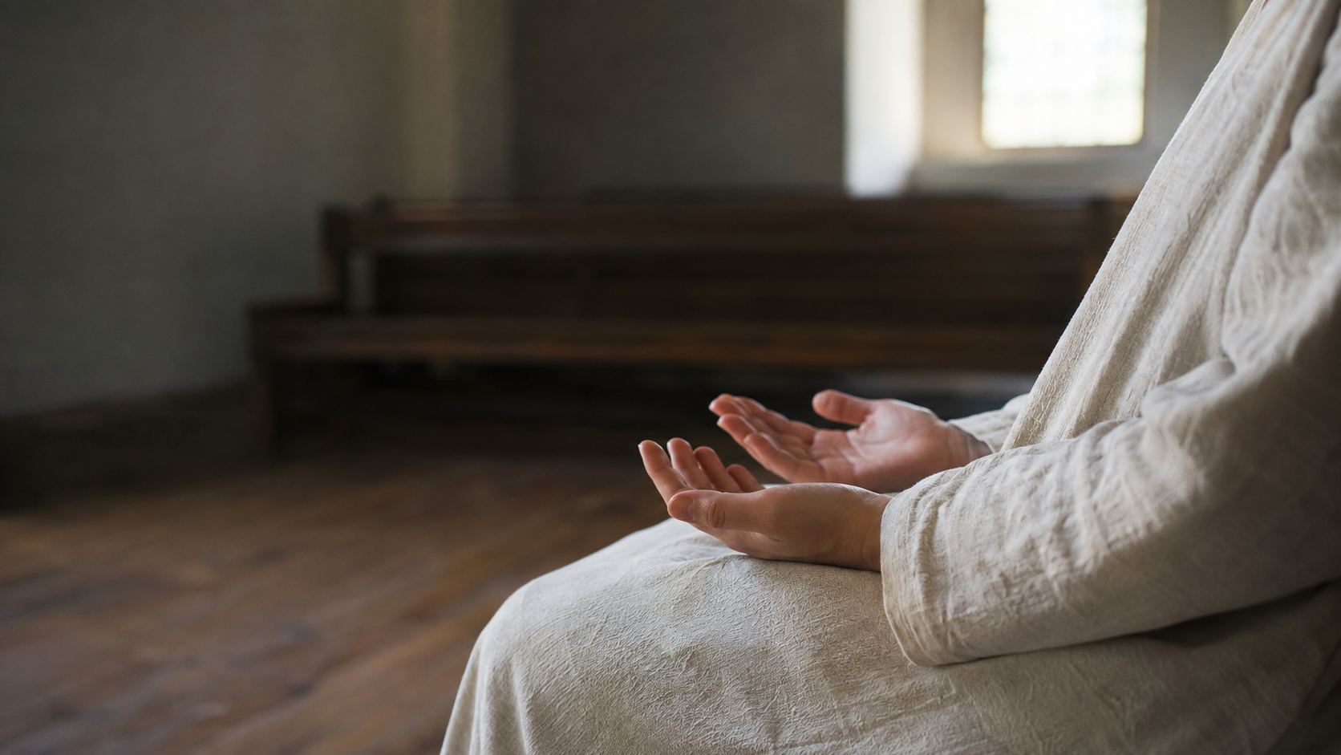
WHAT HAS CHRIST PLACED IN YOUR HANDS?
A meal • A car ride • A skill • An hour
A patient ear • A relationship • A prayer
“You open your hand and satisfy the desires of every living thing”
(Psalm 145:16 NIV).
Notes:
[Sources]
- Psalm 145:16 NIV; sermon examples from the user-provided manuscript.
- Visual: original OpenAI-generated image for this deck.

Slide 25
BIG IDEA
Jesus does not ask His disciples to be sufficient.
He asks us to bring what we have, remain near Him, and participate in His compassion.
Notes:
[Sources]
- Sermon big idea: user-provided manuscript.
- Visual: original OpenAI-generated image for this deck.

Slide 26
OPEN WORSHIP
1 Where am I tempted to send the need away because it feels larger than me?
2 Where am I carrying a burden Christ has not asked me to carry?
3 What has Christ already placed in my hands for the person He is teaching me to see?
Notes:
[Sources]
- Open Worship queries: user-provided manuscript.
- Visual: original OpenAI-generated image for this deck.

Slide 27
The need may be greater than you.
It is not greater than Christ.
We are not the Breadgiver. We are the willing hands through which the Breadgiver chooses to serve.
“You give them something to eat” (Matthew 14:16 NIV).
Notes:
[Sources]
- Matthew 14:16 NIV; sermon conclusion from the user-provided manuscript.
- Visual: original OpenAI-generated image for this deck.

