Slide 1

MERCY
MADE VISIBLE
The Grace That Cleanses, Reconciles, and Gathers
Sunday, August 16, 2026
Notes:
Let the river image settle the room before naming the sermon. The water introduces the downstream metaphor without explaining it yet.
[Sources]
- Sermon manuscript: 8.16.2026_Mercy_Made_Visible_v2.docx
- Image: Greg Sellentin, Unsplash, https://unsplash.com/photos/the-sun-shines-brightly-over-the-water-of-a-river-2c_92oN5FXM
[/Sources]

Slide 2

What happens to
God’s mercy
after it reaches us?
“Lord, help me.”
Notes:
Ask the question and allow a full breath before continuing. This is the opening tension that the entire sermon answers.
[Sources]
- Sermon manuscript: 8.16.2026_Mercy_Made_Visible_v2.docx
- Image: Apex 360, Unsplash, https://unsplash.com/photos/a-hand-reaching-for-something-in-the-water-i6_kzOjH7CA
[/Sources]

Slide 3
THE ONE TRUTH
Holiness is God’s mercy
so deeply received
that it becomes visible through us.
Mercy received. Mercy made visible.
Notes:
State the sermon’s single point once, slowly. The deck will return to it at the major convergences—not as filler, but as the sermon’s governing claim.
[Sources]
- Sermon manuscript: 8.16.2026_Mercy_Made_Visible_v2.docx
- Image: Greg Sellentin, Unsplash, https://unsplash.com/photos/the-sun-shines-brightly-over-the-water-of-a-river-2c_92oN5FXM
[/Sources]

Slide 4

Romans gives us
the ground beneath our feet.
“God has bound everyone over to disobedience
so that he may have mercy on them all.”
ROMANS 11:32 NIV
Notes:
Name the common ground: no superior record, no earned place. The ground beneath every Christian is mercy.
[Sources]
- Sermon manuscript: 8.16.2026_Mercy_Made_Visible_v2.docx
- Scripture: Romans 11:1–2a, 29–32 NIV
- Image: Liana S, Unsplash, https://unsplash.com/photos/a-hand-reaching-out-in-warm-light-RzojtGDoQlQ
[/Sources]

Slide 5
ROMANS 11
Grace moves before we do.
1
2
3
4
AWAKENS
RECONCILES
FORMS
SENDS
Prevenient
grace
Justifying
grace
Sanctifying
grace
Missional
grace
MERCY RECEIVED. MERCY MADE VISIBLE.
Notes:
Move across the four verbs as one divine movement: God awakens, reconciles, forms, and sends. Holiness begins in grace, not self-improvement.
[Sources]
- Sermon manuscript: 8.16.2026_Mercy_Made_Visible_v2.docx
- Doctrinal language follows the sermon manuscript’s Wesleyan/Quaker framing.
[/Sources]

Slide 6
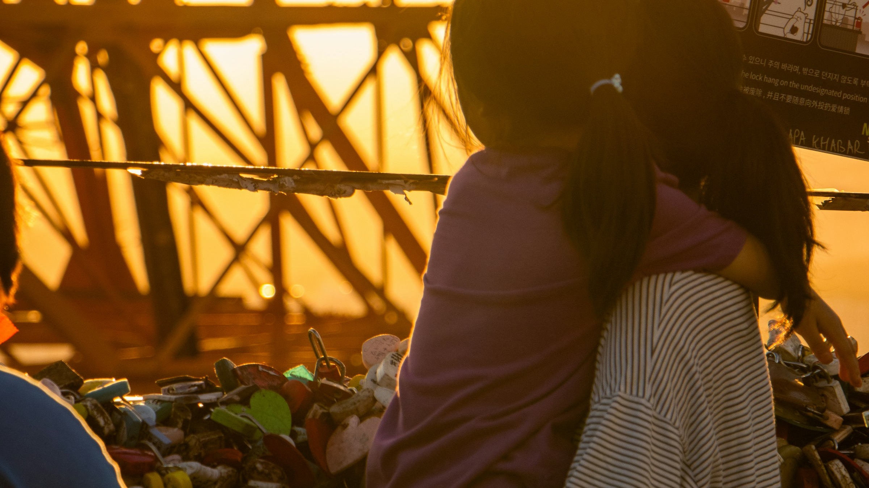
Matthew gives
mercy a face.
Before she says a word,
the story marks her as an outsider.
MATTHEW 15:21–28
Notes:
Let the image hold the mother’s desperation. Name the real historical boundary and the real tension without rushing past either.
[Sources]
- Sermon manuscript: 8.16.2026_Mercy_Made_Visible_v2.docx
- Scripture: Matthew 15:21–28 NIV
- Image: Jeonghun Choi, Unsplash, https://unsplash.com/photos/mother-holds-child-silhouetted-against-the-sunset-svUnNg7v6YE
[/Sources]

Slide 7
She kneels and reduces her prayer
to three words:
“Lord, help me!”
MATTHEW 15:25 NIV
Notes:
Pause after the prayer. Many in the room already know this prayer from their own lives.
[Sources]
- Sermon manuscript: 8.16.2026_Mercy_Made_Visible_v2.docx
- Scripture: Matthew 15:25 NIV
- Image: Jeonghun Choi, Unsplash, https://unsplash.com/photos/mother-holds-child-silhouetted-against-the-sunset-svUnNg7v6YE
[/Sources]

Slide 8
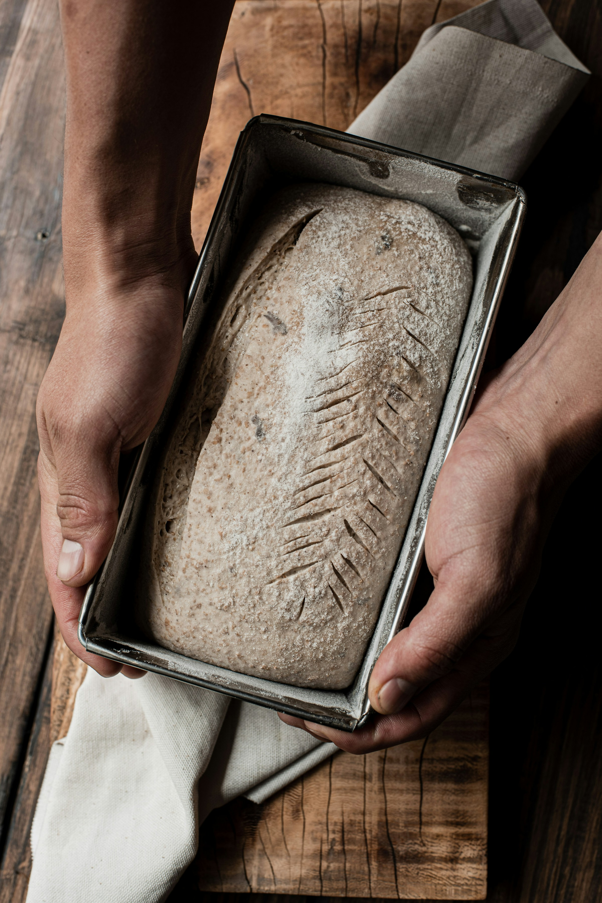
Even what overflows
from Jesus is enough.
“Even the dogs eat the crumbs
that fall from their master’s table.”
MATTHEW 15:27 NIV
Notes:
Her faith does not manufacture mercy or earn it. It trusts the abundance that only Christ can provide.
[Sources]
- Sermon manuscript: 8.16.2026_Mercy_Made_Visible_v2.docx
- Scripture: Matthew 15:27 NIV
- Image: Diego Arenas de Rodrigo, Unsplash, https://unsplash.com/photos/hands-holding-a-loaf-of-freshly-baked-bread-JVY7VSBEhEo
[/Sources]

Slide 9
CHRIST SUPPLIES
BREAD
PLACED
IN THEIR
HANDS
what we cannot create.
FAITH RECEIVES
what it cannot earn.
HOLINESS CARRIES
Christ’s mercy outward.
Notes:
This is the Matthew convergence: Christ remains the supplier; the disciples become distributors. Return to the central point immediately after these three lines.
[Sources]
- Sermon manuscript: 8.16.2026_Mercy_Made_Visible_v2.docx
- Image: Diego Arenas de Rodrigo, Unsplash, https://unsplash.com/photos/hands-holding-a-loaf-of-freshly-baked-bread-JVY7VSBEhEo
[/Sources]

Slide 10
THE OLD TESTAMENT CONFIRMS THE POINT
Grace refuses to remain
where it first arrives.
JOSEPH
PSALM 133
Reconciliation
Shared life
ISAIAH 56
PSALM 67
Welcome
Blessing
MERCY RECEIVED. MERCY MADE VISIBLE.
Notes:
Move through the four witnesses quickly. They do not create four new points; together they confirm the single movement of mercy toward reconciliation, shared life, welcome, and blessing.
[Sources]
- Sermon manuscript: 8.16.2026_Mercy_Made_Visible_v2.docx
- Scripture: Genesis 45:1–15; Psalm 133; Isaiah 56:1, 6–8; Psalm 67.
[/Sources]

Slide 11
A river must receive
before it can give.
Look downstream.
Is anything living there?
Notes:
Allow the picture to do some of the work. A river receives, then carries. Holiness is not a ladder we climb; it is a river we enter.
[Sources]
- Sermon manuscript: 8.16.2026_Mercy_Made_Visible_v2.docx
- Image: Greg Sellentin, Unsplash, https://unsplash.com/photos/the-sun-shines-brightly-over-the-water-of-a-river-2c_92oN5FXM
- Paul N. Anderson, “A Theology of Presence,” Evangelical Friend (1993), p. 4.
[/Sources]

Slide 12
What is living
downstream
from me?
Listen before reacting.
Tell the truth without contempt.
Set a boundary without hatred.
Take one faithful step toward reconciliation.
The wound need not decide
what flows through us.
Notes:
Slow down here. These are not four new points; they are concrete ways the one point becomes visible in ordinary life.
[Sources]
- Sermon manuscript: 8.16.2026_Mercy_Made_Visible_v2.docx
- Image: Apex 360, Unsplash, https://unsplash.com/photos/a-hand-reaching-for-something-in-the-water-i6_kzOjH7CA
[/Sources]

Slide 13
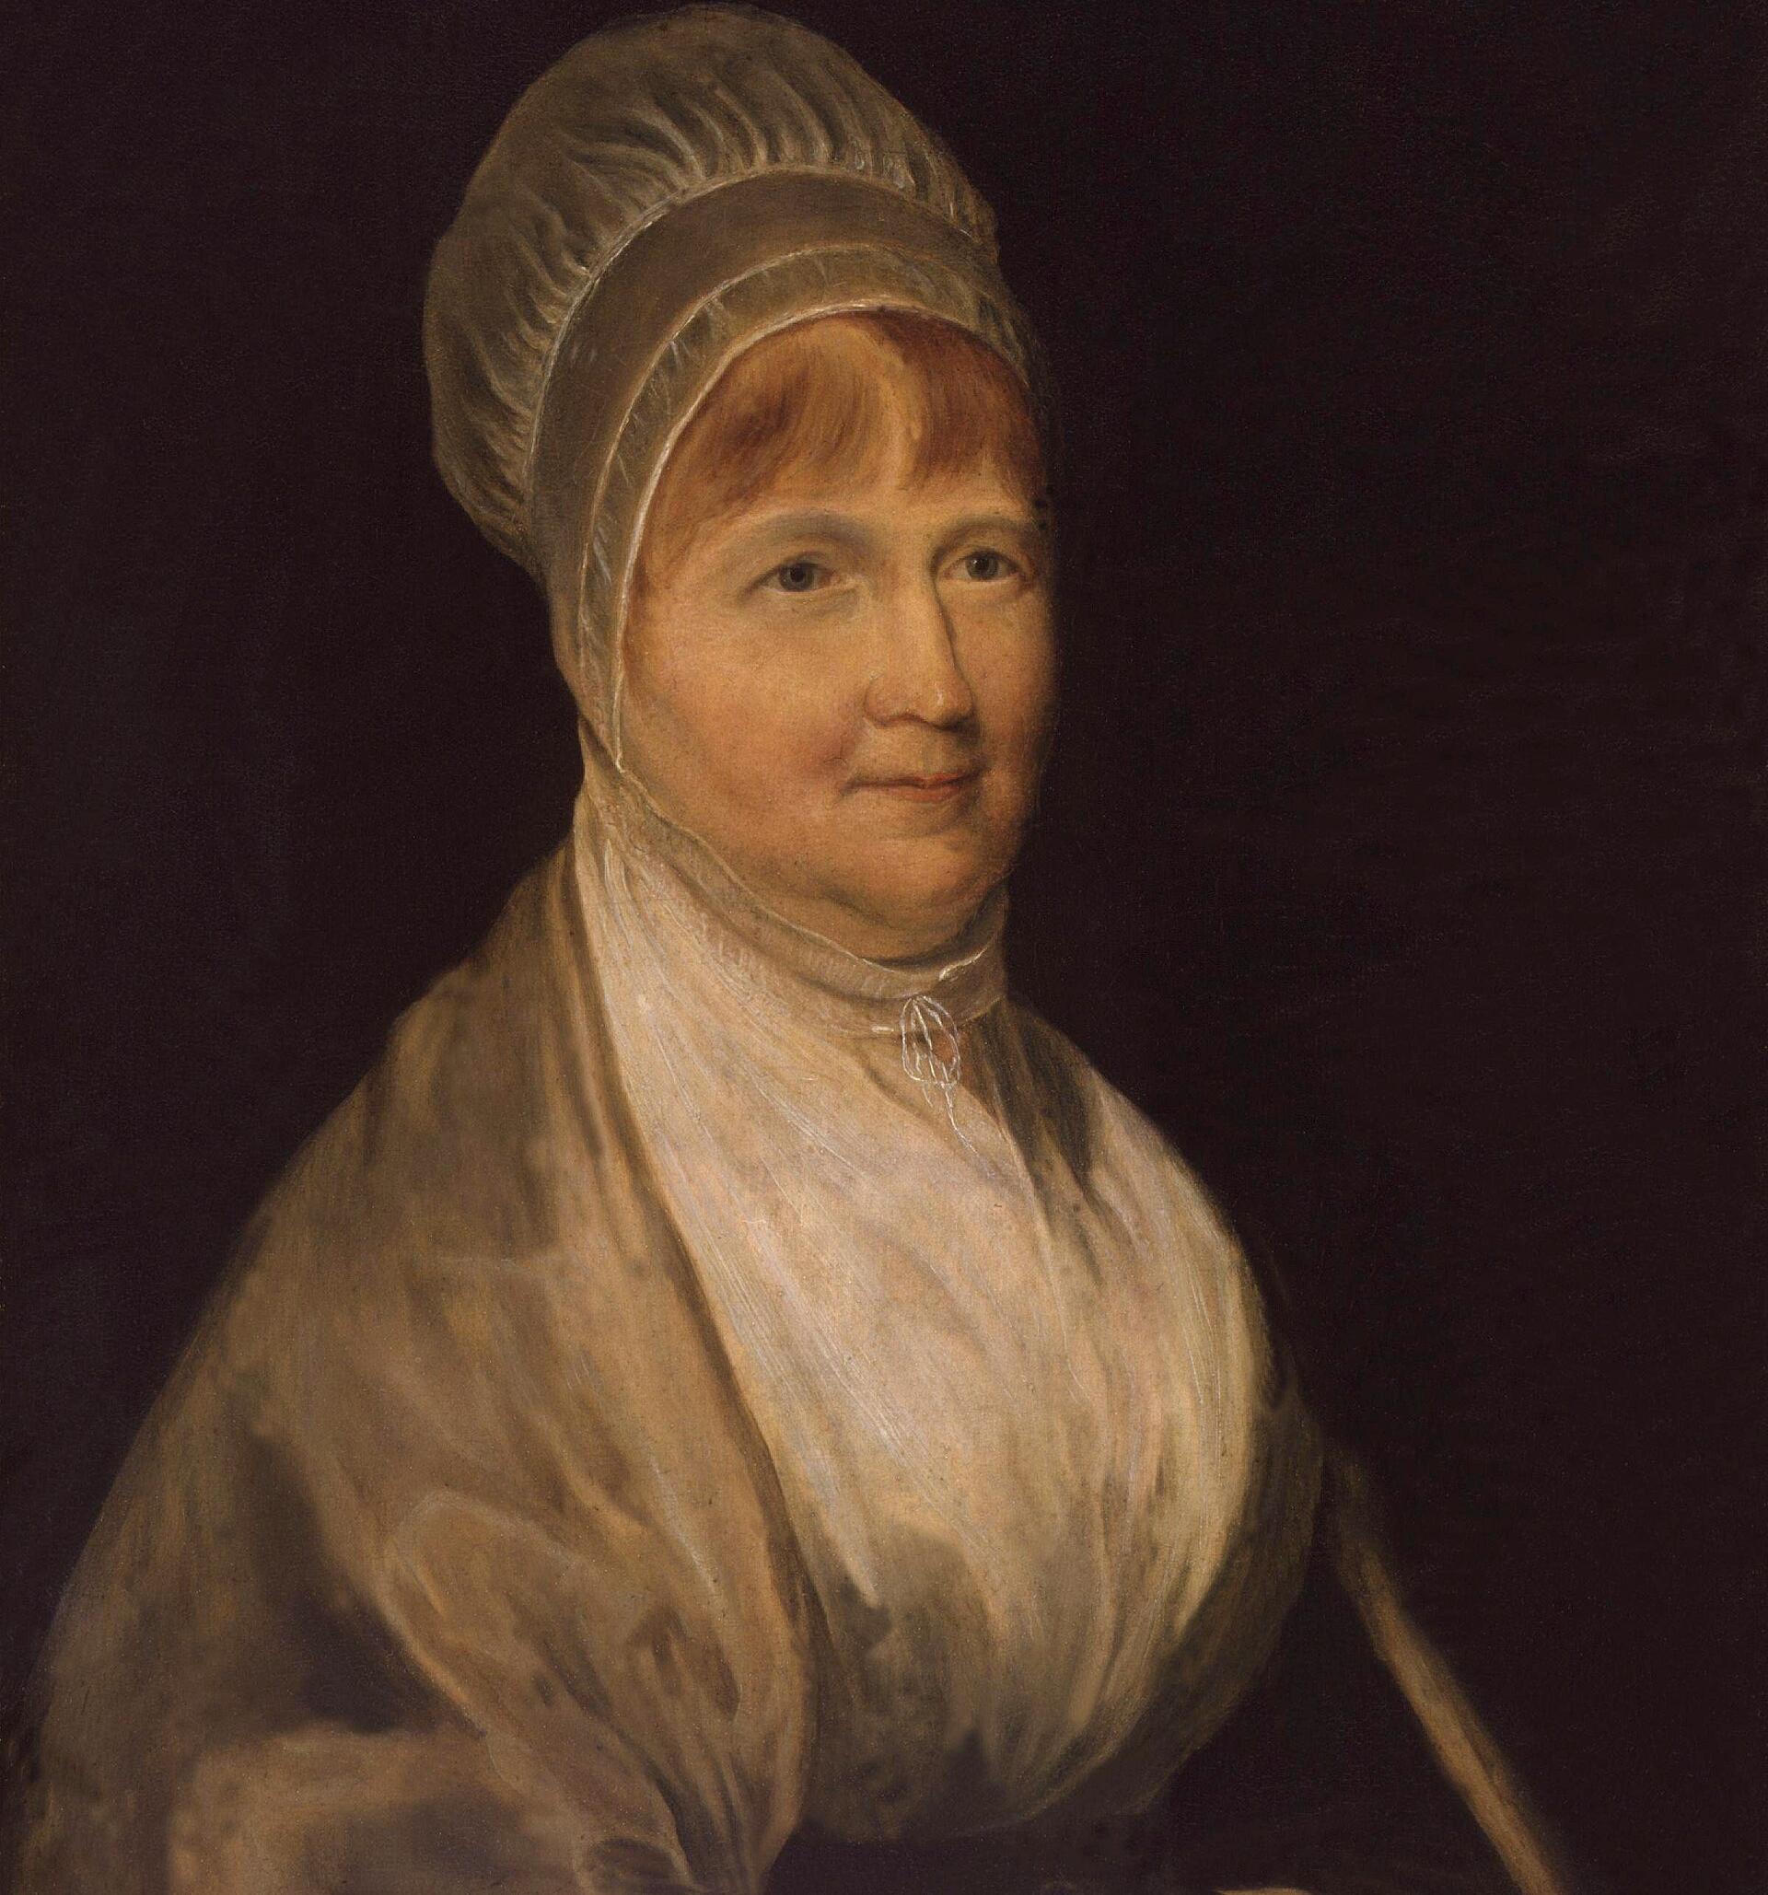
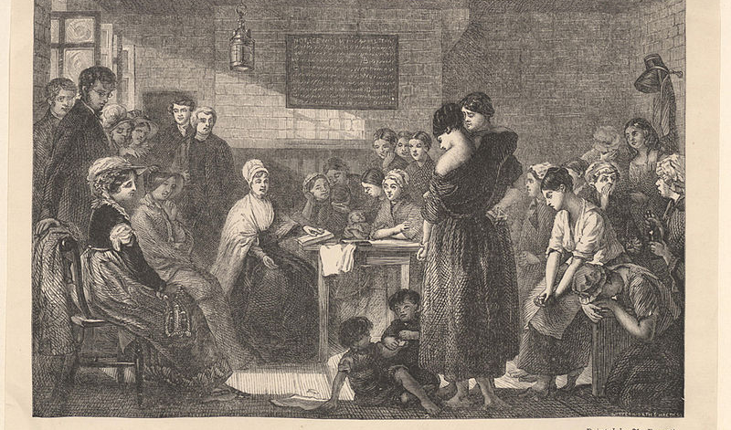
Mercy took form.
ELIZABETH FRY AT NEWGATE • 1813
She clothed babies, comforted mothers,
and prayed among the prisoners.
Notes:
Tell the story: Stephen Grellet carried the need to Elizabeth; Elizabeth began with the need in front of her. She entered afraid, and mercy took form.
[Sources]
- Sermon manuscript: 8.16.2026_Mercy_Made_Visible_v2.docx
- Elizabeth Fry history: Quakers in the World, “Elizabeth Fry,” accessed August 13, 2026.
- Elizabeth Fry history: Quakers in Britain, “The Angel of Prisons: Elizabeth Fry,” Teach Peace Pack (2013), p. 1.
- Portrait: Charles Robert Leslie, Wikimedia Commons, https://commons.wikimedia.org/wiki/File:Elizabeth_Fry_by_Charles_Robert_Leslie.jpg
- Engraving: Jerry Barrett / John Johnson Collection, Wikimedia Commons, https://commons.wikimedia.org/wiki/File:Mrs._Fry_reading_to_the_prisoners_in_Newgate_John_Johnson.jpg
[/Sources]

Slide 14
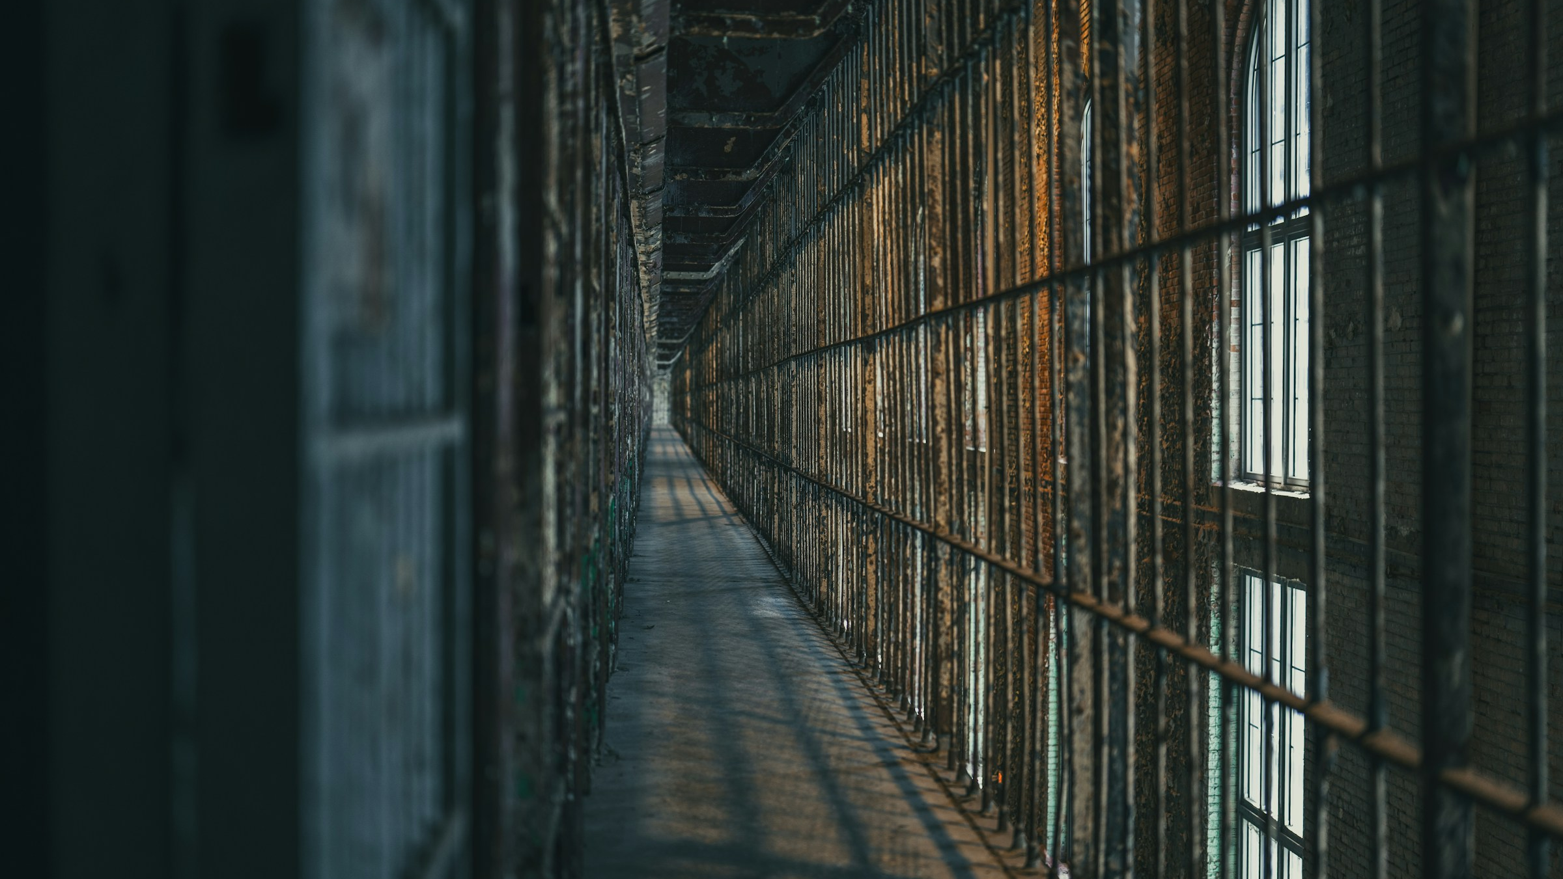
Prison ministry must be entered
“in the spirit,
not of judgment,
but of mercy.”
— ELIZABETH FRY
MERCY RECEIVED. MERCY MADE VISIBLE.
Notes:
Read the quotation with Romans 11 underneath it. The inward mercy she knew became clothing, bedding, prayer, school, community, and public witness.
[Sources]
- Sermon manuscript: 8.16.2026_Mercy_Made_Visible_v2.docx
- Quotation: Britain Yearly Meeting, Quaker Faith & Practice, 5th ed., sec. 23.98.
- Image: Ed Stone, Unsplash, https://unsplash.com/photos/dimly-lit-prison-corridor-with-barred-cells-vx_-8brCCd8
[/Sources]

Slide 15
Now we can see
the whole movement.
COMPASSION
is the source.
TRUTH
performs the inward work.
HOLY PARTICIPATION
carries mercy outward.
WORSHIP
is the final overflow.
Tradition is something we keep.
In Christ, Truth is something that keeps us.
Notes:
This slide gathers the doctrines into one flow. Compassion reveals God’s character; Christ the Truth cleanses inwardly; holy participation carries mercy outward; ministry culminates in worship.
[Sources]
- Sermon manuscript: 8.16.2026_Mercy_Made_Visible_v2.docx
- Scripture supporting worship as overflow: 2 Corinthians 4:15 NIV
- Image: Liana S, Unsplash, https://unsplash.com/photos/a-hand-reaching-out-in-warm-light-RzojtGDoQlQ
[/Sources]

Slide 16
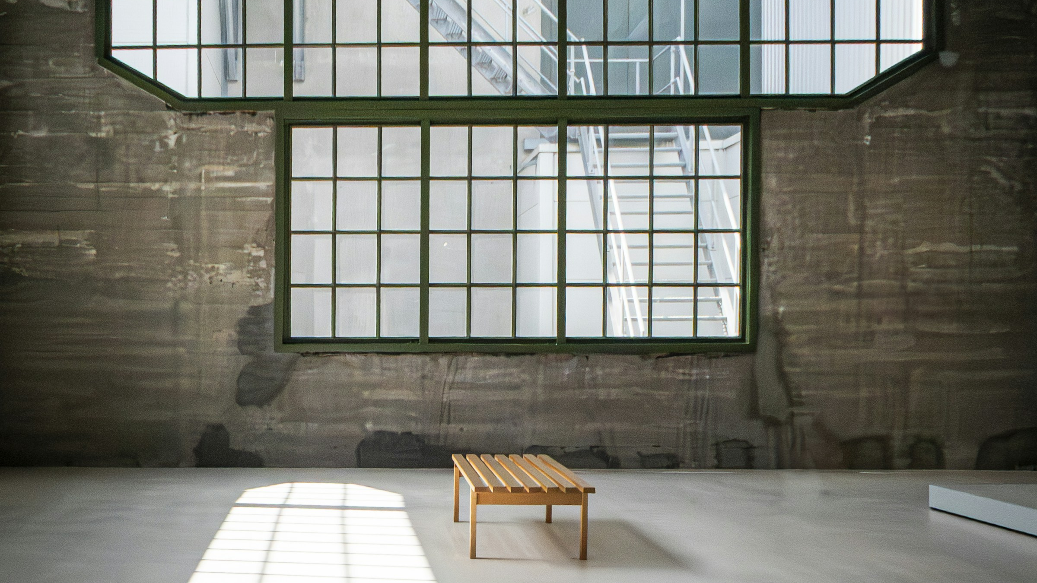
Will His mercy
stop with us?
•
Where does mercy need to become reconciliation?
•
Whom is Christ asking you to see?
•
What concern now needs to take faithful form?
Notes:
Move from proclamation to listening. Ask each query without adding commentary. Let Friends hold the questions before Open Worship.
[Sources]
- Sermon manuscript: 8.16.2026_Mercy_Made_Visible_v2.docx
- Image: Fer Troulik, Unsplash, https://unsplash.com/photos/empty-room-with-large-windows-and-wooden-bench-F985EJTGrxA
[/Sources]

Slide 17
OPEN WORSHIP
Lord Jesus,
let the mercy I have received
become visible through me.
Return to the headwaters. Receive again.
Notes:
Enter Open Worship. Leave the slide up in silence. Do not rush the room.
[Sources]
- Sermon manuscript: 8.16.2026_Mercy_Made_Visible_v2.docx
- Image: Fer Troulik, Unsplash, https://unsplash.com/photos/empty-room-with-large-windows-and-wooden-bench-F985EJTGrxA
[/Sources]

Slide 18
MERCY RECEIVED.
MERCY MADE VISIBLE.
Holiness is God’s mercy so deeply received
that it becomes visible through us.
Notes:
Conclude with the pulse, then the full point. The final return is the answer to the opening question: mercy does not stop with us.
[Sources]
- Sermon manuscript: 8.16.2026_Mercy_Made_Visible_v2.docx
- Image: Greg Sellentin, Unsplash, https://unsplash.com/photos/the-sun-shines-brightly-over-the-water-of-a-river-2c_92oN5FXM
[/Sources]

