Slide 1
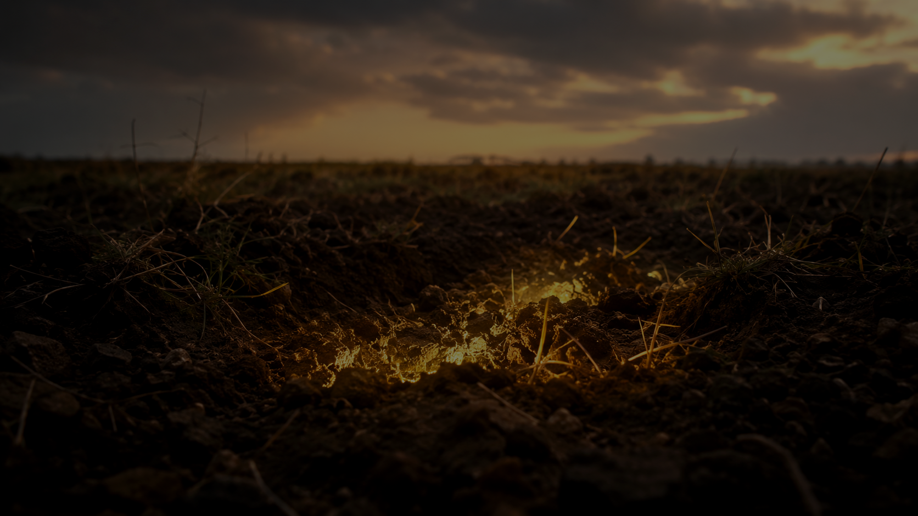
Treasured by God
Matthew 13
Christ sees treasure where sin has buried us,
and He gives all to make us His own.

Slide 2
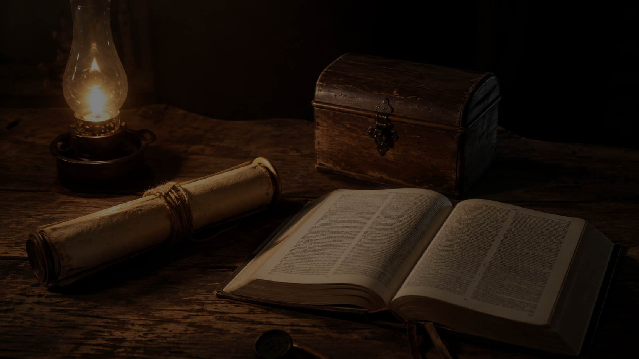
MATTHEW 13
The Lord’s Movement
He sows. He plants. He waits. He grows.
He transforms.
He treasures.
He gathers.
He trains His people to carry treasure.

Slide 3
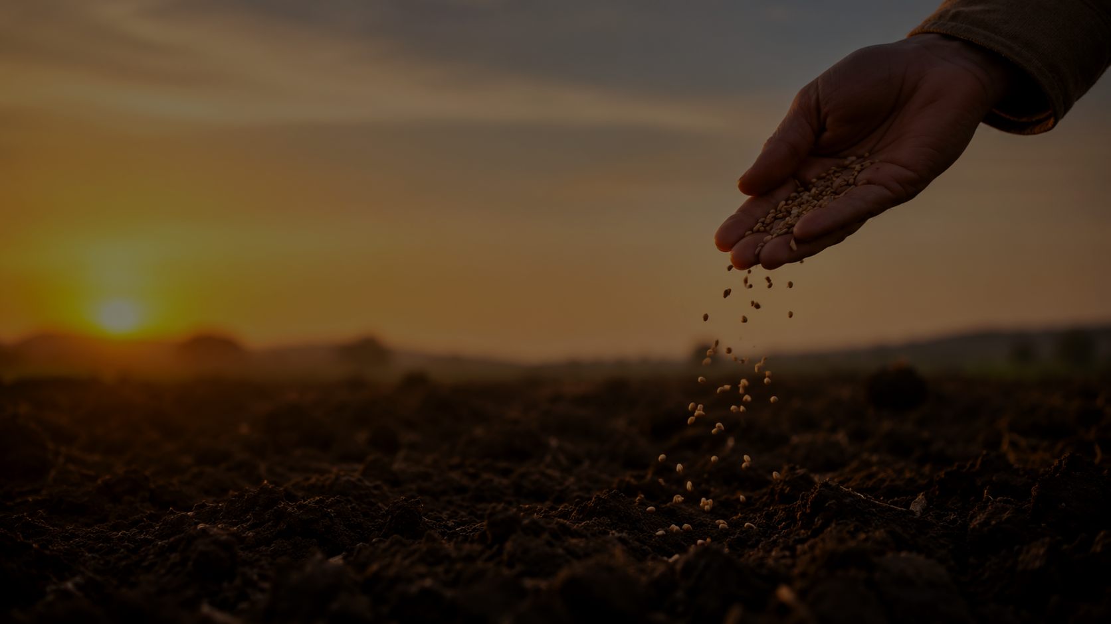
PARABLE 1
The Lord Sows His Word
The seed is good. The heart must become soil.
Matthew 13:3–9, 18–23
The Lord still believes fruit can grow here.

Slide 4
THE SOWER
The Word Meets the Heart
Hard hearts can be broken open.
Shallow hearts can grow roots.
Crowded hearts can be cleared.
Open hearts can bear fruit.
“The word of the kingdom” — Matthew 13:19

Slide 5
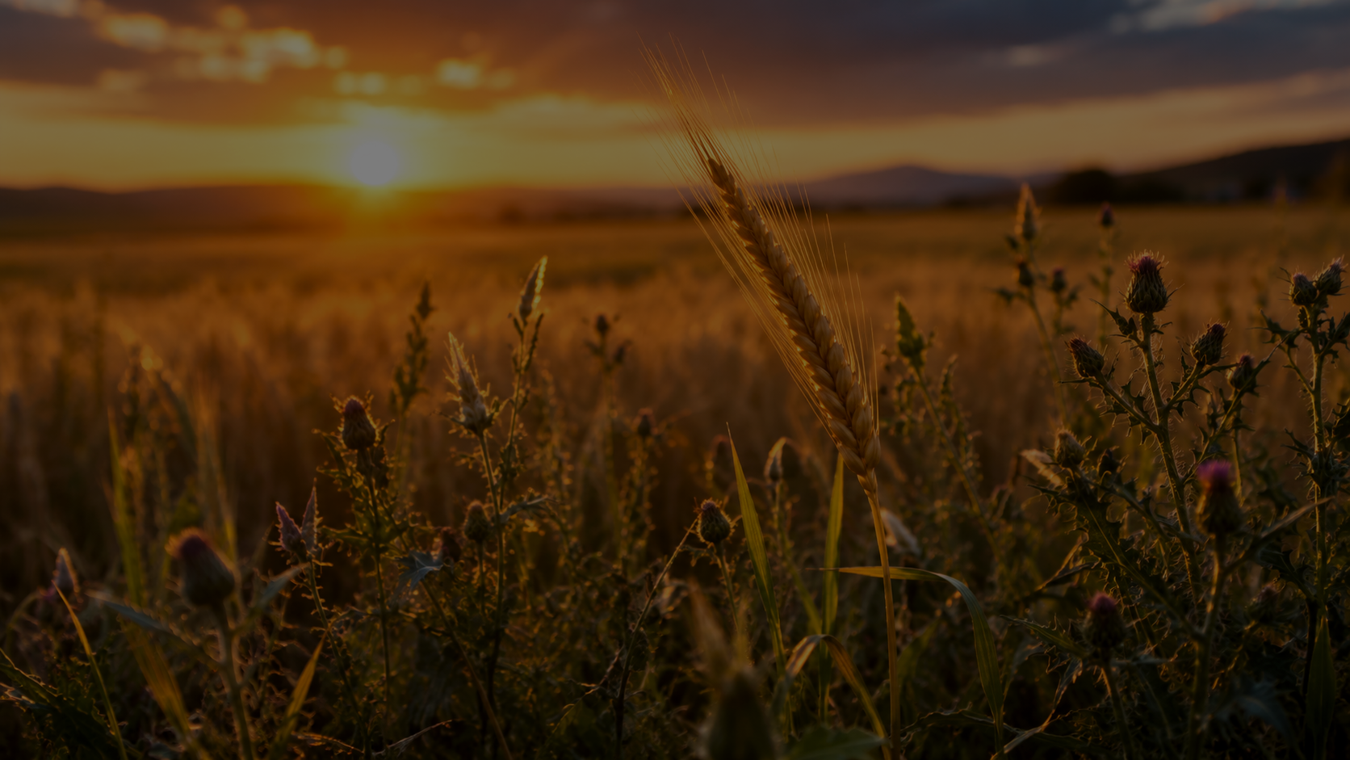
PARABLE 2
Wheat and Tares
The Lord preserves His people in a mixed world.
Matthew 13:24–30, 36–43
The presence of weeds does not mean the wheat is forgotten.

Slide 6

A MIXED FIELD
The Lord Knows His Wheat
Good and evil grow side by side.
The servants are not given final judgment.
The harvest still belongs to God.

Slide 7
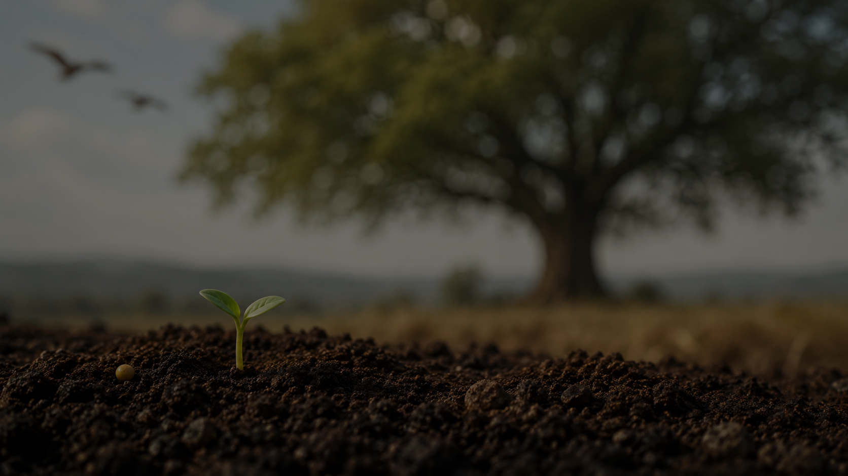
PARABLE 3
The Mustard Seed
Small beginning. Unexpected growth. Shelter for others.
Matthew 13:31–32
The Lord plants small, but He does not think small.

Slide 8
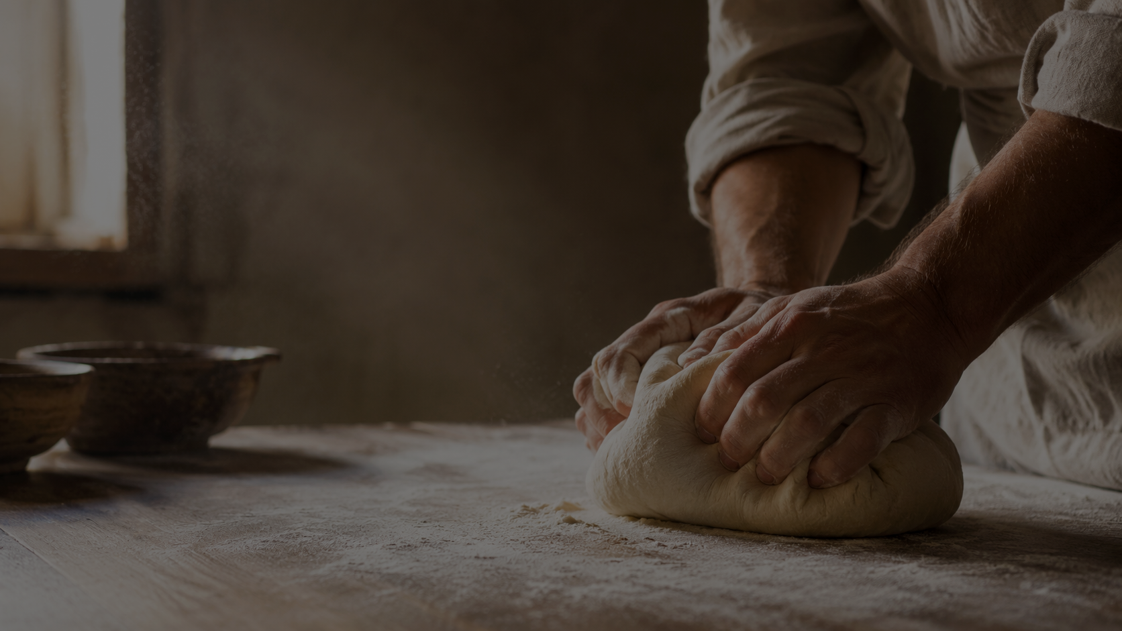
PARABLE 4
The Leaven
Hidden grace works until the whole life begins to rise.
Matthew 13:33
Christ does not patch the surface; He transforms from within.

Slide 9
THE TURN IN THE SERMON
Then Jesus Says…
“The kingdom of heaven is like a treasure hidden in the field.”
Matthew 13:44

Slide 10
PARABLE 5
The Lord Sees Hidden Treasure
Others may see dirt. Christ sees treasure.
Matthew 13:44
Jesus gave all to claim what He loves.

Slide 11
SCRIPTURE WITNESS
God Treasures His People
Exodus 19:5–6 — His own possession
Isaiah 43:4 — precious in His sight
Titus 2:14 — a people for His own possession
Acts 20:28 — purchased with His own blood

Slide 12
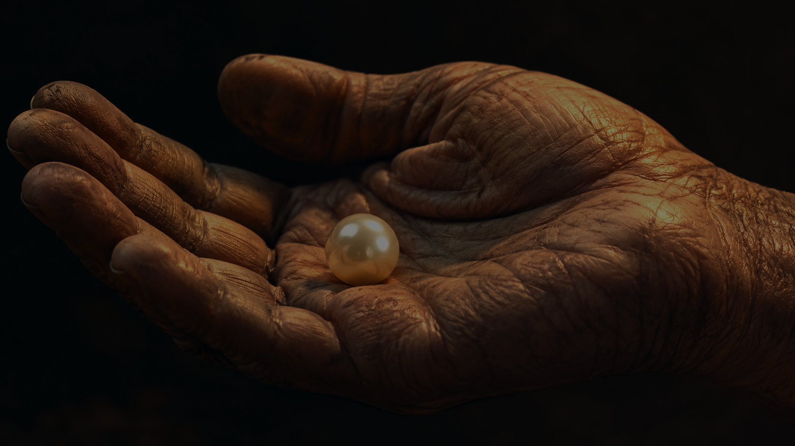
PARABLE 6
The Pearl of Great Value
He seeks, values, and pays the price.
Matthew 13:45–46
The pearl is purchased by the self-giving of Christ.

Slide 13
You are treasured by God.
Treasured enough for Christ to come.
Treasured enough for Christ to redeem.
Treasured enough to be made His own.

Slide 14
GOSPEL CLARITY
Treasured Does Not Mean Unchanged
Not excused in sin.
Not left in shame.
Redeemed, cleansed, and made holy.
He buys the treasure, but He does not leave it in the dirt.

Slide 15
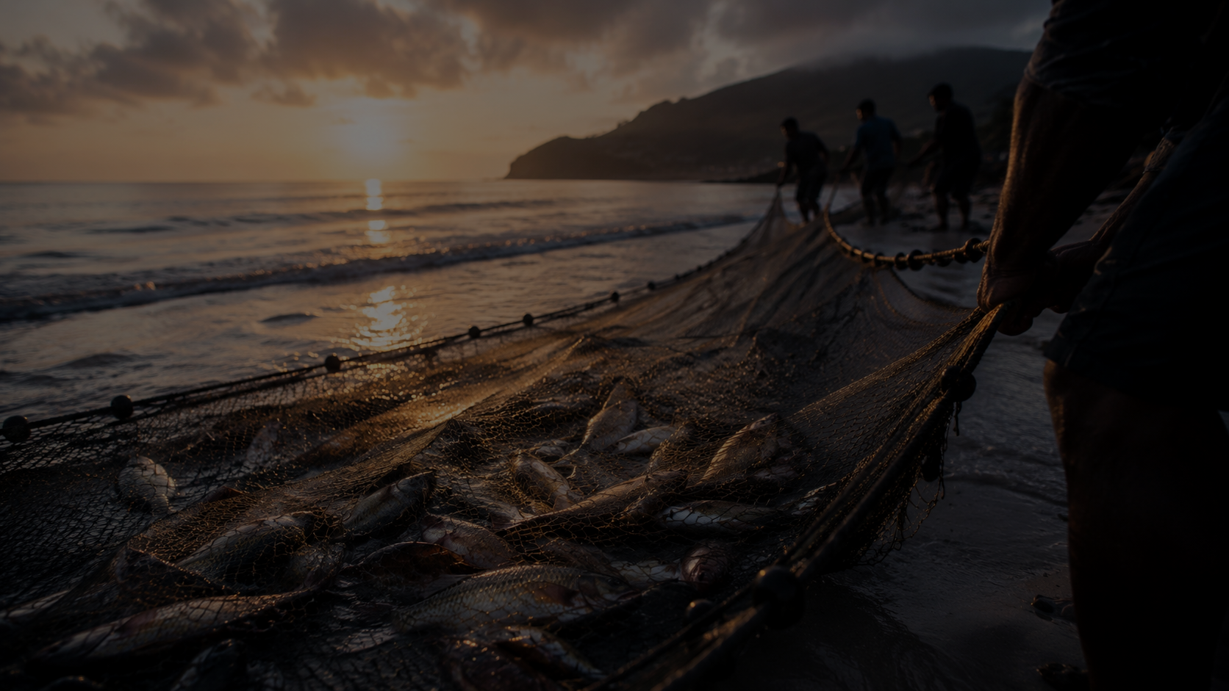
PARABLE 7
The Dragnet
The Lord gathers widely, and He will reveal truly.
Matthew 13:47–50
Grace is wide, but it is not careless.

Slide 16
PARABLE 8
Treasures New and Old
Treasured people become stewards of treasure.
Matthew 13:51–52
Those who receive the treasure learn to carry it.

Slide 17
THE WHOLE MOVEMENT
What the Lord Does
Sows His word.
Preserves His people.
Grows what begins small.
Transforms from within.
Treasures, gathers, and trains.
The kingdom is the Lord’s work in His people.

Slide 18
HOLY RESPONSE
Come to Him
Let the Sower open the soil.
Let the leaven of grace work deep.
Let Christ lift the treasure from the dirt.
Let the Lord train your life for witness.

Slide 19
Christ sees treasure where sin has buried us,
and He gives all to make us His own.
You are treasured by God.

Slide 20
BIG GOSPEL CENTER
You are treasured by God.
Not flattery. Gospel.

