Slide 1
Rejoice in the Lord Always
Philippians 4:4–7
Indiana Yearly Meeting Reflection

Slide 2
Introduction
Susan Morris from Hardin Creek Friends shared a message on Philippians 4.
Let’s turn to God’s Word together.

Slide 3
Main Point
Joy is not a whisper—it’s a bell pealing over a weary land.
Not a mood. Not escapism. Joy is rooted in God’s unchanging presence.

Slide 4
Pause for Reflection
“Rejoice? Now? In this illness? This economy? This grief?”
Paul wrote from prison—not comfort.
Rejoicing is not based on circumstance.

Slide 5
Illustration: A Pastor’s Sin
Sometimes we hesitate.
We miss simple chances to give thanks aloud.
Prayer before a meal isn’t ritual—it’s grace shared.

Slide 6
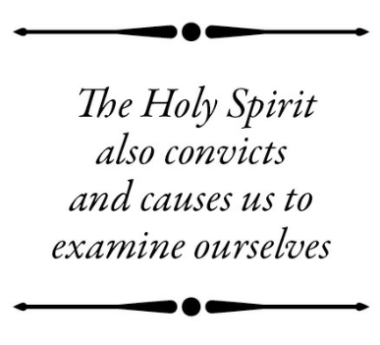
The Spirit Within
Romans 8:16 — “The Spirit testifies with our spirit that we are God’s children.”
God’s peace can break through our busy routines when we pause to listen.

Slide 7
Every Moment is a Time to Rejoice
Prayer. Presence. Fellowship.
Even missed moments can become lessons in grace.

Slide 8
Takeaway: Continuing to Rejoice
Joy is resistance.
A holy defiance of despair.
A surrendered life to Christ’s presence.

Slide 9
Let Joy Be Shared
Let someone else’s hallelujah carry you today.
Joy, like light, is contagious when shared.

Slide 10
Call to Action
Don’t wait for perfect circumstances.
Rejoice now—in your home, workplace, and conversations.
Let joy be the flavor of your witness.

Slide 11
Reflection Questions
What keeps you from rejoicing in this season of your life?
Have you ever missed a moment to share God’s love or offer thanks publicly? What did you learn?
How can you practice “joy as resistance” this week?
Who around you needs your hallelujah to carry them right now?

