Slide 1

WHAT WILL
HEAVEN BE LIKE?
An Invitation to Recover the Christian Hope
July 26, 2026
Notes:
[Sources]
- Paul David Bravard, sermon manuscript, “What Will Heaven Be Like?”
[/Sources]

Slide 2

Last fall, Judy asked me a simple question:
“What will
Heaven be like?”
She was not asking abstractly.
Notes:
[Sources]
- sermon manuscript, opening pastoral story about Judy.
[/Sources]

Slide 3
“We will be with Jesus.”
That answer was true.
But I had answered
a question she was not asking.
What has Jesus actually promised?
Notes:
[Sources]
- sermon manuscript, Judy story and pastoral reflection.
[/Sources]

Slide 4
WHY THIS STUDY
We need a hope firm enough to hold us
For those who are grieving.
For those who fear death.
For those asking what comes next.
For the next Judy who asks.
Notes:
[Sources]
- sermon manuscript, congregational purpose of the Heaven study.
[/Sources]

Slide 5

THE CHRISTIAN HOPE
is not escape.
It is resurrection.
Jesus will return. The dead will be raised.
Creation will be renewed. God will dwell with us.
Notes:
[Sources]
- sermon manuscript, central correction concerning Christian hope.
- Scripture: 1 Corinthians 15:20–58; Revelation 21:1–5 (NIV).
[/Sources]

Slide 6
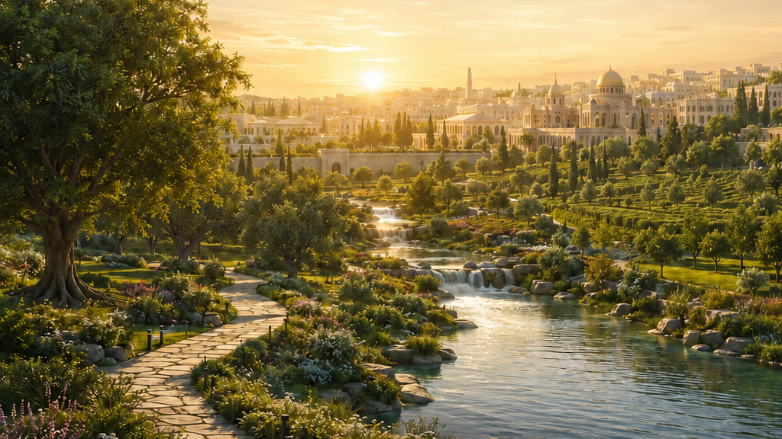
“A resurrected life in a resurrected body,
with the resurrected Christ
on a resurrected Earth.”
Randy Alcorn, Heaven
Notes:
[Sources]
- Randy Alcorn, Heaven (Carol Stream, IL: Tyndale House, 2004).
[/Sources]

Slide 7
THE STORY OF REDEMPTION
The whole biblical story moves toward renewal
CREATED
good
CHRIST
enters
CHRIST
rises
ALL THINGS
made new
Sin corrupts God’s good creation—but God does not surrender it.
Notes:
[Sources]
- sermon manuscript, biblical arc from creation to New Creation.
- Scripture: Genesis 1:26–31; 1 Corinthians 15:20–28; Revelation 21:1–5 (NIV).
[/Sources]

Slide 8
Two moments in one Christian hope
PRESENT HEAVEN
FINAL HEAVEN
With Christ
after death
Raised with Christ
in renewed creation
“At home with the Lord”
(2 Corinthians 5:8 NIV).
The completion of the story
(1 Corinthians 15; Revelation 21).
Notes:
[Sources]
- sermon manuscript, distinction between the present Heaven and final resurrection hope.
- Scripture: 2 Corinthians 5:6–8; Philippians 1:21–23; 1 Corinthians 15:20–58; Revelation 21:1–5 (NIV).
[/Sources]

Slide 9
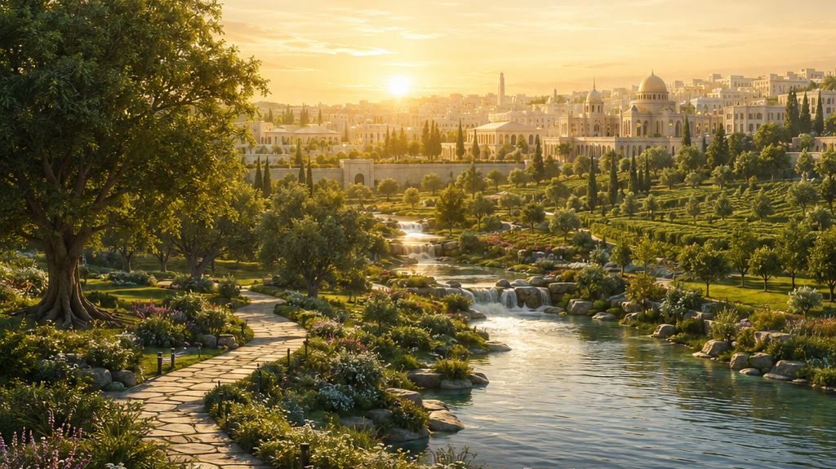
THE FINAL CHRISTIAN HOPE
God does not abandon
our bodies or his world.
Christ raises his people and renews creation.
“Christ has indeed been raised from the dead” (1 Corinthians 15:20 NIV).
Notes:
[Sources]
- Scripture: 1 Corinthians 15:20–23, 35–58 (NIV).
- sermon manuscript.
[/Sources]

Slide 10
The end of the story is not humanity leaving Earth.
It is God coming to dwell
with his resurrected people.
“God’s dwelling place is now among the people, and he will dwell with them”
(Revelation 21:3 NIV).
Notes:
[Sources]
- Scripture: Revelation 21:1–5 (NIV).
- sermon manuscript.
[/Sources]

Slide 11
RESURRECTION
The risen Jesus shows us the pattern
He could be seen.
He could be touched.
He ate with his friends.
Still Jesus… Yet beyond death and decay.
Notes:
[Sources]
- Scripture: Luke 24:36–43; John 20:24–29 (NIV).
- sermon manuscript.
[/Sources]

Slide 12
Creation’s groaning is not the groaning of a funeral.
It is the groaning of childbirth.
“The creation itself will be liberated from its bondage to decay”
(Romans 8:21 NIV).
Notes:
[Sources]
- Scripture: Romans 8:18–25 (NIV).
- sermon manuscript.
[/Sources]

Slide 13
THE SCOPE OF REDEMPTION
In Christ, God is reclaiming…
human beings
human bodies
human relationships
the created order
Redemption is larger than rescuing individual souls.
Notes:
[Sources]
- sermon manuscript, scope of redemption.
- Scripture: Romans 8:18–25; Colossians 1:19–20; Revelation 21:1–5 (NIV).
[/Sources]

Slide 14

Resurrected life will be genuinely human life—
cleansed from everything
that corrupts it.
recognize • serve • create • discover
More alive. More beautiful. More relational. More joyful.
Notes:
[Sources]
- sermon manuscript, discussion of embodied life on the New Earth.
- Scripture: Revelation 21:1–22:5; 1 Corinthians 15:35–58 (NIV).
[/Sources]

Slide 15
LIFE IN THE NEW CREATION
Worship will remain central because Christ is central
Worship will not be limited
to singing around the throne.
Work without frustration. Relationships without manipulation.
Creativity without corruption. Enjoyment without guilt.
Notes:
[Sources]
- sermon manuscript, worship and meaningful activity in the New Creation.
- Scripture: Revelation 22:3–5; 1 Corinthians 15:58 (NIV).
[/Sources]

Slide 16
HOW WE WILL READ ALCORN
We will study with imagination—and discernment
1
2
3
Scripture
clearly teaches
Alcorn reasonably
concludes
Alcorn imaginatively
suggests
Our imaginations remain servants of Scripture.
Notes:
[Sources]
- sermon manuscript, three-category discernment framework for the study.
- Randy Alcorn, Heaven (Carol Stream, IL: Tyndale House, 2004).
[/Sources]

Slide 17
AS FRIENDS, WE BELIEVE
Christ has come
to teach his people himself.
Through the Holy Spirit, the life of the coming kingdom has already begun among us.
“If anyone is in Christ, the new creation has come” (2 Corinthians 5:17 NIV).
Notes:
[Sources]
- sermon manuscript, Friends emphasis on the present work of the living Christ.
- Scripture: 2 Corinthians 5:17 (NIV).
[/Sources]

Slide 18
THE KINGDOM’S FIRSTFRUITS
We become signs of the world Christ has promised
reconciliation where there was hostility
mercy where there was cruelty
truth where there was deception
holiness where there was bondage
Notes:
[Sources]
- sermon manuscript, present signs of the coming kingdom.
- Scripture: 2 Corinthians 5:17–20; Galatians 5:22–25 (NIV).
[/Sources]

Slide 19
COME.
If you are grieving someone you love.
If you have ever felt anxious about death.
If someone you love will someday ask.
If you want to understand the hope of resurrection.
Notes:
[Sources]
- sermon manuscript, congregational invitation.
[/Sources]

Slide 20
WE CAN ANSWER HUMBLY
When the next Judy asks us…
We will be with Jesus.
We will be raised.
We will remain ourselves—without sin and death.
Notes:
[Sources]
- sermon manuscript, concluding pastoral answer.
- Scripture: Philippians 1:21–23; 1 Corinthians 15:35–58; 1 John 3:2 (NIV).
[/Sources]

Slide 21
JESUS CHRIST IS RISEN.
Resurrection has begun.
The love that holds us now will raise us,
restore creation, and bring God’s good work to completion.
HEAVEN — A CONGREGATIONAL STUDY
Wednesdays
August 19–November 18, 2026
Notes:
[Sources]
- sermon manuscript, final proclamation and study invitation.
- Scripture: 1 Corinthians 15:20–23, 54–58; Revelation 21:1–5 (NIV).
- Study schedule supplied in project context: Wednesdays, August 19–November 18, 2026.
[/Sources]

