Slide 1
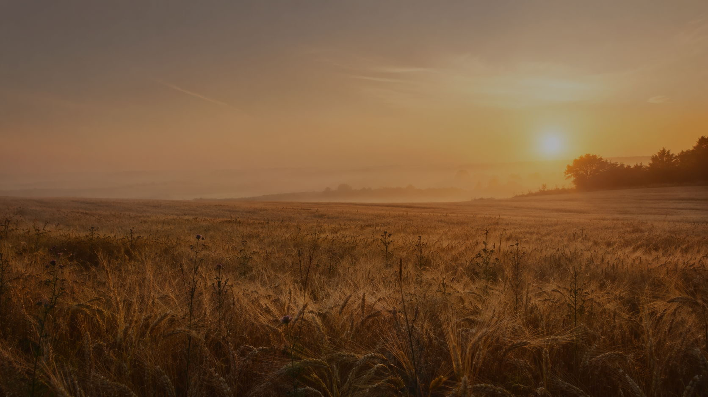
The God Who
Remains in the Field
Holy Presence, Patient Redemption, and the Groaning Hope of Creation
Romans 8 • Matthew 13 • Genesis 28 • Psalm 139

Slide 2
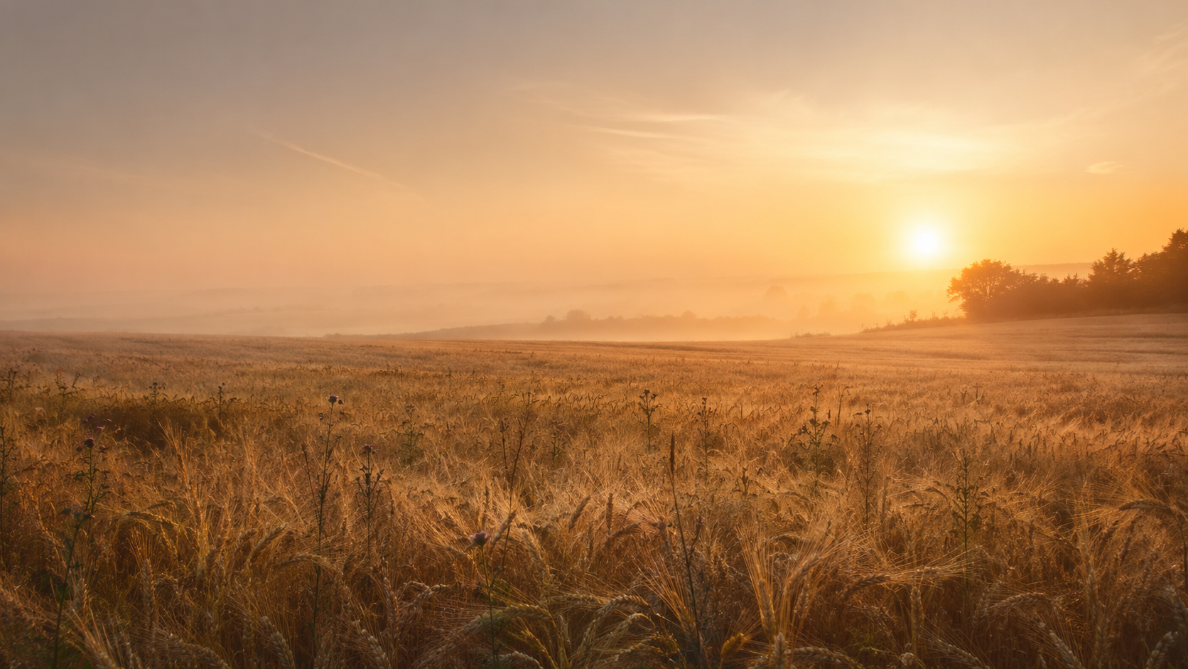

Slide 3
But the master replies,
“Let both grow together until the harvest”
(Matthew 13:30).

Slide 4
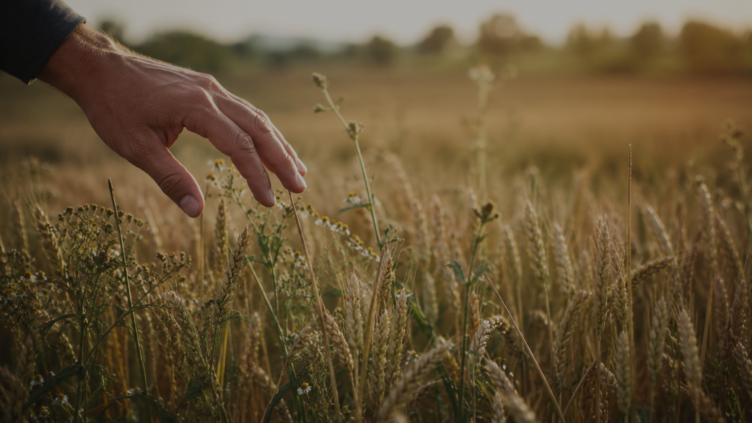
God does not abandon
the mixed field.
God remains present within it, forms a holy people there, and carries creation toward the harvest he has promised.
The God Who Remains in the Field

Slide 5
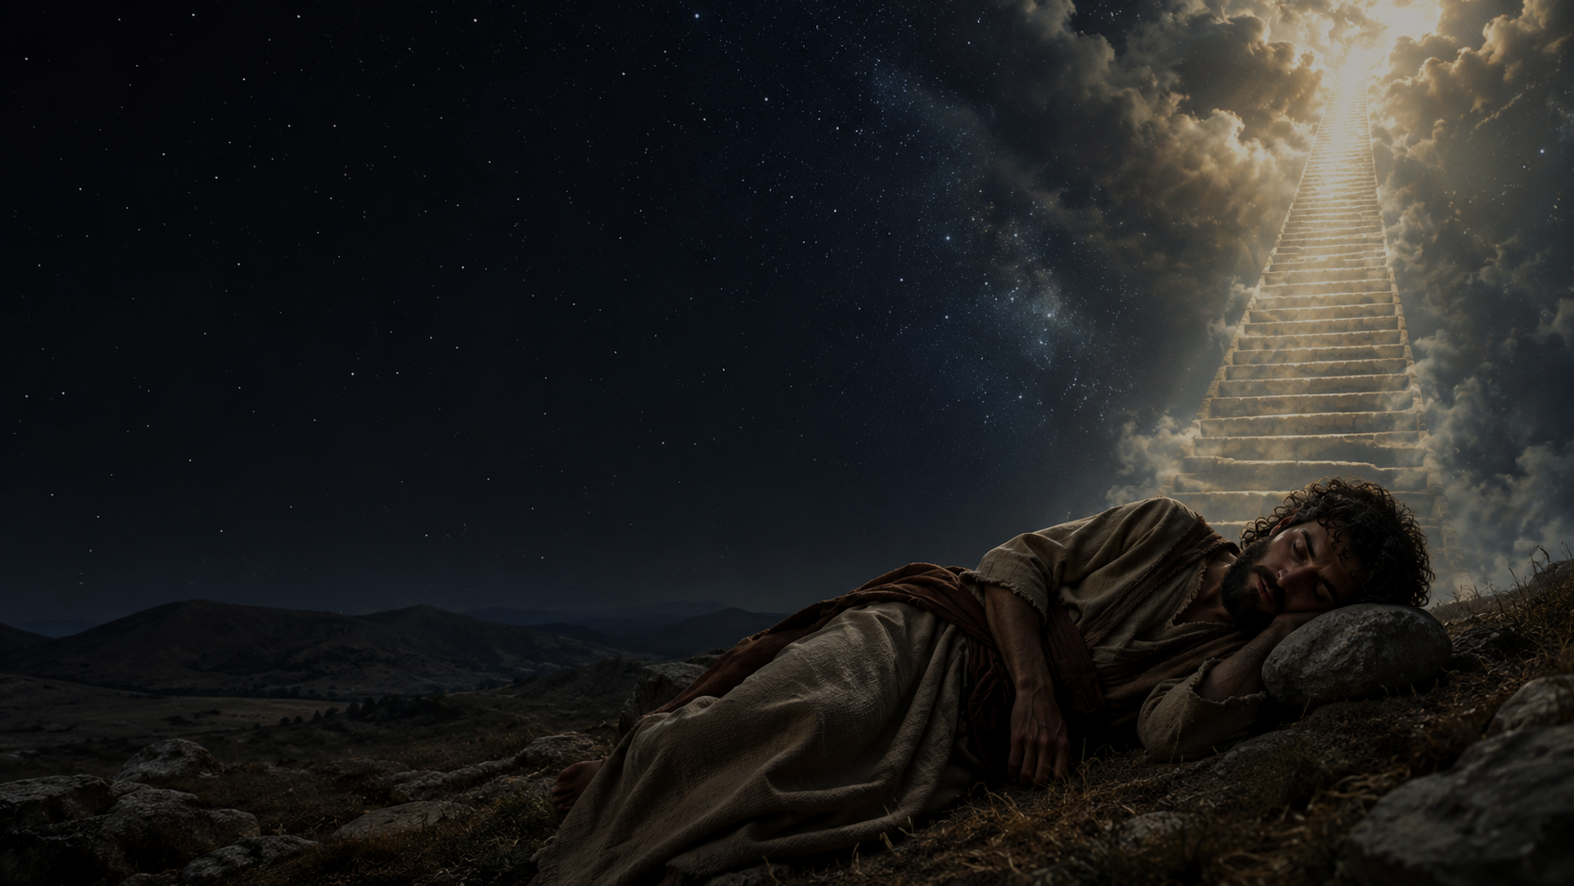
GOD MEETS US IN THE TROUBLED PLACE
Jacob is not a victorious pilgrim.
He is fleeing.
“I am with you and will watch over you wherever you go” (Genesis 28:15, NIV).
Grace does not rename dysfunction as holiness. God comes near to transform.

Slide 6

II. THE PRESENCE THAT SEARCHES AND LEADS
The God who comes near also knows us completely.
“Search me, God, and know my heart; test me and know my anxious thoughts” (Psalm 139:23, NIV).
Holiness begins where we stop hiding.

Slide 7
III. THE STRENGTH OF GOD AND THE PATIENCE OF MERCY
“I am the first and I am the last; apart from me there is no God” (Isaiah 44:6, NIV).
God is patient because God is sovereign, not because evil is harmless.
The Lord of the field has sufficient strength to wait.

Slide 8
IV. WHEAT, WEEDS, AND PREMATURE JUDGMENT
The field belongs to the Son of Man.
“Let both grow together until the harvest” (Matthew 13:30, NIV).
The master refuses to place final judgment into the hands of anxious servants.
The God Who Remains in the Field

Slide 9
HOLY STEADINESS
Anxious systems do not need us to repeat their fear.
They need a people who remain:
clear • connected • responsible • nonreactive
Holiness is Spirit-formed faithfulness where the harvest has not yet arrived.
The God Who Remains in the Field

Slide 10

V. THE SPIRIT FORMS CHILDREN OF THE KINGDOM
Such steadiness is not produced by willpower alone.
“For those who are led by the Spirit of God are the children of God” (Romans 8:14, NIV).
Holiness grows from belonging.
The God Who Remains in the Field

Slide 11
GROANING HOPE
“The creation waits in eager expectation for the children of God to be revealed” (Romans 8:19, NIV).
Creation’s groaning is childbirth, not a death rattle.
God will do for creation what God did for Jesus on Easter morning.
The God Who Remains in the Field

Slide 12
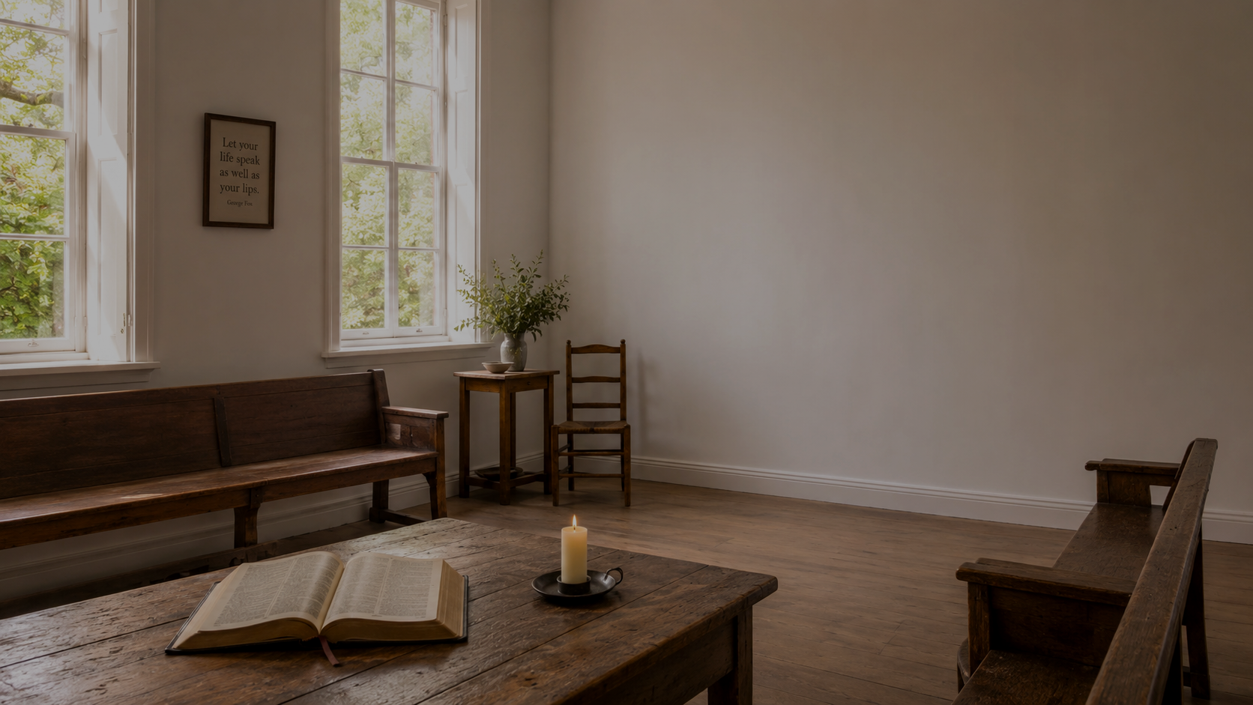
TAKEAWAYS
Learning to Live in the Field
Receive the searching Light.
Resist evil without being shaped by it.
Grow as children of the kingdom.
Wait in hope for the harvest of Christ.
The God Who Remains in the Field

Slide 13
OPEN WORSHIP
Search me.
Steady me.
Make me holy.
Teach me how to remain faithful in the field where you have placed me.
God has not abandoned the field.
God has not abandoned you.
Open Worship

Slide 14
READING SCRIPTURE AS ONE STORY
Promise
Presence
Spirit
Harvest
Genesis 28
Psalm 139
Romans 8
Matthew 13
One redemptive story: God comes near, searches and sanctifies, and brings creation toward resurrection life.
The God Who Remains in the Field

Slide 15
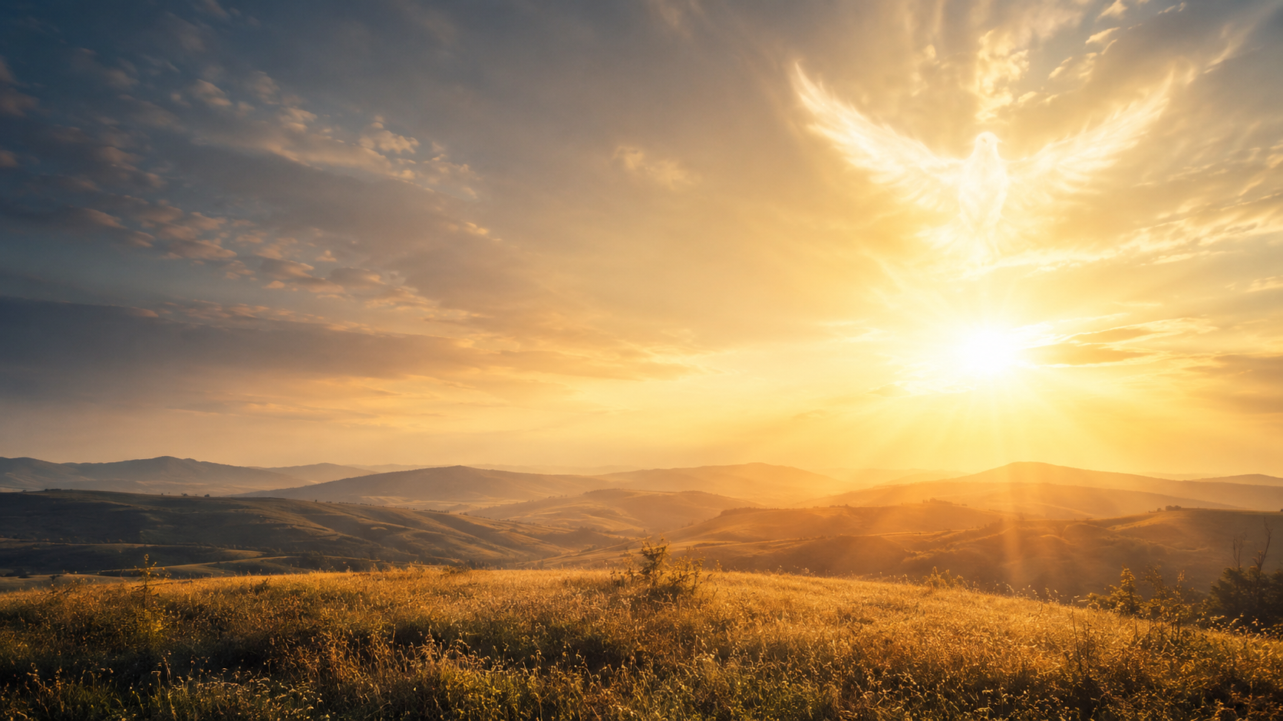

Slide 16


Slide 17
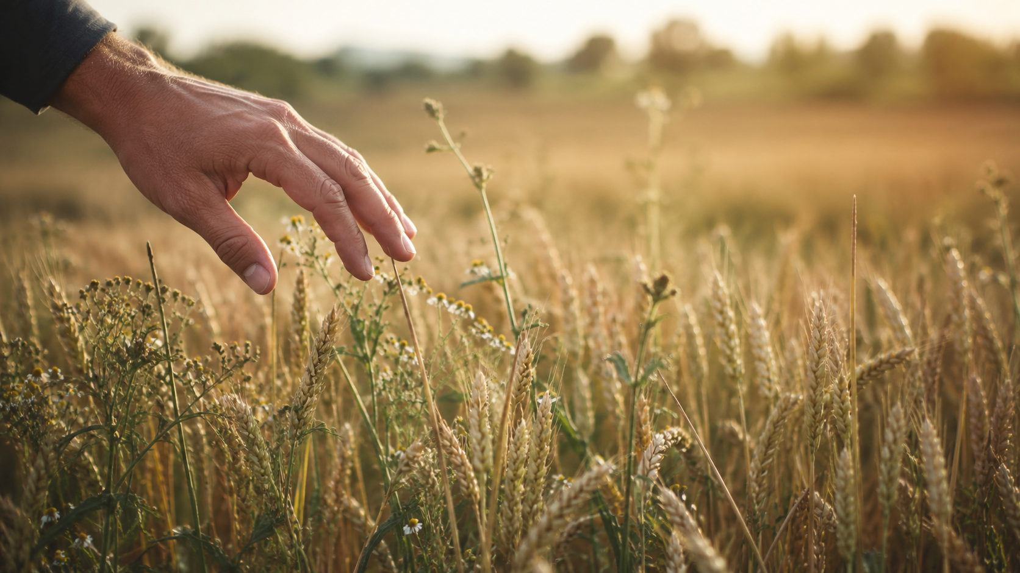

Slide 18
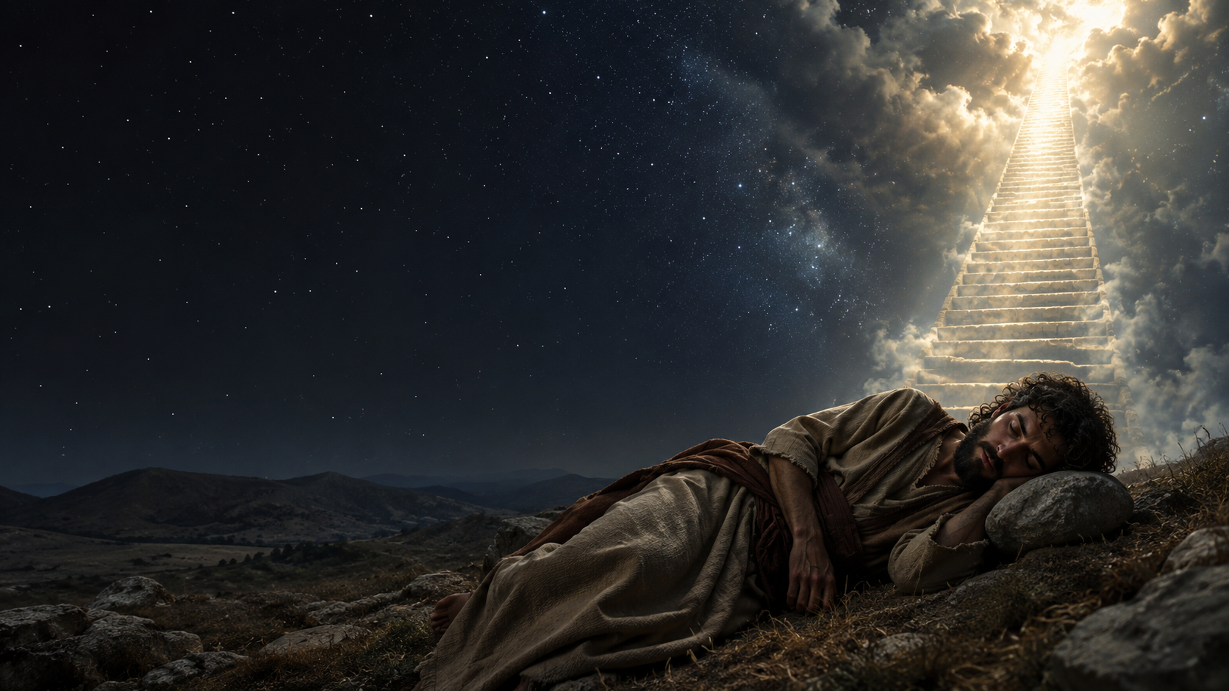

Slide 19
