Slide 1

SUNDAY MORNING WORSHIP
The Good Life
Through Christ
When the Spirit Makes the Heart Good Soil
Genesis 25 • Psalm 119
Romans 8 • Matthew 13
July 12, 2026
The Good Life Through Christ

Slide 2
OPENING QUESTION
Everybody wants
the good life.
But Scripture asks:
Do we know what actually leads to life?
The Good Life Through Christ

Slide 3
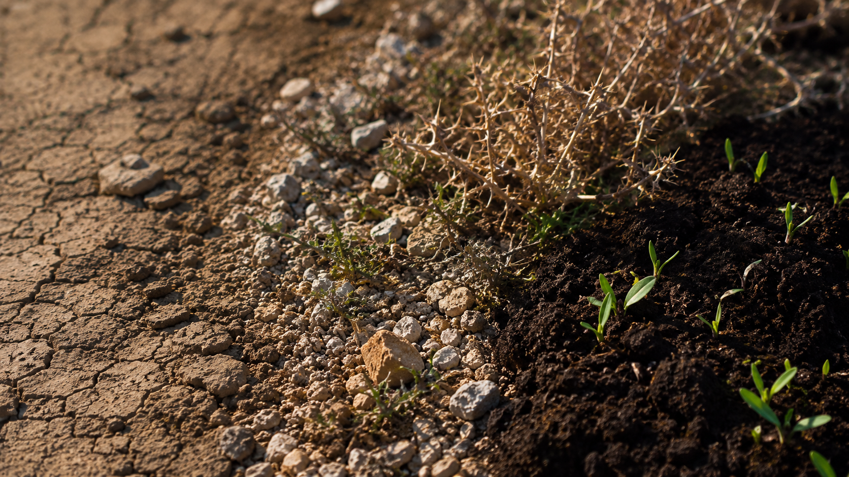
PULSE
The Good Life is not
produced by the flesh;
it is grown
by the Spirit.
Planted by the Word.
Grown by the Spirit.
The Good Life Through Christ

Slide 4
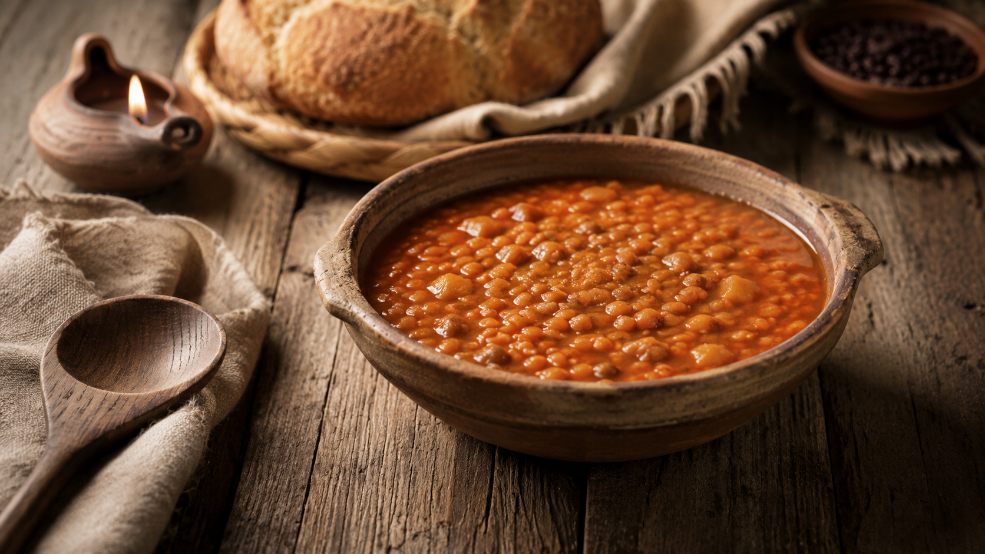
GENESIS 25
A bowl of stew.
A birthright.
A decision.
“So Esau despised
his birthright.”
Genesis 25:34 NIV
The Good Life Through Christ

Slide 5
DISORDERED DESIRE
When hunger
becomes lord,
a bowl can look
bigger than a birthright.
Holiness is desire
healed, reordered,
and led toward life.
The Good Life Through Christ

Slide 6
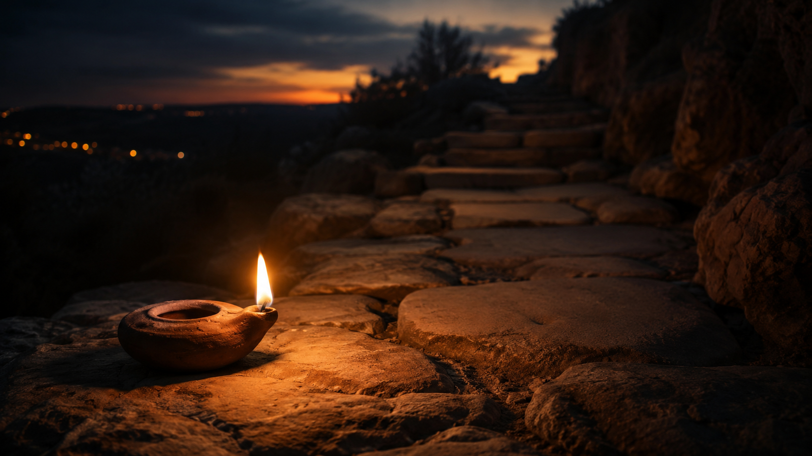
PSALM 119
“Your word is a lamp
for my feet,
a light on my path.”
Psalm 119:105 NIV
Not a floodlight.
Enough light for the next faithful step.
The Good Life Through Christ

Slide 7
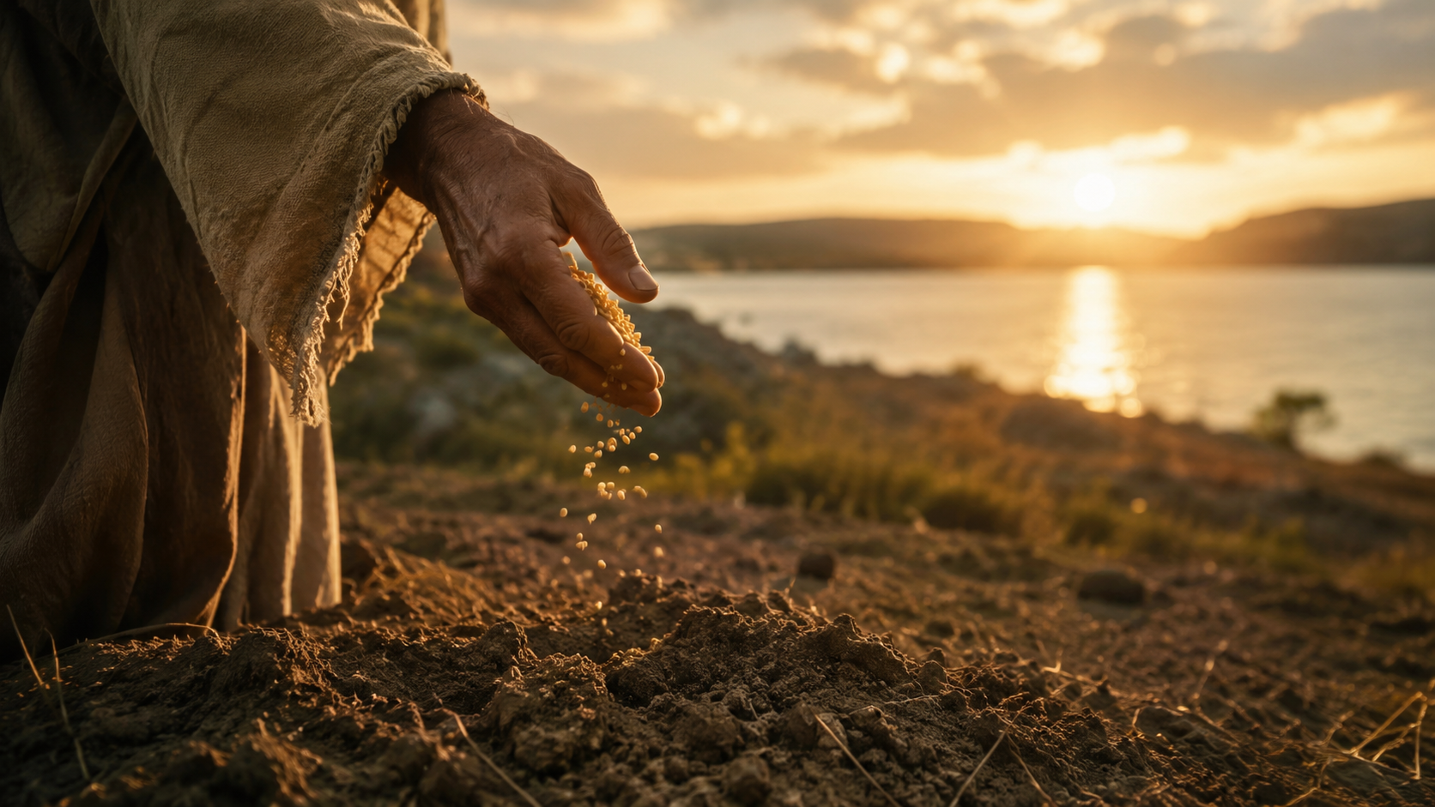
MATTHEW 13
The kingdom
comes like seed.
Small. Scattered. Hidden.
Vulnerable. Full of life.
“A farmer went out
to sow his seed.”
Matthew 13:3 NIV
The Good Life Through Christ

Slide 8
QUESTION OF THE HEART
What kind of soil
is my heart
becoming?
The seed is good.
The issue is the soil.
Hard path • Shallow ground
Crowded thorns • Good soil
The Good Life Through Christ

Slide 9
ROMANS 8
“Therefore, there is now
no condemnation for those
who are in Christ Jesus.”
Romans 8:1 NIV
The Gospel is not,
“Be better dirt.”
The Good Life Through Christ

Slide 10
LIFE AND PEACE
“The mind governed
by the Spirit
is life and peace.”
Romans 8:6 NIV
The flesh cannot produce holiness.
Only the Spirit gives life.
The Good Life Through Christ

Slide 11
BRINGING IT TOGETHER
What does God
want from us?
Live the good life.
Share the good life.
Give thanks.
Desire reordered. Fruit made visible. Life received as gift.
The Good Life Through Christ

Slide 12
INVITATION
Bring your heart
to Christ.
Hard places.
Shallow places.
Crowded places.
Tired places.
The One who sows the seed
also gives the Spirit.
The Good Life Through Christ

Slide 13
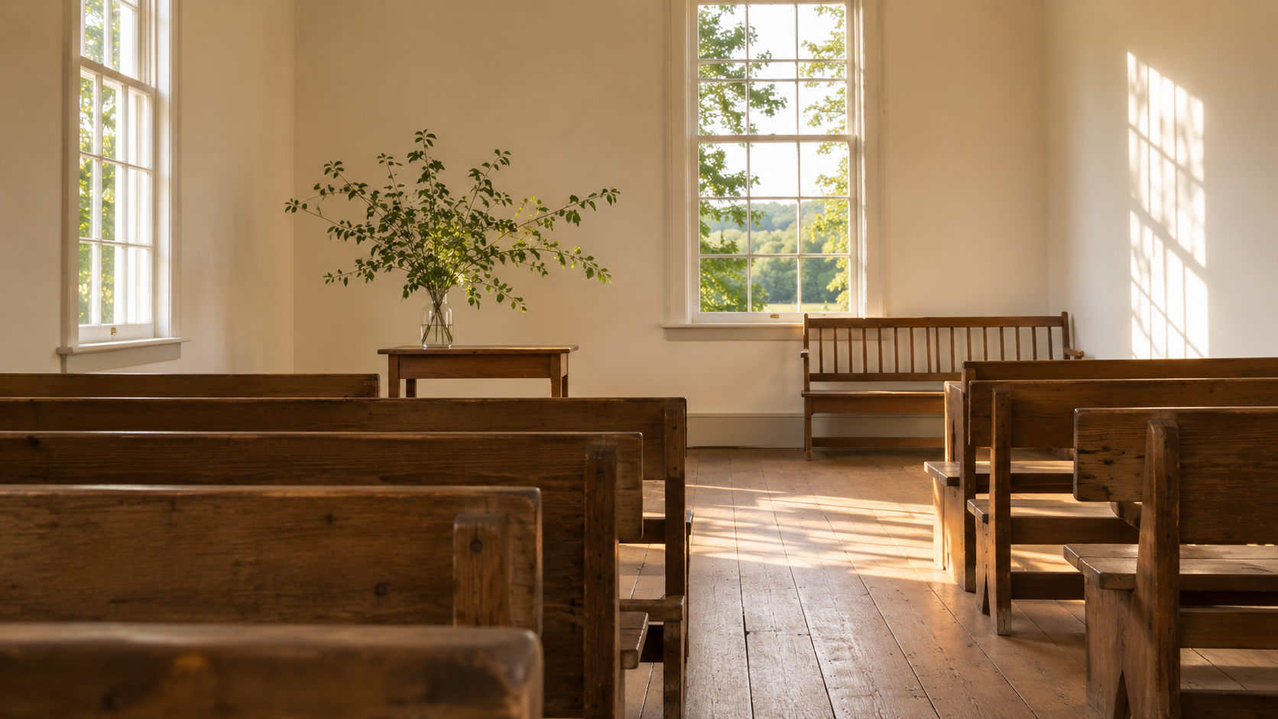
CONCLUSION
The Good Life
is not grabbed
by the flesh;
it is grown
by the Spirit.
What the Spirit grows in us,
God can share through us.
The Good Life Through Christ

Slide 14
OPEN WORSHIP
Queries for
Worship
Lord Jesus, where have I been trading
the good life for something less?
Lord Jesus, make my heart good soil
for the life you want to grow in me.
The Good Life Through Christ

Slide 15
FINAL WORD
Until our lives
become
thanksgiving.
Live the good life.
Share the good life.
Give thanks.
The Good Life Through Christ

Slide 21
