Slide 1
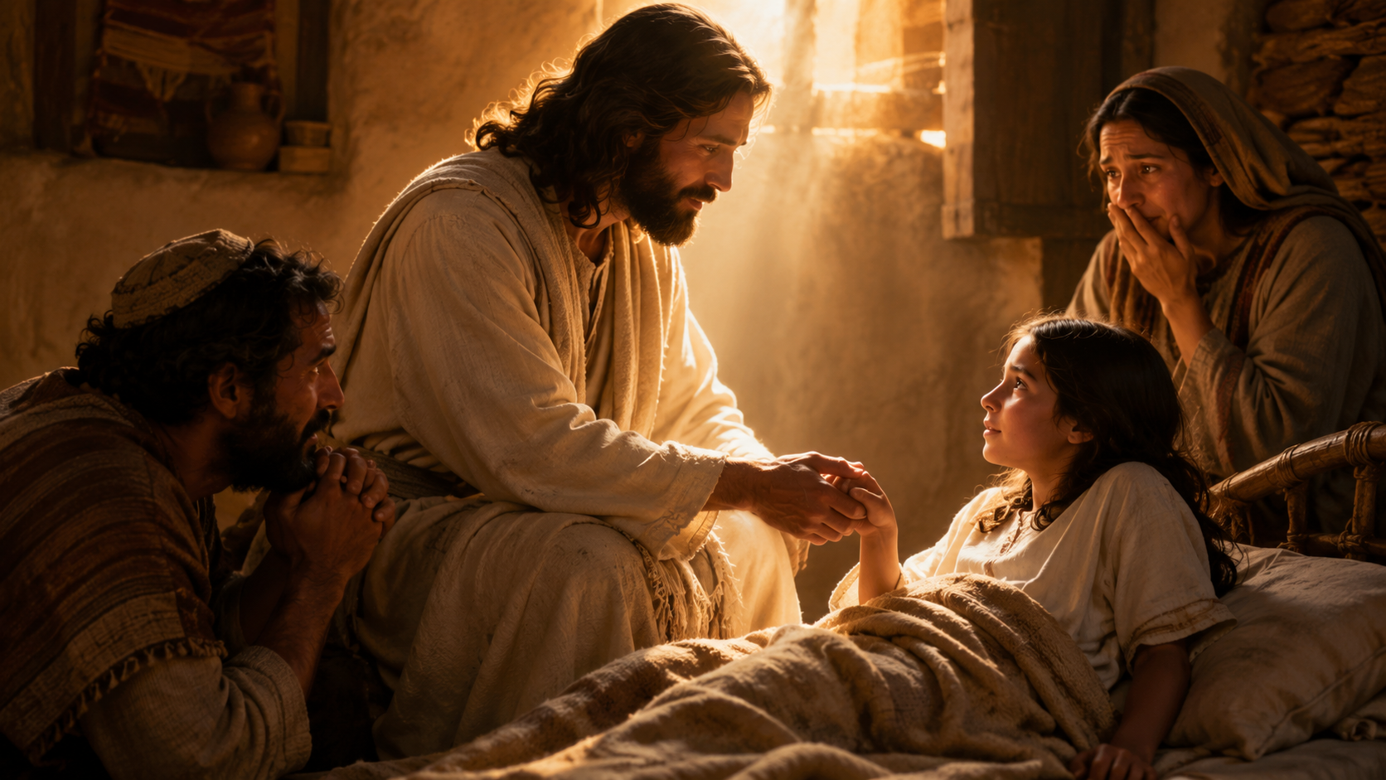
When Mercy Calls
the Dead to Life
Faith follows the promise.
Mercy reveals the heart.
Notes:
Opening title slide.

Slide 2
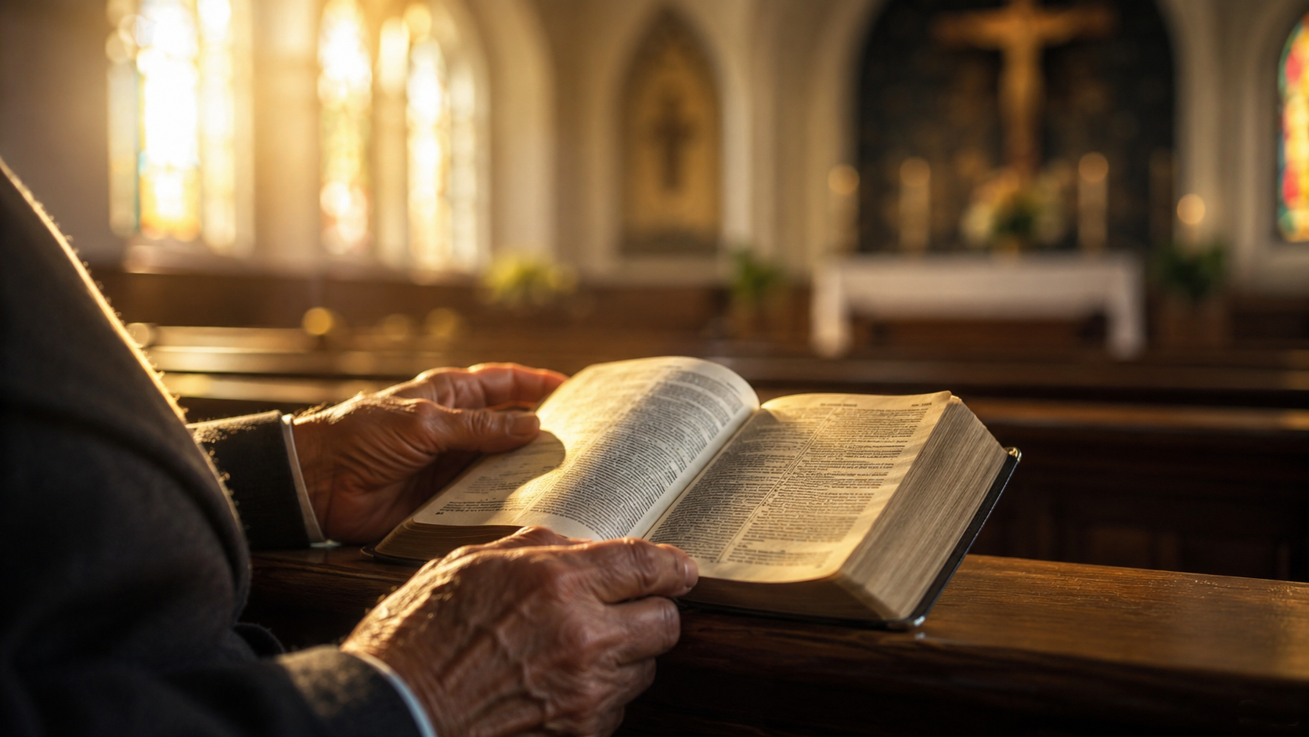
.
Please open your Bibles
to Matthew 9:9-13, 18-26
Notes:
Invite congregation to open Bibles. Read Matthew 9:9-13, 18-26.

Slide 3
These are the words of God
for the people of God.
Response: Praise be to God.
Notes:
Congregational response: Praise be to God.

Slide 4
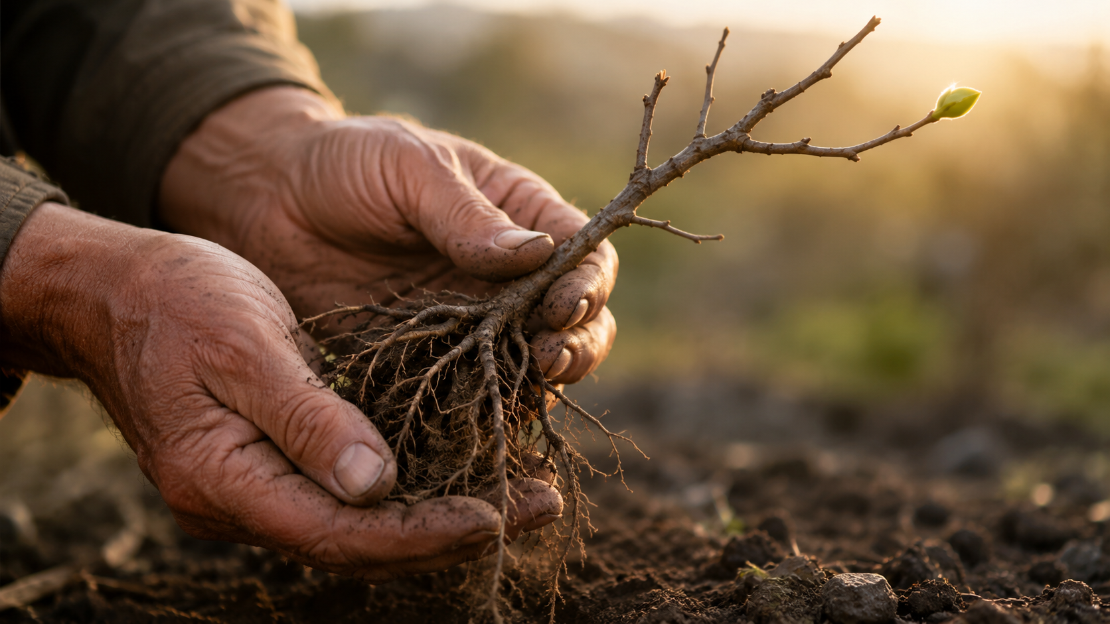
Some things look dead before they look alive.
Notes:
Begin bare-root tree illustration.

Slide 5
The promise is not
in the appearance.
The promise is in the life hidden within it.
Notes:
Continue bare-root tree illustration.

Slide 6
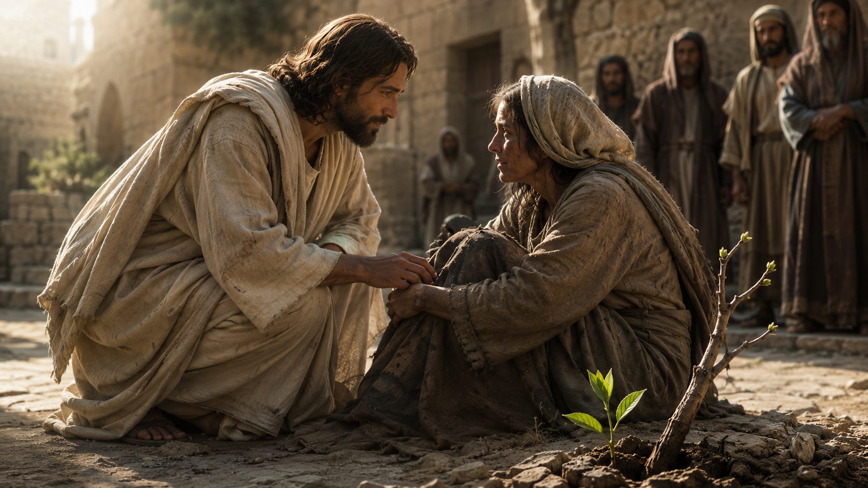
Mercy sees what promise can raise.
Notes:
Transition from illustration to Scriptures.

Slide 7
Faith follows the promise.
Mercy reveals the heart.
Notes:
State the sermon in one sentence.

Slide 8
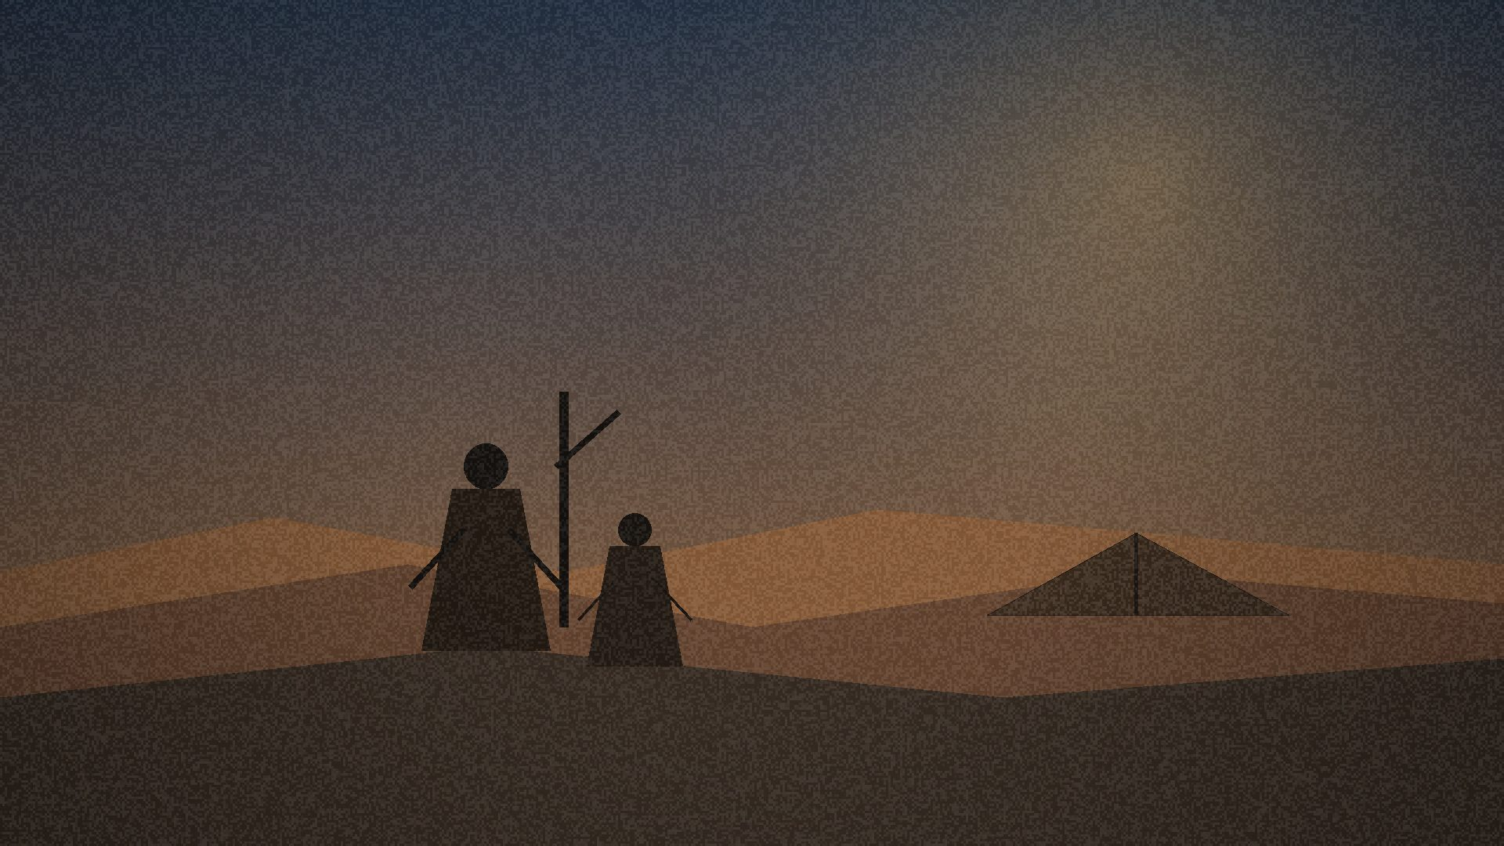
Abram hears:
“Go.”
Notes:
Move to Genesis 12.

Slide 9
“Go from your country, your people and your father’s household to the land I will show you”
(Genesis 12:1, NIV).
Notes:
Read Genesis 12:1.

Slide 10
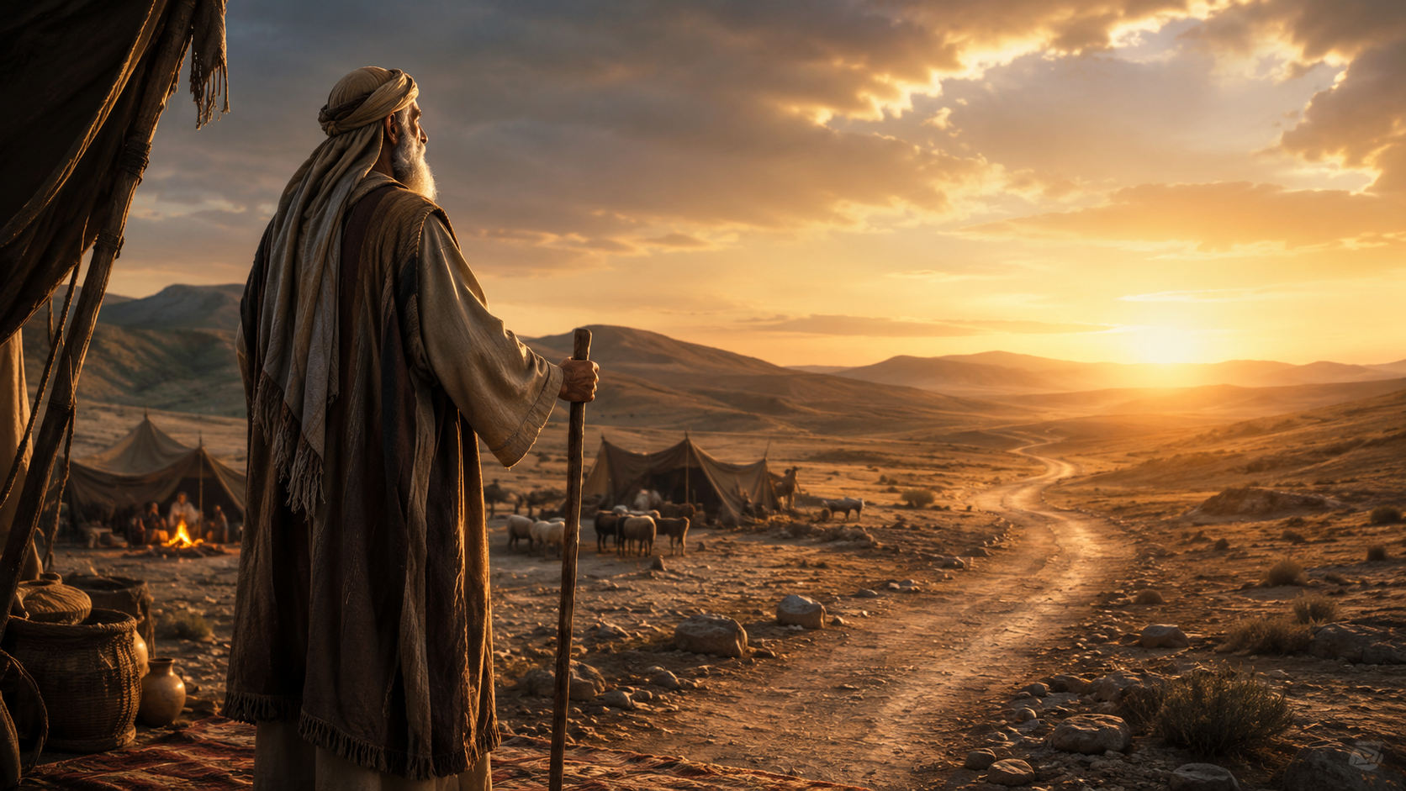
Faith begins when God’s promise
becomes more trustworthy
than visible security.
Notes:
Faith begins not with full certainty, but trust in God.

Slide 11
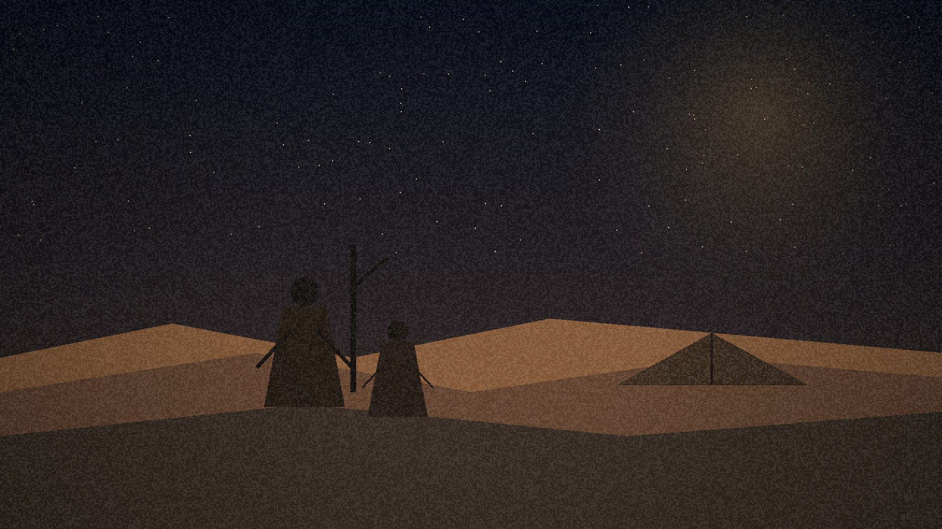
Abram has no map.
He has a promise.
Notes:
Abram and Sarai have no child, no land, no visible evidence.

Slide 12
“For the word of the Lord is right and true; he is faithful in all he does”
(Psalm 33:4, NIV).
Notes:
Psalm 33 foundation.

Slide 13
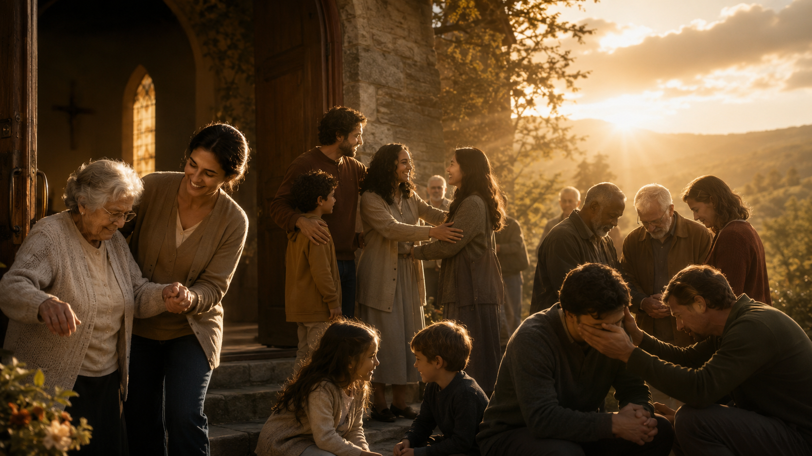
Holiness is God forming a people
through whom his faithful love
becomes visible.
Notes:
Holiness is not a religious trophy, but visible faithful love.

Slide 14
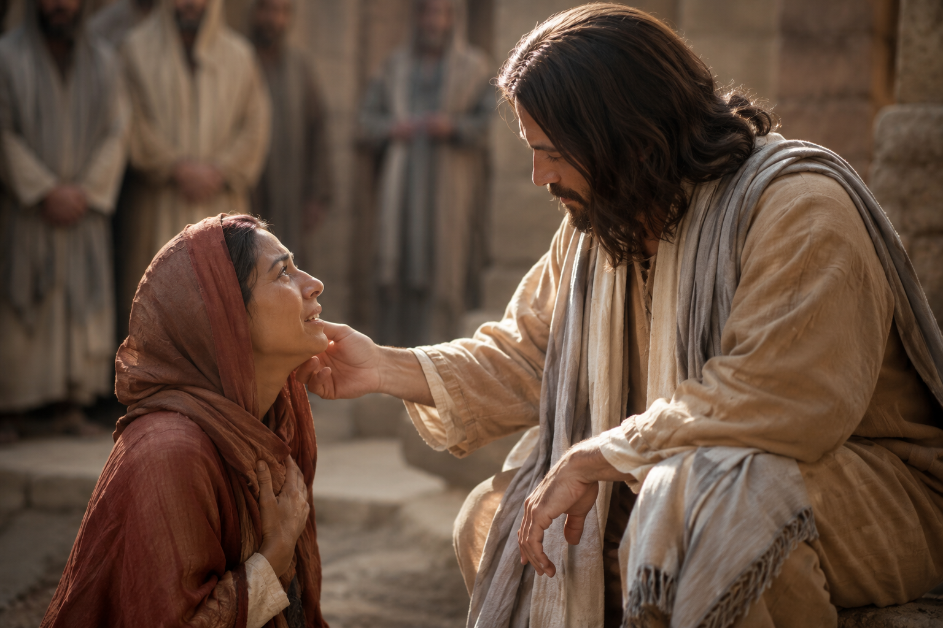
Mercy reveals
the heart.
Notes:
Move to Hosea 6.

Slide 15
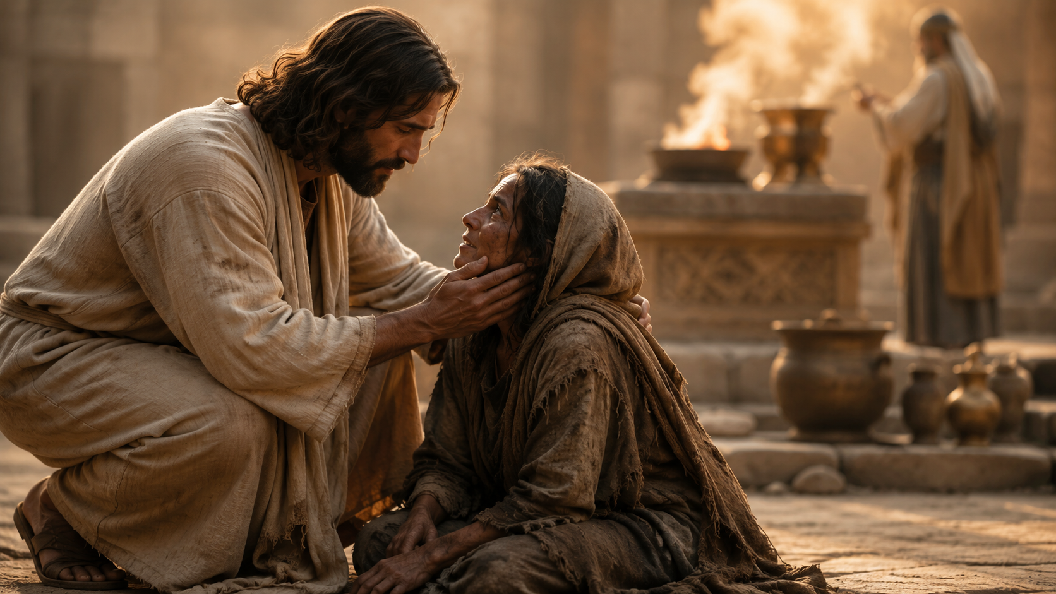
“For I desire mercy, not sacrifice, and acknowledgment of God rather than burnt offerings”
(Hosea 6:6, NIV).
Notes:
Hosea 6:6.

Slide 16
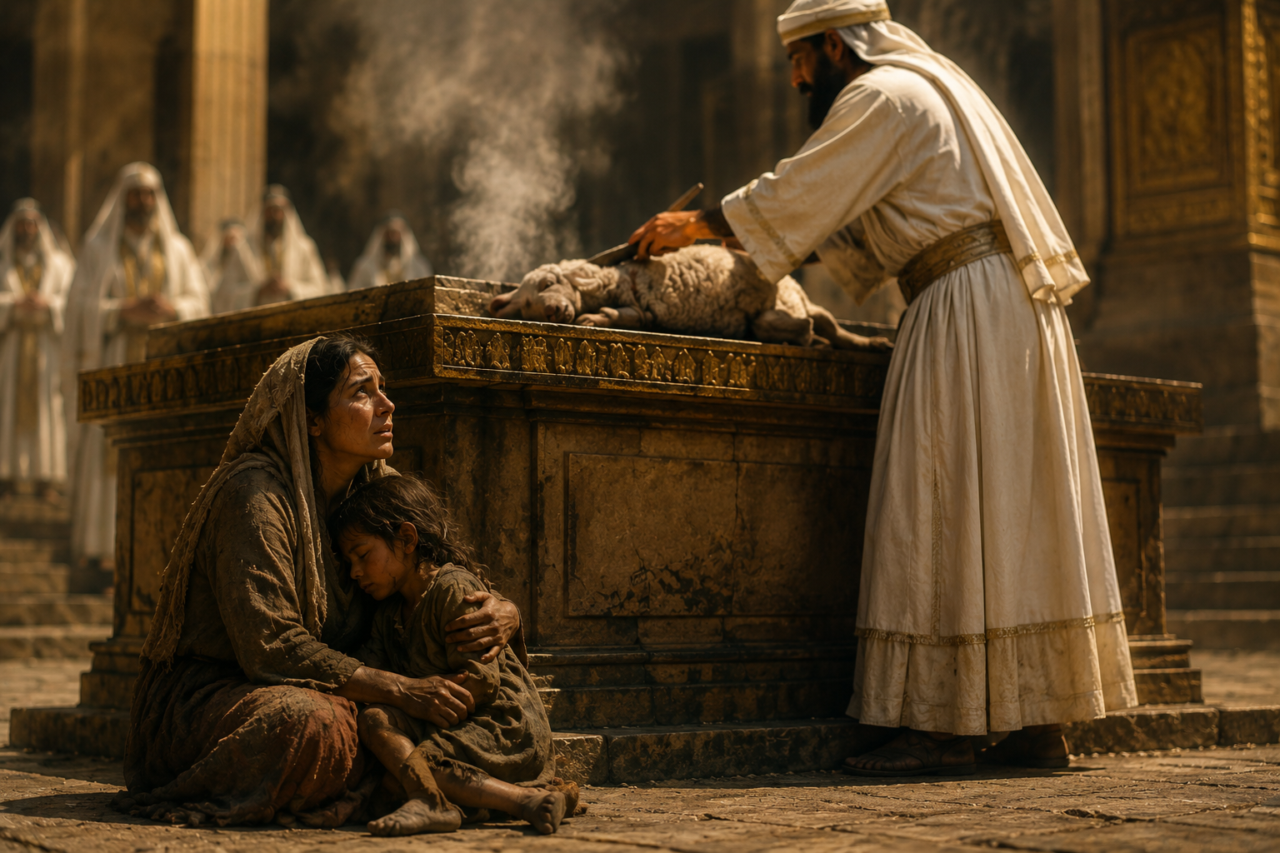
Sacrifice without mercy
is hollow.
Notes:
Religious activity without surrendered love is hollow.

Slide 17

God is not managed
by religious performance.
God is met in surrendered faith.
Notes:
Psalm 50: relationship and trust, not empty ritual.

Slide 18
Jesus embodies
mercy.
Notes:
Move to Matthew 9.

Slide 19
Matthew hears:
“Follow me.”
Notes:
Jesus sees Matthew at the tax booth.

Slide 20
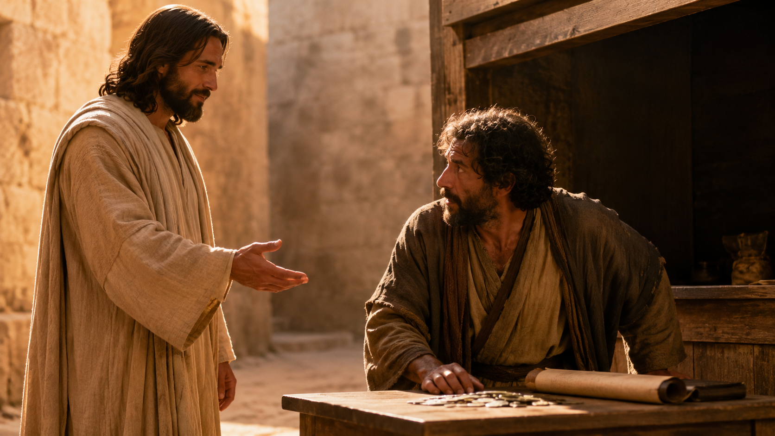
“Follow me”
(Matthew 9:9, NIV).
Notes:
Matthew 9:9.

Slide 21
Jesus sees more
than the booth.
He sees what promise can raise.
Notes:
Matthew is not defined by his tax booth.

Slide 22
The table
is the scandal.
The Pharisees see contamination.
Jesus sees mercy.
Notes:
Dinner with tax collectors and sinners.

Slide 23
“It is not the healthy who need a doctor, but the sick”
(Matthew 9:12, NIV).
Notes:
Matthew 9:12.

Slide 24
“For I have not come to call the righteous, but sinners”
(Matthew 9:13, NIV).
Notes:
Matthew 9:13.

Slide 25
Holiness is not so fragile
that mercy threatens it.
In Jesus, holiness is so whole
that mercy flows from it.
Notes:
Key holiness line.

Slide 26
Faith moves
toward mercy.
Notes:
A synagogue leader kneels before Jesus.

Slide 27
“My daughter has just died. But come and put your hand on her, and she will live”
(Matthew 9:18, NIV).
Notes:
Matthew 9:18.

Slide 28
Sometimes faith sounds like
grief with enough hope
left to kneel.
Notes:
He does not deny death; he brings death to Jesus.

Slide 29
“If I only touch his cloak, I will be healed”
(Matthew 9:21, NIV).
Notes:
The woman reaches for Jesus.

Slide 30
Sometimes suffering has lasted
so long that the only prayer left
is a trembling reach toward Jesus.
Notes:
Twelve years of suffering.

Slide 31
“Take heart, daughter”
(Matthew 9:22, NIV).
Notes:
Jesus turns and names her daughter.

Slide 32
Abram hears:
“Go.”
Faith leaves home.
Notes:
Abram hears Go. Faith leaves home.

Slide 33
Matthew hears:
“Follow me.”
Faith gets up from the tax booth.
Notes:
Matthew hears Follow me. Faith gets up.

Slide 34
The woman says:
“If I only touch his cloak.”
Faith reaches through shame.
Notes:
The woman reaches. Faith reaches through shame.

Slide 35
The father says:
“Come.”
Faith kneels in grief.
Notes:
The father kneels. Faith kneels in grief.

Slide 36

Wherever faith moves toward Jesus,
mercy is already moving toward us.
Notes:
Landing line from the hinge.

Slide 37

The God who gives
life to the dead
Notes:
Move to Romans 4.

Slide 38
“the God who gives life to the dead and calls into being things that were not”
(Romans 4:17, NIV).
Notes:
Romans 4:17.

Slide 39
Faith is not confidence
in our ability to make things work.
Faith is confidence in the God
who keeps his promise.
Notes:
Faith anchored in God’s character.

Slide 40
God calls.
God comes near.
God shows mercy.
God raises.
Notes:
Gospel convergence in Matthew 9.

Slide 41
What anxious religion
cannot see
Notes:
Move to anxious religion.

Slide 42
Anxious religion asks:
“Who might contaminate us?”
Mercy asks:
“Who is Jesus calling to the table?”
Notes:
Contrast anxiety and mercy.

Slide 43
Jesus does not let the Pharisees
define his mission.
Notes:
Jesus does not let others define his mission.

Slide 44
In Jesus,
mercy is holy.
Holiness is merciful.
Notes:
Mercy and holiness are not enemies in Jesus.

Slide 45

Where are we
in the story?
Notes:
Ask where the congregation finds themselves.

Slide 46
Maybe you are Abram.
Faith is calling you
into an unknown future.
Notes:
Abram application.

Slide 47
Maybe you are Matthew.
Jesus is saying,
“Follow me.”
Notes:
Matthew application.

Slide 48
Maybe you are the woman.
Faith is still reaching.
Mercy sees you.
Notes:
Woman application.

Slide 49
Maybe you are the father.
Faith kneels in grief.
And Jesus goes.
Notes:
Father application.

Slide 50
Or maybe sometimes
we are the Pharisees.
There is still time
to learn the heart of God.
Notes:
Pharisees application.

Slide 51

The Holy Response
Follow the promise
Receive mercy
Practice mercy
Notes:
Threefold response.

Slide 52
Follow the promise.
Take the next faithful step.
Notes:
Follow the promise.

Slide 53
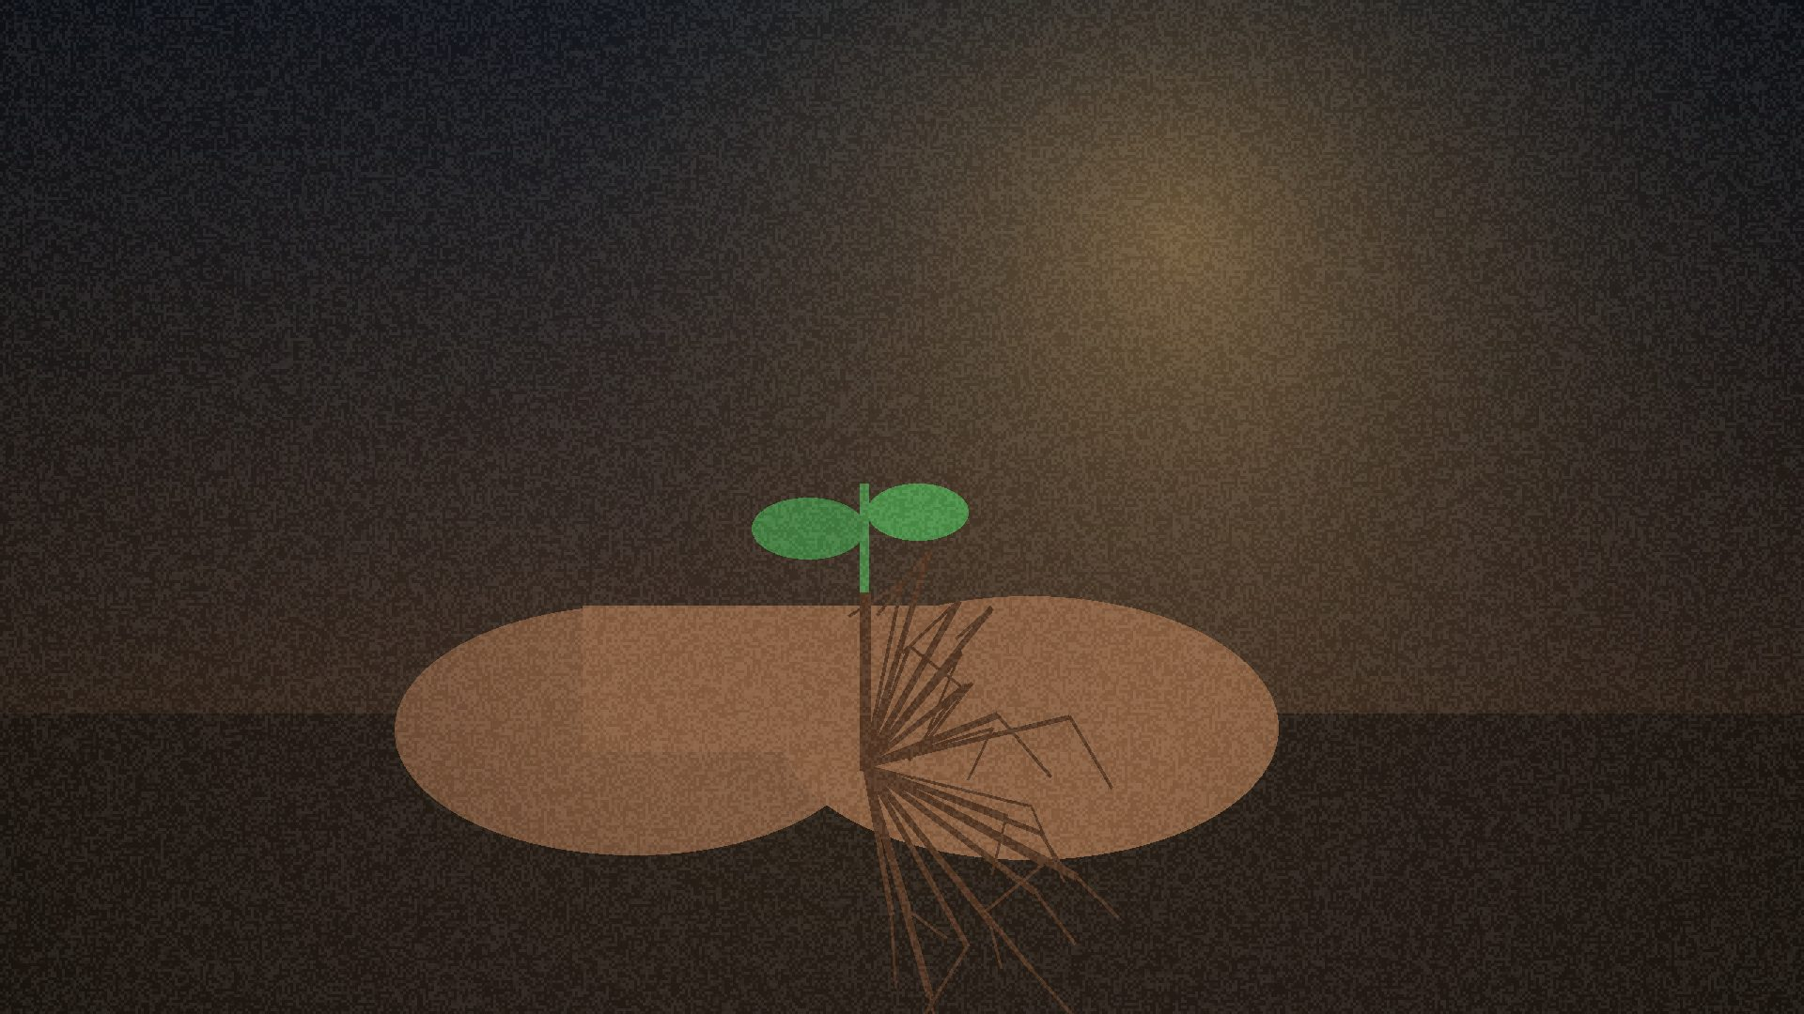
Receive mercy.
Let Jesus meet you
where you actually are.
Notes:
Receive mercy.

Slide 54
Practice mercy.
Mercy makes
holiness visible.
Notes:
Practice mercy.

Slide 55
God knows what the eye
cannot yet see.
Notes:
Return to bare-root tree.

Slide 56
Do not despise the place
where all you have
is a promise.
Notes:
Do not despise the place where all you have is a promise.

Slide 57
Faith follows the promise.
Mercy reveals the heart.
Notes:
Restate remembered truth.

Slide 58
When mercy calls
the dead to life,
the holy people of God
begin to rise.
Amen.
Notes:
Final sentence. Amen.

