Slide 1
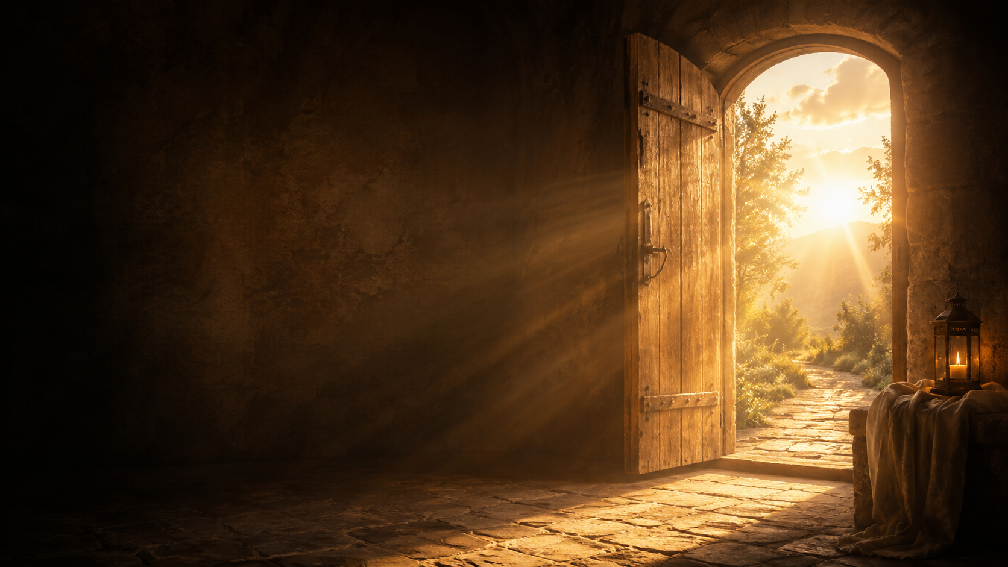
When Freedom
Becomes a Beginning
The Life God Frees, Fills, and Sends
6.28.2026

Slide 2
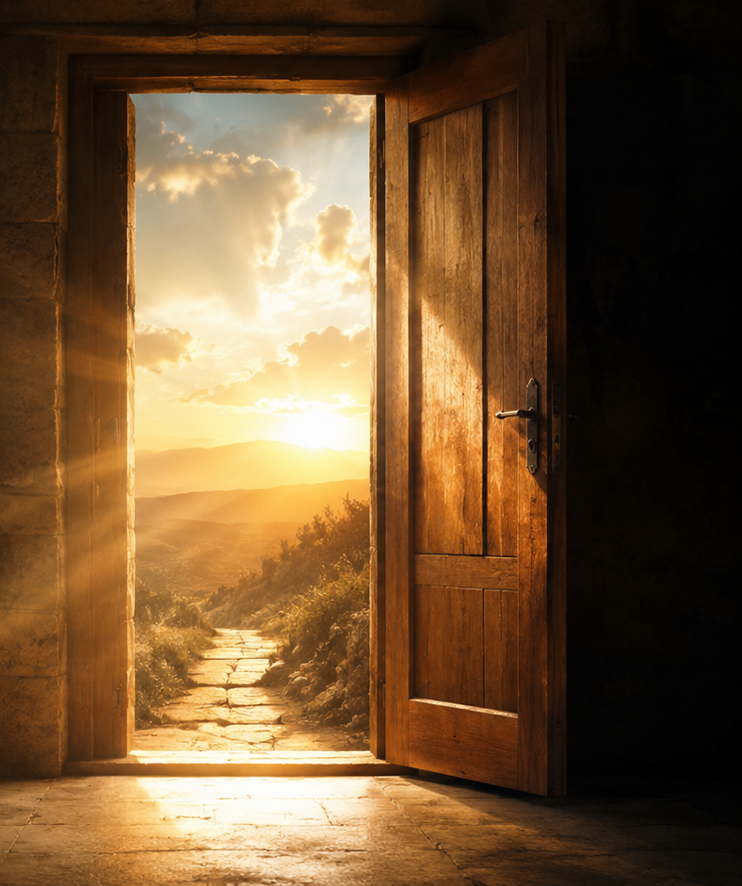
THE QUESTION ROMANS 6 PRESSES INTO US
What if we have treated freedom like an ending, when Jesus means it to become a beginning?

Slide 3
THE GOSPEL CENTER
We are not only saved from sin.
We are saved for God.
A life given to God becomes mercy the world can feel.

Slide 4
ROMANS 6:13
“Offer yourselves to God as those who have been brought from death to life”
(Romans 6:13, NIV).
Freedom is not the ending.
Freedom is the beginning.

Slide 5
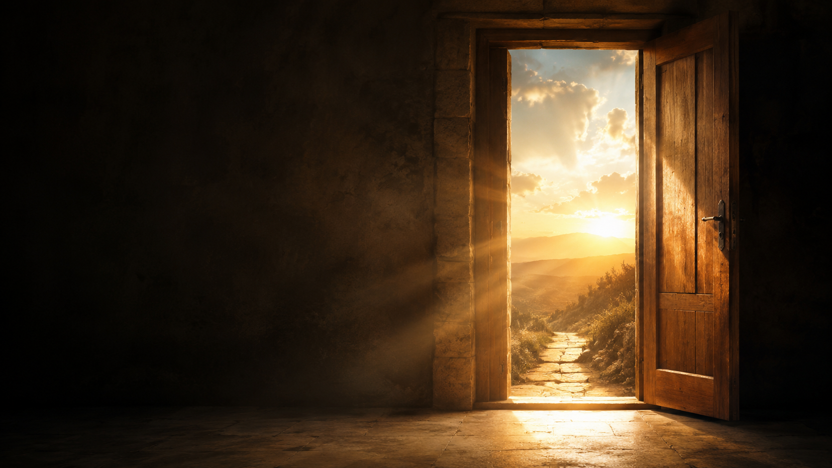
THE LOCKED ROOM
Freedom means
learning how to live
in the open air.
The old room no longer gets to name you.

Slide 6
ROMANS 6:22
“Now that you have been set free from sin and have become slaves of God, the benefit you reap leads to holiness, and the result is eternal life”
(Romans 6:22, NIV).
Set free from sin.
Given to God.
Led into holiness.

Slide 7
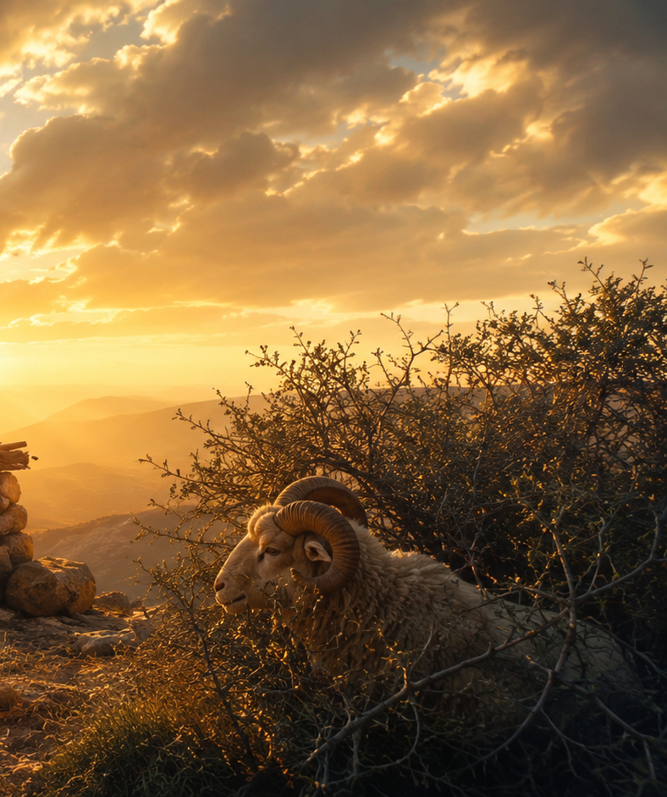
GENESIS 22
Can God be trusted with the life he has freed?
Isaac is the promise Abraham can hold.

Slide 8
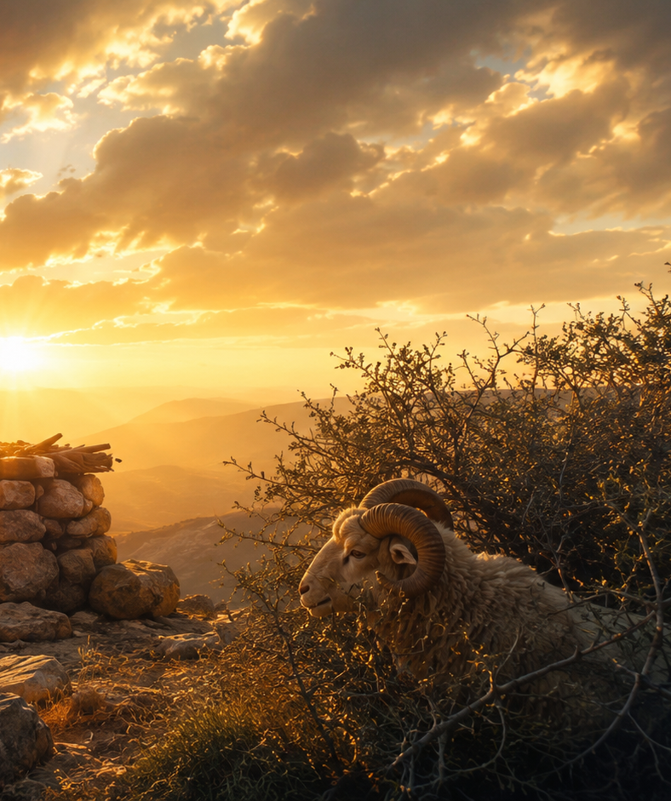
THE FINAL WORD IS PROVISION
“So Abraham called that place The Lord Will Provide”
(Genesis 22:14, NIV).
God can be trusted
with what we love.

Slide 9
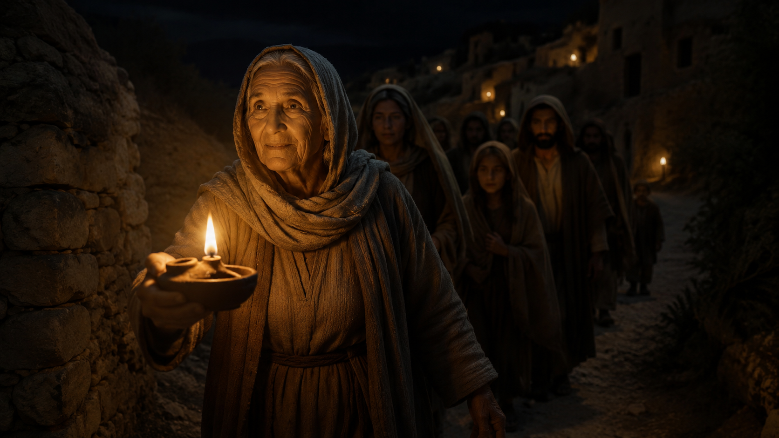
A PARABLE OF LIGHT
“The lamp is mine.
But the light was never meant to stop with me.”
That is surrender.

Slide 10
GOD’S GIFTS BECOME WITNESS
Freedom becomes surrender.
Surrender becomes holiness.
Holiness becomes mercy.
The life God frees is the life God fills.

Slide 11
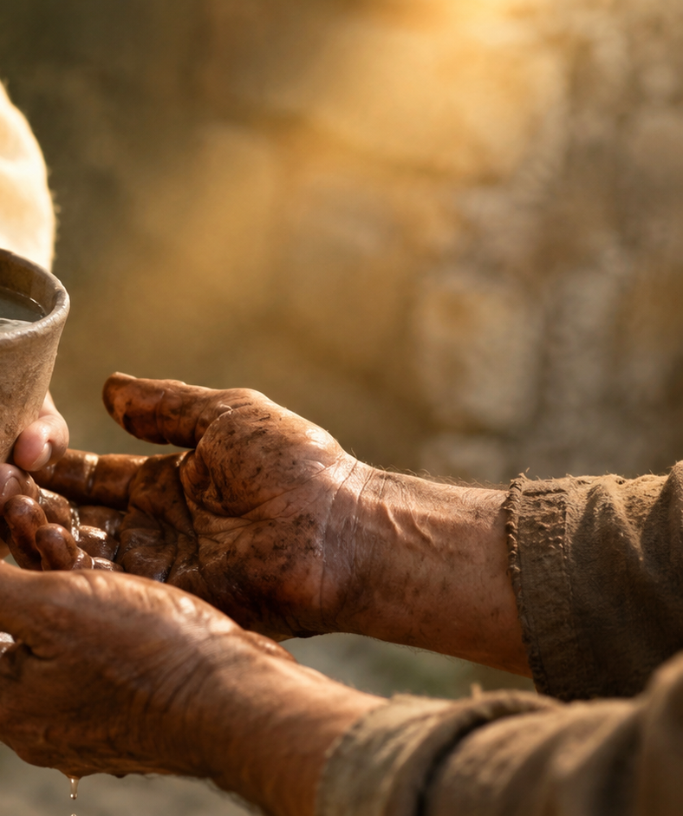
MATTHEW 10:40
“Anyone who welcomes you welcomes me, and anyone who welcomes me welcomes the one who sent me”
(Matthew 10:40, NIV).
To welcome the sent people of Jesus is to welcome Jesus.

Slide 12
MATTHEW 10:42
“If anyone gives even a cup of cold water… that person will certainly not lose their reward”
(Matthew 10:42, NIV).
Mercy does not have to be impressive to be holy.

Slide 13
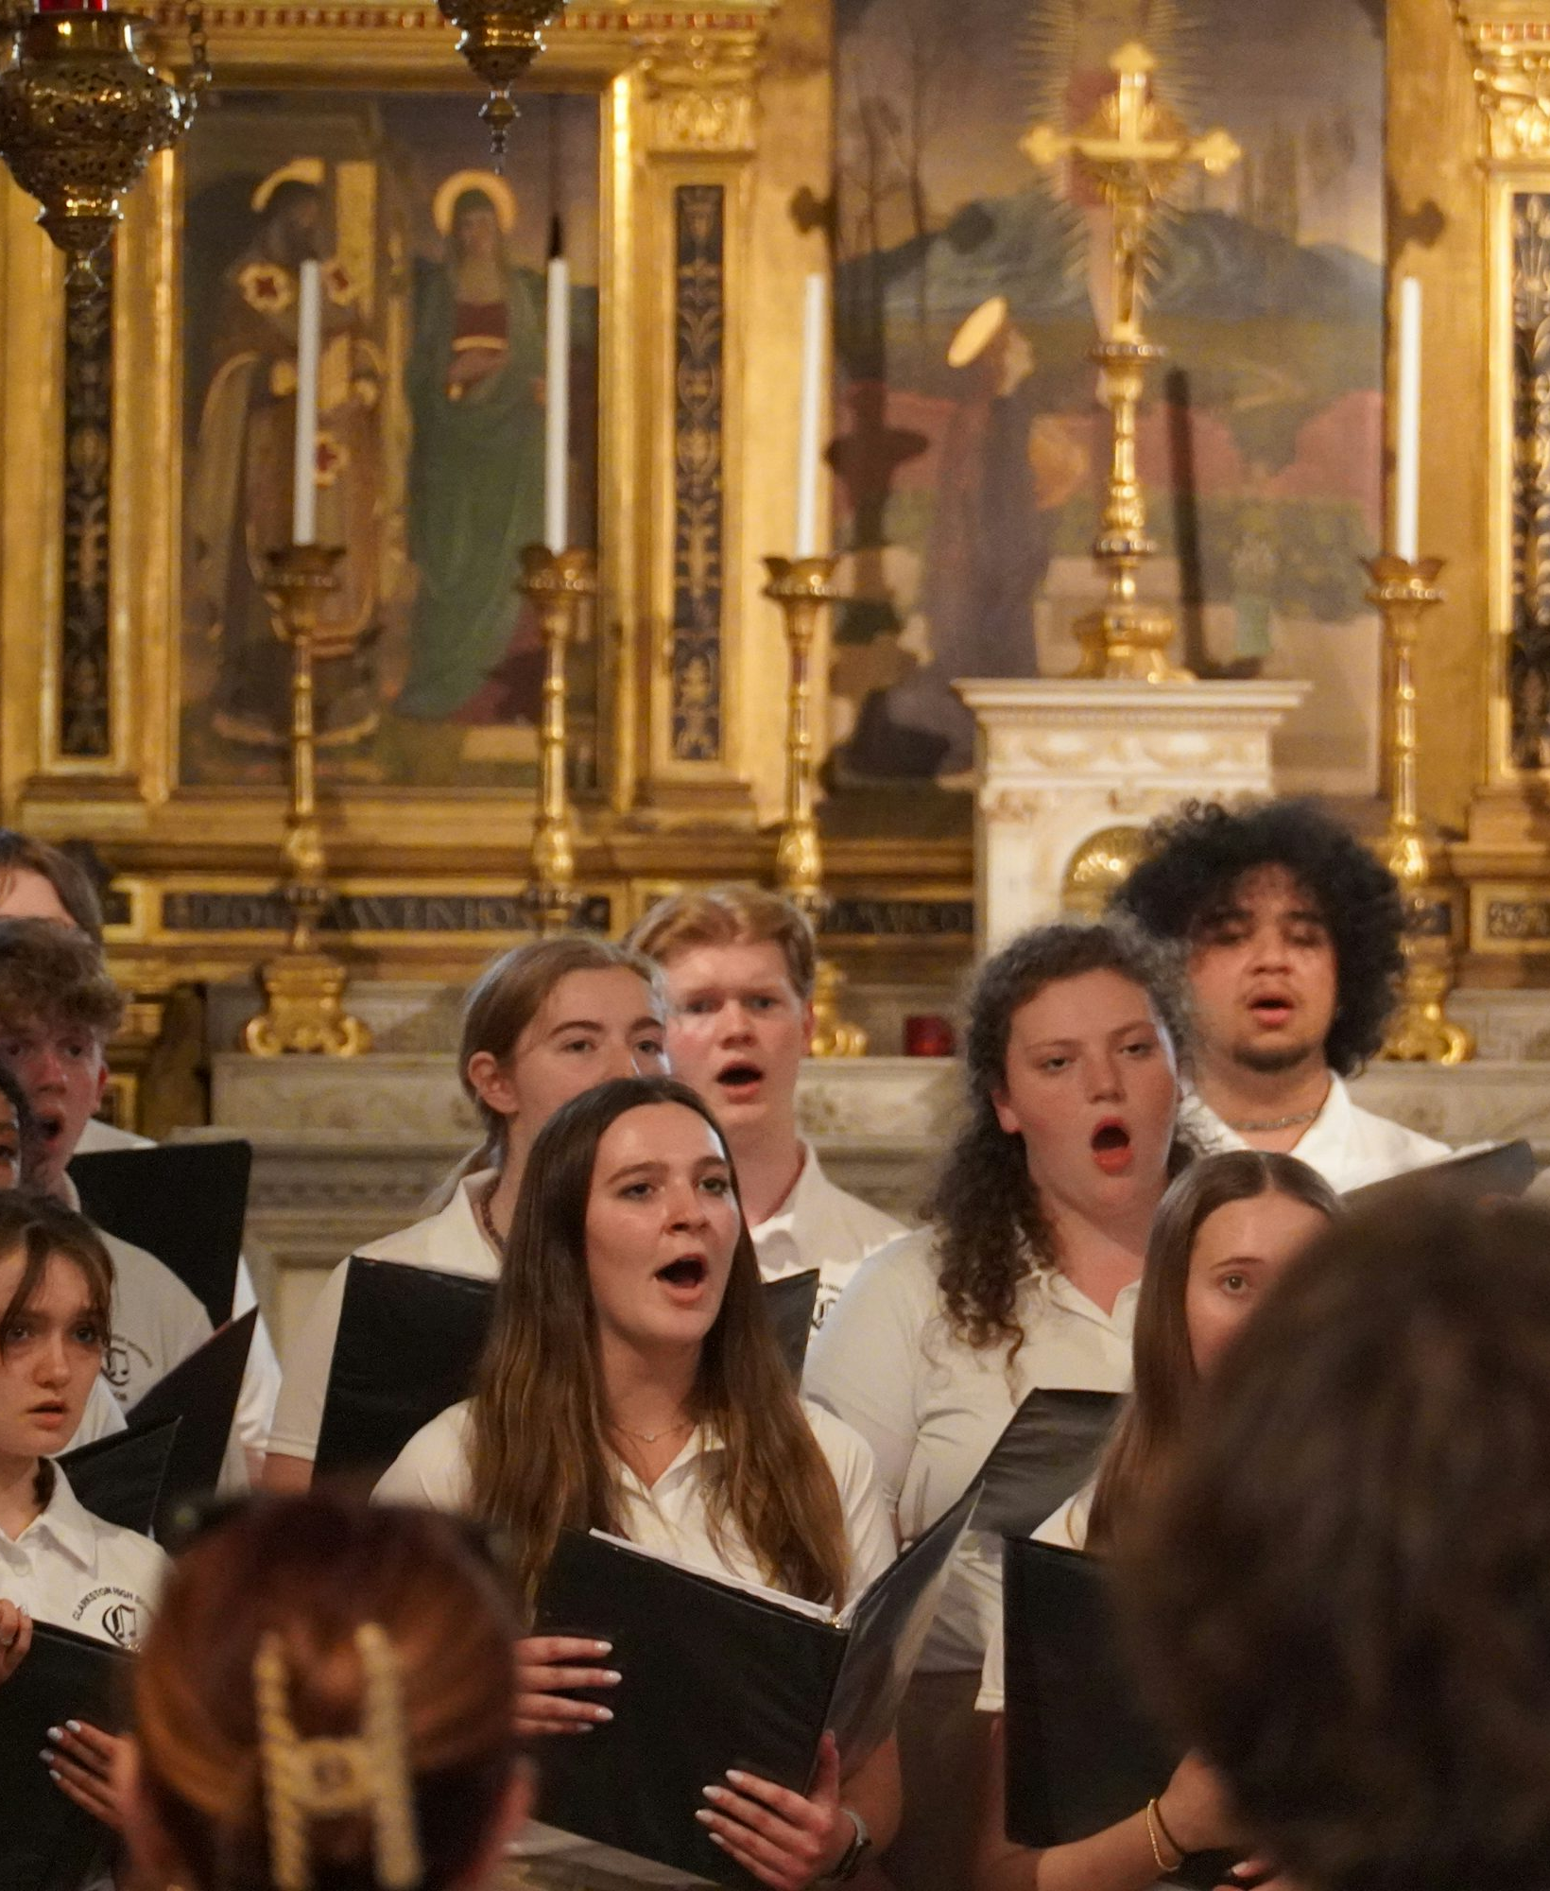
THE KINGDOM SEES WHAT THE WORLD OVERLOOKS
“Do not forget the boy who helped them keep singing.”
A cup of water in Jesus’ name is not small to God.
Choir image: Unsplash

Slide 14
WHERE THE SCRIPTURES MEET
Romans 6 asks: What is my freedom becoming?
Genesis 22 asks: Can God be trusted with what is precious?
Matthew 10 asks: Will freedom become mercy?
And the Gospel answers: Yes.

Slide 15
OPEN WORSHIP QUERY
Lord Jesus,
what is my freedom becoming?
What cup of mercy are you placing in my hand today?
The life God frees is the life God fills,
and the life God fills becomes mercy in motion.

