Slide 1
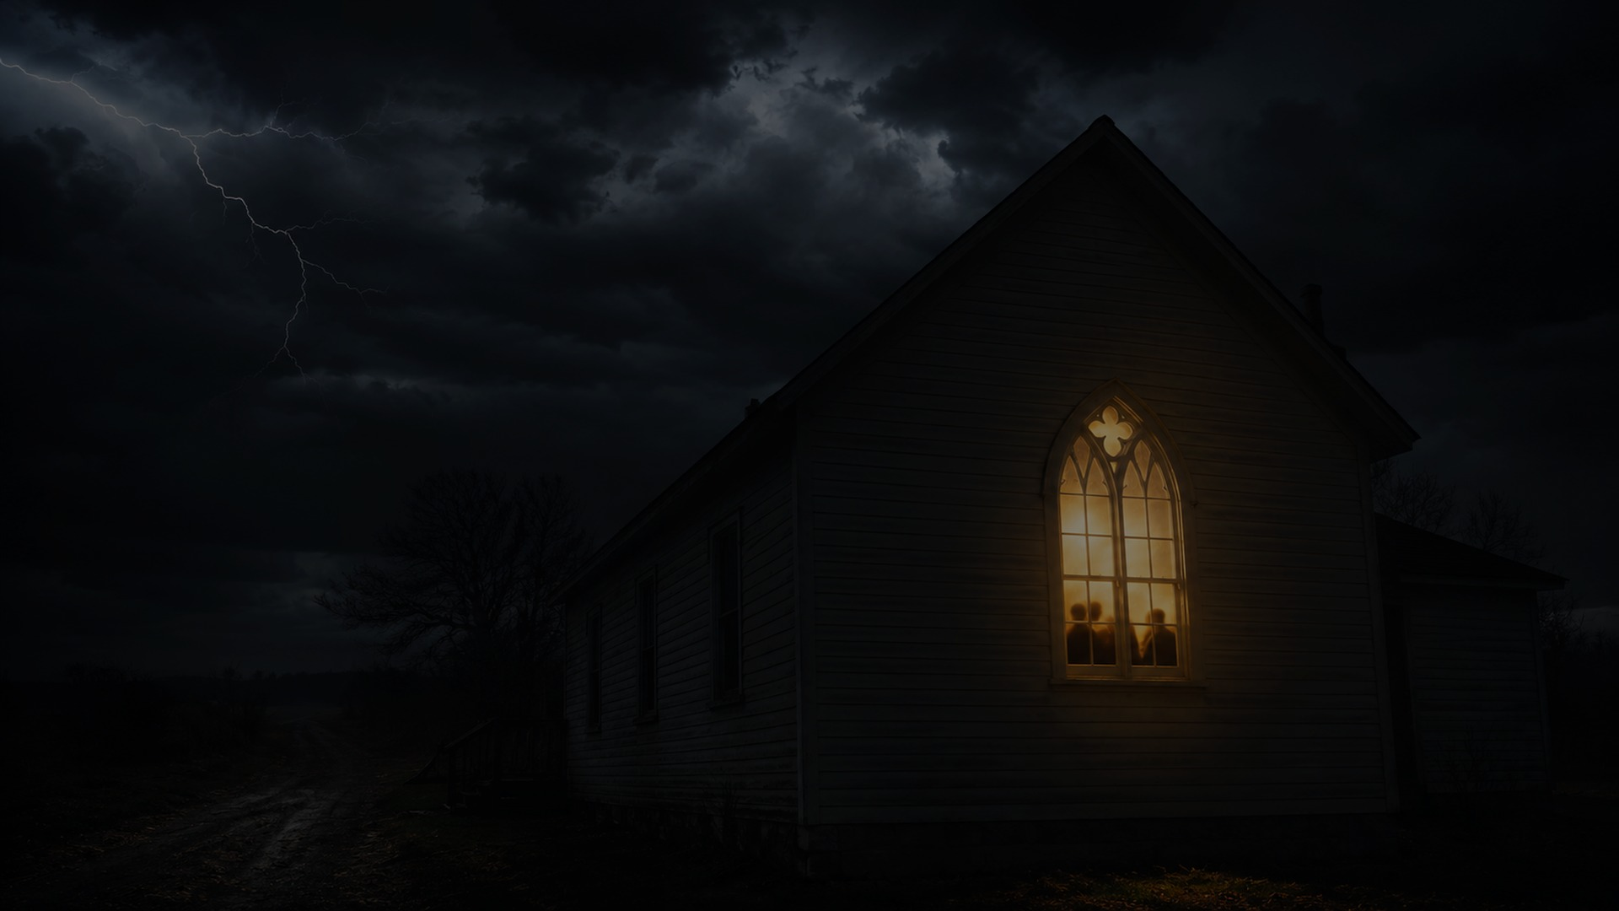
Alive to God
in a Fearful World
Matthew 10:24-39 | Romans 6:1b-11
June 21, 2026
Notes:
Generated background image.

Slide 2
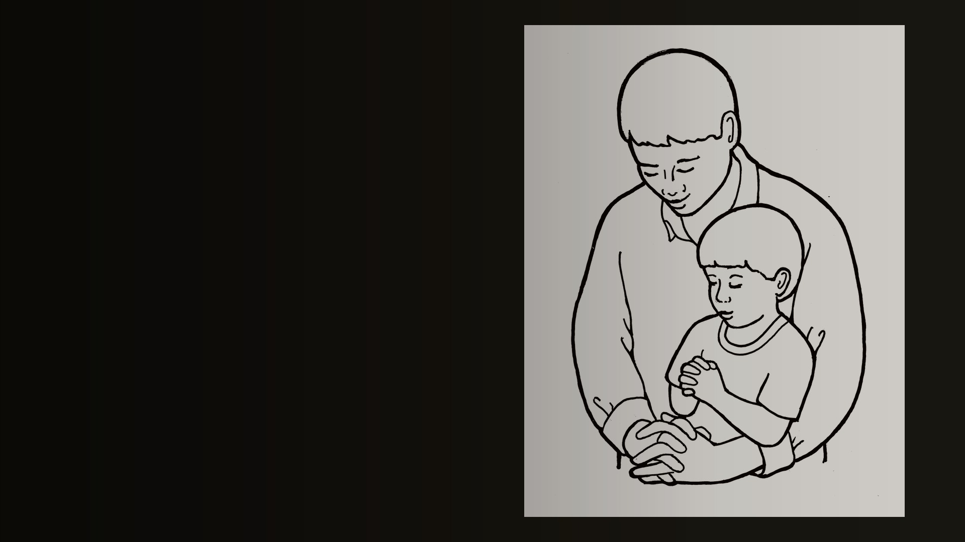
STORY DOORWAY
Watching You
We are formed by
what we watch.
Children learn more from
the life in front of them
than the lesson explained to them.
Alive to God in a Fearful World
Notes:
Image: Prayer Time Illustration, Church of Jesus Christ media library.

Slide 3
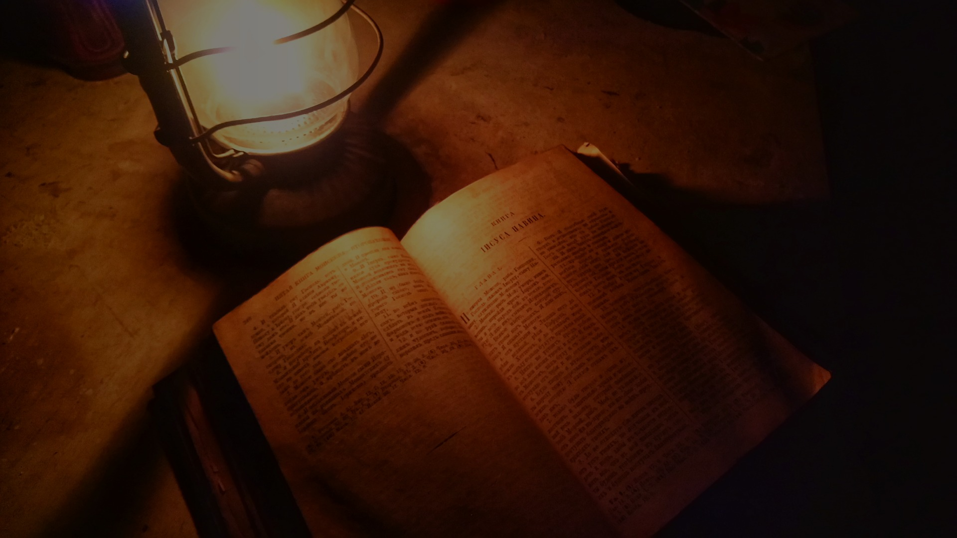
SCRIPTURE READING
Please open your Bibles
to Matthew 10:24-39
These are the words of God
for the people of God.
Praise be to God.
Alive to God in a Fearful World
Notes:
Image: Old Bible by Lamplight, Wikimedia Commons, CC BY-SA.

Slide 4
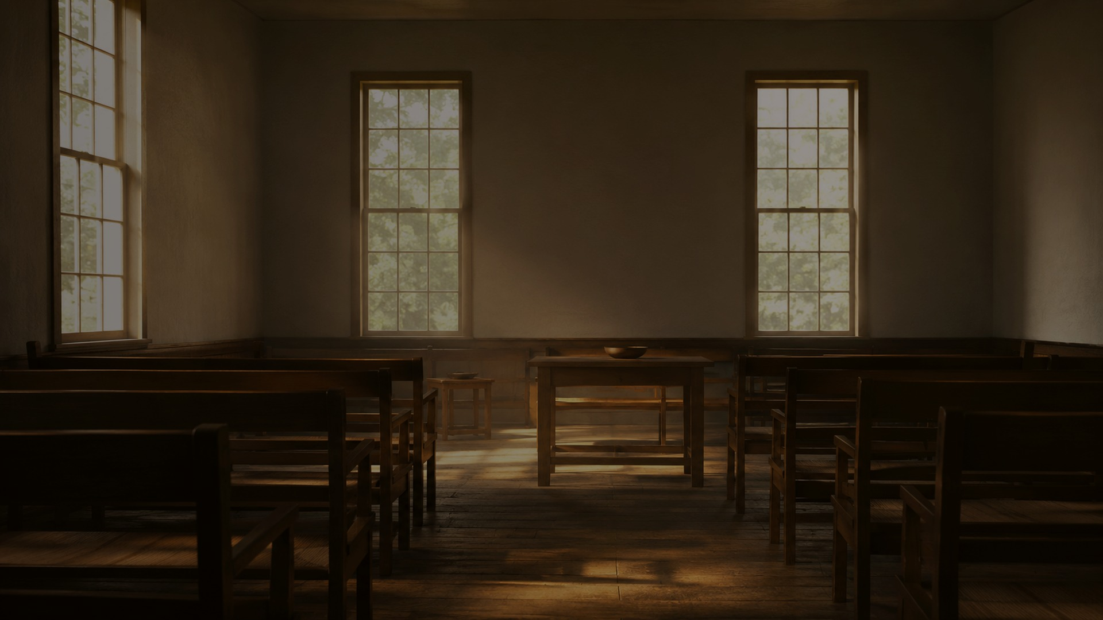
THE SHAPE OF DISCIPLESHIP
“The student is not above
the teacher...”
Matthew 10:24, NIV
Alive to God in a Fearful World
Notes:
Generated chapel background.

Slide 5
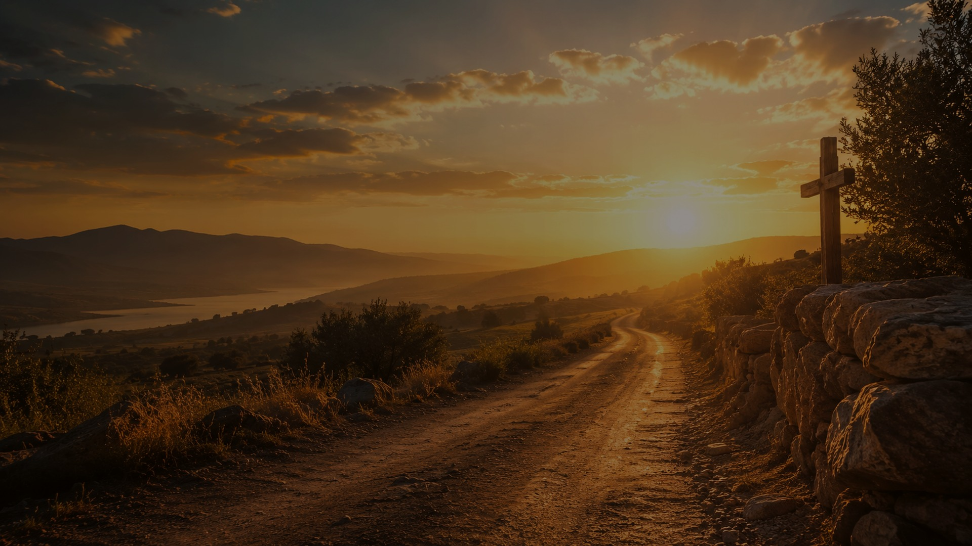
NOT A SMALLER LIFE
A holy life.
A life alive to God.
Free from performance.
Free from control.
Free from defending ourselves.
Free from needing to be first.
Alive to God in a Fearful World
Notes:
Generated countryside cross background.

Slide 6
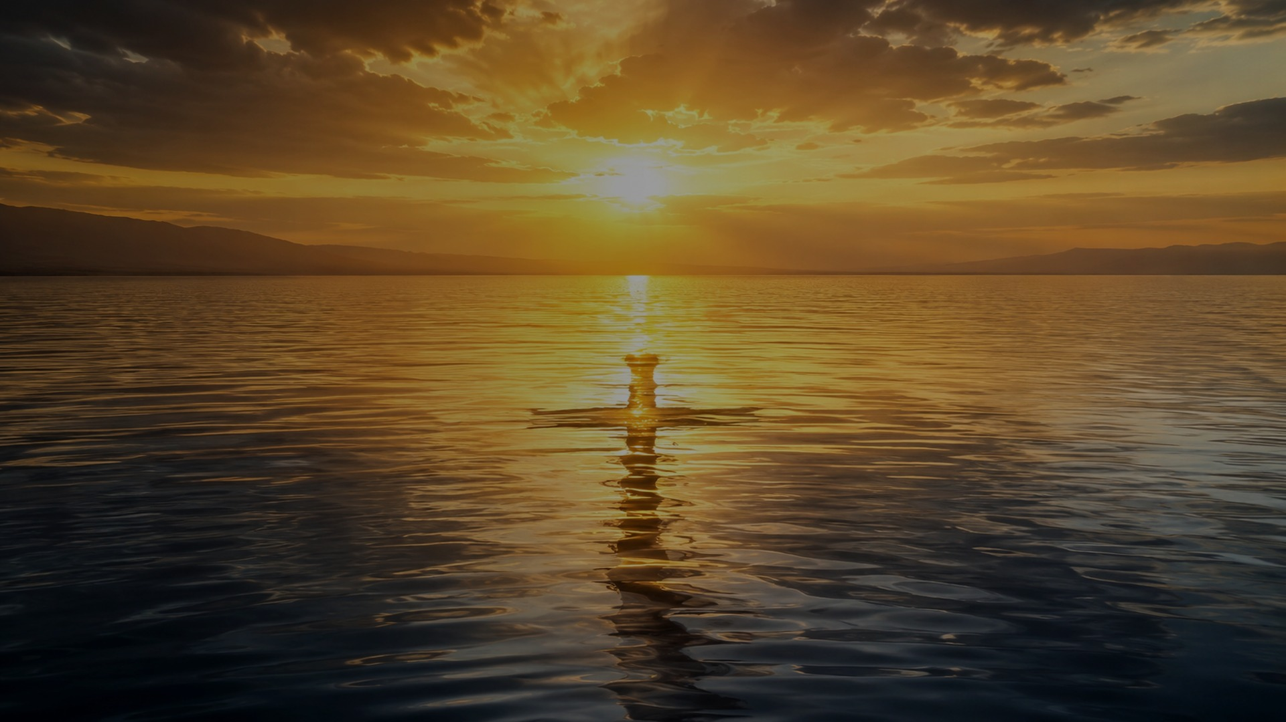
BIG IDEA
We are not faithful
because we are fearless.
We become faithful
because we are alive to God.
Alive to God in a Fearful World
Notes:
Generated sunrise water background.

Slide 7
GOLDEN THREAD
Costly faithfulness.
Never abandoned.
God hears.
God sustains.
God raises.
God sends.
Alive to God in a Fearful World
Notes:
Generated storm church background.

Slide 8
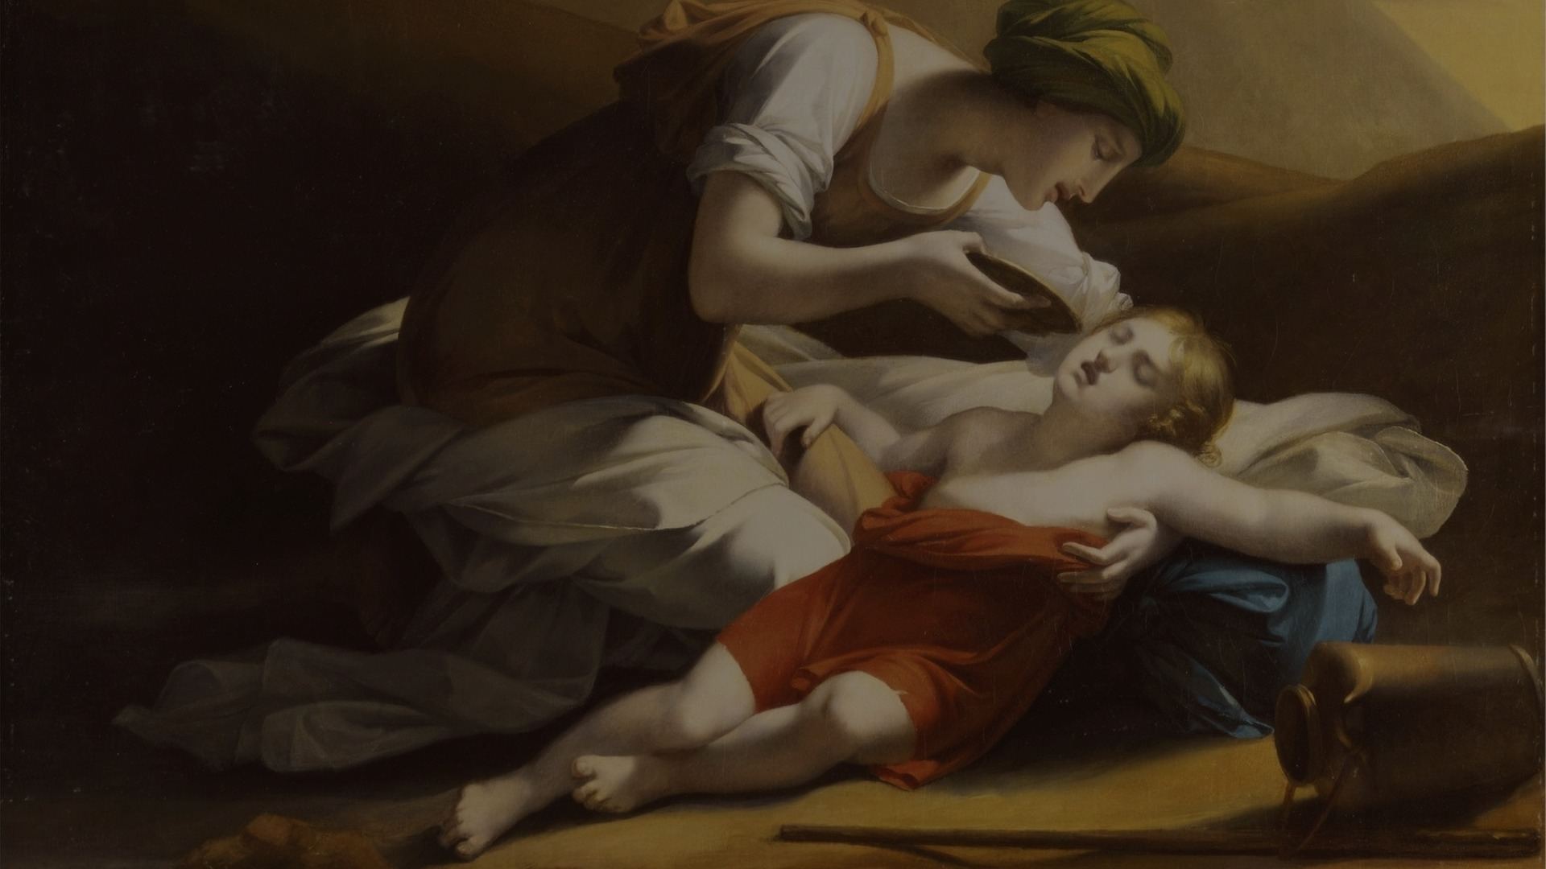
GENESIS 21
God hears
before we see.
“Do not be afraid; God has heard...”
Genesis 21:17, NIV
Alive to God in a Fearful World
Notes:
Image: Charles Paul Landon, Hagar Giving Ishmael Water From the Miraculous Well in the Desert, Wikimedia Commons/public domain.

Slide 9
PSALM 86
Trust becomes prayer.
Faith tells the truth
in the presence of God.
“Hear me, Lord, and answer me...”
Psalm 86:1, NIV
Alive to God in a Fearful World
Notes:
Image: Old Bible by Lamplight, Wikimedia Commons, CC BY-SA.

Slide 10
JEREMIAH 20
Belief when
obedience costs.
Not easy agreement.
Faith gone down into the bones.
“his word is in my heart like a fire...”
Jeremiah 20:9, NIV
Alive to God in a Fearful World
Notes:
Generated storm church background.

Slide 11
PSALM 69
Faith becomes public.
Trust becomes witness.
The holy life turns outward.
“For zeal for your house consumes me...”
Psalm 69:9, NIV
Alive to God in a Fearful World
Notes:
Generated countryside cross background.

Slide 12
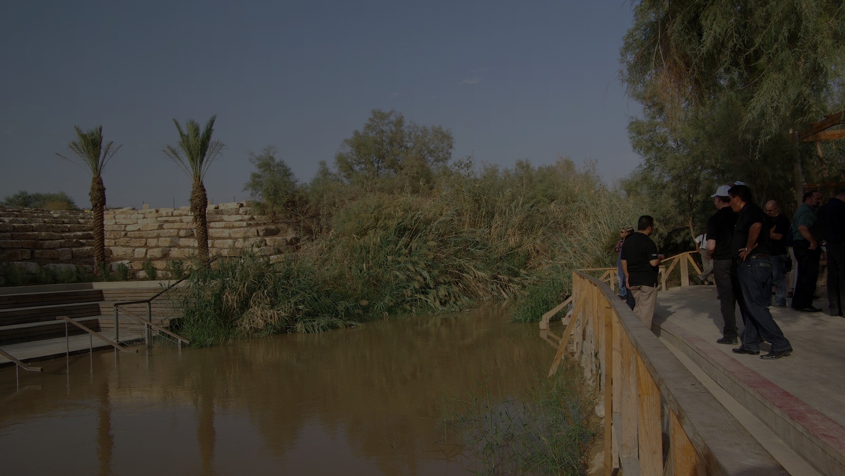
ROMANS 6
Alive to God.
“count yourselves dead to sin
but alive to God in Christ Jesus”
Romans 6:11, NIV
Alive to God in a Fearful World
Notes:
Image: Jordan Baptism site, Wikimedia Commons.

Slide 13
GOSPEL CENTER
In Christ, fear
does not get to be
our master anymore.
Alive to God in a Fearful World
Notes:
Generated sunrise water background.

Slide 14
UNDER PRESSURE
Fear is real.
But fear is not Lord.
Conflict is real.
Rejection is real.
Death is real.
Jesus Christ is Lord.
Alive to God in a Fearful World
Notes:
Generated storm church background.

Slide 15
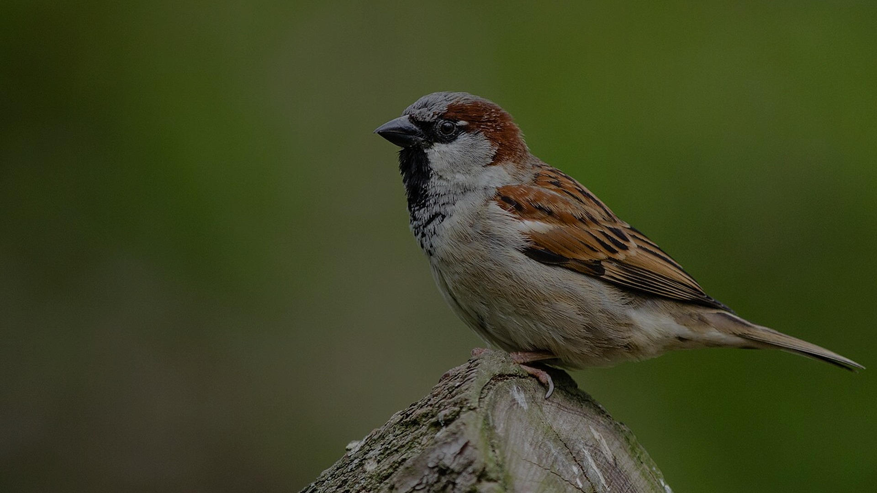
MATTHEW 10:29-31
Your Father sees.
You are worth more
than many sparrows.
Matthew 10:31, NIV
Alive to God in a Fearful World
Notes:
Image: House Sparrow by Mathias Appel, Wikimedia Commons, CC0.

Slide 16
MATTHEW 10
Resurrection-shaped
discipleship
Your Father sees.
Fear does not own you.
Lose your life into Christ’s hands.
Matthew 10:39, NIV
Alive to God in a Fearful World
Notes:
Generated countryside cross background.

Slide 17
CONCLUSION
People are watching.
They do not need a church
pretending to be fearless.
They need a holy people
who know where to take their fear.
Alive to God in a Fearful World
Notes:
Image: Prayer Time Illustration, Church of Jesus Christ media library.

Slide 18
TAKEAWAYS
A holy people
know where to take fear.
Pray in the wilderness.
Speak truth when it costs.
Trust the Father on the hard road.
Live as though resurrection has begun.
Alive to God in a Fearful World
Notes:
Generated countryside cross background.

Slide 19
OPEN WORSHIP QUERY
Lord Jesus,
Where is fear trying to master me,
and what would it mean to live there
as one alive to God?
Alive to God in a Fearful World
Notes:
Generated chapel background.

Slide 21


Slide 22
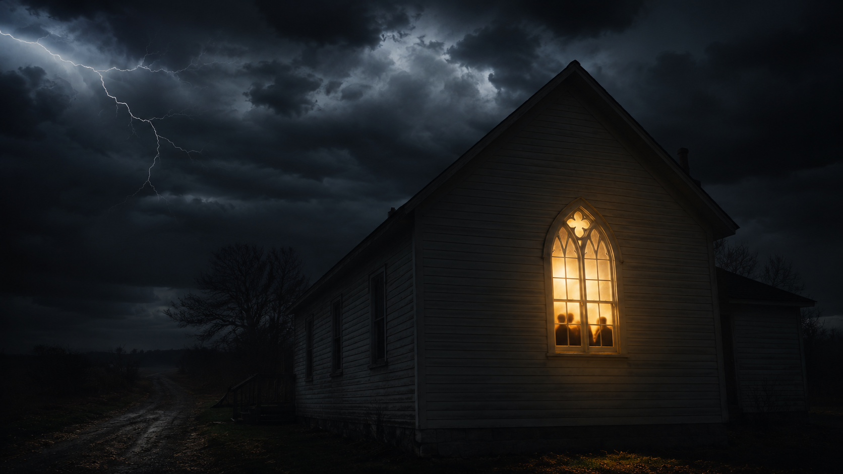

Slide 23
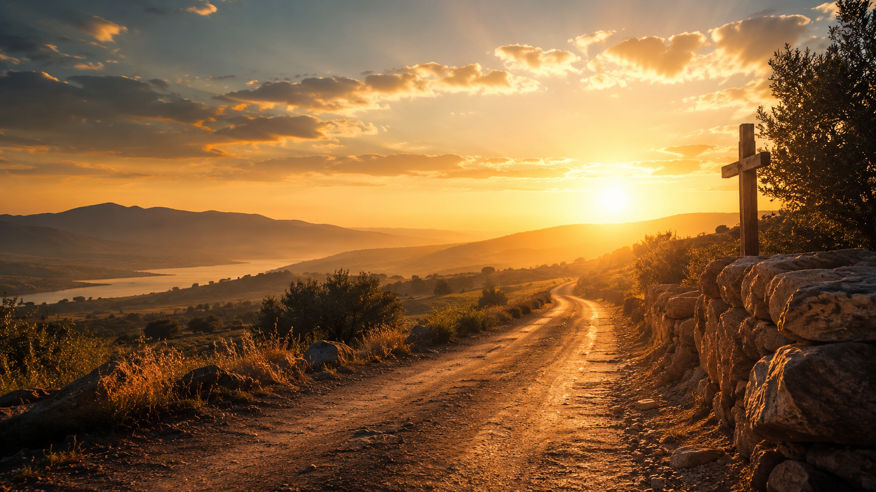

Slide 24
