Slide 1
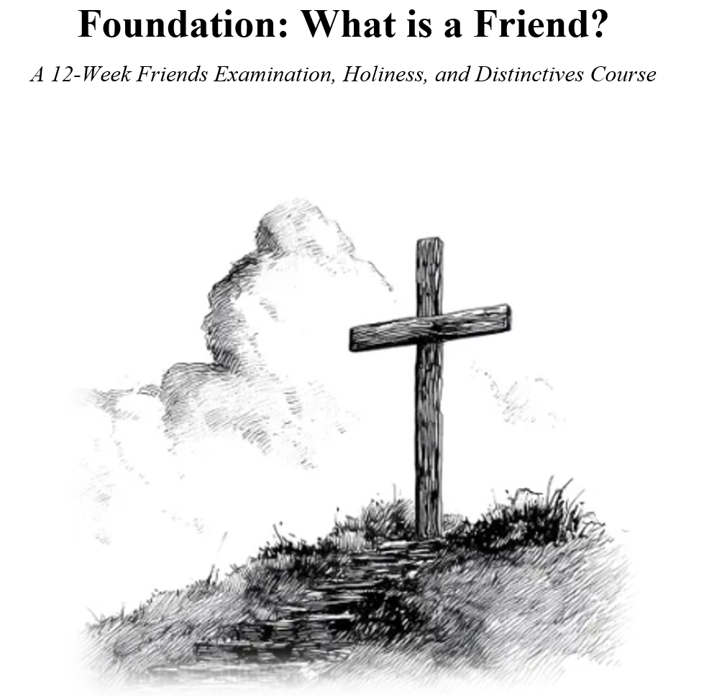

Slide 2

Mary Barrett Dyer A Martyr of Religious Freedom
“The Light Within the Doorway”
A Historical Novelette of Conscience, Courage, and the Light Within

Slide 3
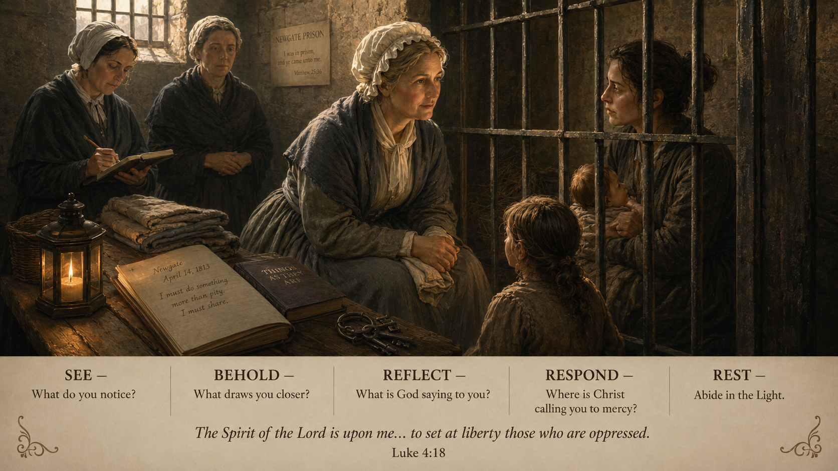

Slide 5

Received Freely,
Sent Faithfully
What Is a Call?
Genesis 18:1–15; Exodus 19:2–8a; Romans 5:1–8; Matthew 9:35–10:8

Slide 6

Please open your Bibles
Matthew 9:35–10:8
Jesus sees • Jesus has compassion • Jesus calls • Jesus sends

Slide 7
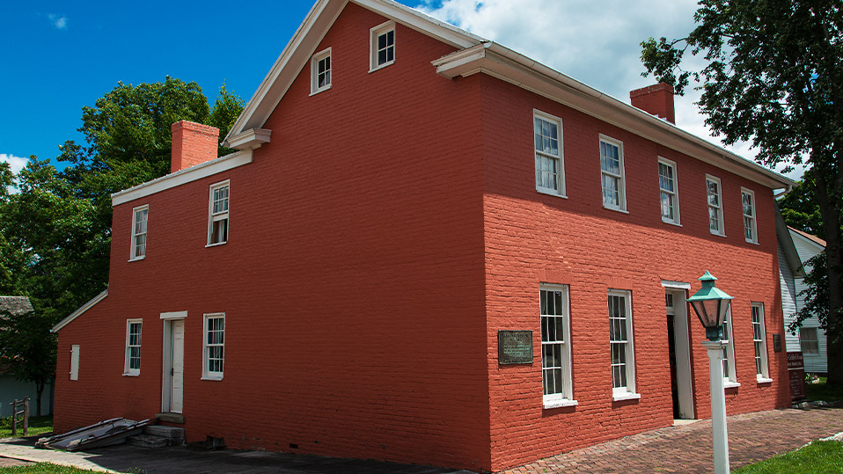
A House Ready for Mercy
Imagine it is the middle of the night in Fountain City, Indiana.
A frightened knock.
A desperate knock.
Someone running toward freedom.

Slide 8

They had to decide whether the mercy they believed in would open the door.

Slide 9
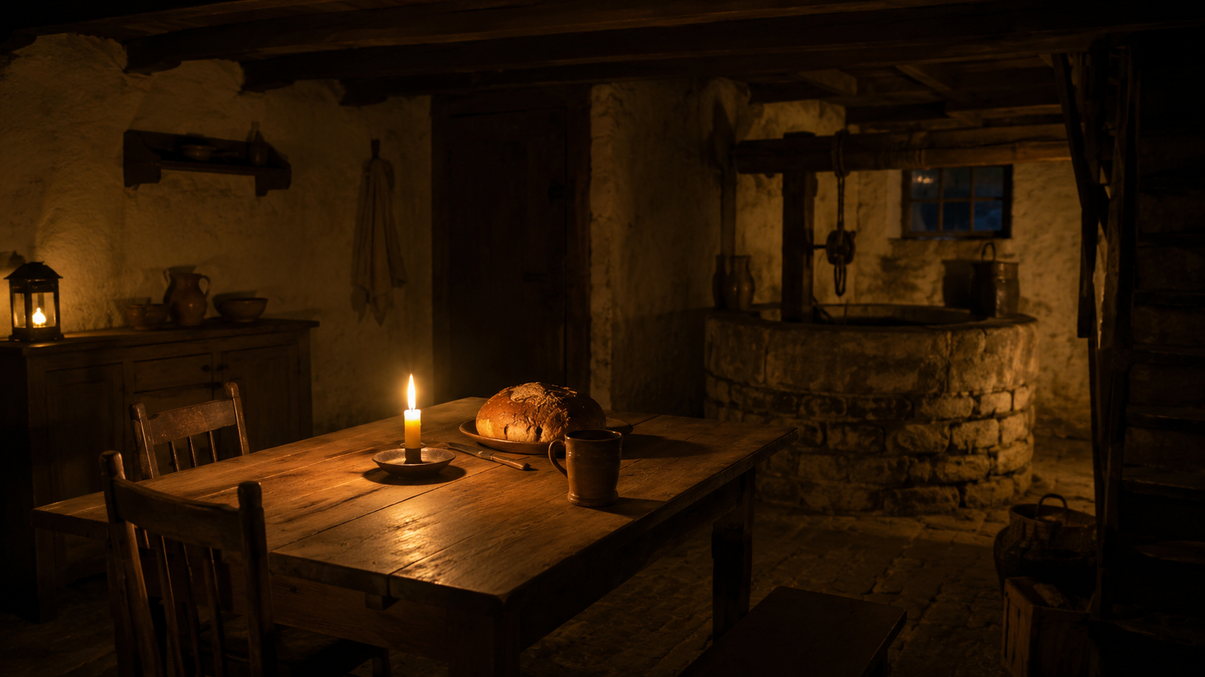
The Coffin House
More than a house—
a life arranged around mercy.
Bread ready.
Water nearby.
Hidden spaces.
Courage in the night.
What kind of faith builds a house ready for frightened people in the night?

Slide 10
The deeper question
What kind of life is Christ forming in me, so mercy has somewhere to land?
Calling is Christ forming a life with room for mercy.

Slide 11
The AHA Moment
Every follower of Jesus has one call
with three movements:
Belong to Christ
Become holy in Christ
Bear witness to Christ
Not first a title—becoming a life with room for the compassion of Jesus.

Slide 12
The biblical frame
Promise • Identity • Gospel • Mission
Genesis 18
Exodus 19
Romans 5
Matthew 9–10
Promise
where the future looks closed
Identity
after rescue
Grace
before worthiness
Mission
from compassion

Slide 13
Why this call matters now
Un-formed lives can do great harm.
Calling is what happens when Jesus lays claim to a life.

Slide 14
A discipleship crisis
A young man is dead.
Another young man has lost decades of his life.
Two families are shattered.
A shove. A knife. A moment of rage, pride, fear, and reaction.
Now everyone is living with what cannot be undone.
This is not just a news item. This is a discipleship crisis.

Slide 15
Formation is life and death
If the church cannot help form people whose anger is submitted to Christ, whose pride is humbled, and whose compassion is stronger than retaliation...
we are not talking about abstract theology anymore.
We are talking about life and death.

Slide 16
First Wave
Belonging Before Doing
Jesus calls unfinished people to himself.
The first call is not,
“Go be impressive.”
The first call is,
“Belong to me.”

Slide 17
You are not uncalled
Before we were useful, we were loved.
Before we were strong, we were received.
Before we could carry mercy, mercy came for us.
“To whom do I belong?”
I belong to Christ.

Slide 18
Second Wave
Formation After Rescue
Holiness is Christ making room in us for mercy.
Rescued from something — rescued for something.

Slide 19
We need that kind of formation
our homes
how we handle disrespect
our children
how we teach accountability
our anger
when pride rises up
Jesus calls his people into another way.

Slide 20
Another way
Pride can dress itself up as strength.
Anger can pretend to be courage.
Retaliation can call itself justice.
“Clothe yourselves with compassion, kindness, humility, gentleness and patience” (Colossians 3:12, NIV).
That is not soft religion. That is holy formation.

Slide 21
Holiness became architecture
Bread ready in the night.
Water drawn quietly.
A household arranged around mercy.
Christ may not be asking us to build a station on the Underground Railroad—
but he is arranging something.

Slide 22
Third Wave
Sent as Compassion
The call becomes visible
when mercy takes flesh.
“Freely you have received; freely give” (Matthew 10:8, NIV).

Slide 23
The heart of calling
We do not serve to become important.
We serve because mercy has reached us
and now wants to move through us.
A visit • A prayer • A meal • A classroom
A hospital room • Jail ministry • A careful letter
Forgiveness offered with trembling hands
A home where someone can breathe again.

Slide 24
What our world needs
Not religious performance.
Not pride baptized in spiritual language.
Not people defending their ego.
The world needs people formed by Jesus:
anger surrendered • pride humbled • compassion strengthened • lives with room for mercy

Slide 25
What do we do with our call?
Receive it with humility.
Surrender to formation.
Practice faithfulness where we are.
Most calling is lived before it is named.

Slide 26
The Coffin House still preaches
Calling does not have to become famous to become faithful.
It does not have to be dramatic to become holy.
A wounded world still needs places
where mercy can be found.

Slide 27
Open Worship
Lord Jesus,
what part of my life are you arranging for mercy?
home • table • time • listening • friendship • resources • presence
anger • pride • fear • need to be respected

Slide 28
Receive freely.
Be formed faithfully.
Be sent compassionately.
May our lives become places where the mercy of Christ can be found, even in the night.

