Slide 1
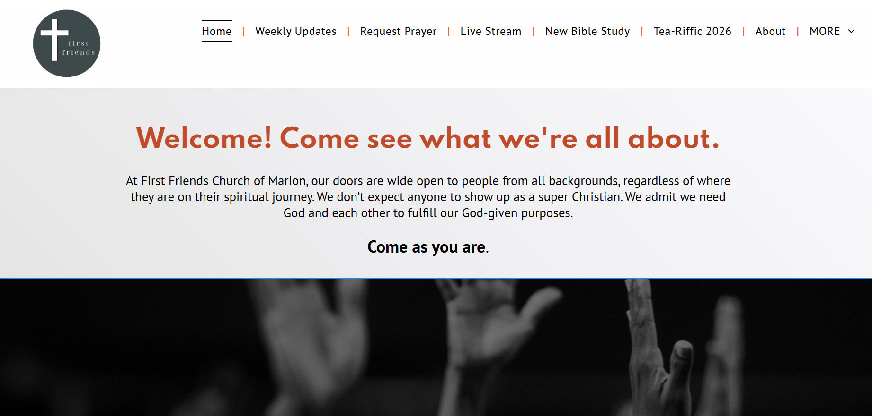

Slide 2
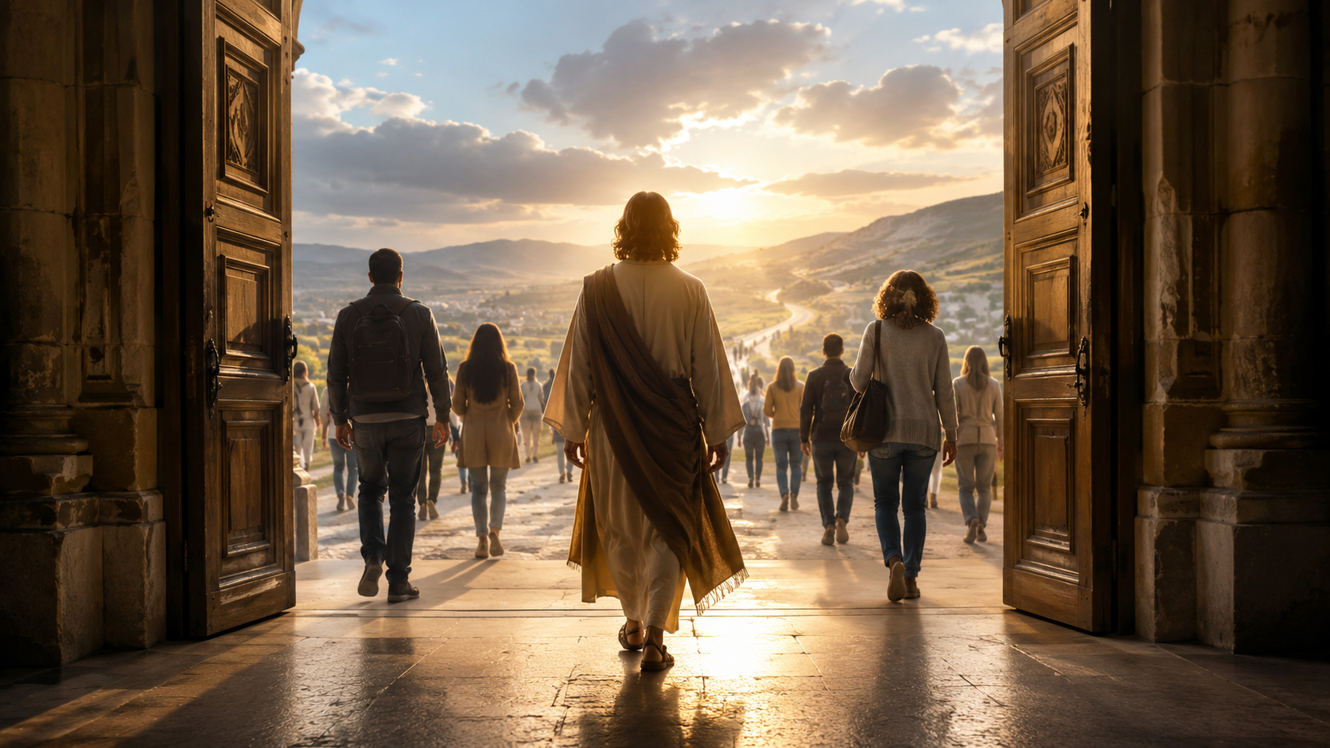
The God Who Makes Us a People
Trinity Sunday
Genesis 1 • Psalm 8 • 2 Corinthians 13 • Matthew 28

Slide 3
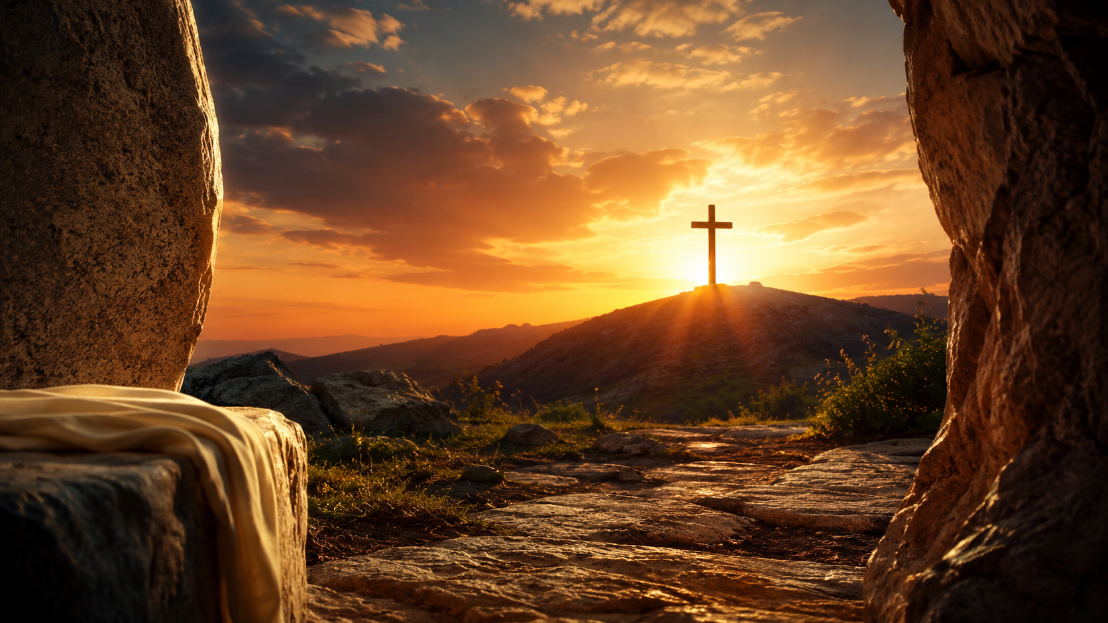
Please open your Bibles
Matthew 28:16–20
These are the words of God for the people of God.

Slide 4
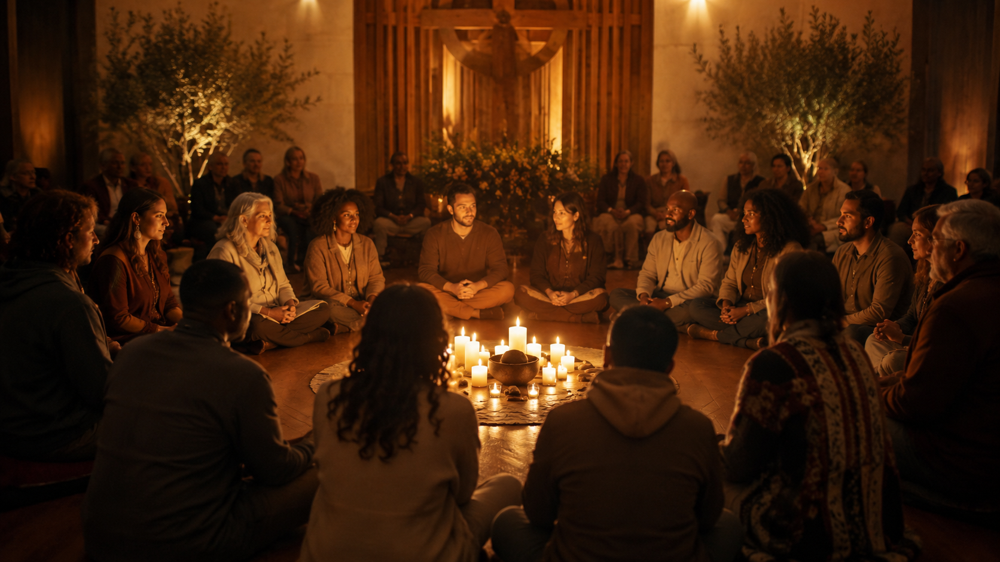
The Triune God creates us for communion,
restores us through the Gospel, and sends us in Christ’s presence as a holy, Spirit-formed people.

Slide 5

A crowd shares space.
A people share a center.

Slide 6
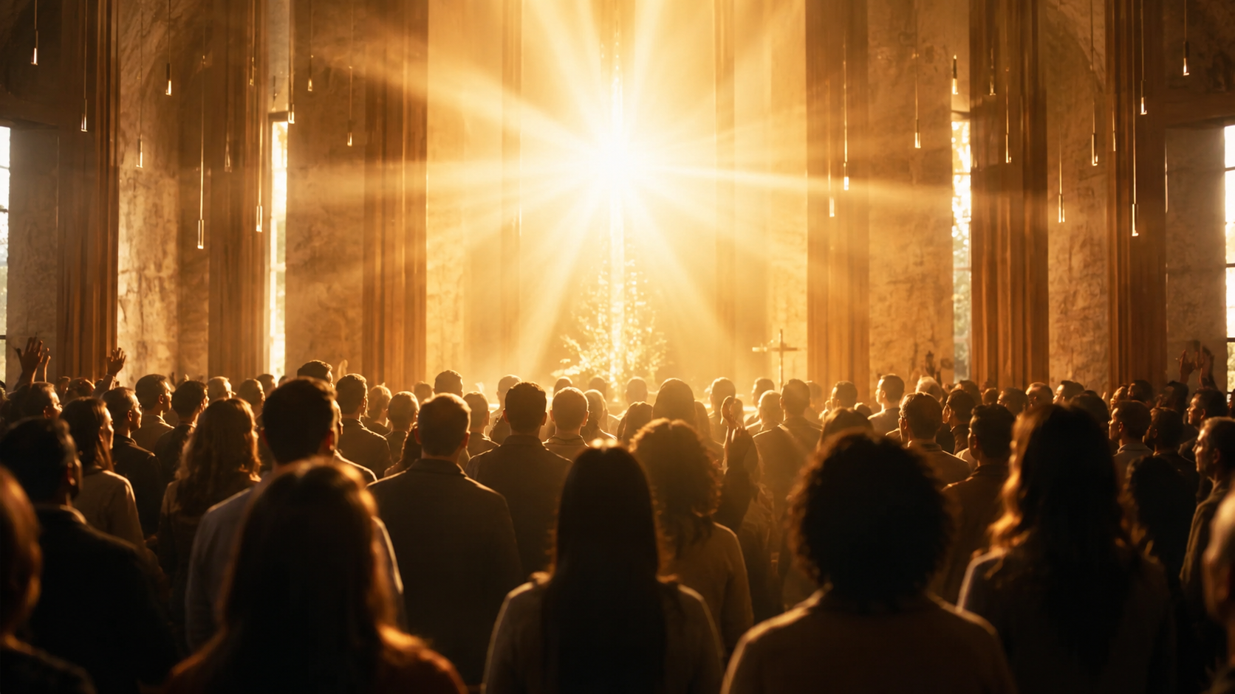
Here is the living God
who creates, restores, indwells, and sends.

Slide 7

Created for communion
Creation begins in God’s goodness, not human achievement.

Slide 8
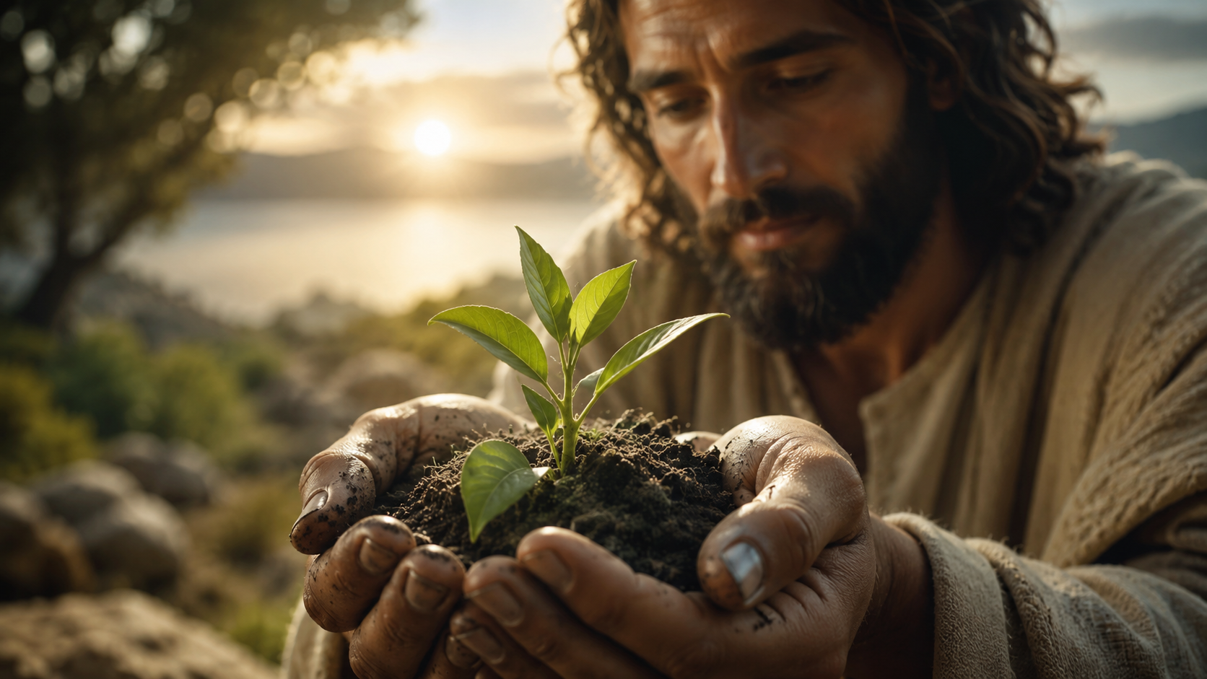
Before we are useful, we are loved.
Before we are productive, we have dignity. Before we are successful, we are called.

Slide 9
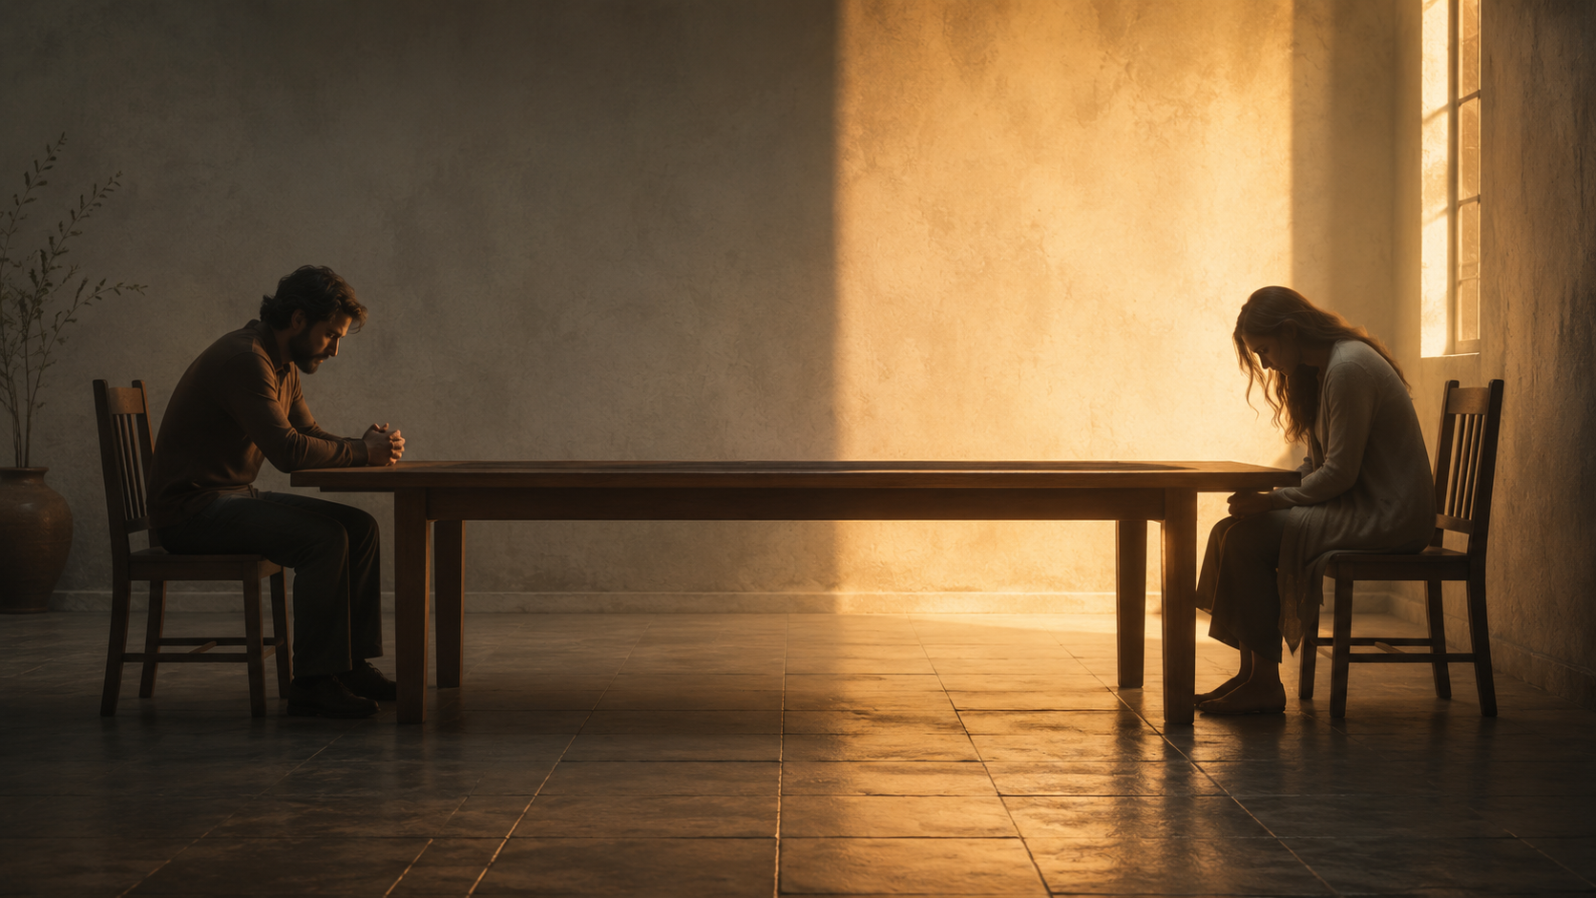
We know fractured communion.
Near physically, yet far relationally. Wanting peace, yet carrying old patterns.

Slide 10
Christ restores what sin has fractured.
The Gospel is not advice. It is God’s restoring work in Jesus Christ.

Slide 11
We are not called to recreate Acts 2 by going backward.
We return to the living Center who made Acts 2 possible.

Slide 12
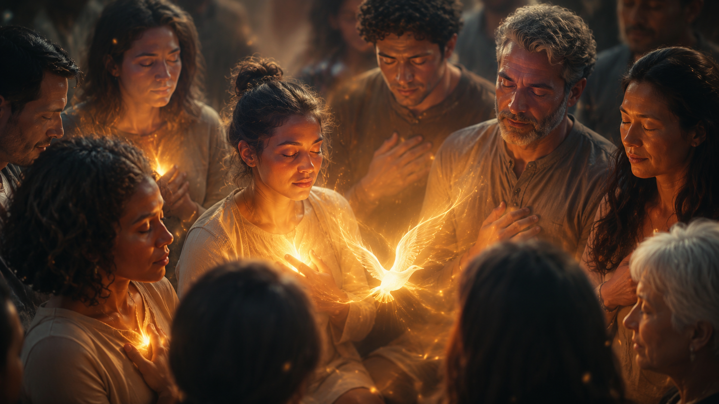
Grace. Love. Fellowship.
The Spirit forms who we are before what we do.

Slide 13
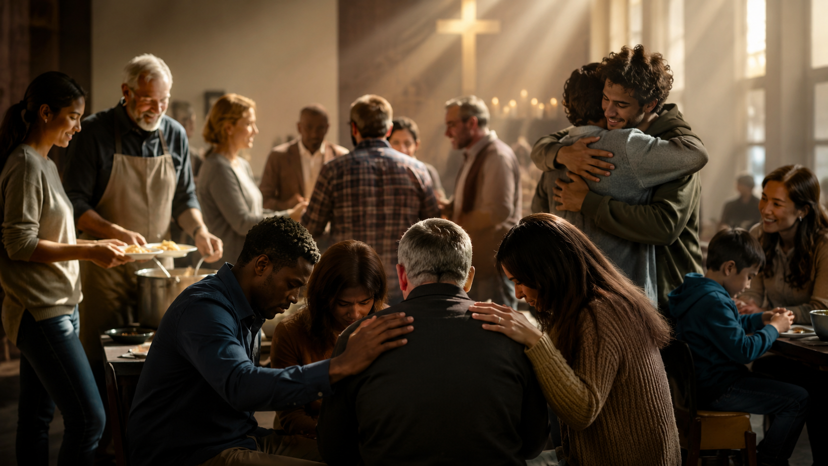
Holiness is not self-improvement.
Holiness is life in Christ, by the Spirit, forming a people in holy love.

Slide 14
The Church is not sent in its own name.
We are sent in the name of the Father, Son, and Holy Spirit.

Slide 15
Not a crowd. A people.
Not self-improvement.
Not survival. Mission.
Holiness in Christ.

Slide 16
The Father creates. The Son restores.
The Spirit fills and forms.
The Church is made by the living God.

Slide 17
Extra Slides Below this Slide ☺

Slide 18
Notes:
Visio Divina image: A crowd sharing space

Slide 19
Notes:
Visio Divina image: A gathered people around light

Slide 20
Notes:
Visio Divina image: Creation goodness

Slide 21
Notes:
Visio Divina image: Image-bearing dignity

Slide 22
Notes:
Visio Divina image: Fractured communion

Slide 23
Notes:
Visio Divina image: Christ restores

Slide 24
Notes:
Visio Divina image: Living Center

Slide 25
Notes:
Visio Divina image: Spirit indwells

Slide 26
Notes:
Visio Divina image: Holy community

Slide 27
Notes:
Visio Divina image: Sent in Christ’s presence

