Slide 1
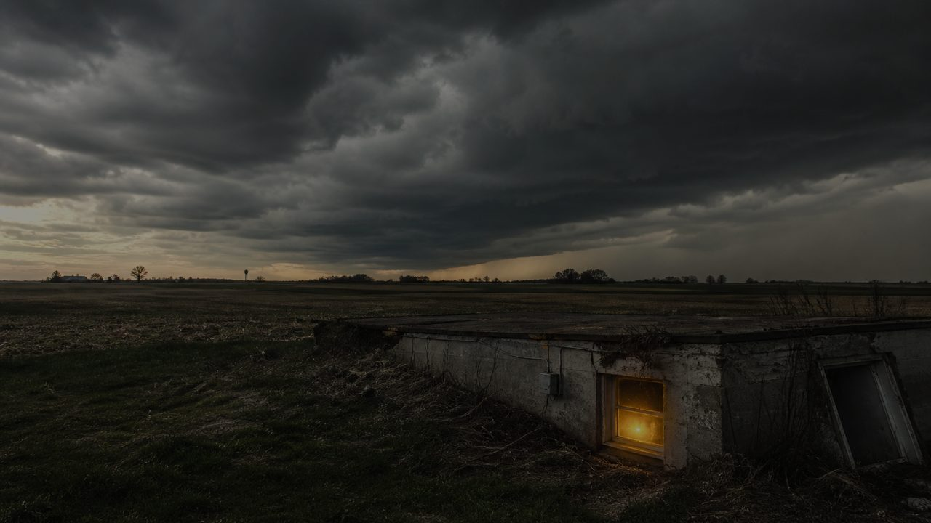
Holy Presence
From Refuge to Living Stones
John 14:1–14 • Acts 7:55–60 • Psalm 31:1–5, 15–16 • 1 Peter 2:2–10
5.3.2026

Slide 2
There are some things we do not think about…
until the storm comes.
Holy Presence: From Refuge to Living Stones

Slide 3
Foundation:
In a storm, what matters is not what looks impressive.
What matters is what can hold.
Holy Presence: From Refuge to Living Stones

Slide 4
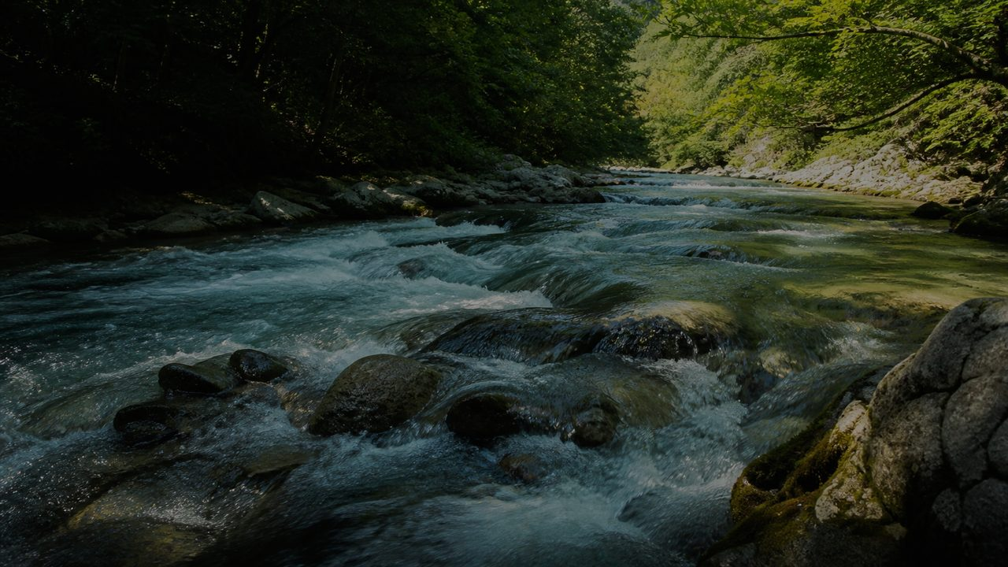
The movement of Scripture:
From Refuge
to Revelation
to Witness
to Living Stones
Holy Presence: From Refuge to Living Stones

Slide 5
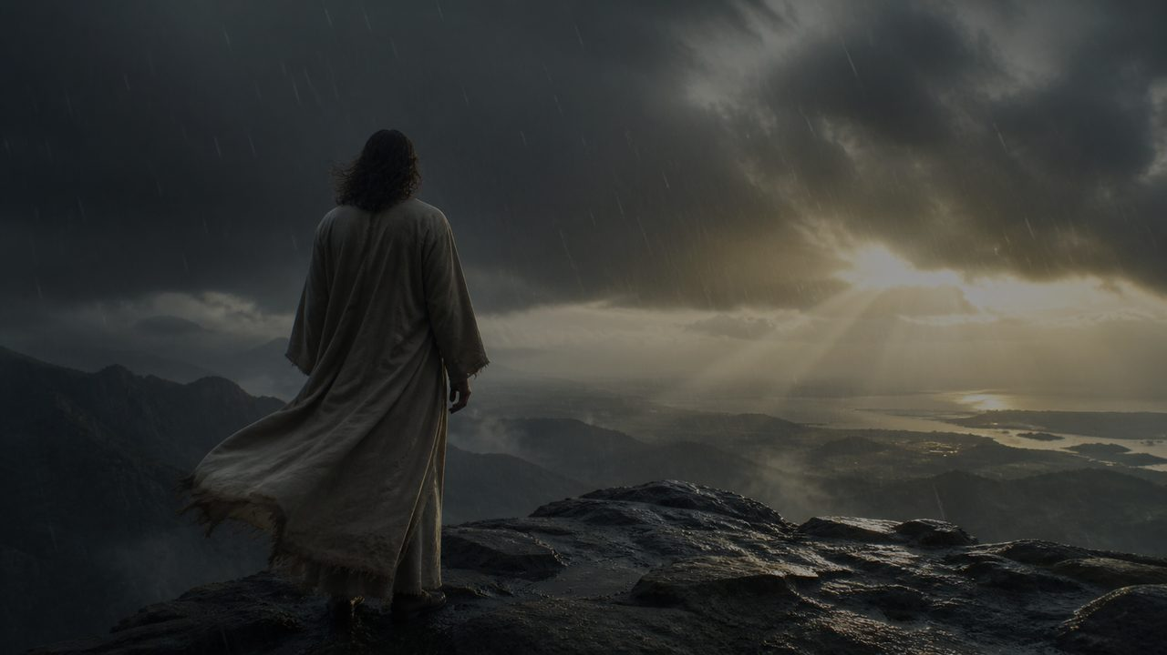
Psalm 31 — Refuge:
God is our refuge.
Refuge does not mean escape from every storm.
“Into your hands I commit my spirit.” (Psalm 31:5, NIV)

Slide 6

Bible interpreting Bible…
Scripture gives us one redemptive pattern:
Refuge
Revelation
Rejection
Resurrection
Holy Witness
Holy Presence: From Refuge to Living Stones

Slide 7
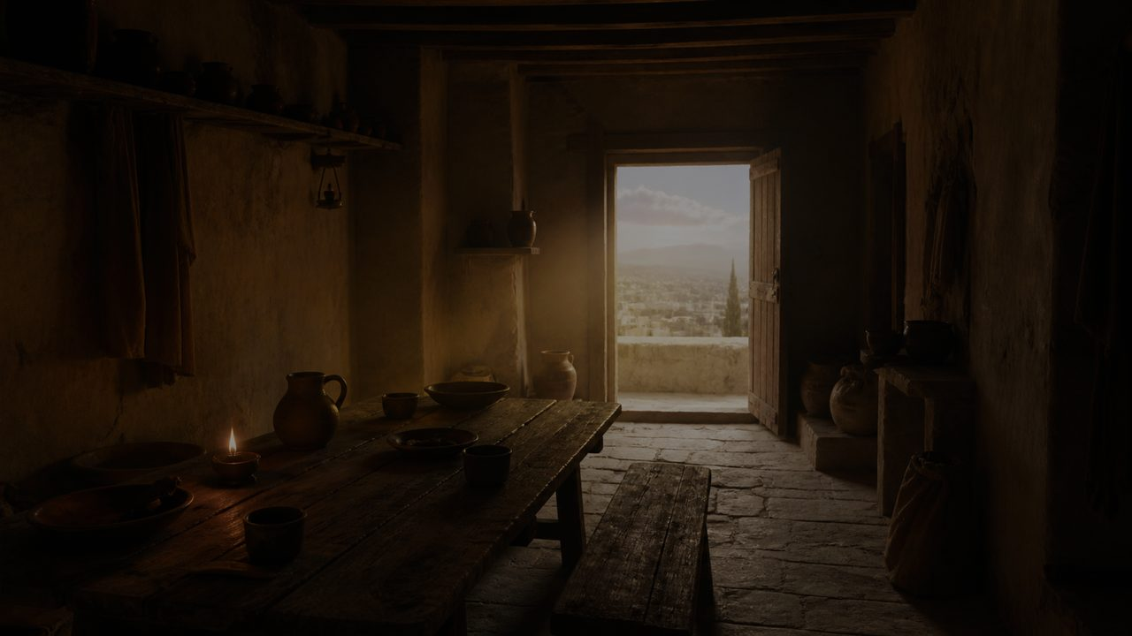
John 14 — Revelation:
Jesus enters the troubled room.
He does not deny reality. He reveals the Father’s purpose.
“Do not let your hearts be troubled.” (John 14:1, NIV)

Slide 8
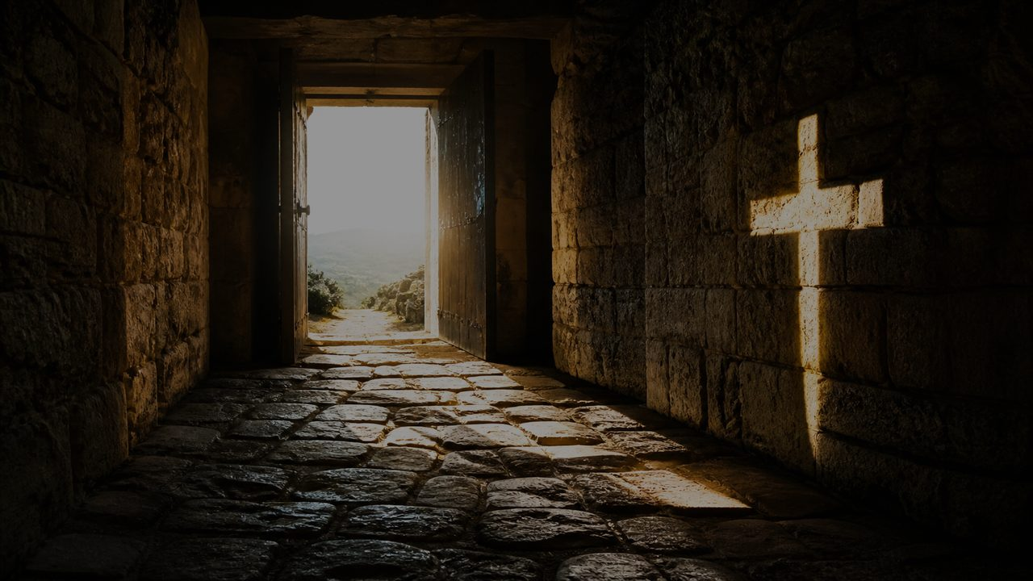
Jesus is the Way.
Jesus is the Truth.
Jesus is the Life.
“I am the way and the truth and the life.” (John 14:6, NIV)

Slide 9
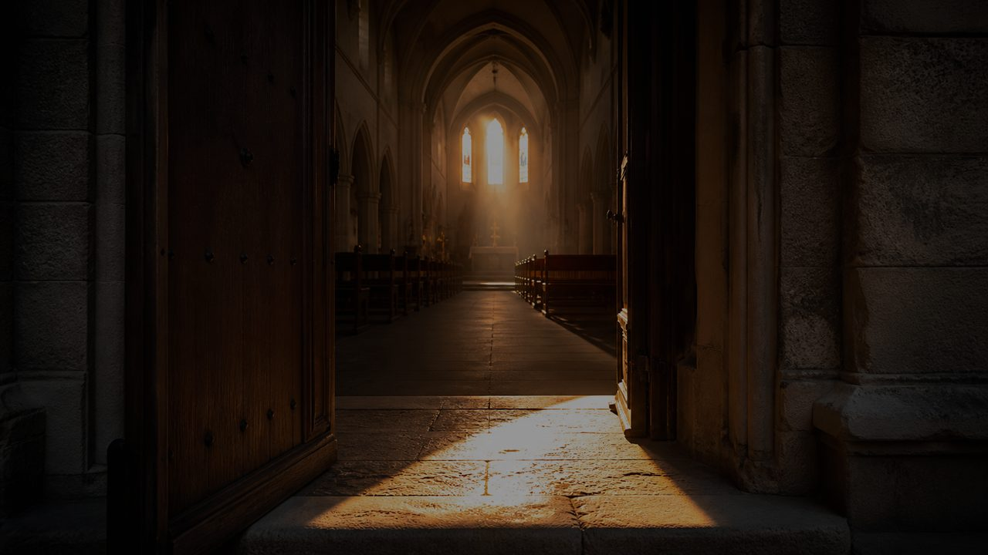
The Gospel of Now:
The Gospel of God is not only “later.”
In Jesus Christ, God has come near — here.
God has opened the way home — here.
God is forming a holy people — here.
Holy Presence: From Refuge to Living Stones

Slide 10
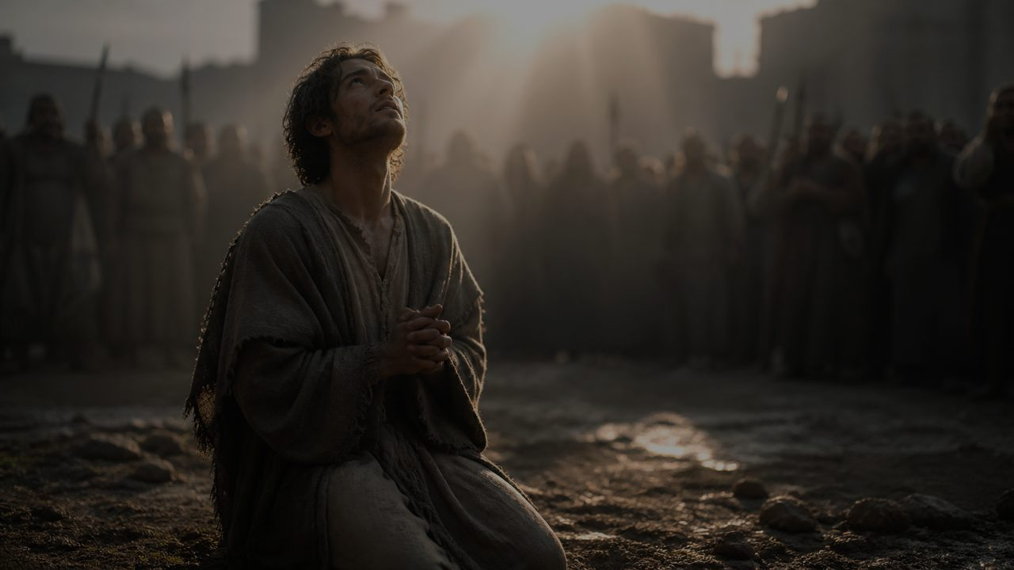
Acts 7 — Witness:
Holy presence under pressure.
Stephen is not delivered from suffering, but he is not abandoned in suffering.
“Lord Jesus, receive my spirit.” (Acts 7:59, NIV)

Slide 11
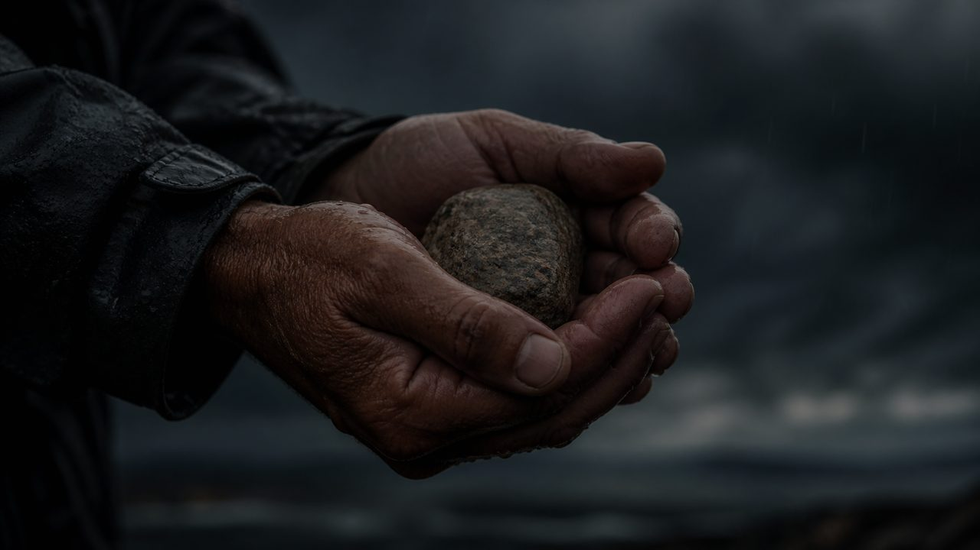
A stone can be used to wound…
or a stone can be used to build.
What are we doing with the stones?
Holy Presence: From Refuge to Living Stones

Slide 12
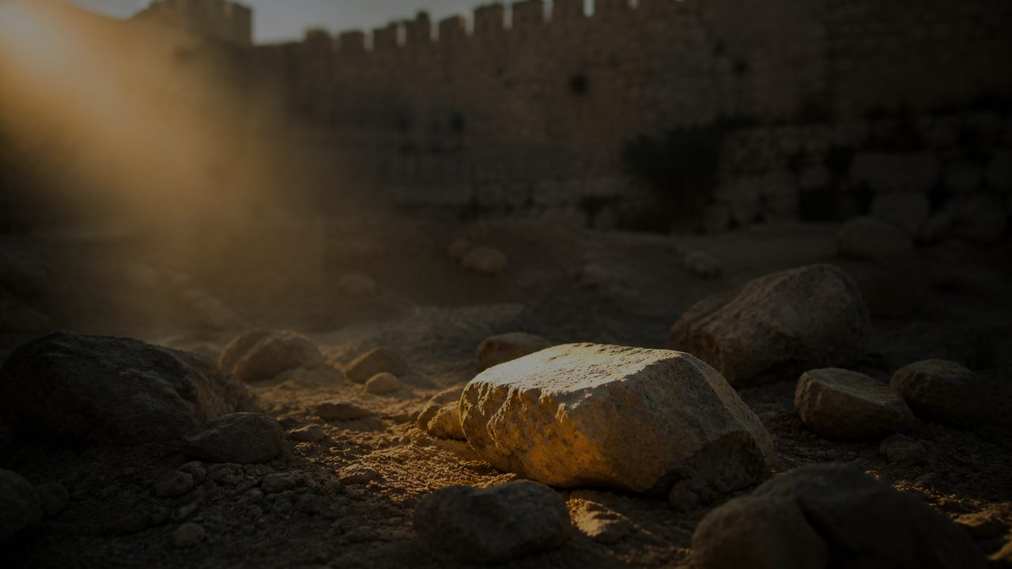
Stephen is connected, but not controlled.
He speaks truth.
He prays for his persecutors.
He is governed by the risen Christ.
Holy Presence: From Refuge to Living Stones

Slide 13
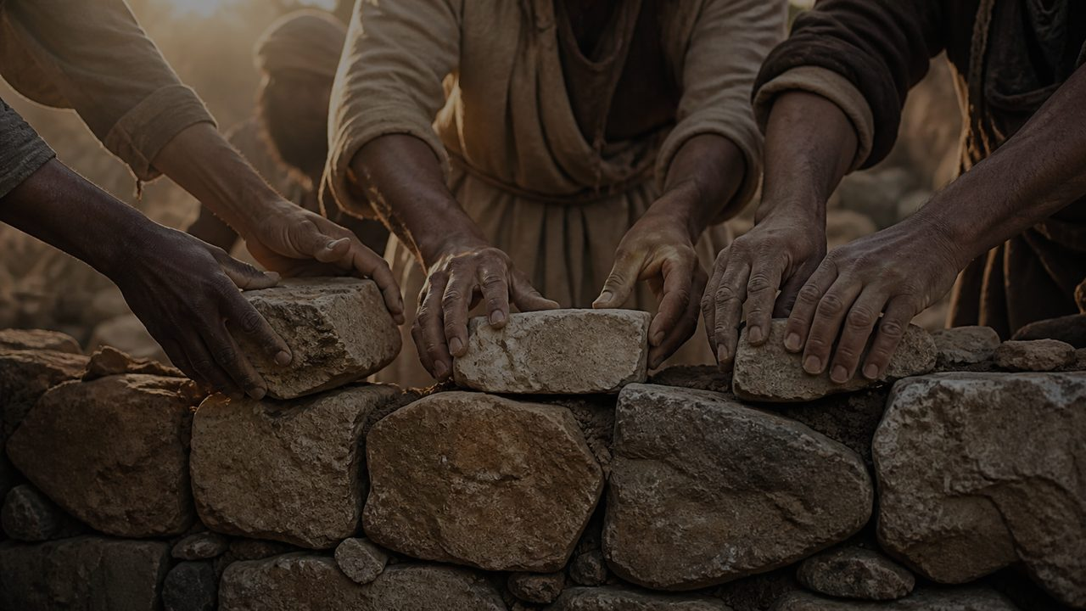
1 Peter 2 — Living Stones:
Christ is the living Stone.
Rejected by people. Chosen by God. Precious to the Father.
“You also, like living stones, are being built into a spiritual house.” (1 Peter 2:5, NIV)

Slide 14
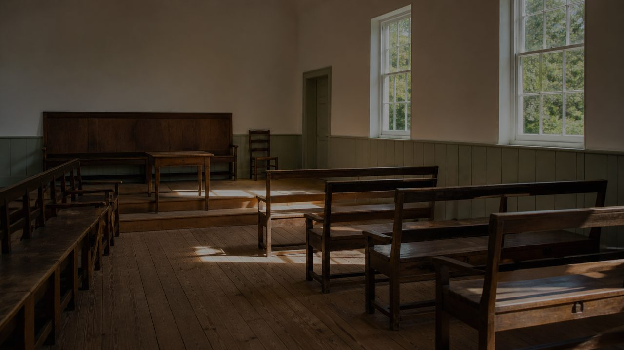
That is the church.
Not a crowd gathered by preference.
Not a brand gathered by taste.
A people built on Jesus Christ.
Holy Presence: From Refuge to Living Stones

Slide 15
Vocation, not triumphalism:
Triumphalism says:
“We are chosen, so we are better.”
Vocation says:
“We are chosen, so we are called.”
Chosen for humble, holy witness.
Holy Presence: From Refuge to Living Stones

Slide 16
The purpose of holiness:
Not self-congratulation.
The life of God becoming visible in a people called out of darkness into light.
“that you may declare the praises of him who called you out of darkness into his wonderful light.” (1 Peter 2:9, NIV)

Slide 17
Friends Faith:
The church is not only a place where people hear about God’s presence.
The church is meant to become
a people of God’s presence.
Holy Presence: From Refuge to Living Stones

Slide 18
The Flow of Holiness:
The river runs all the way through.
Psalm 31 • John 14 • Acts 7 • 1 Peter 2
From refuge → revelation → witness → living stones
Holy Presence: From Refuge to Living Stones

Slide 19
Concluding question:
What are we doing with the stones?
The world knows how to throw stones.
Jesus builds a holy house.
Holy Presence: From Refuge to Living Stones

Slide 20
Remember:
When the storm comes, remember the foundation.
When anxiety rises, remember the refuge.
When the way seems unclear, remember Jesus.
When the world picks up stones, remember mercy.
Holy Presence: From Refuge to Living Stones

Slide 21
Invitation:
Come to Christ, the living Stone.
Let him hold you.
Let him center you.
Let him build you.
Let him make us a people of mercy and light.
Holy Presence: From Refuge to Living Stones

Slide 22
Holiness as the Gospel of God made visible.
Holy Presence
from refuge to living stones

