Slide 1

Notes:
Slide 1 of Visio Divina sermon presentation: Free to Stop Holding the World Together.

Slide 2
Notes:
Slide 1 of Visio Divina sermon presentation: Free to Stop Holding the World Together.

Slide 3

Notes:
Slide 2 of Visio Divina sermon presentation: Free to Stop Holding the World Together.

Slide 4

Notes:
Slide 3 of Visio Divina sermon presentation: Free to Stop Holding the World Together.

Slide 5
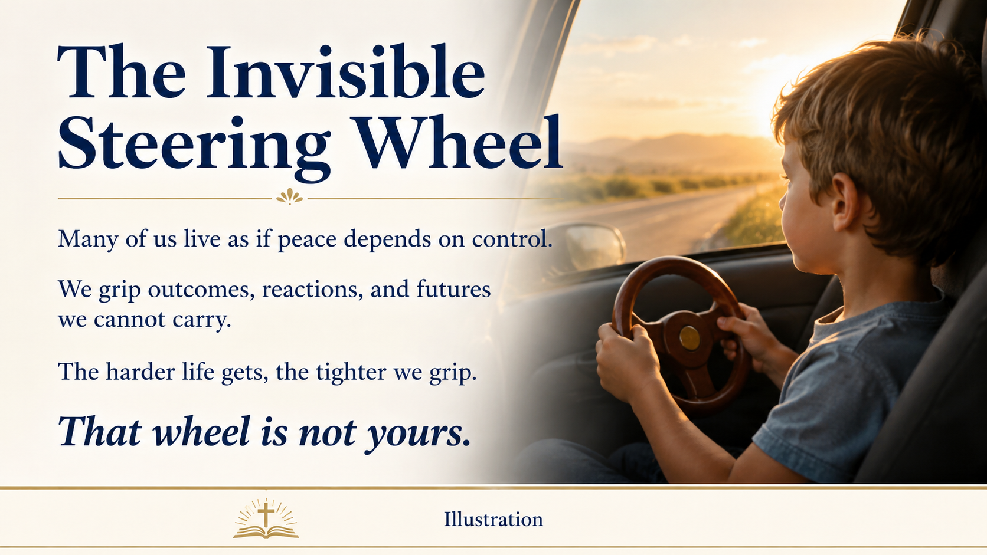
Notes:
Slide 4 of Visio Divina sermon presentation: Free to Stop Holding the World Together.

Slide 6

Notes:
Slide 5 of Visio Divina sermon presentation: Free to Stop Holding the World Together.

Slide 7

Notes:
Slide 6 of Visio Divina sermon presentation: Free to Stop Holding the World Together.

Slide 8

Notes:
Slide 7 of Visio Divina sermon presentation: Free to Stop Holding the World Together.

Slide 9
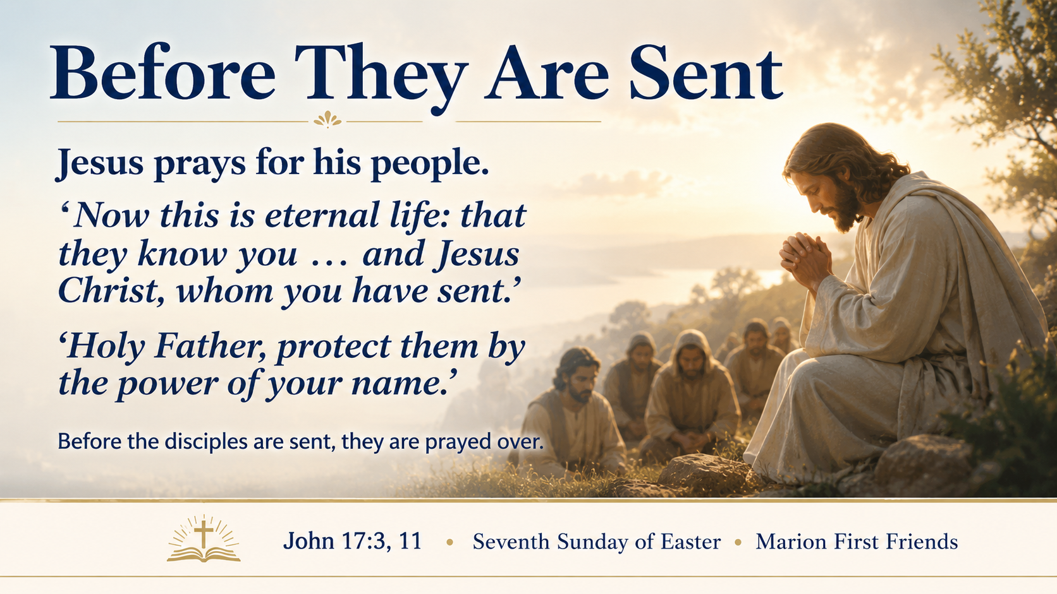
Notes:
Slide 8 of Visio Divina sermon presentation: Free to Stop Holding the World Together.

Slide 10

Notes:
Slide 9 of Visio Divina sermon presentation: Free to Stop Holding the World Together.

