Slide 1
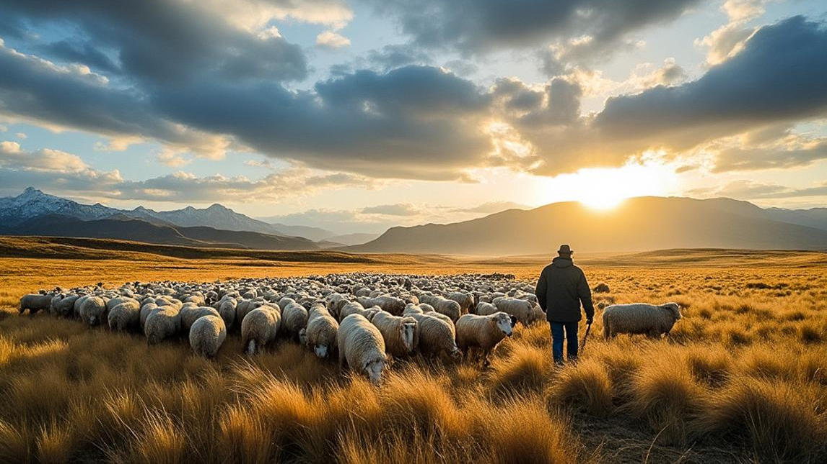
The Shepherd’s Way
April 26, 2026

Slide 2
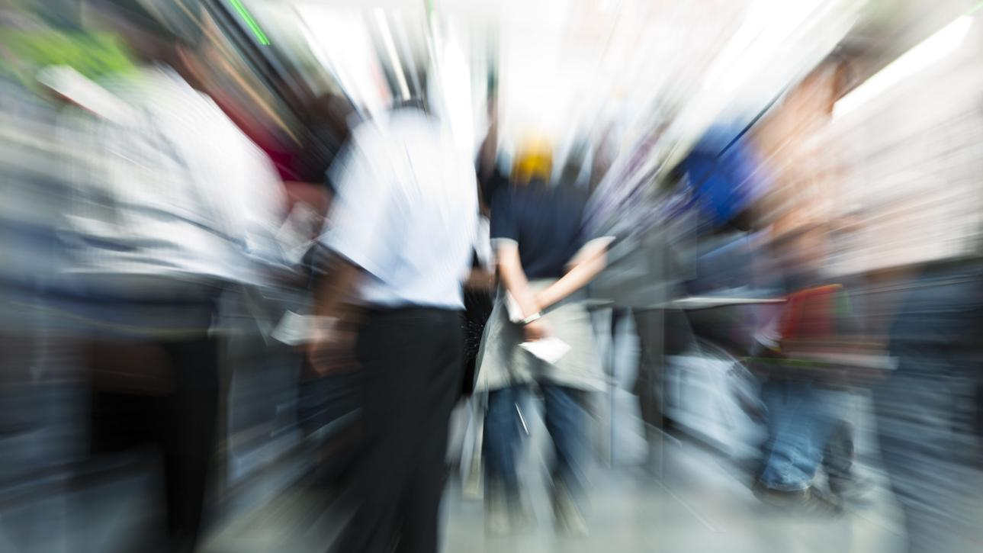
Whose Voice
Are You Living By?

Slide 3

We are all
following something.

Slide 4
We are all
being formed.

Slide 5
Psalm 23 — The Picture
John 10 — The Person
1 Peter — The Path
Acts 2 — The People

Slide 6
The Shepherd Leads

Slide 7
“The Lord is my shepherd…”
(Ps. 23:1)

Slide 8
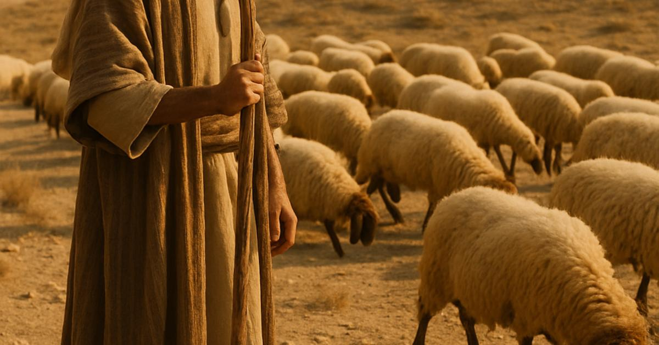
He leads us
through the valley.
The Shepherd
defines reality.

Slide 9

The Shepherd Calls

Slide 10
My sheep listen
to my voice
(John 10:3)

Slide 11
The Shepherd Shapes

Slide 12
Follow in His steps
(1 Pet. 2:21)
God acts
before we respond

Slide 13


The Shepherd Forms a People

Slide 14
They devoted themselves
(Acts 2:42)

Slide 15
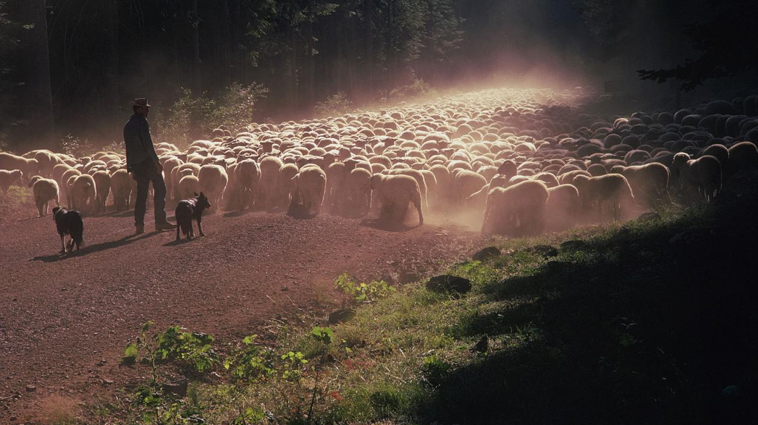
Return to the Shepherd

Slide 16
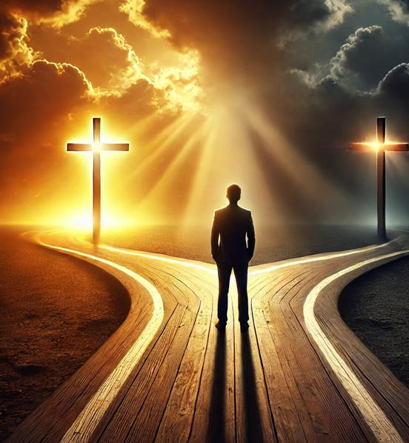
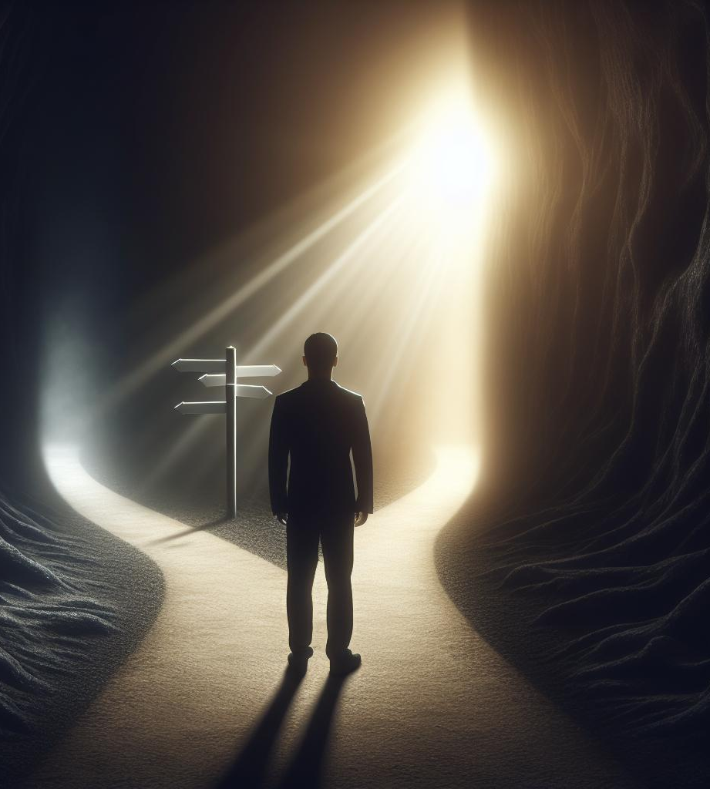
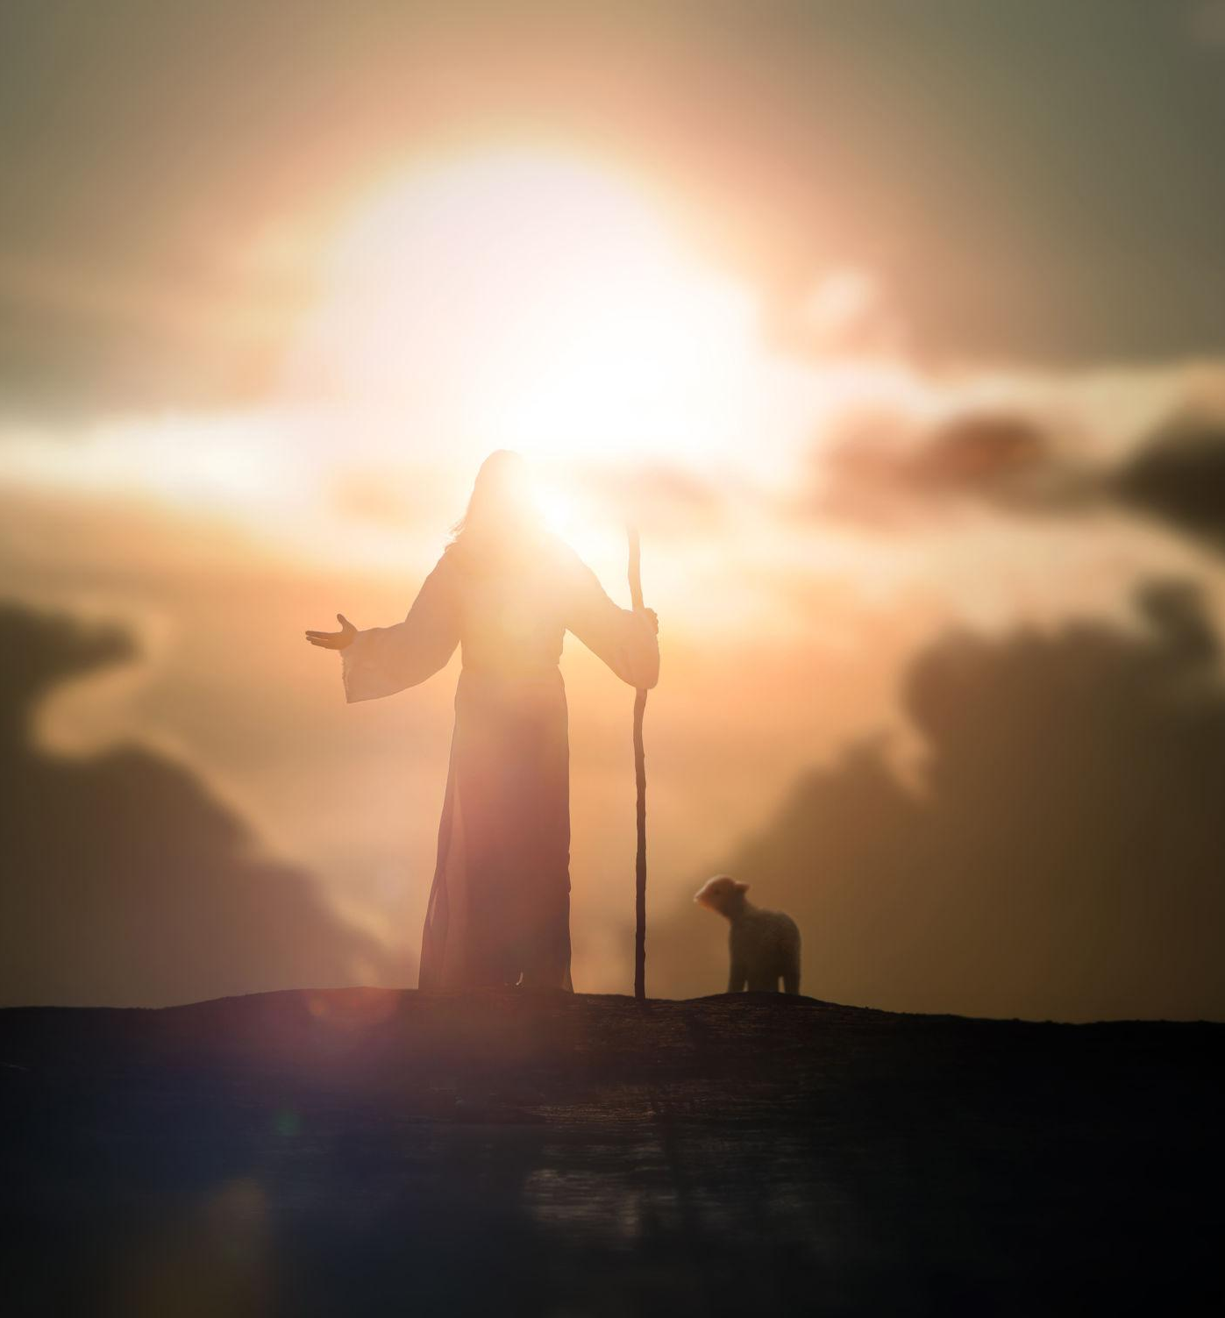
Sit with these images for a moment,
not to analyze, but to notice.

Slide 17
What draws your eye first?
Is it the light? The shadow? The tension between them?

Slide 18
Now gently ask:
Where do I feel pulled in this image? Is there a voice here that feels familiar? Is there a voice here I have been ignoring?

Slide 19
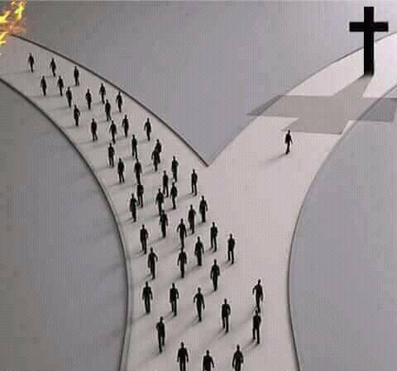
A Friends Reflection:
We are all following something…
The world will always try to speak louder than the Spirit.
  Anxiety speaks.
  Crowds speak.
  Memory speaks.
  Fear speaks.
But Jesus says:
“My sheep listen to my voice;
I know them, and they follow
me.” (John 10:27)

