Slide 1
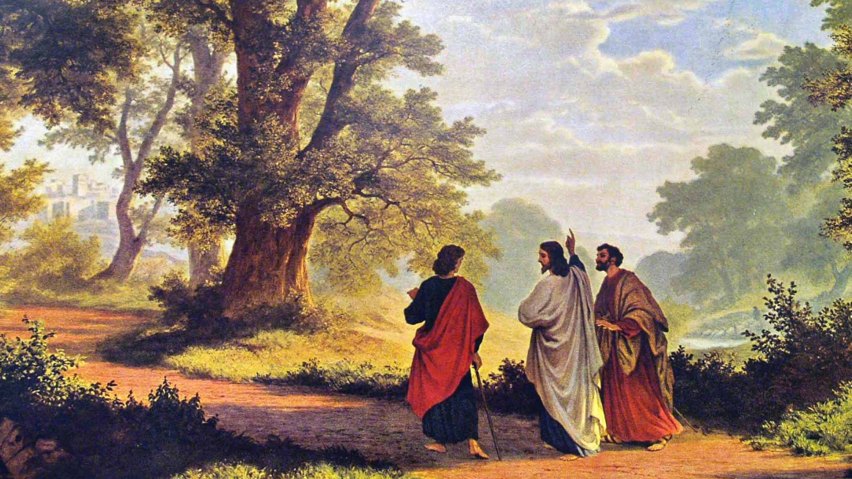
Burning Hearts
and Opened Eyes
The risen Jesus is recognized through the opened Word and shared table,
and when he is truly recognized, he gathers, reforms, and sends a holy people.
4.19.2026
Notes:
[Sources]
- Background image: Robert Zünd, “The Road to Emmaus” (1877), public domain image surfaced via United Methodist News Service: https://www.umnews.org/en/news/walking-with-christ-do-you-know-the-way-to-emmaus
- Foundation statement and sermon arc adapted from user-provided manuscript “4.19.2026 Burning Hearts and Opened Eyes.docx”.

Slide 2
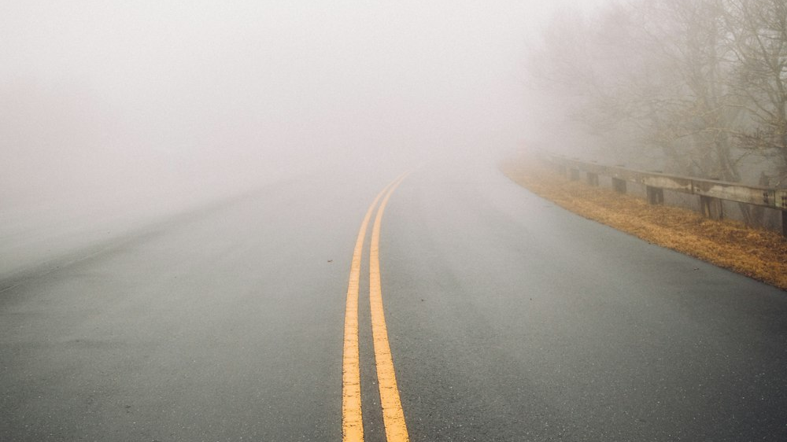

“But we had hoped...” (Luke 24:21, NIV)
The road is right. The vision is fogged.
Notes:
[Sources]
- Foreground sign image supplied by the user in this conversation: “Beware of Invisible Cows.jpg”.
- Background image: Danila Perevoshchikov, foggy road photograph from Unsplash: https://unsplash.com/s/photos/foggy-road
- Scripture quotation: Luke 24:21, New International Version (NIV).

Slide 3
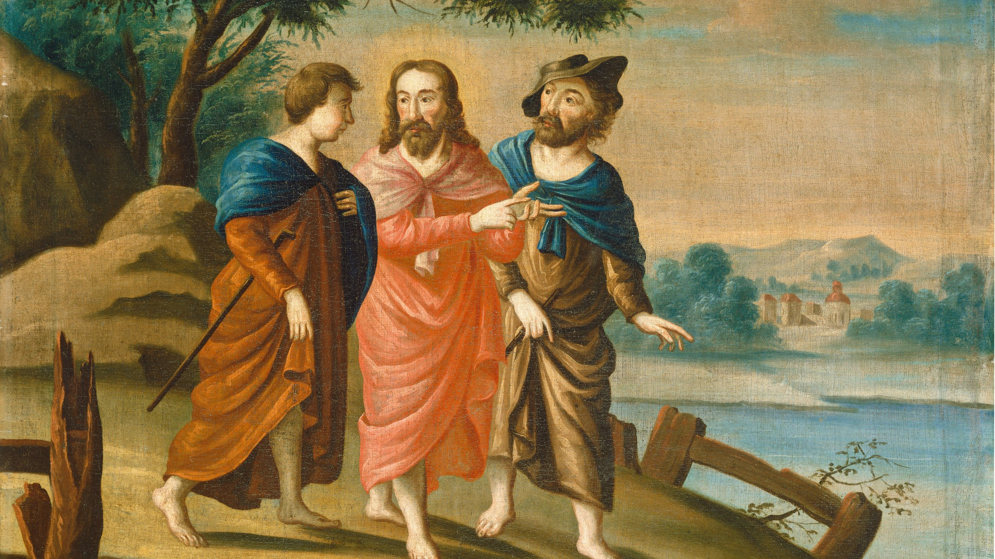
Confusion
on the road
Confusion is real.
Confusion is not the end of the road.
Grace comes before clarity.
Presence comes before perception.
Luke 24:13–27
Notes:
[Sources]
- Background image: “Christ on the Road to Emmaus,” c. 1725–1730, National Gallery of Art, public domain: https://www.nga.gov/artworks/50692-christ-road-emmaus
- On-slide text adapted from user-provided manuscript “4.19.2026 Burning Hearts and Opened Eyes.docx”.

Slide 4
“He explained to them what was said in all the Scriptures concerning himself…”
Seed of the Woman: Genesis 3:15; The Suffering Servant: Isaiah 53 ; The King from Bethlehem: Micah 5:2; Divinity and Reign: Isaiah 9:6-7; The Pierced One: Zechariah 12:10; The Passover Lamb: Exodus 12; The Rock in the Wilderness: Exodus 17; The Bronze Serpent: In Numbers 21; The Priest-King: Genesis 14; The Angel of the LORD: Gen 16:7; The Fourth Man: Daniel 3:25; Prophecy of the resurrection: Psalm 16:10; Isaiah 53:10–12; Jonah 1:17 (and 2:10); Hosea 6:2; Job 19:25–27; Psalm 22…
The Third Day… No Decay… Victory Over Death…
Notes:
[Sources]
- Background image: Shane Hoving, sunlit open Bible photograph from Unsplash: https://unsplash.com/photos/an-open-bible-on-a-table-in-the-sunlight-SZaxKdLwz6o
- Scripture quotation: Luke 24:32, New International Version (NIV).
- Supporting line adapted from user-provided manuscript “4.19.2026 Burning Hearts and Opened Eyes.docx”.

Slide 5
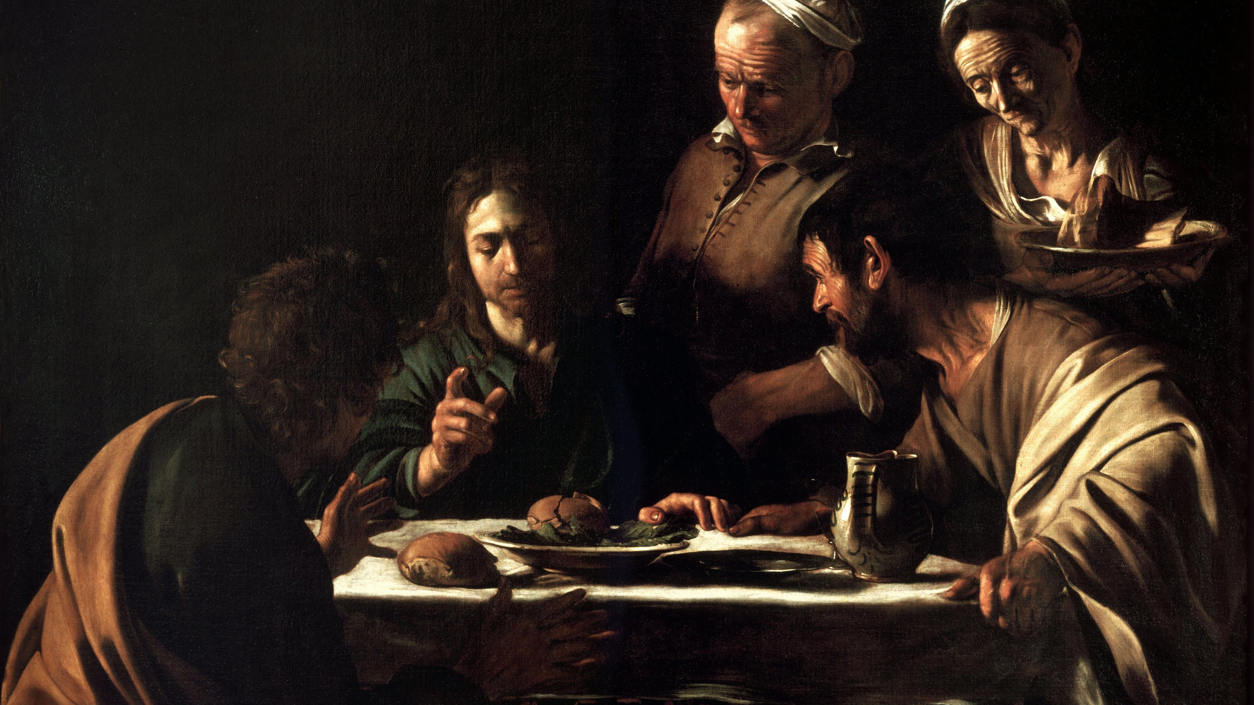
Shared Table, Opened Eyes
“Then their eyes were opened and they recognized him” (Luke 24:31).
Notes:
[Sources]
- Background image: Caravaggio, “Supper at Emmaus” (1606), public domain via Wikimedia Commons: https://commons.wikimedia.org/wiki/File:Supper_at_Emmaus-Caravaggio_(1606).jpg
- Scripture quotation: Luke 24:31, New International Version (NIV).

Slide 6
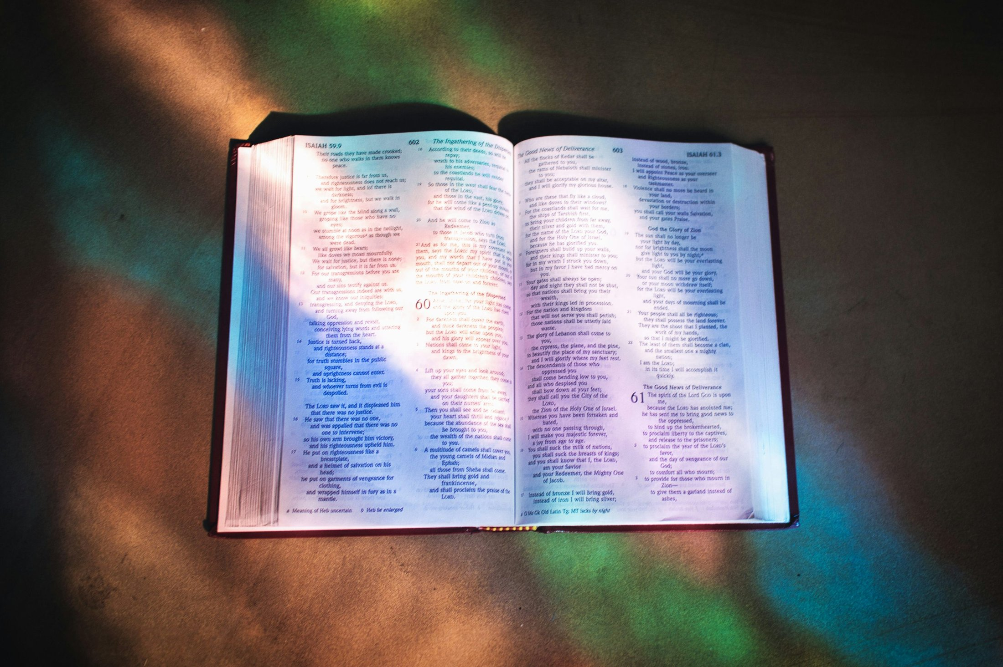
The Opened Word
“Were not our hearts burning within us while he talked with us on the road and opened the Scriptures to us?” (Luke 24:32)
The same Spirit who inspired the Word must illumine the Word.
Acts 2:36–37
Notes:
[Sources]
- Background image: Shane Hoving, sunlit open Bible photograph from Unsplash: https://unsplash.com/photos/an-open-bible-on-a-table-in-the-sunlight-SZaxKdLwz6o
- Scripture quotation: Luke 24:32, New International Version (NIV).
- Supporting line adapted from user-provided manuscript “4.19.2026 Burning Hearts and Opened Eyes.docx”.

Slide 7
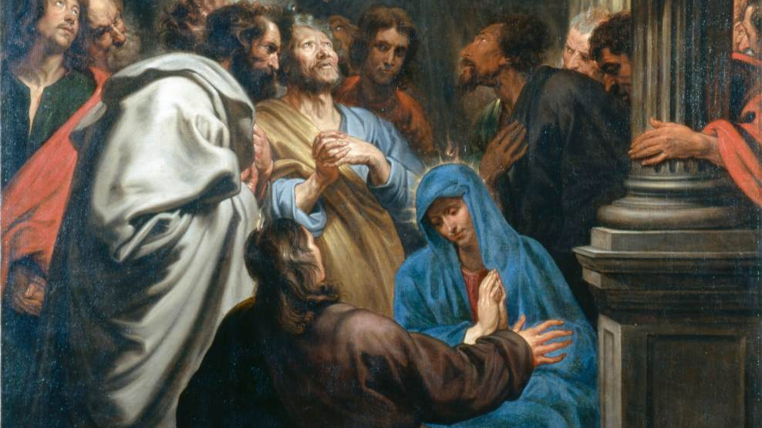
GATHERS
REFORMS
SENDS
Recognition without reform is not yet the full work of Emmaus.
Notes:
[Sources]
- Background image: Anthony van Dyck, “Pentecost,” public domain via Web Gallery of Art / Wikimedia Commons: https://commons.wikimedia.org/wiki/File:Anthony_van_Dyck_-_Pentecost_-_WGA07442.jpg
- On-slide text adapted from user-provided manuscript “4.19.2026 Burning Hearts and Opened Eyes.docx”.

Slide 8
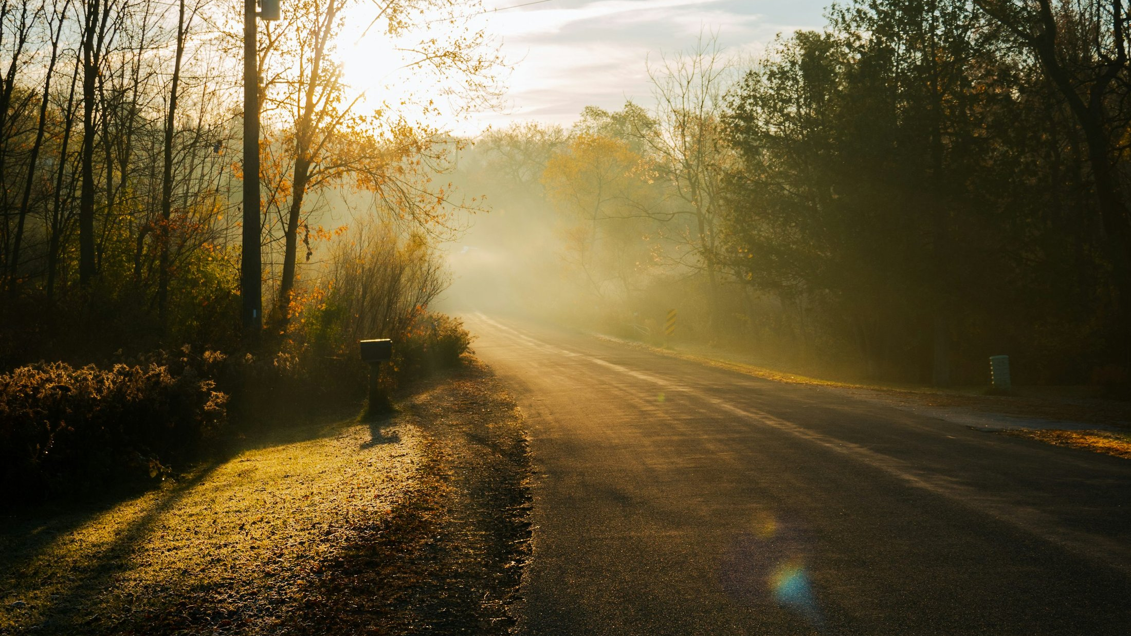
Open our eyes.
Reform our lives.
Send us in holiness.
Where the Spirit opens the Word and Christ is truly recognized, the old life cannot remain untouched.
Notes:
[Sources]
- Background image: early-morning road photograph from Unsplash (related image surfaced in sunrise road search): https://unsplash.com/photos/gray-concrete-road-between-green-trees-during-daytime-SPXPqDdIFco
- Closing lines adapted from user-provided manuscript “4.19.2026 Burning Hearts and Opened Eyes.docx”.

