Slide 1
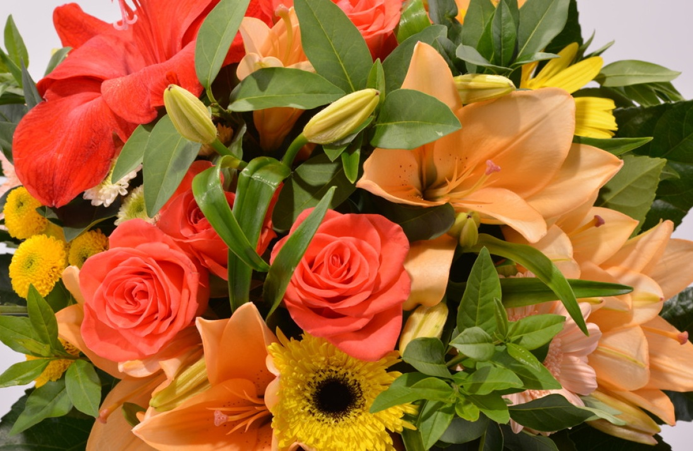

Cut Flowers and New Birth
Why Truth Needs Roots
3.1.2026
Genesis 12:1–4a • Psalm 121 • Romans 4:1–5, 13–17 • John 3:1–17
Notes:
[Sources]
- https://lectionary.library.vanderbilt.edu/2026/02/march-01-2026-second-sunday-in-lent/
[/Sources]

Slide 2
Today’s Roadmap
Texts
Genesis 12:1–4a — God calls Abram by grace
Psalm 121 — The Lord watches over you
Romans 4:1–5, 13–17 — Righteousness is credited by faith
John 3:1–17 — “You must be born again/from above”
Big Idea
Holiness and truth endure only when they are rooted in the living God — not merely “arranged” as ideals.
Notes:
[Sources]
- https://lectionary.library.vanderbilt.edu/2026/02/march-01-2026-second-sunday-in-lent/
[/Sources]

Slide 3
Opener: The Bouquet on the Table
Cut flowers can look alive for a while — but they are severed from roots
A simple image:
Lent exposes what withers
—and re-roots us in Christ.
Beautiful • bright • fragrant
Trim stems • change water • keep it cool
Still… day by day it wilts
Not “bad flowers” — just severed from roots
“You can’t arrange your way into life.”

Slide 4
Trueblood’s “Cut-Flower Civilization”
Why objective truth/right requires living roots
Key claim (paraphrase):
We try to preserve dignity, freedom, and moral seriousness after cutting loose from the faith that gives them roots.
“Belief in objective truth and belief in objective right
are part of what we mean by belief in God.”
— D. Elton Trueblood, The Predicament of Modern Man (1944), 59–60
Notes:
[Sources]
- https://www.religion-online.org/book-chapter/chapter-3-the-impotence-of-ethics/
[/Sources]

Slide 5
1) The Root: God Calls by Grace
Genesis 12:1–4a
God initiates before Abram can prove anything.
“Go… to the land I will show you.” (Genesis 12:1, NIV)
Not résumé-first — relationship-first
Faith begins as a step: “So Abram went…” (Genesis 12:4, NIV)
Holiness grows from answered call, not pressured performance

Slide 6
2) The Keeper: God Watches Over You
Psalm 121
“My help comes from the LORD,
the Maker of heaven and earth.” (Psalm 121:2, NIV)
The temptation: fruit without dependence
We grow exhausted trying to “keep” what only God can keep
When the Lord is trusted as Keeper, anxiety lowers and steadiness grows
Holiness looks like faithful presence (not nervous control)

Slide 7
3) Gift, Not Wages, Romans 4:1–5, 13–17
Paul contrasts two systems:
WAGES
GIFT
Earned
Anxious comparison
Fragile “rightness”
Received by faith
Steady repentance
Rooted righteousness
“Abraham believed God, and it was credited to him as righteousness.” (Romans 4:3, NIV)

Slide 8
4) More Than Sincere: New Birth
Nicodemus is sincere… but Jesus goes to the root.
“No one can see the kingdom of God
unless they are born again.” (John 3:3, NIV)
Not mere moral arrangement — new creation life
“Born of water and the Spirit” (John 3:5, NIV)
The gospel: rescue without condemnation (John 3:16–17, NIV)

Slide 9

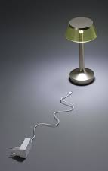
The Unplugged Lamp
Beautiful design, but no power without the Source
If the plug isn’t connected…
Polish it • admire it • discuss it
Power isn’t in the lamp — it’s in the source
So: holiness needs communion with God

Slide 10
Where Are We Arranging Instead of Rooting?
Self-reflection question
Where am I trying to “arrange” a good life (appearance, control, performance)instead of staying rooted in Christ?
Three places to notice it:
Personal life — managing impressions vs. prayerful surrender
Church life — rewarding force vs. patient fruit of the Spirit
Public witness — loud “flowers” vs. steady rooted love

Slide 11
A Clear Invitation
Five simple steps shaped by today’s texts
Hear the call — like Abram (Genesis 12:1–4a)
Trust the Keeper — like Psalm 121
Receive righteousness — gift, not wages (Romans 4)
Come to Jesus honestly — like Nicodemus (John 3)
Be born from above — surrender to the Spirit
Key takeaway: A bouquet can be arranged — but fruit must be grown.

Slide 12
“The LORD will watch over your coming and going
both now and forevermore.” (Psalm 121:8, NIV)
Amen.

