Slide 1
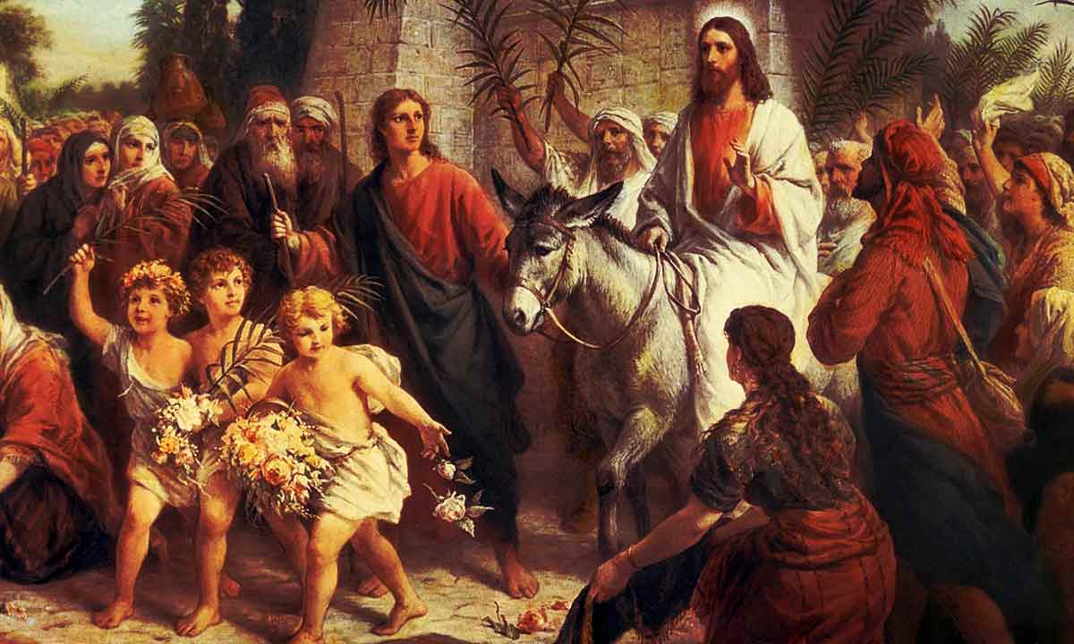
“All Gory, Laud and Honor” Hymn 249
All glory, laud, and honor,
to thee, Redeemer, King,
to whom the lips of children
made sweet hosannas ring.

Slide 2
“All Gory, Laud and Honor”
Thou art the King of Israel,
thou David's royal Son,
who in the Lord's name comest,
the King and Blessed One.

Slide 3
“All Gory, Laud and Honor”
The people of the Hebrews
with psalms before thee went;
our prayer and praise and anthems
before thee we present.

Slide 4
“All Gory, Laud and Honor”
To thee, before thy passion,
they sang their hymns of praise;
to thee, now high exalted,
our melody we raise.

Slide 5
“All Gory, Laud and Honor”
Thou didst accept their praises;
accept the prayers we bring,
who in all good delightest,
thou good and gracious King.

Slide 6
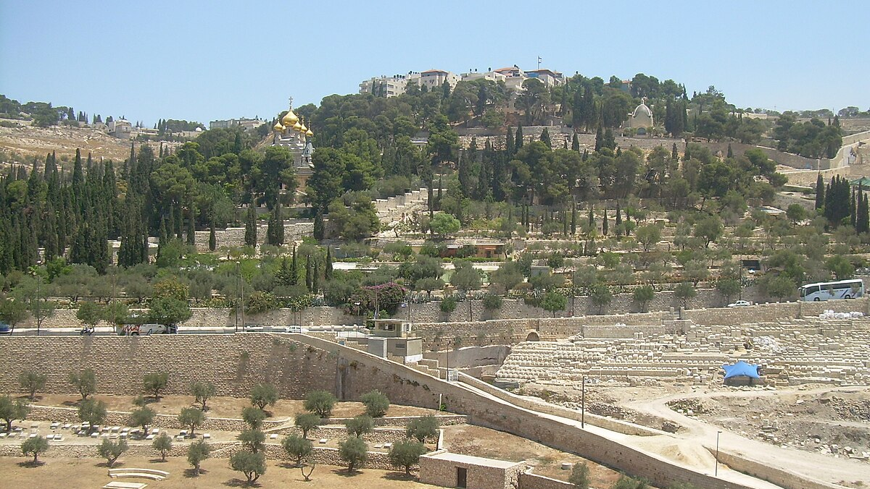
Matthew 21:1–11 • Psalm 118:1–2, 19–29 • Philippians 2:5–11
WHO IS THIS?
Palm/Passion Sunday
3.29.2026
Notes:
[Sources]
User-provided manuscript: 3.29.2026 Who Is This. When the King Arrives.docx.
Revised Common Lectionary, Year A, Palm/Passion Sunday for March 29, 2026: https://lectionary.library.vanderbilt.edu/.
Asset: “Jerusalem, Mount of olives 3862.JPG,” photo by Nemo, Wikimedia Commons, CC BY-SA 3.0, https://commons.wikimedia.org/wiki/File:Jerusalem,_Mount_of_olives_3862.JPG.
[/Sources]

Slide 7
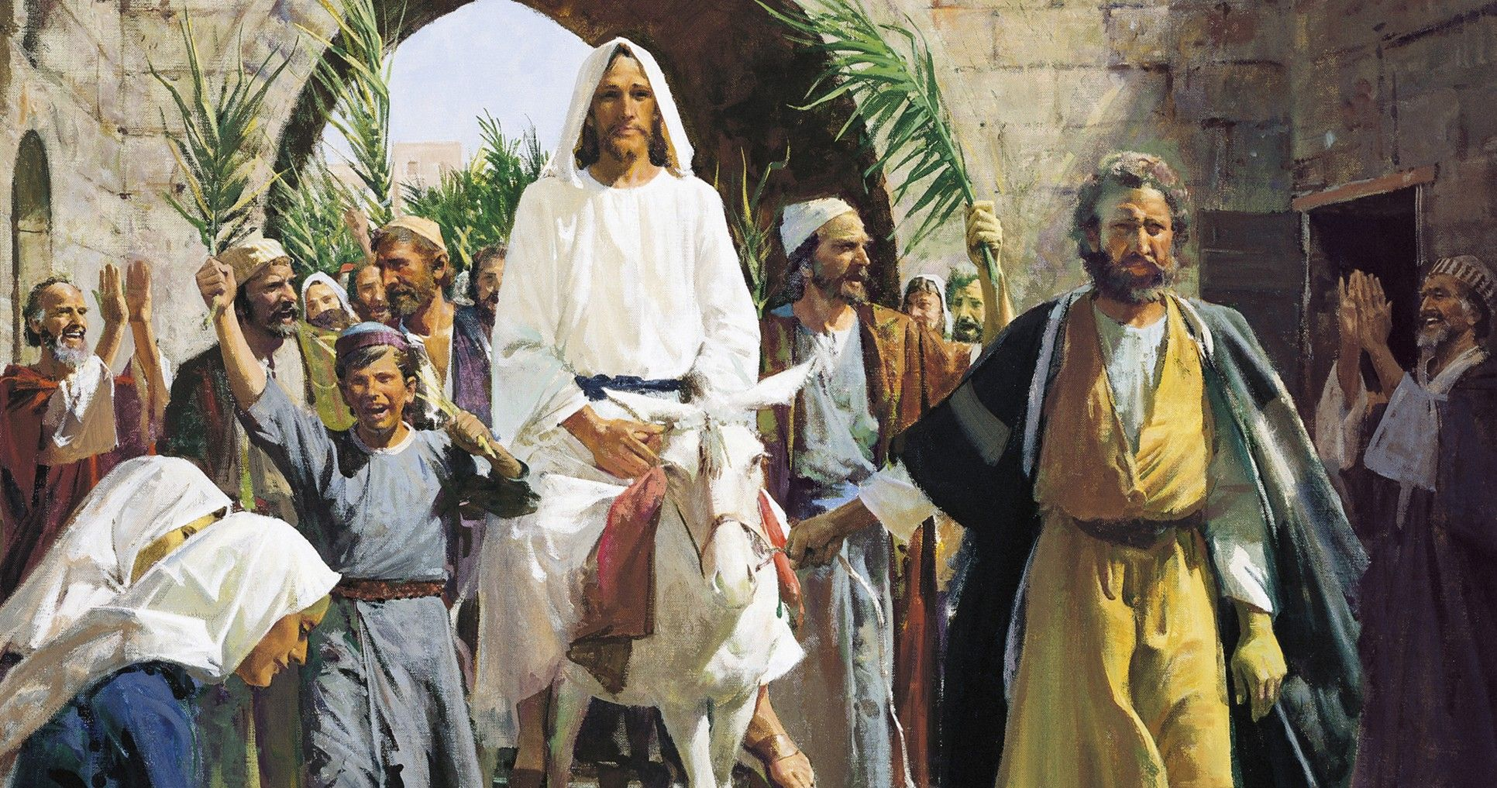
The city is stirred
“When Jesus entered Jerusalem, the whole city was stirred and asked, ‘Who is this?’” (Matt. 21:10).
Not only for Jerusalem.
For the church.
For every heart.
Notes:
[Sources]
Primary text for this slide: Matthew 21:10 (NIV).
Visual emphasis and supporting line adapted from the user-provided sermon manuscript.
Asset: “Christ’s Triumphal Entry into Jerusalem,” The Church of Jesus Christ of Latter-day Saints media library, https://www.churchofjesuschrist.org/media/image/triumphant-entry-jesus-christ-547dd55?lang=eng.
[/Sources]

Slide 8
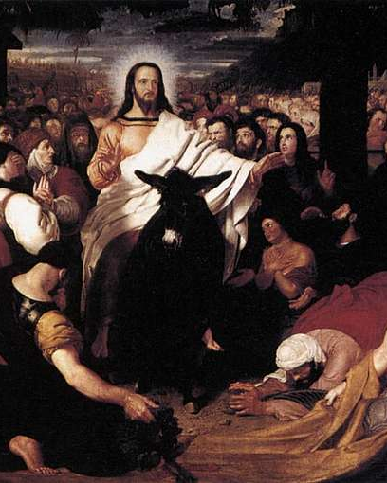
Hearing about Him is not the same as bowing to Him
Many in the crowd had likely heard of Jesus before this day.
But hearing is not the same as yielding.
Some recognize a King.
Others are carried by the crowd.
The gospel begins in a person when Jesus is no longer treated as interesting, useful, or symbolic, but as Lord.
Notes:
[Sources]
Core thesis and supporting language adapted from the user-provided sermon manuscript.
Asset: Benjamin Robert Haydon, “Christ’s Entry into Jerusalem,” public-domain reproduction via PICRYL / Web Gallery of Art, https://picryl.com/media/benjamin-robert-haydon-christs-entry-into-jerusalem-wga11207-8e2388.
[/Sources]

Slide 9
The humble coronation
matthew 21:4–5
“See, your king comes to you, gentle and riding on a donkey” (Matt. 21:5).
Worldly coronation
Christ’s arrival
warhorse
—
donkey
spectacle
—
gentleness
force
—
peace
admiration
—
allegiance
Notes:
[Sources]
Primary text for this slide: Matthew 21:4–5 (NIV).
Comparison points adapted from the user-provided sermon manuscript and the sermon’s line about “the humble coronation of King Jesus.”
[/Sources]

Slide 10
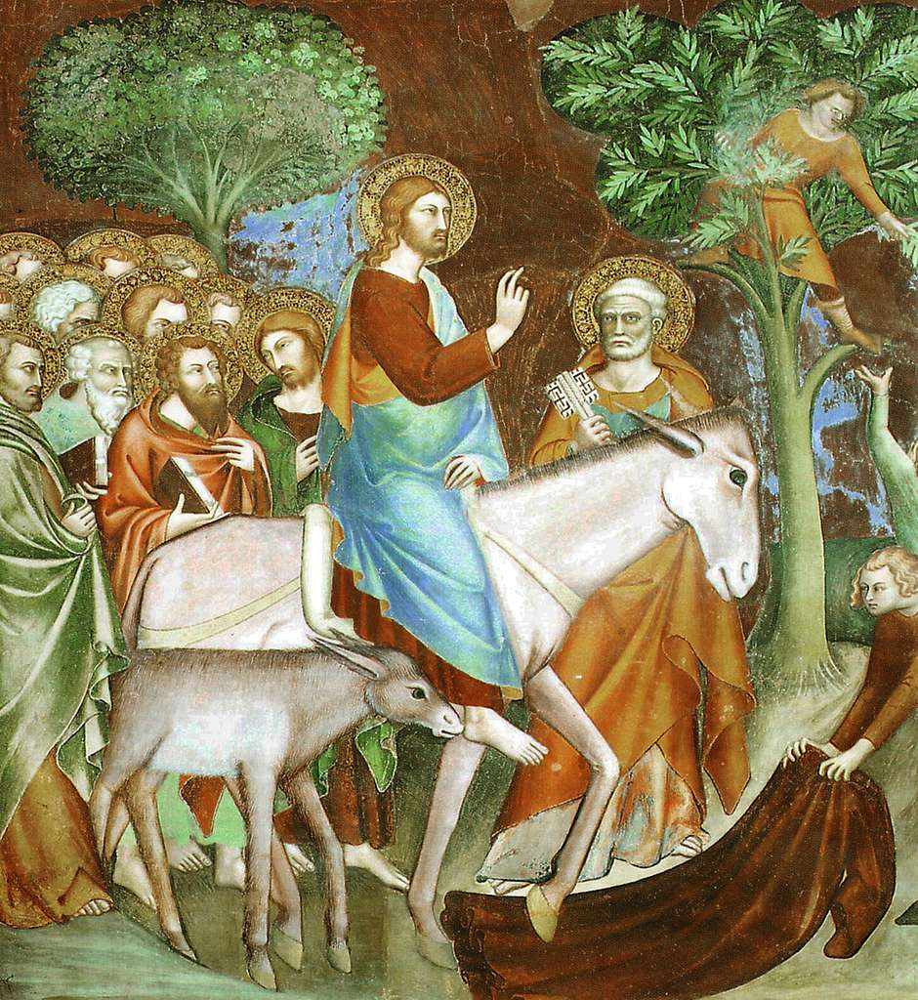
“Hosanna” is a true cry
but a true cry can still carry a shallow expectation
Fast relief
Visible victory
Public reversal
Deeper healing
A new ruler
A truer salvation
≠
“Lord, save us!” (Ps. 118:25).
Notes:
[Sources]
Primary texts for this slide: Psalm 118:25–26 (NIV) and Matthew 21:9 (NIV).
Interpretive emphasis adapted from the user-provided sermon manuscript.
Asset: “SG NT Jesus rides into Jerusalem,” public-domain reproduction via PICRYL, https://picryl.com/media/sg-nt-jesus-rides-into-jerusalem-lippi-memmo-d3919a.
[/Sources]

Slide 11
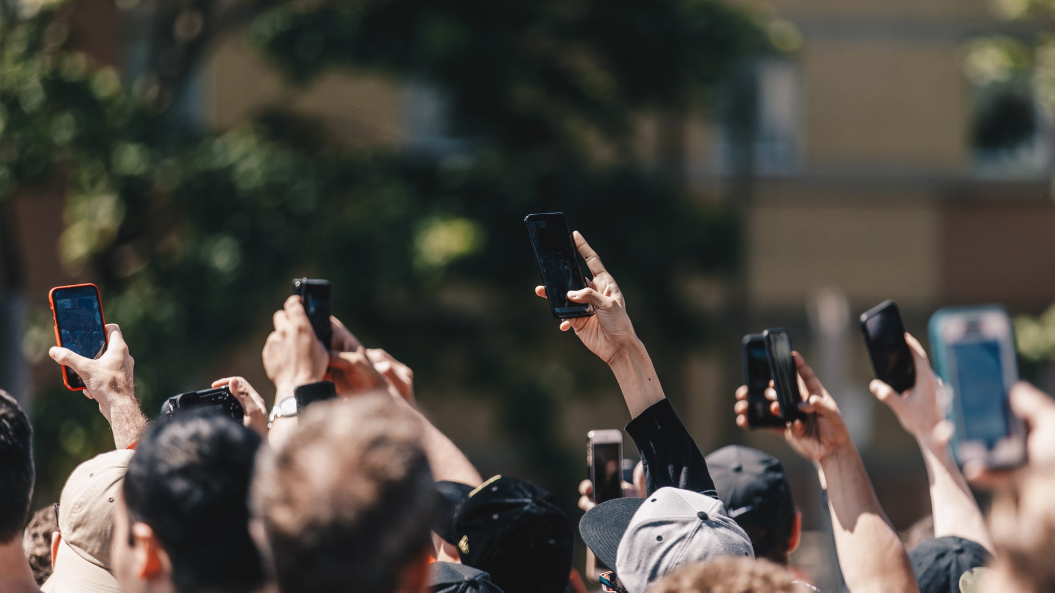
The crowd has multiplied…
palm sunday still speaks today
Crowds form quickly.
Opinions harden fast.
Even a just concern can drift
when truth, humility, and
Christ’s lordship are lost.
Palm Sunday is not a warning against public concern.
It is a warning against letting the crowd become lord of the conscience.
Notes:
[Sources]
Application language adapted from the user-provided sermon manuscript.
Asset: “A Protest In the Street Holds Up Mobile Phones,” photo by Matthew Henry via Burst (Shopify), https://www.shopify.com/stock-photos/photos/a-protest-in-the-street-holds-up-mobile-phones.
[/Sources]

Slide 12
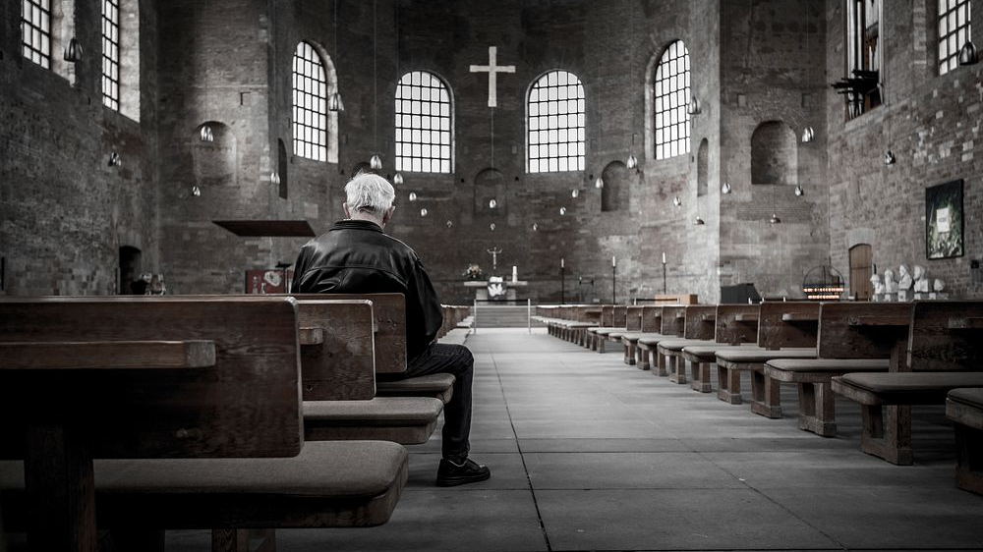
Gathered again to the Divine Center
The answer is not cynicism or isolation.
The answer is to become inwardly gathered around Christ in holy obedience.
wait
listen
test in the Light
Notes:
[Sources]
Thomas R. Kelly, A Testament of Devotion (New York: Harper & Brothers, 1941).
Friends/Quaker application language adapted from the user-provided sermon manuscript.
Asset: “Priest praying at church. Original public domain image from Wikimedia Commons,” via rawpixel, https://www.rawpixel.com/image/3337271/free-photo-image-cross-aisle-altar.
[/Sources]

Slide 13
WHO MOVED
THE HAND?
Faith or the pull of the crowd?
“The Lord looks at the heart.” 1 Samuel 16:7
“Do not follow the crowd in doing wrong.” Exodus 23:2
“Be transformed by the renewing of your mind.” Romans 12:2
Borrowed faith will not sustain you
when the parade ends.
Palm Sunday

Slide 14
Holiness begins…
when jesus is recognized rightly and received fully
Holiness begins when the soul stops negotiating and starts yielding.
Holiness begins when the church stops treating Jesus as mascot
and receives him as Lord.
Holiness begins when a people are freed from crowd-thinking
and gathered again to the Divine Center in holy obedience.
Notes:
[Sources]
Holiness language adapted from the user-provided sermon manuscript.
Supporting theme: Carole Dale Spencer, Holiness: The Soul of Quakerism (Milton Keynes, UK: Paternoster, 2007).
[/Sources]

Slide 15
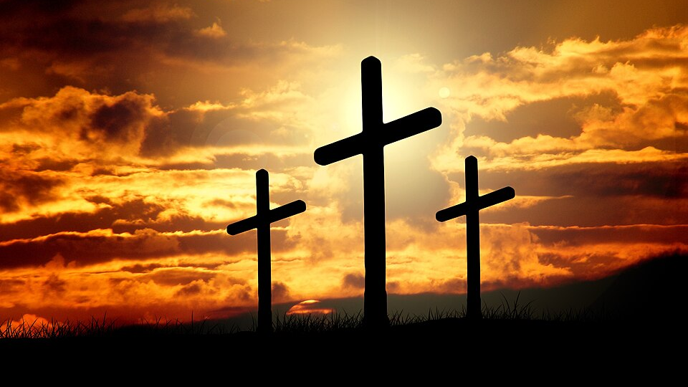
A response for holy week
Who is this?
Where do you need Christ to free you from crowd-thinking and lead you into holy obedience?
Do not merely admire the scene.
Do not merely stand because everyone else is standing.
Receive the King.
Notes:
[Sources]
Closing response adapted from the user-provided sermon manuscript.
Asset: “Cross (3).jpg,” Wikimedia Commons / Pixabay user Geralt, CC0, https://commons.wikimedia.org/wiki/File:%22Cross%22_(3).jpg.
[/Sources]

