Slide 1


Slide 2

April!
Coming Soon…

Slide 3
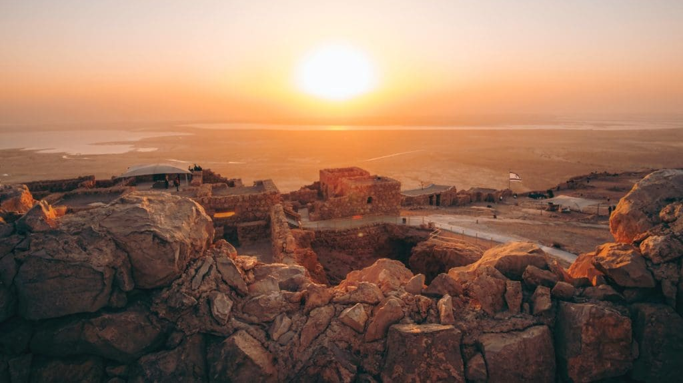
Listen to the Land Bible Study
Tuesday Evenings, 5:30 pm
Temple Church with Pastor Paul & Jeff

Slide 4
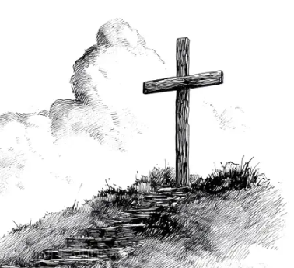
Foundation: What is a Friend?
A 12-Week Friends Examination, Holiness, and Distinctives Course
Date Change:
We will start on April 8th in the Library
Wednesdays at 5:30 pm.

Slide 5

Wednesday, April 1st at 6:30 pm
Saturday, April 4th at 2:00 pm

Slide 6

Easter Breakfast, April 5th, 2026

Slide 7
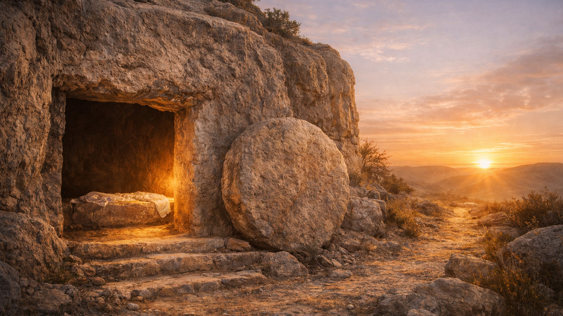
Notes:
[Sources] - Sermon texts: Ezekiel 37:1–14; Psalm 130; Romans 8:6–11; John 11:1–45. [/Sources]

Slide 8
Move the Stone
Obedient Participation in the Life of God
3.22.2026
Ezekiel 37:1–14 · Psalm 130 · Romans 8:6–11 · John 11:1–45
Notes:
[Sources] - Sermon texts: Ezekiel 37:1–14; Psalm 130; Romans 8:6–11; John 11:1–45. [/Sources]

Slide 9
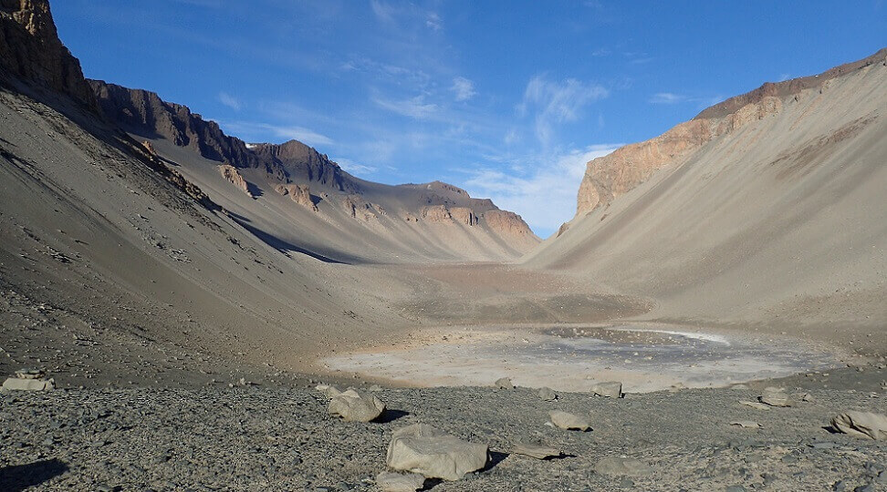

Slide 10
The first truth is that no situation is too far gone for God.
The second truth is that life comes not from our effort, but from God’s own breath.

Slide 11

Take Away 1 · Ezekiel 37 · Psalm 130 · Romans 8 · John 11
No situation is too far gone for God.
Dry bones. The depths.
A sealed tomb.
Scripture piles up impossibility
so no one mistakes resurrection
for self-improvement.
No dead place is beyond the reach of God.
Notes:
[Sources] - Background image: “Desert Sunrise 602,” Public Domain Pictures, CC0 Public Domain, source: turn0image1. - Sermon claim derived from Ezekiel 37:1–14; Psalm 130; Romans 8:6–11; John 11:1–45. [/Sources]

Slide 12
Take Away 2: Ezekiel 37 · Psalm 130 · Romans 8 · John 11
True life comes from the Lord alone, and those who hear his voice must answer with obedient faith.
From despair to breath
From the depths to hope
From flesh to Spirit
From tomb to life
Lent is not only about admitting death;
it is about learning where life comes from.
Notes:
[Sources] - Theological flow and big idea derived from Ezekiel 37:1–14; Psalm 130; Romans 8:6–11; John 11:1–45. [/Sources]

Slide 13

Ezekiel 37 · Romans 8
The Holy Spirit is the agent of new life.
What breath does in Ezekiel,
the Spirit does in Romans.
God does not merely advise
the dead; he animates them.
This is more than encouragement.
It is divine re-creation.
Notes:
[Sources] - Background image: “Tall Grass Sunrise,” Public Domain Pictures, CC0 Public Domain, source: turn0image6. - Sermon claim derived from Ezekiel 37:1–14 and Romans 8:6–11. [/Sources]

Slide 14
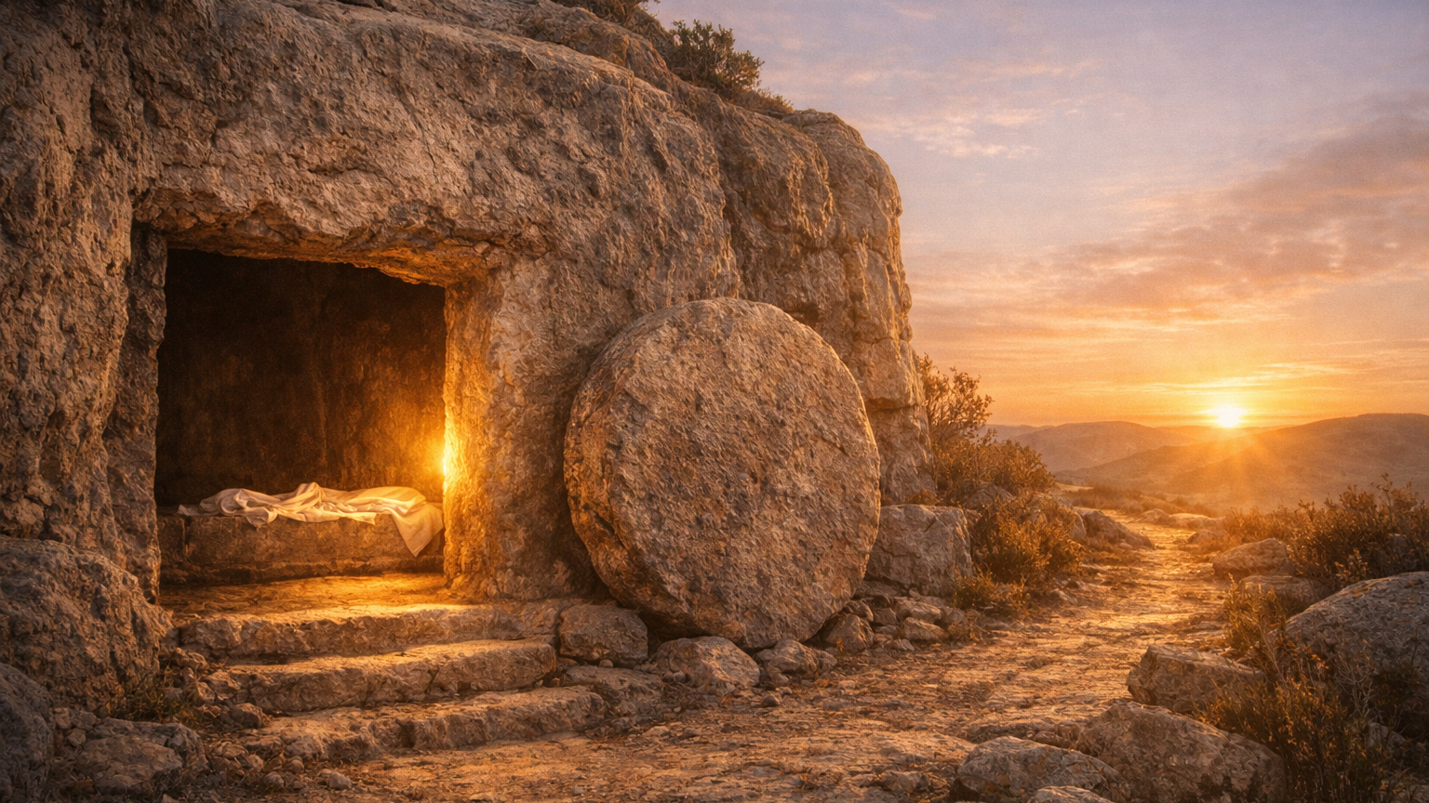
Take Away 3: John 11:1–45
Resurrection has a present tense.
Jesus is not only promising
a future doctrine.
He stands before the tomb
as its source now.
He does not merely explain resurrection;
he embodies present power.
Notes:
[Sources] - Sermon claim derived from John 11:1–45. [/Sources]

Slide 15

Take Away 4: John 11 · Romans 8
Resurrection leads into holiness, not mere relief.
Stones are moved.
Grave clothes come off.
The Spirit forms a holy people
who learn to live in the life
God gives.
Notes:
[Sources] - Background image: “Forest Path Sunrise,” Public Domain Pictures, CC0 Public Domain, source: turn0image2. - Sermon claim derived from John 11:1–45 and Romans 8:6–11. [/Sources]

Slide 16
Reflection question
What stone may Christ
be asking you to move
so, life can be more fully received?
Listen for the voice of the Lord
who still brings life to what feels buried, stalled, or beyond repair.
Notes:
[Sources] - Reflection question and invitation derived from Ezekiel 37:1–14; Psalm 130; Romans 8:6–11; John 11:1–45. [/Sources]

Slide 17
No situation is too far gone for God.
No dead place is beyond the reach of God.
Notes:
[Sources] - Background image: “Desert Sunrise 602,” Public Domain Pictures, CC0 Public Domain, source: turn0image1. - Sermon claim derived from Ezekiel 37:1–14; Psalm 130; Romans 8:6–11; John 11:1–45. [/Sources]

