Slide 1
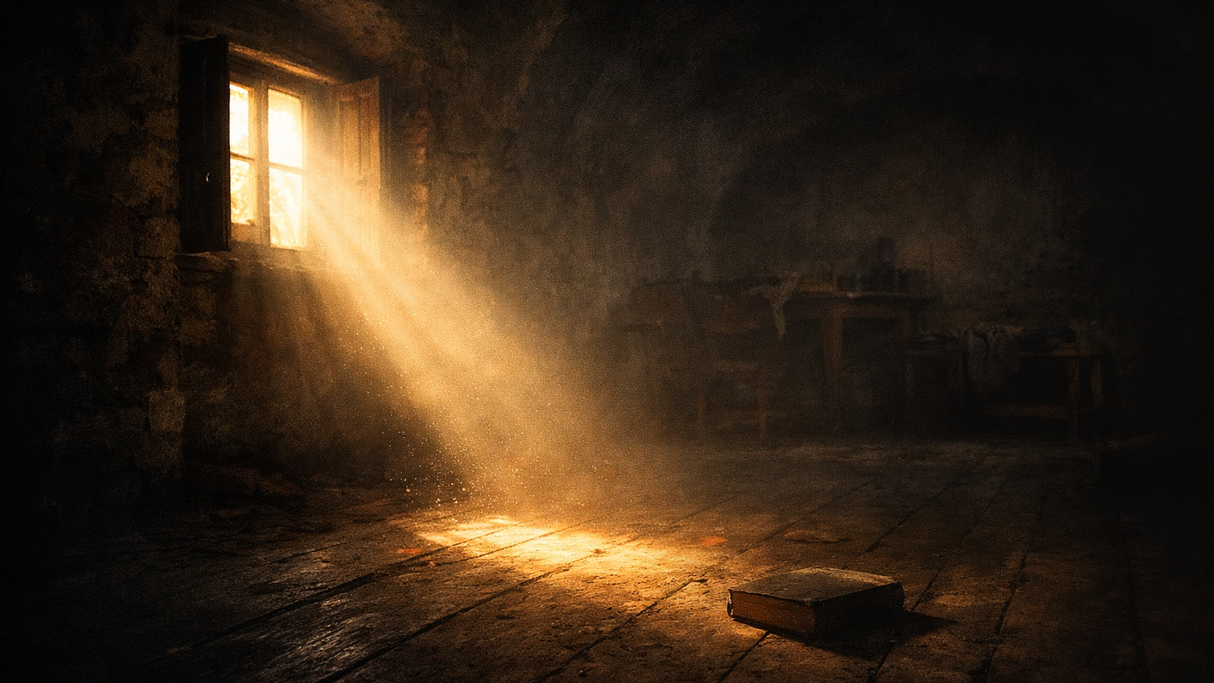
CALL TO WORSHIP
Leader: Come, people of God, out of shadow and into light.
People: We come seeking the mercy and truth of Christ.
Leader: We do not come because we already see clearly.
People: We come because Jesus still opens blind eyes.
Notes:
[Sources] - Revised Common Lectionary, Fourth Sunday in Lent, March 15, 2026
(Vanderbilt Divinity Library):
1 Samuel 16:1–13; Psalm 23; Ephesians 5:8–14; John 9:1–41.

Slide 2
Leader: The Lord looks not at outward appearance, but at the heart.
People: Search us, O God, and lead us in your way.
Leader: The Lord is our Shepherd in green pastures and in dark valleys.
People: We will fear no evil, for you are with us.
Notes:
[Sources] - Revised Common Lectionary, Fourth Sunday in Lent, March 15, 2026
(Vanderbilt Divinity Library):
1 Samuel 16:1–13; Psalm 23; Ephesians 5:8–14; John 9:1–41.

Slide 3
Leader: Once we were darkness, but now we are light in the Lord.
People: Teach us to live as children of light.
Leader: Come, let us worship the living Christ, who meets us in mercy, awakens us in truth, and leads us in holiness.
People: We come to worship, to listen, and to walk in the Light.
Notes:
[Sources] - Revised Common Lectionary, Fourth Sunday in Lent, March 15, 2026
(Vanderbilt Divinity Library):
1 Samuel 16:1–13; Psalm 23; Ephesians 5:8–14; John 9:1–41.

Slide 4
Notes:
[Sources] - Revised Common Lectionary, Fourth Sunday in Lent, March 15, 2026
(Vanderbilt Divinity Library):
1 Samuel 16:1–13; Psalm 23; Ephesians 5:8–14; John 9:1–41.

Slide 5
3.15.2026
The Grace to See
Jesus still opens blind eyes — and holiness is learning to walk in that light.
1 Samuel 16:1–13 • Psalm 23 • Ephesians 5:8–14 • John 9:1–41
Notes:
[Sources] - Revised Common Lectionary, Fourth Sunday in Lent, March 15, 2026
(Vanderbilt Divinity Library):
1 Samuel 16:1–13; Psalm 23; Ephesians 5:8–14; John 9:1–41.

Slide 6
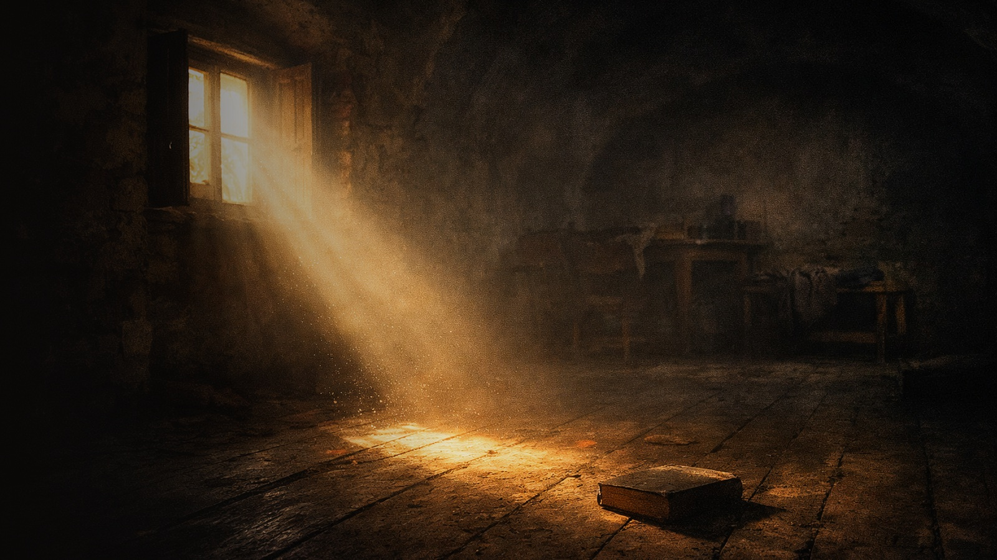
This Sunday’s movement
God sees the heart.
1 Samuel 16
The Shepherd stays with us in the valley.
The good news is not that we have everything figured out, or that we see clearly on our own. The good news is that Jesus brings light where we cannot find our way.
Psalm 23
Christ wakes us to walk in the light.
Ephesians 5
Jesus opens blind eyes and exposes false sight.
John 9
Notes:
[Sources] - Scriptural movement synthesized from 1 Samuel 16:1–13;
Psalm 23; Ephesians 5:8–14; John 9:1–41.

Slide 7
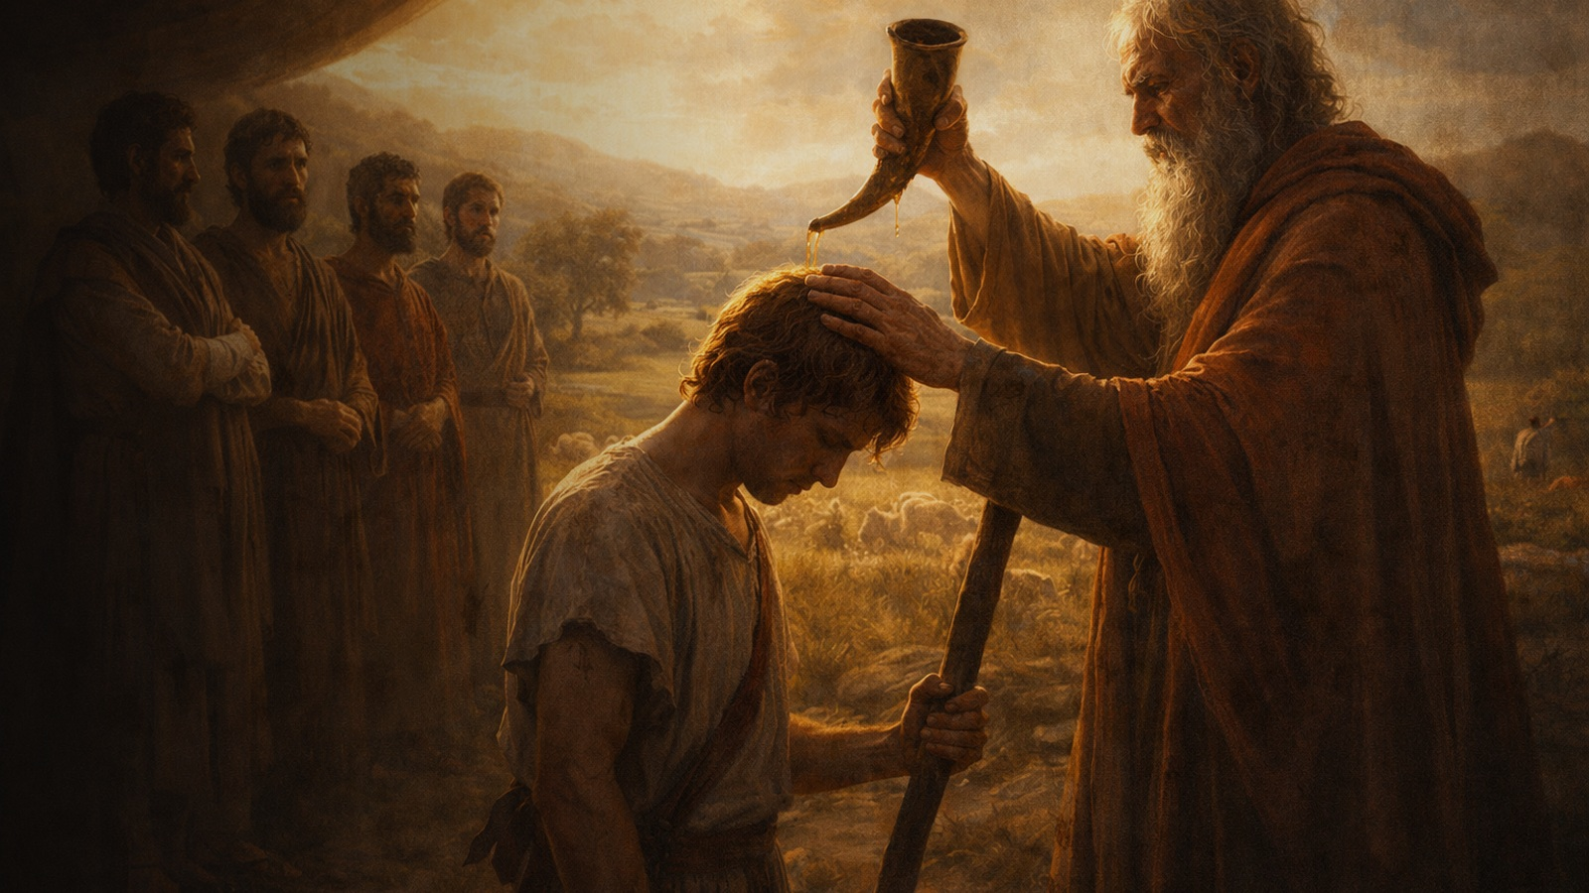
God sees deeper than we do
“People look at the outward appearance, but the Lord looks at the heart.”
(1 Samuel 16:7, NIV)
Samuel sees height, strength, and appearance. God chooses the overlooked shepherd.
Holiness begins where performance ends — when we let God tell the truth about us.
Notes:
[Sources] - 1 Samuel 16:1–13, especially verse 7. - Illustration theme drawn from the sermon manuscript .

Slide 8
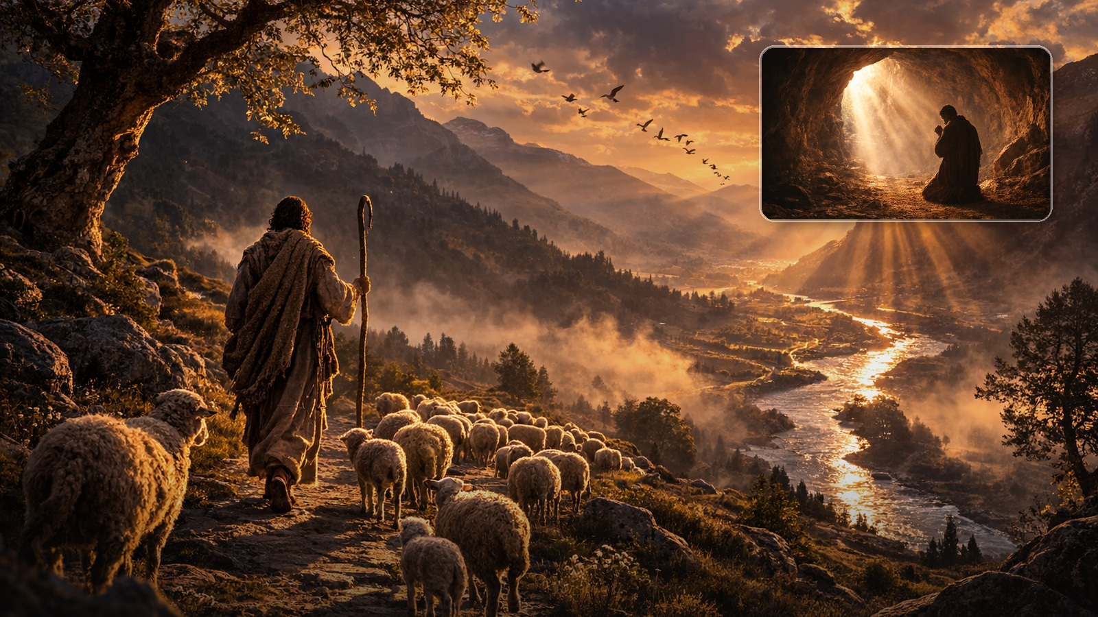
The Shepherd in the valley
“Even though I walk through the darkest valley, I will fear no evil, for you are with me.”
(Psalm 23:4, NIV)
Dark places can become holy places when they become places of prayer, refuge, and remembered presence.
Notes:
[Sources] - Psalm 23, especially verse 4. - Boone cave illustration adapted from the user’s sermon material.

Slide 9
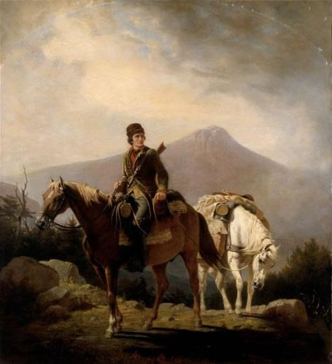
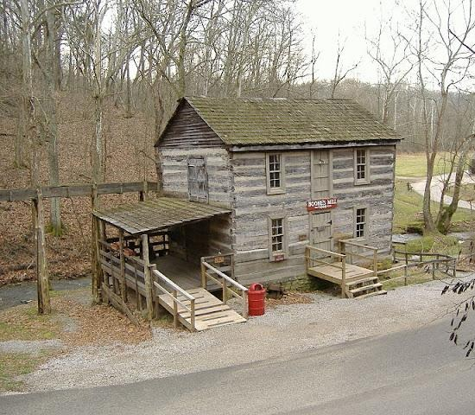
SQUIRE BOONE CAVERNS
100 Squire Boone Rd, Mauckport, IN 47142

Slide 10
The Shepherd in the valley
Boone cave image: not the chase, but the cave, the dark place that became a praying place.
“Even though I walk through the darkest valley, I will fear no evil, for you are with me.”
(Psalm 23:4, NIV)
Dark places can become holy places when they become places of prayer, refuge, and remembered presence.
Notes:
[Sources] - Psalm 23, especially verse 4. - Boone cave illustration adapted from the user’s sermon material.

Slide 11
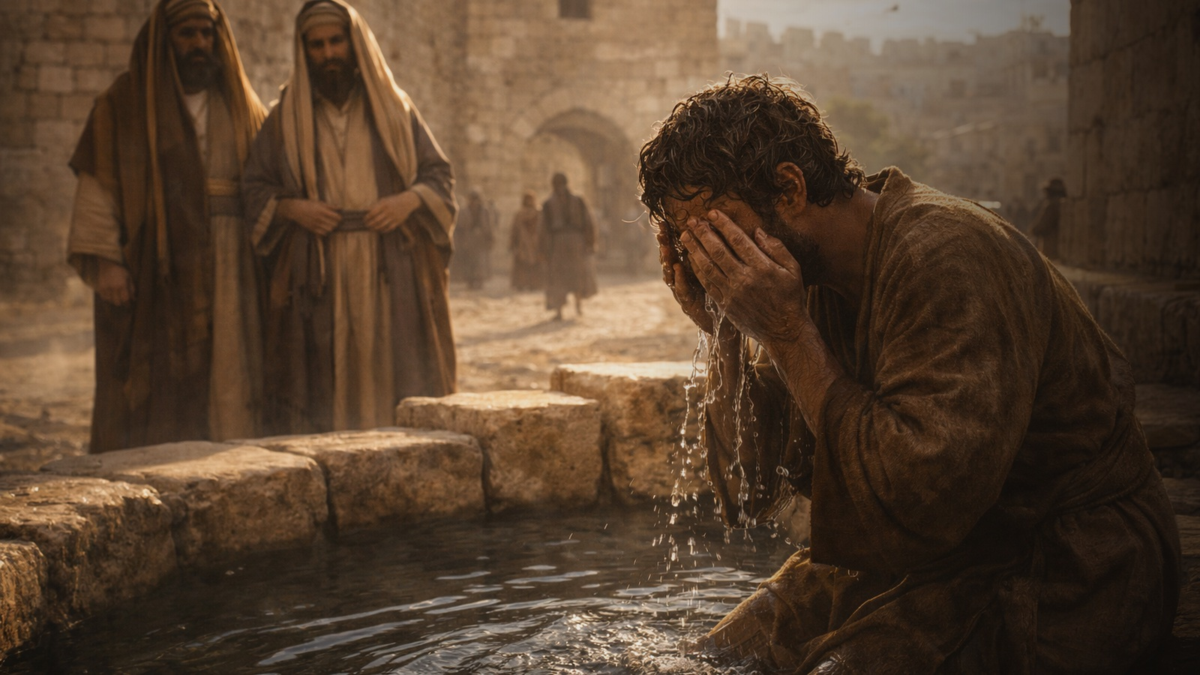
The deepest blindness
is not lack of sight,
it is refusal of light.
“One thing I do know. I was blind but now I see.”
(John 9:25, NIV)
The blind man knows his need. The Pharisees defend their certainty. Jesus heals one kind of blindness and exposes another.
“Wake up, sleeper… and Christ will shine on you.” (Eph. 5:14)
Notes:
[Sources] - John 9:1–41, especially verses 2–3 and 25. - Ephesians 5:8–14, especially verse 14.

Slide 12

Seven Minutes of Light
Read one short Gospel scene from Holy Week slowly.
Sit in silence for two minutes.
Pray: “Lord Jesus Christ, let me see.”
Ask: What am I resisting? Where am I being asked to wait?
End aloud: “The Lord is my shepherd.”
Time. Patience. Listening. Silence.
These practices do not earn grace — they make room to notice it.
Notes:
[Sources] - Application adapted from the sermon manuscript. - Psalm 23:1 and John 9 serve as the prayer frame for the practice.

