Slide 1

A Given Center
Glory That Sends Us Back Down the Mountain
Transfiguration Sunday • 2.15.2026
Notes:
[Sources] - Sermon manuscript ("A Given Center: Glory That Sends Us Back Down the Mountain", 2/15/2026). - Background photo (CC0): https://jooinn.com/images/silhouette-of-mountains-during-sunrise.html [/Sources]

Slide 2
Today’s Scripture Readings
Exodus 24:12–18
Psalm 2 (or Psalm 99)
2 Peter 1:16–21
Matthew 17:1–9
Theme: God reveals Jesus as the beloved Son — and that revelation forms a people who refuse escapism and practice Spirit-grown fruit.
Notes:
[Sources] - Sermon manuscript (lectionary texts + stated theme). - Background photo (CC0): https://jooinn.com/images/silhouette-of-mountains-during-sunrise.html [/Sources]

Slide 3

The battery that won’t hold a charge
Soul-tired often looks like:
Reactivity & quick fixes
Performing / posturing
Control or numbing
Scapegoats & “togetherness pressure”
“What if the center of your life isn’t something you manufacture, but someone you receive?”
Transfiguration Sunday
Notes:
[Sources] - Sermon manuscript (opener imagery + anxiety/reactivity language). - Battery icon: https://creazilla.com/nodes/3230562-battery-low-icon (downloaded PNG). [/Sources]

Slide 4
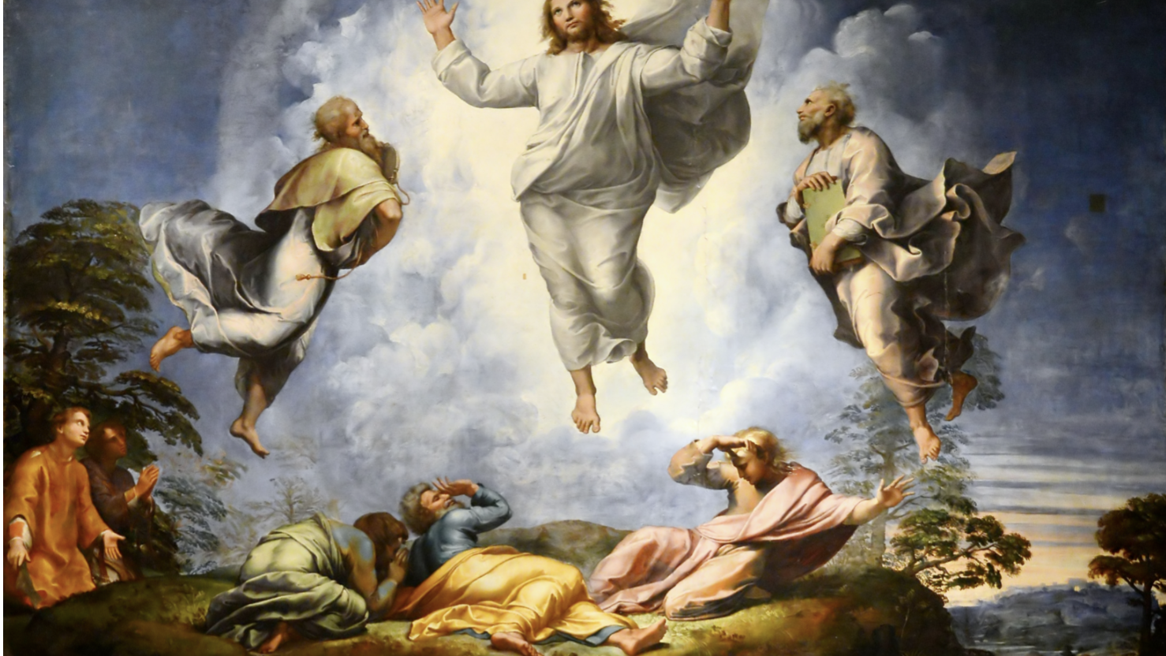
On the mountain, God gives the Center
“This is my Son, whom I love; with him I am well pleased. Listen to him!” (Matthew 17:5, NIV)
Notes:
[Sources] - Sermon manuscript (Matthew 17:1–5 exposition). - Scripture: Holy Bible, New International Version (Grand Rapids: Zondervan, 2011), Matt. 17:5. - Artwork (public domain image as hosted): https://sdcason.com/transfiguration-1516-1520-by-raphael-public-domain-bible-painting/ [/Sources]

Slide 5
Holiness:
Grace-shaped, communal faithful presence
Holiness is not…
Holiness is…
moral strain
a self-improvement project
a spiritual vacation
God’s steadfast presence with us in Christ
Spirit-formed responsiveness to God & one another over time
relational fidelity over time (a people formed, not frantic)
Friends’ counsel: don’t disturb others in their way — wait until God opens the way by his power.
Notes:
[Sources] - Sermon manuscript (holiness definition + Quaker waiting counsel). - For early Friends’ "primitive" vision and holiness transformation framing: Paul N. Anderson, “Primitive Christianity Revived—The Original Quaker Vision,” Quaker Religious Thought 131 (2018). [/Sources]

Slide 6
Grace touches fear — then teaches us to walk
““But Jesus came and touched them. ‘Get up,’ he said. ‘Don’t be afraid.’” (Matthew 17:7, NIV)”
The mountain is not the destination.
The mountain is mercy: clarity & courage.
The valley is faithfulness: ordinary obedience.
The test: does the “charge” hold under pressure?
Notes:
[Sources] - Sermon manuscript (Take Away 1 + quick charge vs steady formation). - Scripture: Holy Bible, New International Version (Grand Rapids: Zondervan, 2011), Matt. 17:7. [/Sources]

Slide 7
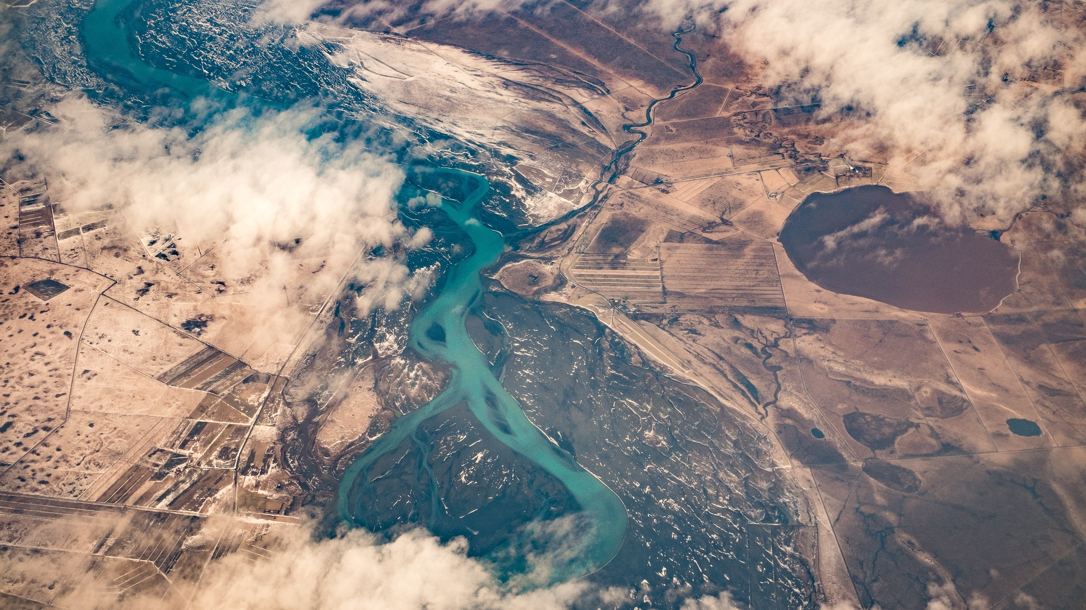
This isn’t “vibes” — it’s witness
“For we did not follow cleverly devised stories… but we were eyewitnesses of his majesty.” (2 Peter 1:16, NIV)
“You will do well to pay attention to it, as to a light shining in a dark place…” (2 Peter 1:19, NIV)
Notes:
[Sources] - Sermon manuscript (Take Away 2: testimony over technique). - Scripture: Holy Bible, New International Version (Grand Rapids: Zondervan, 2011), 2 Pet. 1:16, 19. - Background photo (public domain/CC0 per site): https://www.goodfreephotos.com/iceland/other-iceland/aerial-view-of-a-river-in-iceland.jpg.php [/Sources]

Slide 8
The Flow of Holiness
Headwaters
Riverbanks
Downstream
Jesus revealed
& received
Shared practices
that slow anxiety
Fruit in the valley
(steady love)
“Listen to him!” (Matthew 17:5, NIV)
Fruit: love, peace, gentleness, self-control
Practices: waiting, listening, truth-in-love, worship
Holiness is not a ladder we climb; it’s a river we enter.
Notes:
[Sources] - Sermon manuscript ("Flow of Holiness" metaphor: headwaters → riverbanks → downstream). - Scripture: Holy Bible, New International Version (Grand Rapids: Zondervan, 2011), Matt. 17:5. [/Sources]

Slide 9
Presence before action
“Come up to me on the mountain and stay here…” (Exodus 24:12, NIV)
Why “stay here” matters
Bowen lens:
Anxious systems crave motion & certainty.
Waiting is not inactivity — it is formation.
Presence re-centers us before we manage outcomes.
A calm, non-anxious presence helps the whole system breathe—and choose faithfulness over force.
Notes:
[Sources] - Sermon manuscript (Exodus 24 waiting as "riverbank" for formation; anxious systems quick-fix language). - Scripture: Holy Bible, New International Version (Grand Rapids: Zondervan, 2011), Exod. 24:12. - For "non-anxious presence" and leadership in anxious systems: Edwin H. Friedman, A Failure of Nerve: Leadership in the Age of the Quick Fix (New York: Church Publishing, 2007). [/Sources]

Slide 10
Downstream test
Fruit vs. Force
“But the fruit of the Spirit is love, joy, peace, forbearance, kindness, goodness, faithfulness, gentleness and self-control.” (Galatians 5:22, NIV)
“Against such things there is no law.” (Galatians 5:23, NIV)
Notes:
[Sources] - Sermon manuscript (fruit vs force framing; Galatians 5 lens). - Scripture: Holy Bible, New International Version (Grand Rapids: Zondervan, 2011), Gal. 5:22–23. - Background photo (public domain/CC0 per site): https://www.goodfreephotos.com/iceland/other-iceland/aerial-view-of-a-river-in-iceland.jpg.php [/Sources]

Slide 11
Three simple practices to “hold the charge”
2) Stay present
3) Choose fruit
1) Receive the Center
Start the day with:
“Speak, Lord, I’m listening.”
Slow down reactivity:
• Breathe
• wait
• listen
Ask in conflict:
“What would love do next?”
Question to think about:
What are we rewarding right now, fruit or force?
Notes:
[Sources] - Sermon manuscript (application question + "quick charge" vs steady formation; fruit/force). [/Sources]

Slide 12
The mountain is mercy.
The valley is faithfulness.
“Listen to him!” (Matthew 17:5, NIV)
Let’s go down the mountain with Jesus, re-centered, unhurried, and ready for faithful presence.
Notes:
[Sources] - Sermon manuscript (closing lines and key refrain). - Scripture: Holy Bible, New International Version (Grand Rapids: Zondervan, 2011), Matt. 17:5. - Background photo (CC0): https://jooinn.com/images/silhouette-of-mountains-during-sunrise.html [/Sources]

