Slide 1
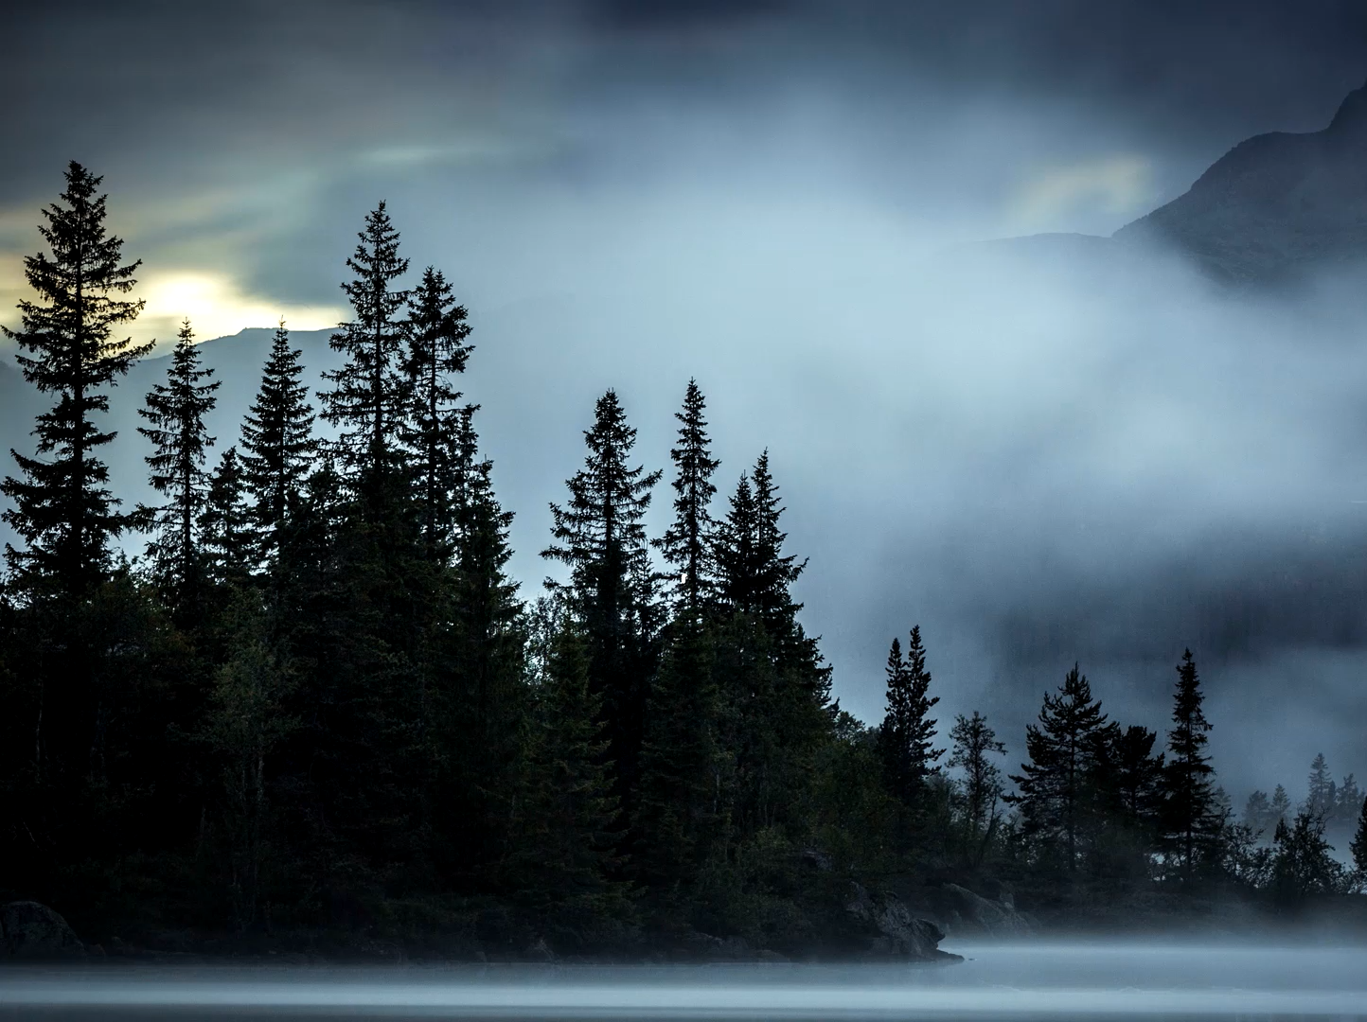
When the Silence Broke
400 Years of Silence
Luke 1–2; Galatians 4:4–5

Slide 2
Standing on the Threshold
We’ve walked the “silent” gap between Malachi and Matthew for eleven weeks.
Empires, roads, valleys, harbors, and the land with Cyndi Parker.
Key question: Where is God when it feels like nothing is happening?

Slide 3
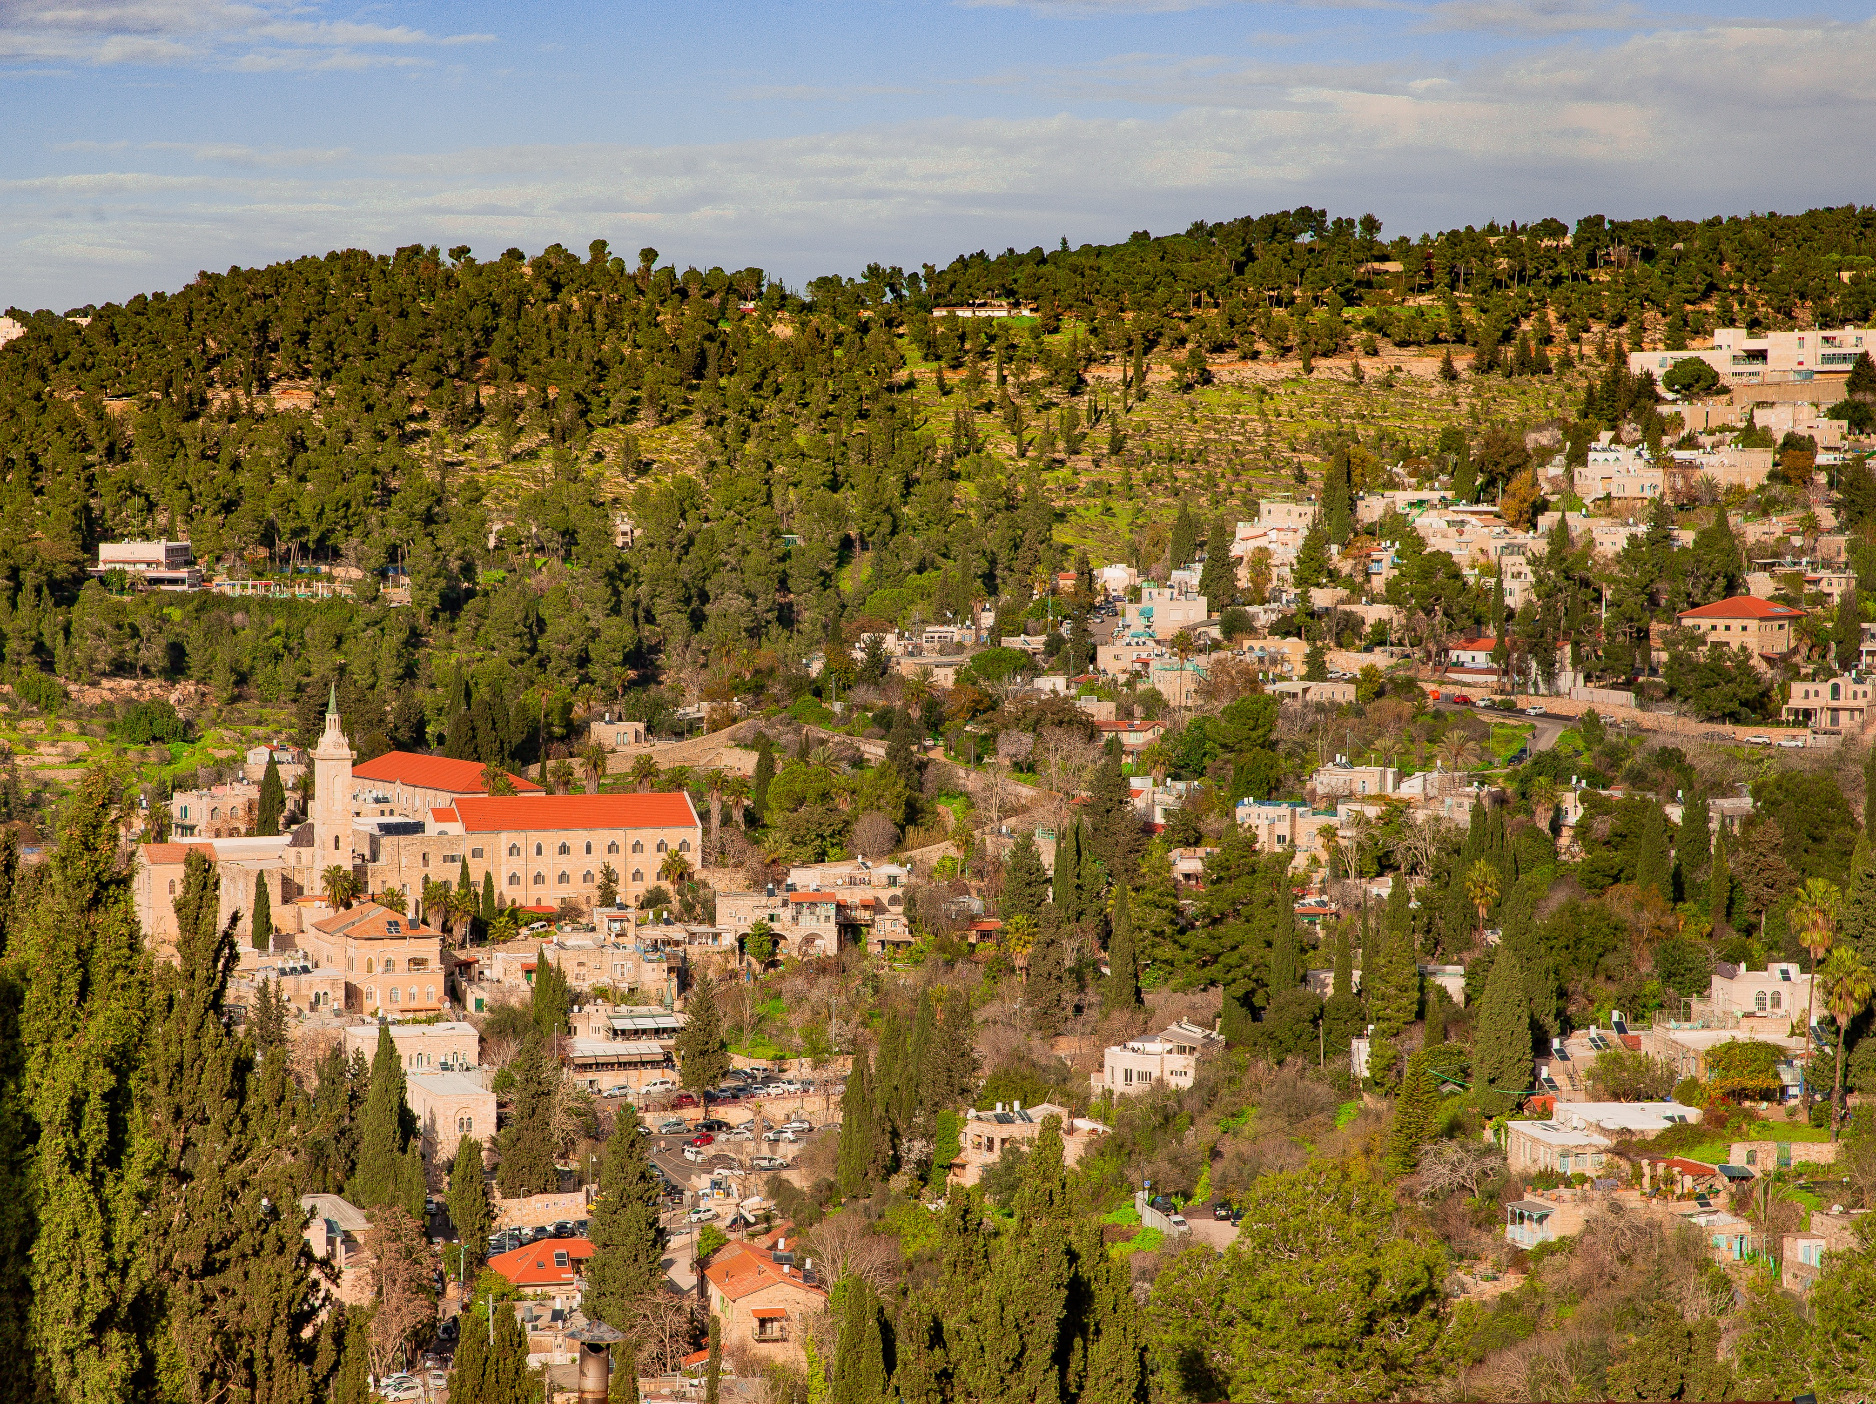
Mary traveled to the Hill Country

Slide 4
Galatians 4:4-5
“But when the fullness of the time came, God sent His Son, born of a woman, born under the Law, so that He might redeem those who were under the Law, that we might receive the adoption as sons.”

Slide 5
How God Set the Stage:
History not random: God arranging the stage (Gal 4:4).
From Persia to Greece to Rome – one Mediterranean world.
Roman law, roads, and power: perfect for news to travel.
A common language: Greek and the Septuagint spread God’s promises.

Slide 6
How God Set the Stage:
New religious structures: synagogues, Pharisees, Sadducees, Essenes.
The Maccabees and Hanukkah: a people who refuse to forget God’s covenant.
Herod’s building, roads, and harbors in the “land between.”
A world tired and expectant: paganism hollow, Israel still waiting.

Slide 7
The Day the Silence Cracked Rumors from Judea
Zechariah: He emerges unable to speak – a vision in the Holy Place
Elizabeth, once barren, gives birth.
Zechariah writes “His name is John” and begins to prophesy.

Slide 8
The Silence Cracked A Girl Named Mary A Census
Rumor: Mary of Nazareth, visited by an angel, conceives by the Spirit.
She hurries to the hill country of Judah to visit Elizabeth.
Rome decrees a census: orders race along Roman roads.
Joseph and very pregnant Mary travel from Nazareth to Bethlehem.

Slide 9
The Silence Breaks Open
Sabbath: the rabbi announces news from Bethlehem of Judea.
Shepherds say angels proclaimed: “good news of great joy…”
For centuries, the prophets were read; tonight, they feel fulfilled.
Under the stars: same hills, new hope – a baby’s cry breaks the silence.

Slide 10
Fullness of Time & Holy Listening
Historically: Roman roads, Greek language, weary spiritual landscape.
Biblically: promises to Abraham, David, the prophets at a tipping point.
Theologically: God not absent – word sinking deep, stage rearranged, hearts prepared.
Friends Lens: holiness as quiet faithfulness, life from the Divine Center.

Slide 11
Immersing Ourselves in the Story
Picture yourself reading
Luke 1–2.
A map is beside you: Nazareth to Bethlehem, Judean hills, Jordan road, Sea of Galilee.
Read slowly: Zechariah, Mary, shepherds in the fields.
Realize: God comes to a specific place, time, and path—for you.

Slide 12
Your “Silent Years”
The silence in your life echoes Israel’s 400 years:
Unanswered prayers and long waiting.
Forces you cannot control.
News that makes you wonder what God is doing.
Advent becomes a practice of trust in God’s quiet work.

Slide 13

Three Advent Invitations
Live in
Live in Luke 1–2 – a paragraph a day; watch where God moves quietly.
Name
Name your “silent years” – relationships, health, work, calling; hold them in the Light.
Practice
Practice faithful presence – calm, Christ-centered, non-reactive in an anxious world.

Slide 14
The same God who worked in 400 “silent” years has not changed.
The same Jesus who came in the fullness of time still comes by His Spirit.
The same Spirit who overshadowed Mary and loosened Zechariah’s tongue is here.
Prayer: “Lord Jesus Christ… come into the silent places of my life.”

