Slide 1

Entrusted,
Not Owned
Whose Are You?
10.4.2026
Notes:
Holiness takes shape as we place our whole life at Christ’s disposal and care for God’s gifts according to God’s purposes.
Visual background, created October 3, 2026. This is an illustrative scene, not a photograph of the people or events in the sermon.
Slide text is editable.

Slide 2

Ordinary work
Oseola McCarty
A lifetime of washing clothes
A gift toward others’ futures
Notes:
Oseola McCarty spent much of her life washing clothes for other people in Hattiesburg, Mississippi. She lived frugally and saved her money. In 1995, at eighty-seven, she arranged a planned gift of $150,000 to the University of Southern Mississippi to help students attend college. This represented most of her life savings.
Think about the ordinary work behind that gift. Laundry keeps returning: finish one load and another waits. Yet the earnings from those ordinary days became an opportunity for people to grow, learn, and begin their adult lives.
Her story invites a question beyond the size of a gift: What might the things placed in our hands make possible in someone else’s life?
Last month we asked what God’s mercy forms in a faithful follower of Jesus. We followed that question through reconciliation, forgiveness, grace, and the shape of the cross. This month we carry it into the places where we say things like: My time. My money. My plans. My church.
Van Arnold, “USM Salutes Renowned Benefactor Oseola McCarty on 115th Birthday,” University of Southern Mississippi, March 7, 2023, https://www.usm.edu/news/2023/release/oseola-mccarty-birthday.php. The university identifies this as a planned gift announced in 1995.
Visual background, created October 3, 2026. This is an illustrative scene, not a photograph of the people or events in the sermon.
Slide text is editable.

Slide 3
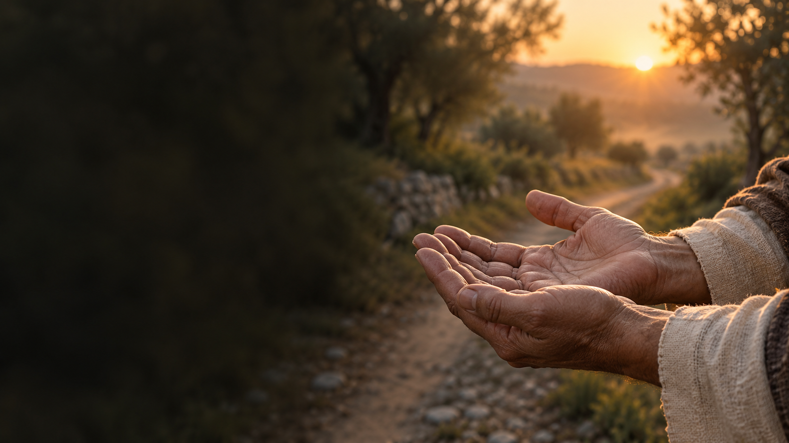
Whose are you?
What I have is
entrusted, not owned
Notes:
Our October question is: Whose are you? And this morning we begin here: What I have is entrusted, not owned.
Scripture Reading
Visual background, created October 3, 2026. This is an illustrative scene, not a photograph of the people or events in the sermon.
Slide text is editable.

Slide 4
The vineyard and the tenants
Matthew 21:33–46
NIV
Notes:
[Read Matthew 21:33–46 from the NIV Bible.]
Jesus tells this story while his authority is being challenged. By its end, the chief priests and Pharisees recognize themselves in it. This is a warning addressed to religious leaders, and we should hear it searching our own religious life.
A landowner prepares a vineyard and places it in the care of tenants. At harvest he sends servants for its fruit. The tenants attack them. When he sends his son, they kill him, seeking the inheritance. Their desire to possess the vineyard has become a refusal of the owner himself.
Visual background, created October 3, 2026. This is an illustrative scene, not a photograph of the people or events in the sermon.
Slide text is editable.

Slide 5
Our work begins
inside a gift
Notes:
Notice the beginning. The vineyard is already planted and prepared when the tenants arrive. Their work matters, but their work begins inside a gift.
So does ours.
We have worked hard. Some of us know what it means to stretch a paycheck, care for someone through the night, or keep showing up when nobody notices. Scripture takes that work seriously. But even our capacity to work comes within a life we did not create. We received breath before we earned wages. Someone taught us things we could not have discovered alone. We have been carried by kindness we could never fully repay.
In the vineyard, responsibility is real. Ownership belongs to another. The trouble begins when the tenants erase that distinction.
It can happen quietly in us. We care for something long enough that we begin to believe we should have the final word over it. We have invested so much. We know its history. We remember what it cost. Eventually, any request for change can feel like someone taking something away.
That can happen with money. It can also happen with a ministry, a family tradition, or a familiar way of being church. The question underneath our reaction is worth hearing: Am I protecting what serves God’s purposes, or am I protecting my need to decide?
Visual background, created October 3, 2026. This is an illustrative scene, not a photograph of the people or events in the sermon.
Slide text is editable.

Slide 6
We can be devoted
to the vineyard…
and still resist its owner
Notes:
We can be devoted to the vineyard… and still resist its owner.
That is why this parable goes deeper than a reminder to be generous. The tenants reject the son. Jesus is bringing his hearers face to face with their response to him. Will they receive God’s authority when it arrives in someone they cannot control?
We face that question whenever following Christ challenges something we have decided to keep for ourselves. We may gladly ask Jesus to bless our plans, but are we willing to let him change them?
C. S. Lewis, in Mere Christianity, describes the Christian life as handing our whole self over to Christ. We can give God portions of our time or resources while holding back the person making the decisions. Christ intends to transform that person.
C. S. Lewis, Mere Christianity, book 4, chap. 8, “Is Christianity Hard or Easy?,” 195–97, user-supplied PDF. Paraphrase; pagination follows the supplied edition, whose publication details are not visible in the extract.
Visual background, created October 3, 2026. This is an illustrative scene, not a photograph of the people or events in the sermon.
Slide text is editable.

Slide 7
The work of holiness
Our whole life
at Christ’s disposal: out with the OLD and in with the NEW.
Notes:
That is the work of holiness. The Spirit reaches into the places we have marked private and begins teaching us how to live there as people who belong to Jesus.
Among Friends, our practice of waiting upon Christ gives us a way to make room for that work. We become still enough to notice our resistance. We listen with Scripture open and with others who can help us discern. Then we respond to the light we have been given.
Sometimes the first thing we notice is fear. What if there will not be enough? What if I am no longer needed? What if the church changes and I no longer recognize my place in it?
Visual background, created October 3, 2026. This is an illustrative scene, not a photograph of the people or events in the sermon.
Slide text is editable.

Slide 8
Fear and faithfulness
Responsibility
without controlling others
Notes:
Fear deserves an honest hearing. It does not have to make every decision. We can take responsibility for what has been entrusted to us without controlling everyone around us. We can speak clearly, remain in relationship, and allow others to carry their responsibilities too.
A parent can love an adult child without managing every outcome. A church member can honor a beloved tradition while asking whether it still helps us follow Jesus. A leader can prepare someone else to serve and rejoice when that person grows.
What I have is entrusted, not owned.
There is judgment in Jesus’ story. God takes seriously the harm done when entrusted power becomes possession. People suffer when leaders treat a community as their property. We should let that warning sober us.
Visual background, created October 3, 2026. This is an illustrative scene, not a photograph of the people or events in the sermon.
Slide text is editable.

Slide 9
The cornerstone
“The stone the builders rejected has become the cornerstone”
(Matthew 21:42, NIV).
Notes:
But Jesus also directs us toward the cornerstone. “The stone the builders rejected has become the cornerstone” (Matthew 21:42, NIV).
The Son whom people reject is the one upon whom God builds. The gospel announces God’s saving action in this Jesus, crucified and risen. He meets our sin with a mercy that calls us to repentance and opens a new life with God. We do not purchase that life with a scholarship or a generous donation. We receive it through Christ, and his grace begins to change what we do with everything else.
That brings Oseola’s story closer to home. We have a story of generosity here at First Friends.
Visual background, created October 3, 2026. This is an illustrative scene, not a photograph of the people or events in the sermon.
Slide text is editable.

Slide 10
An inheritance
that opens doors
The Ralph and Elizabeth Bassett Endowed Fund
Notes:
Delaine Highley and her brother, Roger Bassett, established the Ralph and Elizabeth Bassett Endowed Fund through the Community Foundation of Grant County. After their parents died, they used their inheritance to honor their parents’ commitment to education and interest in young people. The fund supports qualified members of this congregation pursuing education or training beyond high school.
Ralph and Elizabeth belonged to First Friends for more than fifty years. Delaine described their way of living with these words: “They were always giving or helping someone who had less than they had.”
That sentence helps us understand what was passed along: resources and an example. Their children had seen a way of treating people. Through this fund, their parents’ memory is connected to opportunities for others.
There is a searching contrast with the vineyard. Jesus’ tenants grasp for an inheritance. Here, an inheritance is directed toward someone else’s future. We can recognize that choice’s beauty without knowing every private conversation or sacrifice behind it.
What we have received
Community Foundation of Grant County, “Ralph & Elizabeth Bassett Endowed Fund,” accessed October 1, 2026, https://givetogrant.org/bassett/.
Community Foundation of Grant County, “Ralph & Elizabeth Bassett Endowed Fund.” Delaine Highley is quoted in the foundation’s fund story.
Visual background, created October 3, 2026. This is an illustrative scene, not a photograph of the people or events in the sermon.
Slide text is editable.

Slide 11
What we have received
can become
someone else’s beginning
Notes:
What we have received can become someone else’s beginning. An education can open a door. So can a patient conversation, a ride to an appointment, or an older believer taking time to encourage someone who is just beginning to follow Jesus. The gift takes different forms because our lives and circumstances differ. Faithfulness begins with what is actually in our hands.
Some of us are working hard just to meet our needs. Some have less energy than we once had. Christ knows the life he is asking us to offer. We can ask him what faithful love looks like within that life, including its limits.
Perhaps you have experience another person needs. Perhaps you have a story of surviving grief that will help someone feel less alone. Perhaps you have an apology to make, and the thing you must release is your insistence on being right.
These are places where holiness becomes visible. The Spirit makes us more available to Christ and more attentive to the person before us.
Visual background, created October 3, 2026. This is an illustrative scene, not a photograph of the people or events in the sermon.
Slide text is editable.

Slide 12
Sent back into
ordinary life
Day Thirty
Mark 5:18–20
Notes:
Day Thirty of our devotional booklet, “Sent Back into Ordinary Life,” takes us to the man Jesus delivered in Mark 5. After his suffering and the mercy he has received, he wants to go with Jesus. Why leave the one who had restored him?
But Jesus sends him home to tell his own people what the Lord has done and how he has received mercy. The man goes and begins telling his story.
Paul David Bravard, “Day 30: Sent Back into Ordinary Life,” in Held in the Light: Grace in Ordinary Places (Marion, IN: Marion First Friends Church, 2026), Kindle manuscript, 39. Scripture basis: Mark 5:18–20.
Visual background, created October 3, 2026. This is an illustrative scene, not a photograph of the people or events in the sermon.
Slide text is editable.

Slide 13
Mercy restores a life
That life becomes available
for Christ’s purposes
Notes:
There is our bridge from September into October. Mercy restores a life, and that restored life becomes available for Christ’s purposes. Even the story of what God has done for us can become a gift to someone else.
We may prefer an assignment somewhere unfamiliar. Home has people who remember our failures. Our familiar roads lead to difficult conversations and unfinished responsibilities. Yet those may be the very places where Jesus sends us to practice the mercy we have received.
The man in Mark does not need to become someone else before he can obey. He begins with what Jesus has done for him. So can we.
When we leave worship today, we return to our own people. Someone will need patience. A decision will involve our time or money. We may feel the old impulse to tighten our grip. In that moment, we can pause long enough to remember whose we are.
Visual background, created October 3, 2026. This is an illustrative scene, not a photograph of the people or events in the sermon.
Slide text is editable.

Slide 14
God has placed this
in my hands
How does God want me
to care for it?
Notes:
God has placed this in my hands. How does God want me to care for it?
Visual background, created October 3, 2026. This is an illustrative scene, not a photograph of the people or events in the sermon.
Slide text is editable.

Slide 15
A query for the silence
What have I begun to call mine that God has only
entrusted to me?
Notes:
Let us carry one query into the silence: What have I begun to call mine that God has only entrusted to me?
[Moment of quiet.]
Visual background, created October 3, 2026. This is an illustrative scene, not a photograph of the people or events in the sermon.
Slide text is editable.

Slide 16
One faithful step
What is Christ bringing
to your attention?
Notes:
You do not have to solve your whole life in this moment. Notice one thing Christ brings to your attention. It may be a possession, a responsibility, a relationship, or a plan. Ask him what faithfulness would look like there. Then take one concrete step this week.
Make the call. Share what you can. Listen before you defend. Give someone room to grow. Let the response come from the particular place where Christ is meeting you.
The vineyard belongs to God. The Son is worthy of our trust. And the life we have received is a place where his mercy can bear fruit.
Visual background, created October 3, 2026. This is an illustrative scene, not a photograph of the people or events in the sermon.
Slide text is editable.

Slide 17
Entrusted, not owned
What we have received
can become someone else’s beginning
Notes:
What I have is entrusted, not owned. What we have received can become someone else’s beginning.
Closing prayer
Lord Jesus, thank you for the life and mercy we have received. Show us where our hands have closed around what belongs to you. Give us courage to trust your direction and wisdom to care faithfully for what you have entrusted to us. Send us home ready to love, and let your Spirit bear fruit through our ordinary lives. Amen.
Visual background, created October 3, 2026. This is an illustrative scene, not a photograph of the people or events in the sermon.
Slide text is editable.

