Slide 1
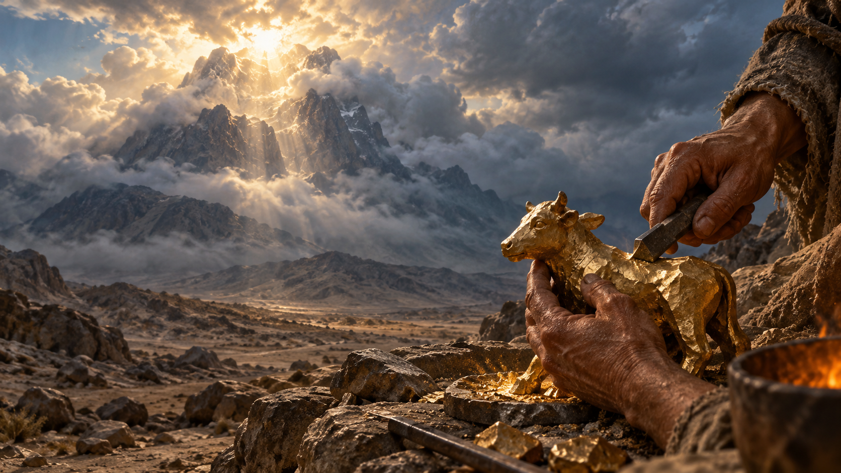
What We Make While We Wait
10.11.2026
Martin Wells
When I cannot see God, I trust:
What We Make While We Wait
10.11.2026
Martin Wells

