Slide 1
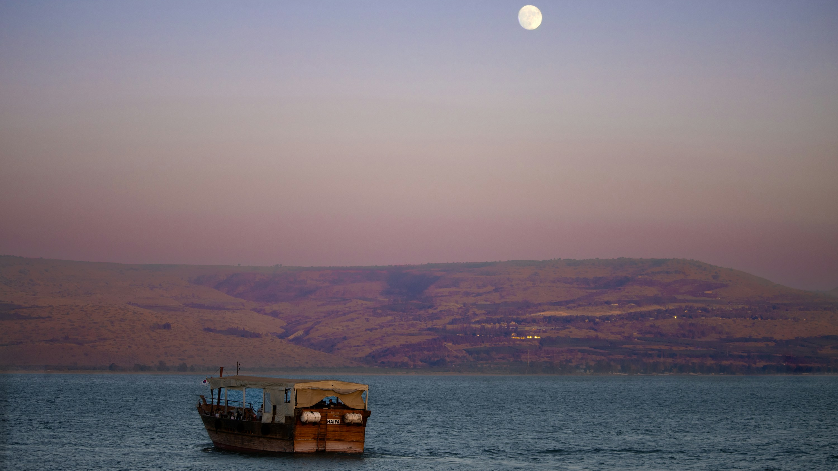
LIGHT IN GALILEE
1.25.2026
Isaiah 9:1–4 • Psalm 27:1, 4–9 • 1 Corinthians 1:10–18 • Matthew 4:12–23 (NIV)
“The people living in darkness have seen a great light (Matthew 4:16, NIV).”
Notes:
[Sources] - Lectionary readings: https://lectionary.library.vanderbilt.edu/ (search “January 25, 2026, Third Sunday after Epiphany”). - Background photo: Unsplash (JR Ross), “A boat floating on top of a large body of water” (Sea of Galilee): https://unsplash.com/photos/a-boat-floating-on-top-of-a-large-body-of-water-t3n4081w_kY [/Sources]

Slide 2
Opening Prayer
A steady, Christ-centered presence.
Lord, quiet our hearts, cleanse us with mercy,
and form us in holy love.
Speak, Lord. We are listening. Amen.
Today’s guiding question:
When the Light comes near, will we keep living guarded,
or will we follow Jesus into a holy way of life?
Notes:
[Sources] - Lectionary readings: https://lectionary.library.vanderbilt.edu/ (January 25, 2026). [/Sources]

Slide 3
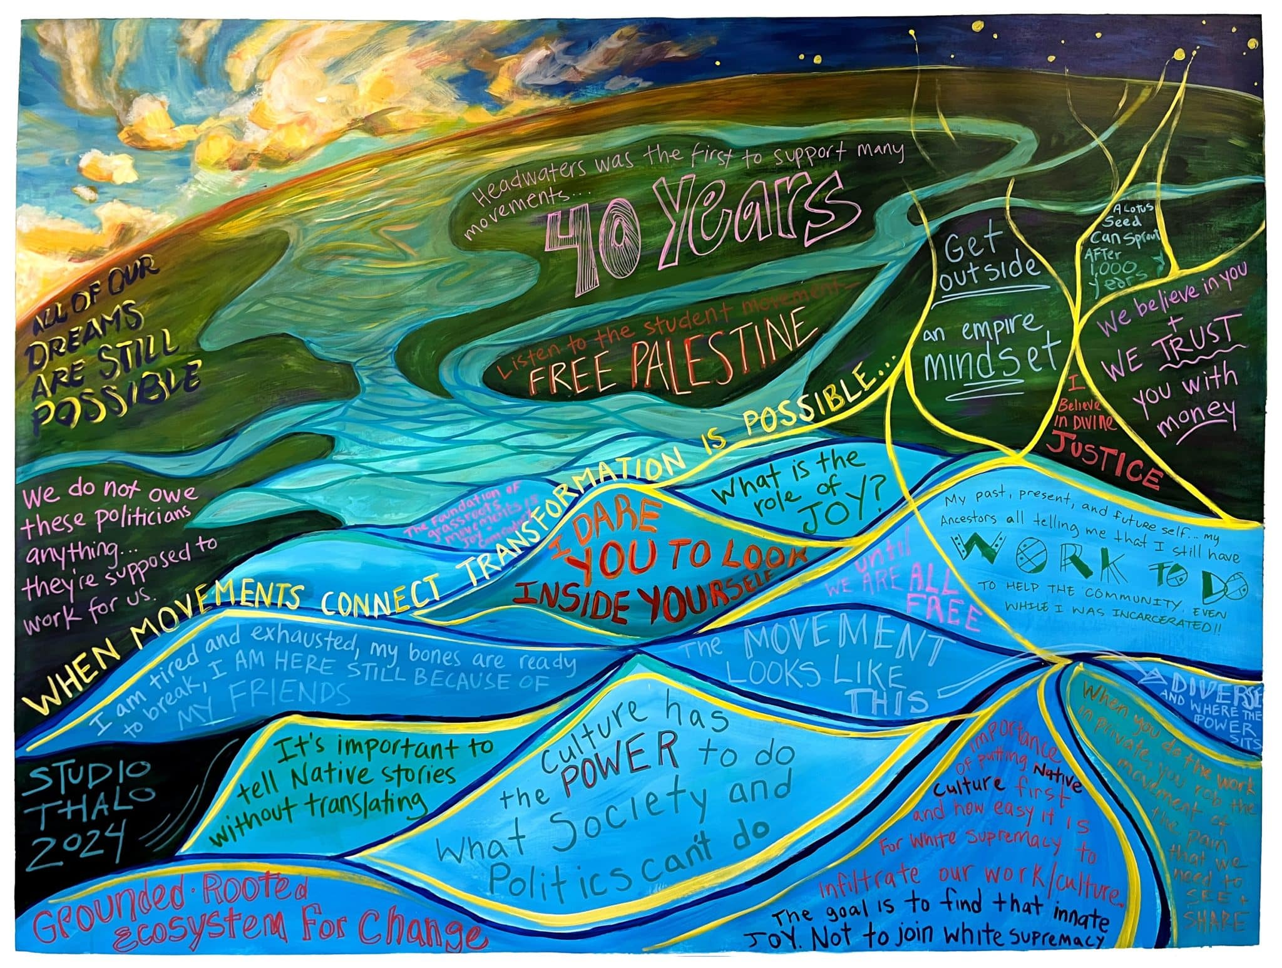
Opener: The Joke That Trains Our Instincts
How repeated satire can shape a community’s reflexes.
MIDWEST FRIENDLINESS IS A GIFT
Yet, repeated jokes can quietly teach us:
• Don’t talk to strangers
• Don’t offer help
• Treat warmth as naïve But Scripture says the Light comes into the shadow, not after the world is "safe," but right into the dark.
Culture often changes
by repetition.
“The people walking in darkness have seen a great light (Isaiah 9:2, NIV).”
Notes:
[Sources] - Image: William Pina, “TV Static.jpg,” Wikimedia Commons (CC BY-SA 3.0): https://commons.wikimedia.org/wiki/File:TV_Static.jpg - Example campaign referenced (“Dr. Rick”/Parentamorphosis): Progressive Insurance campaign overview: https://www.progressive.com/advertising/dr-rick/ [/Sources]

Slide 4
Four Movements in this Message
How the Holy moves among us.
1
Light
in the dark place
2
“One thing”
as our center
3
The cross
that guards unity
4
Follow Jesus
into holy life
Holiness is not polish — it’s presence.
God brings Light into real darkness.
God gathers us to a Center.
God shapes unity at the cross.
God sends us to follow Jesus in ordinary faithfulness.
Light → Center → Cross → Call
Notes:
[Sources] - Lectionary readings: https://lectionary.library.vanderbilt.edu/ (January 25, 2026). [/Sources]

Slide 5
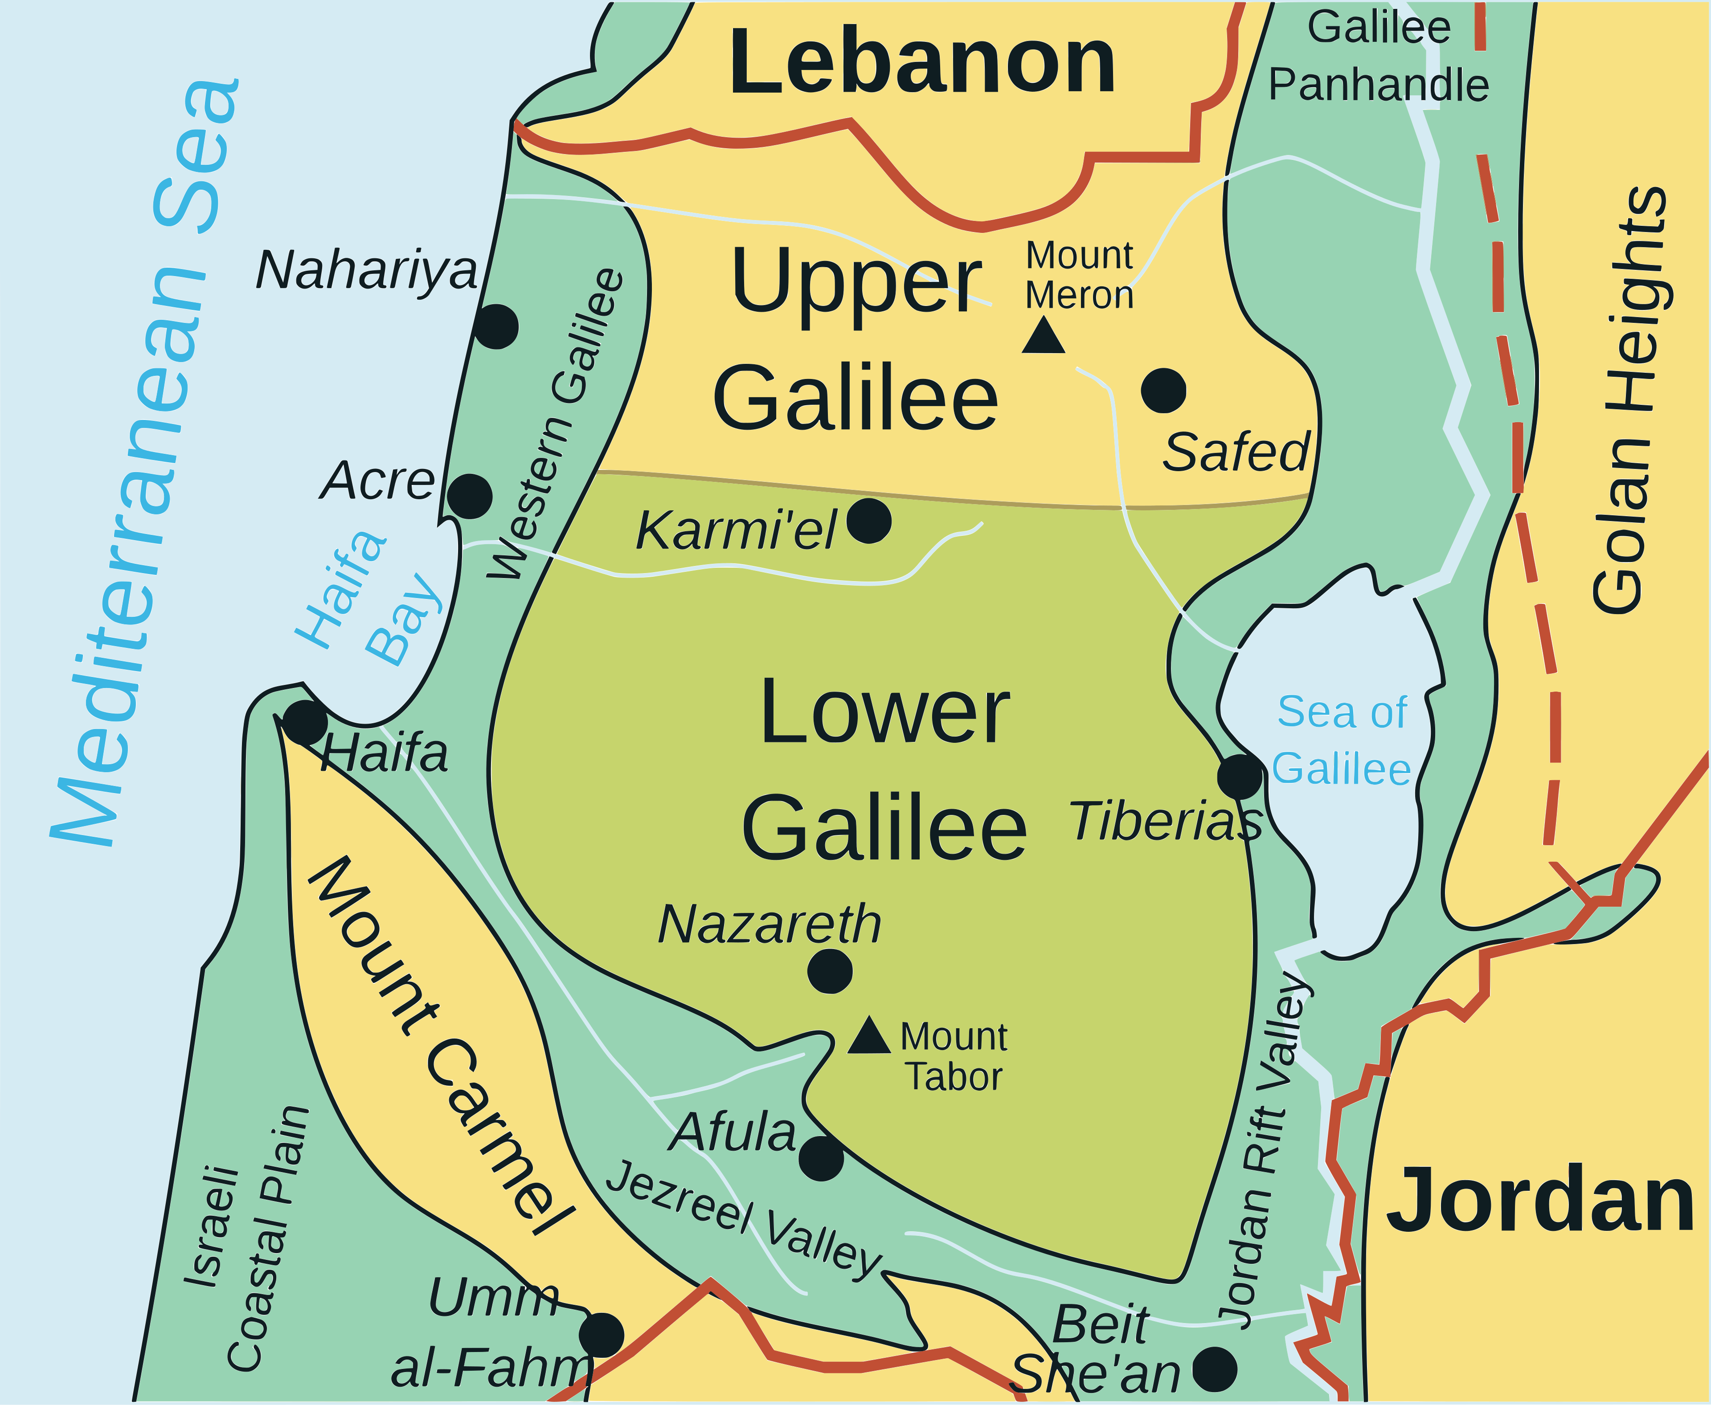
Move 1: Light Doesn’t Wait for Ideal Conditions
Isaiah 9:1–4
“The people walking in darkness
have seen a great light …
a light has dawned (Isaiah 9:2, NIV).”
Isaiah names real darkness — and then dares to say:
Light has dawned.
“You have shattered the yoke that burdens them …
you have broken (Isaiah 9:4, NIV).”
Galilee (Zebulun & Naphtali) — the “overlooked” place.
Notes:
[Sources] - Map image: “Lower Galilee map.svg,” Wikimedia Commons (CC BY 3.0): https://commons.wikimedia.org/wiki/File:Lower_Galilee_map.svg [/Sources]

Slide 6
MOVE 1
Matthew says Isaiah is fulfilled
when Jesus goes to Galilee.
“The people living in darkness
have seen a great light (Matthew 4:16, NIV).”
So the question becomes:
When the Light comes near,
what kind of people
does it make us?
Jesus does not wait for ideal conditions.
He goes where the shadow is thick.
Notes:
[Sources] - Background photo (Sea of Galilee): Unsplash (JR Ross), https://unsplash.com/photos/a-boat-floating-on-top-of-a-large-body-of-water-t3n4081w_kY [/Sources]

Slide 7

Move 2: “One Thing” Becomes Our Center
Psalm 27:1, 4–9
“The LORD is my light and my salvation, whom shall I fear (Psalm 27:1, NIV)?”
“One thing I ask … this only do I seek …
to gaze on the beauty of the LORD (Psalm 27:4, NIV).”
“My heart says … ‘Seek his face!’
Your face, LORD, I will seek (Psalm 27:8, NIV).”
Notes:
[Sources] - Image: “Candle in the dark.JPG,” Wikimedia Commons (CC BY-SA 3.0): https://commons.wikimedia.org/wiki/File:Candle_in_the_dark.JPG [/Sources]

Slide 8
A Gathered Life in an Anxious World
Centering reduces reactivity.
When anxiety rises in a system:
A steadier alternative:
Reactivity increases
Seek the Face of Christ
Stay direct (no triangles)
Hold a non-anxious presence
Let obedience become love
Communication goes indirect
Triangles multiply
We pass anxiety around
“Your face, LORD, I will seek (Psalm 27:8, NIV).”
Steady presence is faithful presence.
Triangles
Notes:
[Sources] - Bowen Family Systems Theory (triangles): Bowen Center for the Study of the Family (overview pages and glossary): https://www.thebowencenter.org/ - Edwin H. Friedman, A Failure of Nerve: Leadership in the Age of the Quick Fix (New York: Church Publishing, 2007). - Thomas R. Kelly, A Testament of Devotion (New York: HarperOne, 1941). [/Sources]

Slide 9
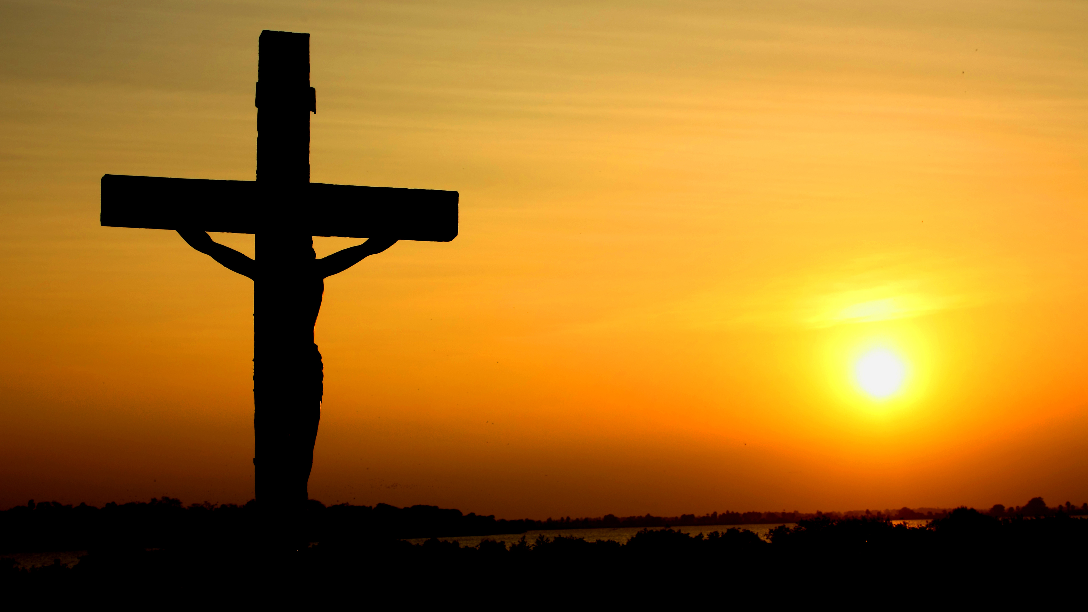
MOVE 3
The Cross Guards Our Unity
The cross keeps leveling pride:
“That there be no divisions among you …
perfectly united in mind and thought
(1 Cor. 1:10, NIV).”
Not “my camp”
Not “my slogan”
Not “winning”
But yielding, repenting, forgiving,
and obeying together.
“Is Christ divided (1 Cor. 1:13, NIV)?”
“The message of the cross …
is the power of God
(1 Cor. 1:18, NIV).”
Notes:
[Sources] - Image: “Cross in sunset.jpg,” Wikimedia Commons (CC BY-SA 3.0): https://commons.wikimedia.org/wiki/File:Cross_in_sunset.jpg - John MacArthur, 1 Corinthians (MacArthur New Testament Commentary) (Chicago: Moody Publishers, 1984). - Carole Dale Spencer, Holiness: The Soul of Quakerism (Colorado Springs: Paternoster, 2007). - Brené Brown, Daring Greatly (New York: Gotham, 2012). [/Sources]

Slide 10

MOVE 4
The Light Calls — and the Call Forms a People
“Repent, for the kingdom of heaven has come near (Mat.4:17).”
Repentance = reorientation
Turning from false centers to the true Center.
“Come, follow me … and I will send you out to fish for people (Mat. 4:19).”
Jesus forms ordinary people for holy mission.
“At once they left their nets and followed him(Mat. 4:20).”
Notes:
[Sources] - Image: “Throwing a cast net.jpg,” Wikimedia Commons (CC BY-SA 4.0): https://commons.wikimedia.org/wiki/File:Throwing_a_cast_net.jpg - N. T. Wright, Surprised by Hope: Rethinking Heaven, the Resurrection, and the Mission of the Church (New York: HarperOne, 2008). [/Sources]

Slide 11
The Pattern Matthew Shows Us
Light → Call → Obedience → Formation → Mission
LIGHT
CALL
OBEDIENCE
FORMATION
MISSION
Jesus doesn’t merely offer information — he forms a people.
Teaching → truth that reforms the mind
Proclaiming → gospel that re-centers the heart
Healing → mercy that restores lives and communities
“Jesus went throughout Galilee … proclaiming the good news … and healing
every disease and sickness (Matthew 4:23, NIV).”
Notes:
[Sources] - Lectionary readings: https://lectionary.library.vanderbilt.edu/ (January 25, 2026). [/Sources]

Slide 12
Four Responses for a Holy Week
Small enough to do • Deep enough to shape us.
Name your darkness without fear
1
“On those living in the land of deep darkness a light has dawned (Isaiah 9:2, NIV).”
2
Choose the “one thing” that re-centers you
Five minutes a day: “Your face, LORD, I will seek (Psalm 27:8, NIV).”
Refuse the pull of triangles
3
Speak directly, pray first, stay humble — “Is Christ divided (1 Corinthians 1:13, NIV)?”
4
Take one concrete step of obedience
“Come, follow me (Matthew 4:19, NIV).” What “net” do you set down?
Holiness is love embodied — steady, warm, and true.
Notes:
[Sources] - Lectionary readings: https://lectionary.library.vanderbilt.edu/ (January 25, 2026). [/Sources]

Slide 13
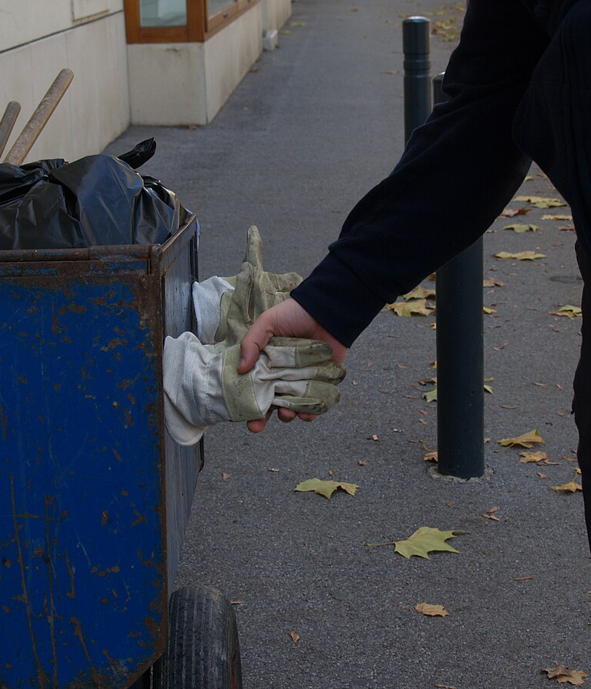
Ordinary Kindness (Holy Friendliness)
A few ways to “treat strangers as not invisible.”
Examples of our culture:
A nod, a wave, a simple “hi”
Hold a door; let someone merge
Return a cart; pick up what someone dropped
Thank workers by name (when available)
Offer help, and release it if declined
In tense moments: “No rush, you’re fine.”
Warmth isn’t naïve, it can be holiness in public.
Recognition with no agenda
Notes:
[Sources] - Image: “Handshake (319795901).jpg,” Wikimedia Commons (CC BY-SA 2.0): https://commons.wikimedia.org/wiki/File:Handshake_(319795901).jpg [/Sources]

