Slide 1
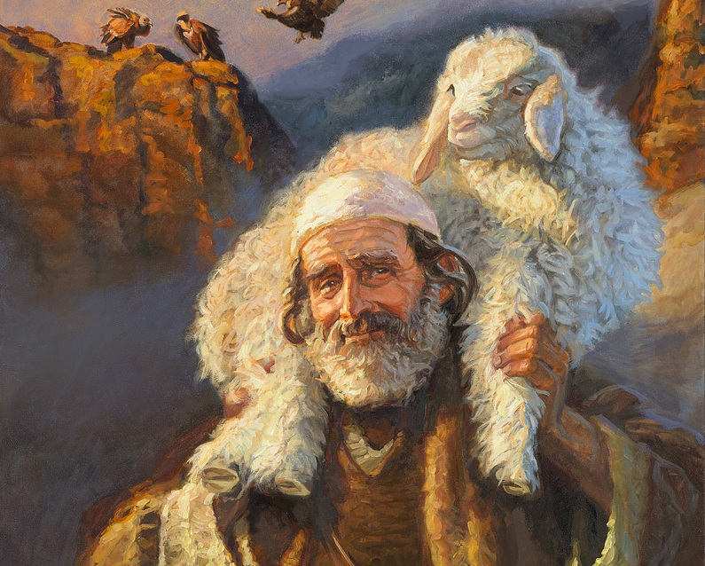
Look to the Lamb
Epiphany • 1.18.2026
Isaiah 49:1–7; Psalm 40:1–11; 1 Corinthians 1:1–9; John 1:29–42.

Slide 2
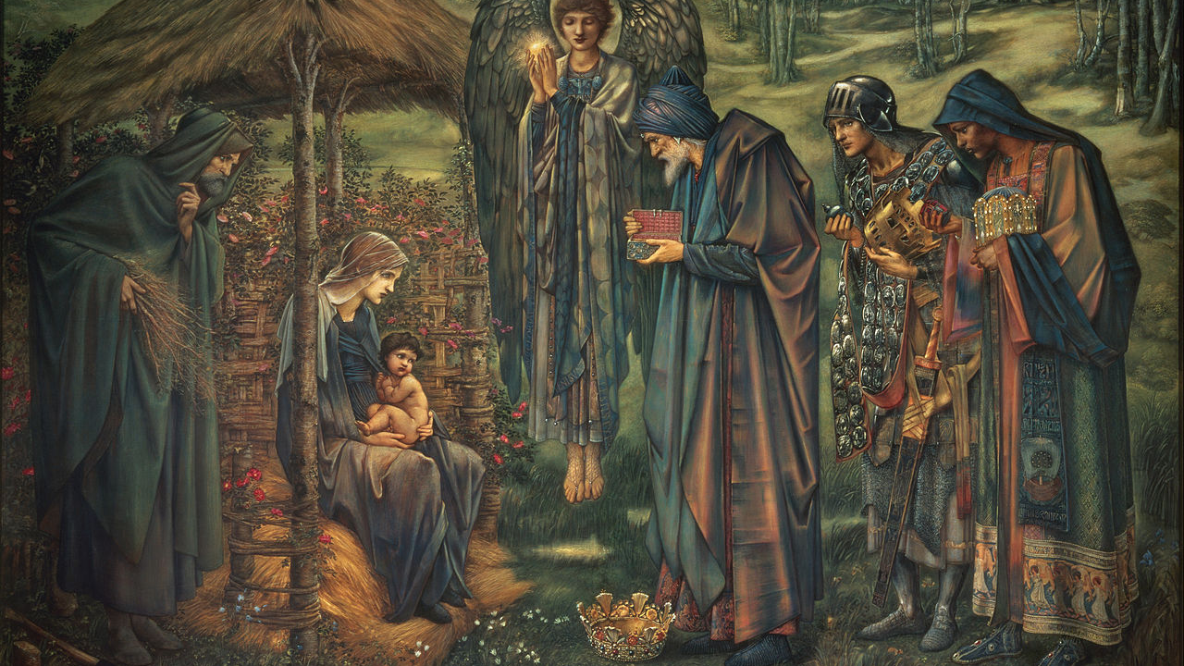
Welcome
You’re welcome here.
We’re Friends following Jesus: listening, obeying, and living holy love together.
Bring your joy. Bring your burden. If you’re unsure, seek Jesus with us.
Christ is here. Let’s worship.
Notes:
[Sources] - https://commons.wikimedia.org/wiki/File:Edward_Burne-Jones_-_The_Star_of_Bethlehem_-_Google_Art_Project.jpg (background image) [/Sources]

Slide 3
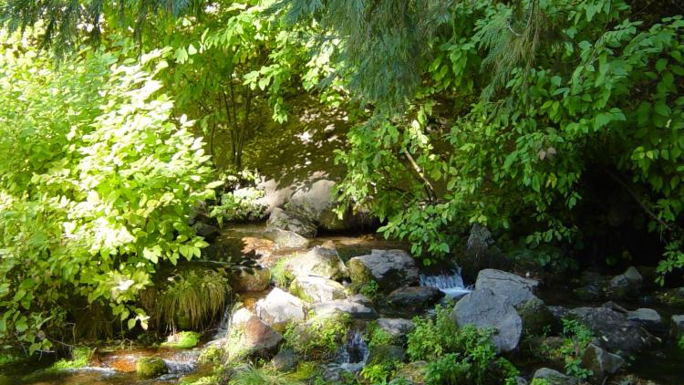
Today’s One Sentence:
In Epiphany, God reveals Jesus as the Servant-Lamb who takes away sin, forming a people who wait, listen, and point others to him with holy lives.
“Look. Wait. Follow. Point.”
Notes:
[Sources] - https://commons.wikimedia.org/wiki/File:Headwaters_of_the_Sacramento_River-750px.JPG (background image) [/Sources]

Slide 4
Simple Map
A Map You Can Track
Three questions to keep us oriented
Who is Jesus?
Who are we?
What do we do?
The Lamb:
God’s saving work revealed.
A sanctified people
held by grace—
learning to wait.
We follow Jesus,
and we point others
to him.
Holiness is a long river: received → formed → sent

Slide 5
Flow of Holiness
The River Image
Upstream → Midstream → Downstream
UPSTREAM
MIDSTREAM
DOWNSTREAM
Receive
Be Formed
Go Public
Wait & listen
Follow & point
Look to the Lamb
Received → Formed → Sent
Notes:
[Sources] - https://commons.wikimedia.org/wiki/File:Headwaters_of_the_Sacramento_River-750px.JPG (background image) [/Sources]

Slide 6
Upstream — Receive
Look to the Lamb
God saves, then we follow
“Look, the Lamb of God, who takes away the sin of the world (John 1:29, NIV).”
John the Baptist points away from himself—and toward God’s mercy.
This is God’s action first (not our self-improvement plan).
Mercy moves toward us—before we perform.
The Lamb bears sin and brings deliverance.

Slide 7
Upstream — Revelation
A Light that Reaches Out
“I will also make you a light for the Gentiles, that my salvation may reach to the ends of the earth (Isaiah 49:6, NIV).”
Epiphany is revelation with a mission-shaped horizon.
Upstream isn’t just “God saves me.”
Upstream is God revealing his Son—so salvation goes outward.
Notes:
[Sources] - https://commons.wikimedia.org/wiki/File:Edward_Burne-Jones_-_The_Star_of_Bethlehem_-_Google_Art_Project.jpg (background image) [/Sources]

Slide 8
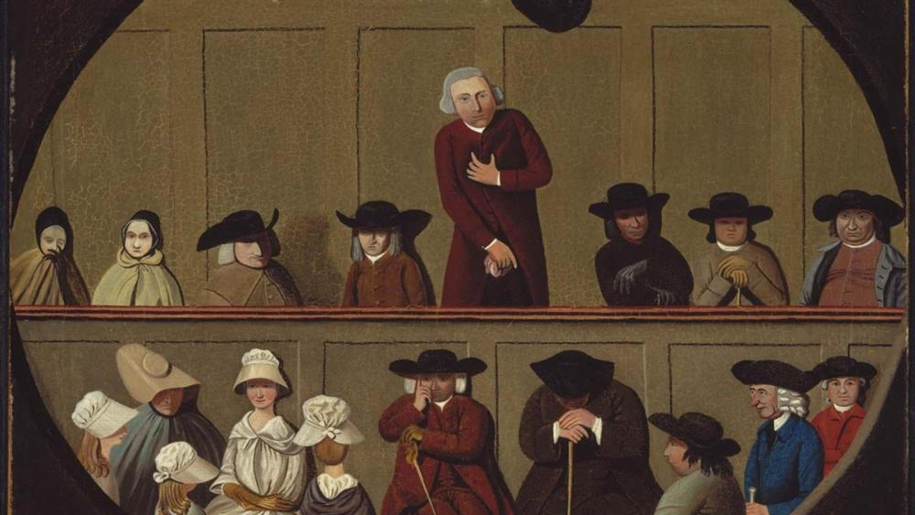
Midstream — Formation
Wait & Be Formed
“I waited patiently for the LORD; he turned to me and heard my cry (Psalm 40:1, NIV).”
Waiting is not passive—it’s attentive, responsive trust.
We don’t manufacture intensity—we pay attention.
Silence is not empty; it’s listening space.
Midstream practices keep us steady in a reactive world.
Notes:
[Sources] - https://commons.wikimedia.org/wiki/File:Painting_of_a_Quaker_Meeting.jpg (background image) [/Sources]

Slide 9
Midstream — Held by Grace
God is Faithful
We are held while we wait
“God is faithful, who has called you into fellowship with his Son, Jesus Christ our Lord (1 Corinthians 1:9, NIV).”
The church is not held together by willpower—it’s held by God’s faithfulness.
Holiness isn’t frantic.
Holiness is faithful.

Slide 10
Downstream — Witness
Follow
“When the two disciples heard him say this, they followed Jesus (John 1:37, NIV).”
Downstream begins with simple obedience.
Revealed → received → followed → witnessed
Notes:
[Sources] - https://commons.wikimedia.org/wiki/File:Headwaters_of_the_Sacramento_River-750px.JPG (background image) [/Sources]

Slide 11
Downstream — Invite
Bring Someone to Jesus
Witness as “come and see”
“The first thing Andrew did was to find his brother Simon and tell him,
‘We have found the Messiah’ (John 1:41, NIV).
And he brought him to Jesus (John 1:42, NIV).”
Witness is not hype or manipulation.
Witness is steady, relational, and invitational.
Find one person—and bring them with you.

Slide 12
Practice for the Week
Before You Fix Anything…
Practice presence
1) 60 seconds of worship silence
Not awkward. Attentive. Listening.
2) Breath prayer
“Jesus, Lamb of God… lead me.”
3) One faithful step
One phone call.
One apology.
One act of service.
One boundary held without venom.
One truth told with love.
Upstream: Look • Midstream: Wait • Downstream: Follow & point

Slide 13
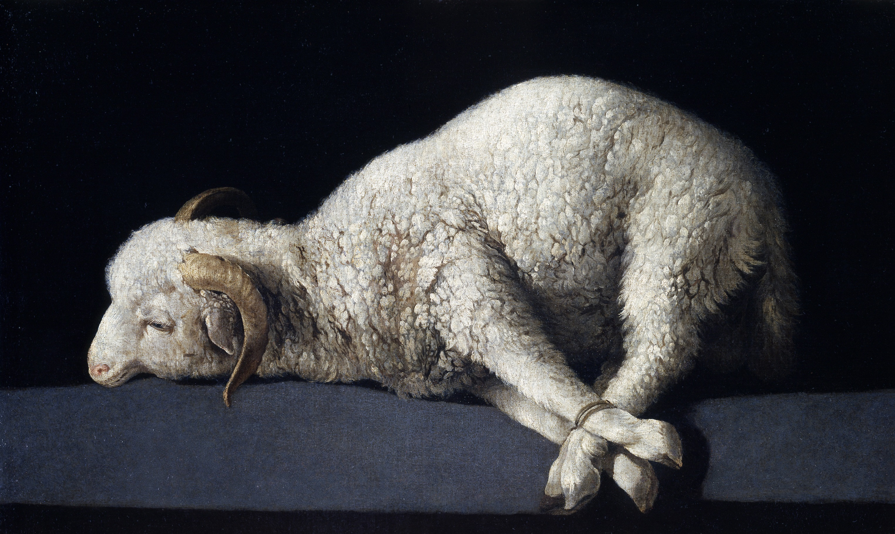
Look. Wait. Follow. Point.
May the Holy Spirit make our holiness
not merely admired, but embodied.
Amen
Notes:
[Sources] - https://commons.wikimedia.org/wiki/File:Agnus_Dei_Zurbar%C3%A1n.jpg (background image) [/Sources]

