Slide 1
GRCoC General Meeting
July 12, 2021

Slide 2
Agenda
GRCoC draft bylaws edits review and vote
Emergency Housing Vouchers
Summer Point-in-Time count
Youth Homelessness Demonstration Program

Slide 3
What are EHVs?
The American Rescue Plan appropriated $5 billion for 70,000 Vouchers awarded to approximately 700 PHAs nationwide.
HUD issued PIH Notice 2021-15, Emergency Housing Vouchers- Operating Requirements on May 5, 2021.
EHVs sunset – After 9/30/23, PHAs may not reissue vouchers that turn over

Slide 4
Eligible Populations
EHVs eligibility is limited to individuals and families who are:
Homeless;
At-risk of homelessness;
Fleeing or attempting to flee domestic violence, dating violence, sexual assault, stalking, or human trafficking; and
Recently homeless, as determined by the Secretary, and for whom providing rental assistance will prevent the family’s homelessness or having high risk of housing instability.

Slide 5
CoCs and CES Requirement
CoCs have a critical role in identifying who should receive an EHV and referring that individual or family to PHA
Determine targeting:
PHAs must work with community partners to determine the best use and
targeting for EHVs along with other resources available in the community.
Referrals from Coordinated Entry:
EHVs will not be filled from PHA’s current waiting list- all EHVs are referred from the Coordinated Entry System in the community or other partner organizations.
CoCs are responsible for determining whether the family qualifies under one of the four eligibility categories for EHVs
GRCoC service area includes 3 PHAs

Slide 6
MOU between CoC and PHA
By July 31:
Outline partnership between CoC and PHA
Determine services that will be offered to participants and who will pay for services
Detail which populations will be prioritized for receiving vouchers and how referrals will be processed
Delineate responsibilities and roles for CoC and PHA
GRCoC has one MoU finalized, one to finalize this week

Slide 7
Key Waivers
Unlike regular HCV admissions, PHAs may not deny an EHV applicant admission regardless of whether:
Any member of the family has been evicted from federally assisted housing in the §A PHA has ever terminated assistance under the program for any member of the family.
The family currently owes rent or other amounts to the PHA or to another PHA in connection with Section 8 or public housing assistance under the 1937 Act.

Slide 8
Key Waivers, cont.
The family has not reimbursed any PHA for amounts paid to an owner under a HAP contract for rent, damages to the unit, or other amounts owed by the family under the lease.
The family breached an agreement with the PHA to pay amounts owed to a PHA, or amounts paid to an owner by a PHA.
The family would otherwise be prohibited admission under alcohol abuse standards established by the PHA in accordance with §982.553(a)(3).
The PHA determines that any household member is currently engaged in or has engaged in during a reasonable time before the admission, drug-related criminal activity.

Slide 9
Summer 2021 Point-in-Time (PIT) Count
General Continuum of Care meeting
July 12, 2021

Slide 10
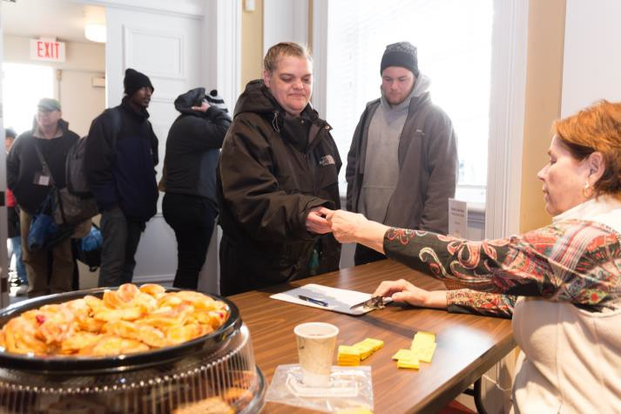
Overview of the PIT Count
The PIT count is a one-day count of sheltered and unsheltered homeless persons
Since 2005, the Department of Housing and Urban Development (HUD) has
required an annual count during the last 10 days of January; we typically conduct one twice a year (but missed the 2020 summer count due to COVID)
Participation in the count:
  Enables us to meet HUD requirement/funding eligibility
  Estimates number of people experiencing homelessness at one time across the
  country
  Illustrates the changing nature of homelessness
  Helps inform, plan, and fund services

Slide 11
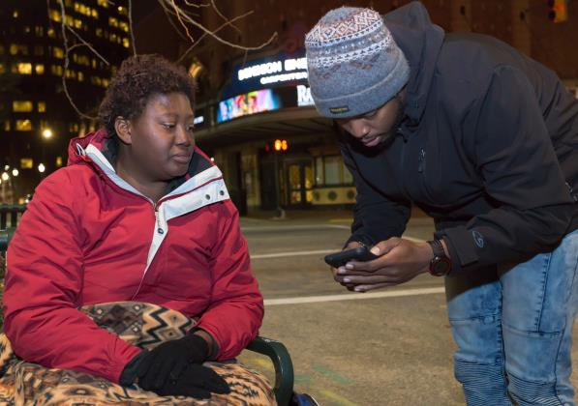
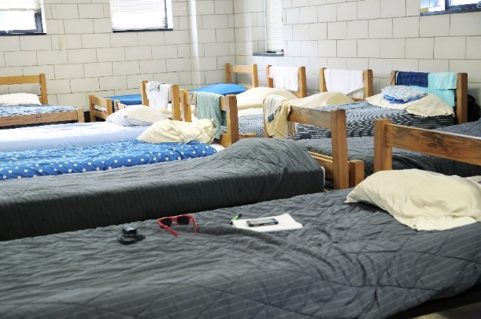
Who is counted? (HUD)
People staying in emergency shelters (including motels paid for by nonprofits/government), transitional housing, or Safe Havens
People staying in domestic violence shelters or fleeing domestic violence/trafficking
People living in places considered unfit for human habitation, such as under a bridge, outdoors in a campsite, or in a car

Slide 12
Who is not counted? (HUD)
People living in crowded conditions
People staying in hotels they pay for themselves
People who are unstably housed
People staying with friends of family
People who are couch surfing
People in institutions with a recent history of homelessness

Slide 13

How we conduct the count
There are two parts to our twice yearly count:
  The count (conducted using the Homeward Community Information System, or HCIS, and through bedcount forms completed by providers that do not use HCIS)
  The survey (includes additional questions of interest in the community, as well as information needed to classify people who are unsheltered into HUD-required categories such as chronically homeless or veterans)

Slide 14
The PIT for providers
DV/SV providers and other emergency shelter, transitional housing, and Safe Haven providers that do not use HCIS:
  Submit bedcount form to Latosha Johnson (ljohnson@homewardva.org) by 7/23
  Complete surveys with adult clients who were in shelter on the night of 7/21
Emergency shelter, transitional housing, and Safe Haven providers that use HCIS:
  Will receive a PIT report from HCIS from Latosha this week to check to make sure data is up-to-date
  Will receive another PIT report from Latosha on 7/23 for confirmation of the numbers
  Complete surveys with adult clients who were in shelter on the night of 7/21
Outreach workers and others working to identify people staying in unsheltered conditions
  Complete surveys with adult clients who slept outdoors on the night of 7/21

Slide 15
Youth questions
There are some questions to be asked of people 24 and under in order to support Youth Housing Demonstration Program (YHDP) activities:
  Do you identify as LGBTQ+?
  Are you currently or have you ever been pregnant or parenting?
  In the past year, have you ever spent more than one night in a row staying with friends or “couch-surfing?"
  In the past year, have you ever stayed someplace where you didn't feel safe?
  Have you ever been offered shelter and turned it down?
  Have you ever had trouble accessing homeless services?

Slide 16
COVID-19 questions
We are also asking a series of questions related to COVID-19:
  Since March of last year, have you tested positive for COVID-19?
  Have you been vaccinated for COVID-19?
  If you haven't been vaccinated for COVID-19, do you plan to get vaccinated when the shot is available to you?
  Do you feel like your loss of housing was in any way caused by COVID-19?
  Have you lost a job or income due to COVID-19?
  Have you had difficulty getting food due to COVID-19?
  Do you still wear a mask in public spaces?

Slide 17
Questions?
In addition to the bedcount form or PIT report and link to the appropriate survey, you will receive a link to a training video
If you do not receive information you expect or need more information, please contact Margot Ackermann – mackermann@homewardva.org

Slide 18
What is the YHDP?
(Youth Homelessness Demonstration Project)

Slide 19
YHDP funding has the potential to radically change youth homelessness programs
Youth can and should be making the critical decisions if our community is selected.
  These will decisions will be made through a regional Youth Action Board
If our community is selected, the Youth Action Board would be tasked with making project recommendations to the CoC board for endorsement and submission

Slide 20
Major components of the YHDP APPLICATION
Leadership Capacity
Community Need
Collaboration
Youth Collaboration

Slide 21
Leadership Capacity and Youth Collaboration
Youth and Young Adults Workgroup
  Youth and Young Adults workgroup will be tasked with developing a YAB (drafting a mission statement, determining membership requirements, how to ensure sustainability)
  Youth and Young Adults workgroup will be tasked with developing guidance for a standing Youth and Young Adults Committee
YAB
  YAB must have at least 3 members between the ages of 18-24, at least 2/3 of YAB members must have lived experience
  YAB will be tasked with making recommendations to CoC board regarding issues surrounding youth homelessness in the GRCoC

Slide 22
Community Need and Collaboration
July 22nd PIT count
  Youth-specific questions
  Youth-specific engagement
Including Youth-specific providers in YYA workgroup and YYA committee.

