Slide 1
Greater Richmond Continuum of Care General Meeting
April 4, 2022

Slide 2
Agenda
What is a CoC/the GRCoC?
Homeward’s role
Standing Committees and Work Groups
Community Data Review
Best Practices to Prevent and End Homelessness Conference
Virginia Homeless Solutions Program application and funding request
2022 Youth Homelessness Demonstration Program

Slide 3
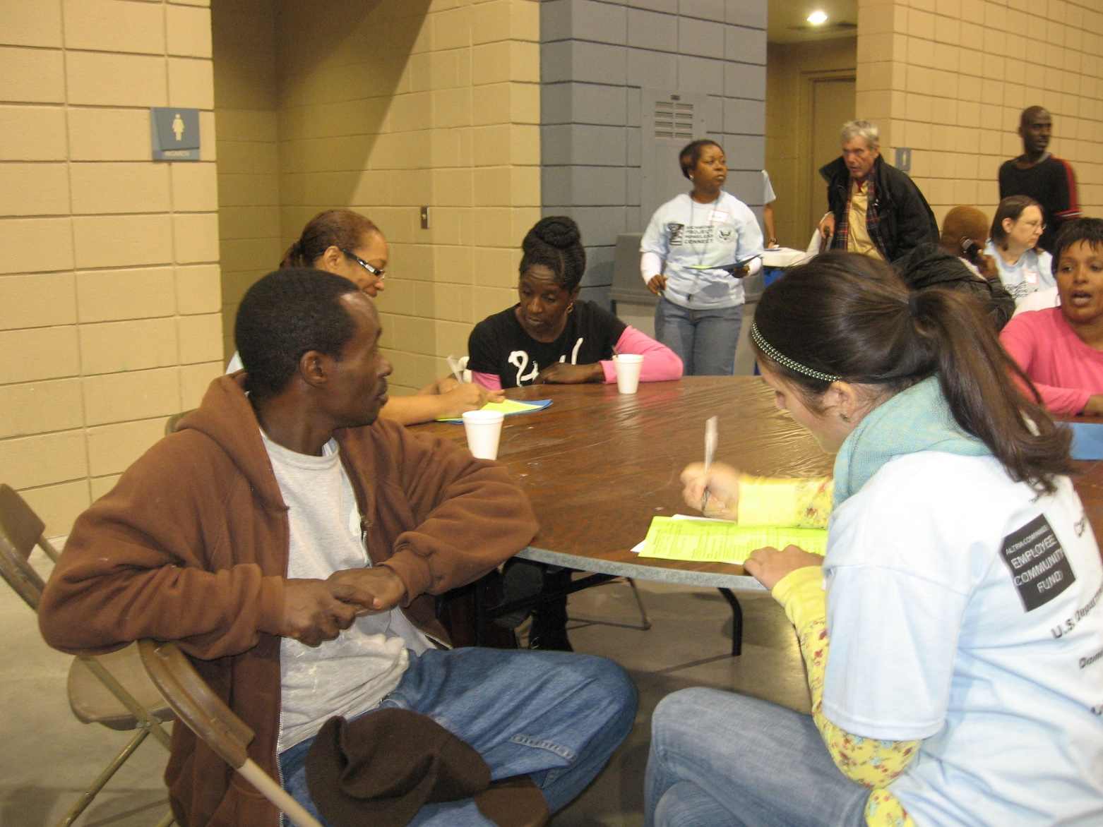
Working together
Continuum of Care

Slide 4
Continuum of Care
The CoC is the community’s infrastructure for inclusive planning, collaborative decision-making, coordinated service provision, and strategic allocation of public resources to address homelessness. Homeward provides data collection and analysis, subject matter expertise, system coordination, and administrative support to the CoC at the request of the CoC board.

Slide 5
The development of Continuums of Care
The concept of a Continuum of Care (CoC) was developed by the U.S. Department of Housing and Urban Development in the 1990’s as a way to allocate funding to address the growing crisis of homelessness in communities.
The CoC Program (HUD funding) is the largest single source of funding for homeless services in Greater Richmond ($5MM/year)
Currently, there are close to 400 CoC’s across the country.
There are 16 CoC’s in the Commonwealth of Virginia. All but one are regional or multi-jurisdictional.
Federal and state funding targeted to fight homelessness are allocated to these regional coalitions to make the best decisions based on community needs.
Numerous statutes and regulations guide and govern CoC’s. The Homeless Emergency Assistance and Rapid Transition to Housing (HEARTH) Act of 2009 is the guiding legislation:
  https://www.federalregister.gov/documents/2012/07/31/2012-17546/homeless-emergency-assistance-and-rapid-transition-to-housing-continuum-of-care-program

Slide 6
HUD definition of homelessness
A person/household is considered homeless
when that person/household:
• Resides in places not meant for human habitation, such as cars, parks, sidewalks, abandoned buildings.
• Resides in an emergency shelter.
• Is fleeing a domestic violence housing situation and no subsequent residence has been identified.
In a hotel/motel paid for by congregation/charitable organization

Slide 7
Ending Homelessness
An end to homelessness means that every community will have a comprehensive response in place that ensures homelessness is prevented whenever possible, or if it can’t be prevented, it is a rare, brief, and one-time experience.
Specifically, every community will have the capacity to:
Quickly identify and engage people at risk of and experiencing homelessness.
Intervene to prevent people from losing their housing and divert people from entering the homelessness services system.
Provide people with immediate access to shelter and crisis services without barriers to entry if homelessness does occur.
Quickly connect people experiencing homelessness to housing assistance and services tailored to their unique needs and strengths to help them achieve and maintain stable housing.
https://www.usich.gov/goals/what-does-ending-homelessness-mean/

Slide 8
Permanent housing
Permanent housing (PH) is defined as community-based housing without a designated length of stay in which formerly homeless individuals and families live as independently as possible.
https://www.hudexchange.info/programs/coc/coc-program-eligibility-requirements

Slide 9
Housing First
“Housing First is a proven approach, applicable across all elements of systems for ending homelessness, in which people experiencing homelessness are connected to permanent housing swiftly and with few to no treatment preconditions, behavioral contingencies, or other barriers.”
United States Interagency Council on Homelessness (USICH)

Slide 10
Working together: basis of our efforts
  “The idea of collaboration is not a new one – the entire Continuum of Care (CoC) concept was born out of the recognition that in order to effectively address homelessness it needed to be done in a coordinated fashion.”
  https://www.hudexchange.info/news/snaps-weekly-focus-working-together-to-end-homelessness//

Slide 11
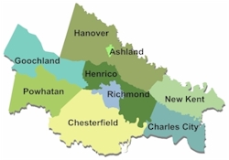
Greater Richmond Continuum of Care (GRCoC)
Established in 1997 by community stakeholders to fight homelessness in the region.
Homeward was created in 1998 to facilitate and support the GRCoC.
More than $4.6 million in HUD funds targeted to homelessness each year for regional providers; $1.6 million in state funds.
Develops policies and procedures locally to maximize services for each household and resources.
Learn more: www.endhomelessnessrva.org
Map retrieved from http://www.richmondregional.org/

Slide 12

Continuum of Care
  A Continuum of Care (CoC) is a broad group of stakeholders coming together to take action against homelessness in a community
    Required by the U.S. Department of Housing and Urban Development (HUD) in order to receive funding targeted for homeless services
    The HUD program was established in 1995 and continues to guide policy on homelessness.
    Responsible for developing policies and procedures to coordinate homeless assistance.
    Community decision-making to increase access to resources and to help our most vulnerable neighbors access assistance to end their homelessness.

Slide 13
GRCoC Membership Structure
Board of Directors
Oversight on funding, policy, and strategy
Active Members
Defined in bylaws; formal partners that receive coordinated funding
General Membership
Limited requirement. General public.

Slide 14
Active Membership
Membership in the Greater Richmond CoC will be available through an open registration process on www.endhomelessnessrva.org or by contacting the Collaborative Applicant and expressing desire to participate in the CoC. The Collaborative Applicant will complete a registration of Active Membership prior to any anticipated CoC vote. An association/ agency member will be considered a member in good standing, or Active Member, by attending 75% of the previous four general meetings and/or through participation in 75% of the meetings of a CoC committee in the past calendar year. Individual members will be considered a member in good standing, or Active Member, by attending 50% of the past four general meetings and/or through participation in 50% of the meetings of a CoC committee in the past calendar year. Active Members are entitled to vote as defined in Article IV and to receive letters for grants indicating length of membership and a description of their participation.

Slide 15
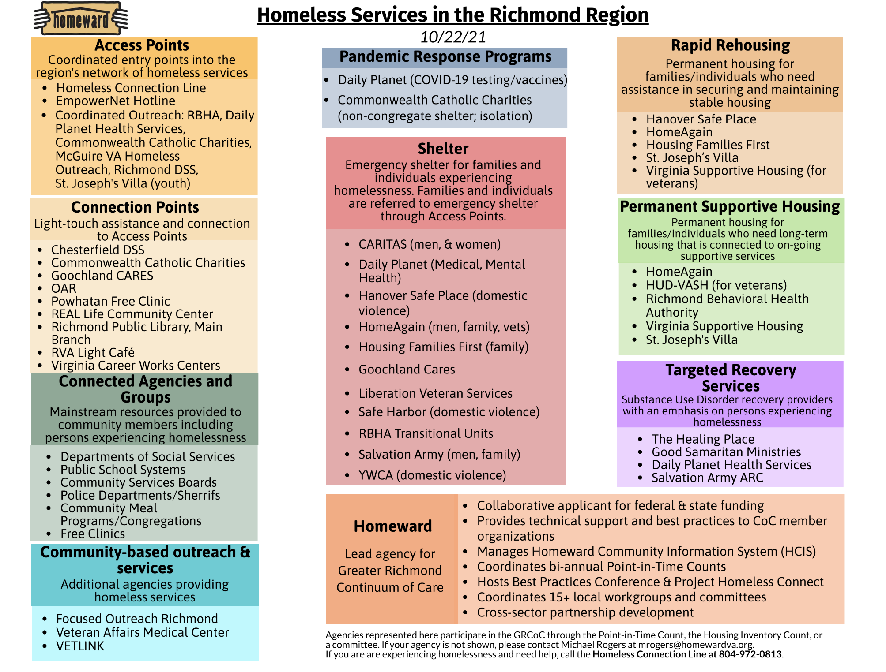

Slide 16

Homeward’s Role in the GRCoC
Homeward and the GRCoC established MoUs for:
HMIS Lead: Identifying needs and trends through data collection
Collaborative Applicant: Coordinated funding applications
Coordinated Entry System Coordinator: System coordination and support for Coordinated Entry programs (Homeless Crisis Line)
Other roles:
Community and partner engagement
Technical assistance and capacity-building for the homeless services network
Planning and policy support through Board, Committees, and work groups (task forces)

Slide 17
Is Homeward the CoC?
While both Homeward and the GRCoC are responsible for planning homeless services, the GRCoC is the decision-making body for coordinated homeless services in Greater Richmond. As the lead agency, Homeward provides technical assistance, staff support, and subject matter expertise to the GRCoC at the request of the CoC Board.

Slide 18
Committees: Ranking and Review
Ranking and Review Committee: coordinates and review the CoC application to the HUD as well as VHSP from DHCD. This committee also establishes and oversees a process to evaluate the performance of CoC member agencies applying for these funds. No member agency that is applying for CoC funds shall serve on this committee.
Composition: Professional (private and public) funders, grant makers. Representatives from ESG entitlement and CDBG recipient jurisdictions. Private foundations.
Recruitment: Collaborative Applicant works with CoC board chair to identify potential candidates.

Slide 19
Committees: Governance
Governance: charged with recruiting qualified, willing members of the CoC to serve as Board members in accordance with the desired composition as outlined in relevant federal and/or state regulations. Updating bylaws. Drafting committee charters, composition, application process.
Composition: Board members.
Recruitment: Collaborative Applicant works with Governance Committee to identify replacements when necessary. Board members can express interest.
Active: Governance meets on an as needed basis. Typically, 3-4 times a year. (Note: bylaws were significantly updated in 2020 and 2021.)

Slide 20
Committees : SPP
System Policy and Process Committee (SPP): responsible for reviewing and updating policies and processes that guide the GRCoC Coordinated Entry System. Many policies endorsed by SPP must be approved by the CoC board.
Composition: One voting member representative from each provider type (e.g., emergency shelter, outreach, permanent supportive housing, etc.) and one non-voting Coordinated Entry (referrals) member,
Recruitment: Applications are accepted every two years. Candidates are reviewed and selected by Governance.
Active: 2-year term. Meet every other week. Complex and demanding work.

Slide 21
Committees: HCIS
HMIS/HCIS Committee: responsible for providing information and guidance to the Greater Richmond CoC related to the implementation of HMIS. Reviewing and voting on HCIS license applications-which must be approved by CoC board.
Composition: Data/HMIS professionals
Recruitment: Application and review are managed by the HCIS committee.

Slide 22
Committees: QIL
Quality Improvement Leadership (QIL) Committee: composed of organizations in the GRCoC that receive HUD CoC, DHCD VHSP, and/or ESG funding. The QIL Work Group will meet to identify and discuss programmatic quality issues in coordinated homeless services
Composition: 2 representatives from each CoC agency that receives ESG (non –CV), CoC, and/or VHSP funding
Recruitment: N/A
Active: Quarterly

Slide 23
General Meetings
General Meetings: A meeting of the Greater Richmond CoC membership is considered a General Meeting. The Greater Richmond CoC membership will meet at least four times per year. Active Members can vote on bylaws and board slate (annual meeting).
Composition: As determined in bylaws
Recruitment: N/A
Active: Quarterly and one Annual Meeting (board slate).

Slide 24
Community Data Review
Point-in-Time Count and Homeless Connection Line

Slide 25
Best Practices Conference
Homeward is excited to share that they are hosting their Best Practices to Prevent and End Homelessness conference in person on Friday, May 6 at the Westin 6631 W. Broad St!
Details on registration and speakers to follow.

Slide 26
Virginia Homeless Solutions Program FY23
GRCoC’s Collaborative Application

Slide 27
Virginia Homeless Solutions Program: Key Points
Every two years (last full competition was in early 2020) , DHCD releases HSNH guidelines for funding programs.
The primary kinds of projects which can be funded through VHSP include
  Emergency Shelter (including Medical Respite)
  Outreach
  Rapid re-housing
  HMIS (the data collection system which is required to be used by all funded agencies)
  Coordinated Entry (the coordinated system for accessing and prioritizing services which is required for all funded agencies)
  CoC Planning (not competitive)
  Targeted Prevention (GRCoC does not currently have VHSP-funded Prevention programs)
Each CoC’s application has to include a proposed cash match of 25% for its collaborative application. Most agencies must raise significant funding to implement these programs. Homeward fundraises to lower the match for included grantees.

Slide 28
VHSP: Key Points, cont.
VHSP competitive and only a Continuum of Care can apply. Individual agencies and for profit companies cannot apply.
  Individual project applicants submit an application to the CoC via Homeward
There are 16 CoCs in Virginia. All but VA Beach are multi-jurisdictional.
The amount of funding available is determined community need, capacity and performance; historically flat funding
The application has two parts: a community narrative and a collaborative budget from combined project applications (i.e., for an Emergency Shelter program.)

Slide 29
DHCD VHSP FY23
Funding Opportunity
The Virginia Department of Housing and Community Development made VHSP guidelines and applications available on February 1, 2022
CoCs must submit consolidated application by April 4 at 5PM
GRCoC’s FY22 funding: $1,647,316
Housing Trust Fund – Homeless Reduction Grant Bonus

Slide 30
HTF-HRG Bonus
Eligible activities:
Rapid Re-housing
Underserved Populations Innovations Project
  Age 60+
  Unaccompanied youth 18-24
  LGBTQ+
  ID/DD/SUD
Permanent Supportive Housing (housing stabilization or rental assistance)
Admin

Slide 31
Underserved Population
Innovative Planning
  Develop pilots of assistance
Outreach/engagement
  Must comply with GRCoC outreach standards
Housing solutions
  E.g. host homes
RRH (including shared housing) and innovative housing solutions

Slide 32
VHSP FY23
Competition Timeline
2/1/22: VaDHCD made VHSP guidelines and applications. CoCs must submit consolidated application by April 4 at 5pm.
2/11/22-2/24/22: How to apply and open office hours webinars
2/15/22: Project applications released through CoC listserv and direct emails
2/25/22: Performance Measurement information session
3/8/22: Project Applications due to CoC
3/11/22: Ranking Committee met to review project applications and develop funding request

Slide 33
Ranking Committee Review
$1,990,950 in requests (not including HTF)
  15 renewals, each requesting increase
  2 new projects: RBH Outreach, Homeward HMIS
  Level funding $1,647,316 (-$343,634)
2 HTF Bonuses: RBH Outreach, VSH Supportive Services at PSH
Consideration 1: full funding
  Are there any project that should not be included?
Consideration 2: level funding
  Where to make cuts?
Consideration 3: some additional funding
  Which cut projects (level funding) would receive some funding?

Slide 34
Ranking Committee Review
Opted for full funding @ $1,990,950
If level funding, no new projects funded, no increase for any renewal grantee
If >level, but <full funding, prioritize funding new projects with preference for RBH outreach project

Slide 35
FY23 Funding Requests
Organization
 | Outreach |  | Centralized or Coordinated Assessment / Entry |  | Targeted Prevention |  | Emergency Shelter Operations |  | Rapid Re-housing |  | BASE REQUEST |  | CoC/LPG Planning (up to 10%) | HMIS (up to 5%) |  | Administration (up to 3%) |  | TOTAL REQUEST (excluding HOPWA) |  | HOPWA (Autofilled - Rows 17 & 18) |  | GRAND TOTAL
CARITAS |  |  |  |  |  |  | 250,000 (19,000) |  |  |  | 250,000 |  |  |  |  |  |  | 250,000 |  |  |  | 250,000
Commonwealth Catholic Charities | 46,695 (11,206) |  |  |  |  |  |  |  |  |  | 46,695 |  |  |  |  |  |  | 46,695 |  |  |  | 46,695
Daily Planet Health Services |  |  |  |  |  |  | 37,200 (4,488) |  |  |  | 37,200 |  |  |  |  |  |  | 37,200 |  |  |  | 37,200
Hanover Safe Place |  |  |  |  |  |  | 52,250 (6,472) |  | 145,000 (46,926) |  | 197,250 |  |  |  |  |  |  | 197,250 |  |  |  | 197,250
HomeAgain |  |  |  |  |  |  | 136,404 (35,259) |  | 109,795 (-21,850) |  | 246,199 |  |  |  |  |  |  | 246,199 |  |  |  | 246,199
Homeward |  |  | 274,938 |  |  |  |  |  |  |  | 274,938 |  | 30,000 (5,000) | 25,000 |  |  |  | 329,938 |  |  |  | 329,938
Housing Families First |  |  |  |  |  |  | 80,000 (7,048) |  | 131,000 (2,761) |  | 211,000 |  |  |  |  | 4,000 |  | 215,000 |  |  |  | 215,000
St. Joseph's Villa |  |  |  |  |  |  |  |  | 338,000 (38,000) |  | 338,000 |  |  |  |  |  |  | 338,000 |  |  |  | 338,000
The Salvation Army |  |  |  |  |  |  | 65,000 |  |  |  | 65,000 |  |  |  |  |  |  | 65,000 |  |  |  | 65,000
YWCA |  |  | 75,000 (43,500) |  |  |  | 62,400 |  |  |  | 137,400 |  |  |  |  |  |  | 137,400 |  |  |  | 137,400
RBH | 122,160 |  |  |  |  |  |  |  |  |  | 122,160 |  |  |  |  | 6,108 |  | 128,268 |  |  |  | 128,268
HOPWA Request (Autofilled from HOPWA section below)
0 |  | Intentionally left blank |  |  |  |  |  |  |  |  |  |  |  |  |  |  |  |  |  |  | 0 |  | 0
0 |  |  |  |  |  |  |  |  |  |  |  |  |  |  |  |  |  |  |  |  | 0 |  | 0
Total |  | 168,855 |  | 349,938 |  | 0 |  | 683,254 |  | 723,795 |  | 1,925,842 | 30,000 |  | 25,000 |  | 10,108 |  | 1,990,950 |  | 0 |  | 1,990,950

Slide 36
FY23 VHSP Process Cont.
3/11/22: All VHSP applicants were notified of Ranking’s decision and informed of the appeals process
3/15/22: Appeals deadline. No appeals filed
3/18/22-3/24/22: Community narrative posted for public comment. No comments received.
3/25/22: Homeward presented draft application and proposed funding request to GRCoC Board
3/28/22: Application approved by board
3/29/22: Homeward submitted application to DHCD.

Slide 37
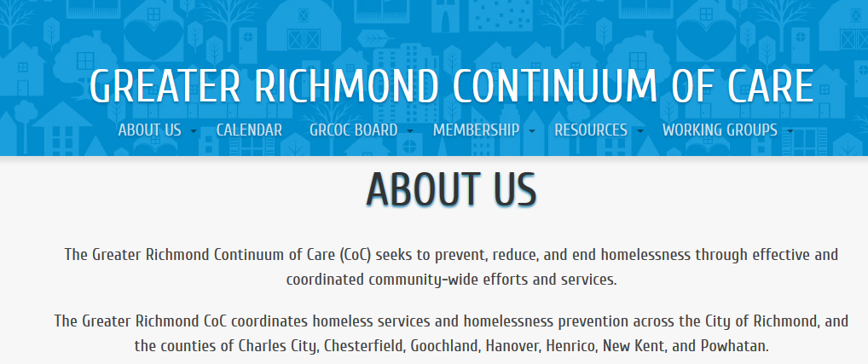
Find out more at www.endhomelessnessrva.org
Michael Rogers
System and Continuum of Care Director
mrogers@homewardva.org
Frances Marie Pugh
Special Projects Manager
fpugh@homewardva.org
www.homewardva.org
www.endhomelessnessrva.org

