Slide 1
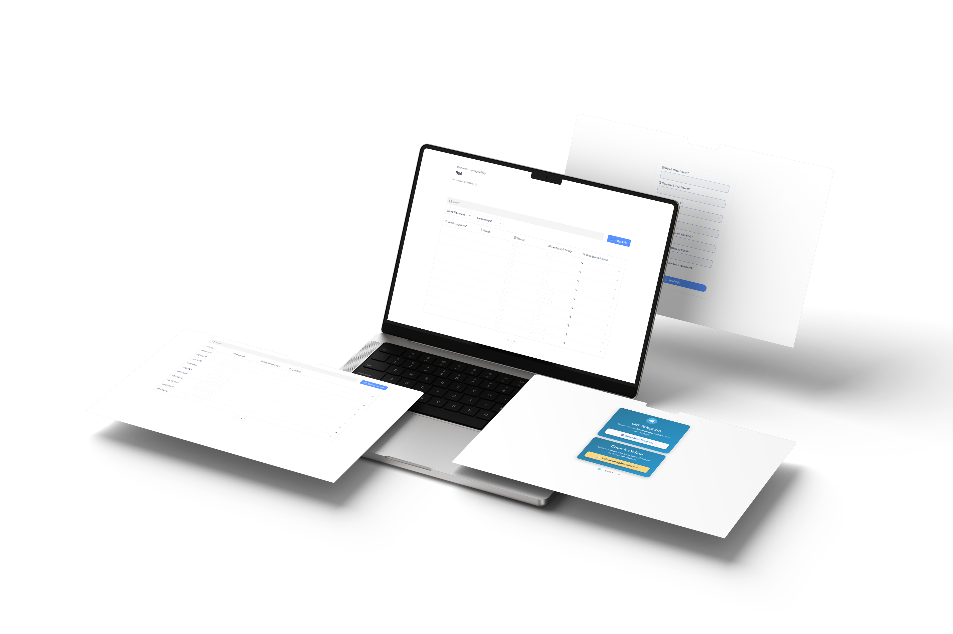

Church Administration Software
Demo & Overview
cipherforces.com | 808-480-0800

Slide 2
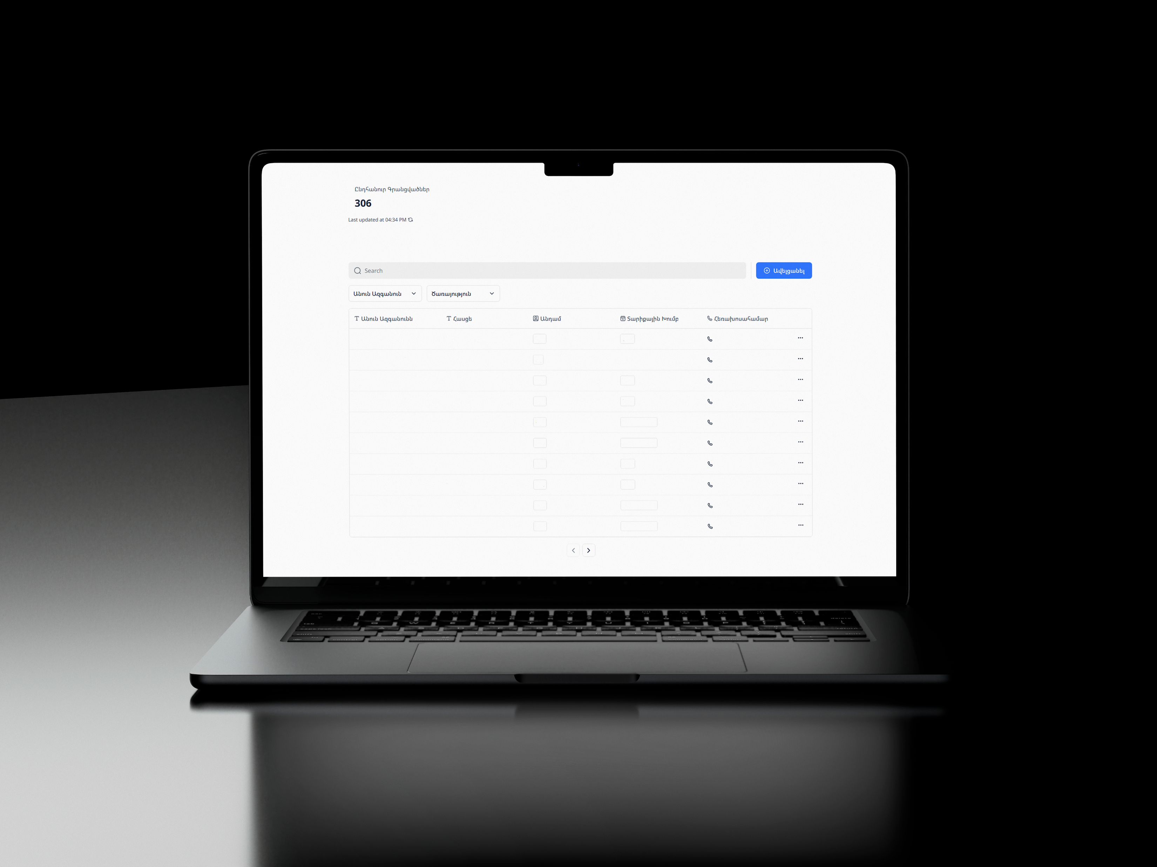
Main page – full member directory
Live member count updates at the top
Search & filter the entire directory
Inline editing per member record
Role-based visibility (Pastor/Admin only)
Data synced from the central database

Slide 3
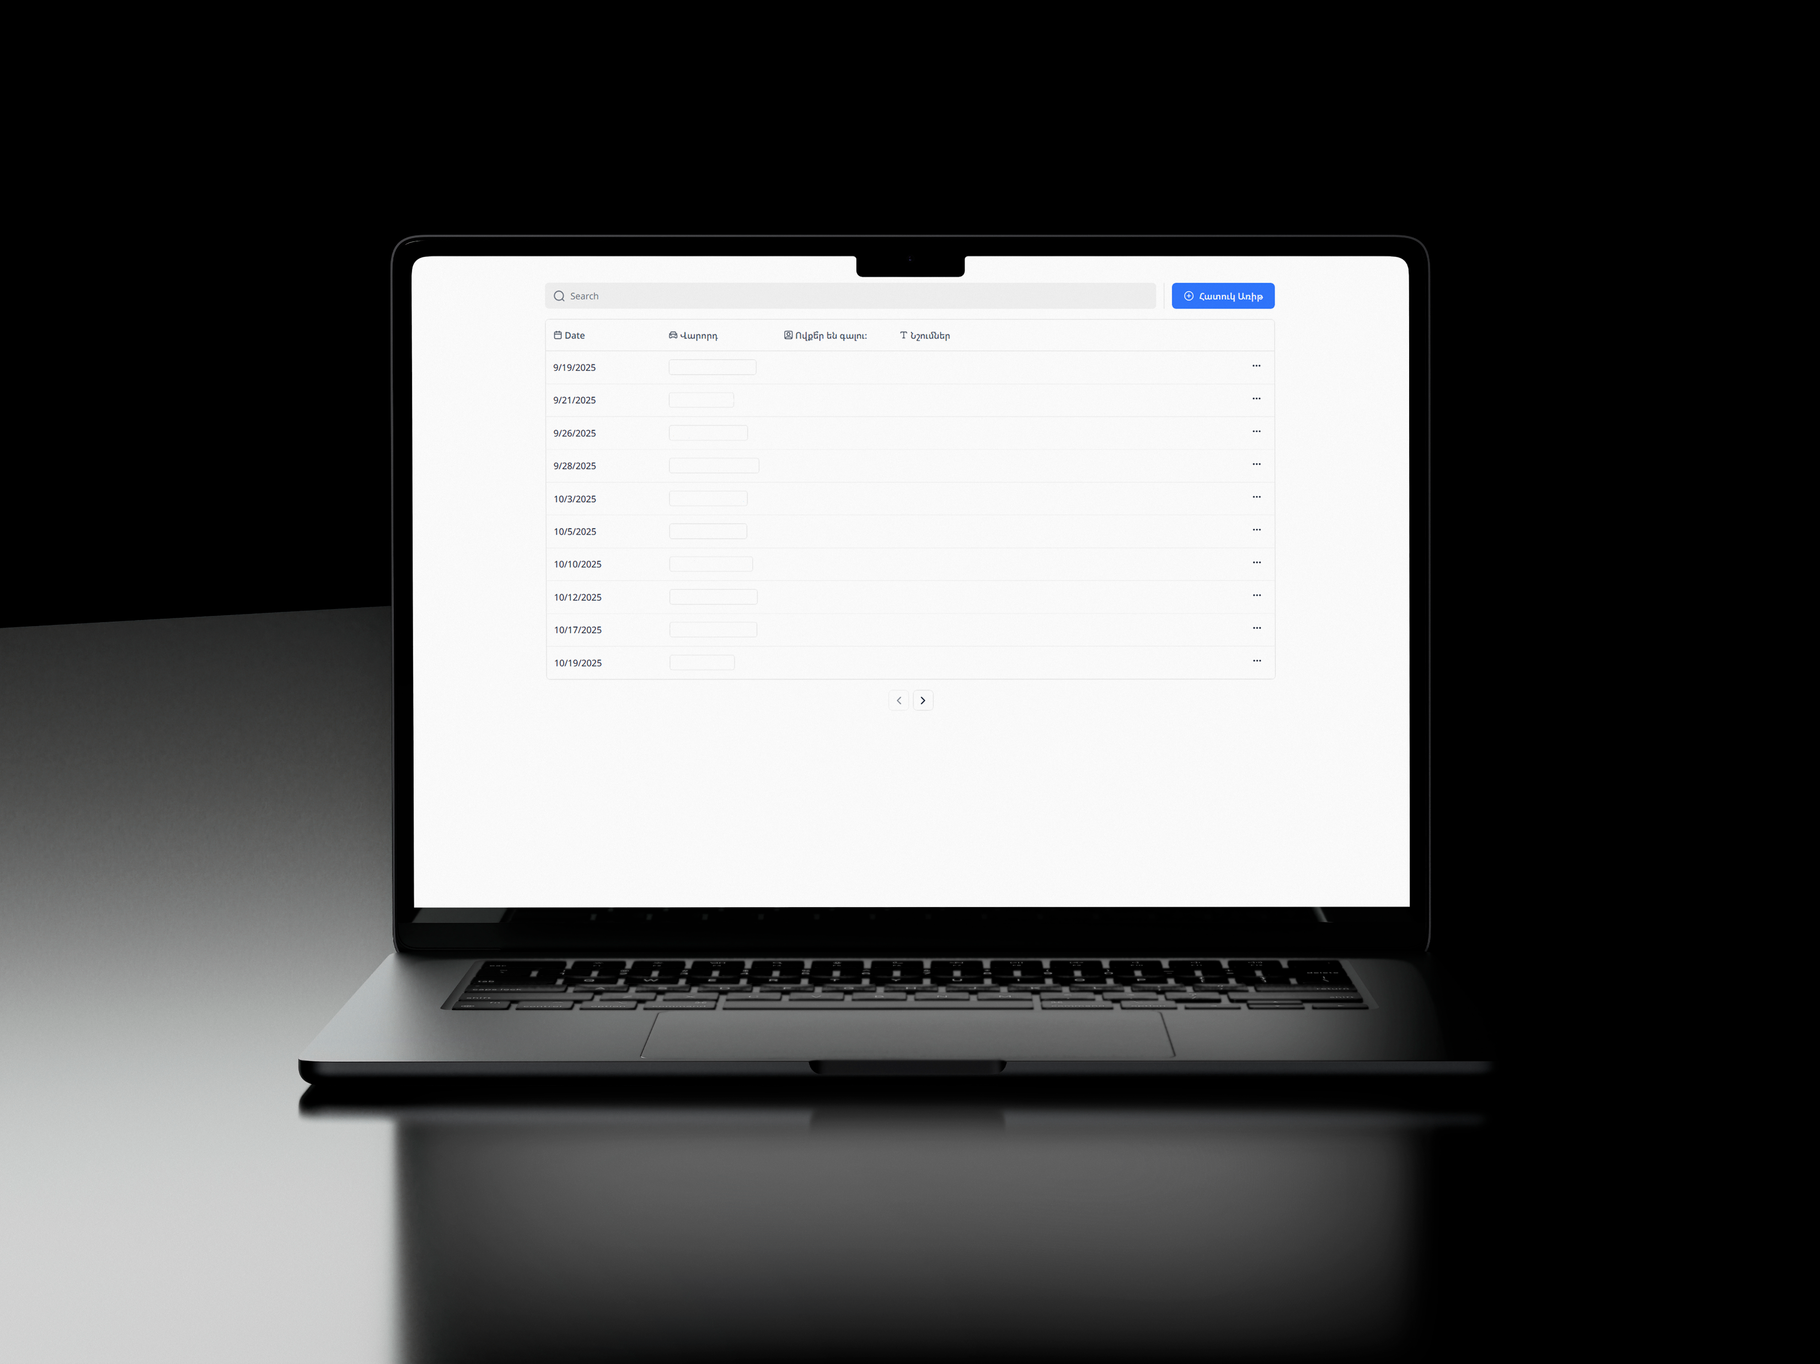
Drivers schedule
Auto-assigned weekly driver rotation
Custom events (park days, outreach, retreats) with the same assignment & messaging flow
Pick riders from a dynamic list (needs driver PErmissions)
Add notes per date (who picks up who)
Send group message to drivers right from the page
Weekly & pre-service Telegram reminders sent automatically

Slide 4
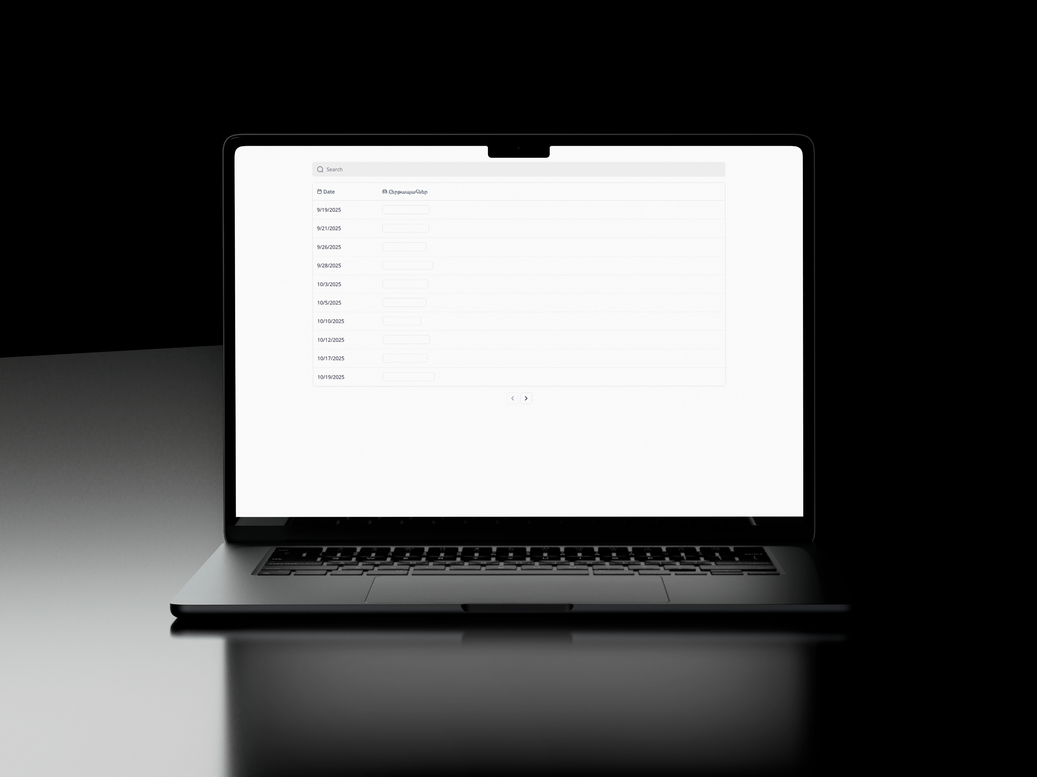
Ushers schedule
Two ushers auto-assigned per service
Edit when needed; changes are instant
Telegram bot posts Monday overview + Thu/Sat reminders
Fast search & clean layout

Slide 5
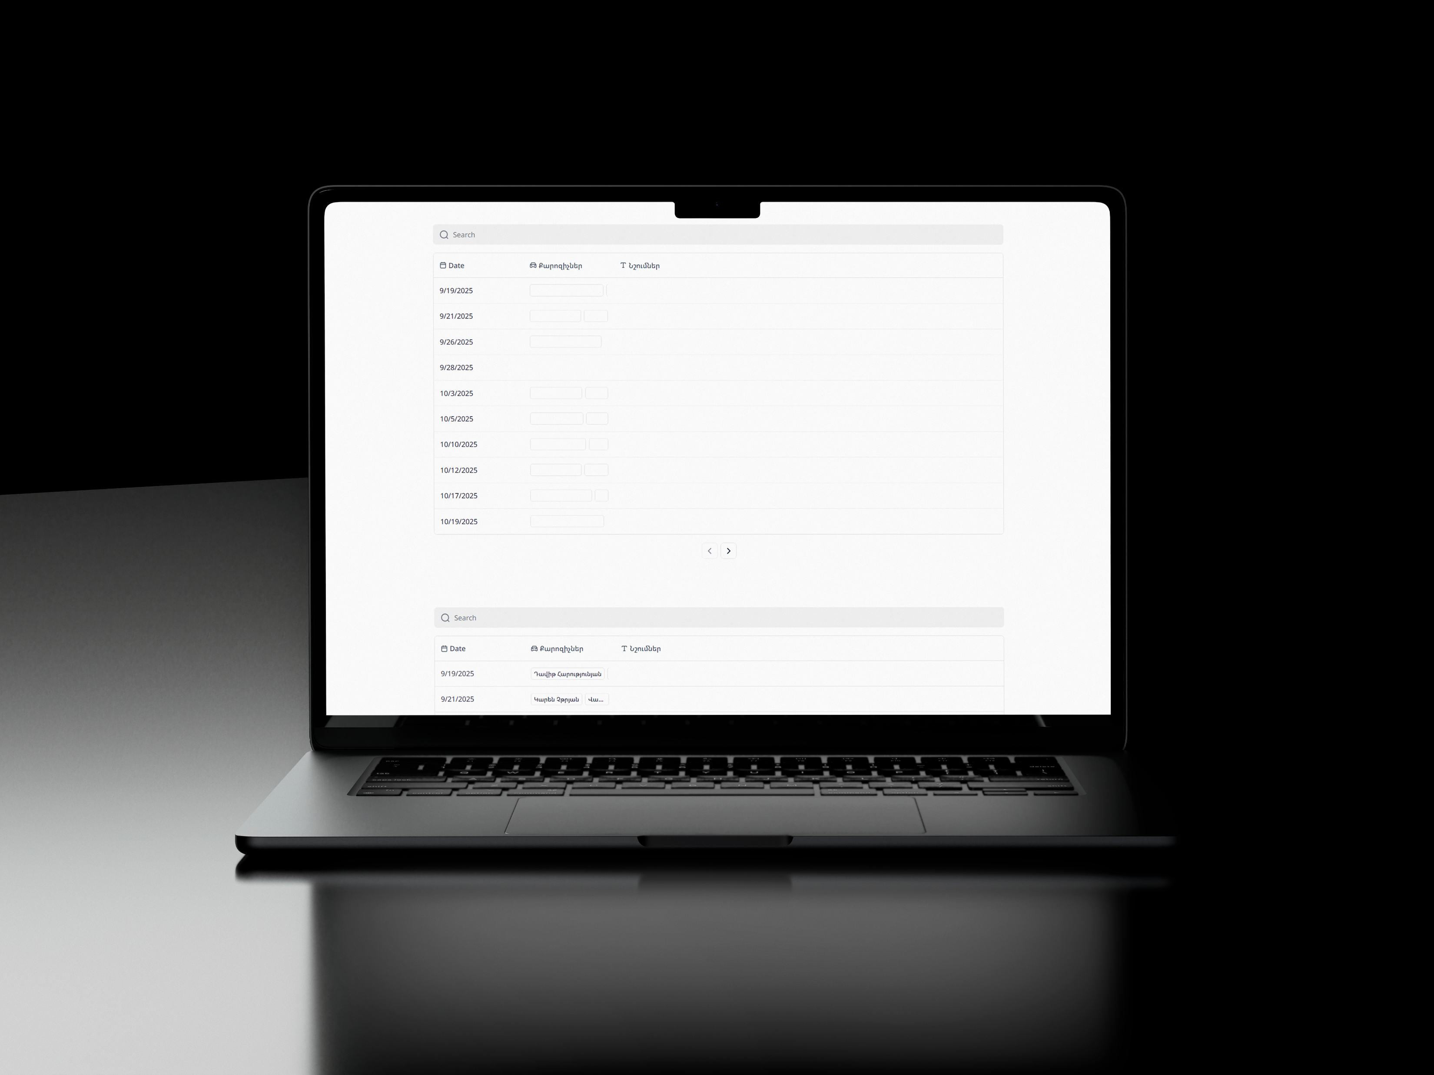
Speaker assignment (pastor only)
Private page for the Pastor
Choose speakers from a dynamic eligible list
Add notes (topic/series/guest) per date
Keeps a clean record of who spoke when

Slide 6
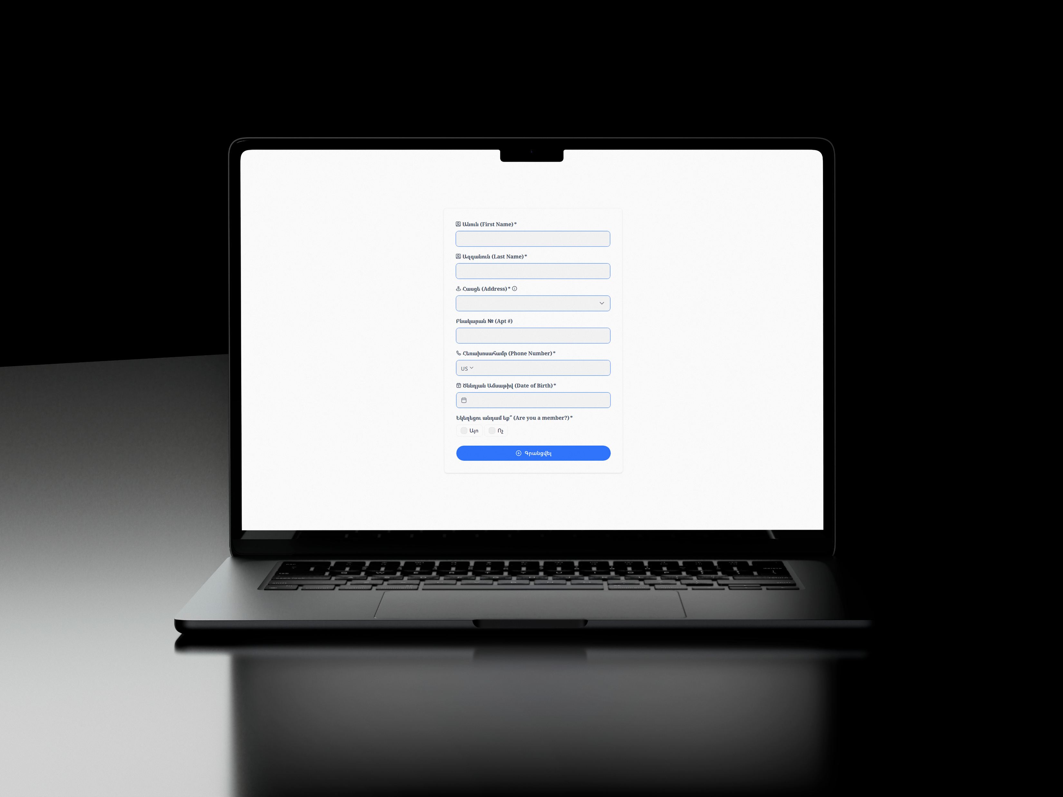
Member registration form
Google Maps address autocomplete
phone validation & formatting
Clean, simple fields with required checks
DOB → auto age & category after submit
Submitting triggers admin Telegram notification

Slide 7
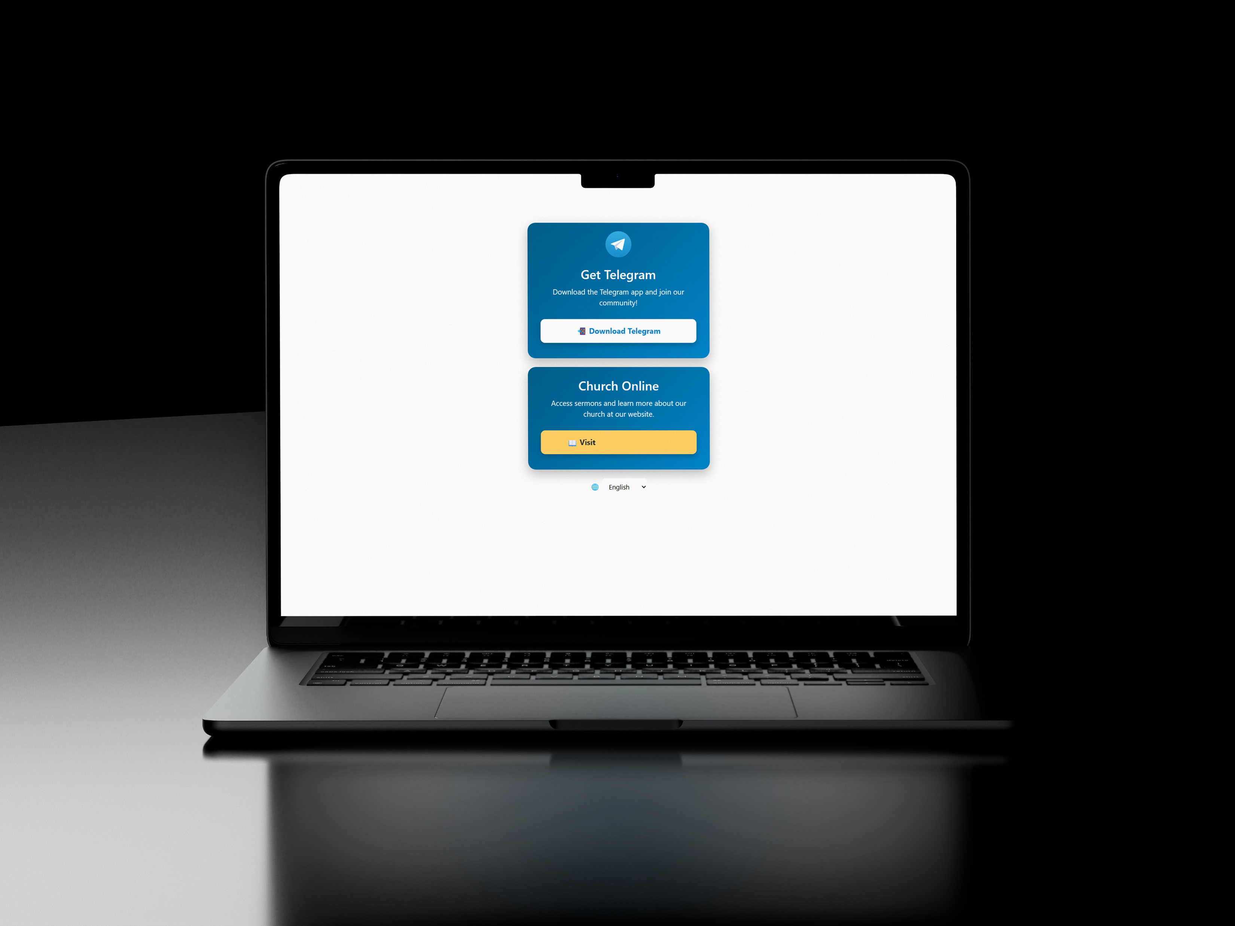
Get telegram/church online
Device-aware Telegram download button
Quick link to our church website
English / RUSSIAN / Armenian language switcher
Shown immediately after registration completes

Slide 8
Included Features
Feature | Overview
Member directory | search, filters, inline edits in one place
Auto schedules | drivers and ushers auto-assigned; quick last-minute updates
Group messaging | built-in chats and automatic reminders (e.g., Telegram)
Notifier | one spot for admins/pastors to broadcast to all church groups
Speaker planning (pastor-only) | private eligible list, notes, and sermon history
Registrations | phone validation, DOB→age/category, instant admin alerts
Camp registration forms | streamlined event/camp sign-ups
Sermon automation | upload triggers a dated webpage that’s added to the main site
Low-friction onboarding | device-aware links and multilingual support (EN/RU/AM)
Time Saved/week
Registrations: 2 hours/week
Driver planning: 2 hours/week
Usher planning: 1 hour/week
Total: ~5 hours/week
*All data in the slides/pictures is cleared for our users privacy.
cipherforces.com | 808-480-0800

