Slide 1

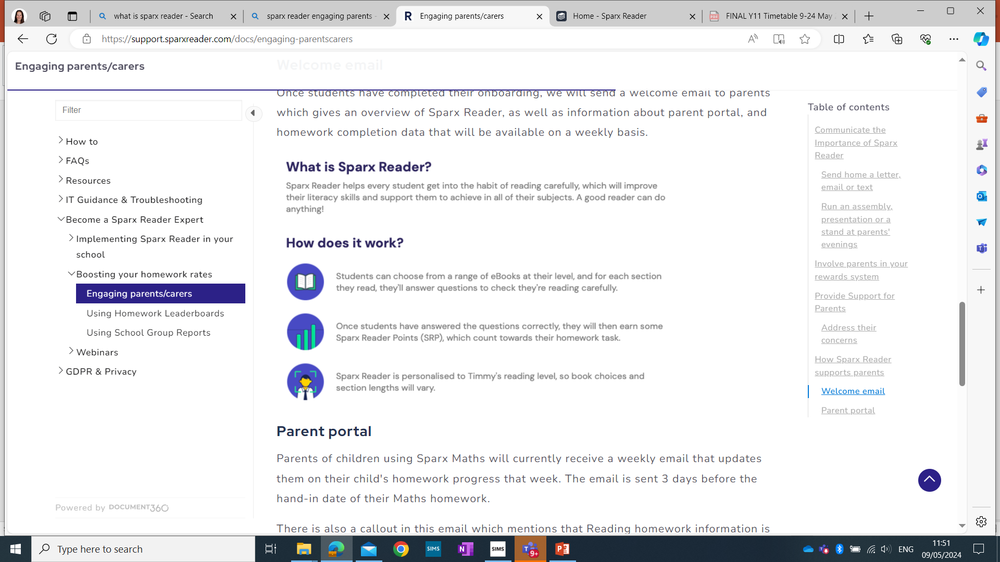

Sparx Reader is an engaging and supportive platform in which pupils can develop their reading and literacy skills. The wide ranging books are allocated to students based on reading level and age appropriate content and interest. Students can access books on any device and can use dyslexia-friendly fonts, colour overlays and reading rulers as required. Books range from highly recommended contemporary reads, easy reads, non-fiction, and fiction classics.
Why has Hove Park School chosen Sparx Reader for our students?
Students need to be proficient, independent readers to succeed at secondary school (and life beyond).
Regular, independent reading routines, that build precision, form a robust habit and, ultimately help students feel a sense of confidence and enjoyment in reading.
Reading proficiency does not happen incidentally: it requires purposeful reading practice.
Parent Portal
Parents will receive a weekly email (from Sparx) that updates them on their child’s homework progress that week. Parents should click on ‘Parent Portal’ on this weekly email to be taken to their child’s Sparx Reader progress and homework completion.
Parent engagement in their child’s homework makes a huge difference to homework completion. Reminding your child of the weekly task (set on Monday; due on Monday) and discussing their current book is valuable support.
How does Sparx Reader work?
Students can choose from a range of EBooks at their level, and for each section they read, they’ll answer questions to check they’re reading carefully.
Once students have answered the questions correctly, they will then earn some Sparx Reader Points (SRP), which count towards their homework task.
Sparx Reader is personalised to the student’s reading level, so book choices and section lengths will vary.
Sparx Reader Points (SRPs)
Year 7 and 8 students: 300 SRPs each week.
Year 9, 10 and 11 students: 400 SRPs each week.
One SRP is equivalent to one minute careful reading – whatever the reading ability of the child

