Slide 1
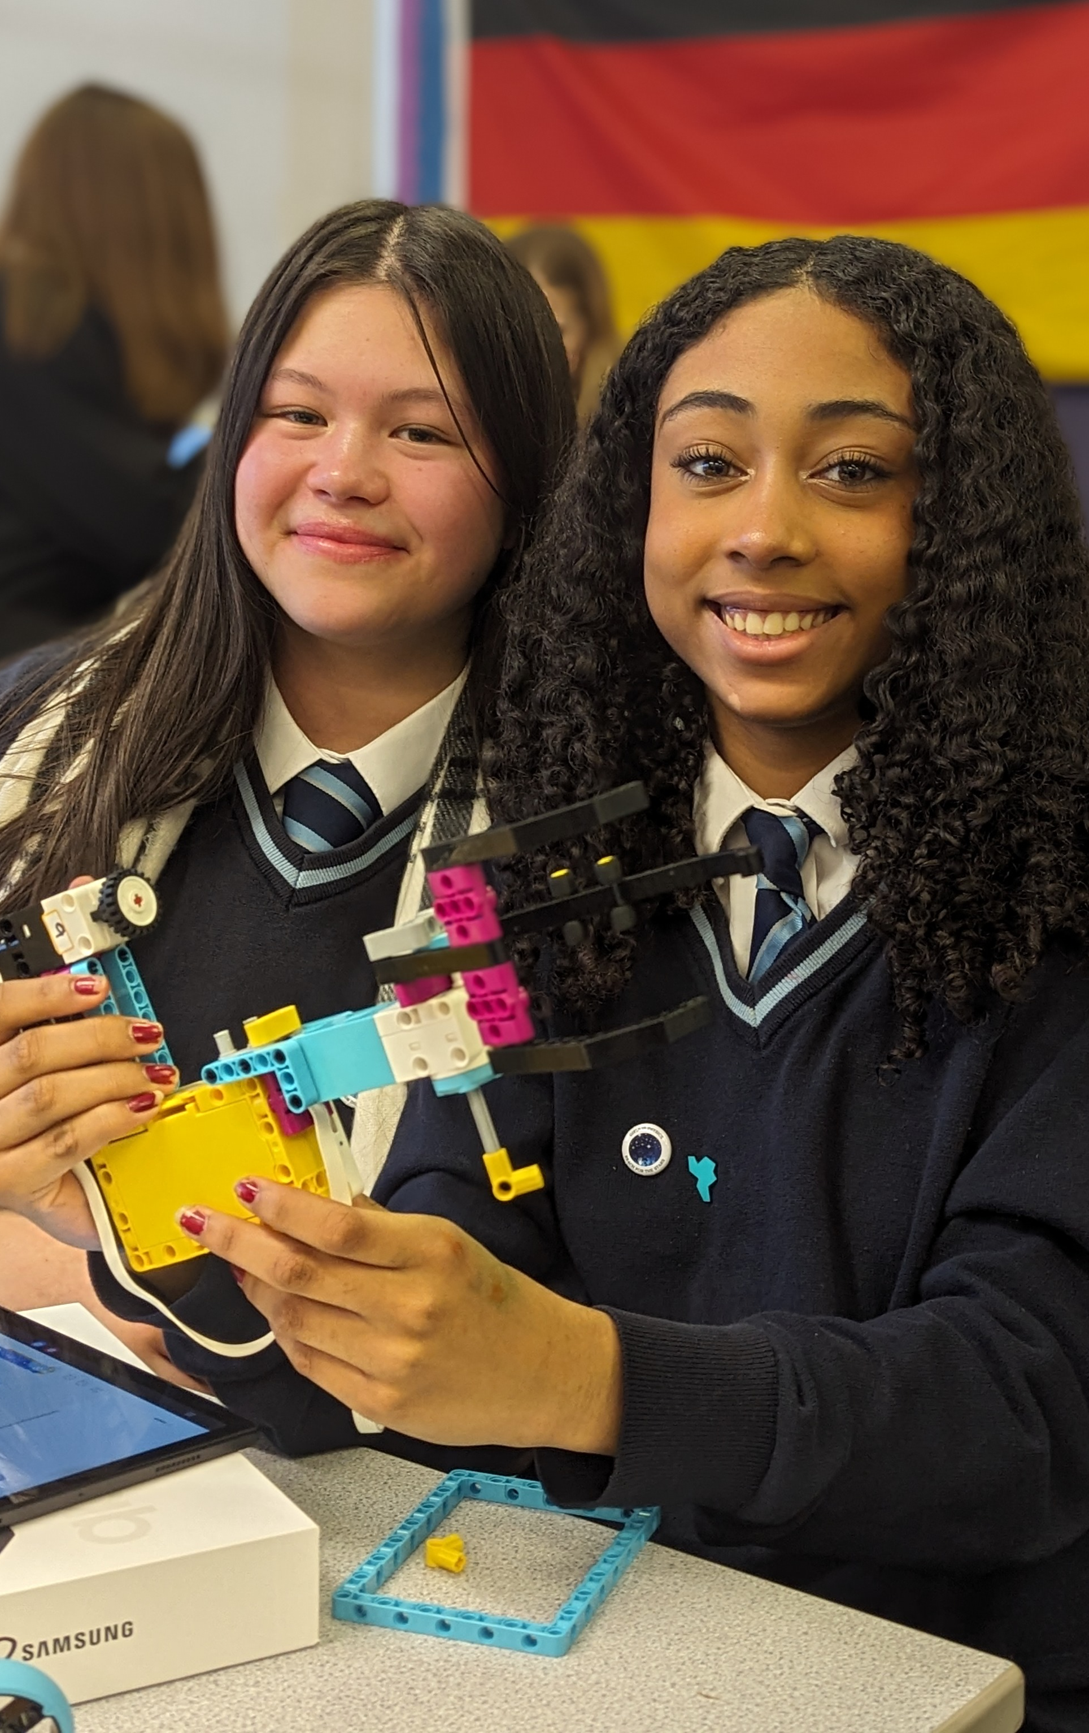

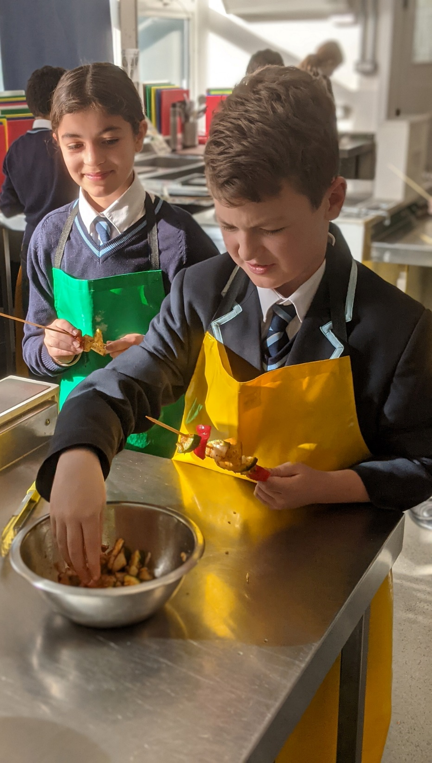
Welcome to
Hove Park!
Miss E Satterly
Head of Year 7

Slide 2

This Evening
Information about transition day on Friday 3rd July
Key school information
SENCo, Faculty leads and iPad staff available in the library

Slide 3
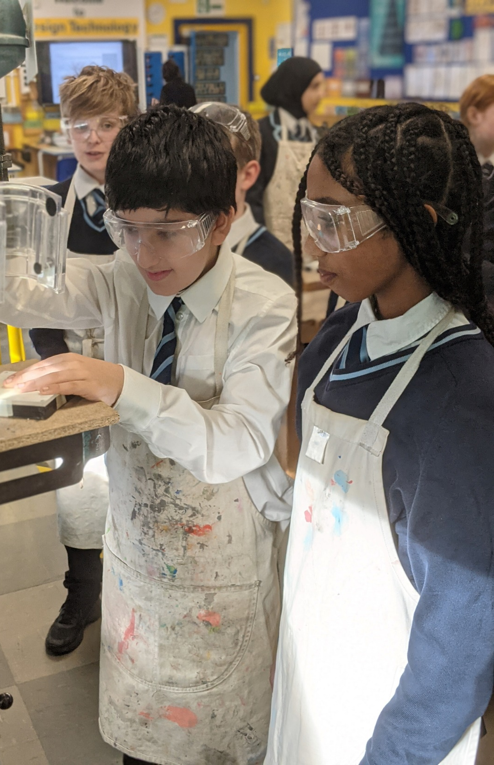
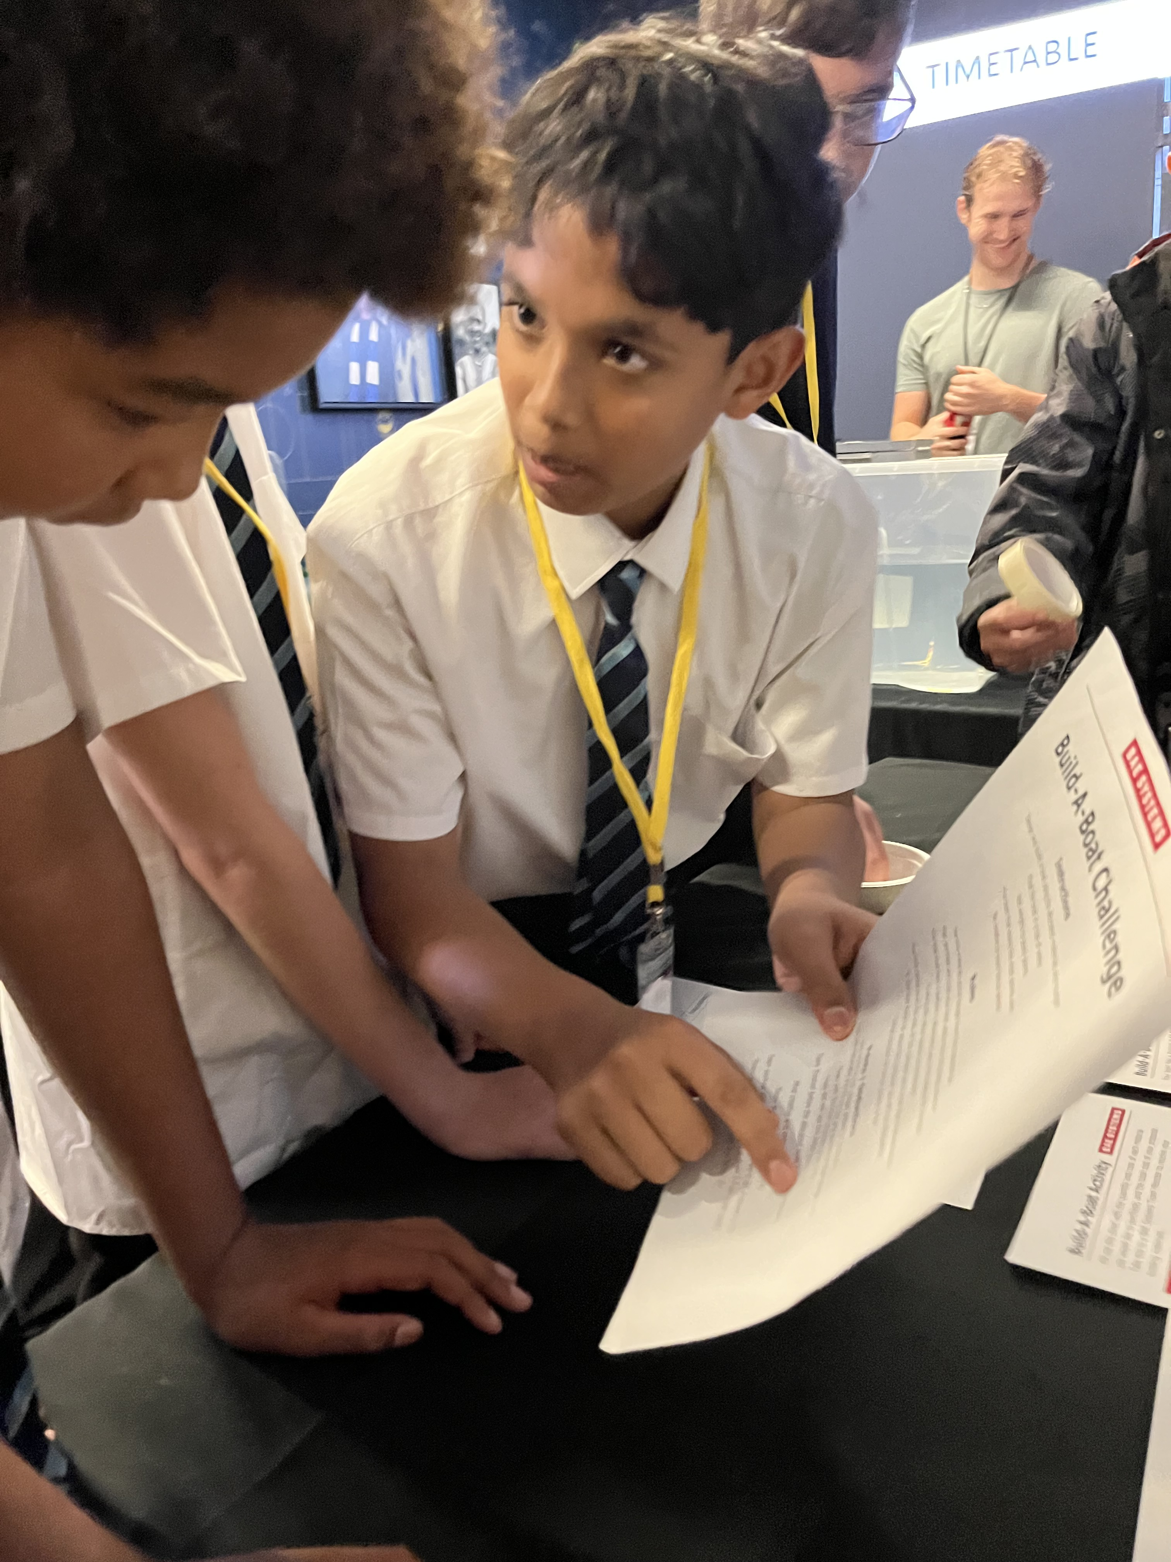
Friday 3rd July
Student arrival from 8.45am for 9.00am start
Assembly
Session 1: Tour of the Campus, transition packs and getting to know one another
Break time
Session 2: Taster lesson
Session 3: Taster lesson
Lunch time: Complimentary meal from canteen
Session 4: Taster lesson
2.20 – 2.30pm: Meet in hall and dismissal
Collection: 2.30pm

Slide 4
Looking Ahead
Summer School:
Monday 27th July - Friday 31st July
Year 7 students only, start the autumn term on; Thursday 3rd September, arrival by 8.25am.
First day will include transition style lessons (lesson 1 will be with the form tutor).
For the first 2 weeks, students will meet in the playground and be collected for each lesson, allowing them time to get used to the campus.

Slide 5
Looking Ahead - Communication
Parent/Carer Meet the Tutor evening in September.
Report at the end of the autumn term with comments from the tutor.
Parent/Carer Evening in the Spring term.
Report at the end of the Summer term with subject comments.

Slide 6


Parklife

Slide 7
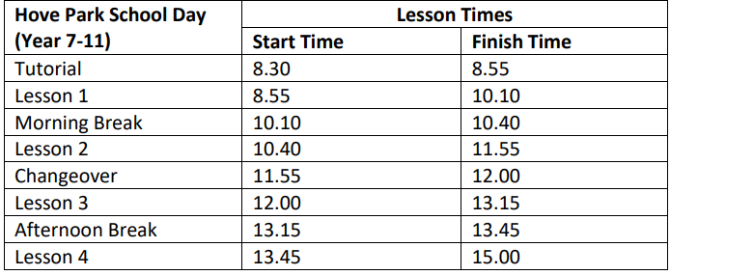
Timetable / Curriculum
Notes:
New times for 2018-2019

Slide 8
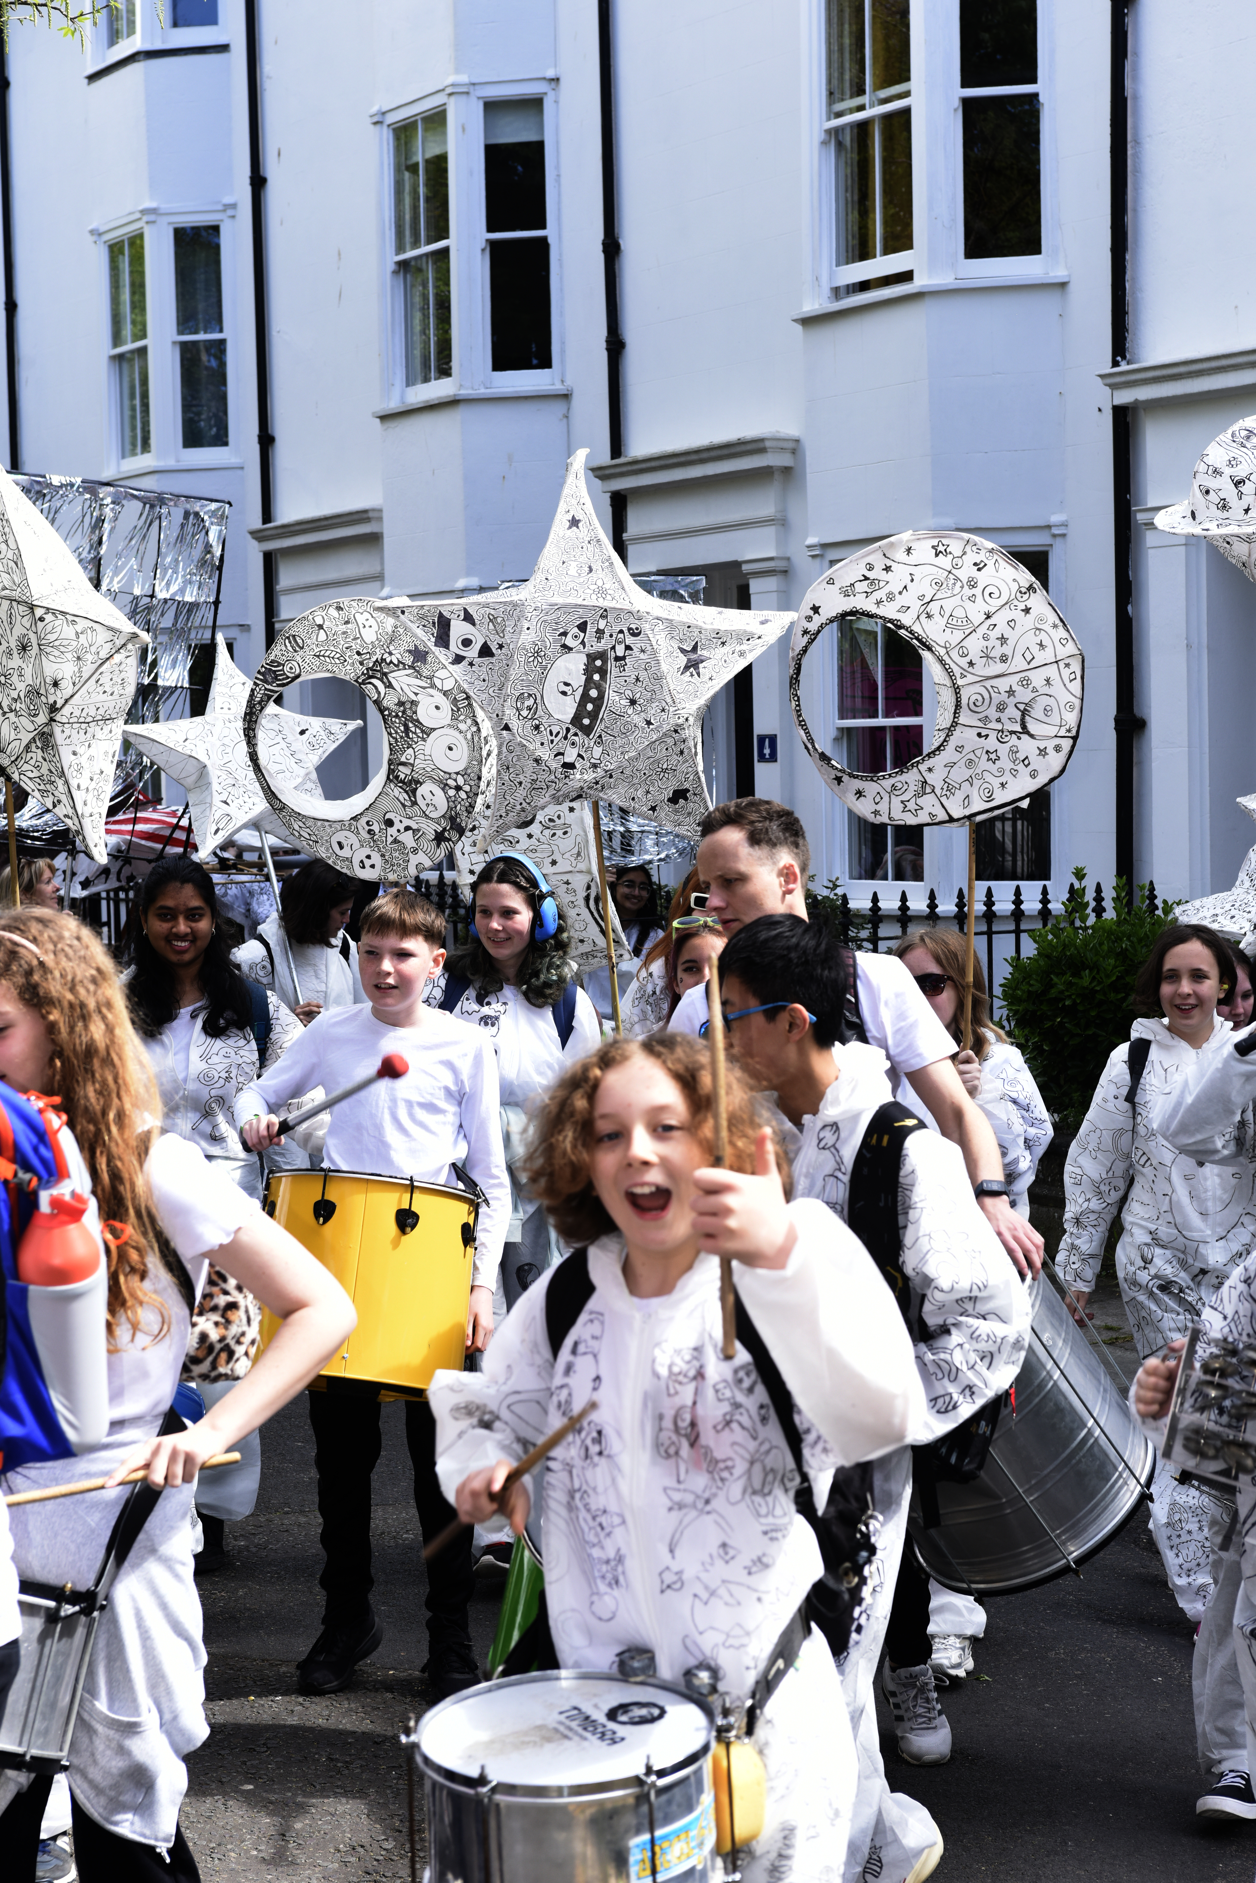
Year 7 Tutor Groupings
There are six tutor groups in Year 7; 7H, 7O, 7V, 7P, 7A and 7R.
There are lots of factors that impact tutor group allocation, including; needs of the child and primary school recommendations.
Tutor groups are a mix of boys and girls, with up to around 30 students in total in each group.
Maths will be taught in mixed ability groupings initially.
Languages being taught are French and Spanish.

Slide 9
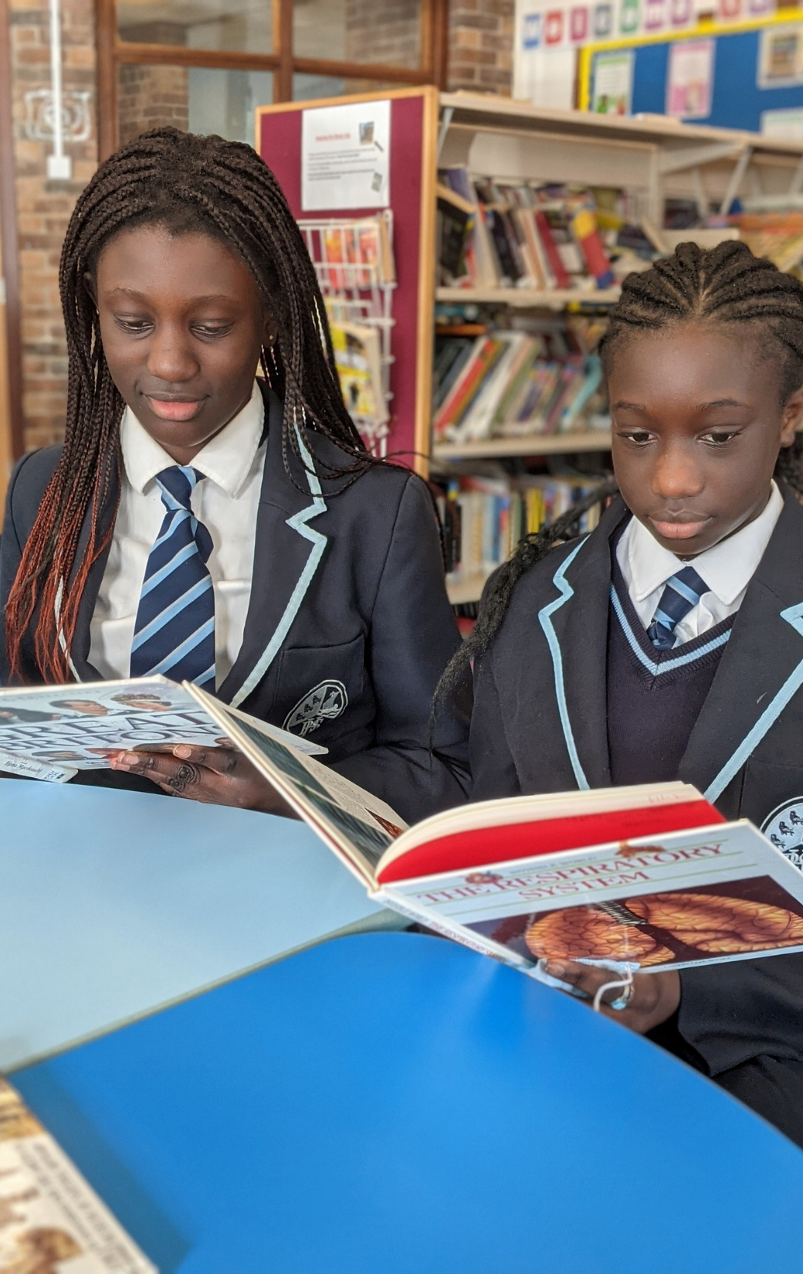
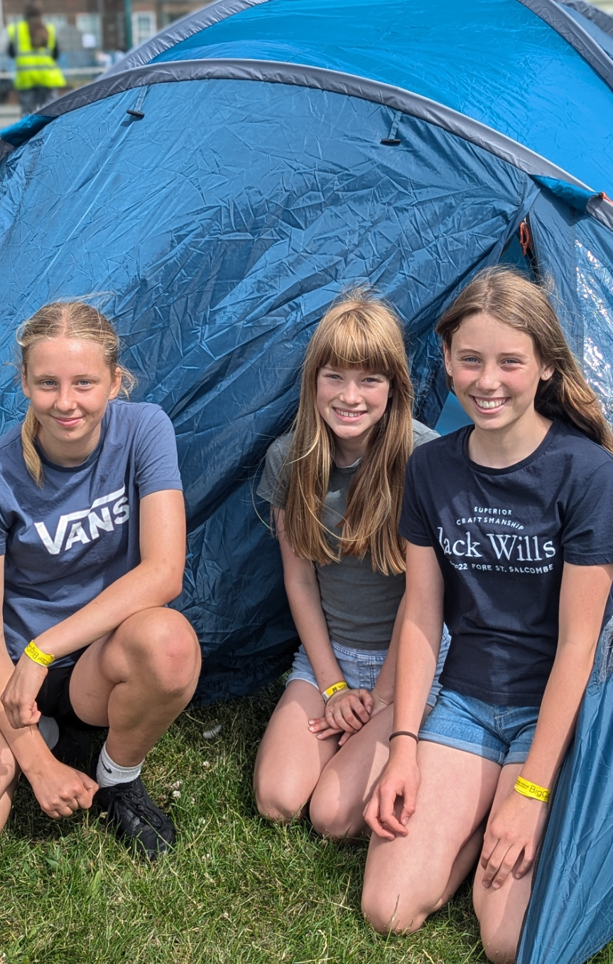
The Role of the
Form Tutor
Being the first point of contact for the student, parents and carers.
Delivering literacy, sustainability and belonging sessions.
Making sure your child is happy and secure, helping them to develop confidence and resilience.
Monitoring their academic performance.
Monitoring their attendance.
Checking student organisation.
Checking the student is prepared for learning – has pen, pencil, iPad and case, bag, correct uniform.
Meet the Tutor Evening- Thursday 10th September

Slide 10
How to Contact HPS Staff
All staff can be contacted easily via email;
initialsurname@hovepark.org.uk
For example:
Miss E Satterly = esatterly@hovepark.org.uk
Your first point of contact is usually your child’s tutor, who can be contacted by email, or a signed parental note.
If you have a subject specific question, you can contact the teacher directly and copy in the year office.

Slide 11
Equipment
It is important that students have a well-equipped pencil case for school. This should include; pens for handwriting, a green pen for annotating work, pencils, coloured pencils, an eraser and a ruler.
Students will also be expected to remember their subject books for the lessons they have on each day.
There is a two-week timetable, so it is important students get into a routine of packing their school bag the night before, with the correct books, for the following day. We will give students two paper copies of their timetable (after the iPad roll out, timetables will also be on TEAMS).
PE Kit must be brought in for PE lessons. Students will have time to change at the start and end of PE lessons.

Slide 12

Hove Park School iPad Package
iPad 11th Generation
Screen Protector
iPad Case
3 Year Insurance Cover
Mobile Device Management License
£11.86 /month. For 36 months.
or
£475 one-off payment

Slide 13

Bring Your Own
Already have your own iPad?
Requirements
Must support iPadOS26
£35 one-off-payment

Slide 14


Uniform
School blazer with school badge.
Plain white cotton shirt and school tie.
School jumper or cardigan (optional).
Plain black formal tailored school trousers.
Hove Park School skirt with logo.
Hove Park School shorts with logo or formal school shorts.
Plain all black shoes.
Please also note; no facial piercings, minimal make up and one stud earring per ear (must all be removed for PE).
Notes:
Stress NO JEANS – Retailers selling jeans as ‘back to school trousers’ – if they’ve got studs on them they are jeans.
Schools need to be ALL BLACK

Slide 15
Second Hand Uniform Sale
Date- TBC
We accept cash or card
Prices: - Blazers £5.00 - Skirts £3.00 - Trousers £2.00 - Jumpers/Cardigans £3.00 - Rugby Tops £3.00 - PE T Shirts £1.50 - Shorts £2.00

Slide 16
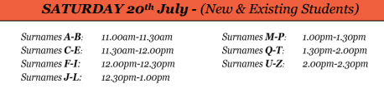
New School Uniform Sale
Saturday 4th July
Khalsa Schoolwear are coming to the NEVILL Campus.
Note the following timings-
4th

Slide 17
Physical Education
PE kit can be bought at Logo Sports; Industrial House, Unit 1, Conway St, Hove. BN3 3LW
All jewellery must be removed for PE lessons and long hair must be tied up.
All students in normal circumstances change into PE kit for lessons.
If a student is unable to participate physically, a note from a parent/carer needs to be brought in and the student will still change into kit and do a non active PE role.

Slide 18
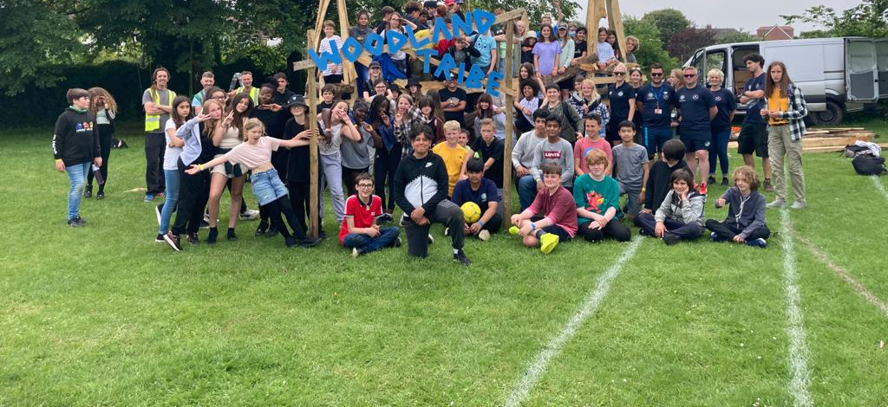
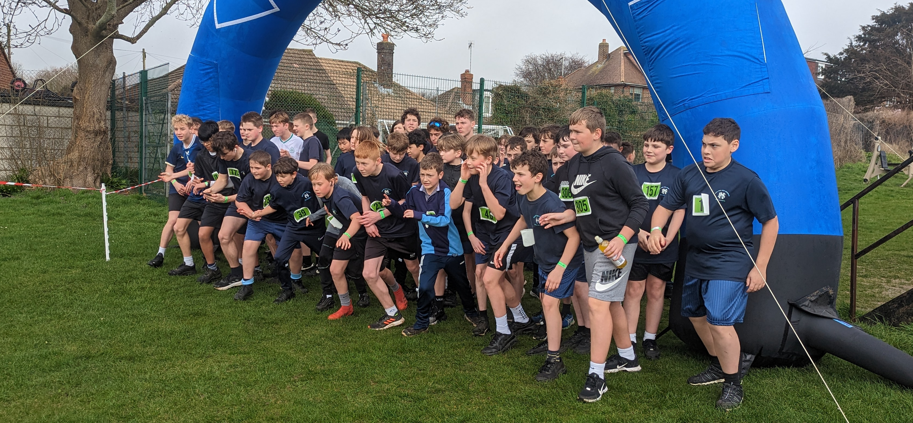
Label Everything!
Please label all uniform, kit and equipment with your child’s name.
It is highly likely that students will lose something across the academic year, but when it is named we can return it to the student.

Slide 19
School Meals
Students either have school lunch or bring a packed lunch.
Students are encouraged to make healthy choices.
The canteen is open at morning and lunch breaks.
There is a cashless payment system, via WisePay in the canteen. The account username and password has/will be sent out to you.
Students are not allowed to leave the school site during the school day.
Notes:
Students either have school dinner (on a cafeteria system) or bring a packed lunch. Our school meal provider is Caterlink .
Biometric system (finger print).
No student is allowed to leave the school site at any time.

Slide 20

Progress and Achievement

Slide 21
Homework for Year 7
 | Subject | How many homework pieces will be set per two-week cycle? | Minimum expected time to spend on each homework?
Year 7 | English, Maths, Science, Set and completed on SPARX Languages, History & Geography Computer Science, Technology, PRE, Art, Drama and Music | 2 x pieces of homework 2 x pieces of homework 1 x piece of homework | 45 minutes 30 minutes 30 minutes
Notes:
Homework is an opportunity for students to: develop their independent learning skills, consolidate understanding of their subjects, review & revise topics learnt in school.
Tasks: consolidation of classwork, revision, watching tutorials, research, learning keywords, spellings & new vocabulary, extended writing, reading, extended projects
In the case of project based homeworks, the work will be published in advance on HPS digital with clear deadlines and success criteria
If in the event no homework is set, students need to be reading around the subject, revising and topping up on their subject knowledge – reference iTunesU.
Also, general reading around a topic, watching the news, discussing learning with family – teach someone else what you’ve been learning about, sharing and talking about work completed on their iPad in school that day

Slide 22


Languages Carousel

Slide 23
IPAD
The iPad will be rolled out during September, so you and students have time to get familiar with them and are ready to utilise in lessons after October half term.
Students will have several Learning for Life sessions on how to use the iPad.
We will also send information home for you, so you can assist students at home.
Orders need to be placed by Wednesday 1st July 2026.

Slide 24


Attendance

Slide 25
Attendance and Punctuality
Be Here Everyday Ready and On time (HERO)
If your child is unable to attend school on a given day, please contact the Attendance Officer (Ms Willard) between 8.00am and 9.00am. Please telephone or email on each day of absence, including child’s full name and year group:
Contact: 01273 082858 or absenceYear7@hovepark.org.uk
Minimum expected attendance is 95%, holidays in term time, will not be authorised. Attendance matters and your support is essential.
Students should arrive by 08:25, ready to start at 08:30.
Notes:
Below MEA student outcomes suffer.
Ms Lisa Carruthers is our EWO (Education Welfare Officer).
Punctuality to school is also extremely important students should arrive by 0825 to be ready to start at 0830.
Personal illness and observance of religious festivals are the only acceptable reasons for non-attendance at school.
We are required by the Local Authority to know why students are absent. On the first day of absence, and then each day of a continued absence, you should contact attendance officer to explain why your child is away. If no call is received, the absence will be recorded as unauthorised. If there are personal problems making regular school attendance difficult, then please contact the school and speak to the Form Tutor.

Slide 26
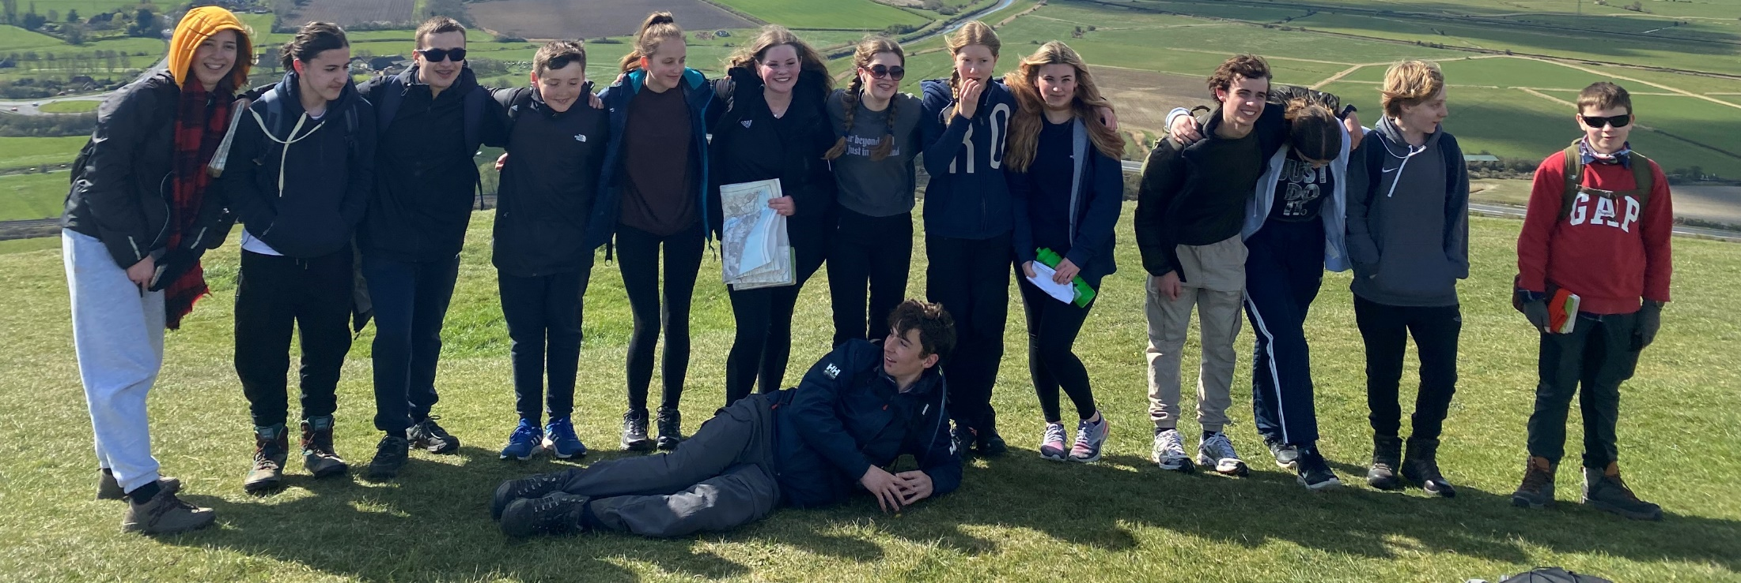
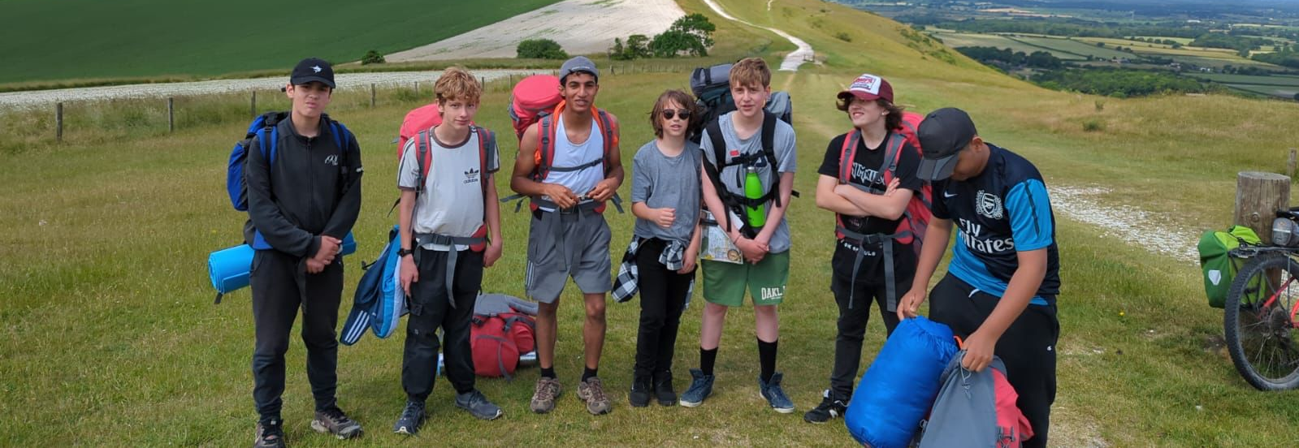
Mobile Phone Policy
Brick phones only.
Mobile phones must be off and away all day.
Phones are not to be used under any circumstances (even at breaktime).
If you need to contact your child urgently, please contact the main office on 01273 082857.

Slide 27
Looking ahead- Hove Park School as One Campus
September 2028
Year 9

Slide 28
Rewards
Moments of excellence are rewarded by House Points.
These moments are linked to our Hove Park Values.
Every term a year group celebration assembly takes place, whereby students are recognized for their attendance, house points and outstanding effort and progress in subjects.
Golden Ticket rewards.
Please use these to support your own motivational conversations at home.

Slide 29







OUR SHARED VALUES
WE ARE
ASPIRATIONAL
WE ARE
RESPECTFUL
WE ARE
PROUD
WE ARE
CONNECTED
WE ARE
COLLABORATIVE
WE ARE
RESPONSIBLE

Slide 30




Slide 31
Every Child Should at Hove Park
Contribute and feel part of their local community.
Spend a night under the stars.
Show an interest and understanding of the wider world, experiencing the vibrant, diverse cultures and languages of those around them.
Reflect the ethos of our shared values in the way that they participate in the life and community of the school.
Be captivated by live theatre, music or sport.
Make a commitment to a club or activity of their choice.
Show resilience in taking on a new challenge.
Take pride in representing their house and / or school in an activity or event.

Slide 32
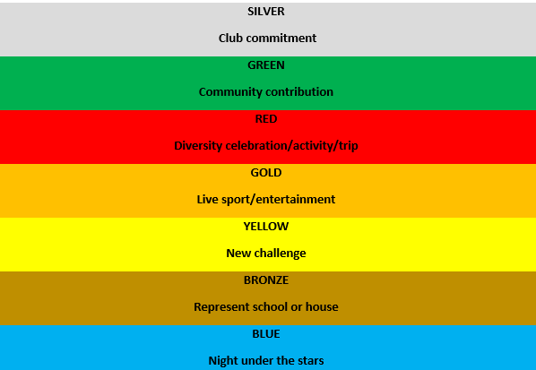
PURPLE
Reflect the ethos of our shared values in the way

Slide 33
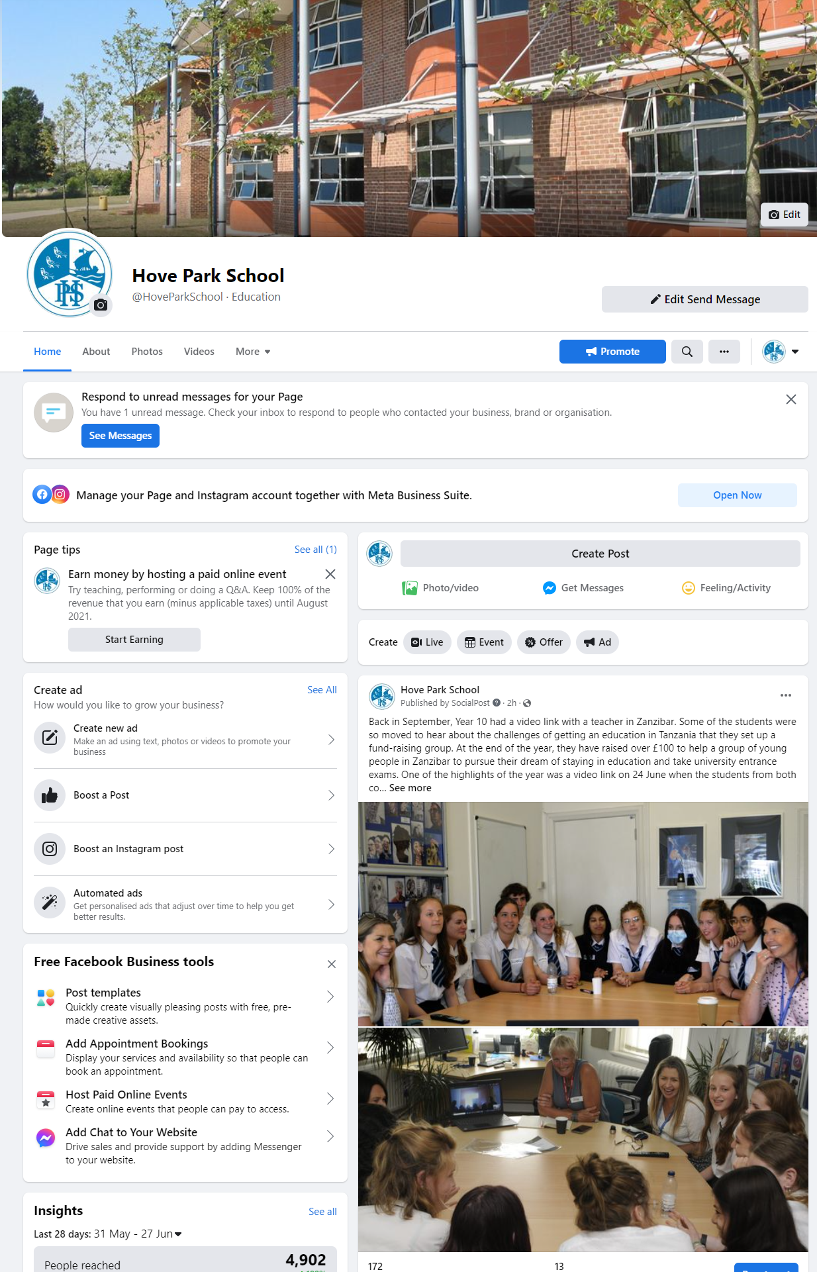
Facebook and
Instagram
Please join our Hove Park School Facebook and Instagram page!
We share school and Hove Park community news regularly on our page.

Slide 34
Quick Reference Information
Valley Main Office: 01273 082857
Absence Number: 01273 082858 or email absenceYear7@hovepark.org.uk
Contacting specific teachers: initialsurname@hovepark.org.uk
Year 7 Team:
Year7office@hovepark.org.uk
esatterly@hovepark.org.uk (Head of Year 7)
aclarke@hovepark.org.uk

Slide 35

SEN Support
Thursday 4th June
Thursday 18th June
Thursday 9th July

Slide 36
Now
Members of Senior Leadership Team
Amanda Flippance- Finance, iPad ordering, Wisepay and Free School Meal queries.
SENCO’s

Slide 37
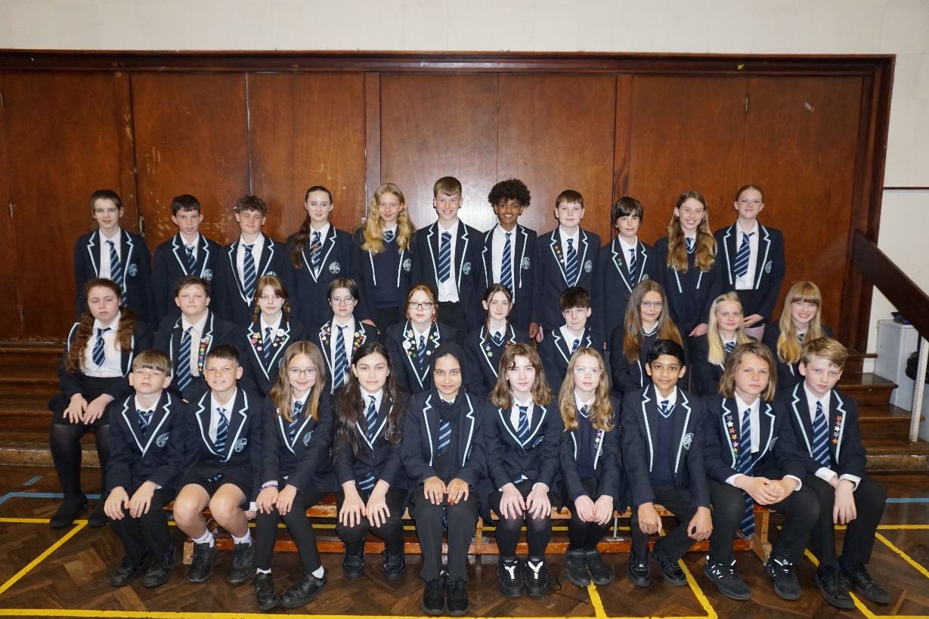
Welcome to the Hove Park School Community.

