Slide 1
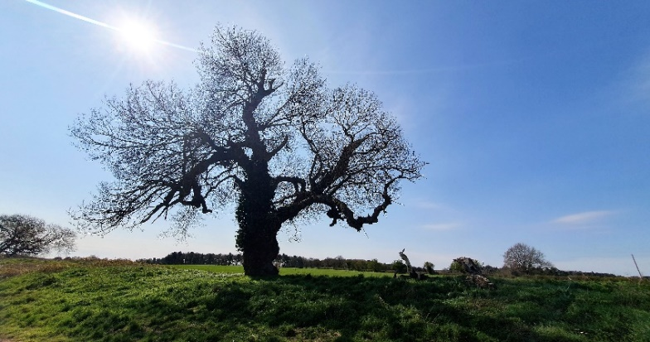
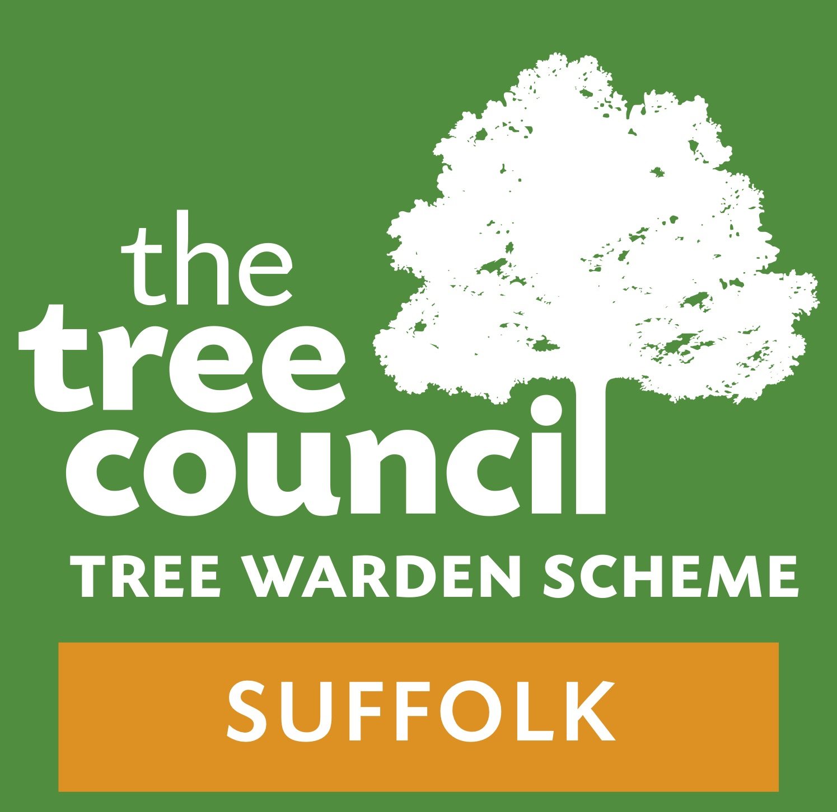
THE BLACK POPLAR: HOW TO SAVE A TREE
www.suffolktreewardens.org.uk

Slide 2
SUFFOLK TREE WARDEN NETWORK (STWN)
Estab. 10 years ago – Reg. Charity 2 years ago
To promote the conservation, protection and improvement of the environment through planting, care, nurture and cultivation of new trees and hedgerows and safeguarding of the existing treescape..
300+ Tree Wardens, all volunteers, working in their Parishes
Tree Nursery Project / Woodland Trust Tree & Hedgerow Packs
5,000 / 35,000 trees p.a. – main species (oak, hawthorn, maple…)
Rare species: Black Poplar, Wild Service (soon – Elm?)
‘Alive in Five’ Tree Planting & Care Campaign

Slide 3
THE BLACK POPLAR: HOW TO SAVE A TREE
Title of BBC R4 Open Country programme Nov. 2025 –
www.bbc.co.uk/programmes/m002k4l0
All thanks to Edgar Wolston Bertram Handsley Milne-Redhead MBE (1906-1996)
Deputy Keeper of the Herbarium and Library at the Royal Botanic Gardens, Kew, 1959 – 1971
President of the Botanical Society of the British Isles,1969
His work led to establishment of the Kew Conservation Unit, 1971
Retired 1971

Slide 4
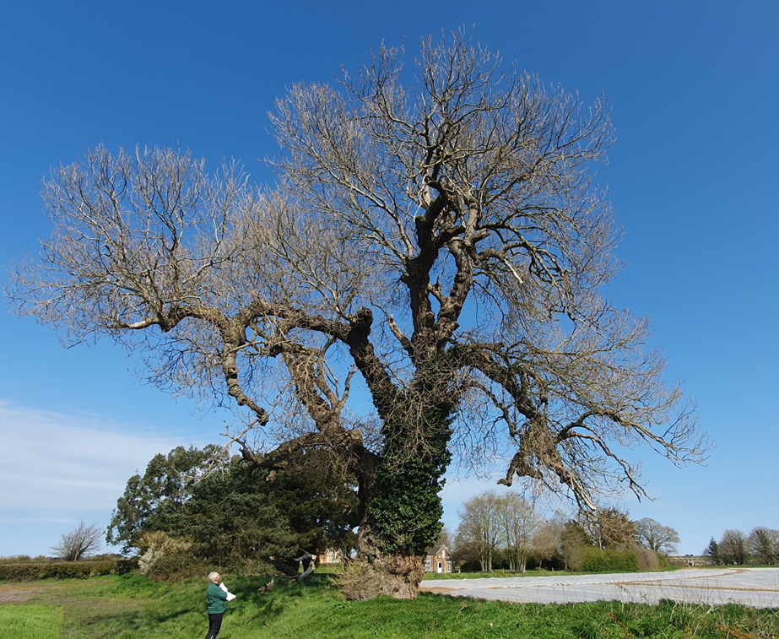
THE black poplar re-discovered!
Obituary in The Independent: “In his retirement Edgar Milne-Redhead….gained much pleasure from his campaign for the replanting of the black poplar.”
Spent 20 years of retirement finding BPs, and propagating new trees
80th birthday cake was decorated with
an image of the Butley tree
Without Edgar, the tree might have
almost disappeared from the landscape

Slide 5
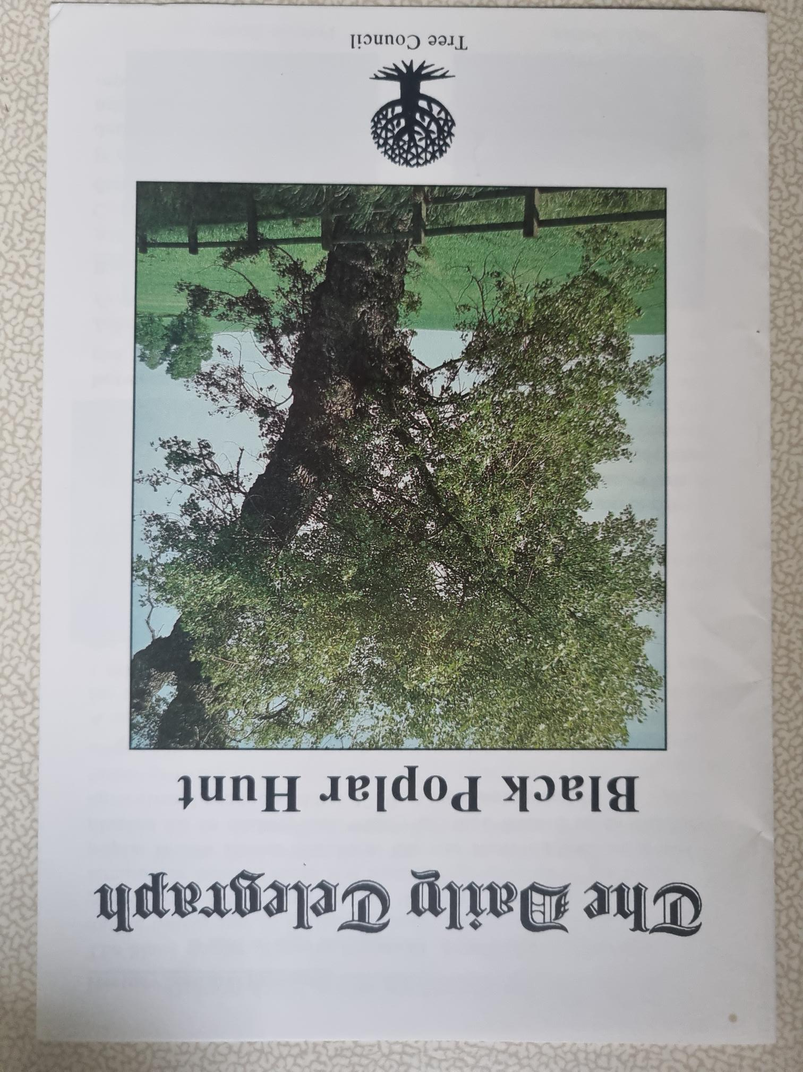
The Black Poplar Hunt
Edgar’s initial assessment was a UK population of c. 1,000 trees
1993 Daily Telegraph article, ‘Help save our biggest tree from the chop’ described the black poplar as the “king of the English Countryside” and “the most endangered native tree in Britain”
‘The Daily Telegraph Black Poplar Hunt’ triggered a national public survey (but illustrated the difficulty of accurate I.D.)
The BSBI recorded population increased to over 2,500 trees – still a very! low number

Slide 6
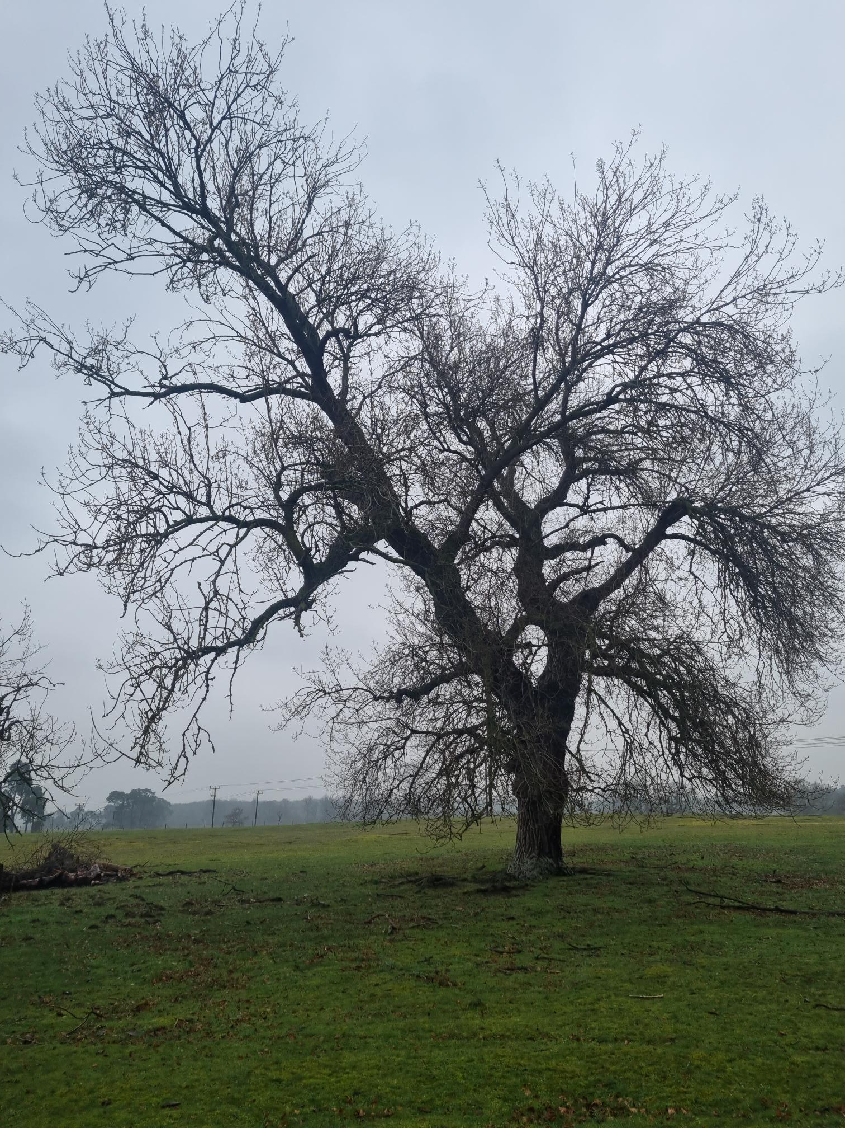
WHY THE EXCITEMENT?
Rarest native timber tree
Richard Mabey - “our grandest native tree”
Oliver Rackham - “No other native tree
can compare…in rugged grandeur….
More than almost any other tree,
[it] reminds us of the splendour
of the medieval countryside”

Slide 7
NATIVE BLACK POPLAR - Classification
Populus nigra var. betulifolia (‘birch leaf’ – diamond-shaped, lightly serrated leaves)
Family: Salicaceae (Genera: Populus (poplar) and Salix (willows))
Vernacular name: Water Poplar
‘Black’ (dark brown) bark, compared to Aspen (P. tremula), White Poplar (P. alba) and Grey Poplar (P. x canescens)
Hybrid black poplar (P. canadensis); Lombardy (P. nigra Italica)

Slide 8
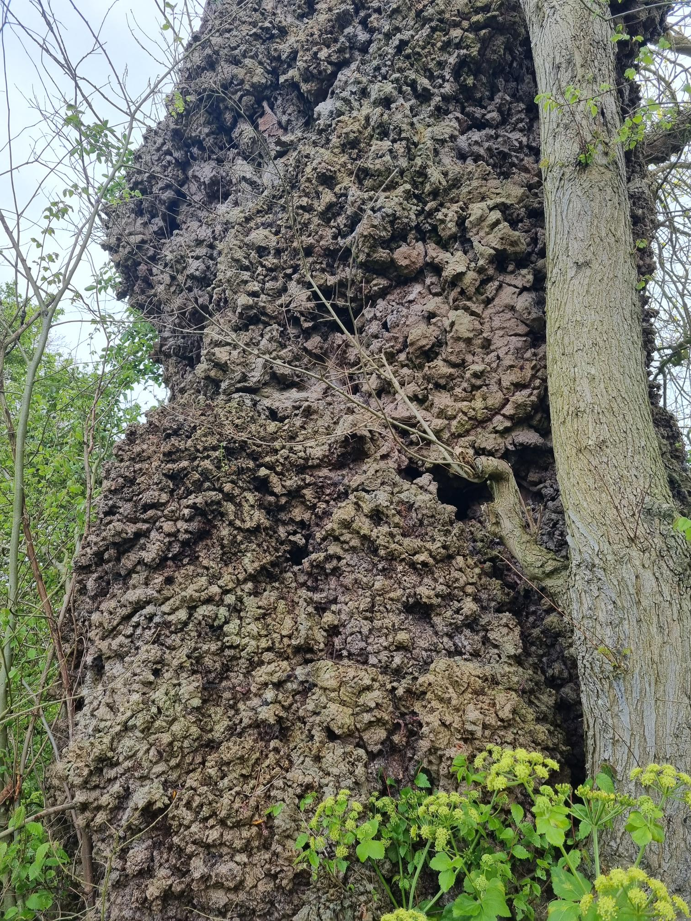
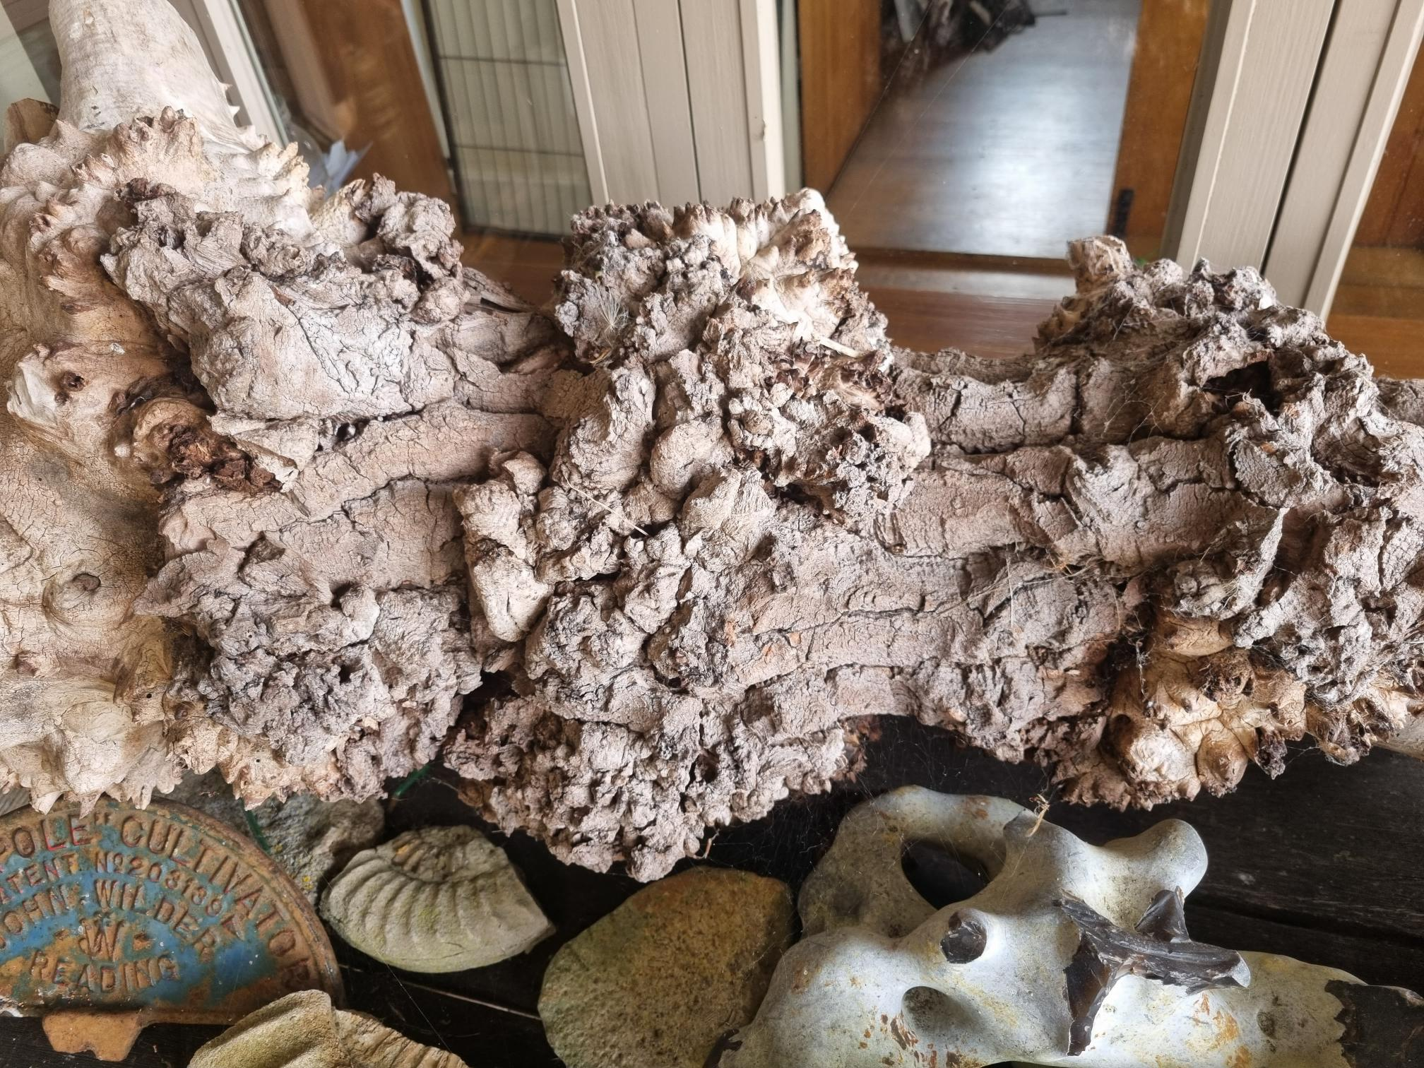
CHARACTERISTICS
Black poplars can grow 40m tall, with a girth up to 6m, for 200-400 years
Distinctive downward-sweeping lower branches
with upward sweeping twigs
Mature trees have heavily fissured trunks
covered with bosses and burrs

Slide 9
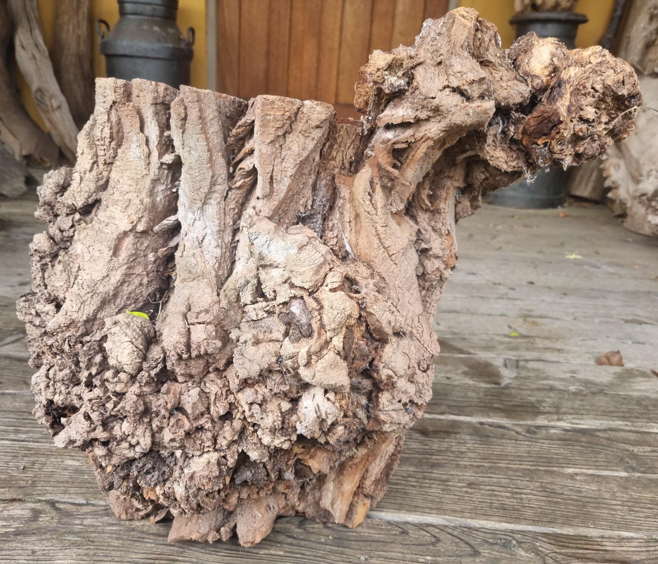
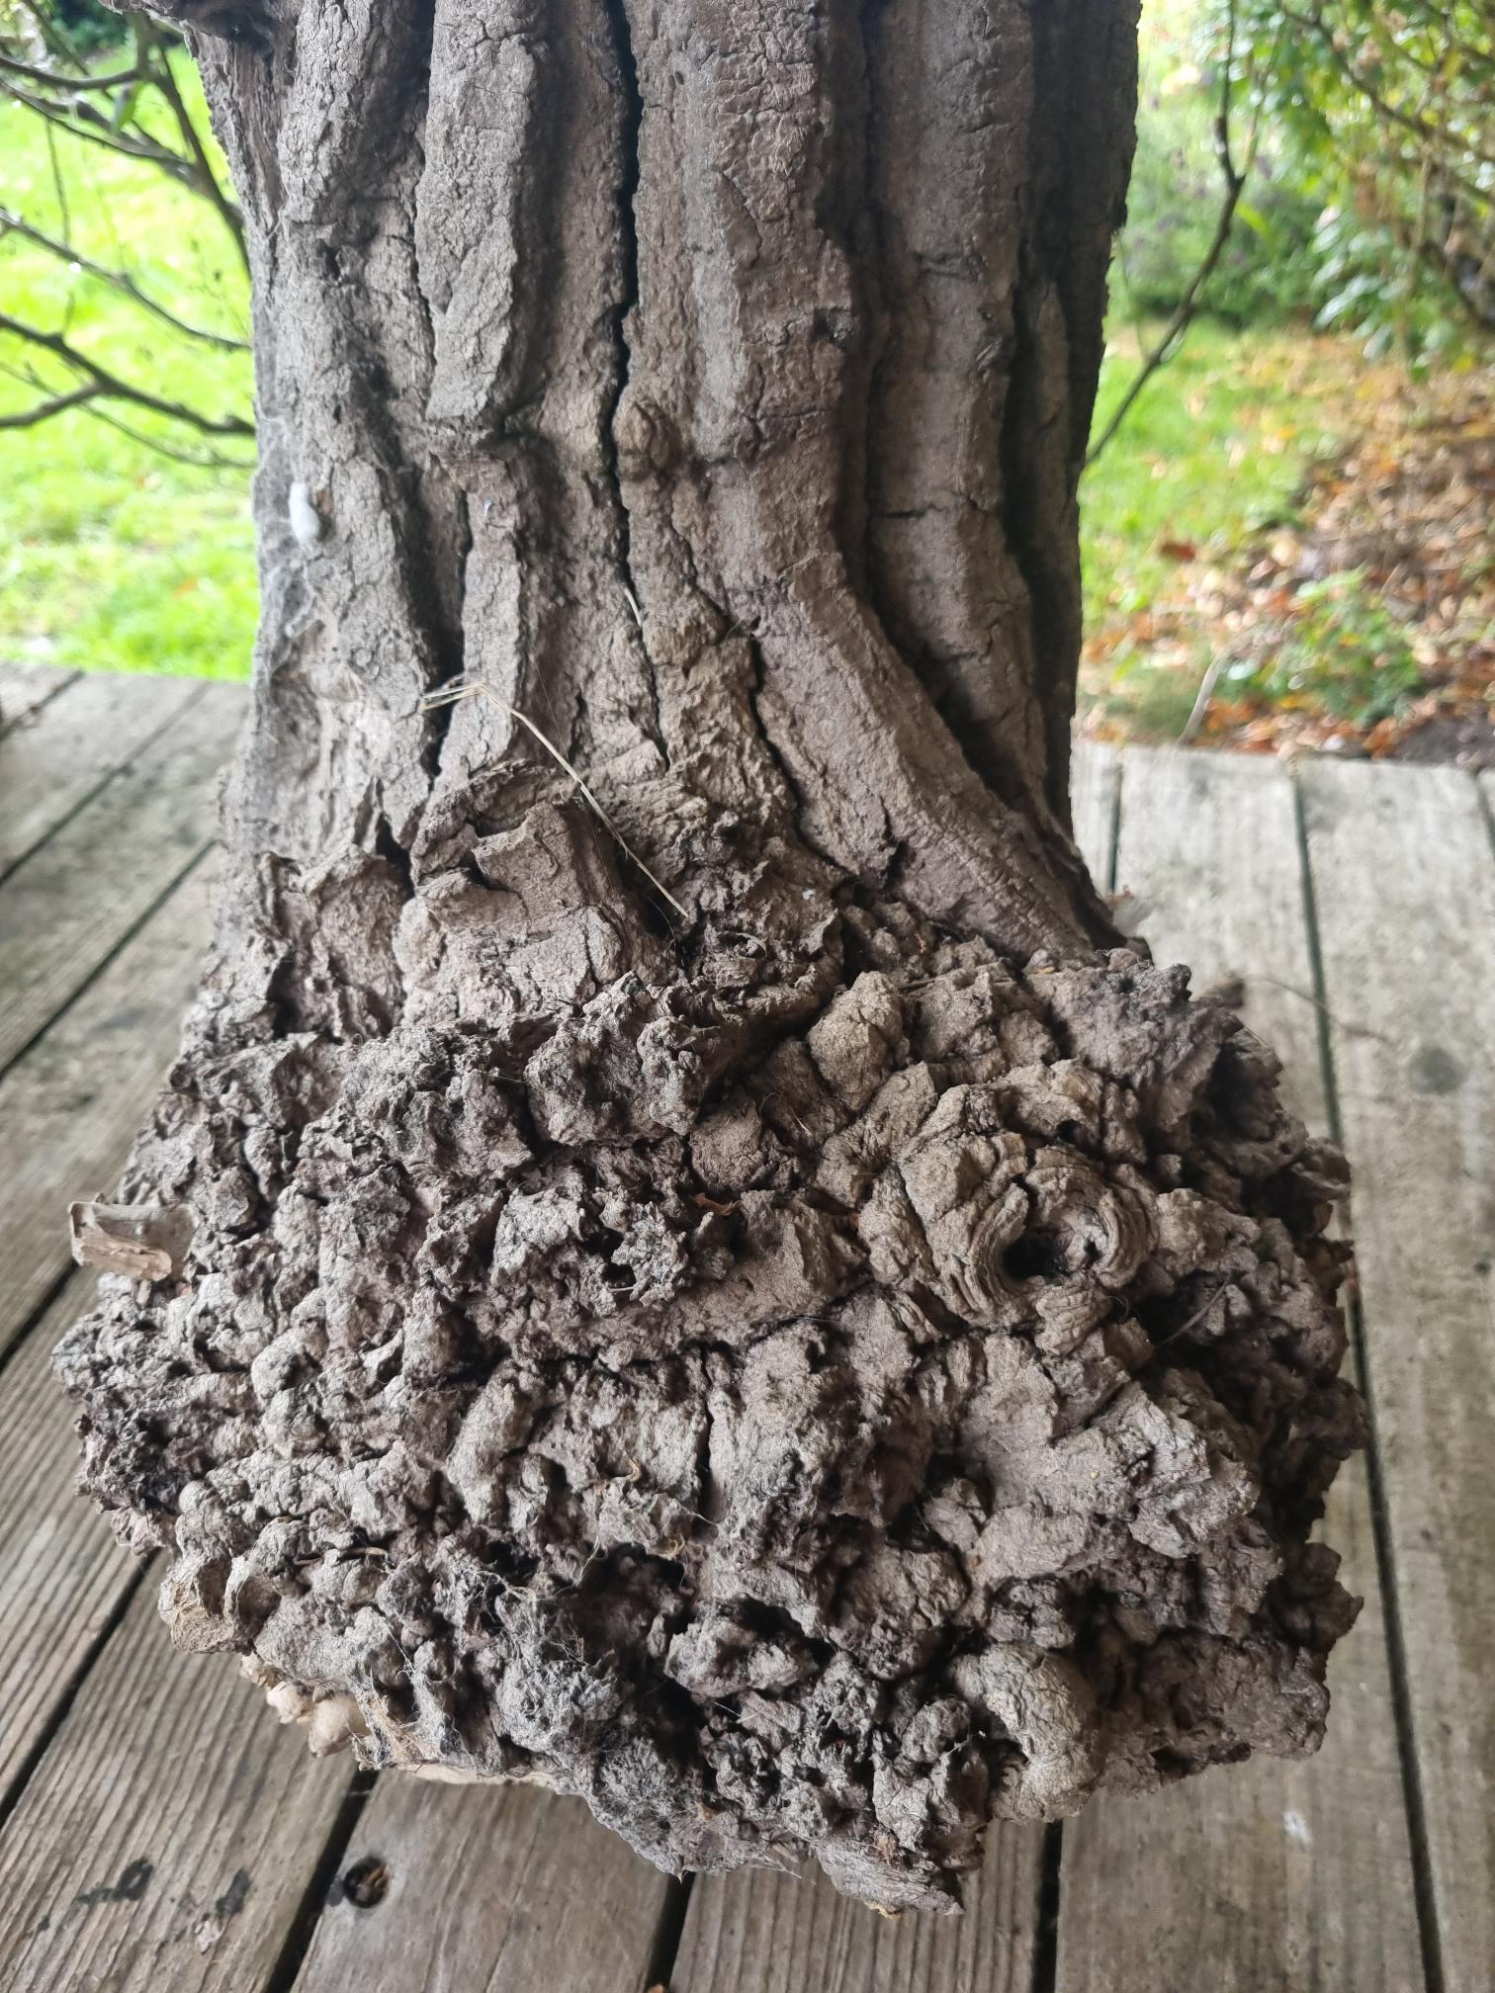
MORE KNOBBLY BITS

Slide 10
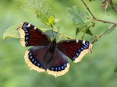
BIODIVERSITY
EUFORGEN: “Ecologically, the tree is important given the large number of insects and animals associated with or depending on it”
Food source for moth caterpillars - including hornet, wood leopard, and poplar hawk moths
Rare butterflies - large tortoise shell, Camberwell beauty
Catkins are an early source of pollen and nectar for native poplar leaf beetle and other insects
Birds benefit from seeds, crowns offer nesting areas

Slide 11
BLACK POPLAR DISTRIBUTION - UK
Mainly south of a line from the Mersey/Lune to the Humber estuaries
Large populations in Cheshire, Shropshire, Worcs., Herefordshire, Glos., Bucks. (Vale of Aylesbury), East Anglia, London (Barnes/Richmond), Sussex, Dorset…
Also a significant Irish population
Black poplars are found throughout Europe, northern Africa and in central and west Asia

Slide 12
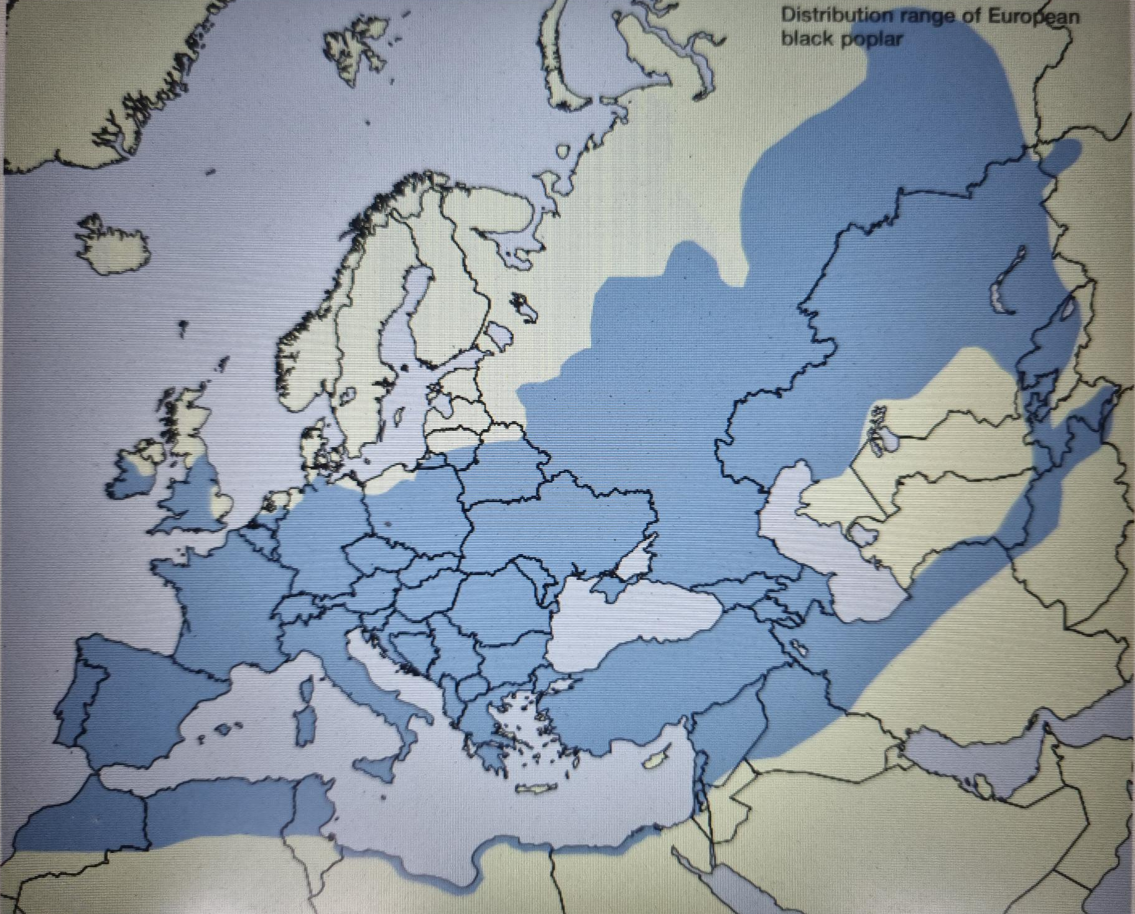
EUFORGEN BLACK POPLAR MAP

Slide 13
Black Poplars – History (1)
“In pre-historic times, it was a tree of winter-flooded riverine woods (a virtually extinct habitat…now), growing with willow, downy birch, alder, ash and elm.”
Riparian tree – found on floodplains, river banks and by ponds
Historical numbers and distribution unknown
1310 – John Petye fined 2 shillings for felling a black poplar at Nowton
John Evelyn’s 1664 book ‘Sylva’ – ‘The Black Poplar grows rarely with us’, but sets out a variety of uses and describes how to propagate by ‘truncheons’

Slide 14
EDGAR’s BSBI BLACK POPLAR SURVEY 1973-88
“Countrymen and farmers over the centuries have found the timber of the native Black Poplar and the poles from pollards useful and it has been extensively propagated.
Cook (1676) - "You that have wet grounds get [some truncheons of Water Poplar] to set by your ditches...for if you set one worth a half penny…they will bring you that yearly for twenty years or more”.
Hunter (1776) - preferred cuttings planted out in nurseries, and mentions rivers, bogs, pasture-grounds and fields as suitable sites for planting.
“None of these authors mentions growing the tree from seed.” .

Slide 15
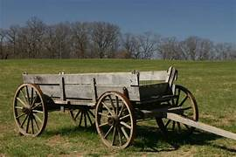
TRADITIONAL USES
It is a fast-growing timber tree – lightweight, fire resistant, ‘springy’, shock absorbing: hence historically a widely grown and important timber for -
- cruck building frames
- floorboards, especially for oast houses
- carts and cart beds, brake blocks, clogs
- thatching spars and poles (from pollards)
Arrows of black poplar wood were found on the ‘Mary Rose’

Slide 16
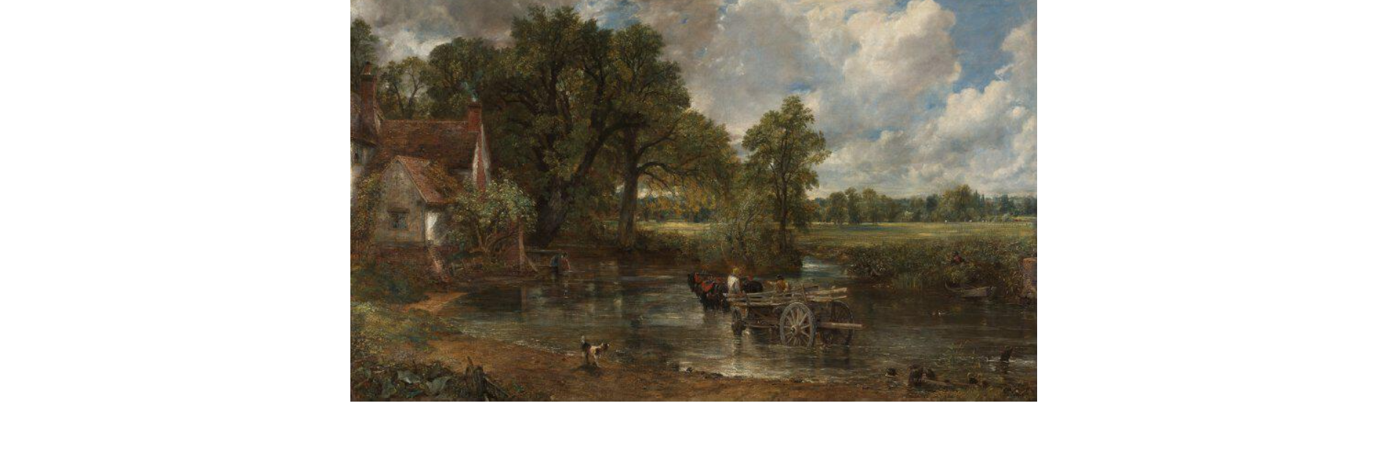
Black PoplarS – History (2)
Featured in Constable’s The Haywain’, said to be his favourite tree? The Stour valley remains a stronghold (2026 is ‘Constable 250’ year)

Slide 17
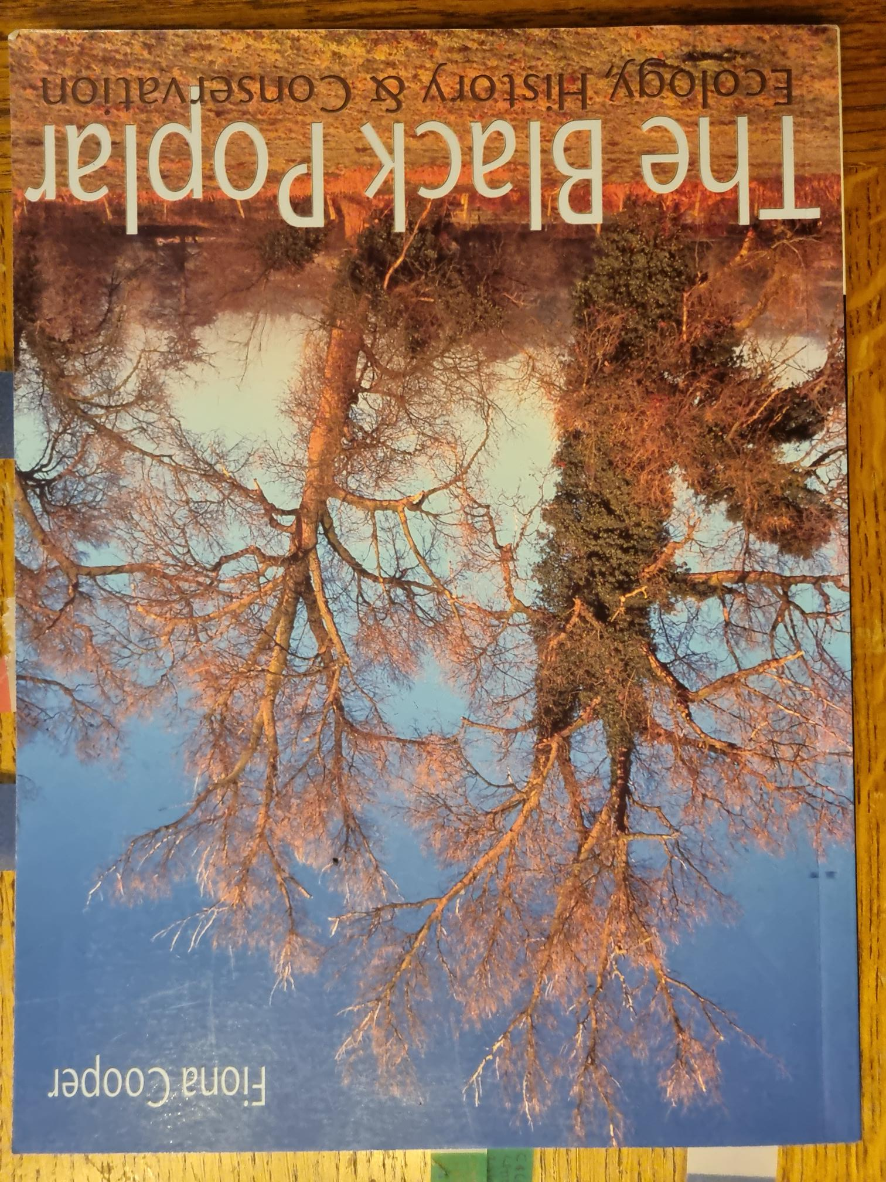
Black Poplars – MORE History
2009 black poplar study of C17th & C18th Norfolk estate maps revealed that -
- 13% of 75 sampled trees were in floodplains
- 29% were associated with commons
- 46% were near farms / farmyards
- 22% were near ponds or moats
‘Association with common land, village greens
and proximity to ponds….’.
Probably reflects their traditional agricultural/domestic uses

Slide 18
INDUSTRIAL USES (POLLARDS?)
The 2009 Norfolk survey also found –
- 13% associated with kilns
- 12% associated with mills,
- 6% associated with smithies,
- 4% associated with malt houses
Suggests a wide range of uses, with an associated level of propagation and planting ?

Slide 19
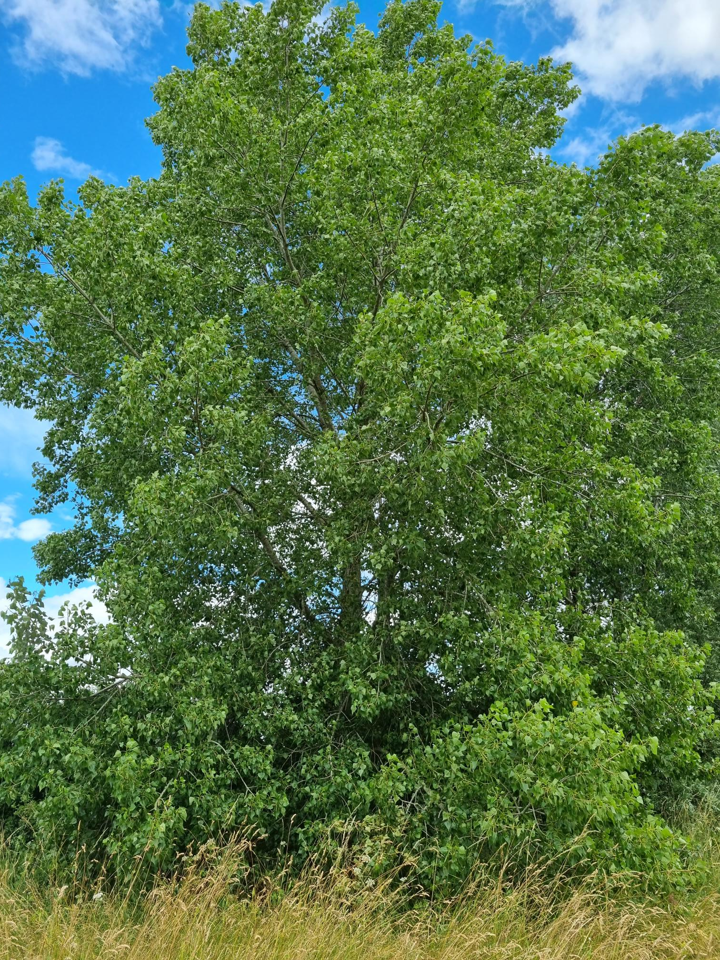
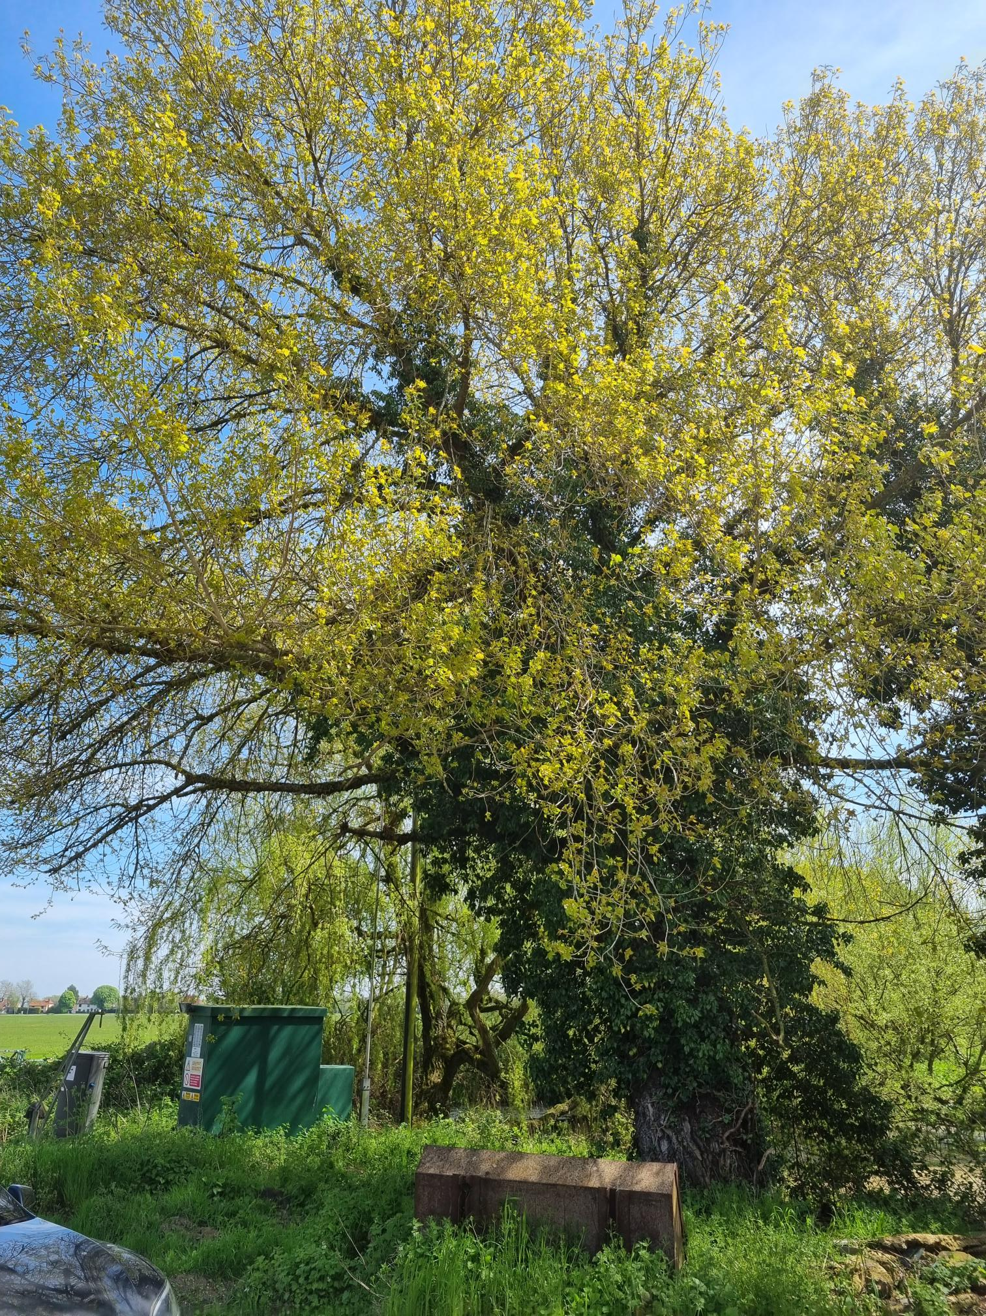
TYPICAL locations (1)
Barking Tye – row of 6 black poplars edging the village green; 2 veteran trees by an adjoining farm pond

Slide 20
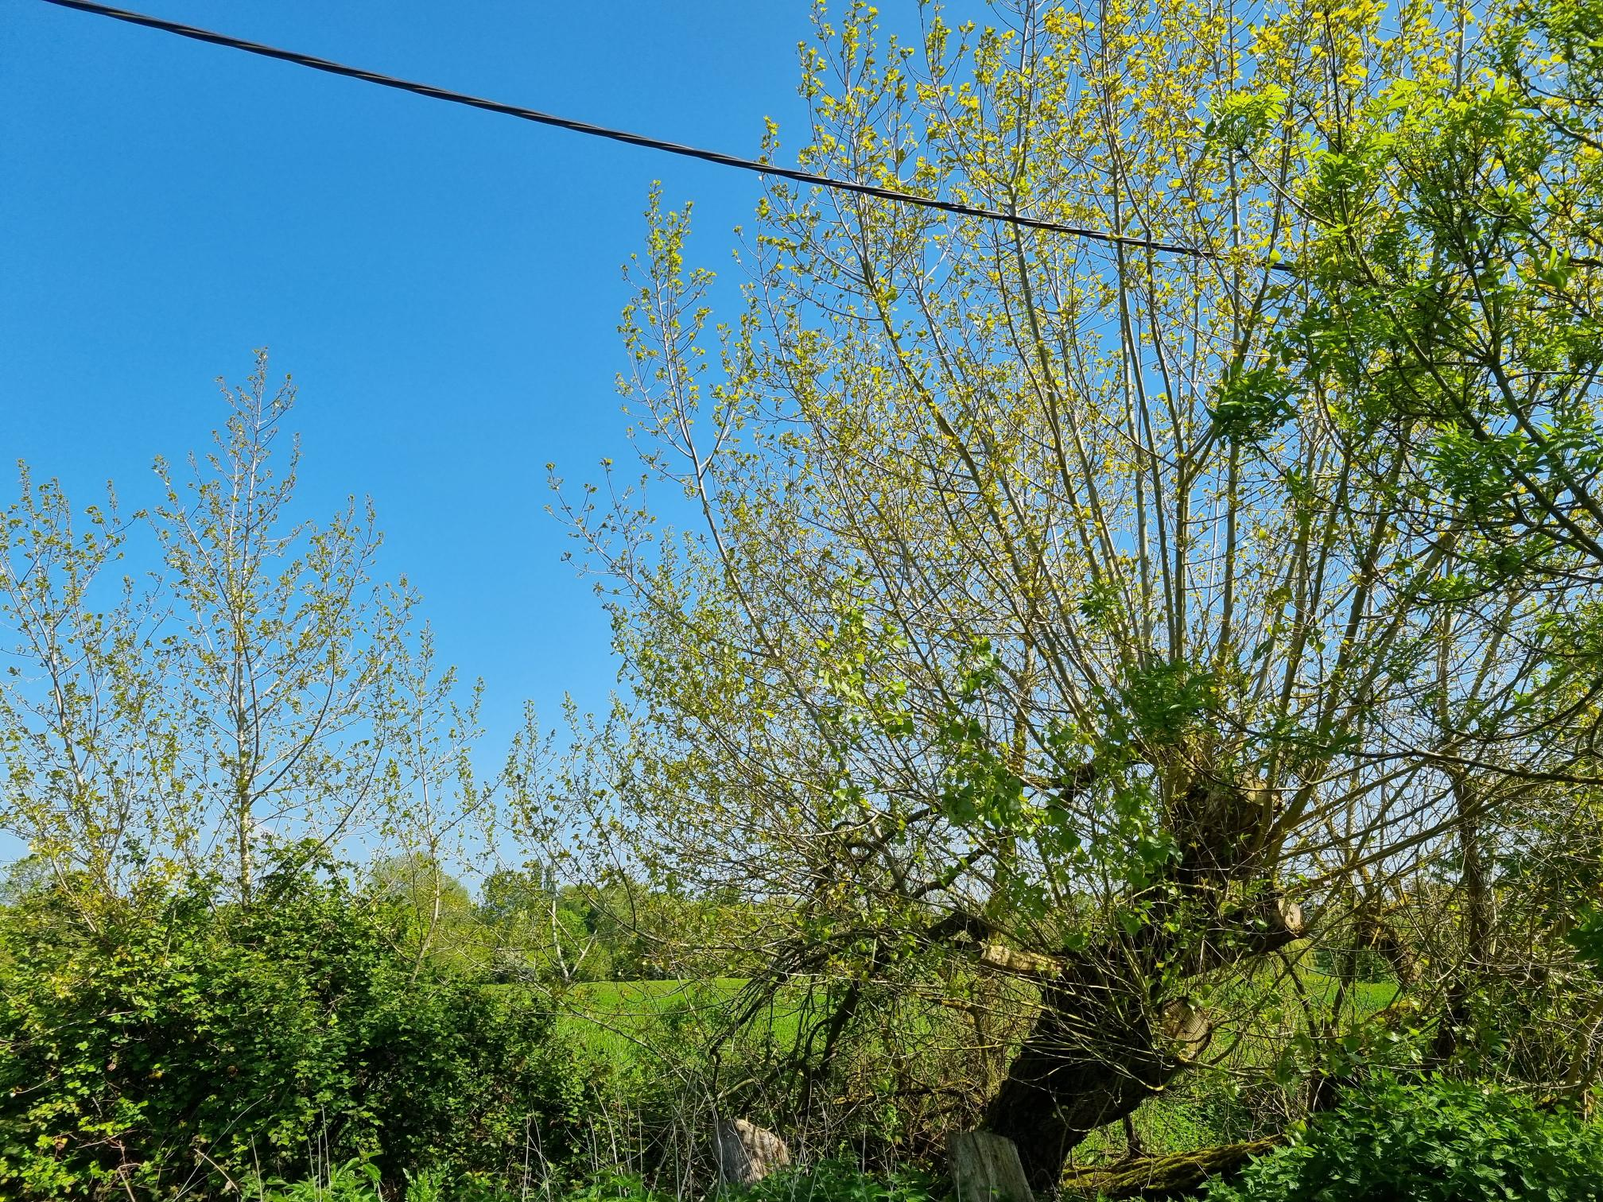
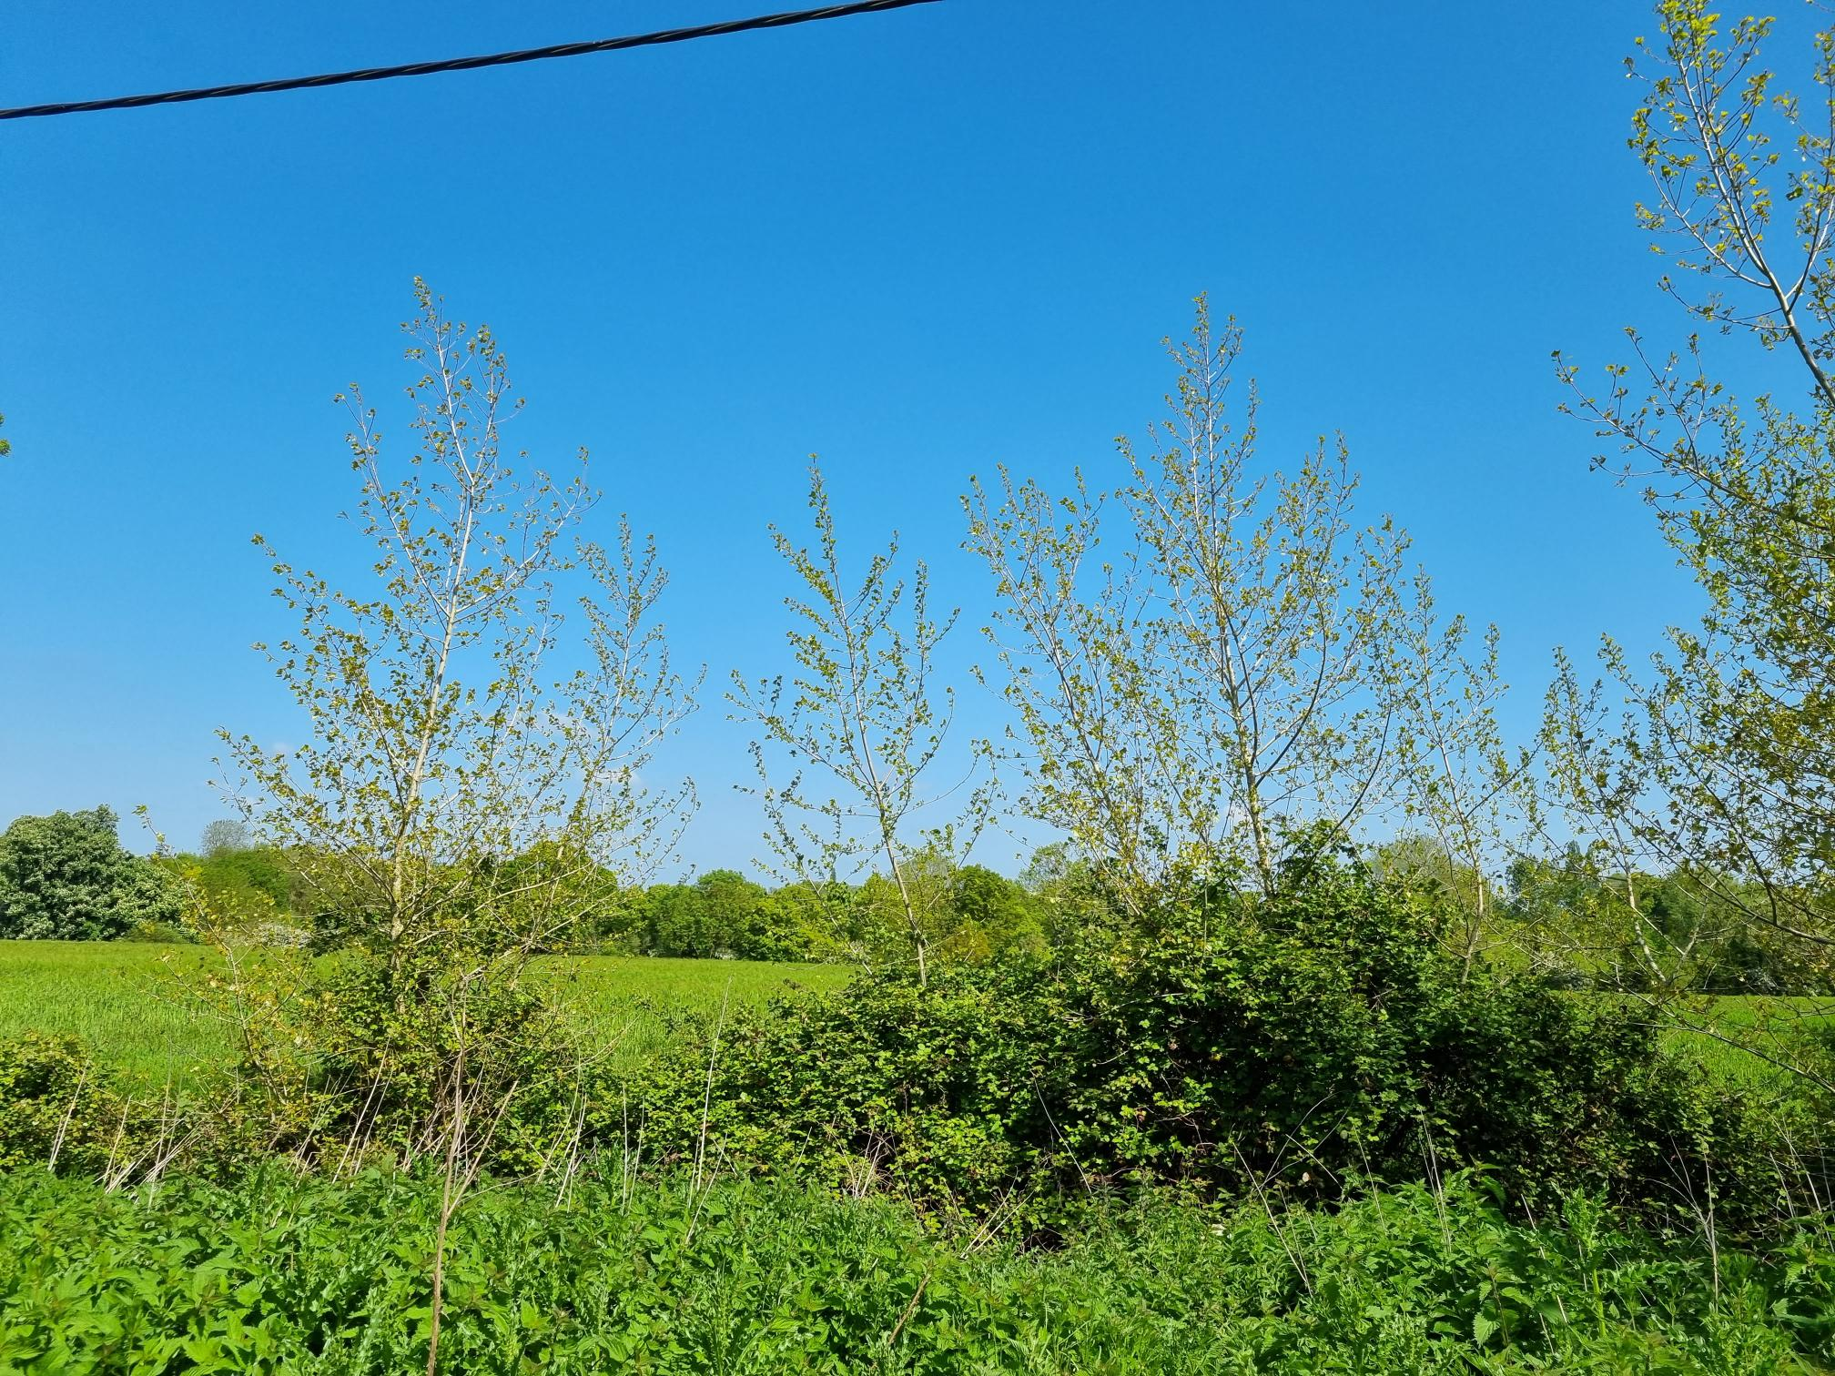
TYPICAL locations (2)
By a pond next to a historic house in Fressingfield: an old pollard with adjacent saplings – from a fallen branch/wind debris?

Slide 21
POPULATION DECLINE
Decline in traditional uses, agricultural drainage, and specific germination conditions all led to a steady population reduction
Often replaced by faster-growing imported hybrids (with which it hybridises easily), and Bryant and May ‘matchstick’ plantations
Relatively short lifespan
Mature Female trees produce huge amounts of seed (white ‘fluff’), which can be unpopular, so many cut down?

Slide 22
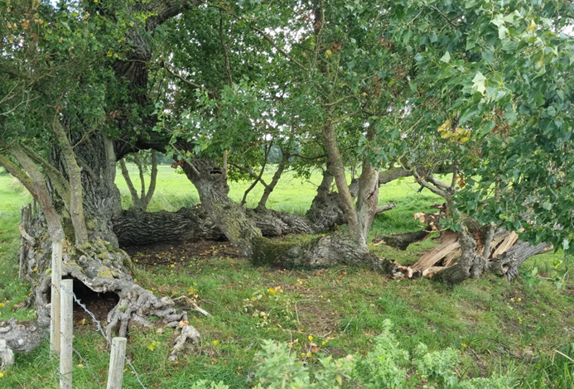
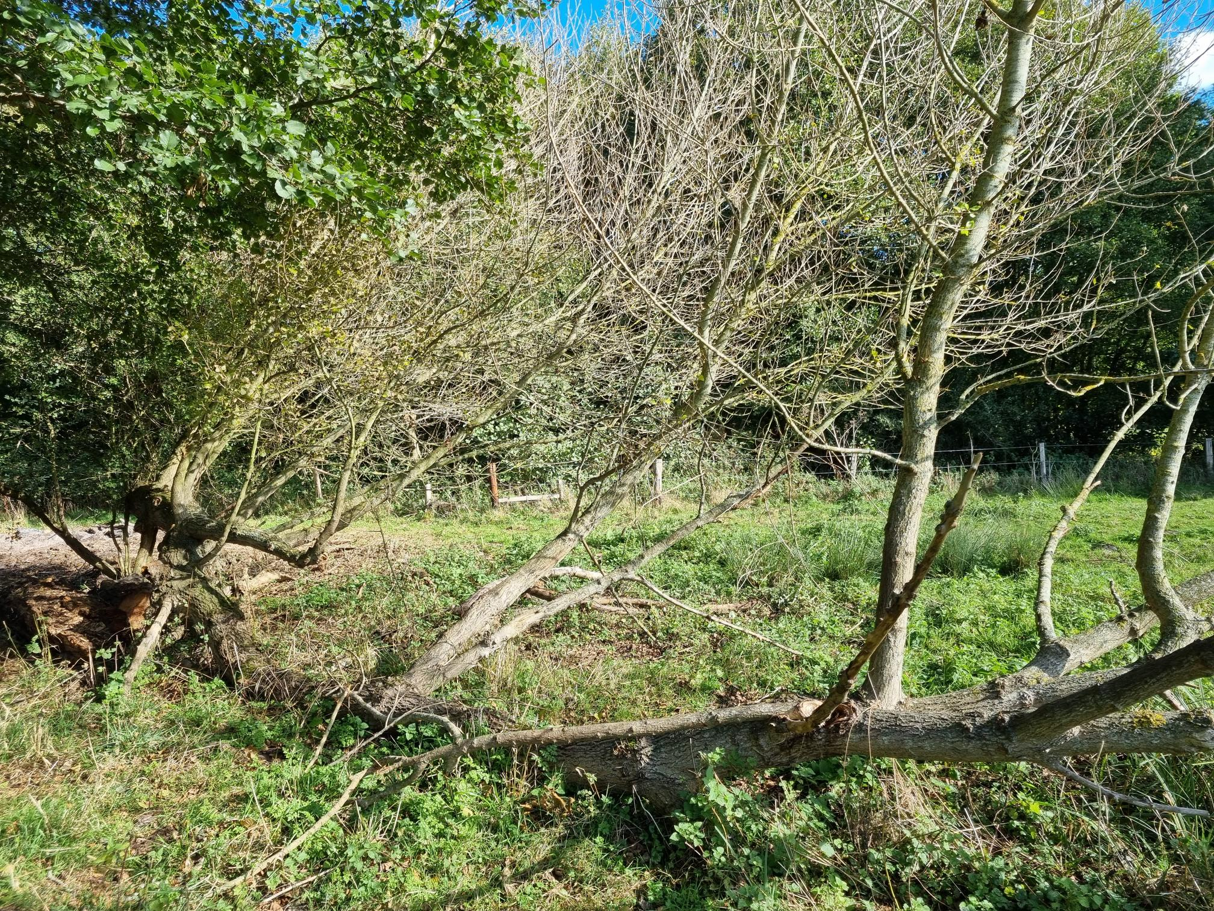
BLACK POPLAR regeneration (1)
Reproduction is possible by broken branches self-rooting along river banks, or fallen trunks putting up new shoots

Slide 23
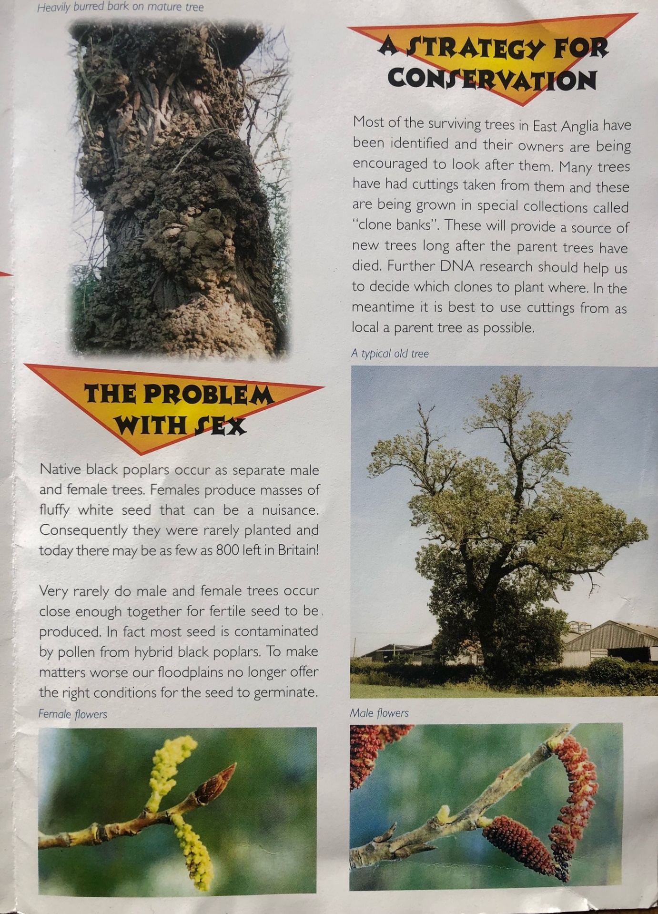
BLACK POPLAR regeneration (2)
Dioecious – red male and green female catkins (March – April) grow on separate trees
Dedham & Stour Valley Project leaflet, 2000

Slide 24
BLACK POPLAR regeneration (3)
Reproductive when 10-15 years old
M and F trees need to grow in close proximity, and fertilised seeds needs to fall on mud which remains damp from June to autumn
But these ideal germination conditions “….virtually vanished once serious agricultural drainage works began in the C17th”
It can hybridise with other poplars – creates risk of mis-identification and mis-labelling
Accurate identification of black –v- hybrid poplars is very difficult!
Thankfully, black poplars are easy to ‘strike’ from cuttings and ‘truncheons’ hammered into the ground

Slide 25
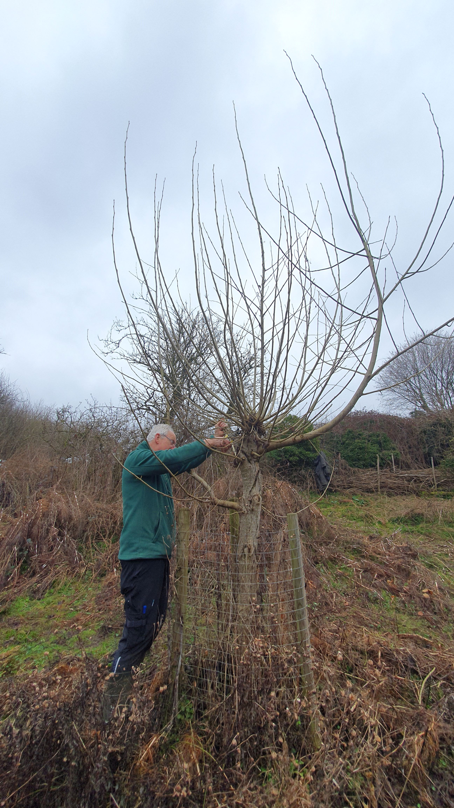
SUFFOLK PROJECT: PRE-2001
Considerable work was done 1990’s-2000’s in Suffolk by the County Recorder, Sue Hooton, and colleagues
Two clone banks were established:
Alphamstone, Dedham Vale NL (N. Essex)
Nowton Park, Bury St. Edmunds
Alphamstone site also contained a Nursery
Extensive survey work was done and a
valuable database set up and operated by SBIS

Slide 26
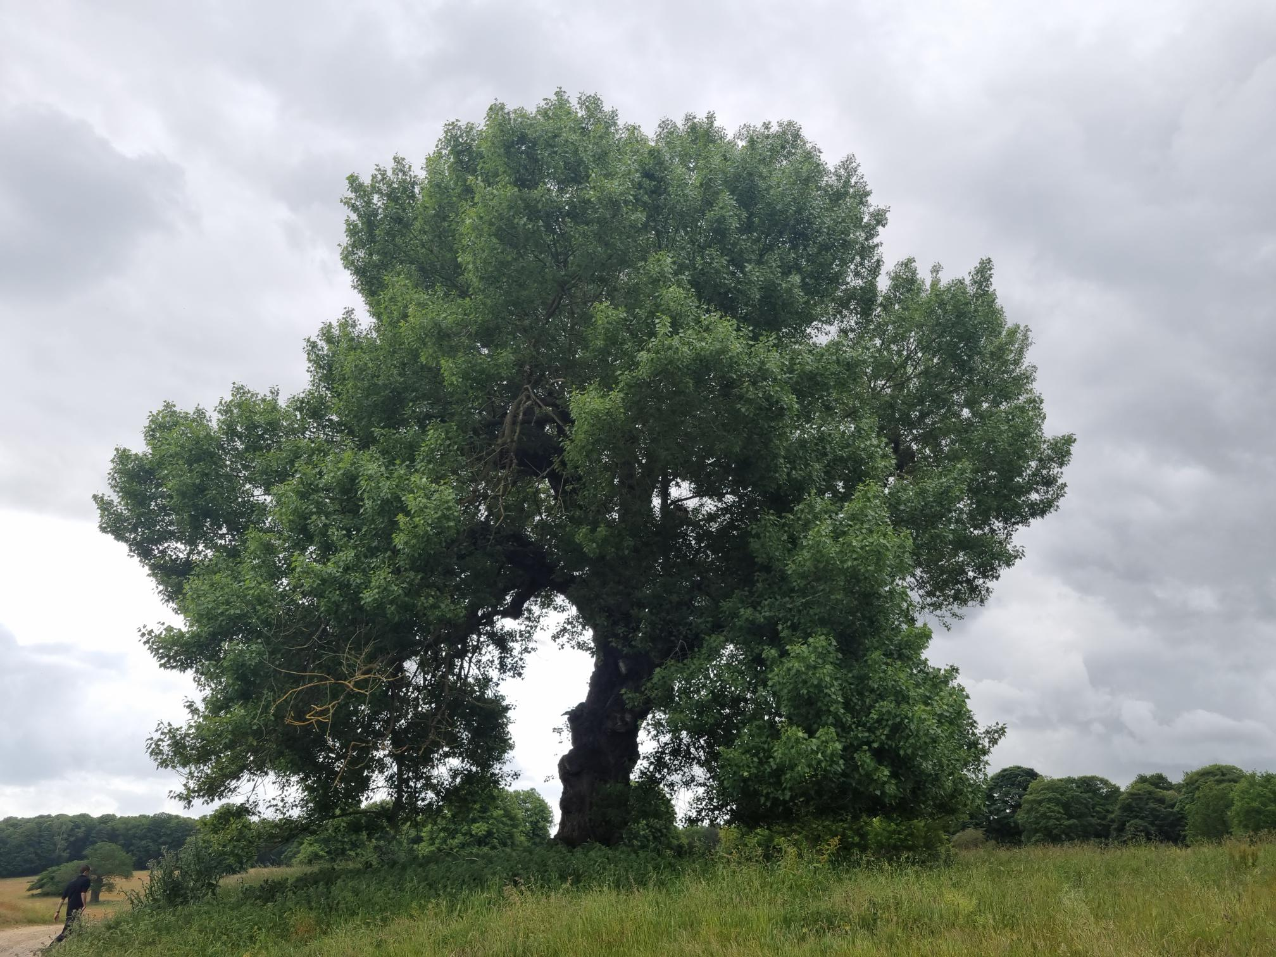
SUFFOLK PROJECT: 2021 onwards
Both clone banks now expanded with new clones; nursery moved to Nowton Park; new clone bank at Jimmy’s Farm
Yr. 1 – 130 Yr. 4 (25/26) - 600
Distributed free of charge to
farmers, conservation groups, NT…
Strict clone no. traceability from
cutting to sapling to planting
Ongoing survey and DNA testing
programme

Slide 27
National Black Poplar Work
A National Black Poplar Group was set up by the Forestry Commission in 1994
Various local black poplar working groups were established around the country
English Nature drafted a national species action plan in 1994, but it was not included in the UKBAP
The last Black Poplar Conservation Group meeting was in 2010* (possibly the victim of austerity)
We are now re-establishing a national project

Slide 28
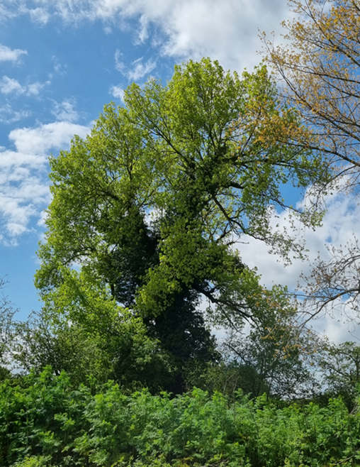
EAST ANGLIA & NATIONAL PROJECTS
Norfolk survey programme conducted in 2022 – only 6 different clones (5 male, 1 female)
Forest Research advise there are only c.210 clones
in the UK – so finding new genotypes is critical
(some recently found in Dorset)
April 2024 National Conference at Calke Abbey -
40+ participants: huge enthusiasm to save the
species

Slide 29
Wellcome Sanger Inst. – WGS project
275 DNA samples from national population submitted for Whole Genome Sequencing – Darwin Tree of Life Project
WGS data analysis will be completed by our partners FEM/Uni. of Udine (which lead the European Genome Project) with a database of EU black poplar populations to which UK trees can be compared
This will provide an understanding of the origins and diversity of the UK population, and inform future breeding decisions
Hopefully this will enable us to ‘Save the Tree’

Slide 30
FUTURE USES FOR BLACK POPLARS?
Biodiversity, and CO2 absorption
EUFORGEN: suitable for –
- bioenergy and pulp & paper production
- soil protection and afforestation in polluted industrial zones
- soil stabilization and watershed protection
tolerant of high water levels and a good pioneer tree, especially in riparian woodlands
Suffolk trees at Butley & Icklingham – evidence of drought tolerance, so possibly a ‘climate change’ option?

Slide 31
HELP (AND THANK YOU)!
If you want black poplar saplings to plant, contact –
davidappleton@suffolktreewardens.org.uk M: 07900 982022
If you know the locations of any possible black poplars, please let me know (10 digit grid ref if poss. please – www.gridreferencefinder.com)
Project donations always welcome!
Thank you for listening
www.suffolktreewardens.org.uk

