Slide 1
Acne Management in Primary Care
IPAS Fall Conference
October 20, 2025
Notes:
I want to thank the IPAS CME committee for asking me to present at this year’s conference.

Slide 2
Disclosures
No financial disclosures
Many photos in the presentation come from Visual Dx
Notes:
I have attributed all of the photos in this presentation to the online source I took them from.

Slide 3
Objectives
Describe
Describe common acne lesions and explain the grading of acne severity
Understand and apply
Understand and apply the appropriate acne treatment recommendations based on the American Academy of Dermatology (AAD) guidelines
Recognize
Recognize indications and timing of referral to dermatology
Notes:
As we know it can take some time for patients to be seen by a dermatology specialist. Hopefully, I can provide a refresher and increase confidence in our ability to provide ongoing acne care to our patients.
This lecture will be applicable to patients >9 to adult.

Slide 4
Why do we care about acne?
Affects nearly 50 million people in the US
About 85% of teenagers have acne and it can persist into adulthood
Causes scarring, dyspigmentation
Can lead to depression, anxiety, low self-esteem
Cost of $3 billion/year

Slide 5
What do primary care providers struggle with:
“How do you define severity of acne? I need a refresher on the grading system.”
“What is the best way to describe acne lesions in my clinical note?”
“What are the best OTC products for acne?”
“What is the best initial treatment for acne?”
“When is it appropriate to use oral antibiotics and for how long?”
“When do you add spironolactone? Does it need to be monitored?
Notes:
I asked some of our newer PAs in family medicine what they struggle with the most in acne management and here are some of the comments I received back.

Slide 6
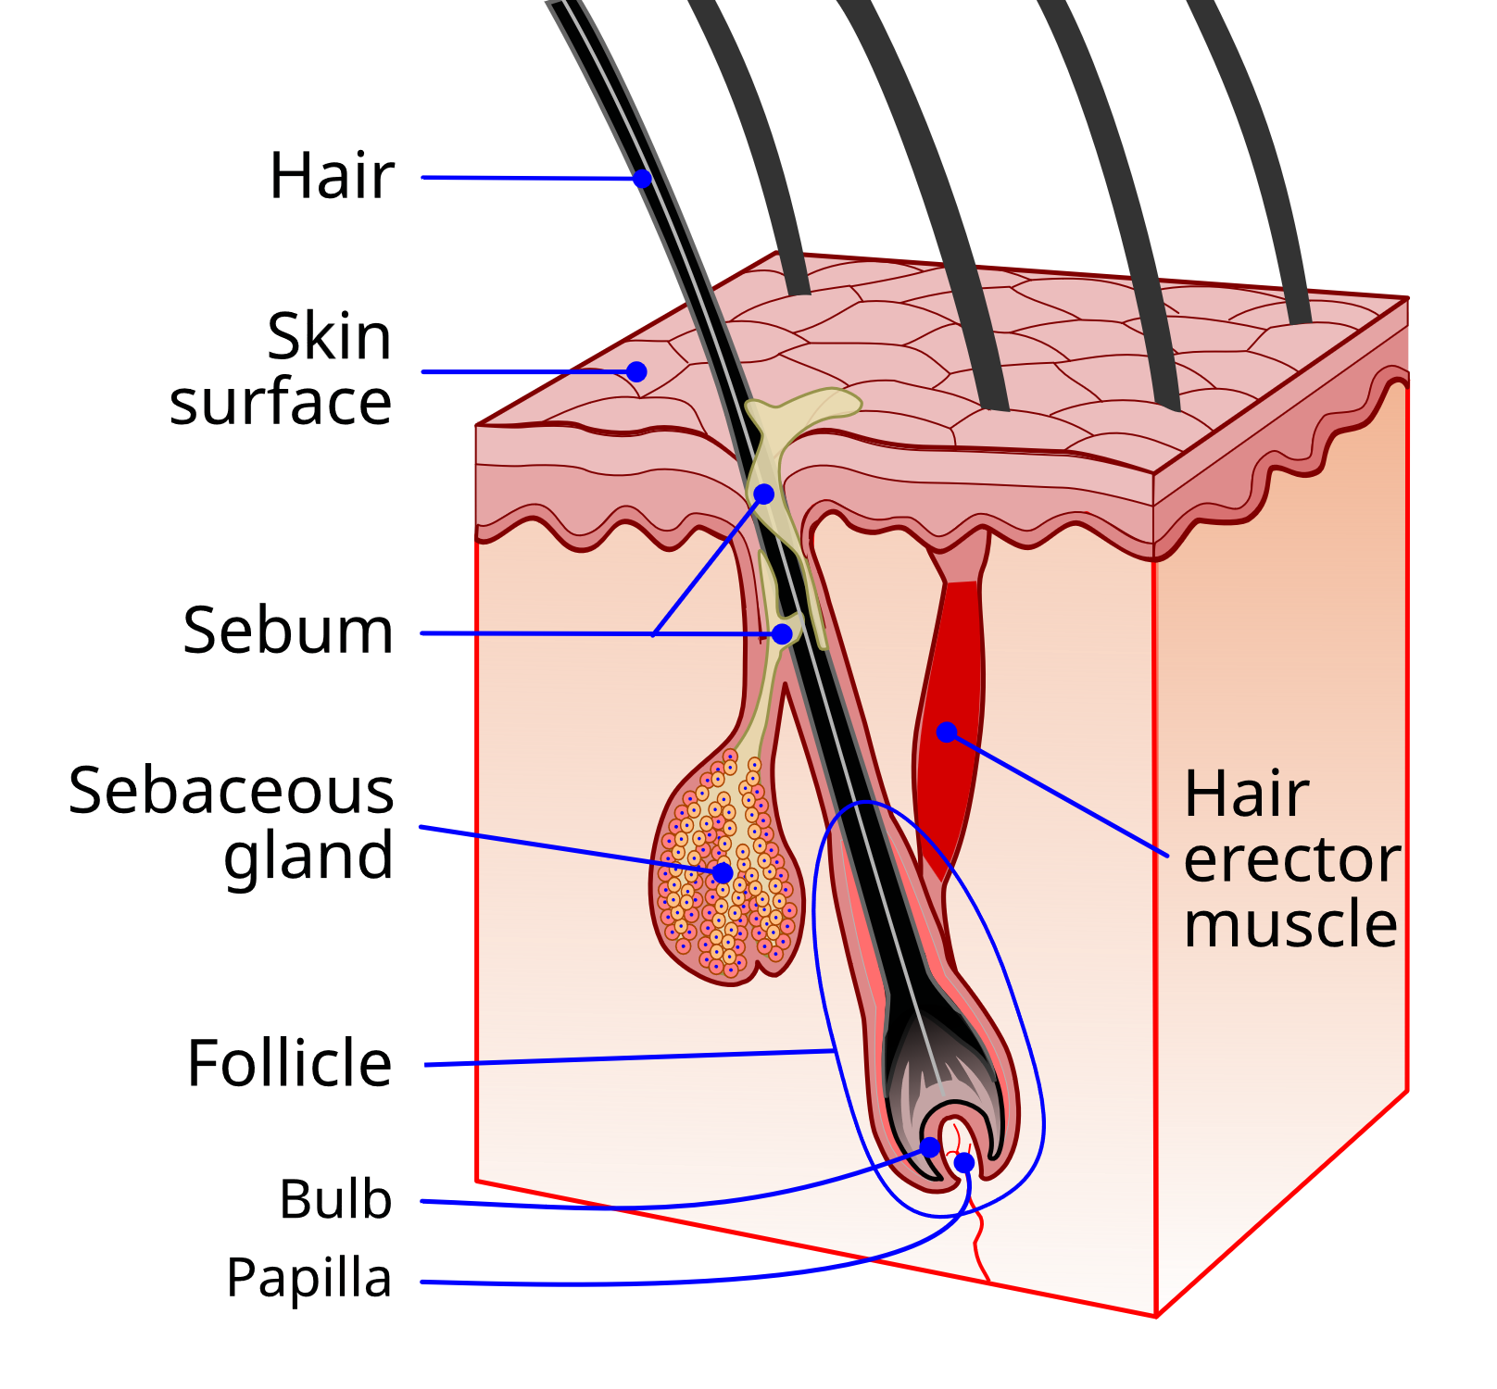
Pathogenesis
Sebum overproduction
Abnormal shedding of follicular epithelium
Follicular colonization by Cutibacterium acnes
Inflammation
By National Institutes of Health - This image has been extracted from another file, Public Domain, https://commons.wikimedia.org/w/index.php?curid=6910143
Notes:
Here is a quick review of the pathogenesis of acne.
Image of a pilosebaceous unit.
Sebum overproduction can be either due to excessive androgen hormones or increased sebaceous glad sensitivity to normal levels of androgens.
Cutibacterium acnes was previously called proprionibacterium acnes. Gram positive anaerobic rod
There may be a genetic component to acne
Food with high glycemic index seem to affect acne severity (sugary drinks, starchy foods, highly processed foods and skim milk)
Stress, tobacco smoke or damaged skin may also contribute

Slide 7
Case - Emily
Emily is a 16-year-old 10th grader involved in volleyball who presents with a concern of “persistent acne on my face and back for the past 8 months”.
HPI: Acne has gradually worsened and primarily affects her face (cheeks, forehead, chin) and upper back. She has had blackheads and whiteheads and has noted inflamed red bumps and occasional painful nodules. She has tried OTC benzoyl peroxide wash and salicylic acid pads with minimal improvement. Acne is worse during menses. She has become more self-conscious about her appearance.
PMH: Healthy, no other medications other than the topical acne treatments. No known allergies.
FH: Mom had acne as a teenager. No fam hx of PCOS.
SH: Non-smoker, “mostly” balanced diet but high in dairy and processed carbs

Slide 8
Acne Lesions
Notes:
It wouldn’t be a derm talk without lots of pictures. I am grateful to have access to Visual Dx for awesome photos.

Slide 9
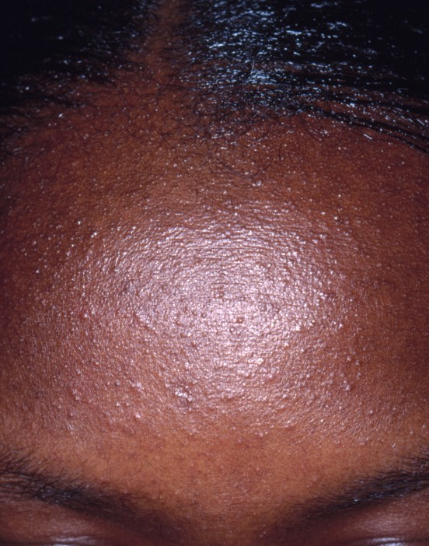
Closed Comedones
Papules formed by the accumulation of sebum and keratin in the hair follicle
“Whiteheads”
Photo from Visual Dx 2010

Slide 10
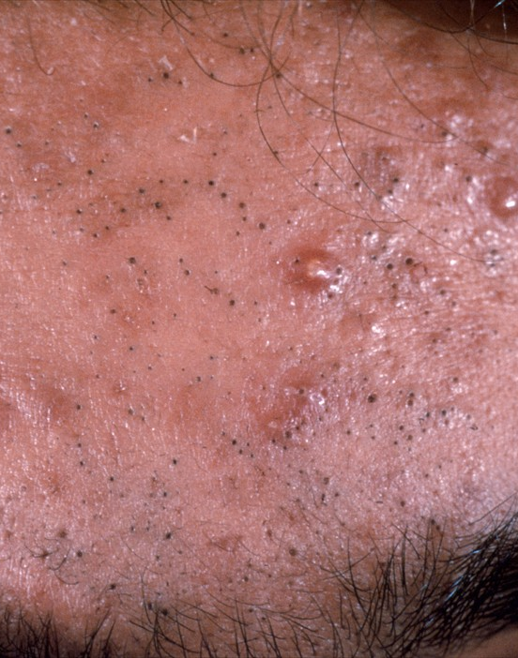
Open Comedones
Distension of the hair follicle leads to opening of the follicle
Oxidation of lipids
Deposition of melanin
“Blackheads”
Photo from Visual Dx 2012

Slide 11
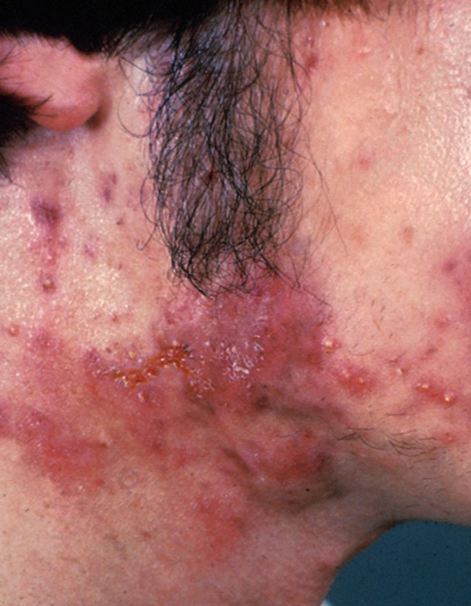
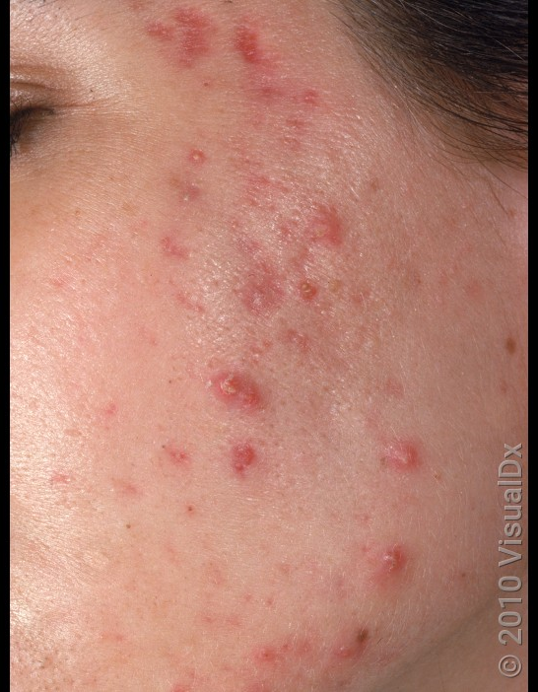
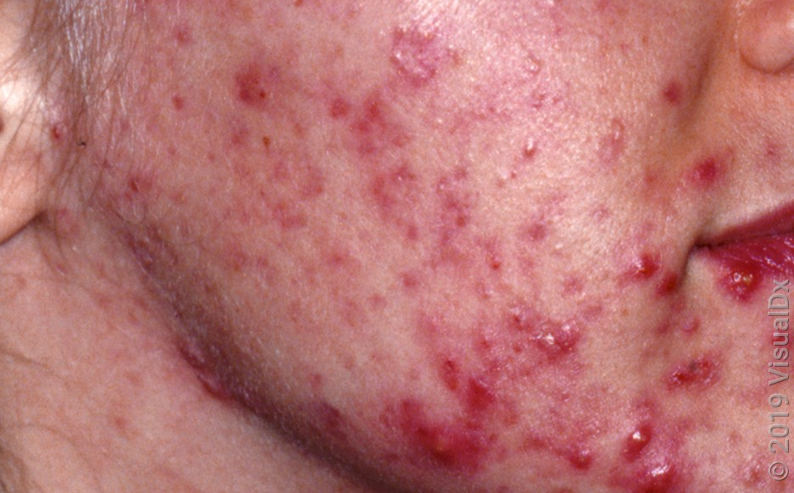
Inflammatory Lesions
Includes papules, nodules and cysts
Caused by the follicle rupture triggering an inflammatory response
Photos from Visual Dx 2010, 2012 & 2019
Notes:
As you can see, a patient can have different type of lesions mixed together. It is beneficial to describe the lesion type, severity and distribution
1. Pustules and large inflammatory nodules along the neck and jawline
2. Papules and pustules of varying sizes – with red scarring near the temple
3. Large pustules and papules with post-inflammatory changes across the cheeks and jawline

Slide 12
Acne Grading
No universally accepted system
Recommended to consistently use a single system to facilitate decision-making and treatment response
Investigator Global Assessment (IGA) is most used in the US
Others include the Leeds revised acne grading system, Global Acne Severity Scale and Comprehensive Acne Severity Scale
An ideal grading system should include types of acne lesions, number of lesions, region(s) of skin involvement and be simple, accurate, and reproducible.
Notes:
Acne grading continues to be a sticking point due to the lack of a universal system. It is no wonder that primary care providers are not sure how to grade the acne. Current systems are subjective.
Acne lesion counting is time consuming. It is generally done in research settings.
Serial clinical patient photos can be a good way to assess treatment response.
There is thought that AI combined with patient photographs may someday provide a more reproducible/standardized evaluation.

Slide 13
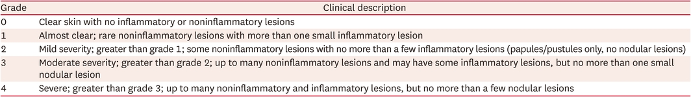
Investigator Global Assessment (IGA)
Table 4. Investigator Global Assessment Scale (IGA) by US FDA
Notes:
One of the most widely used scales and is easy to use.
Developed by the FDA in 2005 to be used in trials.
The term “severe” can be interpreted differently by different providers.
Limitations: Only assesses acne on the face. Doesn’t address hyperpigmentation/scarring or patient quality of life

Slide 14
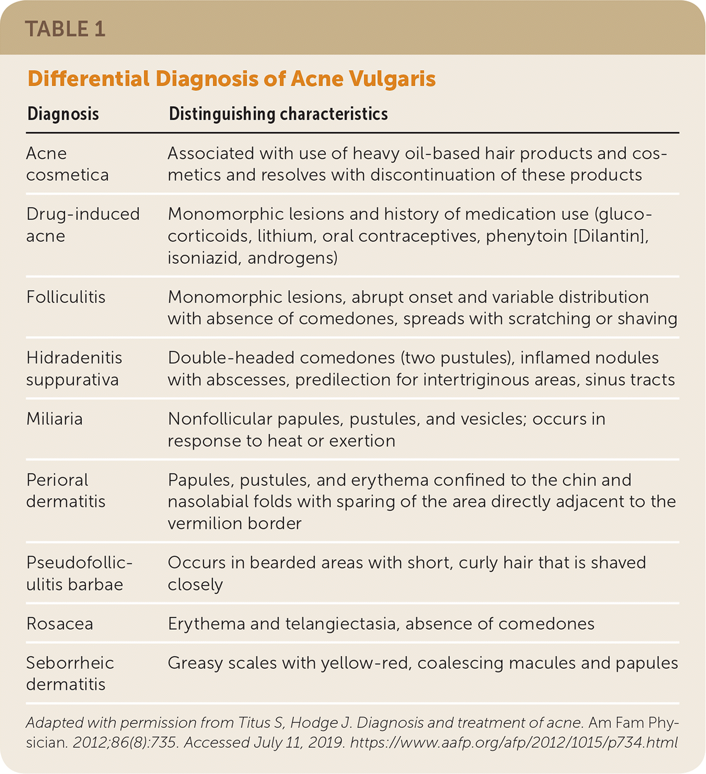
Notes:
We need to remember that not all bumps on the face are acne. This is a list from the American Family Physician that provides an excellent differential diagnosis for acne.

Slide 15
Treatment Recommendations
Based on the American Academy of Dermatology (AAD) guidelines

Slide 16
What to dermatologists want primary care to do?
Do something!!
Jump in and don’t be afraid to start treatment.
Follow the guidelines.
Remind patients it can take 8-12 weeks for any results – be patient!
Skin turnover takes about 1 month. It will take about 2 cycles for any inflammation to calm down.
Notes:
Similar to how I asked my PA colleagues in family medicine what they wanted to know about acne, I asked Michael Elliott a PA colleague in dermatology at Uiowa, what he would want primary care providers to know about the treatment of acne and this is what he had to say.

Slide 17
What options are available for acne treatment?
Topical therapies – both OTC and prescription
Systemic antibiotics
Hormonal agents
Oral isotretinoin
Physical modalities
Complementary and alternative medicine
Dietary and environmental interventions
Notes:
We will review each of these areas.

Slide 18
5 Good Practice Statements
When managing acne with topical medications, we recommend multimodal therapy combining multiple mechanisms of action.
For patients with acne, we recommend limiting the use of systemic antibiotics when possible to reduce the development of antibiotic resistance and other antibiotic associated complications.
It is recommended that systemic antibiotics are used concomitantly with benzoyl peroxide and other topical therapy.
For patients with larger acne papules or nodules, we recommend intralesional corticosteroid injections as an adjuvant therapy.
For patient with severe acne who have failed standard treatment with oral or topical therapy, we recommend isotrenitoin.
Notes:
The American Academy of Dermatologists updated their treatment recommendations in 2024. This resulted in 18 evidence-based recommendations and 5 good practice statements.
If you are going to remember something from this lecture, this is it!!

Slide 19
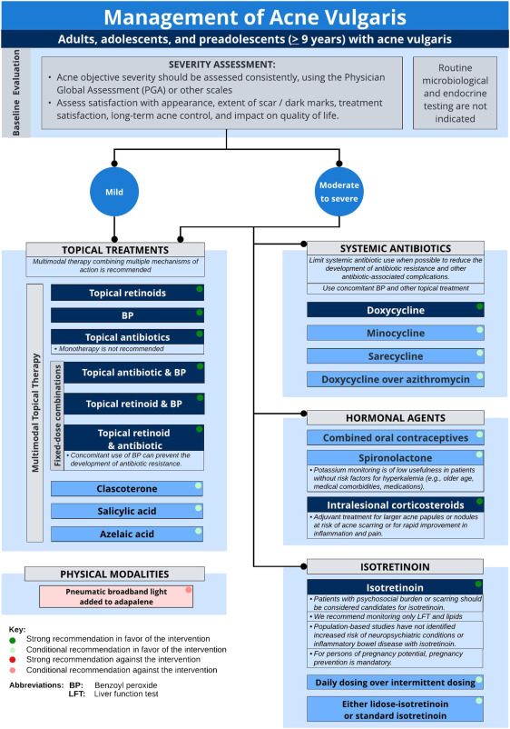
J Am Acad Dermatol
Volume 90, Number 5
Notes:
This flow diagram of acne management is from the guidelines that we will review.
You first start with the baseline evaluation.
We have already discussed how to rate acne severity.
It is important to remember to individualize therapy based on the patient’s goals as well as benefits and risks of treatments, severity and extent of acne, cost and patient preference.
Please make note that routine microbiological and endocrine testing are not indicated.
Don’t worry, we will come back to this diagram after we have discussed the options.

Slide 20
Topical Therapies - Retinoids- *Recommended
Vitmain A derivitives are the “cornerstone of therapy since they are BOTH comedolytic and anti-inflammatory
  4 types: tretinoin, adapalene, tazarotene, and trifarotene
  Side effects: burning, dryness, erythema, exfoliation, and pain – worse with higher concentrations
  Start with pea-sized amount applied to face at bedtime every other night.
  OK to use facial moisturizer prior to application
  Creams and lotion formulations better for sensitive skin
  Adapalene 0.1% gel available OTC (Differin)
Notes:
Mainstay of acne treatment!
Used for initial and maintenance therapy. Can be used as monotherapy.
All retinoids are slightly different in activity/tolerability/efficacy

Slide 21
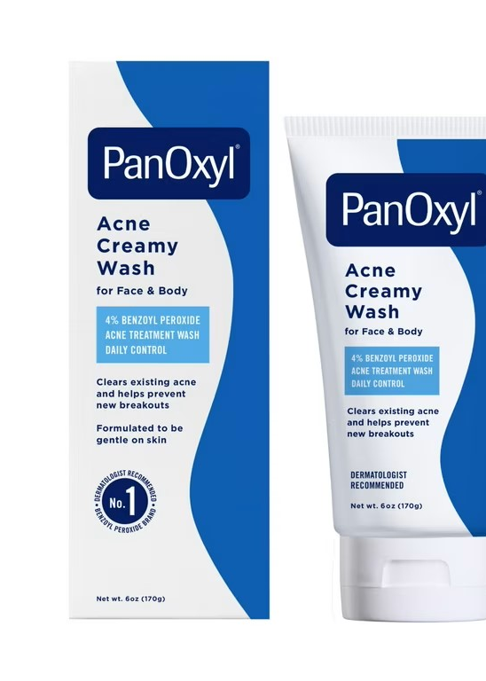
Topical Therapies – Benzoyl Peroxide- *Recommended
Topical Antimicrobial agent Available OTC!
  Mildly comedolytic
  Side effects: burning, stinging, dryness, erythema, peeling, pain, fabric staining
  Water-based and wash-off formulations better tolerated
  A good choice: Pan-Oxyl 4% creamy wash – cost $9.88
  No C. acnes resistance has been reported
Image from Wal-Mart.com
Notes:
To use: Wet the area – massage into skin for 1-2 minutes and then rinse off.
Start with every other day and can potentially work up to 2 times/day.
Use sunscreen!

Slide 22
Topical Therapies – Topical antibiotics- *Recommended
Includes erythromycin, clindamycin, minocycline and dapsone
  Both antibacterial and anti-inflammatory
  Avoid monotherapy!! Combine with benzoyl peroxide
  Well tolerated
  Lack of active comparator studies to say whether one agent is superior
Notes:
Use of Dapsone and benzoyl peroxide together caused a orange-brown skin discoloration which CAN be washed off. Use at different times of day.
Rare case reports of C.diff diarrhea with clindamycin use

Slide 23
Topical Therapies – Fixed-dose combinations- *Recommended
Improve patient adherence!
  Benzoyl peroxide and topical retinoid
  Benzoyl peroxide and topical antibiotic
  Topical retinoid and topical antibiotic (must also use benzoyl peroxide!)
  May or may not be more affordable than individual agents
  Insurance likely dictates what is covered.

Slide 24
Topical Therapies – Others – *Conditionally Recommended
Clascoterone
  topical antiandrogen
  beneficial but $$$
Salicylic acid
  topical comedolytic
  OTC
  moderate evidence
Azelaic acid
  Topical comedolytic, antibacterial, and anti-inflammatory
  May be better for sensitive or darker skin due to lightening effect
Notes:
Clascoterone – Binds to antiandrogen receptor and inhibits androgen mediated lipid and inflammatory cytokine synthesis
In pregnancy risk of fetal harm not expected wit topical azelaic acid, BP, erythromycin and clindamycin.

Slide 25
Systemic Antibiotics
Used to treat moderate to severe acne
Doxycycline *Recommended – 100 mg QD or BID
  minocycline (more side effects)and sarecycline (cost) *Conditionally recommended
Antibacterial and anti-inflammatory
Contraindicated in pregnancy, lactation and under age 9 years
Side effects: GI related, phototoxicity
Limit use! 3 months
Use with benzoyl peroxide and other topical therapies
Notes:
In 2021, dermatologists prescribed more oral antibiotics per clinician than all other specialties – mostly for acne.
Associated with inflammatory bowel disease, C. diff and Candida vulvovaginitis
If you start doxycycline have them back for a follow up at 4 months so you can see if there has been any sustained improvement after 3 month of therapy and then 1 month off.

Slide 26
Hormonal Agents – Combined Oral Contraceptives (COCs) - *Conditionally Recommended
Anti-androgenic – less androgen production, decreased free testosterone
4 COCs FDA approved for acne – no superior COC
Improvement at 3-6 months
Can be combined with other oral/topical therapies
Notes:
Approved COCs – norgestimate/EE, norethindrone acetate/EE/ferrous fumarate, drospirenone/EE, and dropspirenone/EE/levomefolate
Be sure patient’s are appropriate for COC use – Follow medical eligibility criteria for contraceptive use
Tetracyclines have not been shown to decrease COC effectiveness

Slide 27
Hormonal agents -Spironolactone – *Conditionally Recommended
Anti-androgenic – decreases testosterone production and inhibits binding to androgen receptors
Not FDA approved for acne
Side effects: menstrual irregularities, diuresis, breast tenderness/enlargement, gynecomastia, fatigue, headache, dizziness
Dose: 25 - 200 mg/day
Potassium monitoring of low usefulness without risk factors
Contraindicated in pregnancy
Notes:
Risk factors for hyperkalemia – older age, medical co-morbiditities, medications – HTN, diabetes, CKD, ec

Slide 28
Hormonal Agents – Intralesional Corticosteroid
*Good Practice Statement
Adjuvant therapy for larger acne papules or nodules
Limited trial data
Side effects: skin atrophy, systemic absorption, adrenal suppression
Dose: 2.5-5 mg/ml of triamcinolone

Slide 29
Oral Isotretinoin
*Good Practice Statement
Approved for severe recalcitrant nodular acne vulgaris
  Can also be used for moderate, recalcitrant acne (when other options are not ideal)
Mechanism unknown
  Reduces size and secretion of sebaceous glands which indirectly reduces C. acnes
  Inhibits comodogenesis by normalizing keratinocyte keratinization
  Anti-inflammatory properties
Limited trial data

Slide 30
Oral Isotretinoin
Side effects: dryness of skin/mucous membranes (lips), dry eyes/nose, hypertriglyceridemia, nausea, fatigue, musculoskeletal. Resolve when treatment is discontinued.
Lab monitoring: LFTs, lipid panel, pregnancy test
Pregnancy prevention is mandatory!
  Teratogenic
  Must enroll in iPLEDGE REMS
  2 forms of contraception for those who can become pregnant – LARC preferred
  1 month before, during, and 1 month after treatment
Notes:
REMS stands for Risk Evaluation and Mitigation Strategy
Enrolling in iPLEDGE is done through on online portal with a registered prescriber
LARC – long acting reversible contraception

Slide 31
Oral Isotretinoin
Daily dosing over intermittent dosing is *Conditionally Recommended
Either standard isotretinoin or lidose-isotrenitoin is OK - *Conditionally Recommended.
Dose: standard 0.5-1.0 mg/kg/day or low dose <0.5 mg/kg/day
Notes:
The difference is to do with bioavailability related – standard is better with high fat meal, the lidose version it doesn’t matter.
Limited data about comparing standard to low dose. Recent studies suggest low dose may have similar effectiveness.

Slide 32
Physical Modalities
Includes: acne lesion extraction, chemical peels, laser and light-based devices, microneedle radiofrequency devices, and photodynamic therapy.
Evidence is insufficient to make a recommendation
*Recommendation AGAINST adding pneumatic broadband light to adapalene 0.3% gel based on low certainty evidence. Associated with hypepigmentation and purpura.
Notes:
This treatment combines broadband pulse light therapy and vacuum suction technology

Slide 33
Complimentary and Alternative Medicine
Insufficient evidence to develop a recommendation
Looked at: topical tea tree oil, topical green tea, topical which hazel, oral pantothenic acid (Vitamin B5), oral or topical zinc, and oral or topical niacinamide (Vitamin B3).
Notes:
No surprise here.

Slide 34
Dietary and Environmental Interventions
Evidence is conflicting about a low-glycemic load diet
Evidence is insufficient for the use of low dairy diet, low whey diet, omega-3 fatty acids and chocolate.

Slide 35
J Am Acad Dermatol
Volume 90, Number 5
Notes:
Along with the 5 good practice statements, this diagram is the one you should have easy access to for reference and review!

Slide 36
Dermatology Referral

Slide 37
When to refer to dermatology
Refer if you are not getting the results you expected.
Refer if you have questions about treatment. (At UI Healthcare this can be an e-consult.)
Refer if you think the patient would benefit from oral isotretinoin

Slide 38
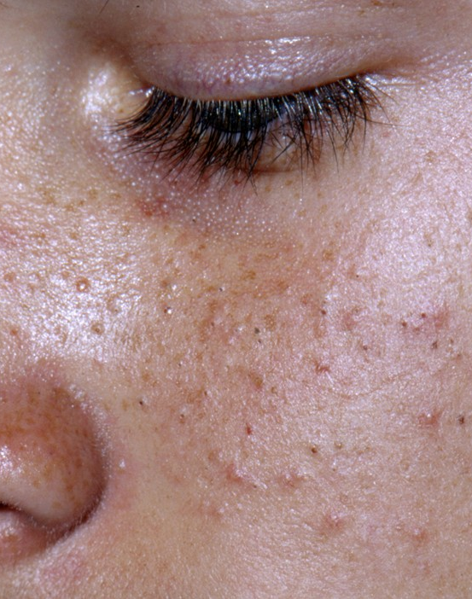
Case continued – Emily
PE: General - Healthy appearing
Skin – Multiple open and closed comedones. Inflammatory papules and pustules on cheeks and chin. No scarring. Sparse inflammatory papules on upper back. No hirsuitism.
Photo from Visual Dx 2013
Notes:
What is the severity of her acne. What treatments would you recommend?

Slide 39
Case continued - Emily
Diagnosis: Moderate inflammatory acne
Treatment: Topical – Benzoyl peroxide 4% wash: Apply AM when in the shower -> Antibacterial and comedolytic.
Topical - Adapalene 0.1% gel: apply nightly -> Prevents comedone formation and treats existing lesions.
Topical Antibiotic: Clindamycin 1% gel (may be combined with benzoyl peroxide) -> reduces inflammation and bacterial load -> Must be used with benzoyl peroxide to prevent resistance
Oral – Doxycyline 100 mg daily for 3 months -> reduces inflammation and bacterial load. -> Must be used with benzoyl peroxide to prevent resistance
Lifestyle and Skincare – Use non-comedogenic skincare products. Cleanse face 2 times/day with gentle cleanser. Discuss that dairy and high glycemic foods may contribute (evidence variable). Stress management. Offer emotional support/reassurance.
Follow-up: Reassess in 8-12 weeks.
Notes:
What would you want to discuss at follow up? Objective and subjective improvement, compliance with regimen, next steps – maybe OCP?

Slide 40
Questions?
Leslie Veit, MPAS, PA-C
Clinical Associate Professor
Family and Community Medicine
leslie-veit@uiowa.edu
uihc.org

Slide 41
Special Thanks to Michael Elliott, MPAS, PA-C
Notes:
I appreciate the time Michael provided giving me guidance and reviewing the presentation.

Slide 42
References
Reynolds RV, Yeung H, Cheng CE, et al. Guidelines of care for the management of acne vulgaris. J Am Acad Dermatol. 2024;90(5):1006.e1-1006.e30. doi:10.1016/j.jaad.2023.12.017
Bae IH, Kwak JH, Na CH, Kim MS, Shin BS, Choi H. A Comprehensive Review of the Acne Grading Scale in 2023. Ann Dermatol. 2024;36(2):65-73. doi:10.5021/ad.23.094
Oge' LK, Broussard A, Marshall MD. Acne Vulgaris: Diagnosis and Treatment. Am Fam Physician. 2019;100(8):475-484.
Notes:
Here are the references I used for this talk.

Slide 43
Thank you
Leslie Veit, MPAS, PA-C
Clinical Associate Professor
Family and Community Medicine
leslie-veit@uiwoa.edu
uihc.org

