Slide 1
Smart Notes, Less Burnout:
Ambient AI for the Modern Clinician
Lindsey Knake MD, MS
Associate Chief Health Information Officer – Inpatient Pediatrics
October 21st, 2025

Slide 2
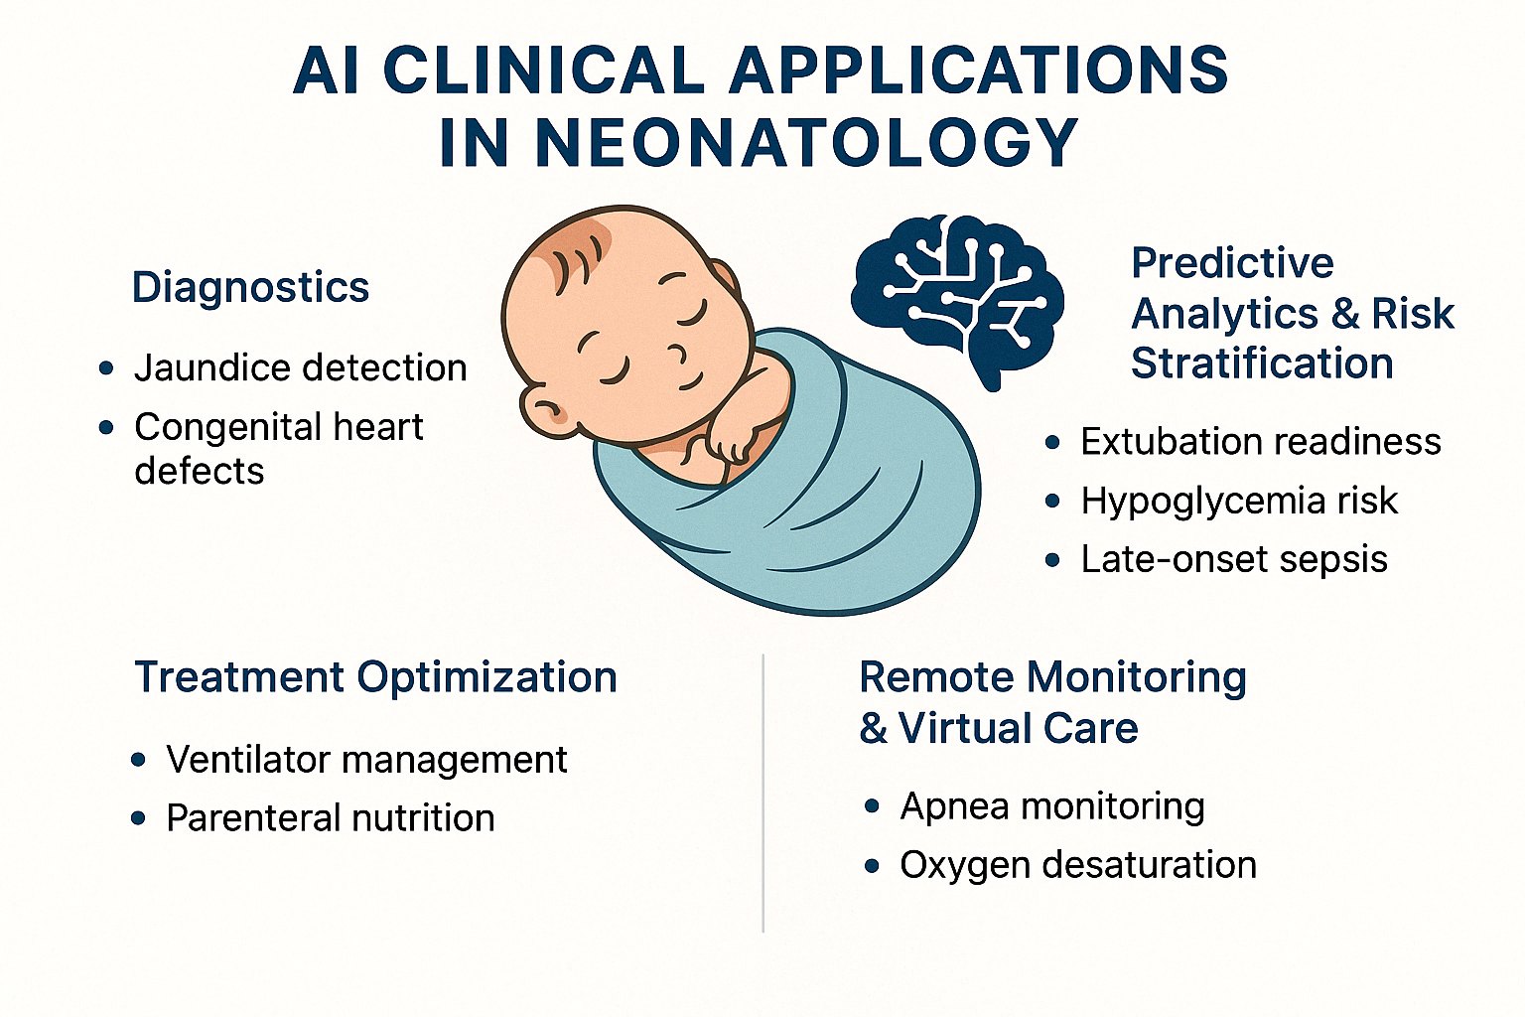
Learning Objectives
Understand a brief overview of AI and Machine Learning terminologies
Describe Ambient AI and its role in Clinical Documentation
Review data on Ambient AI and Burnout for clinicians
Image generated by ChatGPT 4o (4/21/25)

Slide 3

Disclaimers!
I have no financial relationships with any companies or applications we discuss
I do pay for ChatGPT and have access to Microsoft CoPilot
AI did help me create this talk!
I frequently learn from use cases shared by others so please share how you use AI
Image created using CoPilot

Slide 4
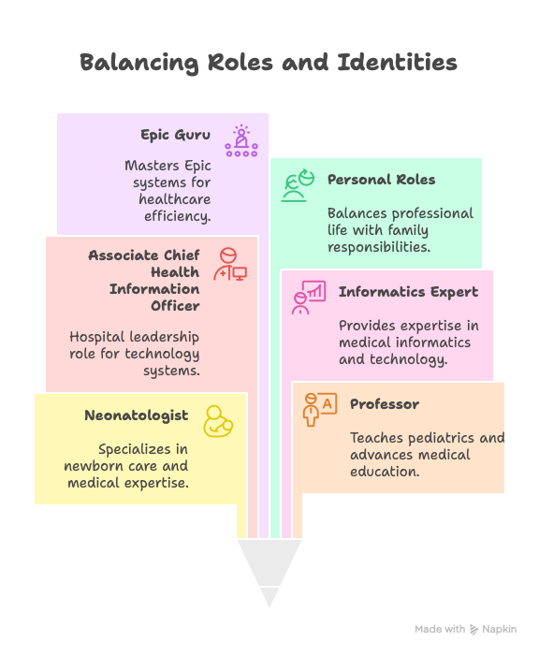
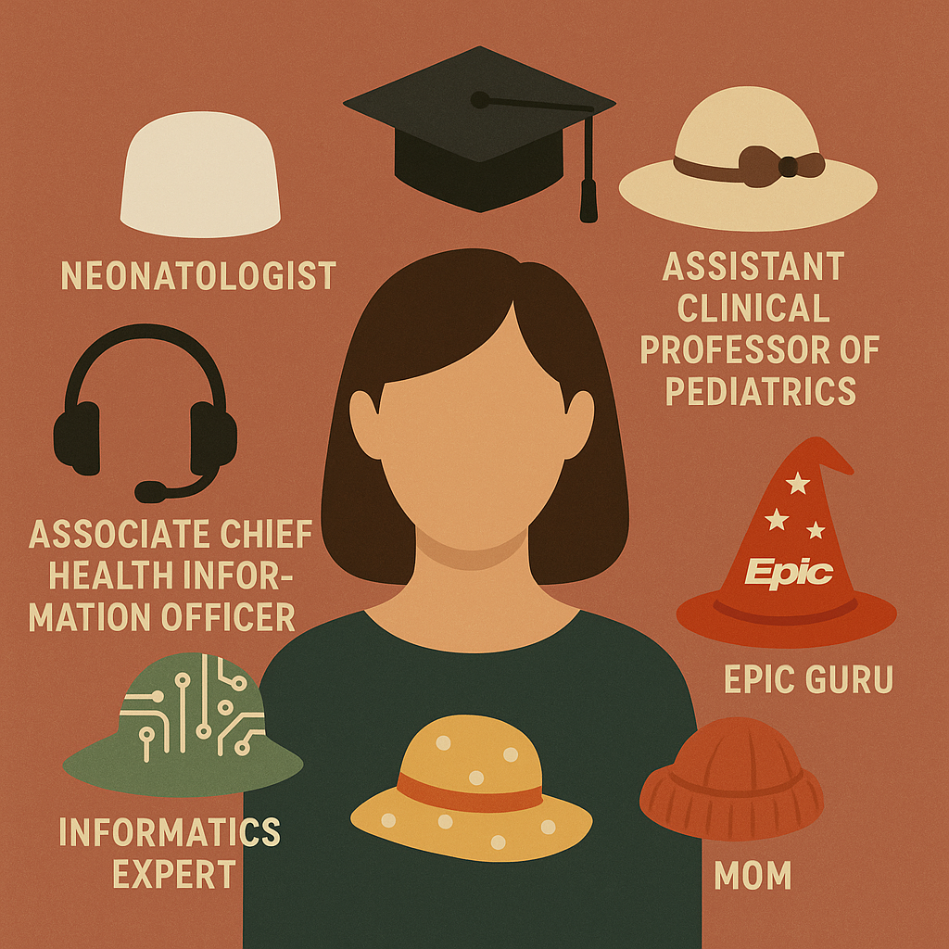
Who Am I?
Image created using ChatGPT
Notes:
We are all balancing many roles/hats and I love learning from others and everyone one. I encourage people to use the chat to share what they use AI or ChatGPT for in their daily lives!
In this day and age where we are asked and expected to do more and more, I’m hoping we can break through that expectation of the only way to do it all is to work 100 hours a week. Expectations should continue to shift and change that we can be there for our kids and families and still have an exciting and fulfilling career.

Slide 5
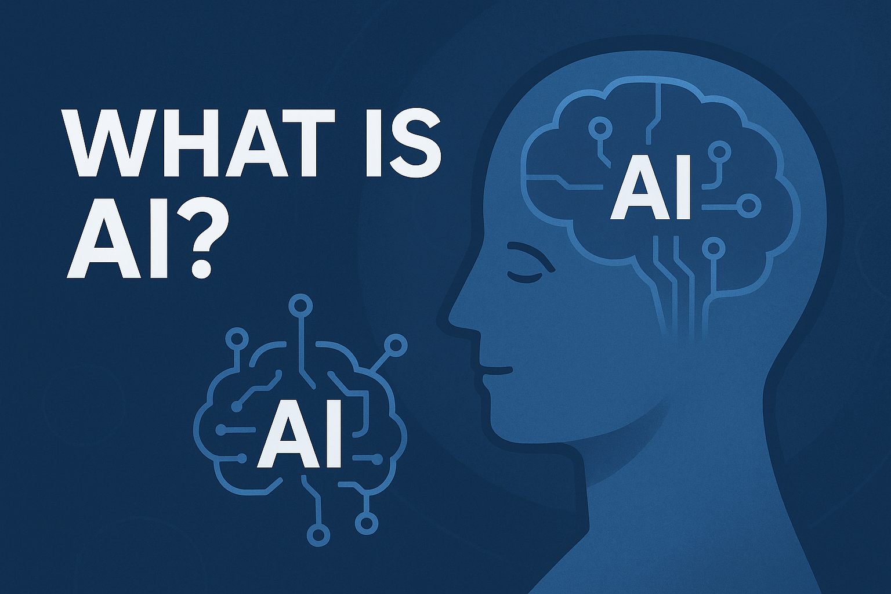
What is AI?

Slide 6
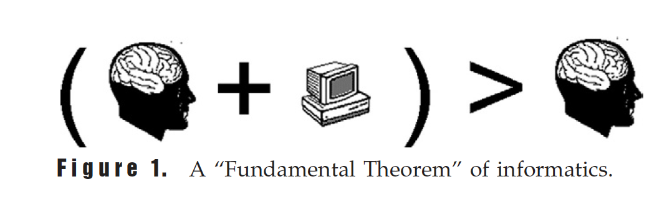
Biomedical Informatics Definition
“The interdisciplinary field that studies and pursues the effective uses of biomedical data, information, and knowledge for scientific inquiry, problem solving, decision making, motivated by efforts to improve human health”
(Friedman. 2009).
Notes:
Friedman “ A person working in partnership with an information resource is better than that same person unassisted”

Slide 7



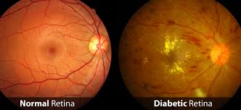
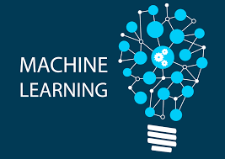
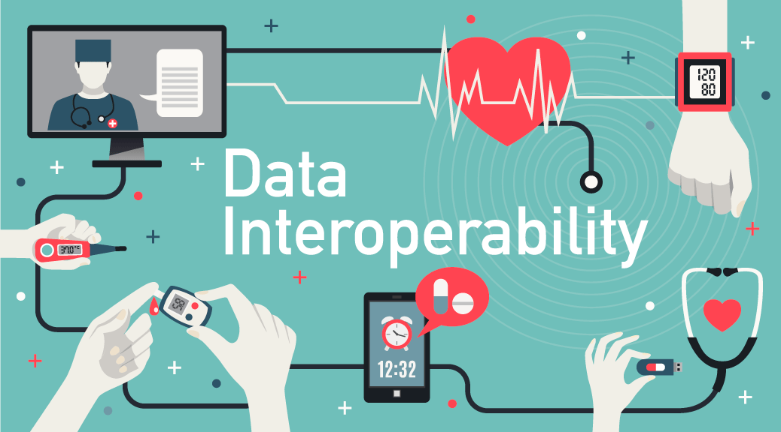
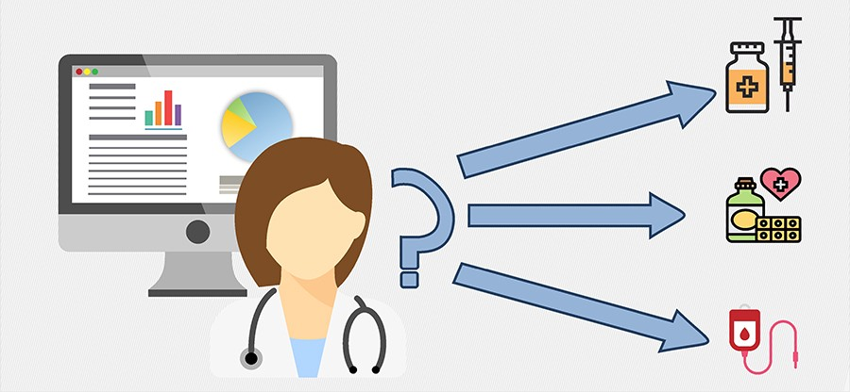
Biomedical Informatics
Notes:
More than just using AI in medicine
“Using technology and data to connect the dots” – Kevin Johnson
Bioinformatics- using genetics and the genome to help predict disease and/or responses to medication with personalized medicine
AI and imaging: University of Iowa has been at the forefront of AI in medicine by identifying early signs of diabetic retinopathy with Dr. Abramoff and IDx
Using technology to solve problems in medicine
Data interoperability and home device monitoring is beginning to expand here at UIHC. Already being used in certain clinics (OB, nephrology, cardiac?)
Data analytics wit SlicerDicer
Clinical decision support and EHR optimization to help reduce physician burnout

Slide 8

Artificial or Augmented Intelligence

Slide 9
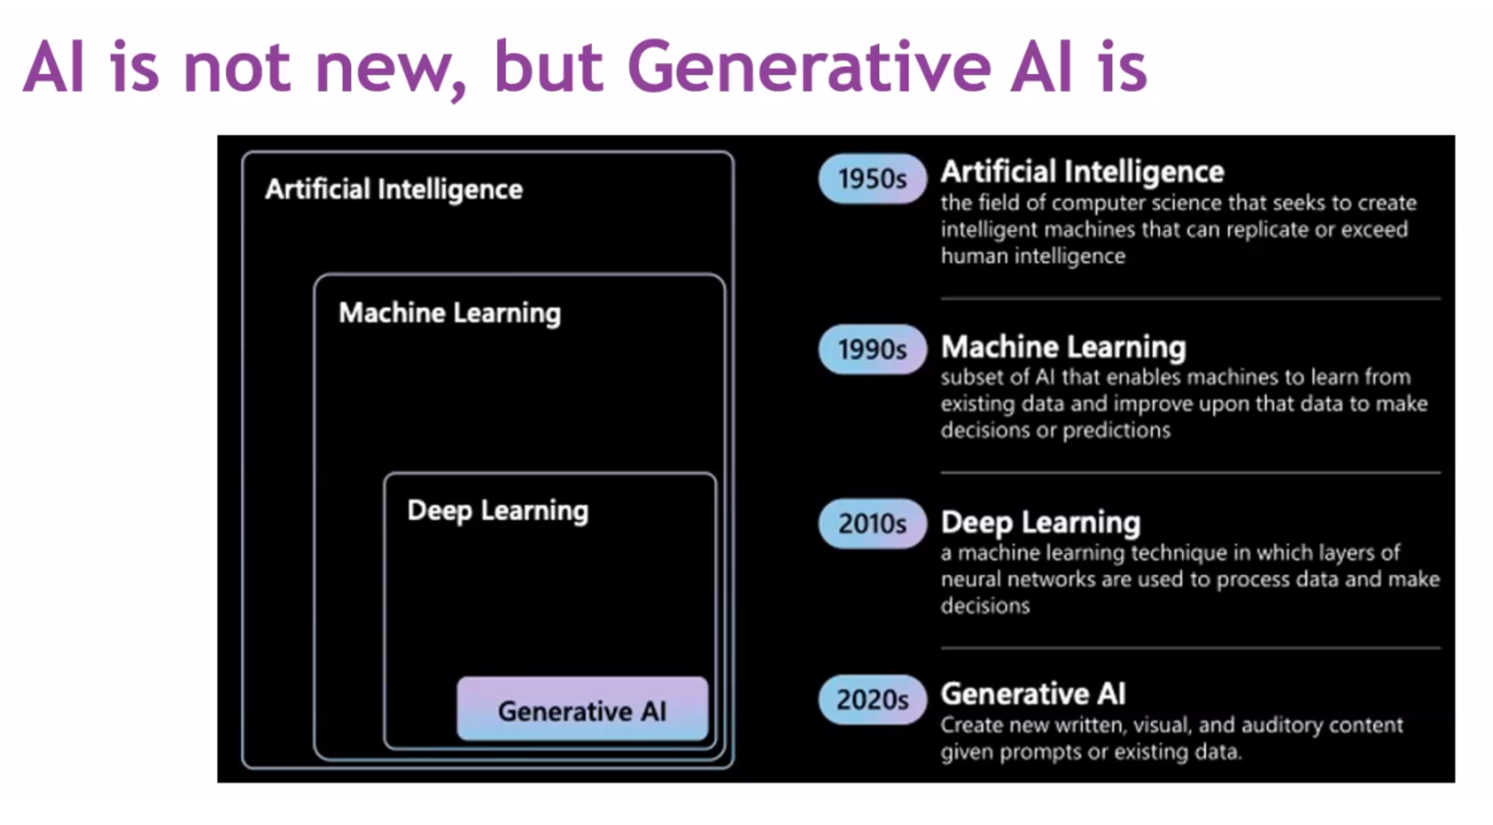
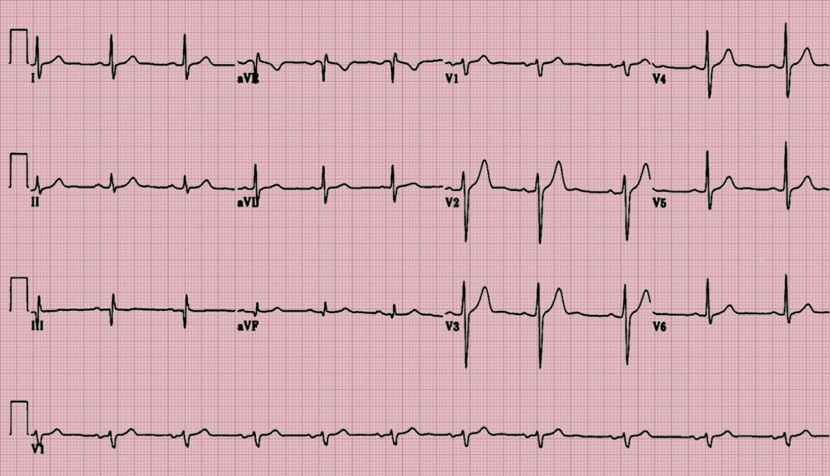
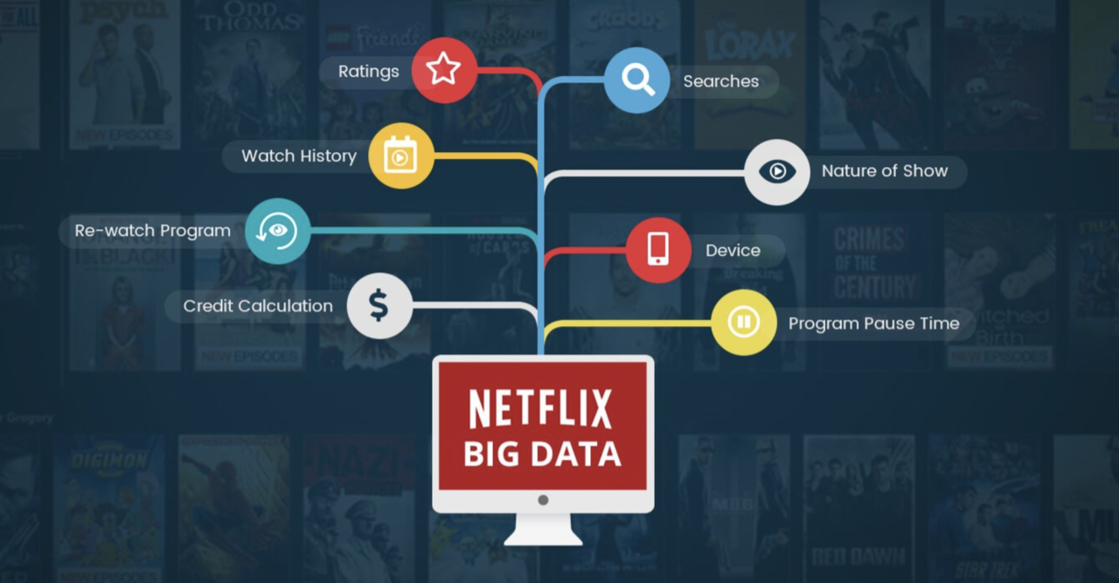
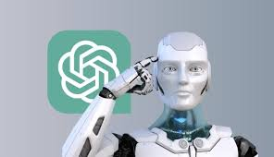

Slide 10
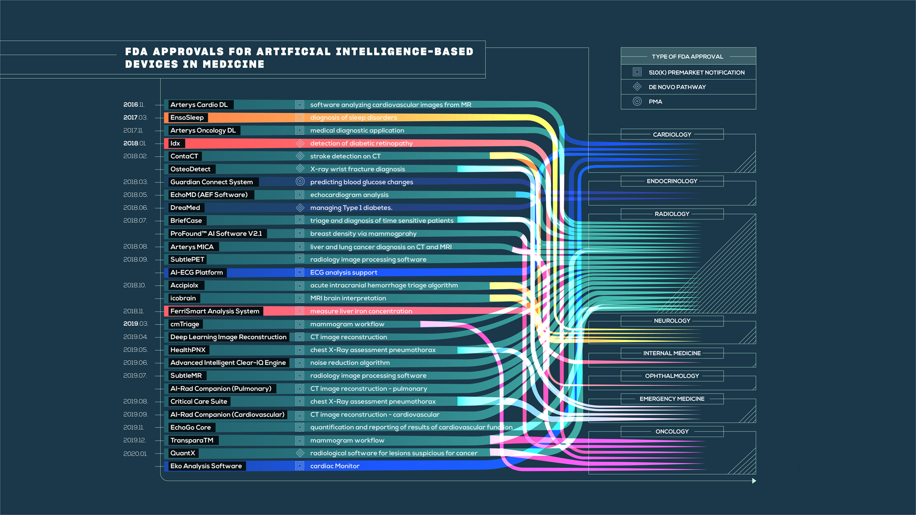
FDA Approved AI Algorithms - 2020
Notes:
Aug 7, 2024 there are 950 AI/ML enable medical devices
AI term was first used in 1956 (rules based systems by experts)
-automated EKG interpretations were once considered AI but are hardly considered that today.
-AI is a computer algorithm that attempts to understand and learn from data presented to it. (finds associations in data that clinicians may not be aware of, however only as good as the parameters and data that is put into the algorithm)
-ML can generally be under the umbrella of AI (supervised and unsupervised machine learning)
Idx from the University of Iowa
Radiology is the leading area for ML and AI

Slide 11
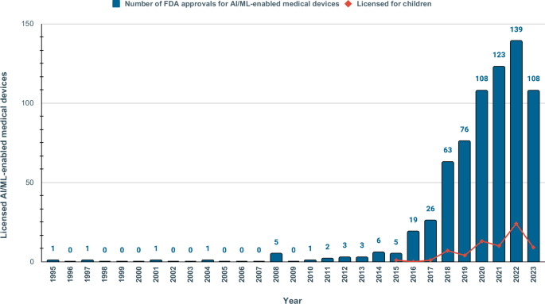
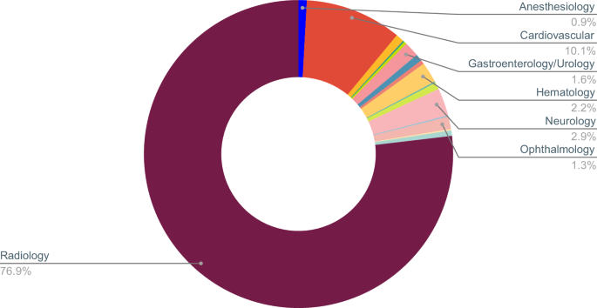
FDA Approved Algorithms - 2024
Notes:
950 total approved in Aug 2024
Very few with data on race/ethnicity (3.6%)
Only 1.9% with scientific publication with safety and efficacy data
Only 9% with a prospective study for post-market surveillance

Slide 12
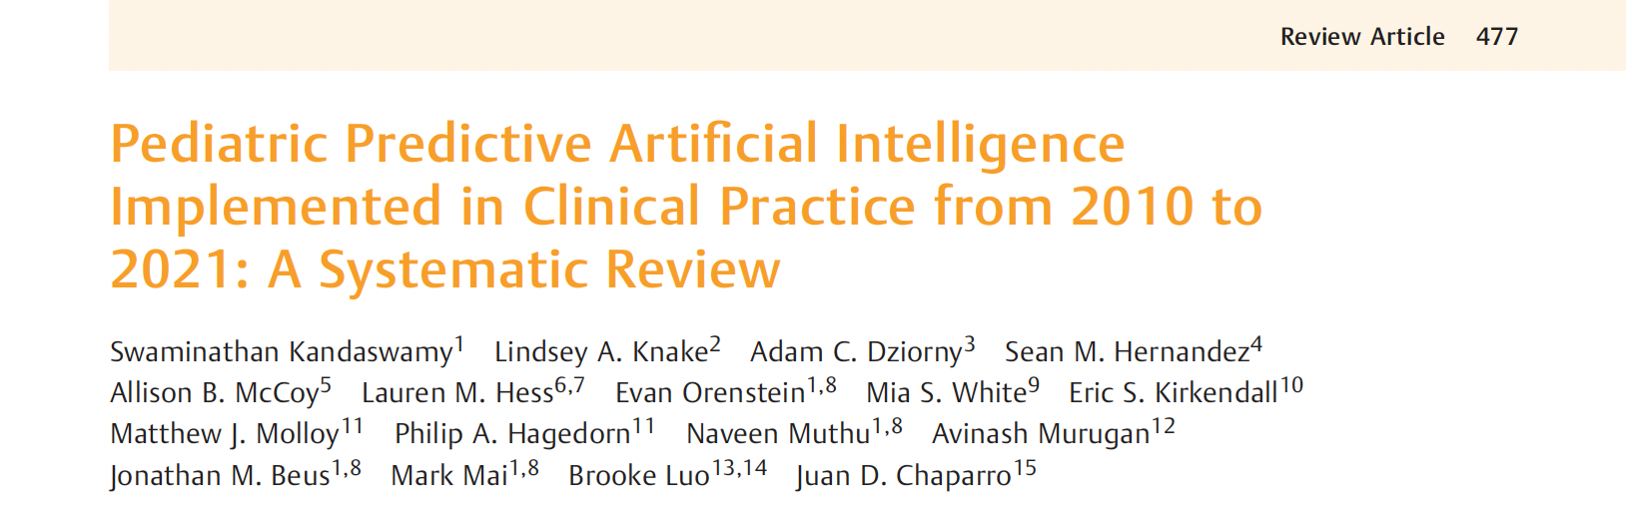
Is AI Implemented into Clinical Practice?
Of the 126 full text articles reviewed, only 17 (or 14%) met inclusion criteria for clinical implementation

Slide 13
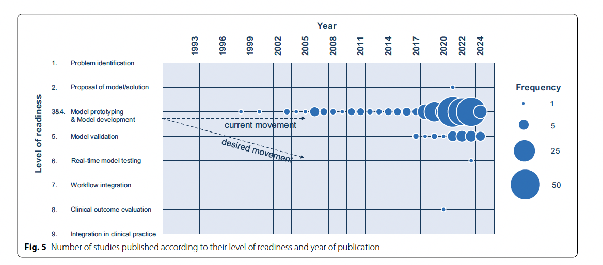
Implementation in PICU and NICU
Of the 262 full text articles reviewed, 66% were NICU studies but only 31 (12%) reached level 5 of readiness

Slide 14

Understanding Machine Learning
Image generated by Microsoft CoPIlot (7/7/25)

Slide 15
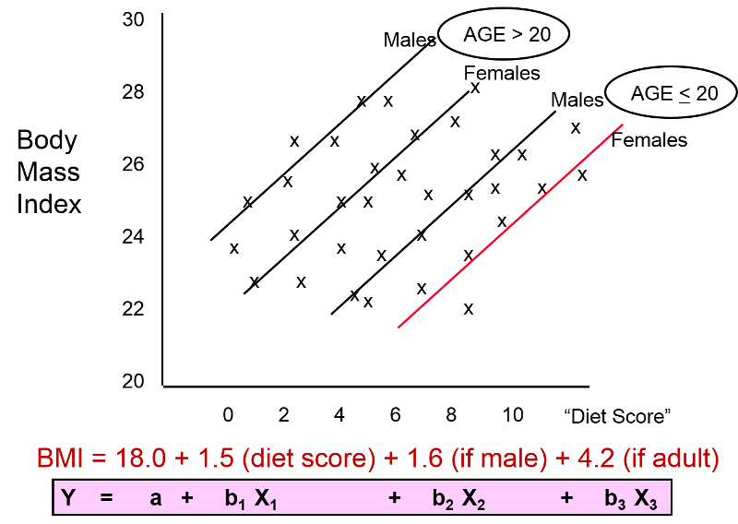
Simple Linear Regression
Boston University
Notes:
X axis is the predictor or independent variable
Y axis is the outcome or depended variable
The beta coefficients allow you to control for the other variables
If age is >20 is the highest predictor of having a higher BMI

Slide 16
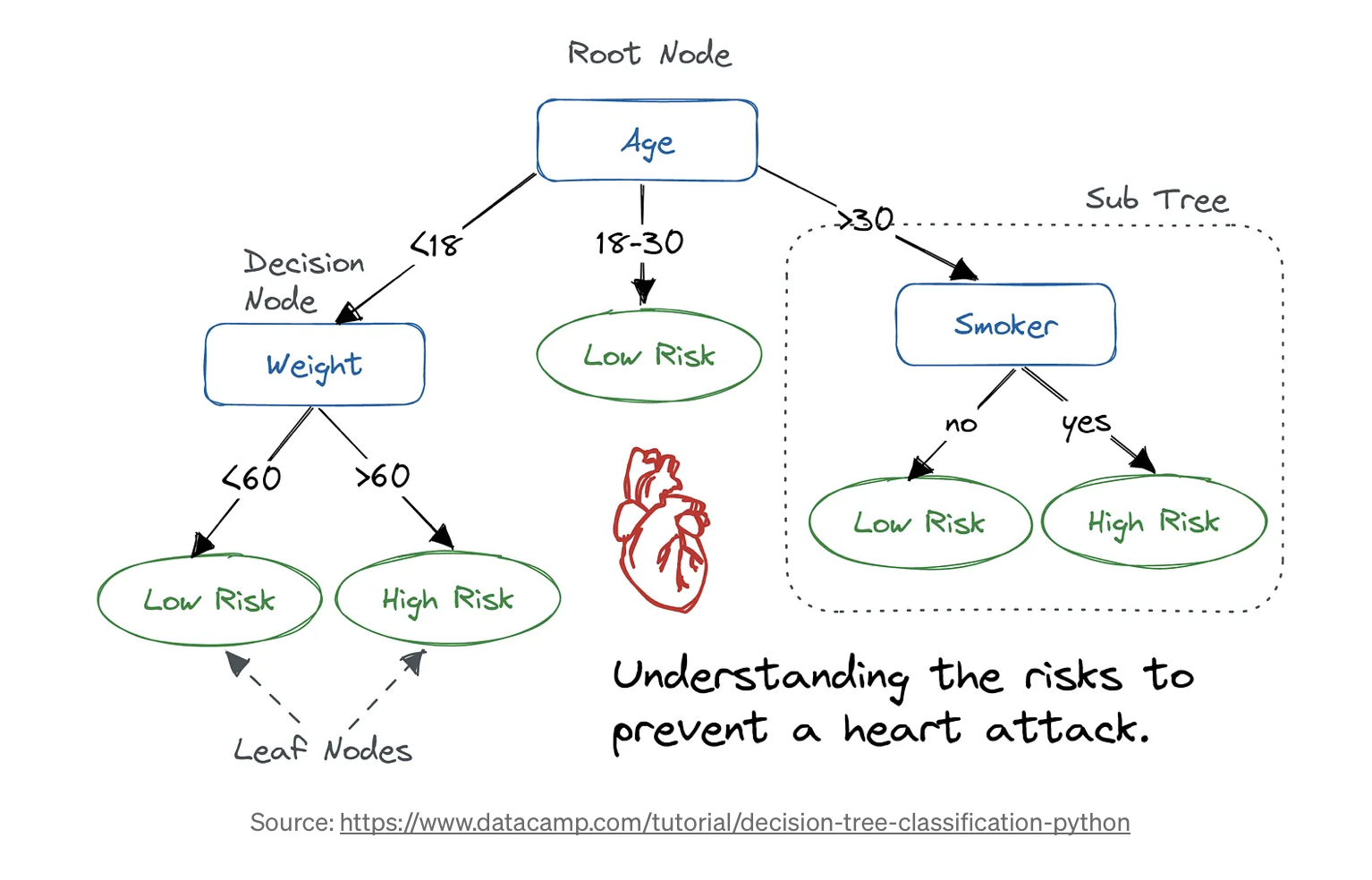
Simple Decision Trees
Allows for analysis of non-linear problems
Doesn’t handle linear problems well
Easier interpretability
At risk of over fitting
Interpretable AI

Slide 17
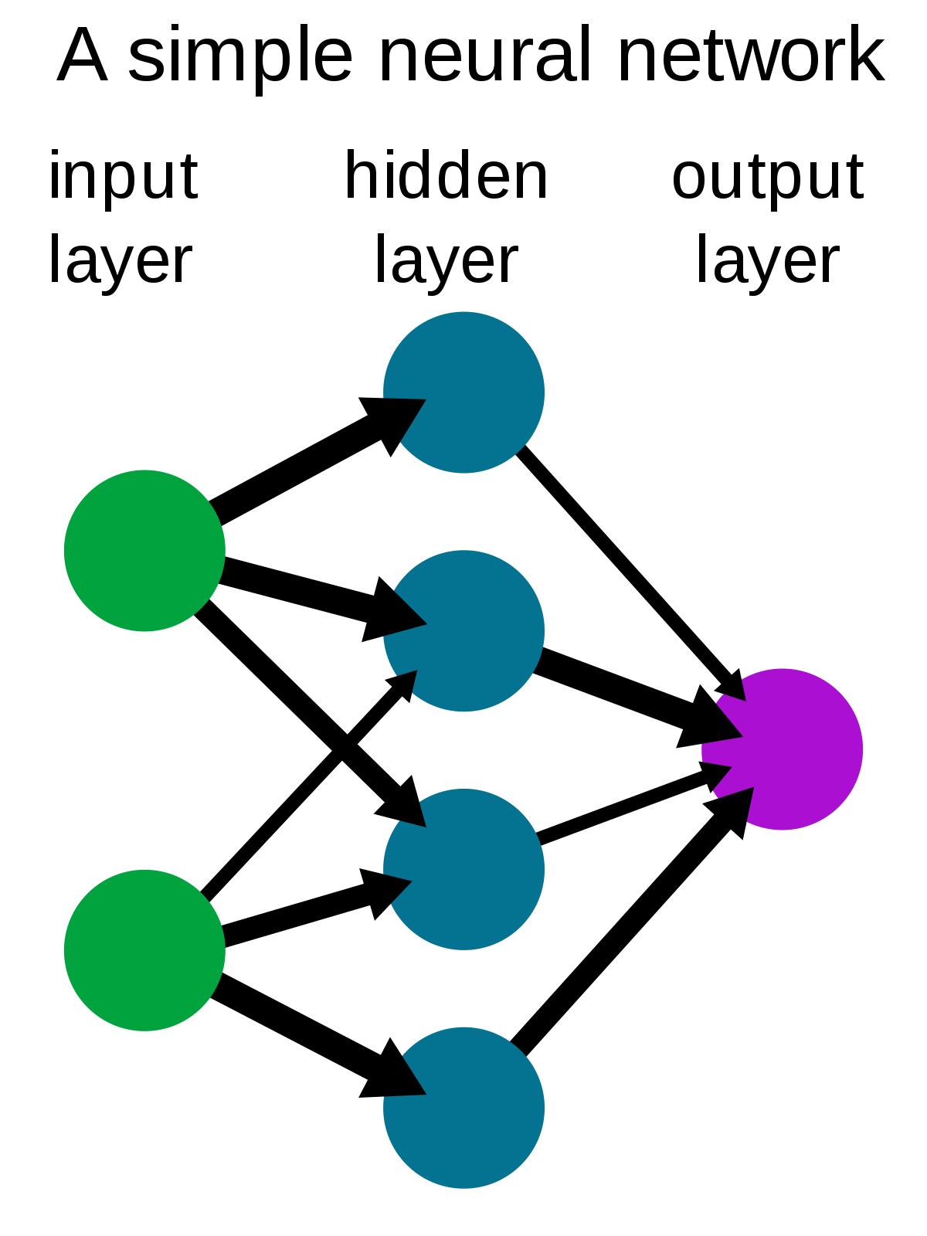
Machine
Learning
Allows for “complex” analysis of non-linear problems
Can adjust the number of hidden layers, inputs, and outputs
Poor physician acceptance and uptake based on “black box” answers
Notes:
Quick example of why AI algorithms can be confusing and not explainable.
ML algorithm is setting the weights of the hidden layer in a trial and error fashion to optimize the output of interest

Slide 18
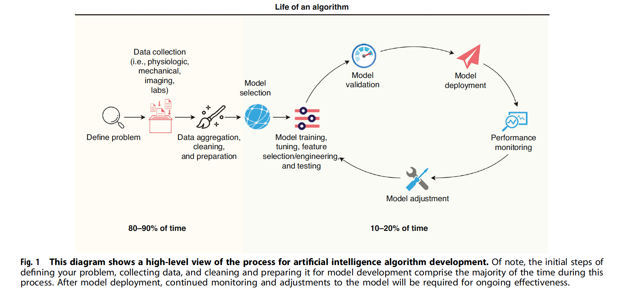
Life Cycle of Prediction models

Slide 19
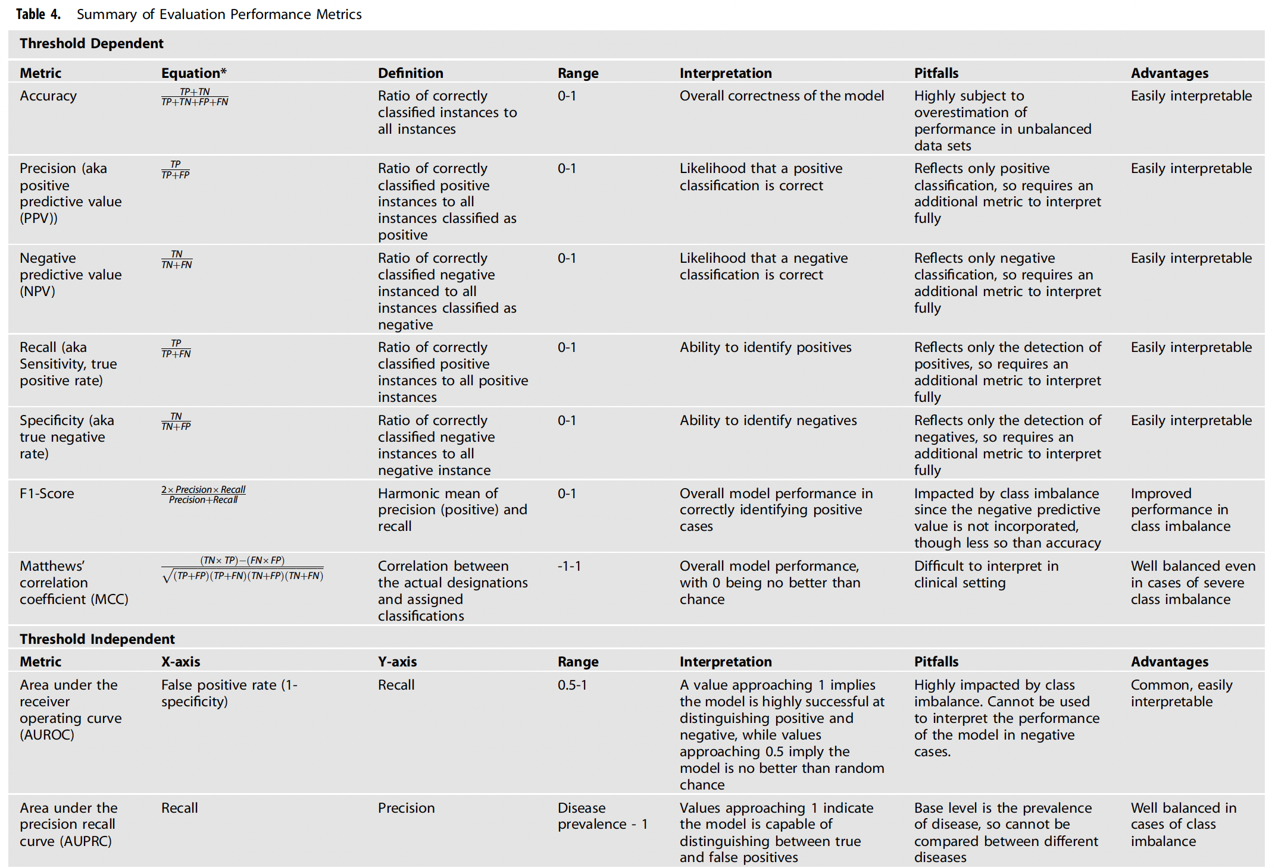

Slide 20
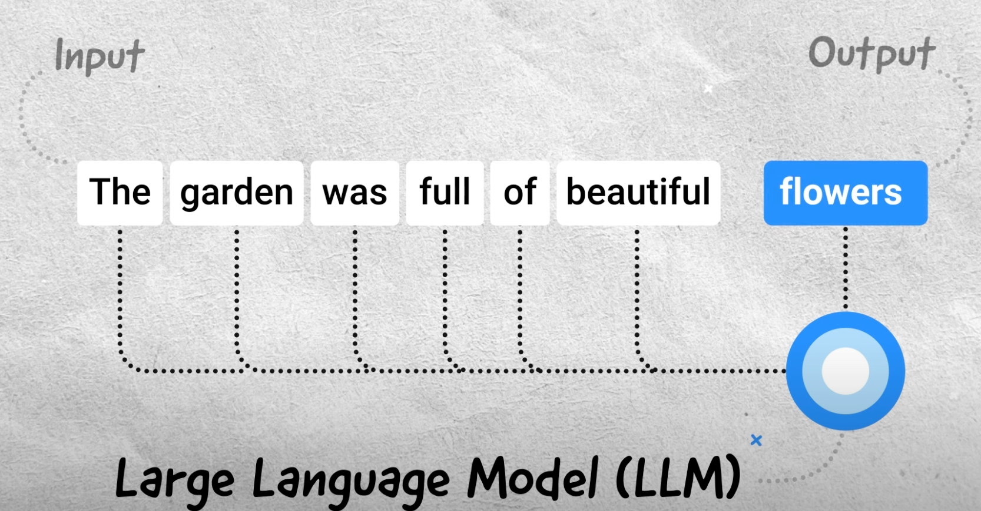

PROBABILITY

Slide 21
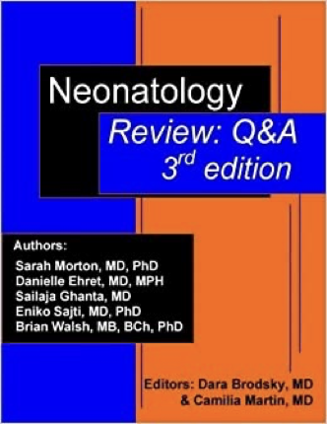
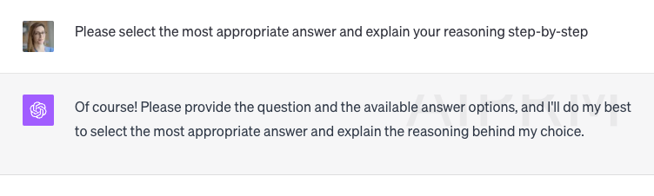
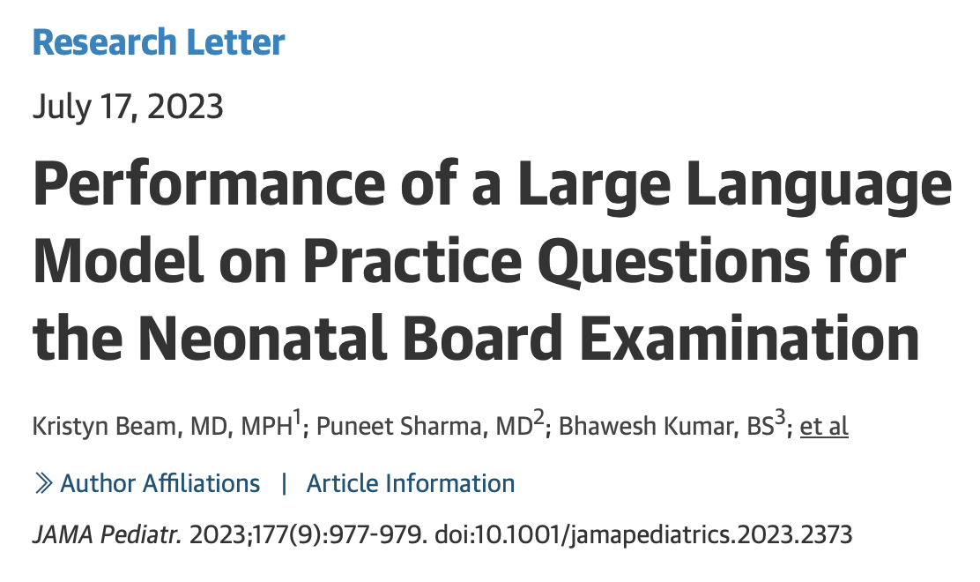
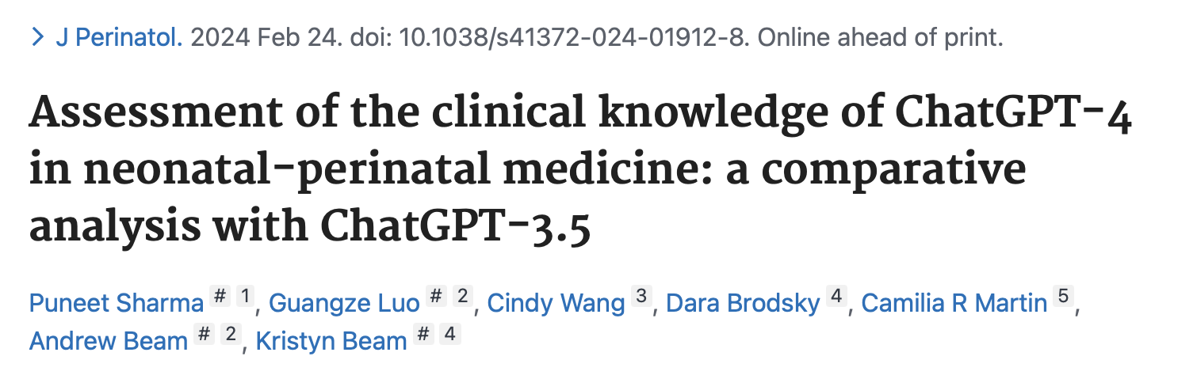
ChatGPT for Neonatology
ChatGPT (3.5) got 45% of the questions correct
ChatGPT (4) got 70% of the questions correct

Slide 22
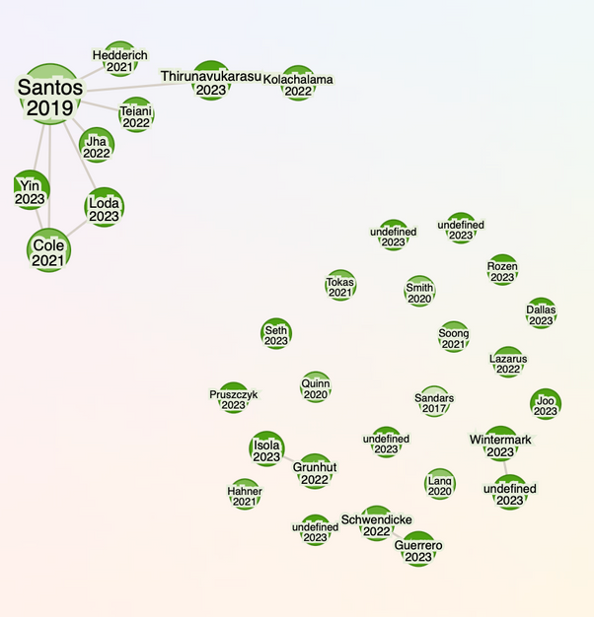
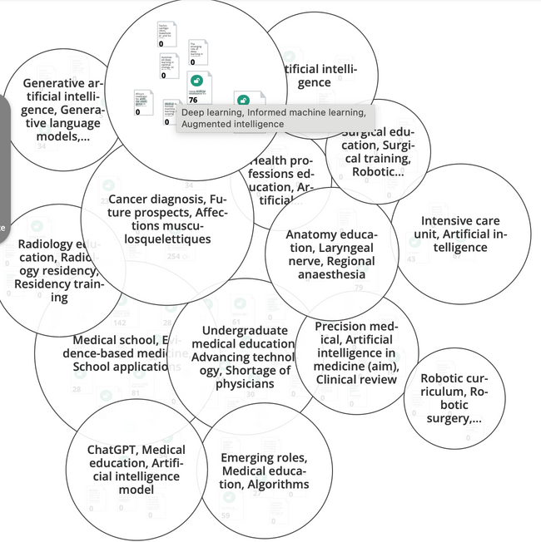
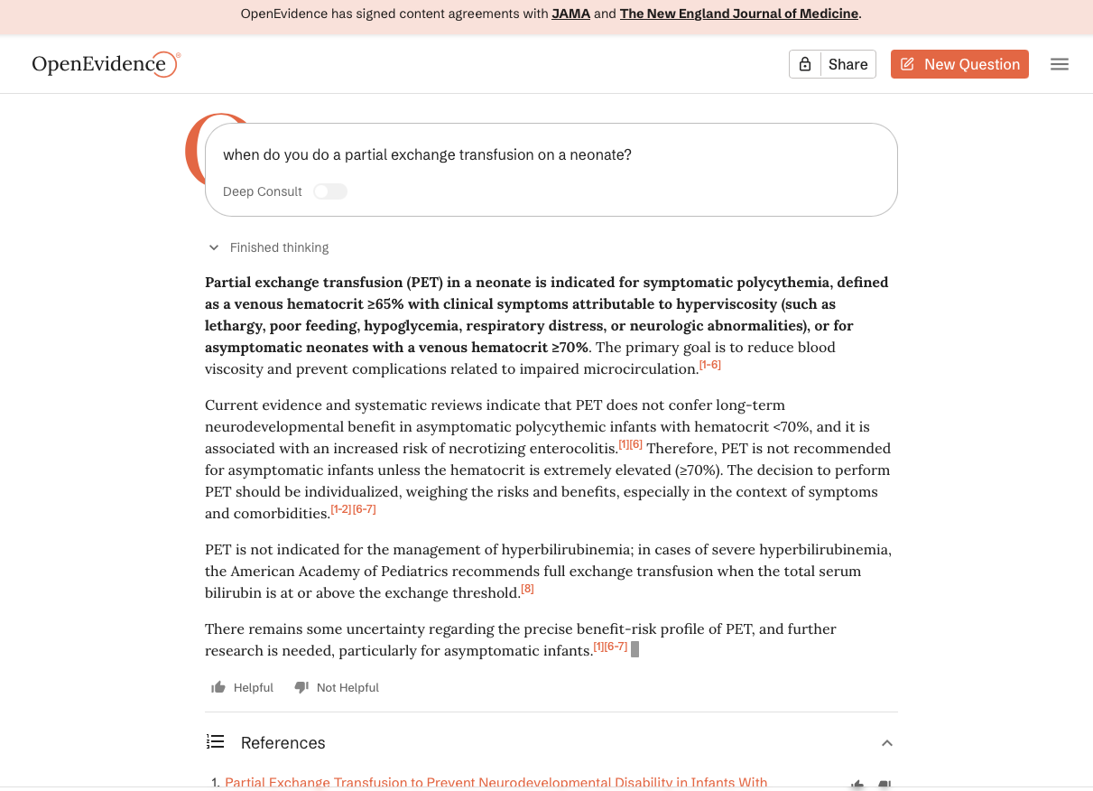
Literature Reviews
research rabbit
open knowledge maps
open evidence
Notes:
When I asked open evidence about most recent data the papers were still 2010 Cochrane reviews. Meaning likely all the old RCTs are old with no new data.

Slide 23
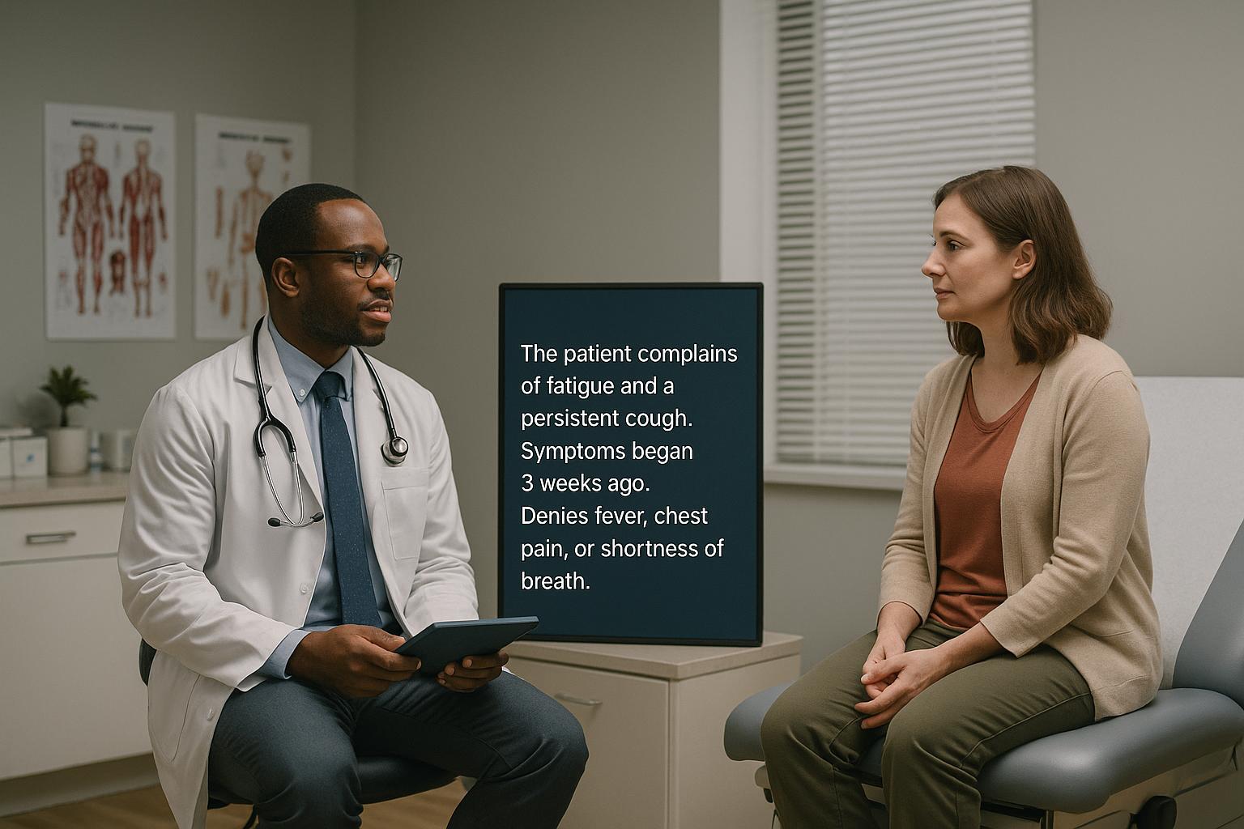
Ambient AI
Image generated by ChatGPT 5 (10/16/25)

Slide 24
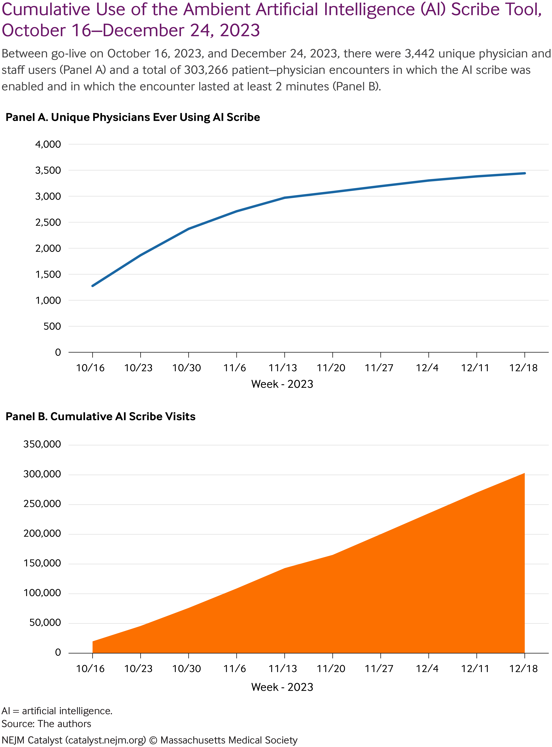
What is Ambient AI?
In 2025, approximately 90 commercial platforms
Fastest growing new technology
The magnitude of burnout reduction with ambient AI is comparable to that achieved with human scribes
Notes:
Approximately 90 commercial platforms as of 2025

Slide 25
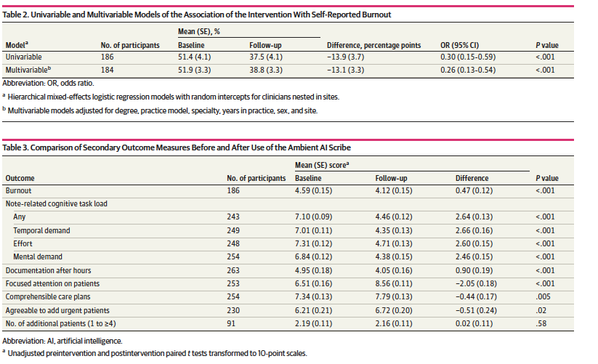
Multi-center QI Study on Clinician Experience
Decreased Burn out!
Decreased Cognitive Load
Decreased Documentation Time (10.8 minutes saved per workday)
Slightly More agreeable to more patients?
Notes:
This was after 30 days of abient scribe use
10

Slide 26
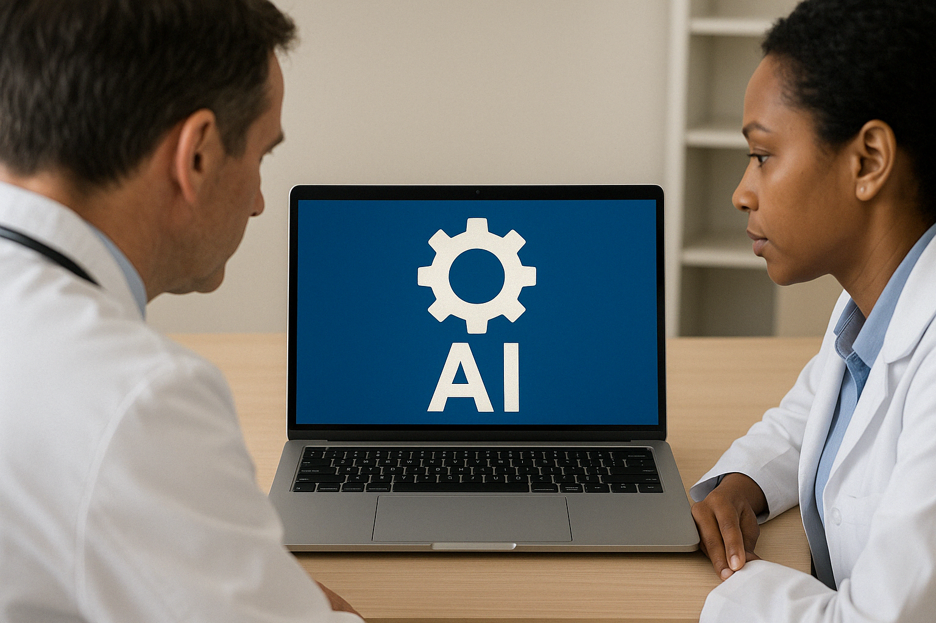
AI Integration in EHR
Image generated by ChatGPT 4o (4/21/25)

Slide 27
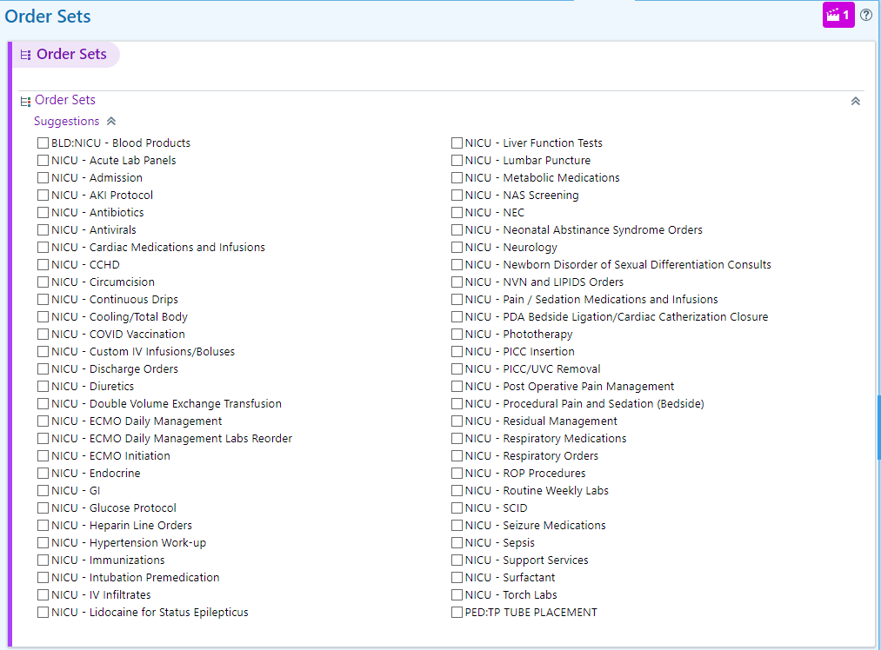
Ordersets as Clinical Decision Support

Slide 28
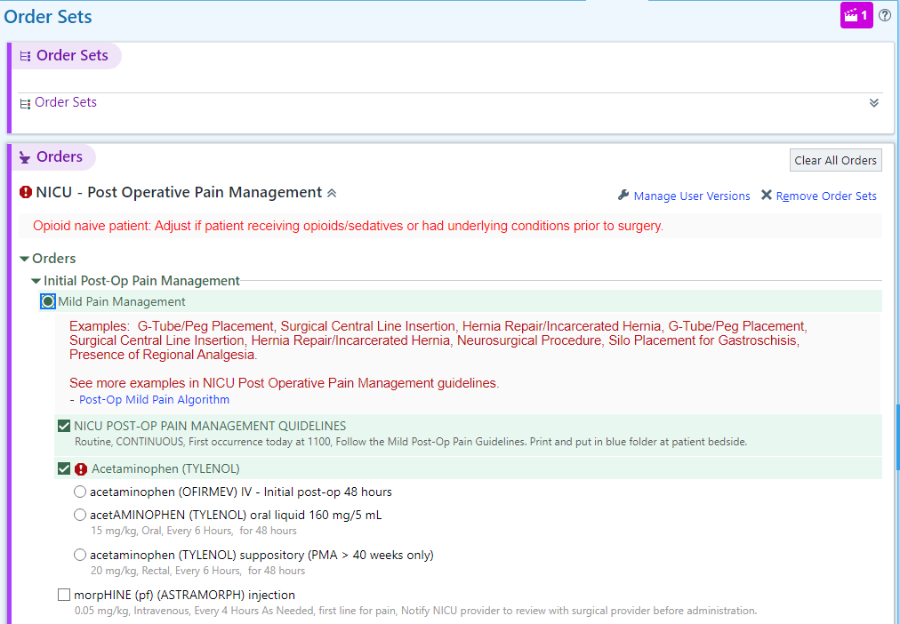
With Links to Protocols and Help Text

Slide 29
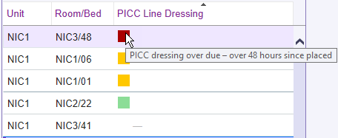
Patient List as a form of CDS
Knake et al. Successfully Transitioning an Interruptive Alert into a Noninterruptive Alert for Central Line Dressing Changes in the Neonatal Intensive Care Unit. Applied Clinical Informatics. 2024.

Slide 30
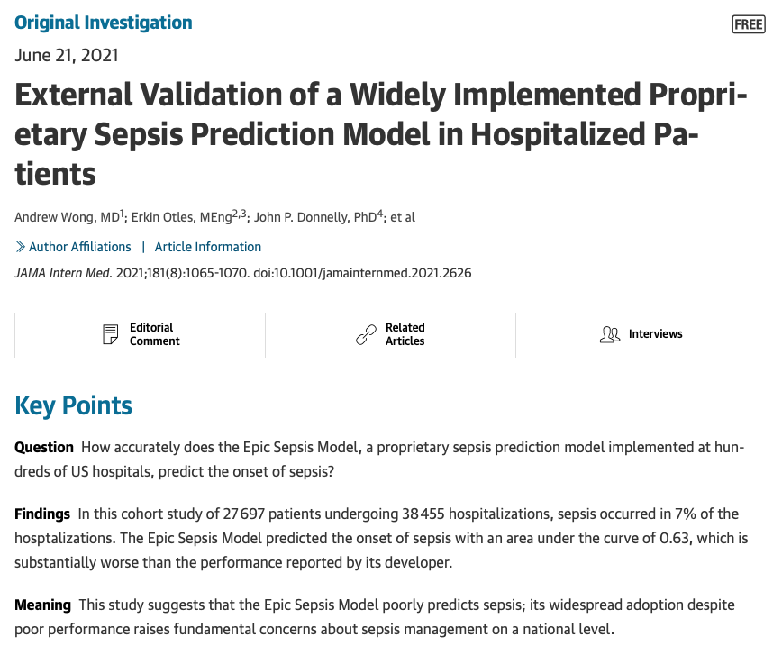
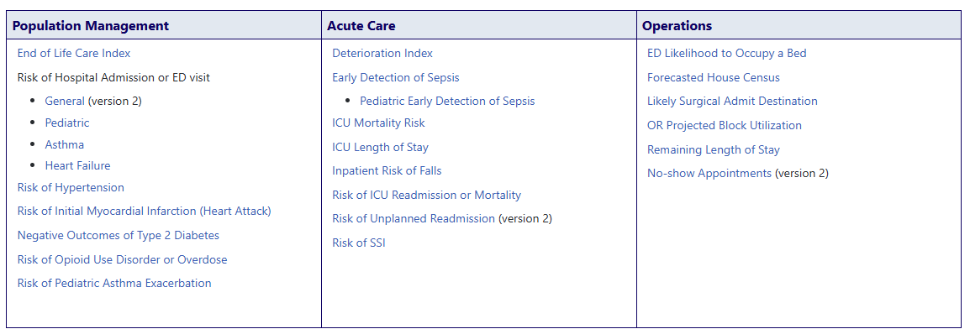
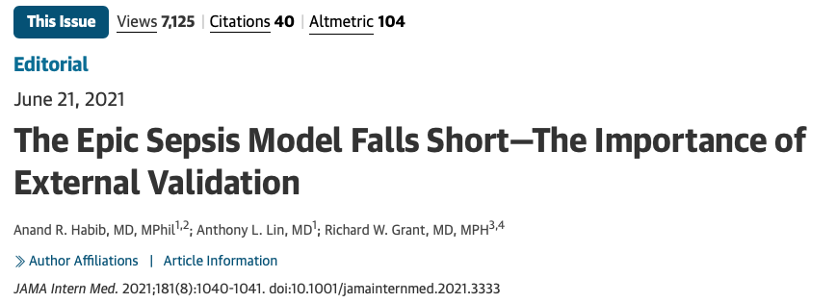
Epic Prediction Tools
Notes:
Not many pediatric models and version 2.0 of sepsis

Slide 31
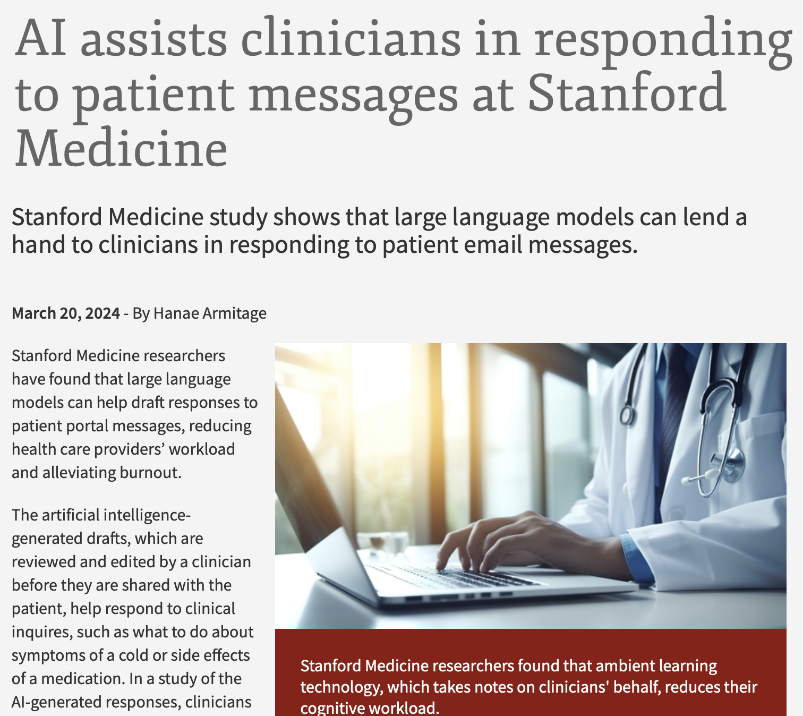
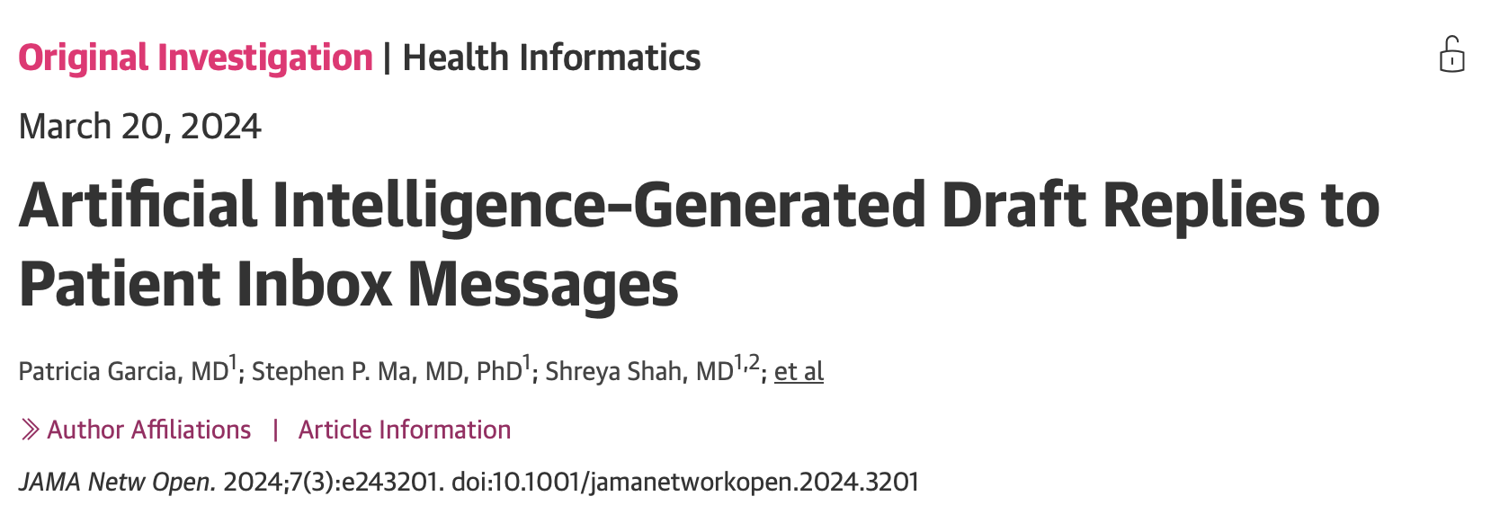
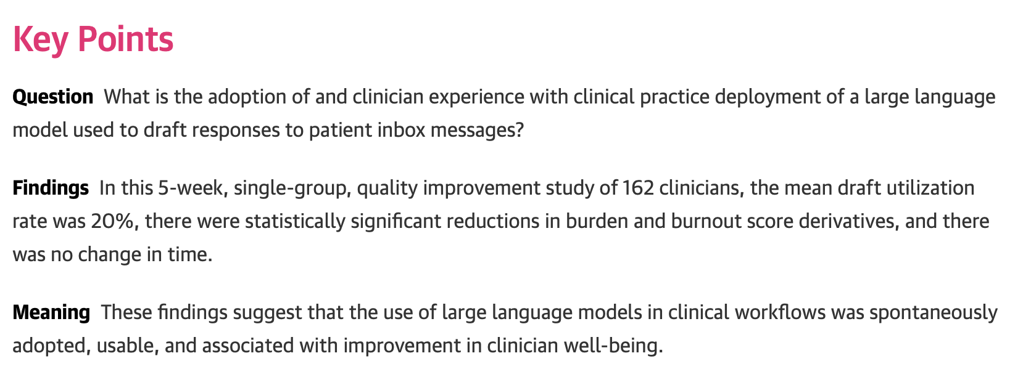
Future Direction for LLMs in EHRs

Slide 32
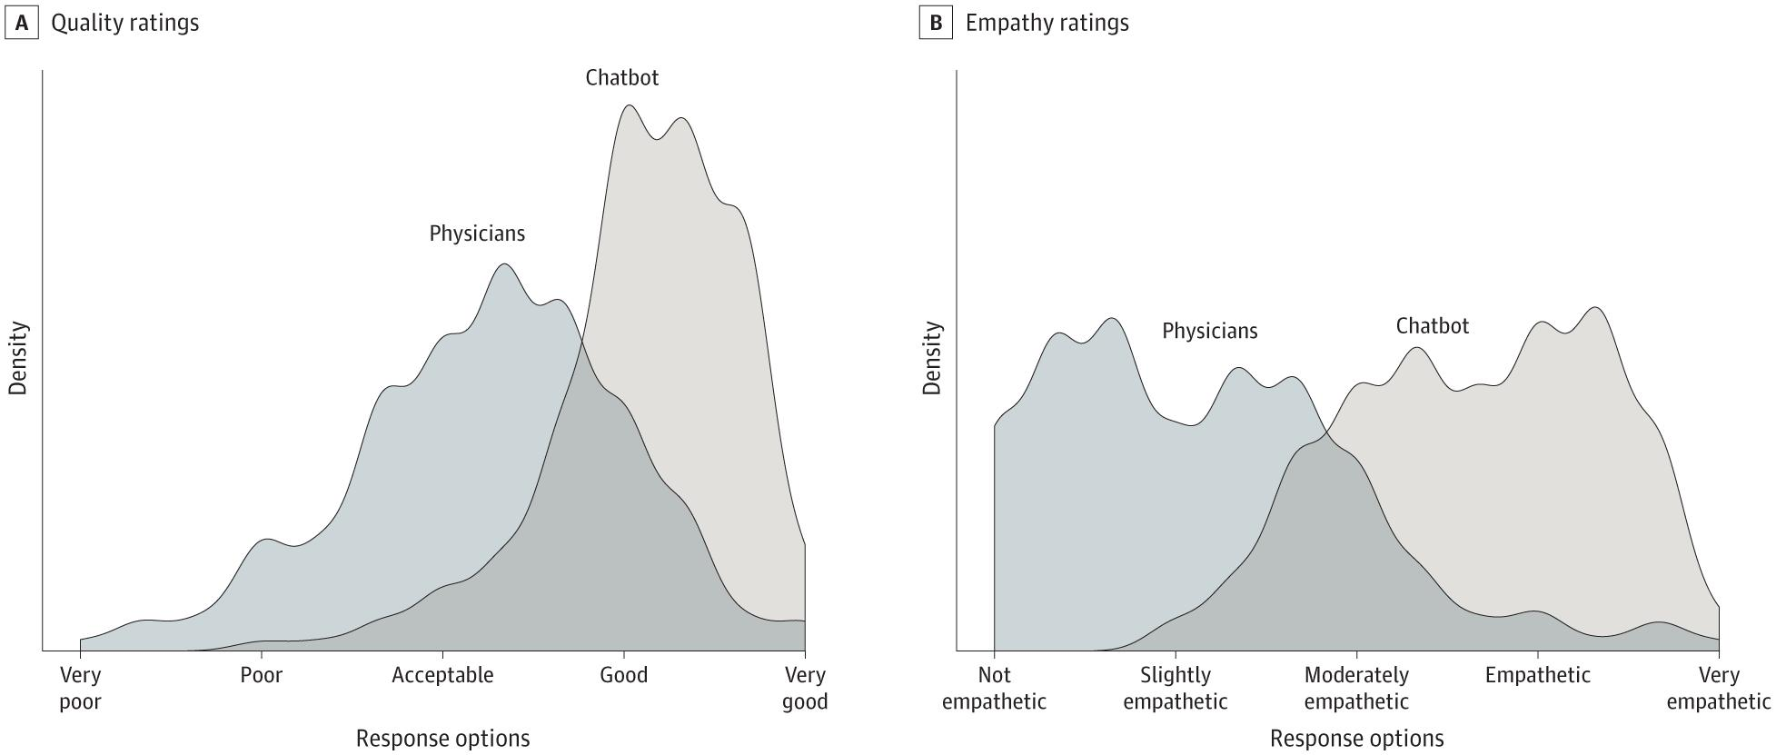
Chatbots are Empathetic
Notes:
A quality improvement study at NYU Langone Health found that GenAI-drafted responses to patient messages were rated higher for communication style and empathy than those written by clinicians, with usable GenAI responses more likely to be described as empathetic and using more subjective and positive language.^{[19]} However, GenAI responses were also more complex and less readable, which may hinder effective communication for patients with low health or English literacy.

Slide 33
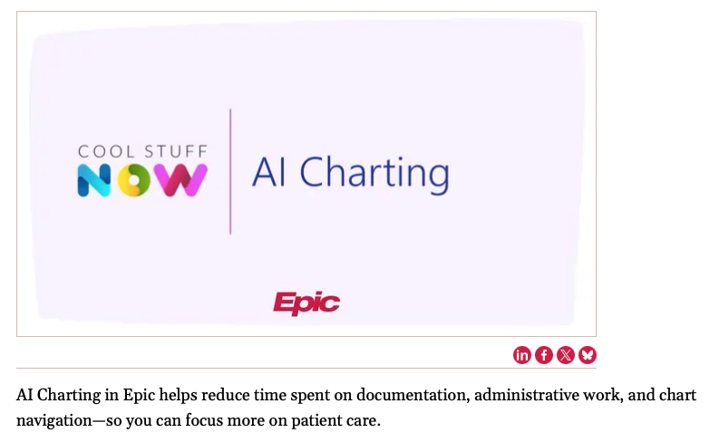
Epic AI suite – Announced at 2025 UGM meeting
Art – new scribe and Clinical AI assistant (chart summarization, problem list entry, etc.)
Emmie – a patient-facing Chatbot
Penny – a Revenue management assistant

Slide 34

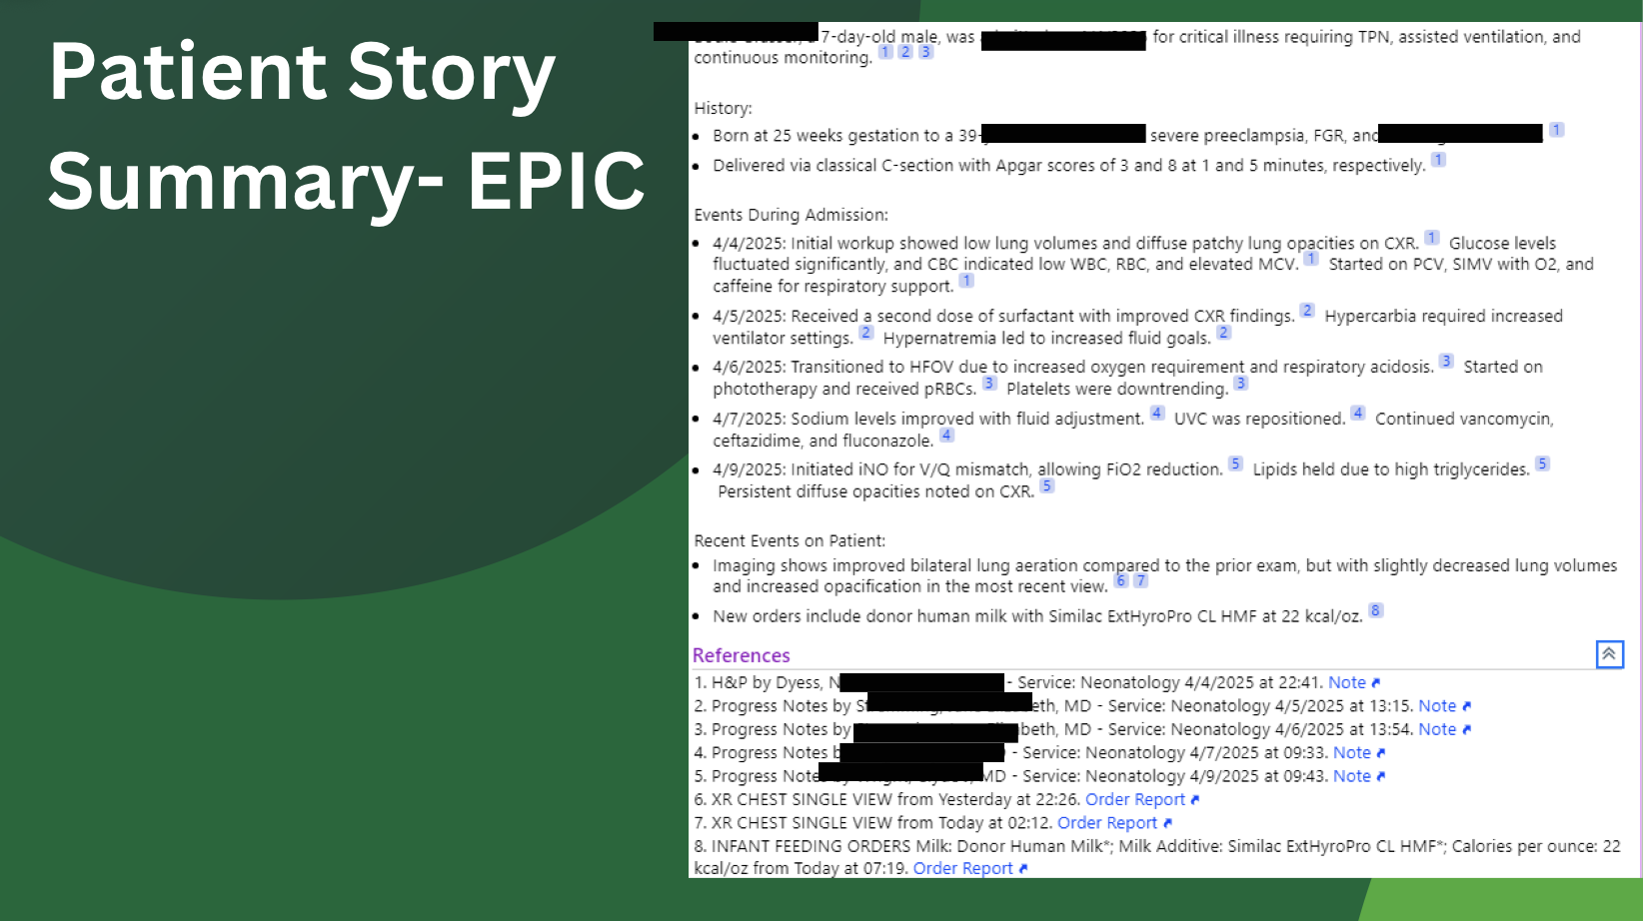
Epic’s Version of a Patient Summary

Slide 35
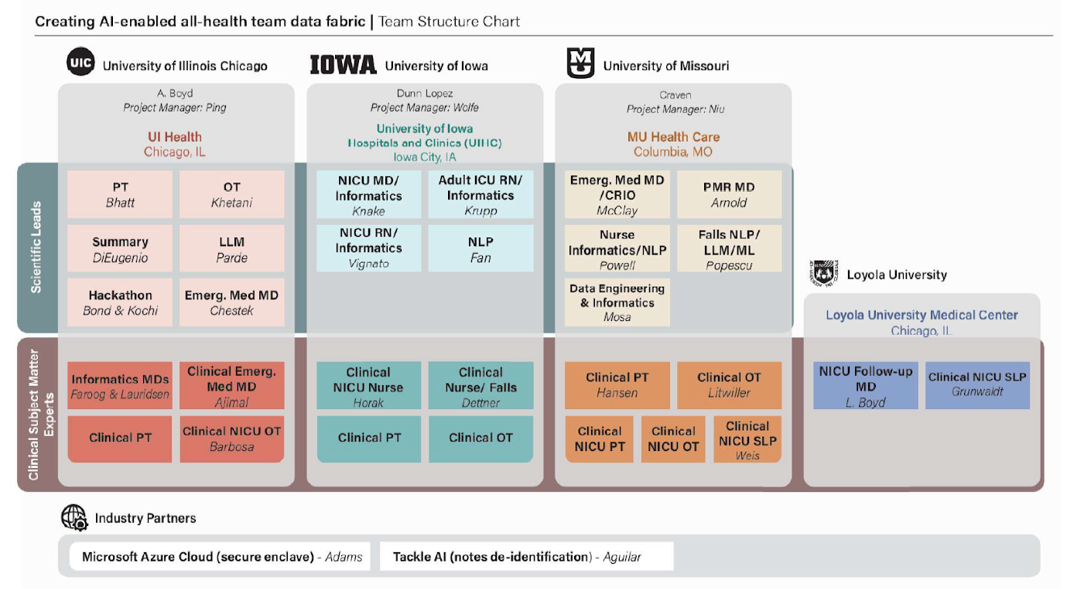
ARPA-H Grant
Notes:
Advanced Research Projects Agency for Health (ARPA-H) is a research funding agency that supports transformative biomedical and health breakthroughs – ranging from the molecular to the societal – to provide health solutions for all.
New Federal agency hosted in HHS and NIH authorized in Fiscal Year 2023
Follow on the model of DARPA, ARPA-E, and BARDA,
High risk, High reward research
DARPA example, connecting two computers to talk, first push for self driving cars in competition.

Slide 36
AI-Powered Healthcare at UIHC: Evidently and Nabla

Slide 37
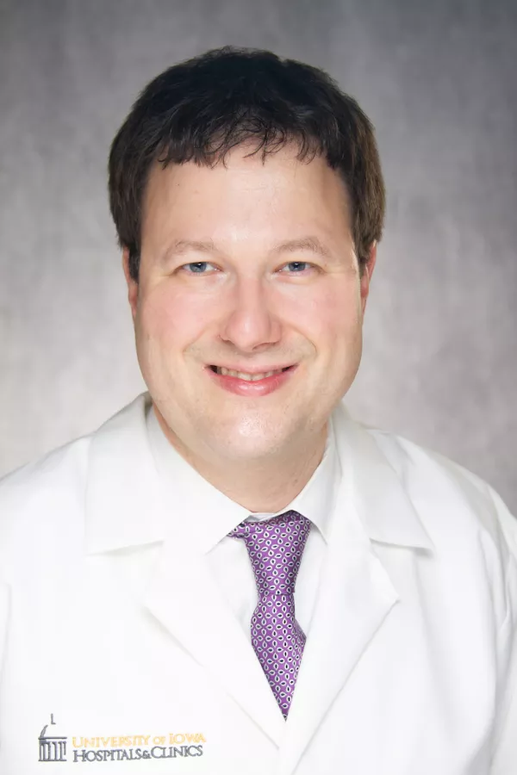
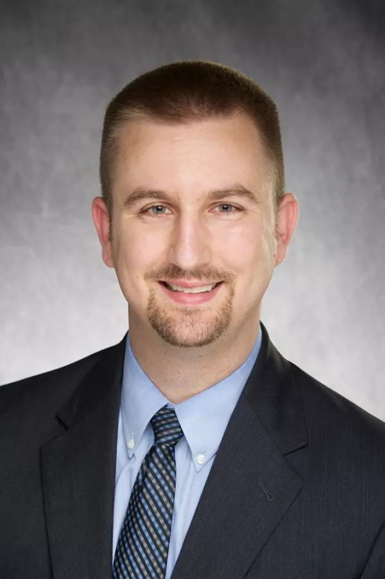

Iowa Pediatric AI Implementation Team
James Blum, MD
Chief Health
Information Officer
Anesthesia
Jason Misurac, MD, MS
Associate Chief Health
Information Officer
Pediatric Nephrology
Lindsey Knake, MD, MS
Associate Chief Health
Information Officer
Pediatrics/Neonatology
Chair of Clinical AI Task Force

Slide 38



Ambient AI Scribe: Nabla
Patient-Clinician conversation
Transcription and extraction
Note generation and formatting
Notes:
Real-time transcription of encounter
No recording of the conversation is created or stored
Note generated within 60 seconds of completing visit
Available on mobile device (iOS and Android) or desktop
Epic integration allows export of Nabla text to SmartPhrase (.NABLAHPI, for example)
Multiple note templates allow tailoring of notes
“Magic edit” allows notes to be regenerated with instructions
Patient permission (not consent) before each visit

Slide 39



Trial of Nabla at UIHC
Misurac, Knake, Blum. The Effect of Ambient AI Notes on Provider Burnout. Applied Clinical Informatics. 2024

Slide 40
Quotes from Users
Clinicians may lose their typical voice or note template but maybe worth the trade-off
“When I get to make eye contact, well, that's a positive reinforcer. I was like, wow, I really enjoyed that conversation [with the patient]. And I didn't have to spend it typing. And then these few minutes of rest in my brain while I'm confident that [the ambient scribe] is at least going to remind me of all the important details”
“It's not exactly like the words I would choose to write in the note, but it has the same exact meaning, and I think that's been more important to me than, like, making it my own, is that, like, I'm—, it's still conveying the exact same information that I would convey, and it really, I think, has improved that relationship with the patient, right? I just feel more present with them”
“[The ambient scribe] is not my voice, right? [The ambient scribe] is a very different voice from my voice. My notes have a certain voice … And so when I read the note, it doesn't sound like me. But in the interest of efficiency, I'm OK. It’s fine. I mean, let's get the note done” (Participant 18).

Slide 41
Key Points from Interviews
Clinicians report improved patient presence and perceived efficiency
Focusing on document types that work better with Nabla templates help reduce clinician frustration
  Not great with highly templated notes or procedures
Onboarding that pairs super-users with novices or short office hours may help clinicians calibrate length, salience, and tone

Slide 42

Neonatology Rounds
Ambient AI
NICU Note Template
Subjective:
BB, a 1-day-old male, was born weighing 880 grams. Fluid management is being adjusted, with a focus on sodium and dextrose levels. There are no current concerns regarding respiratory status. The only noted risk factor for infection is a bulging bag at presentation, but it was intact until delivery, indicating cervical insufficiency.

Slide 43

Neonatology Rounds
Ambient AI
NICU Note Template
RDS (respiratory distress syndrome in the newborn)
- RDS managed with surfactant therapy. Current chest X-ray is the best in the unit, and the baby is on no respiratory settings.
- Monitor respiratory status. Consider extubation to NIPPV or Nava in the future, but no immediate changes planned to allow PDA to declare itself.
Neonatal hypoglycemia
- Glucose levels trending down. Current glucose infusion rate (GIR) is suboptimal for basal needs.
- Increase dextrose delivery by starting a D20 piggyback at 0.5 mL/hour. Plan to increase dextrose further tonight if sodium levels tolerate. Consider adjusting UAC fluids to maintain nutritional balance.
Need for observation and evaluation of newborn for sepsis
- Risk factors for infection include bulging bag at presentation, though it was intact until delivery.
- Obtain CBC and CRP tomorrow (48 hours post-delivery).

Slide 44


Prenatal Consult
Ambient AI
NICU Note Template

Slide 45


Family Meeting
Still needs MD summarization at the end but captured much of the conversation!
Notes:
-First question I asked the family is what are you concerned about.
-summarized the thoughts at the end about not wanting her to be on long term medications

Slide 46
Informal Conclusions
Many Ambient AI technologies are out there
  Work with your legal team to determine what is the correct path
Ambient AI Tech is usually providing free usage to trainees
  Graduates will have the expectation that technology will be there to help them
Must still give encouragement and feedback to trainees to know how to write and evaluate clinical notes

Slide 47
Evidently: Medical Record Summarization

Slide 48


Evidently
Accessed within Epic:
Patient highlights:
Notes:
Cognitive AI platform
Concept identification and tagging throughout EHR
Generates cohesive Epic-embedded view of patient data from:
UIHC
CareEverywhere
Media tab
Creates customizable problem-oriented views
Creates AI overview of patient for rapid chart review

Slide 49

Evidently
AI patient summaries: “patient 2-liner”

Slide 50

Prenatal Consult Example

Slide 51



Evidently
Quickly find the source of the data:

Slide 52

AI tools in Medical Education
Image generated by ChatGPT 5 (10/16/25)

Slide 53


Medical Education
RISKS:
de-skilling (over-dependence on AI)
mis-skilling (uncritical reliance on AI)
never-skilling (AI displaces skill acquisition)
Abdulnour RE, Gin B, Boscardin CK. Educational strategies for clinical supervision of artificial intelligence use. N Engl J Med. 2025 Aug 21;393(8):786-797.

Slide 54


UpToDate Expert AI

Slide 55
A 45-year-old M patient with asthma and allergies is having worsening cough at night.
Should he call his doctor and get an appointment?
Or ask ChatGPT what to do?
What may be the risk or benefits of asking an LLM for medical advice?
How should we talk to our patients about using this new technology?

Slide 56

ChatGPT 5 answer (10/1/25)

Slide 57

Final ChatGPT Differential

Slide 58
Are patients already doing this and using it?
Yes Absolutely!
We all need to start thinking about how to talk to our patients about AI technologies and how to warn them about the risks/benefits

Slide 59

AI for Personal Help
Image generated by Microsoft CoPIlot (7/7/25)

Slide 60

Top 10 list from ChatGPT
Notes:
Microsoft co-pilot meeting summarization!
Emails and letter writing assistance!

Slide 61



House Projects

Slide 62


Trip Planning and Surviving Kid Activities

Slide 63



Fellowship Goals and Objectives
Image generated by ChatGPT 4o (5/21/25)

Slide 64
How to get involved and learn more
Start trying to use it!
  Talk with you institution about rules and options
Ask AI how to use AI
Ask your friends and colleagues
Advocate for your hospital system
Take online courses to learn more
Image generated by Microsoft CoPIlot (7/7/25)

Slide 65

Informatics Training Opportunities
Image generated by ChatGPT 4o (4/21/25)

Slide 66
Clinical Informatics Fellowship at Iowa
2-year Clinical Informatics fellowship open to residents or fellows of all specialties
  20% clinical time in primary specialty (open to moonlighting)
  80% rotation time with CIO, CMIO, clinical informatics, data analysts
    Become certified Epic Physician builder
    Learn how to take informatics projects from start to finish in the institution
    Learn data analytic skills
    Required Informatics capstone project with presentations and publications

Slide 67

Combined Fellowships

Slide 68



Questions?
“The future directions of artificial intelligence and clinical decision support for doctors to predict extubation success in neonates” created by DALLE and ChatGPT
NeoMINDAI.com
Lindsey-knake@uiowa.edu
Lindsey Knake MD, MS
Assistant Professor
Associate Chief Health Information Officer
@lindseyknake
@lindseyknake
Notes:
NeoMIND-AI pre-conference session

Slide 69

AI Device Integration
Image generated by ChatGPT 4o (4/21/25)

Slide 70



Open vs Closed Loop FiO2 Control
Notes:
First example was “proof of concept open loop control”
Short-term feasibility studies have been done with closed-loop control of inspired oxygen
More effective at keeping the FiO2 within target range
This technology is already available in the Netherlands and is being tested using two different controllers (important for ROP and hyperoxia)
Clio algorithm SpO2 target rangne 90 -95% Oxygenie narrower range 91-95% (slightly different algorithm design)
- Oxygenie had less lazer treatment for ROP, shorter durations of therapy (fewer days requiring cpap or MV support also0
-another field of nursing informatics to try to help make nursing charting and practices better

Slide 71


Closed loop for automated weaning
Chatburn, Mireles-Cabodevila. Closed-Loop Control of Mechancal Ventilation:Description and Classification of Targeting Schemes. Respiratory Care. 2011.
Notes:
This looks scary: OMG engineering diagram!
Control circuit for an adaptive pressure targeting scheme (eg, Pressure Regulated Volume Control). The controller is designed so that inspiratory pressure relative to PEEP (IP) is adjusted to meet the target tidal volume, given changes in resistance (R), compliance (C), and volume (V_{mus}) generated by patient effort (P_{mus}). IP will increase if R increases or C decreases. IP will decrease if V_{mus} increases. T_{I} = inspiratory time

Slide 72



Closed Loop FiO2 Control
Study (Year) | Patient Population & Setting | Design | Time in Target SpO₂ Range | Hypoxemia/Hyperoxemia | Other Outcomes
Claure et al. (2001)​pubmed.ncbi.nlm.nih.gov​pubmed.ncbi.nlm.nih.gov | 14 VLBW infants on ventilators (GA ~25 wks); frequent desats | 2×2 hr crossover (auto vs. manual with dedicated nurse); SpO₂ target 88–96% | 75% vs 66%of time in target (cLOx vs manual; P<.05) | Hypoxemic episodes <88%: ~15/hr both; hyperoxemic >96%: 10 vs 13/hr (slightly fewer with auto); shorter episode duration with auto | Nurse made 29 adjustments/hr manually vs auto adjusting continuously. Concluded cLOx as effective as a 1:1 nurse in maintaining saturations.
Urschitz et al. (2004)​researchgate.net | 20 preterm infants (ventilated/CPAP) in NICU | Randomized crossover 4–12 hr (manual vs auto FiO₂; CLiO₂ system) | 90.5% vs 81.7% in target range (P<.001) | Fewer deviations outside range with auto; both hypo- and hyperoxemia reduced under CLiO₂ | First CLiO₂ prototype trial. Demonstrated feasibility and ~9% improvement in normoxemia time with closed-loop control.
Hallenberger et al. (2014)​pubmed.ncbi.nlm.nih.gov​pubmed.ncbi.nlm.nih.gov | 34 preterm infants on ventilator or CPAP (multicenter) | 24 h crossover (manual vs CLACsupport); targets per unit protocol (90–95% typical) | 71.2% vs 61.4%median time in target (P<.001) | Fewer desaturation events and less overshoot reported with CLAC | Manual FiO₂ adjustments reduced (52 vs 77 median per 24h, P=.007). Concluded automated control improved SpO₂ stability and eased workload​pubmed.ncbi.nlm.nih.gov​pubmed.ncbi.nlm.nih.gov.
Zapata et al. (2014)​pubmed.ncbi.nlm.nih.gov​pubmed.ncbi.nlm.nih.gov | 20 ELBW infants on oxygen (no ventilation) | 12 h RCT (parallel groups: Auto-Mixer® device vs manual); target 85–93% | 58% vs 33.7% in target (P<.05) | Hyperoxia (SpO₂ >95%): 26.5% vs 54.8% of time (auto vs manual); brief SpO₂ <85% dips occurred slightly more often with auto | Avg SpO₂ was lower with auto (89.8% vs 92.2%), indicating avoidance of oversaturation​pubmed.ncbi.nlm.nih.gov. No manual interventions needed in auto group vs ~80 adjustments in 12h manually.
van Kaam et al. (2015)​pubmed.ncbi.nlm.nih.gov​pubmed.ncbi.nlm.nih.gov | 50 preterm infants (ventilated or CPAP) in 8 NICUs | 24 h crossover (manual vs auto; evaluated at two SpO₂ target ranges 89–93% and 91–95%) | Lower target:62±17% vs 54±16%; Higher target:62±17% vs 58±15% in range (P<.001 for both) | Time <80% SpO₂ (hypoxemia) reduced with auto at both targets; time >98% SpO₂ (extreme hyperoxia) reduced with auto in low-target group​pubmed.ncbi.nlm.nih.gov​pubmed.ncbi.nlm.nih.gov | Benefits were similar on invasive vs noninvasive support. Automated control significantly cut hypoxemic time in all scenarios. Manual FiO₂ changes reduced during auto control.
Plottier et al. (2017)​pubmed.ncbi.nlm.nih.gov​pubmed.ncbi.nlm.nih.gov | 20 preterm infants on CPAP/high-flow (Tasmania) | 4 h auto period vs two 4 h manual periods (before/after); PID algorithm (OxyGenie prototype) | 81% vs 56%median time in target or in room air (P<.001) | Time spent in hypoxemia and hyperoxemia both reduced; prolongeddesats/oversats “virtually eliminated” under OxyGenie​pubmed.ncbi.nlm.nih.gov​pubmed.ncbi.nlm.nih.gov | Each infant showed improvement with auto. Manual adjustments fell from 2.3 per hr to 0.24 per hr. O₂ use was unchanged, indicating better efficiency(no extra O₂ needed)​pubmed.ncbi.nlm.nih.gov​pubmed.ncbi.nlm.nih.gov.
Reynolds et al. (2019)​vapotherm.com | 17 preterm infants on high-flow nasal cannula (UK) | 8–12 h crossover (IntellO₂ automated vs manual); target 90–95% SpO₂ | 80% vs 49%median time in target (P<.0001) | Fewer prolonged desats: median 0 episodes ≥60s <80% SpO₂ with auto vs several with manual​vapotherm.com; hyperoxic episodes also fewer with auto | IntellO₂ (Vapotherm) maintained saturations significantly closer to target​vapotherm.com. Authors noted 31% absolute gain in time in range and improved stability with automation.
Sturrock et al. (2020)​f.hubspotusercontent00.net​f.hubspotusercontent00.net | 24 extremely preterm infants on ventilators (UK) | 2×12 h crossover (manual vs auto; SLE6000 ventilator with OxyGenie) | Target range adherence ↑ (significantly)with auto (exact % not reported; ~85% vs ~68% estimated) | Desaturations >30s or >60s significantly fewer with auto (P=.03 and .002)​f.hubspotusercontent00.net; manual FiO₂ changes near-zero with auto vs ~11 per 12h manually (P<.001) | No difference in number of blood gas or X-ray checks​f.hubspotusercontent00.net. Concluded closed-loop O₂ yielded fewer prolonged desats and more time in range, without adverse effects​f.hubspotusercontent00.net​f.hubspotusercontent00.net.
Nair et al. Automated Oxygen Delivery in Neonatal Intensive Care. Frontiers in Pediatrics. 2022.
Notes:
Review article with 17 papers
No studies have shown improvements yet in long term outcomes such as ROP, BPD, etc.

Slide 73


Is this coming to the US soon?
No current FDA approval
Still investigational
Still waiting for larger studies looking at improving long term outcomes such as BPD, ROP ,etc.
Only 9% of units in UK are using this technology
Nair et al. Automated Oxygen Delivery in Neonatal Intensive Care. Frontiers in Pediatrics. 2022.
Notes:
-similar to implementing volume targeted ventilation in neonates, it takes time to buy and get used to these new technologies.

Slide 74


How to use Deep Research
Notes:
17 papers were included in the table

Slide 75

Predictive Analytics

Slide 76

SAL20250417

Slide 77


SAL20250417

Slide 78

HeRO Score
Surgical NEC in a 6 day old 30 wk, 900g infant; uncomplicated delivery, advancing feeds

Slide 79

HeRO Score
CPAP, 21% with increasing apnea;
time of blood culture & intubation

Slide 80



Forecasting tools use AI to predict the next value
Bilirubin (NeoPrediX)
PaCO2
(Etiometry T3)
Notes:
Include these examples?

