Slide 1
Basic Fracture Care Principals
OCTOBER 2025
IOWA PA SOCIETY FALL CME
Mary Greve, MPAS, PA-C, MHA
University of Iowa, Department of Orthopedics
Mary-Greve@uiowa.edu

Slide 2
Disclosures
None

Slide 3

Objectives
At the end of this, you should know or be able to:
Basics of early fracture management
Describe fractures accurately
Implement an initial treatment plan
Plan for appropriate follow up

Slide 4
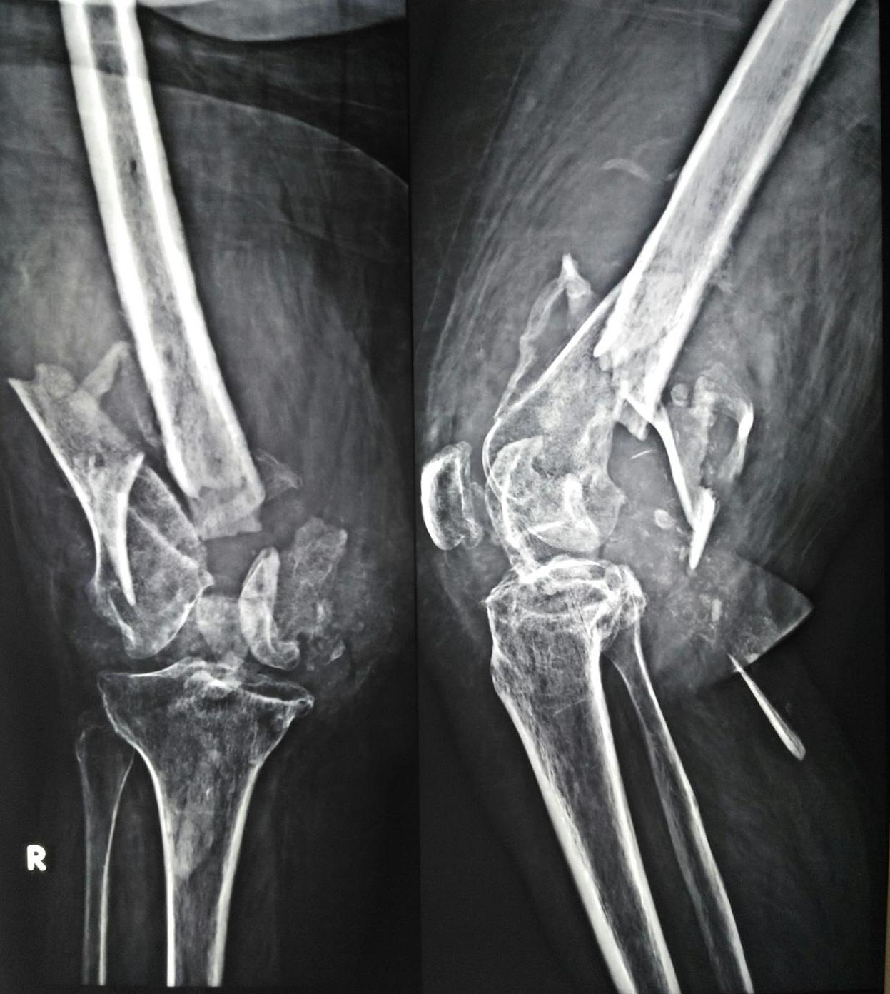
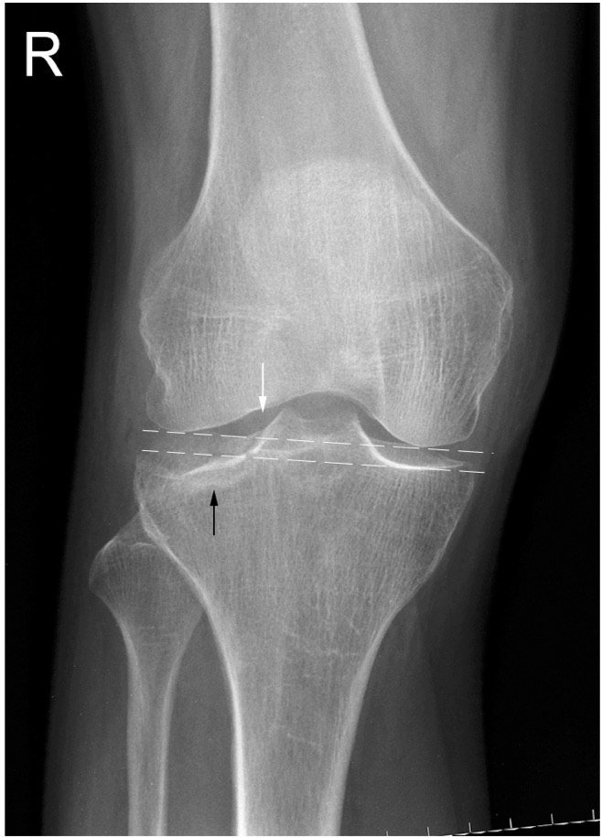
Orthopedic Trauma – There are Fractures….

Slide 5
Where to Start?

Slide 6

History

Slide 7
Basics for a Fracture Workup - History
History
  What was the mechanism of injury?
  When did the injury occur?
  For lower extremity injuries – Can the patient weight bear?

Slide 8
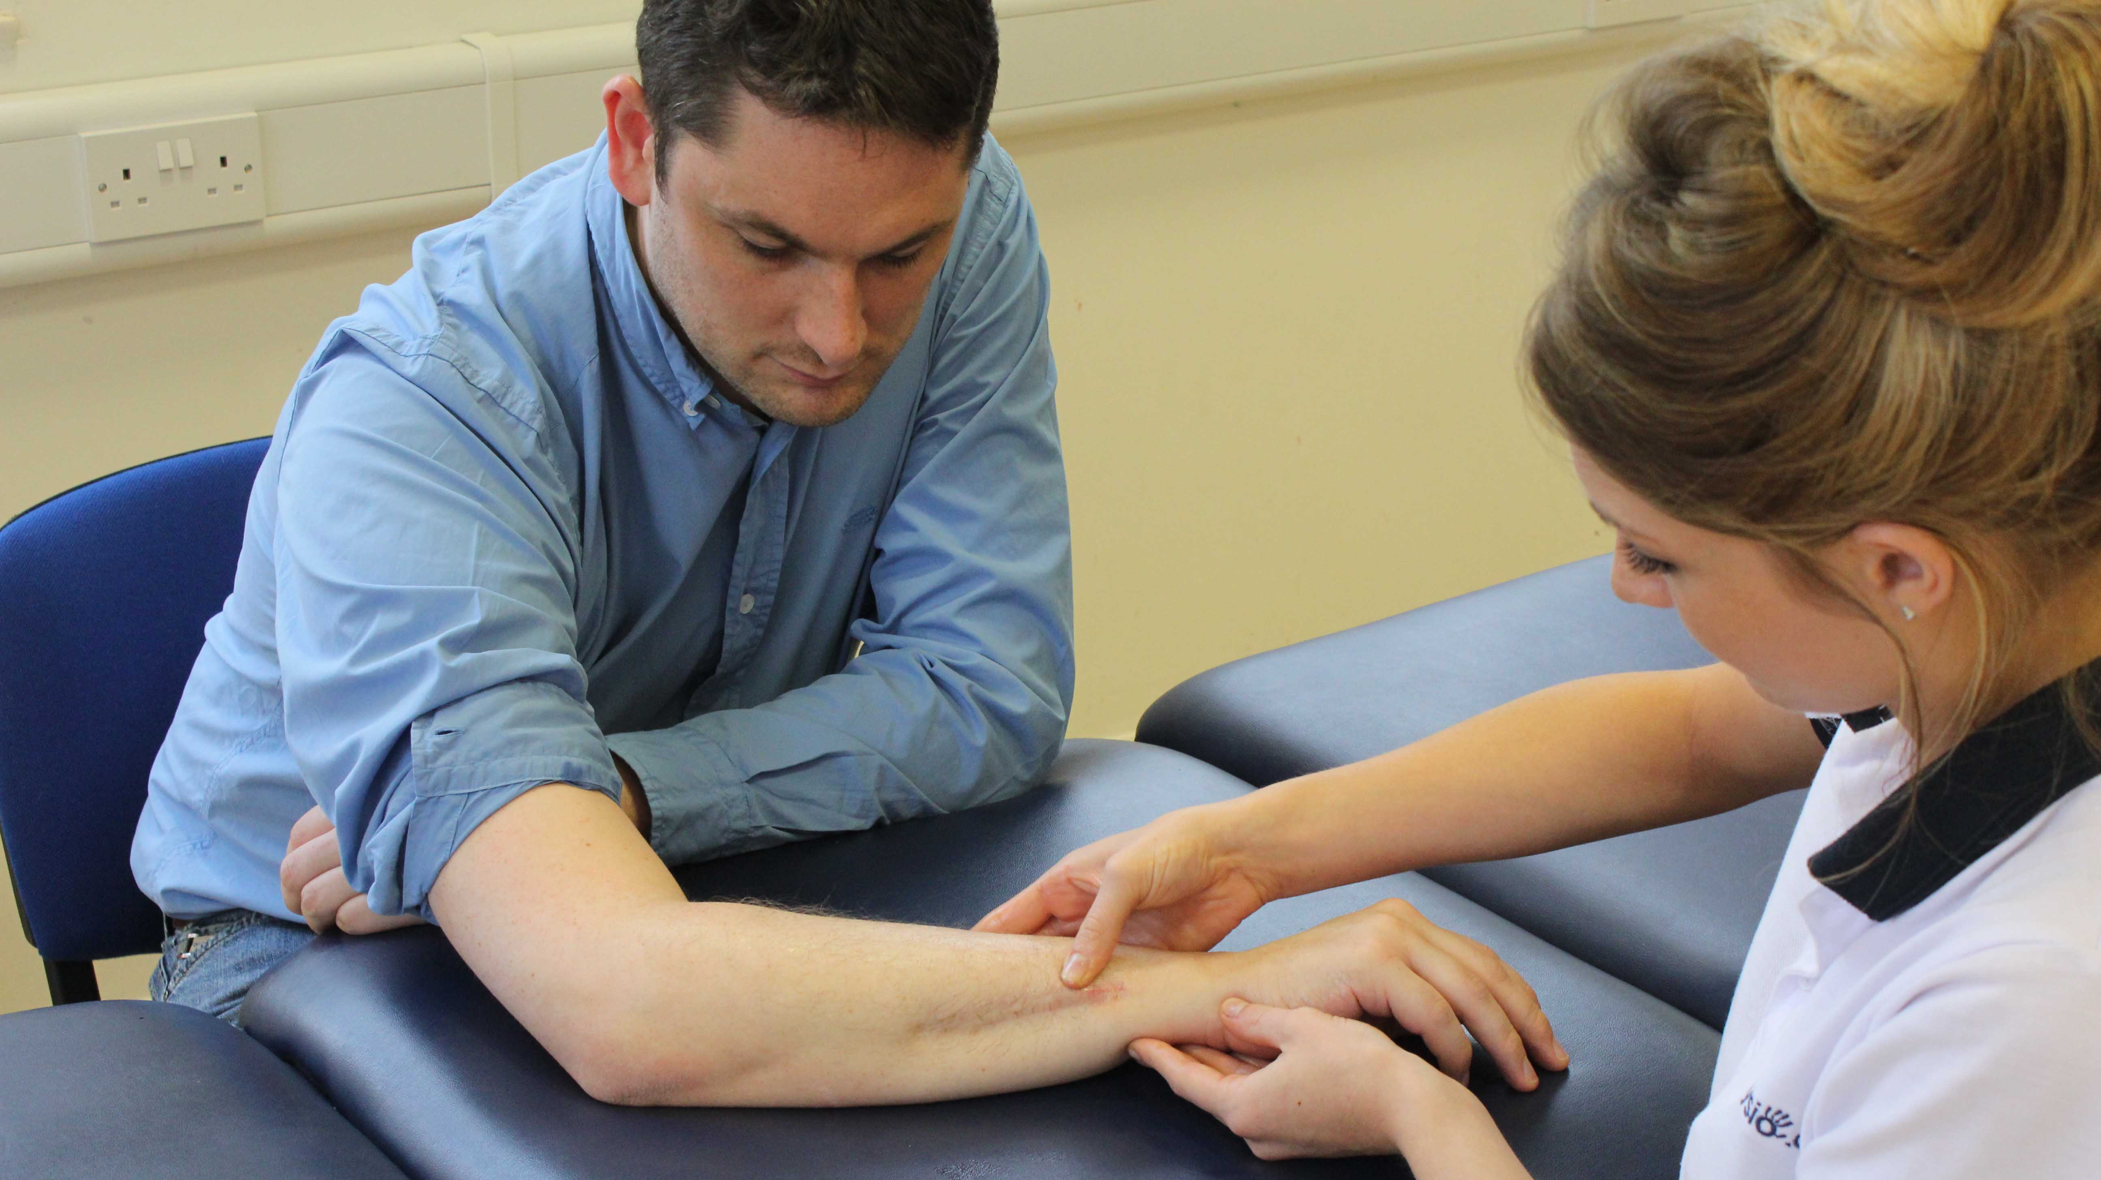
Exam

Slide 9
Basics for a Fracture Work Up - Exam
Physical Exam
  Inspection
    Ecchymosis, swelling, skin exam, deformity
  Neurovascular check – DOCUMENT!!!
  Examine joint above and below
  Range of Motion
    Do not want to passively move anything until you know there’s no fracture or dislocation
    Ok to ask for active ROM (patient moves what they can) because they aren’t going to hurt themselves.

Slide 10
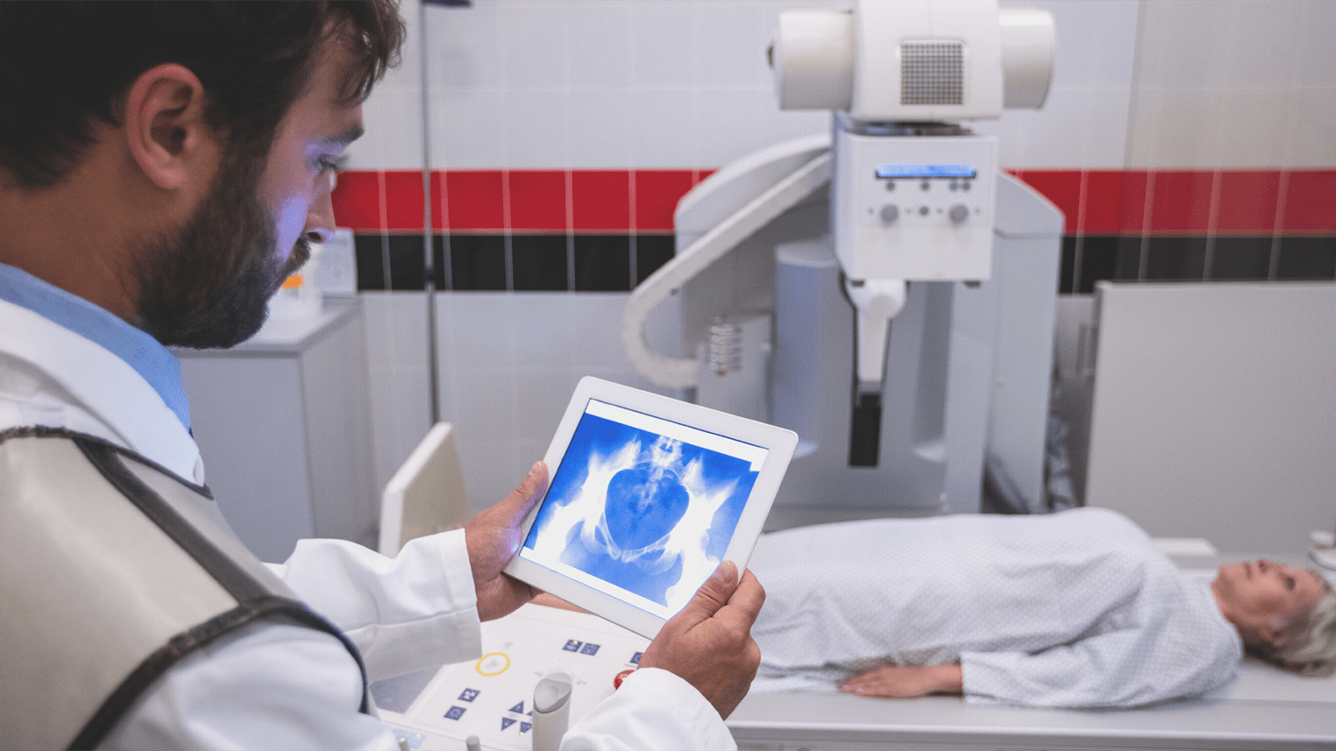


Slide 11
Basics for a Fracture Work Up - Imaging
Always get films of what you need
  For instance, if you think a patient has an ankle fracture, order ankle films, not tib fib films
  If you aren’t sure what to get, ask Radiology (see addendum on this presentation)
  Long bone films should include a full view of the joint above and below
  In addition, always order images of the joints above and below a long bone fracture
    Ex: forearm fractures require images of the elbow and wrist
  Make sure films are good quality. This is your responsibility!

Slide 12
Basics for a Fracture Workup - Imaging
Xrays
  Always get at least two views of the injured area at 90-degree angles to each other (called orthogonal views)
    WHY?

Slide 13
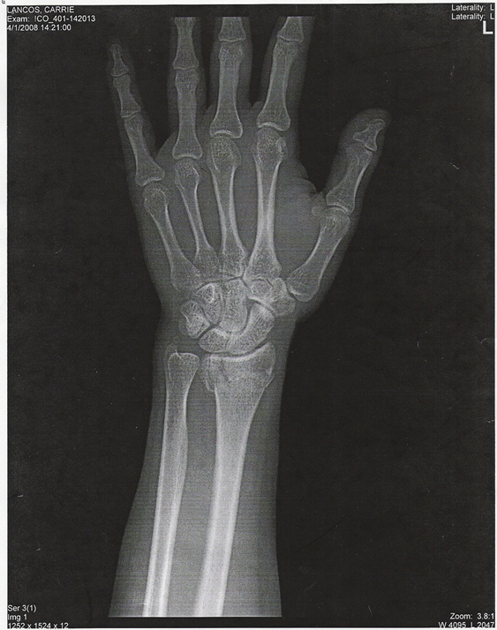
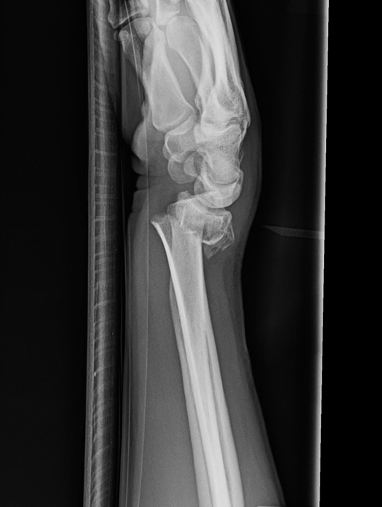
Because this…can also look like this

Slide 14

Treatment

Slide 15
Basics for a Fracture Work Up – Decision Making
Treatment
  What can/should you do acutely?
    Nondisplaced fractures – splint and follow with Ortho in 1-2 weeks usually appropriate
      Keep NWB if unsure
    Displaced fractures usually need to go to the ED for reduction
      Can call Ortho to get input if not significantly displaced
    Open fractures need urgent/emergent referral
    Anything that is not NVI deserves an Ortho consult immediately

Slide 16
Pearls
Document NV status when you see the patient and after any casting, splinting, wrapping, etc.
Stick to active ROM
Get quality and orthogonal views
For long bone fractures, get images of joint above and below
Nondisplaced fractures probably ok to stabilize and send to Ortho in 1-2 weeks
Displaced or open fractures or compromised NV status need consult

Slide 17

Questions?

Slide 18
If You Can’t Describe a Fracture, You Probably Shouldn’t Treat It

Slide 19

Here’s Your Crash Course

Slide 20
Exam and Imaging Done. Now What?
Which bone is broken?
Is it an open or closed injury?
Where is the injury in the bone? (proximal, midshaft, distal)
What’s the fracture pattern? (transverse, oblique, spiral)
Is it displaced? (translated, angulated, rotated, short)
Does it go into the joint?

Slide 21


Exam and Imaging Done. Now What?
Which bone is broken?
Is it an open or closed injury?
Where is the injury in the bone? (proximal, midshaft, distal?)
What’s the fracture pattern?
Is it displaced? (translated, angulated, rotated, short?)
Does it go into the joint?

Slide 22
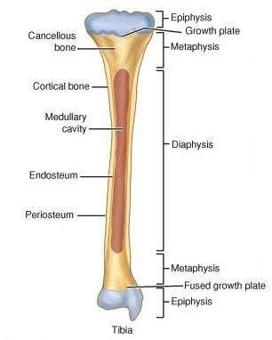

Long Bone Anatomy
Proximal
Review of long bone anatomy
  Diaphysis (shaft)
  Metaphysis
  Physis (growth plate)
Where is the fracture
  Proximal (closest to the midline)
  Midshaft
  Distal (furthest from the midline)
Midshaft
Distal

Slide 23
Exam and Imaging Done. Now What?
Which bone is broken?
Is it an open or closed injury?
Where is the injury in the bone? (proximal, midshaft, distal?)
What’s the fracture pattern? (transverse, oblique, spiral)
Is it displaced? (translated, angulated, rotated, short?)
Does it go into the joint?

Slide 24
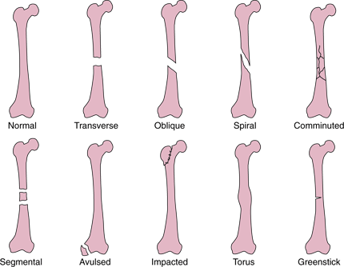
Fracture Pattern

Slide 25
Exam and Imaging Done. Now What?
Which bone is broken?
Is it an open or closed injury?
Where is the injury in the bone? (proximal, midshaft, distal?)
What’s the fracture pattern? (transverse, oblique, spiral)
Is it displaced? (translated, angulated, rotated, short?)
Does it go into the joint?

Slide 26
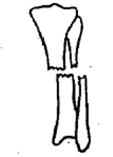
How to Describe Displacement - Translation
Translation – the bone slides on itself in a straight path
Measure in shaft width
~50% translated

Slide 27
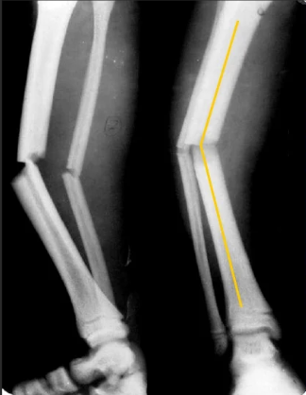
How to Describe Displacement - Angulation
Angulation - the bone is “bent”
  Describe where the apex (tip) is pointing
  Can measure the angle in degrees
    Like the yellow line

Slide 28
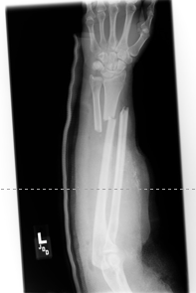

How to Describe Displacement - Rotation
Rotation – usually clinically apparent

Slide 29
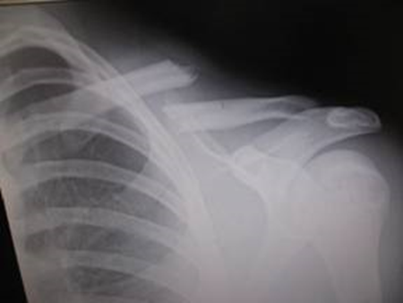
How to Describe a Fracture - Shortening
Shortening – how much do bones overlap (measured in mm or cm)

Slide 30
Exam and Imaging Done. Now What?
Which bone is broken?
Is it an open or closed injury?
Where is the injury in the bone? (proximal, midshaft, distal?)
What’s the fracture pattern? (transverse, oblique, spiral)
Is it displaced? (translated, angulated, rotated, short?)
Does it go into the joint?

Slide 31
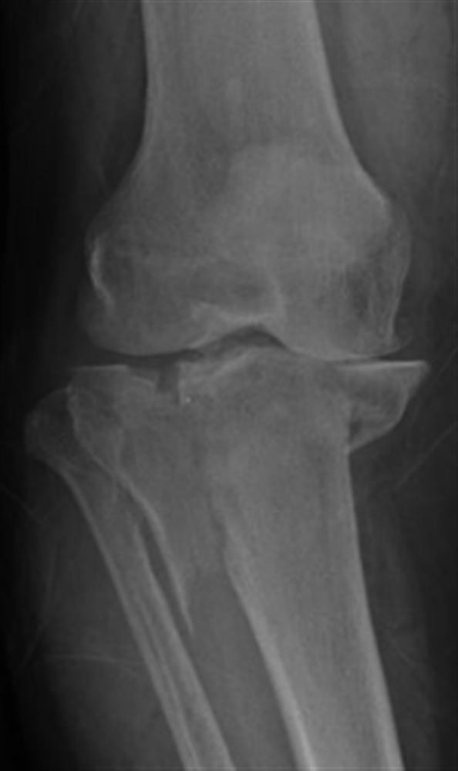
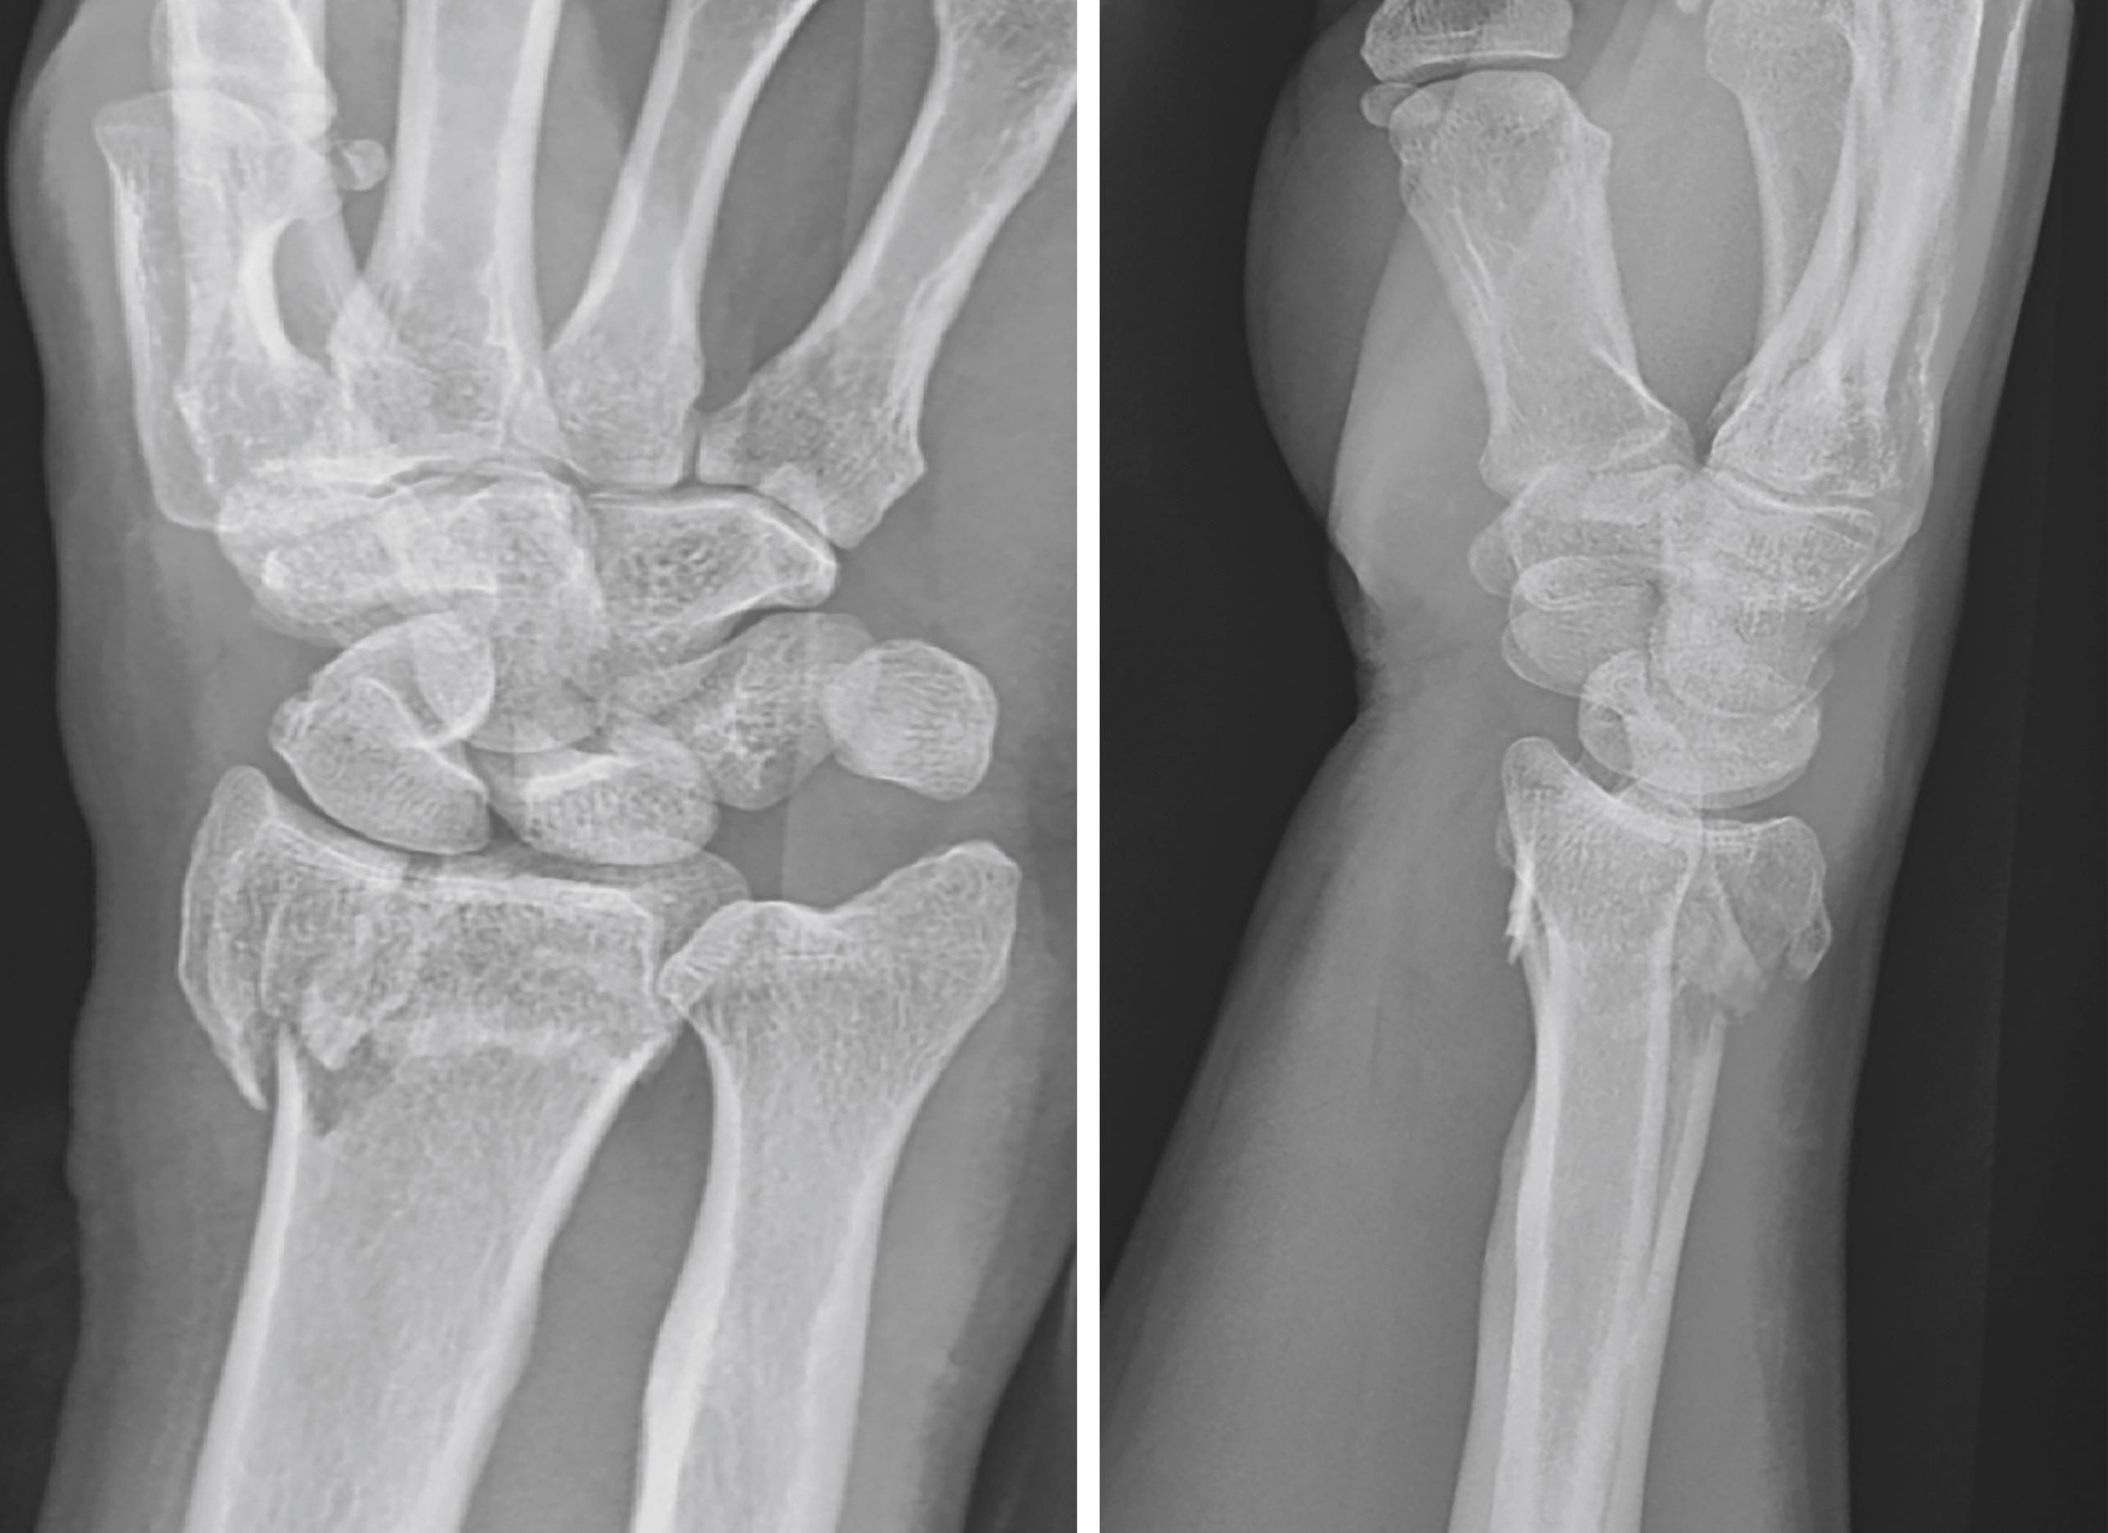
Describing a Fracture – Is it Intraarticular?
Intraarticular – does the fracture go into the joint?

Slide 32
Put it Together
When thinking through fractures, know:
  What films do you have?
  What bone is injured?
  Is it an open or closed fracture?
  Where is the injury
    Proximal, midshaft, distal?
  What’s the fracture pattern? (transverse, oblique, spiral)
  Is it displaced (angulated, translated, shortened)? If so, how much?
  Does it go into the joint?

Slide 33
Ready to Try One?

Slide 34
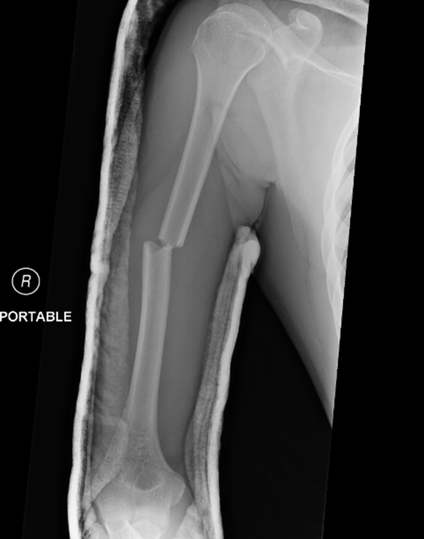
How Would You Describe This?
AP Humerus, good quality
Humerus fracture
  midshaft
  transverse
  translated 25%
  no rotation
  no shortening

Slide 35
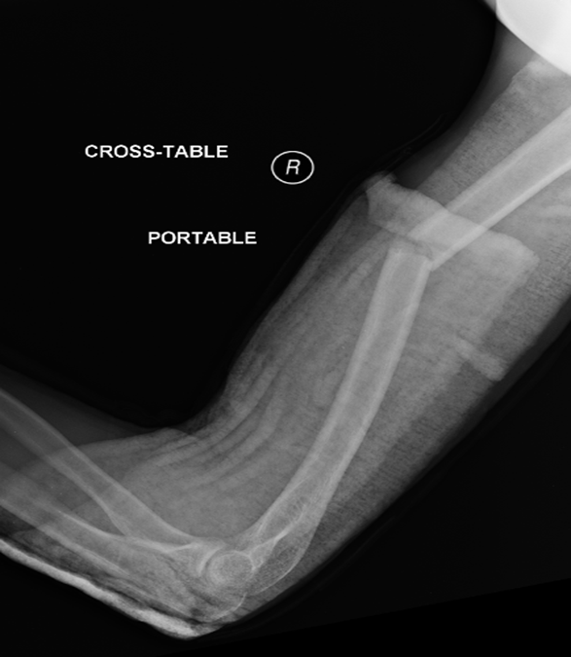
How Would You Describe This?
Lateral view – does not include shoulder
Midshaft humerus fracture that is transverse on the AP but shows angulation on lateral
  Apex anterior ~25deg

Slide 36
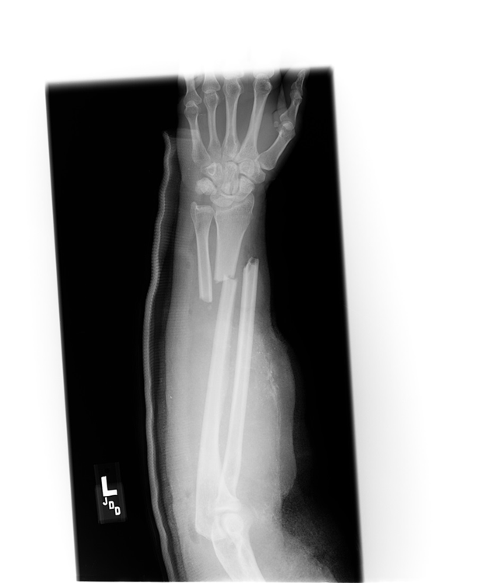
How Would You Describe This?
This is an AP view of the forearm and is an adequate study
Fractures of the radius and ulna at the junction of the middle and distal 1/3s of the bone
The fractures are 100% translated and not comminuted
It’s also shortened and rotated
(Air bubbles in soft tissue suggest open fracture)

Slide 37
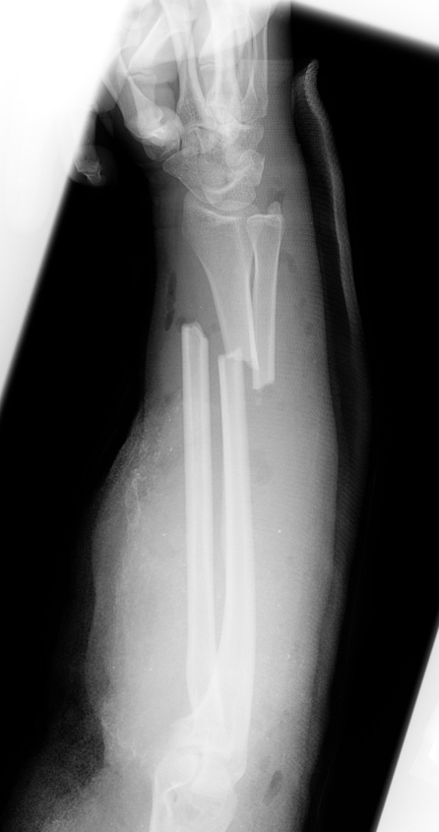
How Would You Describe This?
Lateral view confirms what you saw on AP
Not a perfect lateral.
Could send back but this patient needs
to go to the OR

Slide 38
Questions?

Slide 39
Red Flags

Slide 40
Red Flags – Open Fractures
If a wound is found in an area with an acute fracture, a work up is necessary
  (this does not mean every abrasion is an open fracture, use clinical judgement but be thorough in your exam)
  If a fracture is present, assume it is an open fracture and send to the ETC
  These are emergent

Slide 41
Red Flags – Neurovascular Status
If you have concerns about a patient’s NV status after a fracture, do not wait to see if this resolves overnight
  Call the Ortho resident and consider referral to the ETC

Slide 42
Red Flags – Compartment Syndrome
Compartment syndrome is unlikely to present through Urgent Care but you must know about it
  Usually presents within 24 hours of an injury
  The 5 Ps (pain, pallor, pulselessness, paresthesias, poikilothermia – or cool extremity)
  However, these are all late findings! If you see the last four, you have probably missed the diagnosis
  * Pain out of proportion is most important

Slide 43
Red Flags – Compartment Syndrome
Compartment syndrome is unlikely to present through Urgent Care but you must know about it
  Usually presents within 24 hours of an injury
  The 5 Ps (pain, pallor, pulselessness, paresthesias, poikilothermia – or cool extremity)
  However, these are all late findings! If you see the last four, you have probably missed the diagnosis

Slide 44
Word about Occult Fractures
An occult fracture is one that is there but not seen on plain films
Most common is radial head (kids and adults) and scaphoid but can be anywhere
If you suspect a fracture but plain films are negative:
  Treat as though it’s a fracture
  Repeat films in 7-10 days
    If there is a fracture, you should see “resorption” of the fracture then

Slide 45
Questions?

Slide 46
Pediatric Fractures

Slide 47
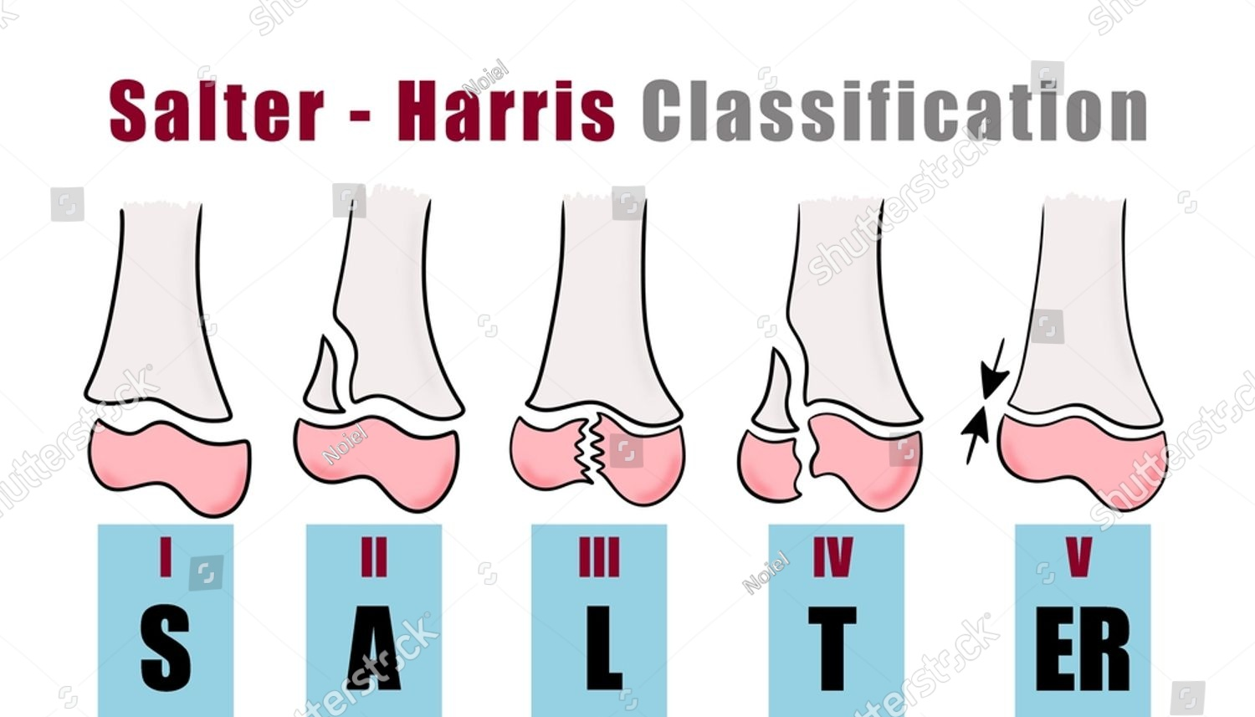
Salter Harris Classification

Slide 48
Pearls
ONLY use SH classification with pediatric fractures that involve the growth plate
  This system does NOT fit:
    Adults
    Peds fractures that do not touch a growth plate
Roman numerals
Pneumonic
  S – same
  A – above
  L – lower
  T – through
  R - ruined

Slide 49
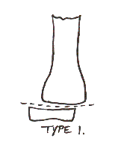
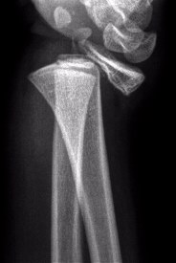
Salter Harris I = “Same” Level as Growth Plate

Slide 50
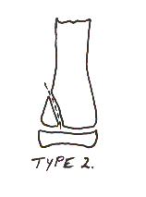
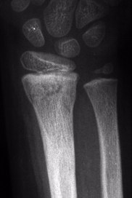
Salter Harris II – “Above” Growth Plate
The schematic on the left needs to be flipped upside down to match the wrist film on the right. Keep this in mind when trying to apply schematics to plain Xrays
*Most common question to see on PANRE

Slide 51
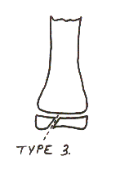
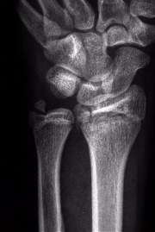
Salter Harris III – “Lower” than the Growth Plate

Slide 52
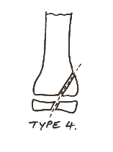
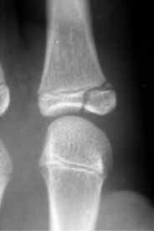
Salter Harris IV – “Through” the Growth Plate

Slide 53
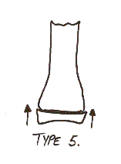
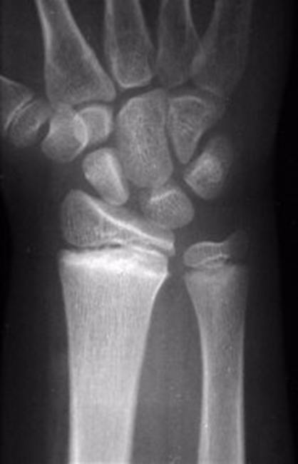
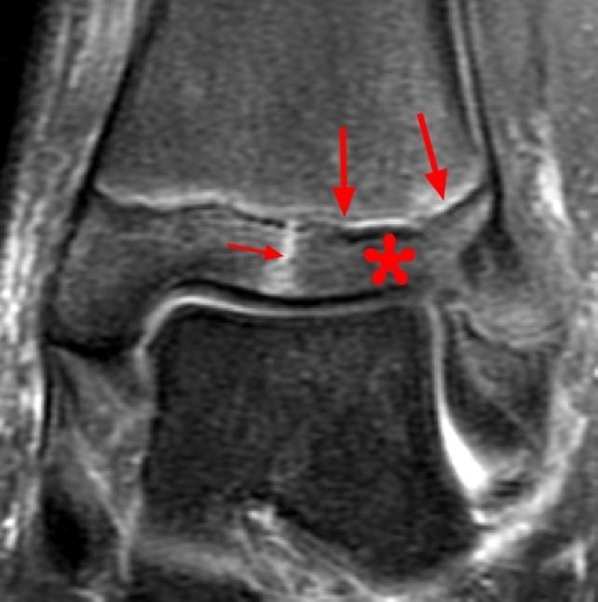
Salter Harris V – “Ruined” Growth Plate

Slide 54
Salter Harris Fractures
In general, get Ortho involved

Slide 55
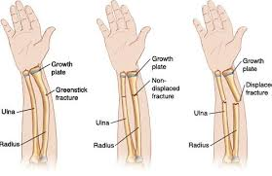
Greenstick Fractures (Pediatrics)
Occurs when a child’s bone bends and then “cracks” rather than breaking all the way through (this is very simplified)
They like to slip so earlier referral to Ortho is a good idea (3-5 days)

Slide 56
Questions?

Slide 57
Which Films to Order?

Slide 58
What Films to Order?
Clavicle – AP, Grashey, Axillary of the shoulder plus an AP of the clavicle
Shoulder injuries – AP, Grashey (true AP view), Axillary of the shoulder
Elbow injuries – AP, lateral, radial head of elbow
Forearm injuries – AP and lateral forearm (consider wrist and elbow films)
Wrist – AP, lateral, oblique of wrist

Slide 59
What Films to Order?
Knee injuries – AP, lateral, merchant of knee
Tibia injuries – AP and lateral of the tibia (consider knee and ankle films)
Ankle injuries – AP, lateral, mortise of the ankle. Consider tib/fib films with suspected Maisonneuve fracture
Foot – AP, lateral, oblique of foot. Consider weight bearing films if you are concerned about a Lisfranc injury

Slide 60
Adult Fractures You Should Know

Slide 61
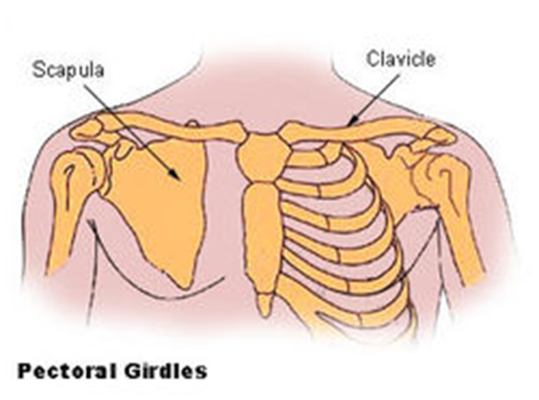
Clavicle Fractures

Slide 62
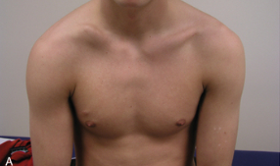
Clavicle Fractures
Very common – 5% all fractures seen in ED
Mechanism – Fall on outstretched hand (FOOSH)
Exam
  Usually swollen with a lump at the site
  Deformity often present
  Patient splints arm
  Listen to lungs! 3% have Ptx.

Slide 63
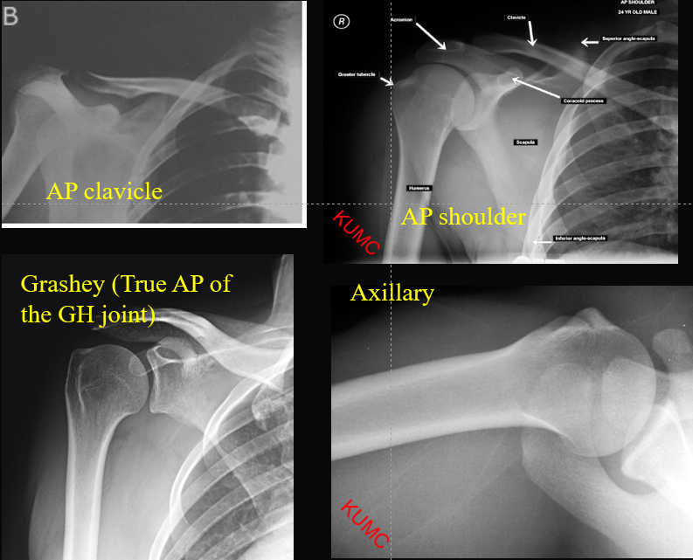
Clavicle Fractures
Xray
  AP Clavicle view
  +/- Shoulder films
    (AP, Lateral, Axillary)

Slide 64
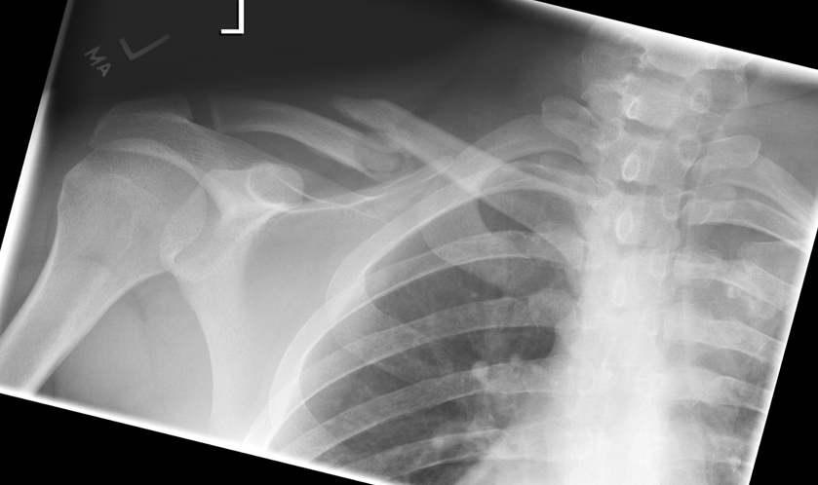
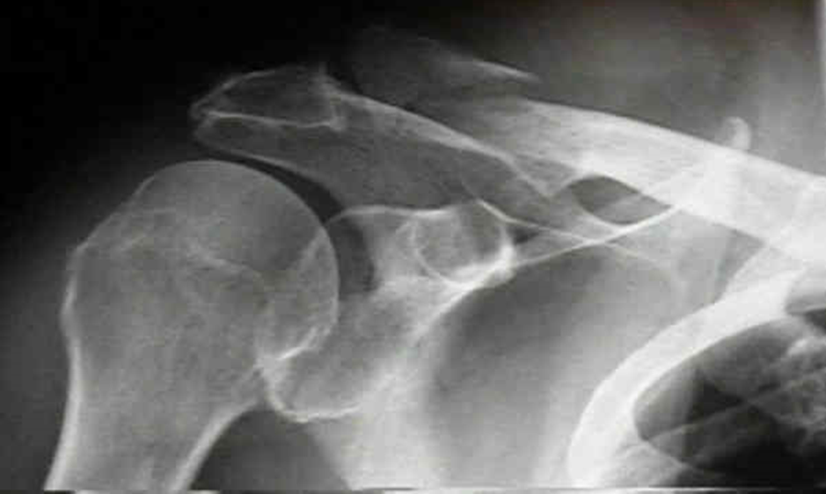
Clavicle Fractures
Fracture location
  85% are midshaft, 15% are in the distal 1/3, 5% are in the proximal 1/3 (often best seen on advanced imaging)
Midshaft
Distal

Slide 65
Clavicle Fractures
70+% will go on to heal without surgical intervention BUT there’s a push toward surgery for several reasons:
  Reduces risk of non-union considerably
  Improves deformity
  May make return to sport/work quicker for some
  Would avoid making prediction about need for surgery if you do not work with an orthopedic surgeon

Slide 66
Clavicle Fractures
Treatment
  Put in a sling for comfort
  NSAIDS/APAP +/- 1-2 days of opiates for pain
  Discourage use of arm overhead
  See Ortho within 7-10 days for surgical consult

Slide 67
Clavicle Fractures
Distal clavicle fractures – same treatment but can be a little tricky in the long run with respect to healing/function. Would get to Ortho.

Slide 68
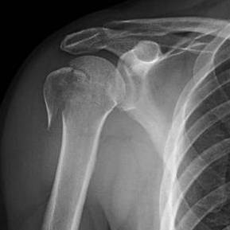
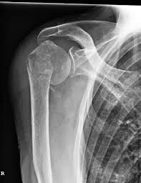
Proximal Humerus Fracture

Slide 69
Proximal Humerus Fractures
Most commonly seen in women who are older than 65
  See more often in the winter after falls on ice/snow
  These are typically fragility fractures
They can occur in younger, healthy patients but then they are typically higher energy injuries (ex: MVA) and probably presenting to the ETC instead

Slide 70
Proximal Humerus Fractures
Ask questions about other possible injuries
Often hit their head or face during the fall
  Remove glasses because they often have bruising around their face/eyes

Slide 71
Proximal Humerus Fracture
Exam
  Often very guarded and painful on exam
  May be painful enough that it is challenging to get an exam/history
  May see early ecchymosis
  Ok to ask for active ROM but avoid passive ROM

Slide 72
Proximal Humerus Fractures
Order shoulder films to include an AP, Grashey, and Axillary
  The Grashey view is a true AP of the glenohumeral joint
  An axillary is needed to make sure the shoulder is not dislocated
    If the Xray tech really doesn’t feel comfortable getting an axillary (they are painful), could do a Scapular Y view but ask Radiology to read it because it can be tricky

Slide 73
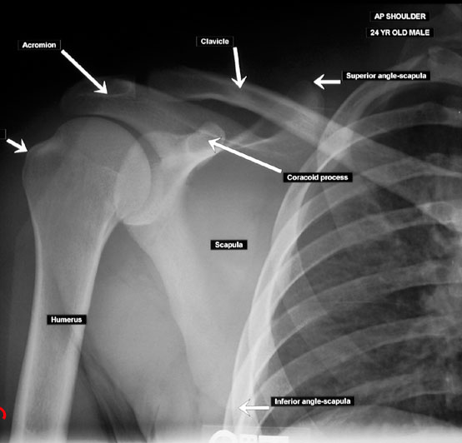
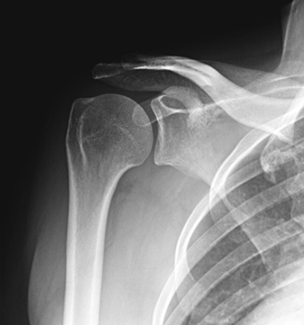
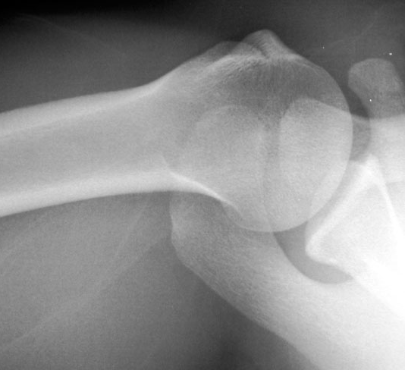
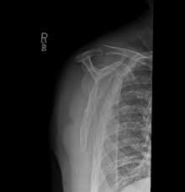
Shoulder Films
AP Shoulder
Grashey
Axillary
Scap Y

Slide 74
Proximal Humerus Fractures
If the shoulder is dislocated, immediate referral to the ETC for an Ortho consult is necessary
If the shoulder is not dislocated, it may be treated in a sling (or sling and swathe) for comfort
  Refer to Ortho within 7 days

Slide 75
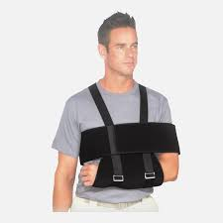
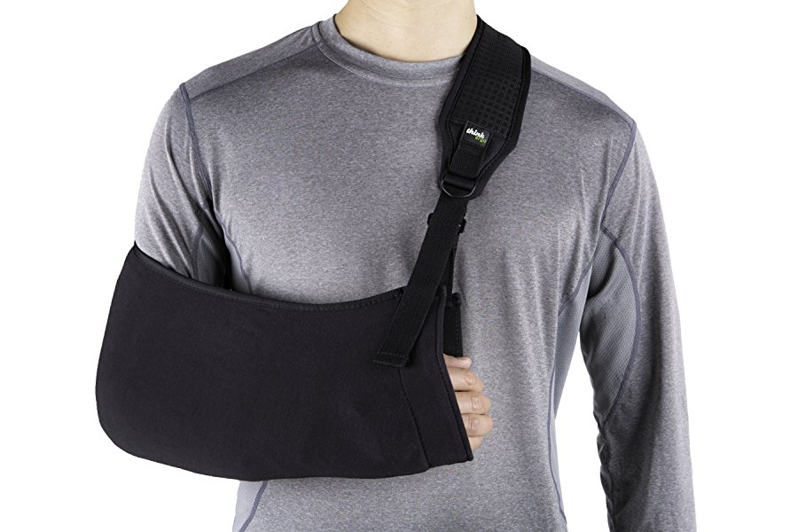
Proximal Humerus Fractures
Sling and swathe (left) is more comfortable but harder to put on alone
Consider this when choosing for your
patient

Slide 76
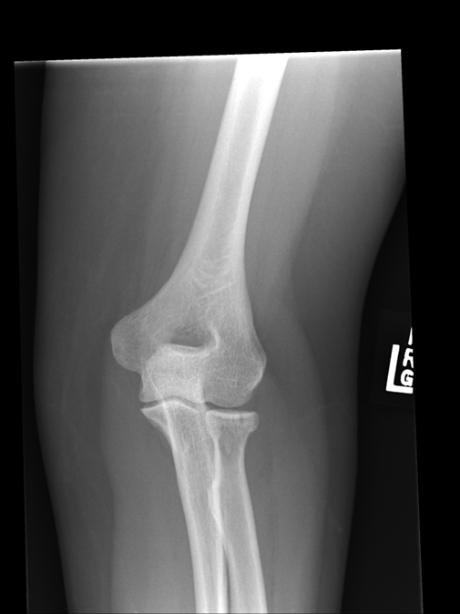
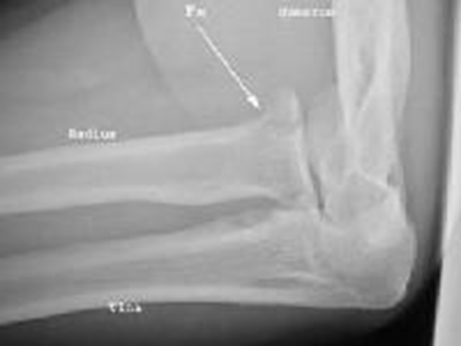

Radial Head Fractures (Adults)

Slide 77
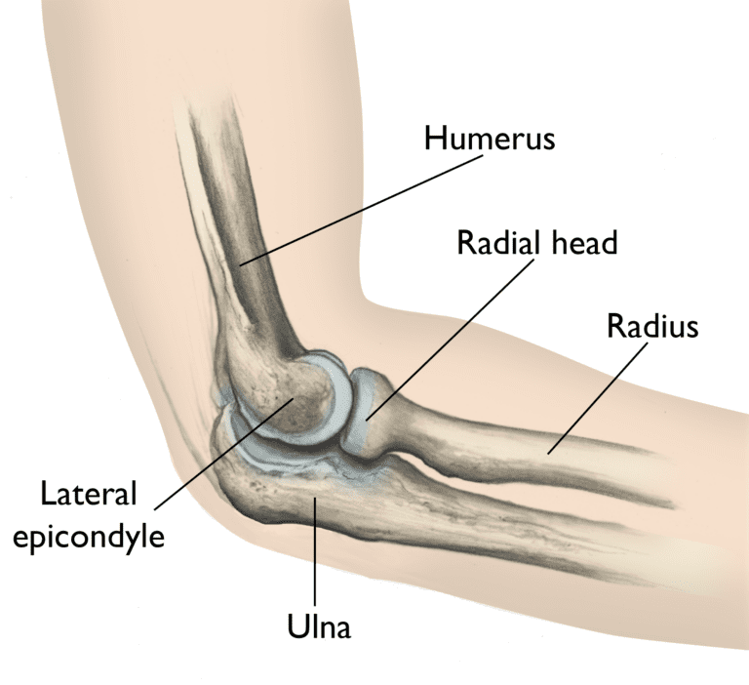
Radial Head Fractures

Slide 78
Radial Head Fractures
FOOSH injuries
Patients often complain of wrist or forearm pain, not elbow pain
  Always examine the elbow in any patient with wrist/forearm pain after a fall! Always palpate directly over the radial head or you’ll miss it.
Exam
  Won’t see much on inspection (no real swelling, ecchymosis)
  Pinpoint tender over radial head
  Pain with supination/pronation of forearm

Slide 79
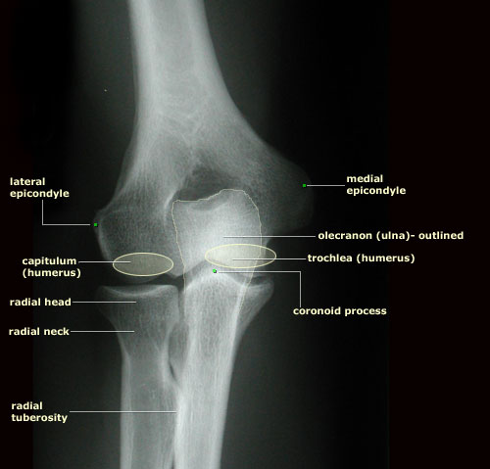
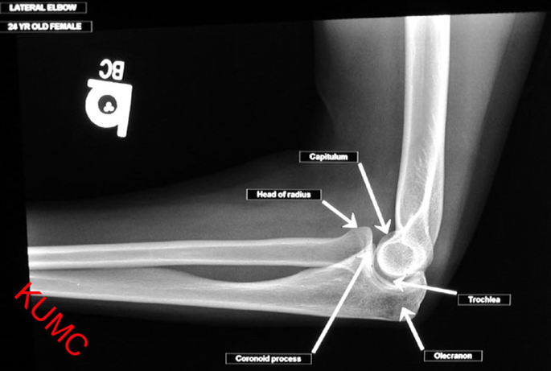

Radial Head Fractures
Xrays – AP, lateral, radial head views
Lateral

Slide 80
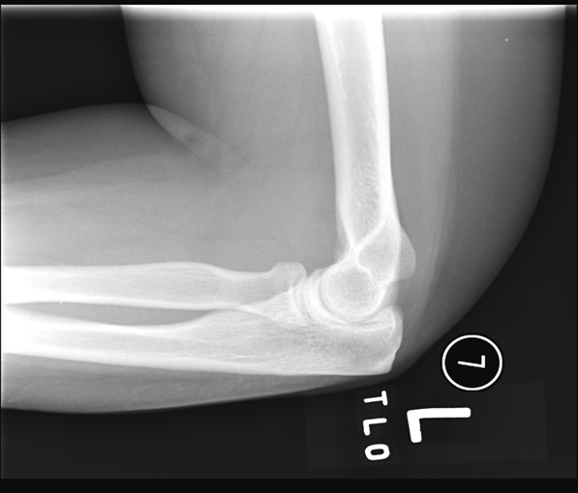

Radial Head Fractures
Radial Head View (Lateral on left; Radial Head on right)

Slide 81
Radial Head Views
Can be very hard to see on Xray
Have high suspicion for occult fracture
  Treat as though it’s a fracture and reimage in 7 days
Treatment – for nondisplaced fracture
  Sling x 2 days for pain
  Then d/c sling as much as possible and start active ROM
  Stiff elbows stay stiff
  If patient’s ROM is better in 2-3 weeks, allow to return to function slowly, otherwise refer to Ortho

Slide 82

Wrist Fractures

Slide 83
Wrist Fracture
Most commonly from FOOSH
Bimodal distribution
  Younger patients (athletes/kids)
  Older women
    If you see in a woman >50, almost always a fragility fracture. Send for DEXA.
Exam
  Swelling, ecchymosis early
  Deformity
  Tender

Slide 84



Wrist Fractures
Xrays – AP, lateral, Oblique

Slide 85


Wrist Fractures (Adult)

Slide 86
Wrist Fracture (Adults)
Early Treatment
  If obvious deformity or clear displacement on Xray, splint and send to ED
  If no clear deformity clinically or on Xray, can splint and have Ortho follow up within a week
  Elevation, NSAIDs, +/- opiates

Slide 87

Ankle Fractures

Slide 88

Ankle Fractures
Exam:
Usually swollen and ecchymotic early on
Look for areas of pinpoint tenderness
  Bone tenderness of soft tissue?
May not be able to weight bear

Slide 89



Ankle Fractures
Xrays
  AP, lateral, and mortise (true AP)

Slide 90
Ankle Fractures
Types
  Avulsions
  Stable
  Unstable
  Maisonneuve

Slide 91

Ankle Fractures - Avulsions
Avulsions fractures = radiographic evidence of a “bad sprain.”
Symptomatic Treatment
  Ice, NSAIDS, APAP
  Crutches if needed – weight bearing as tolerated
  Boot if needed for comfort
    Ok to have off at rest/sleep
    Can work out of it as tolerated

Slide 92
Ankle Fractures – Stable or Unstable
Critical distinction and one that will drive treatment, consults, and urgency of follow up
The mortise = the ankle joint
  Should always be symmetrical (“intact” on radiology reports)
  If it’s not, the ankle is unstable
  Even if it appears symmetrical, you need to prove it’s stable

Slide 93

Ankle Fractures – Stable or Unstable
Mortise intact
Medial mortise is wide = unstable

Slide 94
Ankle Fractures – Stable or Unstable
STABLE - One sided injury is stable (can often be treated in a boot, WBAT)
    A distal fibula fracture with no medial sided injury (deltoid ligament or medial malleolus fracture)
UNSTABLE - Two sided injuries are unstable (need consideration for surgery)
    Both medial and lateral malleoli are fractured
    OR, lateral malleolus is fractured and there is a disruption of the deltoid ligament

Slide 95

Ankle Fractures – Stable or Unstable
Stable
  One sided ankle fracture
    Distal fibula fracture
    No medial sided injury

Slide 96
Ankle Fracture – Stable
Acute Management
  If you are sure it’s stable:
    Put patient into a boot
    Can WBAT but give crutches
    See Ortho in 1-2 weeks
    Ice, elevation, NSAIDs
  If unsure
    Put patient into a boot
    Keep NWB
    Ice, elevation, NSADS
    See Ortho within 7 days
    Could also do a stress test – tests the mortise

Slide 97

Ankle Fractures – Unstable
Unstable injuries have fractures on both sides (lateral and medial)
Treatment
  If they are not dislocated or subluxated AND are NVI, can go into a splint and see Ortho the next day. Keep NWB
  Dislocated or subluxated ankles fractures need to be seen in ED
  If unsure, ask Ortho to review

Slide 98


Ankle Fractures – Unstable (Maisonneuve)
Maisonneuve Fractures (PANRE question!)
  Usually medial sided injury (either medial malleolus fracture or widened mortise)
  Also with proximal fibula fracture.
  Always get tib/fib films if you suspect this.
  Typically surgical!

Slide 99
Ankle Fractures – Unstable (Maisonneuve)
Acute treatment
  Splint, NWB
  Call Ortho
    Could see next day if no dislocation/subluxation AND NVI.
    If dislocated or subluxated, ETC is reasonable

Slide 100
Ankle Fracture Pearls
Avulsion fractures are essentially Xray evidence of sprains
Stable fractures can WBAT in a boot
Don’t miss unstable fractures – look for them! If unsure, it’s better to over treat
Always think of more significant injuries when you see a medial malleolus fracture without a lateral fracture

Slide 101

Metatarsal Fractures

Slide 102
Metatarsal Fractures
Common fractures
Often twisting injury or crush injury
Exam
  Swelling that can be diffuse
  Early ecchymosis doesn’t always show up. If there, can be on plantar aspect of foot
  Limp/Non weight bearing

Slide 103


Metatarsal Fractures
Xrays – Oblique, AP, Lateral

Slide 104

Metatarsal Fractures – 5th MT Fractures

Slide 105


5th Metatarsal Shaft Fractures
Most go on to heal
Not usually displaced enough to need surgery but if there is a lot of displacement, it’s worth an Ortho consult within a week
Treatment
  Hard soled shoe or boot for comfort
  WBAT (may need crutches)
  Ice, elevation, NSAIDS

Slide 106


5th Metatarsal Shaft Fractures
Hard Soled Shoe
Boot

Slide 107

Jones Fracture

Slide 108


Jones Fracture

Slide 109
Jones Fracture
High Rate of Nonunion (up to 30%)
Treatment
  Typically 6-8 weeks in a case, NWB
  Sometimes need surgery
  Would put in a splint or a boot and have NWB before getting to Ortho within 1-2 weeks
  Elevation, NSAIDS, APAP

Slide 110

Avulsion Fracture of the 5th MT

Slide 111

Avulsion Fracture of the 5th MT
One of the most common fractures of the foot
Comes from sudden twisting injury
Exam
  Usually tenderness at the tuberosity
  Can have some swelling and ecchymosis
  Sometimes complain of ankle pain

Slide 112
Avulsion Fracture of the 5th MT
Treatment
  Because this injury essentially crosses the ankle joint, you must immobilize the ankle as well as the injured foot
  Boot (ok to come off for showering, rest, and sleep) rather than a hard soled shoe
  Usually there is no need for opiates, Tylenol is appropriate
  WBAT, see Ortho in 1-2 weeks

Slide 113


Jones vs Avulsion
Jones
Avulsion

Slide 114
Lisfranc Fractures
Presents with diffuse foot pain, inability to bear weight, and possibly swelling/ecchymosis, but not always
May see widening at the Lisfranc joint on Xray but may need weight bearing films or advanced imaging to see it
  Get bilateral weight bearing AP view if suspected so you can compare to the uninjured side

Slide 115

Lisfranc Fractures
Disruption of the Lisfranc joint with or without a fractures of the proximal second metatarsal

Slide 116
Toe Fractures
Very common and nearly always do well with symptomatic treatment
  Buddy tape
  Hard soled shoe
  NSAIDS or APAP
  WBAT, return to activities as tolerated
  Follow up only if pain persists more than several weeks
Exception
  Significant displacement in a great toe warrants Ortho referral

Slide 117





Toe Fractures

Slide 118

Toe Fractures
Buddy Tape

Slide 119
Pediatric Fractures You Should Know

Slide 120


Clavicle Fracture

Slide 121

Pediatric Clavicle Fractures
Common FOOSH injuries
Typically see midshaft fractures in kids

Slide 122
Pediatric Clavicle Fractures
Often painful
Kids will guard their arm
Exam can sometimes show deformity and swelling but can also look normal
If pinpoint tenderness, get an AP clavicle view (same as previous slide)

Slide 123
Pediatric Clavicle Fractures
These typically do very well
Treatment includes:
  A sling
  No PE/recess until seen by Ortho in 1-2 weeks
  NSAIDS and/or Tylenol

Slide 124

Supracondylar Humerus Fractures

Slide 125


Pediatric Supracondylar Humerus Fractures

Slide 126
Pediatric Supracondylar Humerus Fractures
Common with FOOSH injuries
One of most common peds fractures
See most often in kids ages 5-7

Slide 127
Pediatric Supracondylar Humerus Fractures
Exam will show a child who guards their arm (sometimes)
They really dislike any motion of their elbow
May or may not have pinpoint tenderness
MUST MUST MUST get neurovascular exam
  DOCUMENT IT

Slide 128


Pediatric Supracondylar Humerus Fractures
Order an AP and Lateral of the elbow

Slide 129
Pediatric Supracondylar Humerus Fractures Pearls
Most fractures presenting to Urgent Care will be subtle
Don’t be afraid to enlist the help of Radiology with peds elbows films! They are challenging!

Slide 130
Pediatric Supracondylar Humerus Fractures
Also look for positive Fat Pad or Sail sign
  This shows that there is bleeding in the joint which typically comes from either a radial head fracture or a supracondylar humerus fracture
  If the history and exam fit and a positive Fat Pad or Sail sign is present, assume it’s a fracture

Slide 131

Pediatric Supracondylar Humerus Fractures

Slide 132

Pediatric Supracondylar Humerus Fractures

Slide 133
Pediatric Supracondylar Humerus Fractures
If the fracture is nondisplaced or minimally displaced AND the child is NVI, the arm can be placed in a posterior splint and sent to Ortho the next day
  APAP and NSAIDS for pain
If there is any displacement and/or the child is not perfectly neurovascularly intact, send to the ED
If unsure, send to ED

Slide 134

Pediatric Supracondylar Humerus Fractures

Slide 135

Pediatric Radial Head/Neck Fracture

Slide 136
Pediatric Radial Head/Neck Fracture
Typically happens following a FOOSH injury
Accounts for 5-10% of all pediatric elbow fractures but you will see them commonly in Urgent Care
Typically see in kids ages 8-10

Slide 137
Pediatric Radial Head/Neck Fracture
Exam:
  Child will guard their arm
  They will have pain with motion but may be able to move fairly well
  No significant swelling/bruising
  May have pinpoint tenderness over the radial head

Slide 138

Pediatric Radial Head/Neck Fracture
Order AP, Lateral, and Radial Head views

Slide 139
Pediatric Radial Head/Neck Fracture
Treatment
  If minimally, or nondisplaced, AND NVI, ok to splint and refer to Ortho the next day
    APAP and NSAIDS for pain
  If modestly or significantly displaced, if there are concerns about dislocation, or if there are concerns about NV status, refer to ETC

Slide 140


Both Bones Forearm Fractures

Slide 141
Pediatric Both Bones Forearm Fractures
FOOSH injury
These are midshaft fractures (not to be confused with distal radius/ulna fractures)
Common fractures but probably present to the ED more often than UC because deformity often exists

Slide 142
Pediatric Both Bones Forearm Fractures
Exam
  Often there is a deformity
  Very painful
  Check and document NV status!

Slide 143
Pediatric Both Bones Forearm Fractures
Order AP and lateral forearm films
Should also obtain elbow and wrist films if possible (again, do this for all long bone fractures)

Slide 144
Pediatric Both Bones Forearm Fractures
Treatment
  If nondisplaced, NVI, and relatively comfortable, could consider splinting with early morning Ortho consult the next day
  Would still call to discuss with resident/APP
  Most times, these will be somewhat displaced and painful so ETC referral is reasonable
    Splint before you send
    NSAIDS and APAP are ok
    Always ok to send if unsure

Slide 145

Pediatric Distal Radius Fractures

Slide 146
Pediatric Distal Radius Fractures
Very common
Peak incidence is during growth sports (10-12 for girls, 12-14 for boys) but can be seen in younger kids
FOOSH injury

Slide 147
Pediatric Distal Radius Fracture
Exam
  May see deformity
  They are very guarded and generally painful
  May have some early ecchymosis
  Pinpoint tender, withdrawals from pain

Slide 148

Pediatric Distal Radius Fracture
Order lateral, oblique, and AP views of the wrist (ordered to match slide below)

Slide 149
Pediatric Distal Radius Fracture
Consider two types:
Extraphyseal – does not go into the growth plate
Physeal injury – enters the growth plate

Slide 150
Pediatric Distal Radius Fracture
Treatment
  Thinking is mostly similar between the two from an Urgent Care perspective
  If nondisplaced and NVI, ok to splint with follow up in ortho the next day
  If displaced, or if there are concerns about NV status, send to the ETC

Slide 151
Pediatric Distal Radius Fracture
  It is very challenging to do a closed reduction in an Orthopedic outpatient clinic
  If there is any suspicion that a closed reduction is needed, call the ortho resident to discuss sending the patient through the ETC

Slide 152

Pediatric Buckle Fractures in the Wrist

Slide 153
Pediatric Buckle Fractures in the Wrist
Very common in young children
FOOSH injuries
Often the child has a simple fall and may state that they have pain but not be terribly uncomfortable
Can sometimes take a day or two for parents to realize that their child continues to favor the arm

Slide 154
Pediatric Buckle Fractures in the Wrist
Exam
  Often skin and inspection will be normal
  May have a small amount of wrist swelling
  Can usually elicit tenderness that is directly over the fracture
  Kids won’t guard as much with this fracture as they do with others
  *Can be easy to miss!

Slide 155
Pediatric Buckle Fractures in the Wrist
Order lateral, oblique, and AP of the wrist (again in order to match the films below)

Slide 156
Pediatric Buckle Fractures in the Wrist
These are “incomplete” fractures that will often show up as a tiny buckle in the cortex
May also be called Torus fractures
Often missed on the AP but evident on the lateral

Slide 157


Pediatric Buckle Fractures in the Wrist
Hard to see on the AP, evident on the lateral

Slide 158
Pediatric Buckle Fractures in the Wrist
Treatment
  In the UC setting, it is reasonable to place these in a cock up wrist splint and send to Ortho within 1-3 days
  FP will often treat definitively with a cock up wrist splint
  In an Ortho setting, parents often choose casting over splinting because it is more protective and allows kids to be more active

Slide 159

Tibia Shaft Fractures

Slide 160
Pediatric Tibial Shaft Fractures (Toddler Fractures)
Common fracture in young children (usually walkers under the age of 3)
  If you see it in a child who is not yet walking, concerning for non-accidental trauma
Usually results from a low level fall or while sliding down a slide on a parent’s lap

Slide 161
Pediatric Tibial Shaft Fractures (Toddler Fractures)
Presentation
  Often presents in a child who immediately begins crying after a fall or injury
  Parents will notice that they avoid weight bearing on the leg
  If the parent tries to stand the child up on their lap, the child will recoil their leg to avoid standing on it

Slide 162
Pediatric Tibial Shaft Fractures (Toddler Fractures)
Exam
  As stated in previous slide
  Skin is usually fine
  No clear deformity
  May find pin point tenderness but may be difficult to tell depending on the age of the child or how painful they are

Slide 163

Pediatric Tibial Shaft Fractures (Toddler Fractures)
Order AP and lateral tib/fib films

Slide 164
Pediatric Tibial Shaft Fractures (Toddler Fractures)
Again, make sure you have good quality films and can see the knee and ankle on the same Xray
To be complete, films should be done of the joint above and below (knee and ankle) to look for other injury

Slide 165
Pediatric Tibial Shaft Fractures (Toddler Fractures)
Treatment
  Most often, these are nondisplaced
    If this is true and if NVI, ok to splint and send to Ortho for a cast the next morning
    If pain seems out of proportion to injury, please call Ortho APP or resident
  If displaced, or there are concerns about NV status, refer to ETC

Slide 166

Pediatric Tibial Shaft Fractures (Toddler Fractures)

