Slide 1
April 13, 2026 Iowa PA Society Conference Des Moines, Iowa
Polypharmacy & Deprescribing
Prevention & Risk Reduction
Caroline Woods, PA-C, CAQ-Psych, MPH, CHES (she/hers)
Preventive Health Center of Iowa City, PLLC
phcic52240@gmail.com
Notes:
avery@capturmngt.com 515-750-2059 April 13th, 1:50 to 2:35 pm
Own consulting business: education, workshops, medical & nursing & scientific editing, health coaching
PA experience mostly in psychiatry: started IM, UC, EM, community health, then the CH clients led me to interest in psychiatry

Slide 2
Prevention at All Levels
PRIMARY PREVENTION Clue in patients on your approaches Leadership support
SECONDARY PREVENTION Check PMP routinely (eg, delegates) Review how patient handles their Rxs Screen objectively
TERTIARY PREVENTION Intervention with deprescribing Co-Rx antecdotes (eg, naloxone)
Notes:
SOURCE: Caswell J. Preventive Health Strategies: Balancing Primary, Secondary & Tertiary Approaches. J Prev Med 2024: Vol 9, No 3: p 257. doi.10.36648/2572-5483.9.3.257
Screening eg: “When have you ever taken more or less meds than prescribed?”

Slide 3
Polypharmacy & Deprescribing
POLYPHARMACY
AAFP Regular use of at least 5 medications
CDC Use of > 5 meds concurrently
Review “The term polypharmacy is imprecise.”
DEPRESCRIBING
AAFP Action to ID & DC/taper inappropriate or unnecessary Rx
UpToDate “A process of medication withdrawal, supervised by a health care professional, with the goal of managing polypharmacy and improving outcomes.”
Notes:
AAFP: Polypharmacy: Evaluating Risks and Deprescribing | AAFP
CDC: Polypharmacy and Health-Related Quality of Life/Psychological Distress Among Patients With Chronic Disease
Review: Pazan et al 2021. Polypharmacy in older adults. Eur Geriatr Med. Jun;12(3):443-452. doi: 10.1007/s41999-021-00479-3.

Slide 4
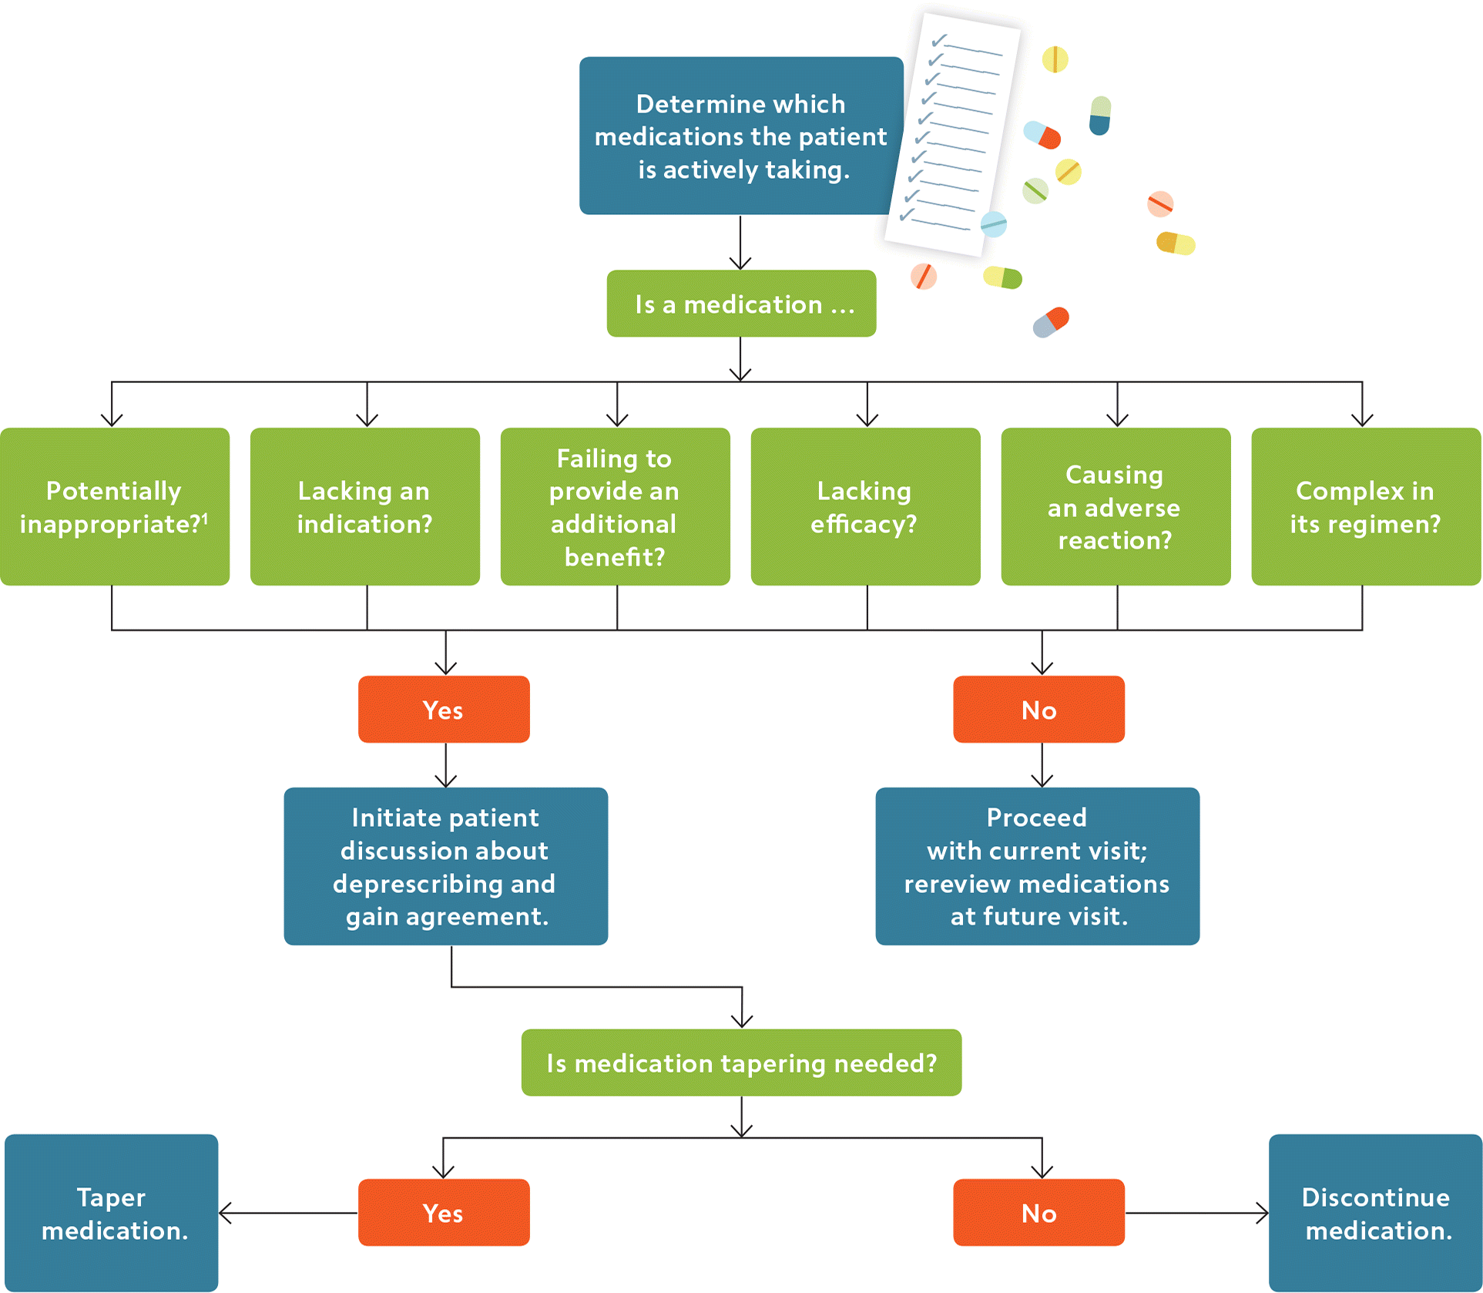
Notes:
Deprescribing Unnecessary Medications: A Four-Part Process | AAFP

Slide 5
ADHERENCE
ADHERENCE = ACTIVE PATIENT PARTICIPATION
Assumptions that should be addressed
The Rx is obtained promptly & taken as prescribed
Patient will alert clinic on any Rx variations
Patient stores their medicine per label
Note: compliance is more so the patient passively following the Rx without asking questions, etc

Slide 6
Key components of Rx adherence
Originally, a proprietary adherence tool was created.
It was supported with validity, sensitivity, & specificity studies.
Later, however, it was debunked.*
It’s components can still be used to start a conversation.
*Research on an adherence tool model was retracted after an independent statistical review of the data concluded that the results were misleading and the authors were unable to adequately address the concerns.
Notes:
Retracted: Predictive Validity of a Medication Adherence Measure in an Outpatient Setting - Morisky - 2008 - The Journal of Clinical Hypertension - Wiley Online Library
Debunked: Morisky et al 2008. Predictive Validity of a Medication Adherence Measure in an Outpatient Setting. J Clinical Hypertension, 10: 348–354. https://doi.org/10.1111/j.1751-7176.2008.07572.x.

Slide 7
EXAMPLES OF ADHERENCE QUERIES
What does this medication mean to you? [Conviction]
What concerns do you have about this med? [Concern]
How much does this medicine cost? [Financially, emotionally]
Notes:
Sample: nationalepinet.org/wp-content/uploads/2021/03/AdherenceEstimator-3-16-21.pdf

Slide 8
LACK OF ADHERENCE REASONS
Being human: forgetfulness, not liking the taste, etc
Apathy of the significance of the underlying disorder
Inconvenience
Dislike of the precautions or potential adverse effects
Financial concerns
Misunderstanding of prescription instructions
No faith in the medication’s efficacy
Physical difficulties (eg, with swallowing, opening bottles, etc)
Reduction, fluctuation, or disappearance of symptoms

Slide 9
Apply deprescribing to a sample Rx
Scenario: A person takes lorazepam, 1 mg po 1-2x/d maximum prn restlessness
Rx amt: #60 pills dispensed & picked up every 30 days for past 2 years
Pt says: “My anxiety is worsening & I just want another refill”
Thoughts? Options?
Do nothing -- If so, make it an active choice & discuss w/ patient
Use adherence queries: Do you use them all up? I’m curious about any side effects you may have?
Note that it’s a prn, may not be working effectively anymore
With your expertise, decrease the total dispensed slowly

Slide 10
Duo stim-benzo use
Apply “polypharmacy” when managing duo stim-benzo use
Understand why the patient likes taking these meds
Only do rapid discontinuation with oversight
Taper slowly
2. Review physiological effects of duo stim-benzo use with patients
3. Ask if there is a difference being patients who know what they want and patients who seem demanding

Slide 11
Provide self-care & staff support when deprescribing

Slide 12
Drug Misuse Occurs at All Levels
Death
Near-overdose
More unsafe, risky behaviors
Giving Rx to children or pets
Other changes in using the Rx: taking w/ alcohol, sharing w/ others, etc
Small adjustments in Rx directions: taking more than prescribed or more often, not taking with food
Selling the Rx, stealing others’ meds, not keeping it in a safe space

Slide 13
The Practice of Cultural Humility
Cultural humility = Letting the individual tell you who they are.
Cultural competency = Placing cultural generalizations on the patient.
Motivational interviewing = Positive guidance to move out of ambivalence.
Cultural humility allows better connections with the individual.
Incorporate cultural humility when using motivational interviewing.

Slide 14
Scenarios to Discuss
Leadership supports being proactive about counseling patients to decrease their scheduled Rxs.
A patient says “I’m not using hydrocodone” yet has hydrocodone Rx on file.

Slide 15
Define cultural humility, motivational interviewing & cultural competency

Slide 16
Cultural Humility
Person-centered
Allows you to really connect with the individual
Lets the person in front of you tell you who they are
How it differs from cultural competency/generalizations
How it differs from motivational interviewing

Slide 17
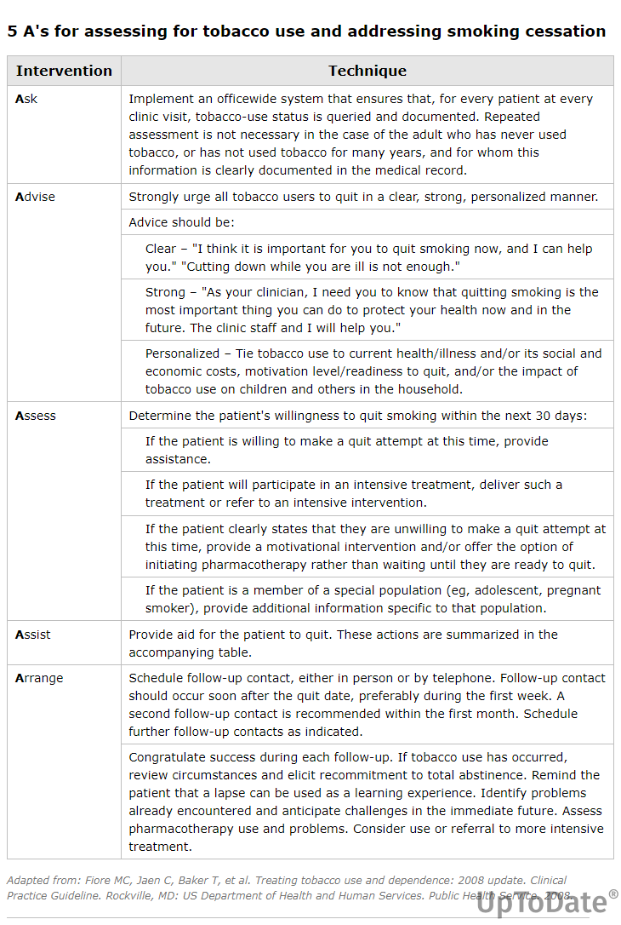
Motivational Interviewing
Centers around patient being ambivalent about change
Evidence based, can use stages-of-change model
Used in SUD tx, lifestyle changes, encouraging medication adherence
Notes:
SOURCE: UpToDate, Accessed 4-12-26: 5 A's for assessing for tobacco use and addressing smoking cessation

Slide 18
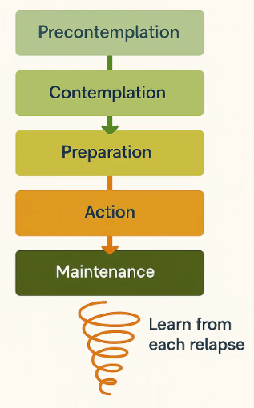
Stages of Change

Slide 19
Q & A

