Slide 1
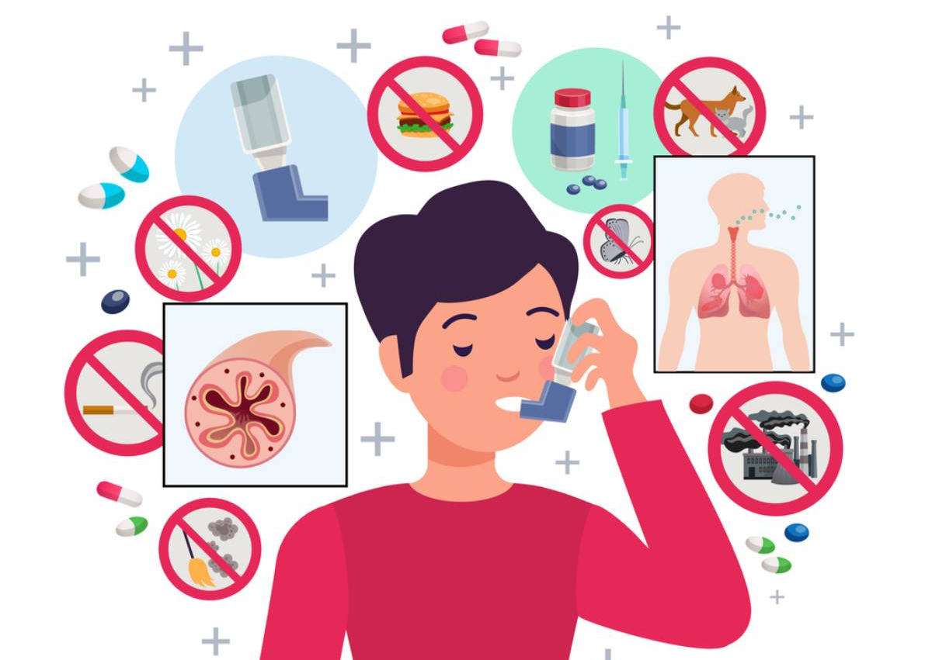
Asthma Updates 2025: Practical, evidence-based care for front-line clinicians
Nicholas Rains, MS, PA-C
Iowa Allergy, Asthma, and Immunology
Ankeny, IA

Slide 2
Learning Objectives
Review current evidence-based guidelines for the diagnosis and management of asthma, including recent updates to stepwise therapy and biologic treatment options.
Identify key clinical indicators that help differentiate asthma severity and control and apply these to patient case scenarios to optimize individualized treatment plan.
Discuss practical strategies for improving patient outcomes, including adherence, inhaler technique, environmental modifications, and integration of new therapies into clinical practice.

Slide 3
Disclosure
I have NO financial disclosure(s) or conflicts of interest with the presented material.

Slide 4


The Allergist’s Role in Asthma Care
Allergists are specialists trained extensively in airway inflammation, immunologic mechanisms, and environmental triggers – the three core drivers of asthma.
Asthma is not a single disease; allergists excel in phenotyping and endotyping (T2-high vs. non-T2), critical for modern management.
Approach to asthma through holistic lens: allergy, environment, immunology, and respiratory function.

Slide 5

Roadmap
Pathophysiology & Diagnosis
Outpatient Management – Global Initiative for Asthma (GINA) 2025 key practice changes (AIR, tracks, stepwise)
Biomarkers, phenotyping, and monitoring
Severe asthma & biologics (selection, monitoring, and stopping rules)
Practical cases & implementation tips
Q & A

Slide 6
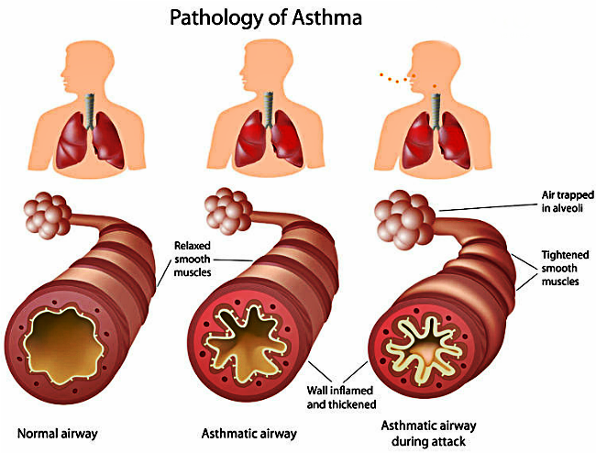
Quick Review: What is Asthma??
Core Mechanisms:
Chronic airway inflammation → intermittent symptoms
Bronchial hyperresponsiveness
Variable expiratory flow
T2 (type-2) inflammation vs non-T2 endotypes:
Eosinophils
IgE
IL-4/IL-5/IL-13 pathways → drive many responses
Why do we care about all these inflammatory markers & pathways?
Faria N et al. Biologic Therapies for Severe Asthma: Current Insights and Future Directions. J Clin Med. 2025 May 2;14(9):3153. doi: 10.3390/jcm14093153. PMID: 40364184; PMCID: PMC12072268.

Slide 7
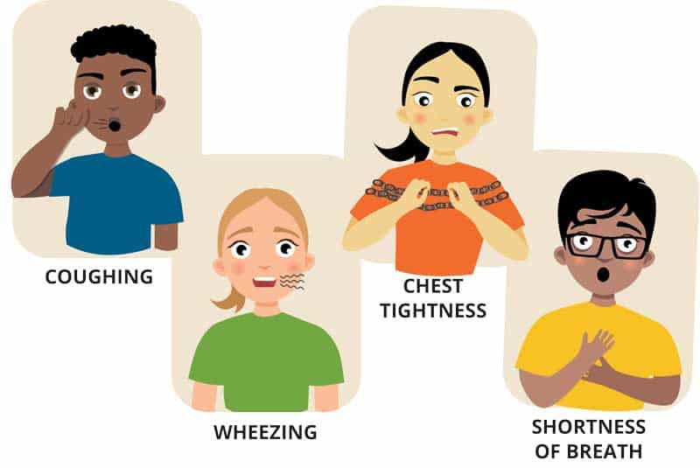
Clinical Presentation & Triggers
Typical symptoms: cough, wheezing, dyspnea, chest tightness
May be variable – often worse at nighttime
Exercise
Allergen exposure
Common triggers include:
Viral URIs
Environmental allergens
Exercise
NSAIDs (if susceptible)
Irritants
Weather
Occupational exposures
Smoke

Slide 8
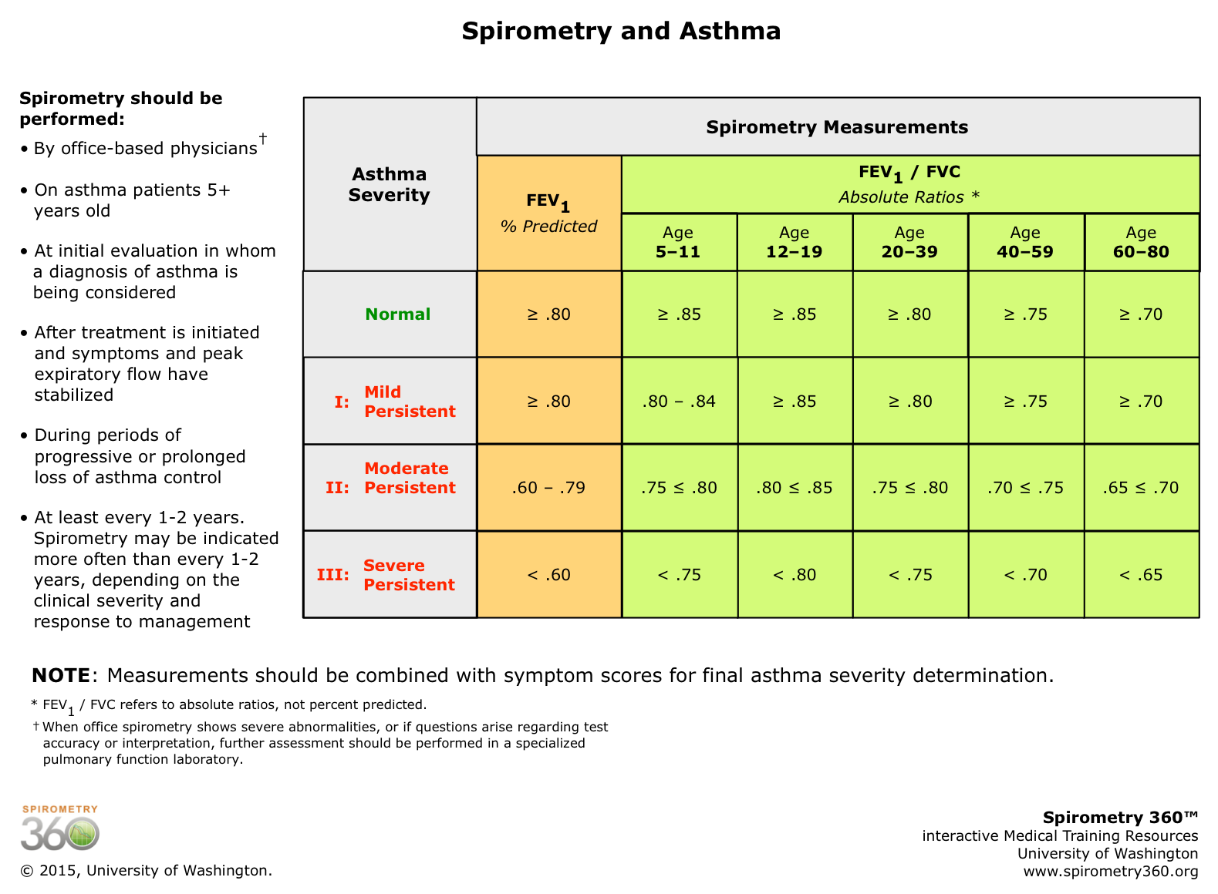
Diagnosis
Remember…asthma is a clinical diagnosis
History of variable symptoms + evidence of variable expiratory airflow when available
GINA 2025 clarification for “variable expiratory airflow” → airflow does not need to be abnormal at the exact time of assessment.
Objective testing to support diagnosis:
Spirometry with bronchodilator testing
Peak flow variability
FeNO
Methacholine challenge (spirometry normal, clinical suspicion high)
Global Initiative for Asthma. Global Strategy for Asthma Management and Prevention, 2025 update. Fontana, WI: Global Initiative for Asthma; 2025.

Slide 9
Inhaler Category Overview
Controller (Maintenance) Inhalers
Reduce inflammation and prevent exacerbations
Inhaled corticosteroids (ICS): fluticasone (Flovent, Arnuity Ellipta), budesonide (Pulmicort), mometasone (Asmanex), beclomethasone (Qvar Redihaler)
ICS/LABA combiations: budesonide-formoterol (Symbicort), fluticasone-salmeterol (Advair, Wixela), fluticasone-vilanterol (Breo Ellipta), mometasone-formoterol (Dulera)
Triple therapy inhaler (ICS + LABA + LAMA): fluticasone-umeclidinium-vilanterol (Trelegy Ellipta)
Reliever (Rescue) Inhalers
Provide rapid bronchodilation during symptoms or exacerbations
SABA: albuterol (ProAir, Ventolin, Proventil), levalbuterol (Xopenex)
ICS-formoterol (Anti-Inflammatory Reliever/AIR): budesonide-formoterol (Symbicort)
ICS-albuterol (AIR): budesonide-albuterol (Airsupra)

Slide 10
Device Types & Technique Pearls
Device Type | Examples | Key Points | Pros | Cons
Metered-Dose Inhaler (MDI) | Albuterol HFA, Qvar Redihaler, Symbicort | Aerosolized medication propelled by HFA | Familiar, inexpensive | Requires coordination
Dry Powder Inhaler (DPI) | Arnuity Ellipta, Breo Ellipta, Advair Diskus, Trelegy | Breath-actuated powder | No coordination needed | Needs strong inspiratory effort
Soft Mist Inhaler (SMI) | Spiriva Respimat, Combivent Respimat | Slow-moving mist | High lung deposition | More costly
Nebulizer | Albuterol, Budesonide | Aerosolized via compressor | Good for young/elderly | Bulky, time-consuming

Slide 11
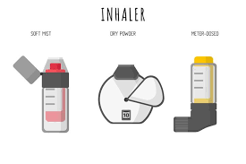
Choosing the Right Inhaler in Practice
Considerations for Inhaler Selection:
Cognitive ability and manual dexterity
Inspiratory flow capacity
Cost and insurance formulary
Preference and adherence likelihood
Device availability (Ellipta, HFA, DPI, etc.)
GINA 2025 Emphasis:
ICS-formoterol as preferred AIR inhaler for adults/adolescents.
Ensure patient has a written Asthma Action Plan with clear inhaler instructions.
Reassess adherence and inhaler technique at every visit before stepping up therapy.

Slide 12

Global Initiative for Asthma (GINA) 2025
Key practice changes and practical implications

Slide 13
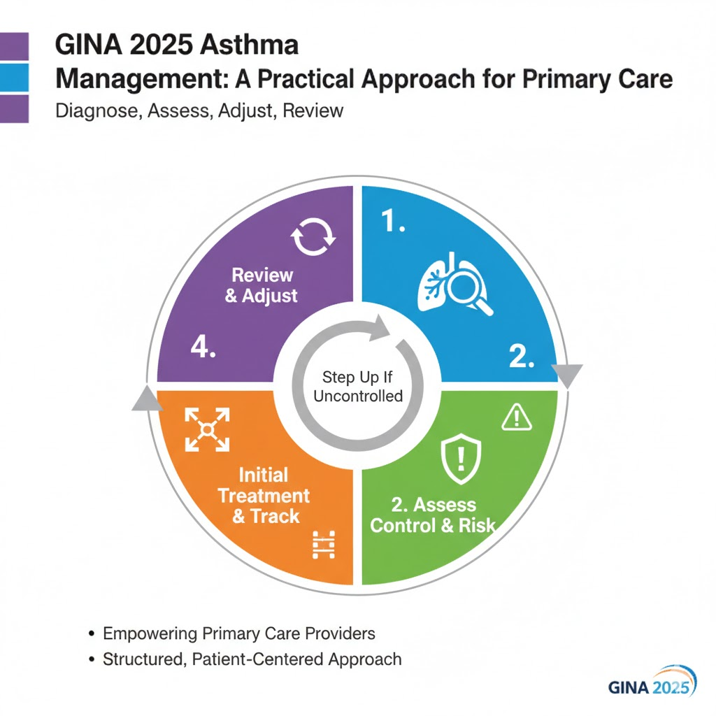

Slide 14
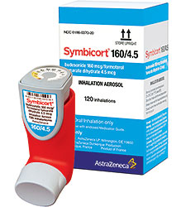
High-Level 2025 GINA Messages
Universal emphasis on inhaled anti-inflammatory therapy
Avoid SABA-only approaches
Access to inhaled anti-inflammatory relievers
GINA reinforces AIR (anti-inflammatory reliever) strategies in many settings.
ICS-formoterol
ICS-albuterol
Global Initiative for Asthma. Global Strategy for Asthma Management and Prevention, 2025 update. Fontana, WI: Global Initiative for Asthma; 2025.

Slide 15
GINA 2025 Management Tracks
Track 1 (preferred):
AIR approach → low dose ICS-formoterol used both as maintenance and as a reliever
Single inhaler maintenance and reliever therapy [SMART/AIR])
Significant reductions in severe exacerbations vs SABA reliever
Track 2:
Conventional maintenance controller (ICS+LABA) with SABA reliever (used when AIR is unavailable or not feasible)
Global Initiative for Asthma. Global Strategy for Asthma Management and Prevention, 2025 update. Fontana, WI: Global Initiative for Asthma; 2025.

Slide 16
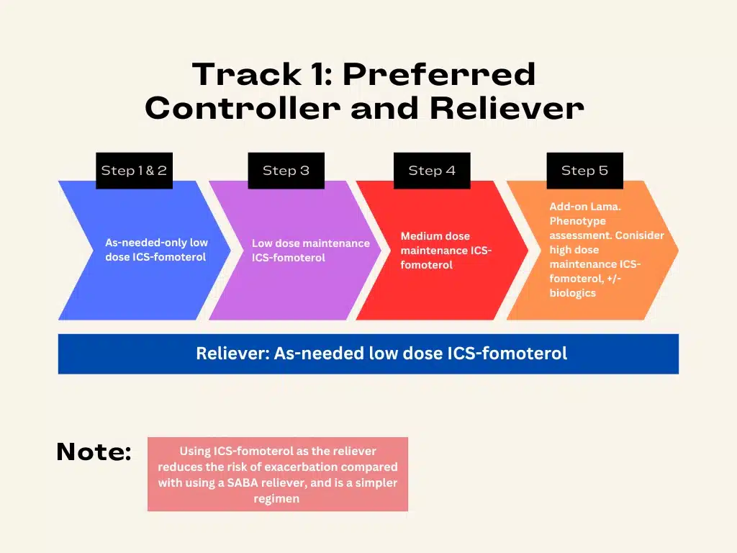
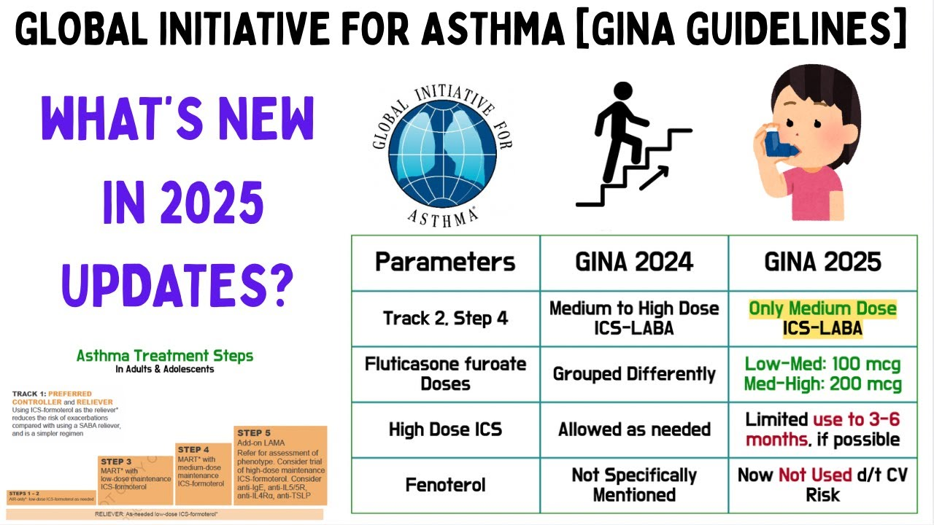
Starting Therapy & Step-Wise Approach
Adolescents/adults:
Start with ICS-containing option
AIR preferred
Escalate based on control and exacerbation history

Slide 17

Exacerbation Prevention & Risk Factors
Key modifiable risk factors include:
Poor adherence
Incorrect inhaler technique
Smoking
Comorbidities (obesity, GERD)
Allergen/occupational exposures
Psychosocial factors
GINA 2025 emphasizes individualized risk assessment and targeted interventions
Global Initiative for Asthma. Global Strategy for Asthma Management and Prevention, 2025 update. Fontana, WI: Global Initiative for Asthma; 2025.

Slide 18

Biomarkers, phenotyping, & monitoring

Slide 19
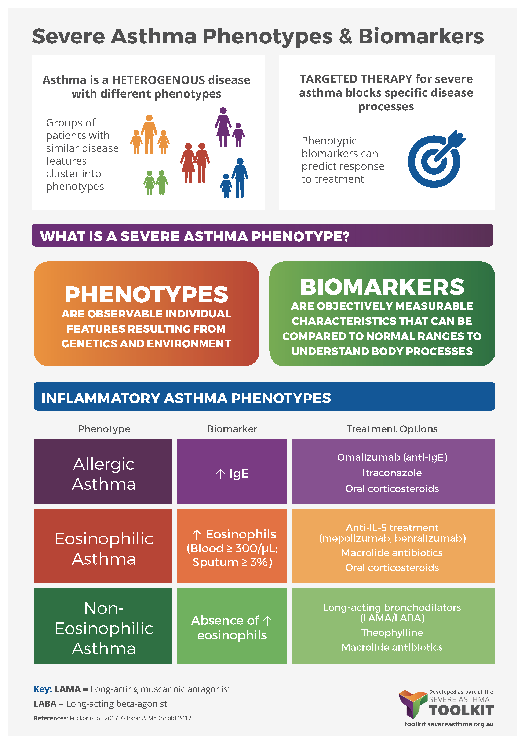
Role of Biomarkers
GINA 2025 gives more clear guidance on T2 biomarkers
Support diagnosis
Predict response for ICS/biologics
Phenotype severe disease
Please remember, biomarkers are adjuncts to clinical assessment, not replacements
Practical Thresholds:
Eosinophils > 150-300 cells/uL
FeNO thresholds vary by context
Consult local lab/cutoffs
Use caution – combine with clinical picture

Slide 20

When To Order What?
New/worsening control despite moderate-high dose ICS
Check adherence
Inhaler technique
Consider FeNO and blood eosinophils
Severe/uncontrolled symptoms
Full work-up, including spirometry
Imaging, if applicable
Allergy testing
FeNO/eosinophils
Alternative diagnoses and comorbidities

Slide 21


Severe Asthma: Biologics & Management

Slide 22
Definition & Practical Approach
GINA 2025:
Severe = asthma that remains uncontrolled despite maximal optimized therapy (high-dose ICS-LABA PLUS treatable contributory factors addressed).
Asthma that requires above therapy to prevent it from being uncontrolled
Difficult to treat vs severe asthma clarifications in GINA 2025 guidelines
Global Initiative for Asthma. Global Strategy for AsthmaManagement and Prevention, 2025 update. Fontana,WI: Global Initiative for Asthma; 2025.

Slide 23

Biologic Options
Biologics currently used in severe asthma target:
IgE (omalizumab/Xolair)
IL-5 pathway (benralizumab/Fasenra)
IL-4, IL-13 (dupilumab/Dupixent)
TSLP (Tezepelumab/Tezspire)
Driven by phenotype/biomarkers, comorbidities, access/insurance
Head-to-head and comparative data are emerging
Dupilumab and Tezepelumab have shown broad benefits in some analyses
Faria N, Costa MI, Fernandes AL, Fernandes A, Fernandes B, Machado DC, Machado F, Simão L, Ribeiro L, Ferreira L, Boaventura R, Lima R, Ferreira J. Biologic Therapies for Severe Asthma: Current Insights and Future Directions. J Clin Med. 2025 May 2;14(9):3153. doi: 10.3390/jcm14093153. PMID: 40364184; PMCID: PMC12072268.

Slide 24
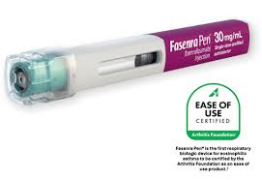

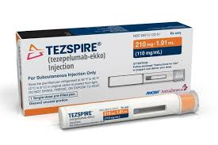
How To Choose A Biologic
Confirm severe asthma
Optimize adherence/technique
Phenotype
Blood eosinophils
FeNO
IgE
Review comorbidities
Hives
Eczema
CRSwNP
Consider patient preferences
Injection frequency
Home vs clinic
Insurance/access

Slide 25
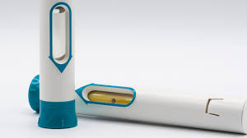
Stopping Biologics & Long-Term Management
Evidence shows that some patients may lose control after discontinuation of biologic
Tezepelumab reports of gradual loss of control
Decisions to stop biologics must be individualized
Sustained clinical control
Stable lung function
Suppressed inflammatory biomarkers
No need for oral corticosteroids
Monitoring after stopping must be planned.
Discontinuation of biologic therapy in severe asthma: Evidence and strategies for safe withdrawal: A scoping review
Ramirez-Villamizar, Johanna et al.
World Allergy Organization Journal, Volume 18, Issue 9, 101107

Slide 26
Practical Implementation & Quality Improvement

Slide 27
Practical Clinical Tools
Quick clinical checklist:
Diagnostic/history template
Inhaler technique demo sheet
FeNO/eosinophil ordering protocols
Biologic referral pathway
Asthma exacerbation action plan
Timing of follow-up
EMR order sets can help with efficiency
Inhaler teach-back technique

Slide 28
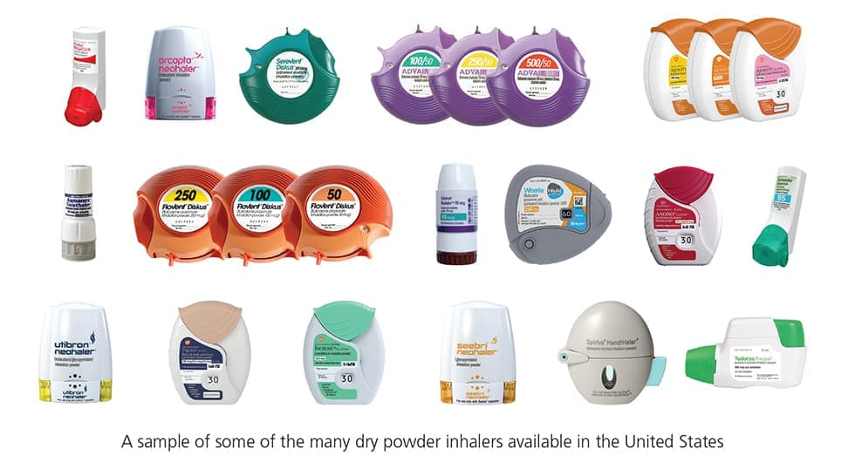
Patient Education & Shared Decision Making
Teach use of AIR
Review written action plans
Ensure inhaler devices match patient ability
DPI vs HFA; spacers
Discuss goals
Reduce exacerbations
Minimize steroid use
Follow-up goals

Slide 29
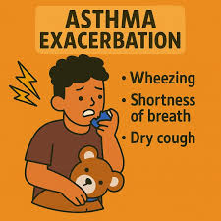
Acute Care & Exacerbation Management

Slide 30
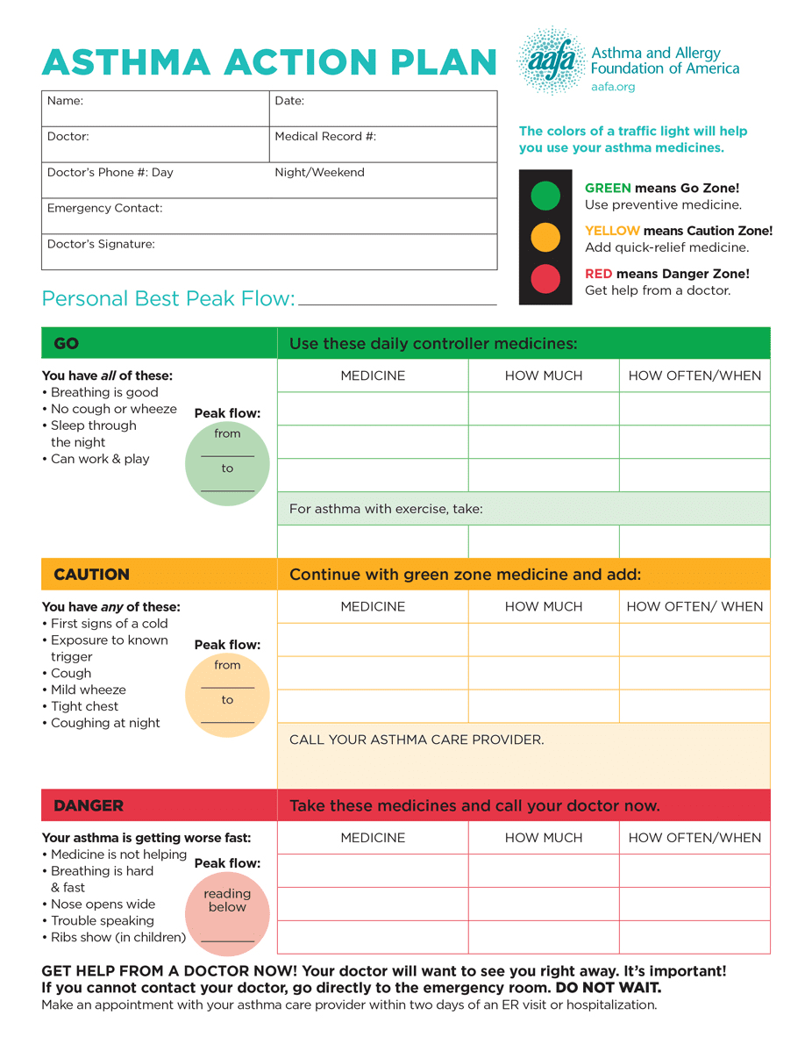
Recognizing Severity & ED Pearls
Danger Signs:
Silent chest
Inability to speak full sentences
Tachypnea
Hypoxia
Bradycardia
Exhaustion
Early ICS and reliever strategies are critical
Systemic corticosteroids for moderate-severe asthma exacerbations

Slide 31
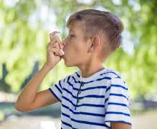
Special Populations & Public Health

Slide 32
Children, Pregnancy, & Equity/Access
Children (age < 5):
GINA 2025 emphasizes safety of ICS use in children
AIR adaptations where evidence supports it
Pregnancy:
Continue controller therapy
Avoid SABA-only use.
Benefits of controlling asthma significantly outweigh risks of uncontrolled asthma on mother and baby.
Equity/access:
GINA 2025 highlights access issues (inhaler access)
Global Initiative for Asthma. Global Strategy for Asthma Management and Prevention, 2025 update. Fontana, WI: Global Initiative for Asthma; 2025.

Slide 33

Why Refer To An Allergist??
Uncontrolled asthma despite moderate to high dose ICS/LABA
≥2 steroid bursts/year or ≥1 hospitalization.
Diagnostic uncertainty (normal spirometry but typical symptoms).
Allergen trigger suspected but not identified.
Considering biologic therapy or step-down planning.
Pediatric or pregnancy asthma with complexity.
Need for allergy testing or environmental intervention.

Slide 34
Cases

Slide 35
Case #1
22-year-old male with intermittent wheezing and dry cough. Symptoms are worse during URIs and occur less than 2x/week. He does not have any nighttime awakenings due to symptoms. Spirometry is within normal limits w/o obstruction.
Diagnosis?
Next steps?

Slide 36
Case #2
48-year-old female currently on high dose ICS-LABA-LAMA (Trelegy) and albuterol as rescue inhaler. Needing albuterol at least 3x/week. She has experienced 2 exacerbations this year requiring oral prednisone. Chest XR is unremarkable. Labs show absolute eosinophil count of 350 cells/uL.
Phenotype?
Next steps?

Slide 37

Summary: Take Home Points
Asthma = clinical diagnosis.
Objective tests, when available
Normal spirometry does not exclude asthma
GINA 2025 reinforces anti-inflammatory reliever (ICS-formoterol) as the preferred track.
Always check adherence, inhaler technique, and comorbidities when stepping up or down therapy.
Use T2 biomarkers to phenotype and guide biologic selection
Adjuncts to the clinical picture; allergist referral
Biologics are effective for severe asthma; choose based on phenotype, comorbidities, and patient preference. Monitor response.
Plan for access, inhaler availability, and patient education – equity matters.

Slide 38



Ankeny
West Des Moines
Taking students for rotations!

Slide 39
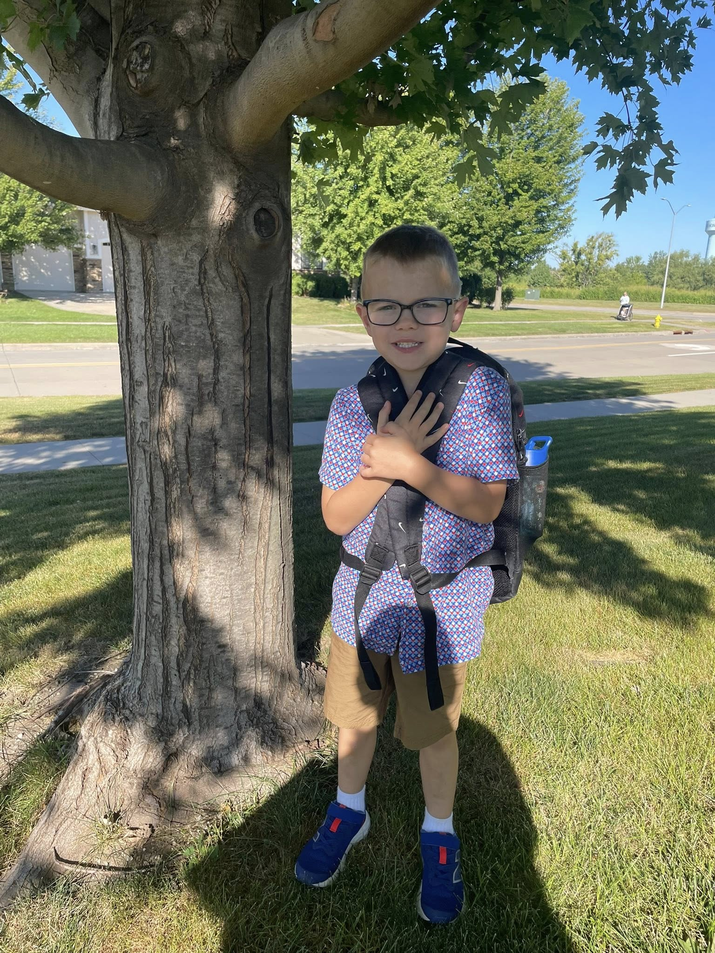
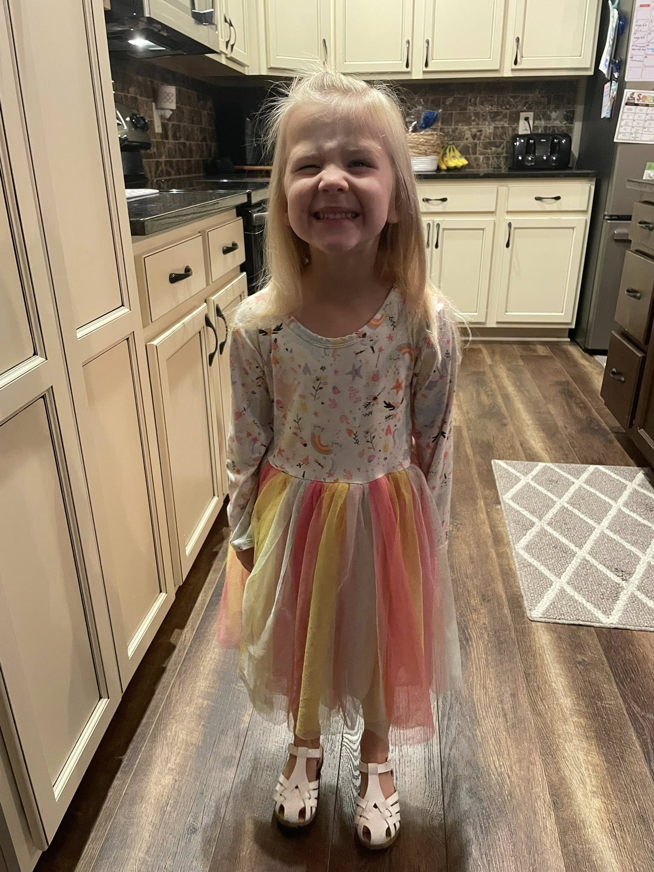
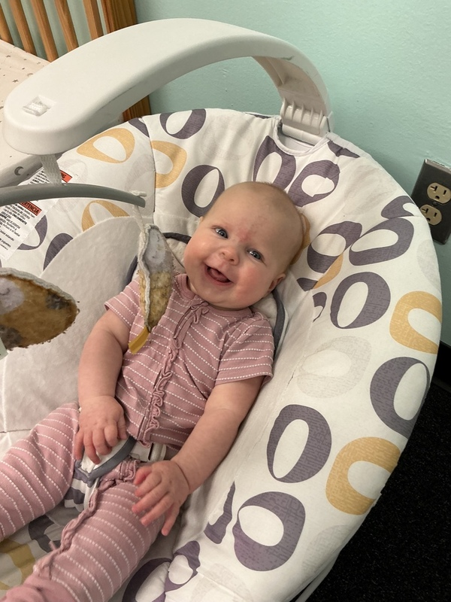
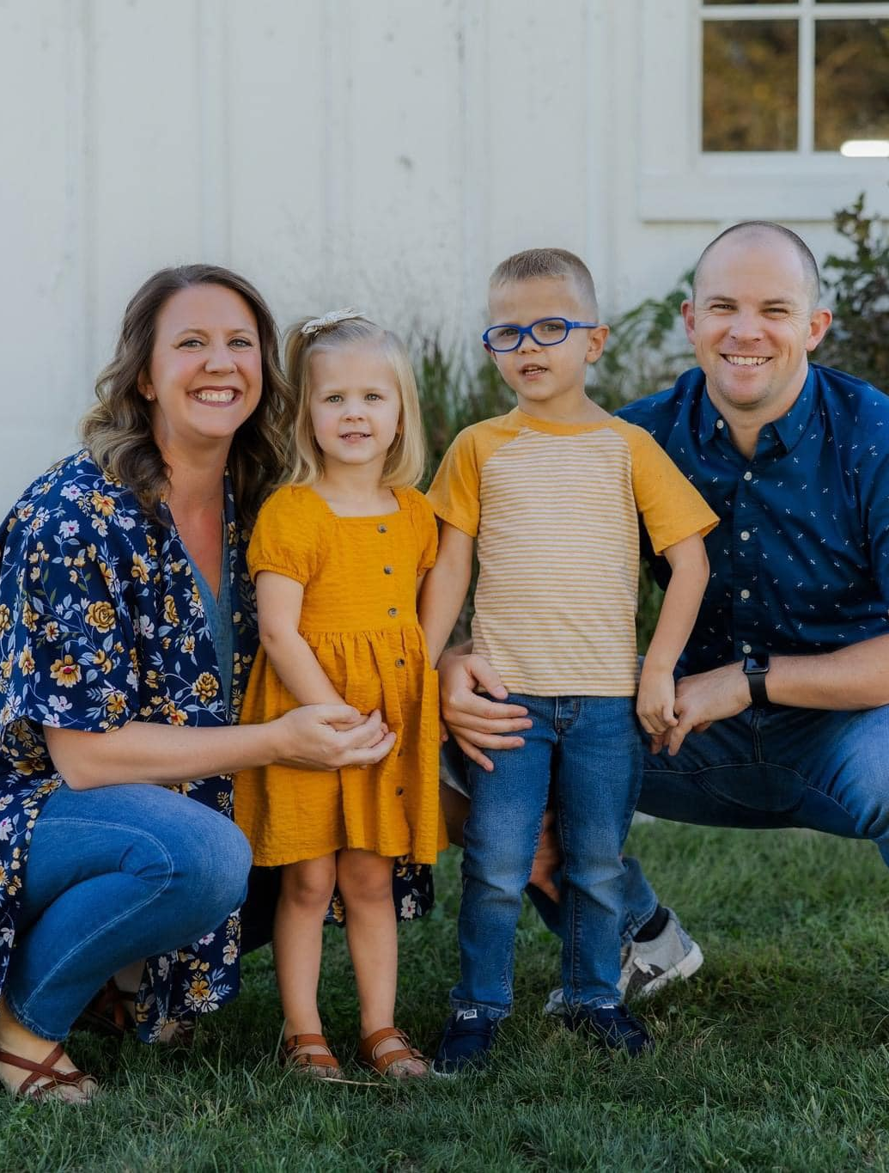
Questions??

